Slide 1
PYTHON PROGRAMMING & DATA SCIENCE

Slide 2

Data Science
Data Science
Data science is a deep study of the massive amount of data, which involves extracting meaningful insights from raw, structured, and unstructured data that is processed using the scientific method, different technologies, and algorithms.
It is a multidisciplinary field that uses tools and techniques to manipulate the data so that we can find something new and meaningful.
In short, we can say that data science is all about:
Asking the correct questions and analyzing the raw data.
Modeling the data using various complex and efficient algorithms.
Visualizing the data to get a better perspective.
Understanding the data to make better decisions and finding the final result.

Slide 3
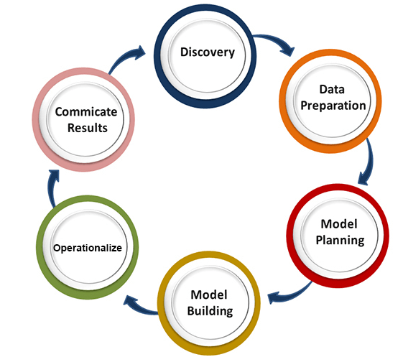
Data Science
Data Science Lifecycle
The life-cycle of data science consists of 6 stages.

Slide 4
Data Science
Data Science Lifecycle
1. Discovery:
The first phase is discovery, which involves asking the right questions.
When we start any data science project, we need to determine what are the basic requirements, priorities, and project budget.
In this phase, we need to determine all the requirements of the project such as the number of people, technology, time, data, an end goal, and then we can frame the business problem on first hypothesis level.

Slide 5
Data Science
Data Science Lifecycle
2. Data preparation:
Data preparation is also known as Data Munging.
In this phase, we need to perform the following tasks:
Data cleaning
Data Reduction
Data integration
Data transformation
After performing all the above tasks, we can easily use this data for our further processes.

Slide 6
Data Science
Data Science Lifecycle
3. Model Planning:
In this phase, we need to determine the various methods and techniques to establish the relation between input variables.
We will apply Exploratory data analytics(EDA) by using various statistical formula and visualization tools to understand the relations between variable and to see what data can inform us.
Common tools used for model planning are:
SQL Analysis Services
R
SAS
Python

Slide 7
Data Science
Data Science Lifecycle
4. Model-building:
In this phase, the process of model building starts.
We will create datasets for training and testing purpose.
We will apply different techniques such as association, classification, and clustering, to build the model.
Following are some common Model building tools:
SAS Enterprise Miner
WEKA
SPCS Modeler
MATLAB

Slide 8
Data Science
Data Science Lifecycle
5. Operationalize:
In this phase, we will deliver the final reports of the project, along with briefings, code, and technical documents.
This phase provides us a clear overview of complete project performance and other components on a small scale before the full deployment.
6. Communicate results:
In this phase, we will check if we reach the goal, which we have set on the initial phase. We will communicate the findings and final result with the business team.

