Slide 1
PYTHON PROGRAMMING & DATA SCIENCE

Slide 2

Turtle graphics
Turtle is a special feathers of Python.
Using Turtle, we can easily draw in a drawing board.

Slide 3
Turtle graphics
turtle methods:
Commonly used turtle methods are :
METHOD PARAMETER DESCRIPTION
Turtle() None It creates and returns a new turtle object
forward() amount It moves the turtle forward by the specified amount
backward() amount It moves the turtle backward by the specified amount
right() angle It turns the turtle clockwise
left() angle It turns the turtle counter clockwise
penup() None It picks up the turtle’s Pen
pendown() None Puts down the turtle’s Pen

Slide 4
Turtle graphics
turtle methods:
METHOD PARAMETER DESCRIPTION
up() None Picks up the turtle’s Pen
down() None Puts down the turtle’s Pen
color() Color name Changes the color of the turtle’s pen
fillcolor() Color name Changes the color of the turtle will use to fill a polygon
heading() None It returns the current heading
position() None It returns the current position
goto() x, y It moves the turtle to position x,y
begin_fill() None Remember the starting point for a filled polygon

Slide 5
Turtle graphics
turtle methods:
METHOD PARAMETER DESCRIPTION
end_fill() None It closes the polygon and fills with the current fill color
dot() None Leaves the dot at the current position
stamp() None Leaves an impression of a turtle shape at the current location
shape() shapename Should be ‘arrow’, ‘classic’, ‘turtle’ or ‘circle’

Slide 6
Turtle graphics
Plotting using Turtle(or)Executing a Turtle Program
The following 4 steps are used for executing a turtle program :
Import the turtle module
Create a turtle to control.
Draw around using the turtle methods.
Run turtle.done().

Slide 7
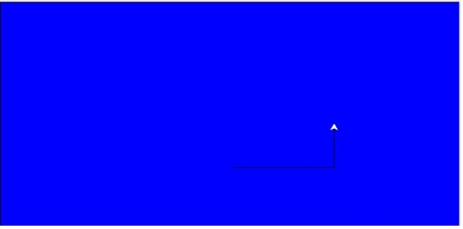
Turtle graphics
Examples
creates a graphics window
import turtle
my_window = turtle.Screen()
my_window.bgcolor("blue")
my_pen = turtle.Turtle()
my_pen.forward(150)
my_pen.left(90)
my_pen.forward(75)
my_pen.color("white")
my_pen.pensize(12)

Slide 8
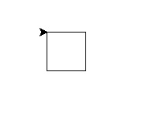
Turtle graphics
Examples
Example 2
Draw a Square
import turtle
my_pen = turtle.Turtle()
for i in range(4):
my_pen.forward(50)
my_pen.right(90)
turtle.done()

Slide 9
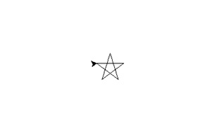
Turtle graphics
Examples
Example3
Draw a star
import turtle
my_pen = turtle.Turtle()
for i in range(50):
my_pen.forward(50)
my_pen.right(144)
turtle.done()

Slide 10
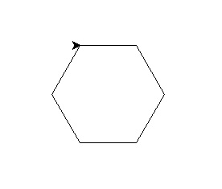
Turtle graphics
Examples
Example 4
Draw a Hexagon
import turtle
polygon = turtle.Turtle()
my_num_sides = 6
my_side_length = 70
my_angle = 360.0 / my_num_sides
for i in range(my_num_sides):
polygon.forward(my_side_length)
polygon.right(my_angle)
turtle.done()

Slide 11

Turtle graphics
Example 5
Draw a square inside another square box.
import turtle
my_wn = turtle.Screen()
my_wn.bgcolor("light blue")
my_pen = turtle.Turtle()
my_pen.color("black")
def my_sqrfunc(size):
for i in range(4):
my_pen.fd(size)
my_pen.left(90)
size = size - 5
my_sqrfunc(146)
my_sqrfunc(126)
my_sqrfunc(106)
my_sqrfunc(86)
my_sqrfunc(66)
my_sqrfunc(46)
my_sqrfunc(26)()

Slide 12
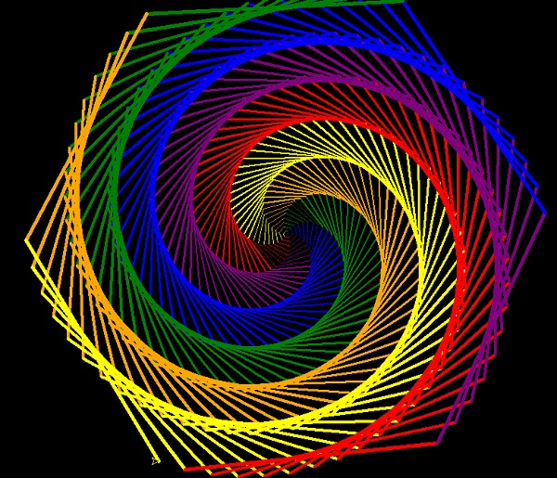
Turtle graphics
Example 6
Drawing a pattern
import turtle
colors = [ "red","purple","blue","green","orange","yellow"]
my_pen = turtle.Pen()
turtle.bgcolor("black")
for x in range(360):
my_pen.pencolor(colors[x % 6])
my_pen.width(x/100 + 1)
my_pen.forward(x)
my_pen.left(59)

