Slide 1


Department of Artificial Intelligence and
Data Science
Optimal Length Utilization
Dr.P.Indira Priya M.E.,Ph.D.,
Professor
R JAI SAARATHI (221801019)
O JOEL SAM (221801021)

Slide 2
Problem Statement
Develop an automated system to optimize pipe cutting in industrial manufacturing, minimizing material waste and maximizing efficiency. The system will analyze stock data to determine optimal sizes and quantities of pipes for cutting, aiming to reduce usage of large pipes, improve material utilization, and enhance overall operational efficiency.

Slide 3
Motivation
Material Waste Reduction: Minimize the amount of pipe material discarded as scrap during the cutting process.
Cost Savings: Reduce procurement and inventory costs by optimizing pipe usage.
Improved Efficiency: Streamline the pipe cutting process, leading to faster production cycles and increased output.
Sustainability: Promote environmentally friendly practices by reducing material waste and conserving resources.

Slide 4
Objectives
Develop an advanced algorithm to optimize pipe cutting with minimizing waste and meeting specific length requirements. Create a practical tool for industry application, test its effectiveness, and ensure its versatility for various cutting scenarios. Reduce operational costs, improve resource utilization, and support environmental sustainability by significantly decreasing material waste.

Slide 5
Abstract
This project develops an advanced algorithm for optimizing pipe cutting from larger stock lengths, aiming to minimize waste and reduce operational costs. The algorithm enhances resource utilization by efficiently meeting specific length requirements and supports sustainability by lowering material waste. A practical software tool will be created, validated with real-world data, and compared to traditional methods. The project will provide adaptable solutions for various scenarios and include detailed documentation to support implementation and ongoing improvement.

Slide 6
Introduction and Overview of the Project.
Efficiently cutting pipes from larger stock lengths is a vital process in industries such as construction, manufacturing, and plumbing. The challenge, known as the pipe cutting problem, involves optimizing the way these large pipes are cut into smaller, required lengths to minimize waste and reduce costs. Traditional methods often result in substantial material waste, leading to higher operational expenses and environmental impact.

Slide 7
Literature Survey
S.No | Author Name | Paper Title | Description | Journal | Volume/Year
1 | A. Kumar, D. Verma, and A. Kumar | A Review of Cutting Stock Problem Solutions with Metaheuristics: Recent Trends and Future Directions | A review of various metaheuristic techniques for solving cutting stock problems, highlighting recent trends and future research directions. | IEEE Access | Vol. 11, 2023

Slide 8
Literature Survey
S.No | Author Name | Paper Title | Description | Journal | Volume/Year
2 | Y. Li, H. Wang, and Z. Liu | An Adaptive Genetic Algorithm for the Cutting Stock Problem with Multiple Patterns | This paper presents an adaptive genetic algorithm for solving complex cutting stock problems, emphasizing its flexibility and efficiency. | IEEE Transactions on Evolutionary Computation | Vol. 27, No. 1, 2023

Slide 9
Literature Survey
S.No | Author Name | Paper Title | Description | Journal | Volume/Year
3 | J. K. Lee and J. K. Kim | Enhanced Integer Programming Approaches for Large-Scale Cutting Stock Problems | The study explores how enhanced integer programming can optimize material usage in large-scale cutting operations, offering robust solutions. | IEEE Transactions on Evolutionary Computation | Vol. 20, No. 2, April 2023

Slide 10
Existing System
Manual Cutting Plans: Operators develop cutting plans manually, which can lead to inefficiencies and higher material costs. This method often fails to optimize waste management effectively and struggles with complex length requirements. The lack of systematic approach can result in suboptimal use of stock material. Consequently, this approach may lead to excessive leftover material and increased operational expenses.
Heuristic Algorithms: Methods like First Fit and Best Fit allocate pipe lengths based on immediate fit, providing quick solutions. These algorithms are simple and easy to implement but do not always ensure the minimum waste. They may not consider the overall optimization of material use, leading to inefficient cutting patterns. The approach is often limited in handling complex scenarios and varying demands.

Slide 11
Drawback of Existing System
Inefficiency: Manual planning often results in suboptimal cutting patterns, leading to increased material waste
High Costs: Higher material costs due to inefficient use of stock pipes.
Time-Consuming: Developing and adjusting plans manually is labor-intensive and slow.
Limited Flexibility: Difficult to adapt to complex or changing cutting requirements.

Slide 12
Proposed System
Advanced Optimization Algorithm: A smart method that finds the best way to cut pipes, saving material and meeting size needs.
Real-Time Data Processing: Quickly analyzes data to create the best cutting plan right away.
User-Friendly Interface: Easy-to-use design for entering data and seeing the best cutting plans.
Versatility: Can handle different types of pipes and cutting needs across various industries.
Sustainability: Focuses on reducing waste and saving resources, helping the environment.
Feedback Loop: Continuously improves the cutting plan by learning from real-world results.

Slide 13
Methodology
1.Define Problem
Reduce waste, optimize pipe cutting efficiency.
2. Data Acquisition
Upload & validate pipe sizes/quantities (CSV).
3. Optimization
Best Fit Decreasing (BFD) algorithm for minimal waste.

Slide 14
Methodology
4. Simulation & Validation
Test and validate cutting patterns.
5. Results
Visualize patterns, export reports (CSV, PDF).
6. Continuous Improvement
Monitor, refine, and improve over time.

Slide 15
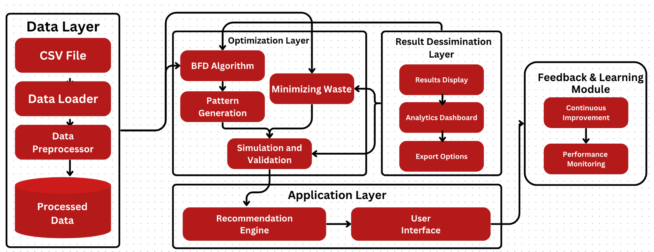
System Architecture

Slide 16
List of Modules
Data Acquisition Module
Data Input Interface
Data Validation
Optimization Engine
Algorithm Core
Pattern Generation
Simulation & Validation
Results Dissemination Module
Results Display
Analytics Dashboard
Export Options
Feedback & Learning Module
Performance Monitoring
Continuous Improvement

Slide 17
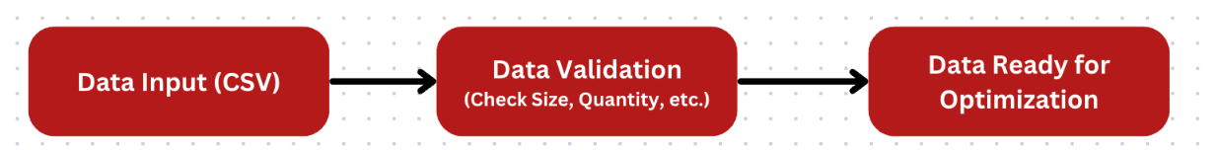
Data Acquisition Module
Main Purpose: Collect and validate the input data required for pipe-cutting optimization.
Key Components:
Data Input Interface: Users upload data (e.g., pipe sizes and quantities) via CSV.
Data Validation: Ensures the data is complete and correct before processing.

Slide 18
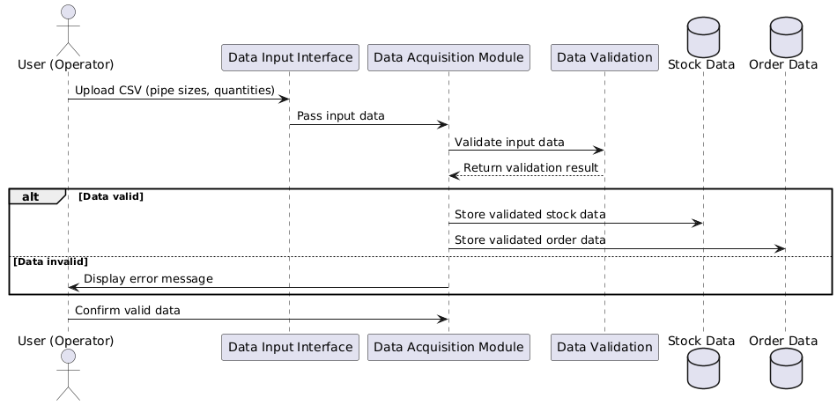
Data Acquisition Module

Slide 19
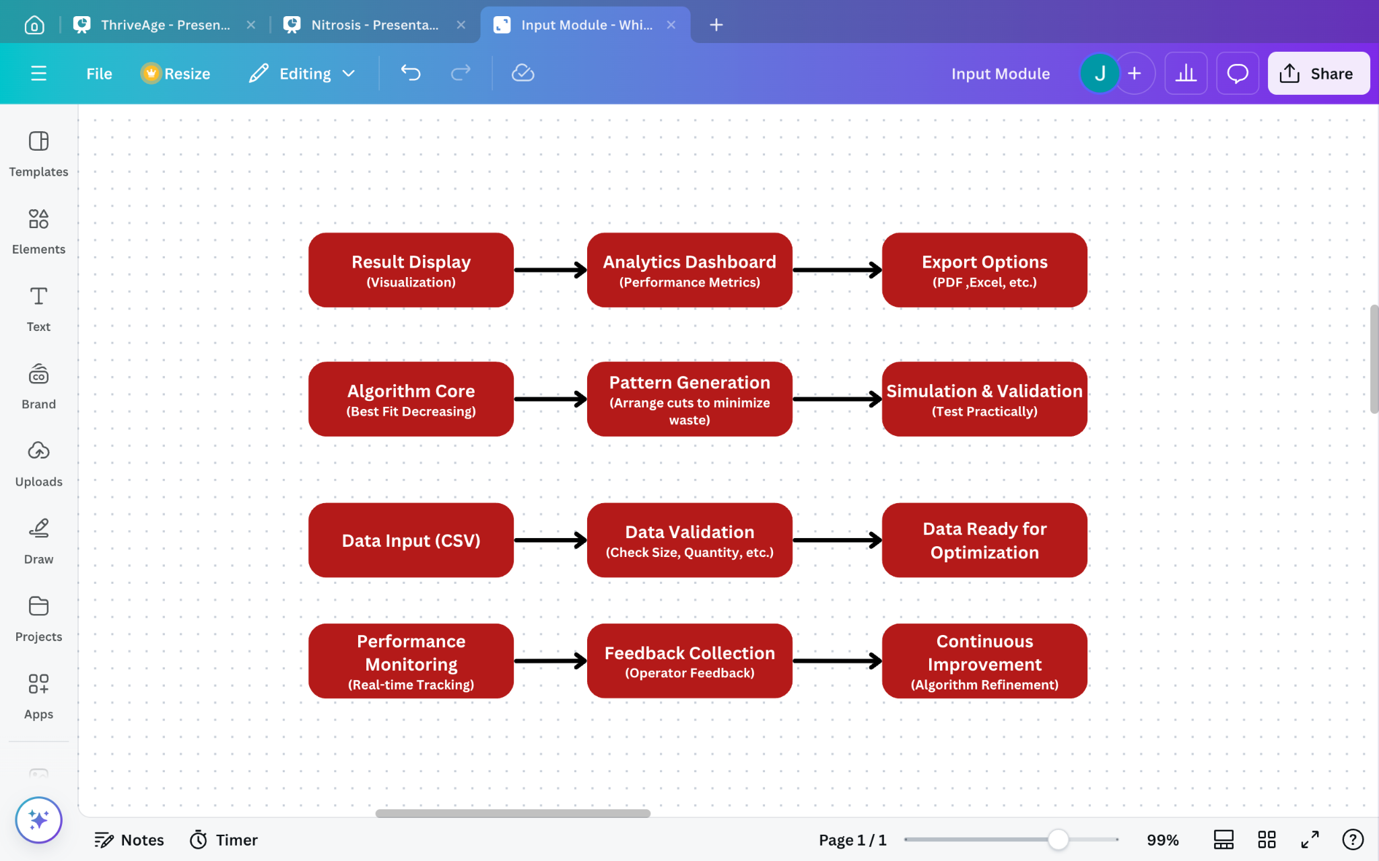
Optimization Engine
Main Purpose: Generate optimal cutting patterns to minimize waste and maximize efficiency.
Key Components:
Algorithm Core: Uses the Best Fit Decreasing algorithm to allocate pipes based on the available lengths.
Pattern Generation: Creates cutting patterns for pipes.
Simulation & Validation: Tests the patterns in a simulated environment to ensure practicality.

Slide 20
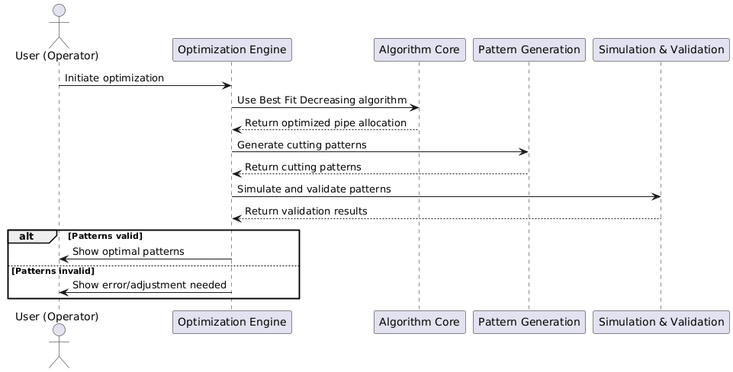
Optimization Engine

Slide 21
Results Dissemination Module
Main Purpose: Present the results of the optimization process.
Key Components:
Results Display: Visualizes the cutting plans using bar charts and pipe usage summaries.
Analytics Dashboard: Provides performance metrics and waste reduction insights.
Export Options: Allows users to export the results in different formats like CSV or PDF.

Slide 22
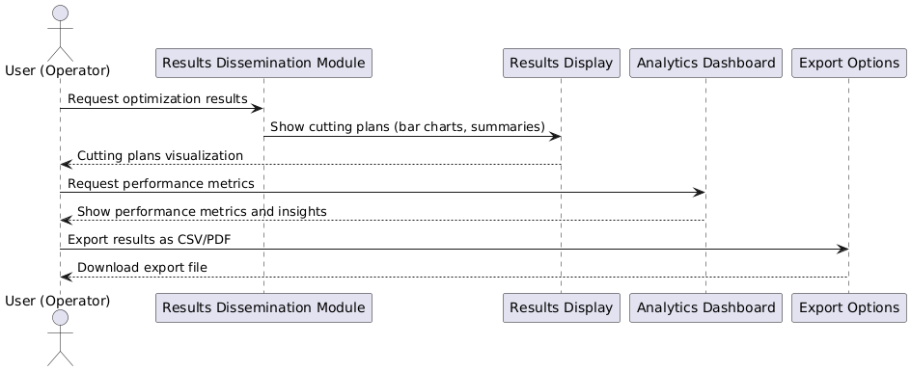
Results Dissemination Module

Slide 23
Feedback & Learning Module
Main Purpose: Continuously improve the optimization process by learning from past data.
Key Components:
Performance Monitoring: Tracks real-time performance of the cutting plans.
Continuous Improvement: Uses feedback to refine the algorithm for better future results.

Slide 24
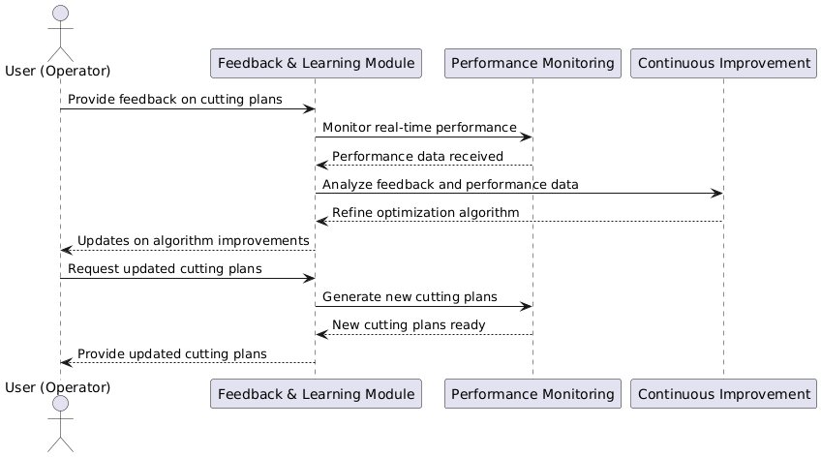
Feedback & Learning Module

Slide 25
Result and Discussion
Main Purpose: Continuously improve the optimization process by learning from past data.
Key Components:
Performance Monitoring: Tracks real-time performance of the cutting plans.
Continuous Improvement: Uses feedback to refine the algorithm for better future results.

Slide 26
References
A. Kumar, D. Verma, and A. Kumar, "A Review of Cutting Stock Problem Solutions with Metaheuristics: Recent Trends and Future Directions," IEEE Access, vol. 11, pp. 59342-59364, 2023, doi: 10.1109/ACCESS.2023.3275412.
Y. Li, H. Wang, and Z. Liu, "An Adaptive Genetic Algorithm for the Cutting Stock Problem with Multiple Patterns," IEEE Transactions on Evolutionary Computation, vol. 27, no. 1, pp. 123-136, Feb. 2023, doi: 10.1109/TEVC.2022.3180709.
J. K. Lee and J. K. Kim, "Enhanced Integer Programming Approaches for Large-Scale Cutting Stock Problems," IEEE Transactions on Automation Science and Engineering, vol. 20, no. 2, pp. 320-331, April 2023, doi: 10.1109/TASE.2023.3205361.

Slide 27
Thank You

