Slide 1
Course - Introduction
CPE 545

Slide 2
What is Communications Software?
Software that facilitates communication between remote systems to exchange information in various formats: text, audio, video.
What is embedded communications software?
When the remote systems are embedded devices like cell phones, watches, routers, switches, MP3 players…
Communication systems consist of devices that have a wide range in complexity
Software design is determined by the function each kind of device performs in the network

Slide 3
Communication Software Strategy
Issues common to communication equipment
Protocols and standards
International Organization for Standards (ISO), Internet Engineering Task Force (IETF), 3rd Generation Partnership Project (3GPP)
Code size
Real-time processing
Issues due to increasingly more complex next generation smart devices
Running tasks on multiple processors
Inter Process Communication (IPC)
Reducing development cycle
Micro-kernels
Middleware distributed software (RPC, MOM)

Slide 4
OSI Layers
Key Observations
7 layers
Each of them can be implemented in hardware or software
Lower layers are mostly implemented in hardware while the higher layers are mostly in software
All 7 are not required to be implemented to execute a system

Slide 5
Physical Layer
Provides hardware means to transmit/receive data
Electrical specifications
Functional and procedural specifications
A/D conversion
Modulations/Demodulations
Handles the physically adjacent nodes (point-to-point)
All in hardware. Examples:
RS232, RS422
RF Modules and Modems in wireless
PHY Ethernet Controllers

Slide 6
Data Link Layer
Provides for more reliable transmit/receive of data between peers
Data Integrity through error detection and correction
(Cyclic Redundancy Check) CRC
Collision Detection and Avoidance
Viterbi or Turbo decoding
Both Hardware and Software
MAC (Media Access Layer) layer
Provides addressing and channel access control
LLC (Logical Link Control) layer
Provides Multiplexing, flow and error control
Examples:
ISDN, ATM, Ethernet MAC

Slide 7
Network Layer
Responsible for delivery of packets from source to destination
Allows for independent link layer end points
Provides network addressing to route the data packets
Routers are used to forward packets from node to node
Routing protocols are usually implemented in software

Slide 8
Transport Layer
Provides network independent end-to-end integrity between the end points
Transmission Control Protocol (TCP) - connection oriented
Connection established prior to data transmission
Ack sent upon receipt of data providing reliability, ordering and data integrity
User Datagram Protocol (UDP) - connectionless
Assumes that error checking and correction is either not necessary or performed by higher layers
Usually implemented in software except when to support large number of connections.
TCP Offload Engine
As name suggests offloads TCP/IP stack processing to a dedicated hardware unit, Network Interface Cards
Hard to integrate into computing systems, requiring extensive changes in the operating system

Slide 9
Communication Devices
Repeaters to regenerate signal (Physical Layer)
Layer 2 switches (Data Link Layer)
Switches MAC frames between LAN segments on the same subnet based on their dest address
Monitors traffic and learns about the MAC address of the nodes on its ports
Layer 3 switches or Routers (Network Layer)
Forwards IP frames across LAN segments and WANs based on their dest address
Hosts are not on the same sub-net
If dest host is not directly connected, it forwards the packet to another router (routing tables)
Routing tables gets updated by neighboring routers according to the routing protocols
Routing Information Protocol (RIP)
Open Shortest Path First (OSPF)
Border Gateway Protocol (BGP)

Slide 10
Communication Eco-system
Communication devices can refer to any kind of device that facilitates communication
These devices transmit data between different computers or computing devices
Each device plays a specific role and implements specific communication functions
Protocol and Systems Software
Architected for performance and memory efficiency
Communication Companies
Electronic Design Automation (EDA) tool vendors (Altera, Xilinx)
Semiconductor component vendors (ASIC design - fabless)
RTOS, tools and software vendors
Contract Manufacturers (CMs)
Equipment Manufacturers (EMs)
Home, Enterprise and service-provider users

Slide 11
What is Middleware?
Middleware’s multiple definitions.
Software that mediates between an application program and a network.
Software that contains a set of services to allow multiple processes running on one or more computers to interact across a network
General term for any programming that serves to glue together separate, already existing applications

Slide 12
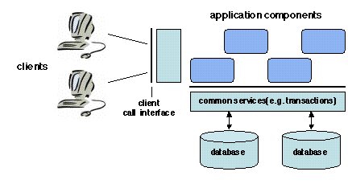
Motivation for Middleware
Component Based Software
Applications composed of software components
Client user interface (presentation layer)
Information management (Database)
Application specific functionality (business logic)

Slide 13
Motivation for Middleware
Applications use an intermediate software (middleware) that resides on top of the operating systems and communication protocols to perform the following functions:
Hiding distribution.
Hiding the heterogeneity of the various hardware components, operating systems and communication protocols that are used by the different parts of an application.
Providing uniform, standard, high-level interfaces to the application developers and integrators, so that applications can easily interoperate and be reused, ported, and composed.
Supplying a set of common services to perform various general purpose functions, in order to avoid duplicating efforts and to facilitate collaboration between applications.

Slide 14
Motivation for Middleware
Reusing Legacy Software
Adopt a common language -- independent standard to interconnect with other applications
Define the interface and interchange protocols implemented in a software acting as exchange-bus or broker
User wrapper to bridge the legacy interface with the new interface

Slide 15
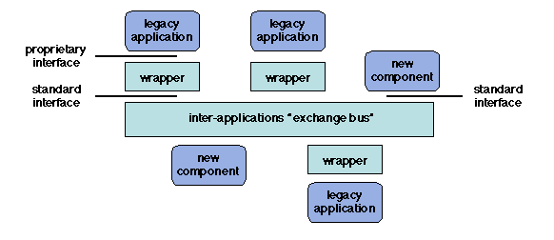
Motivation for Middleware

Slide 16
Motivation for Middleware
The middleware architecture of a system can be designed according to the following requirements and motivations:
Managed entities. Middleware systems manage different kinds of entities which differ by their definition, properties, and modes of communication (e.g. objects, agents, and components).
Service provision structure. The entities managed by a middleware system may have predefined roles such as:
client (service requester) and server (service provider),
publisher (information supplier) and subscriber (information receiver).
peer to peer - all entities are at the same level and a given entity may indifferently assume different roles
Service provision interfaces. Communication primitives provided by a middleware system may follow the synchronous (blocking) or asynchronous (non-blocking) paradigm.

Slide 17
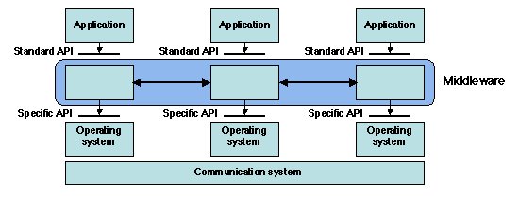
Motivation for Middleware

