Slide 1
Middleware Principles and Basic Patterns
CPE 545

Slide 2
Software component - terminology
A software system is organized as a set of parts, or components
A software component is a unit of composition with contractually specified interfaces and explicit context dependencies.
In order to provide its service, a component usually relies on services provided to it by other components.
A provided service is usually embodied in a set of interfaces, each of which represents an aspect of the service.
Software components can be used to offer a modular approach to products

Slide 3
Interaction Mechanisms between Components
Components interact through an underlying communication system by means of:
Asynchronous transient event.
Asynchronous persistent message passing
Synchronous call

Slide 4
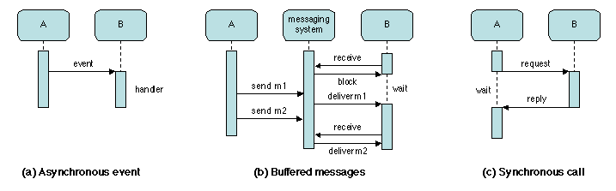
Interaction Mechanisms Asynchronous transient event
A thread executing in component A produces an event to a specified set of recipients and continues execution.
The "transient" attribute means that the message is lost if no recipient is waiting for it.
Reception of the event by component B starts the execution of a program (the handler) associated with that event.
Usage:
It may be used by A to request a service from B, when no result is expected;
It may be used by B to observe or monitor the activity of A.

Slide 5
Interaction Mechanisms Asynchronous persistent messages (Buffered messages)
A message is transmitted by a sender to a receiver over a the communication system provides a buffering function ("persistent" attribute)
If the receiver is waiting for the message, the communication system delivers it;
If not, the message remains available until the receiver attempts to read it.

Slide 6
Interaction Mechanisms Synchronous transient call
A (the client of a service provided by B) sends a request message to B (server) and waits for a reply (e.g. RPC).

Slide 7
Combination
Synchronous and asynchronous interactions may be combined to allow the service requester to continue execution after issuing the request.
The provider may inform the requester, by an asynchronous event, that the results are available. Requester still needs to request (pull) to get the results.
or the requester may call (poll) the provider at a later time to find out about the state of the execution.

Slide 8
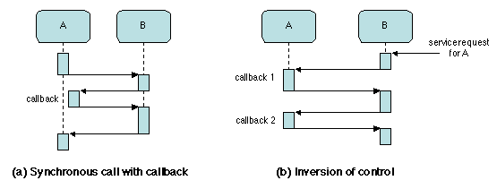
Interaction Mechanisms Synchronous call with callback
It may happen that execution of the call from A to B relies on a callback from B to a function provided by A.
The callback is executed by a new thread, while the original thread keeps waiting for the completion of the initial call.

Slide 9
Interaction Mechanisms Inversion of control (triggered by asynchronous event)
The service provided by B to A may be requested from an outside source, with A still providing callback to B. This interaction pattern is called inversion of control, because the flow of control is from B (the provider) to A (the requester).
It typically occurs when B is "controlling" A, and the request for service originates from the outside, triggered by an external event such as a timing signal.
Kernel
Microkernel
HW driver

Slide 10
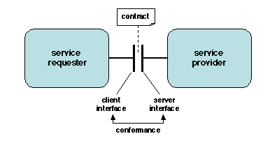
Interfaces
An interface is a concrete description of the interaction between the requester (client) and the provider (server) of the service.
The server interface should be "conformant" with the client interface;

Slide 11
Interfaces
The concrete representation of an interface consists of a set of operations, which may take a variety of forms:
Synchronous procedure or method call, with parameters and return value;
asynchronous procedure call;
Access to an attribute, i.e. a data structure (this can be converted into the previous form by means of "getter" or "setter" functions on the elements of the data structure);
event source (sender) e.g. clicking a button -- or sink (receiver) e.g. how to handle clicked button);
data stream provider (output channel) or receiver (input channel);

Slide 12
Interfaces - characteristics
A number of notations, known as Interface Description Languages (IDL), have been designed to formally describe interfaces.
Neither the requester nor the provider should make any assumption on the other party, beyond the information explicitly specified in the interface.
Anything beyond the client or server interface is seen by the other party as a "black box". This rule is known as the encapsulation principle.
The encapsulation principle ensures independence between interface and implementation, and allows a system to be modified by "plug and play”; hence the rest of the system remain compatible.

Slide 13
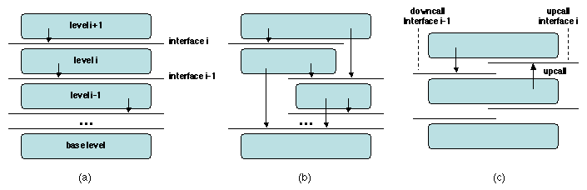
Architectural Patterns examples
Multilevel Architectures (Layered Architecture)
A complex system may be described at different levels of abstraction.
Each level i defines its own entities, which provide an interface to the upper level (i+1).
These entities are implemented using the interface provided by the lower level (i-1), down to a predefined base level
An alternative view is to consider each level as a virtual machine, instruction set is defined by its interface. By virtue of the encapsulation principle, a virtual machine hides the implementation details of all the lower levels.

Slide 14
Architectural Patterns examples
Each layer receives synchronous calls from the upper layer, and asynchronous calls from the lower layer.
The upper (application) layer activates the kernel (and hardware-provided functions) through synchronous downcalls.
On the other hand, the hardware typically activates the kernel through asynchronous interrupts (upcalls), which trigger the execution of handlers.

Slide 15
Architectural Patterns examples
A microkernel-based operating system consists of two layers.
The microkernel proper, which manages the hardware resources (processor, memory, I/O, network communication), and provides an abstract resource management API to the upper level.
The kernel, which implements a specific operating system using the API of the microkernel.

Slide 16
Microkernel
A Microkernel is a highly modular subsystem composed of OS-neutral abstractions, providing only essential services such as process abstractions, threads, IPC, and memory management primitives.
All device drivers, etc., which are normally part of an OS kernel, run on the microkernel as just another user process
Multiple operating systems can then be layered on top of these abstractions, and are thus viewed as simply another application.
This focus on modularity allows for scalability, extensibility and portability not found in monolithic operating systems (Unix, Linux, DOS, etc.)
Because of its highly modular nature, many of the services commonly found in “kernel space” are found in “user space” on a microkernel

Slide 17
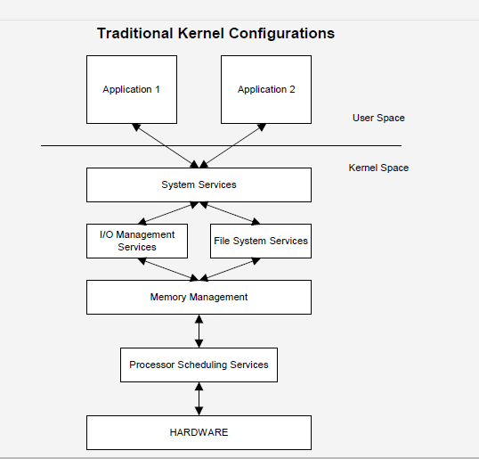
Microkernel

Slide 18
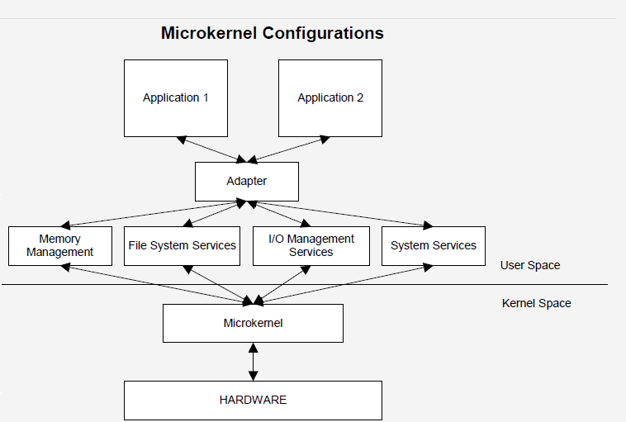
Microkernel

Slide 19
Microkernel
In most microkernel-based organizations, an operating system kernel is structured as a set of servers, each of which is in charge of a specific function .
A typical system call issued by an application is processed as follows:
The kernel analyzes the call and downcalls the microkernel using the appropriate function of its API.
The microkernel upcalls a server in the kernel and may interact with the hardware.
The microkernel returns to the kernel, which completes the work and returns to the application.

Slide 20
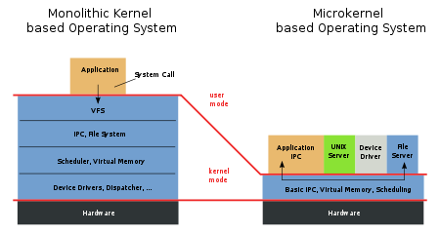
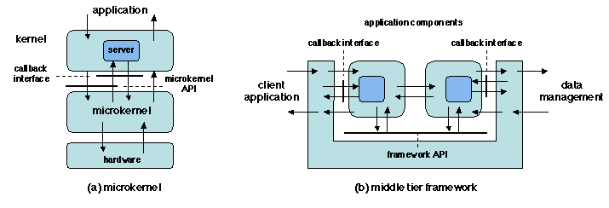
Microkernel
Adding a new function to a kernel is done by developing and integrating a new server.

Slide 21
Frameworks
The middle tier framework - interacts with both the client and the data management tiers, and mediates the interaction between these tiers and the server application program.
A Client application program uses the API provided by the framework and supplies a set of callback interfaces (via callback registration).
A client application request is handled by the framework, which activates an appropriate application component (via callbacks), interacts with it using its own API and the component's callback interface, and finally returns to the client.

Slide 22
Frameworks
Both above examples illustrate inversion of control.
To provide its services, the framework uses callbacks to externally supplied software modules
These modules in turn must respect the framework contract
by providing a specified callback interface,
by using the framework API.

Slide 23
Distributed Objects
An object is a software representation of a real-world entity which consist of state and related behavior. An object stores its state in fields and exposes its behavior through methods.

Slide 24
Distributed Objects Encapsulation
An object has an interface, which comprises a set of methods and states (attributes).
The only way of accessing an object is through its interface.
No part of the state is visible from outside the object, other than those explicitly present in the interface, and the user of an object should not rely on any assumption about its implementation.
Encapsulation achieves independence between interface and implementation. Changing the implementation of an object is invisible to its users, as long as the interface is preserved.

Slide 25
Distributed Objects- properties Classes and instances
A class is a generic description that is common to a set of objects (the instances of the class).
The instances of a class have the same interface (hence the same type), and their state has the same structure; they differ by the value of that state.
Each instance is identified as a distinct entity.
Instances of a class are dynamically created, through an operation called instantiation; they may also be dynamically deleted, either explicitly or automatically (by garbage collection) depending on the specific implementation of the object model.

Slide 26
Distributed Objects- properties Inheritance
A class may be derived from another class by specialization, i.e. by defining additional methods and/or additional attributes, or by redefining (overloading) existing methods.
The derived class is said to extend the initial class (or base class) or to inherit from it.
Some models also allow a class to inherit from more than one class (multiple inheritance).

Slide 27
Inheritance - Java
When we talk about inheritance, the most commonly used keyword would be extends and implements. These words would determine whether one object IS-A type of another.
IS-A Relationship:
IS-A is a way of saying : This object is a type of that object.

Slide 28
Inheritance - Java
Let us see how the extends keyword is used to achieve inheritance:
public class Animal {
}
public class Mammal extends Animal {
}
public class Reptile extends Animal {
}
public class Dog extends Mammal {
}

Slide 29
Inheritance - Java
In the example above, the following are true:
Animal is the superclass of Mammal class.
Animal is the superclass of Reptile class.
Mammal and Reptile are subclasses of Animal class.
Dog is the subclass of both Mammal and Animal classes.
Considering the IS-A relationship, we can say:
Mammal IS-A Animal
Reptile IS-A Animal
Dog IS-A Mammal
Hence : Dog IS-A Animal as well

Slide 30
Inheritance - Java
With use of the extends keyword the subclasses will be able to inherit all the properties of the superclass except for the private properties of the superclass.
We can assure that Mammal is actually an Animal with the use of the instance operator.
public class Dog extends Mammal {
public static void main(String args[]){
Animal a = new Animal();
Mammal m = new Mammal();
Dog d = new Dog();
System.out.println(m instanceof Animal);
System.out.println(d instanceof Mammal);
System.out.println(d instanceof Animal);
}
}

Slide 31
Inheritance - Java
An interface is a collection of abstract methods. The implements keyword is used by classes to inherit from interfaces. Interfaces can never be extended by the classes.
public class MammalInt implements Animal
{
public void eat()
{
System.out.println("Mammal eats");
}
public void travel()
{
System.out.println("Mammal travels");
}
public int noOfLegs()
{
return 0;
}
public static void main(String args[])
{
MammalInt m = new MammalInt();
m.eat(); m.travel();
}
}
interface Animal
{
public void eat();
public void travel();
}

Slide 32
Inheritance - Java
HAS-A relationship:
This determines whether a certain class HAS-A certain thing. This relationship helps to reduce duplication of code as well as bugs.
This shows that class Van HAS-A Speed.
By having a separate class for Speed, we do not have to put the entire code that belongs to speed inside the Van class., which makes it possible to reuse the Speed class in multiple applications.
public class Vehicle{}
public class Speed{}
public class Van extends Vehicle {
private Speed sp;
}

Slide 33
Class & Interface - Java
An interface is a collection of abstract methods. A class implements an interface, thereby inheriting the abstract methods of the interface.
An interface is not a class. Writing an interface is similar to writing a class, but they are two different concepts. A class describes the attributes and behaviors of an object. An interface contains behaviors that a class implements.
Unless the class that implements the interface is abstract, all the methods of the interface need to be defined in the class.

Slide 34
Class & Interface - Java
Extending Interfaces:
An interface can extend another interface, similarly to the way that a class can extend another class. The extends keyword is used to extend an interface, and the child interface inherits the methods of the parent interface.
The following Sports interface is extended by Hockey and Football interfaces.

Slide 35
Class & Interface - Java
//Filename: Sports.java
public interface Sports {
public void setHomeTeam(String name);
public void setVisitingTeam(String name);
}
//Filename: Football.java
public interface Football extends Sports {
public void homeTeamScored(int points);
public void visitingTeamScored(int points);
public void endOfQuarter(int quarter);
}
//Filename: Hockey.java
public interface Hockey extends Sports {
public void homeGoalScored();
public void visitingGoalScored();
public void endOfPeriod(int period);
public void overtimePeriod(int ot);
}

Slide 36
Class & Interface - Java
When overriding methods defined in interfaces there are several rules to be followed:
The signature of the interface method and the same return type or subtype should be maintained when overriding the methods.
An implementation class itself can be abstract and if so interface methods need not be implemented.
When implementation interfaces there are several rules:
A class can implement more than one interface at a time.
A class can extend only one class, but implement many interfaces.
An interface can extend another interface, similarly to the way that a class can extend another class.

Slide 37
Class & Interface - Java
An interface is similar to a class in the following way:
An interface can contain any number of methods.
An interface is different from a class in several ways, including:
You cannot instantiate an interface.
An interface does not contain any constructors.
All of the methods in an interface are abstract.
An interface cannot contain instance fields. The only fields that can appear in an interface must be declared both static and final.
An interface is not extended by a class; it is implemented by a class.
An interface can extend multiple interfaces.

Slide 38
Class & Interface - Java
Interfaces have the following properties:
An interface is implicitly abstract.
Each method in an interface is also implicitly abstract.
Methods in an interface are implicitly public.
When a class implements an interface, you can think of the class as signing a contract, agreeing to perform the specific behaviors of the interface. If a class does not perform all the behaviors of the interface, the class must declare itself as abstract.

Slide 39
Class & Interface - Java
/* File name : Mammal.java */
public class Mammal implements Animal {
public void eat() {
System.out.println("Mammal eats");
}
public void travel() {
System.out.println("Mammal travels");
}
public int noOfLegs() {
return 0;
}
public static void main(String args[]){
Mammal m = new Mammal();
m.eat();
m.travel(); }
}
interface Animal
{
public void eat();
public void travel();
}

Slide 40
Distributed Objects- properties Polymorphism
Polymorphism is the ability, for a method, to accept parameters of different types and to have a different behavior for each of these types. Thus an object may be replaced, as a parameter of a method, by a "compatible" object.
The notion of compatibility, or conformance is expressed by a relationship between types, which depends on the specific programming model or language being used.

Slide 41
Polymorphism - Java
A Deer IS-A Animal
A Deer IS-A Vegetarian
A Deer IS-A Deer
A Deer IS-A Object
When we apply the reference variable facts to a Deer object reference, the following declarations are legal:
public interface Vegetarian{}
public class Animal{}
public class Deer extends Animal implements Vegetarian{}
Deer d = new Deer();
Animal a = d;
Vegetarian v = d;
Object o = d;

Slide 42
Remote Objects
Encapsulation: a powerful tool in a heterogeneous environment.
The user of an object only needs to know an interface for that object, which may have different implementations on different locations.
Dynamic creation of object instances allows different objects to be created with the same interface, possibly at different remote locations –
middleware must again provide a mechanism for remote object creation, in the form of factories
Inheritance and polymorphism is useful for distributed applications developers, who are confronted with a changing environment and have to define new classes to deal with new situations.
A generic (base) class is first designed to capture a set of object features that are common to a wide range of expected situations. Specific, more specialized, classes are then defined by extending the base class

Slide 43
Remote Objects
Objects that make up an application may be located on distributed sites.
A client application may use an object located on a remote site by calling a method of the object's interface, as if the object were local.
Objects used in this way are called remote objects, and a method call on a remote object is called Remote Method Invocation.
Middleware must:
locate an implementation of the servant object on a remote site,
send the parameters to the object's location,
perform the call,
and return the results to the caller.
A middleware that performs these tasks is an Object Request Broker, or ORB.

Slide 44
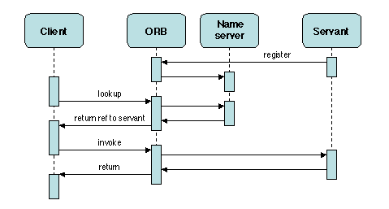
Remote Objects
The remote object must first be located, which is usually done by means of a name server or trader; then the call itself is performed. Both the lookup and the invocation are mediated through the ORB.

Slide 45
Patterns for Distributed Object Middleware - Proxy
The PROXY pattern is one of the first design patterns identified in distributed programming
Context. Applications organized as a set of objects in a distributed environment
A client requests a service provided by some possibly remote object (the servant).
Problem. Define an access mechanism that:
does not involve hard-coding the location of the servant into the client code,
does not necessitate deep knowledge of the communication protocols by the client

Slide 46
Patterns for Distributed Object Middleware - Proxy
Desirable Properties. Transparency. Access should be efficient at run time. Programming should be simple for the client.
Constraints. The client and the server are in different address spaces.
Solution. Use a local representative of the server on the client site. All information related to the communication system and to the location of the servant is hidden in the proxy, and thus invisible to the client.

Slide 47
Patterns for Distributed Object Middleware - Proxy
A pre-processing phase, which essentially consists of marshalling the parameters and preparing the request message.
The actual invocation of the servant, using the underlying communication protocol to send the request and to receive the reply.
A post-processing phase, which essentially consists of unmarshalling the return values.

Slide 48
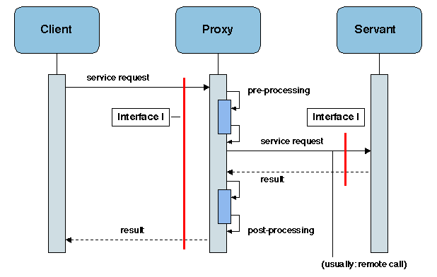
Patterns for Distributed Object Middleware - Proxy

Slide 49
Patterns for Distributed Object Middleware - Factory
Context. Applications organized as a set of objects in a distributed environment
Problem: Dynamically create families of related objects (without specifying the exact class of object that will be created), while allowing some decisions to be deferred to run time (such as choosing a concrete subclass to implement a given interface).
The factory method pattern relies on inheritance, as object creation is delegated to subclasses that implement the factory method to create objects

Slide 50
Patterns for Distributed Object Middleware - Factory
Desirable Properties.
The implementation details of the created objects should be abstracted away.
The creation process should allow parameters.
Evolution of the mechanism should be easy (no hard-coded decisions).
Constraints. The main constraint results from the distributed environment: the client (requesting object creation) and the server (actually performing creation) are in different address spaces.

Slide 51
Patterns for Distributed Object Middleware - Factory
Solution:
Use two related patterns: An Abstract Factory defines a generic interface for creating objects; A Concrete Factory performs the actual creation of the object for that interface.
Abstract Factory provides a way to encapsulate a group of individual factories that have a common theme without specifying their concrete classes
The client code has no knowledge whatsoever of the concrete type, not needing to include any header files or class declarations related to it. The client code deals only with the abstract type.
Objects of a concrete type are created by the factory, but the client code accesses such objects only through their abstract interface.

Slide 52
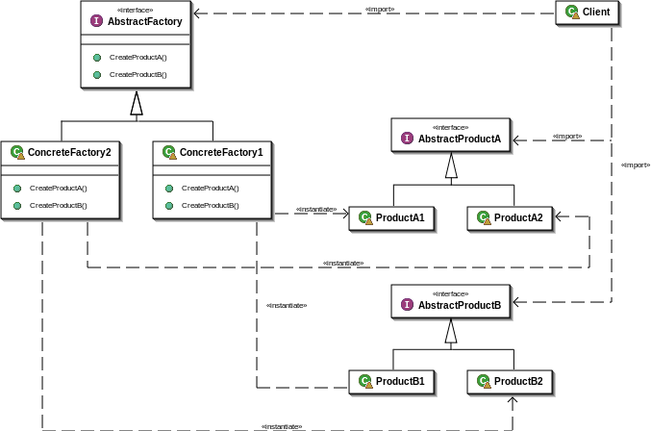
Patterns for Distributed Object Middleware - Factory

Slide 53
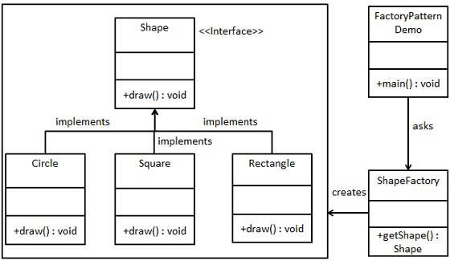
Patterns for Distributed Object Middleware - Factory
We're going to create a Shape interface and concrete classes implementing
the Shape interface. A factory class ShapeFactory is defined:

Slide 54
Patterns for Distributed Object Middleware - Factory

Slide 55
Patterns for Distributed Object Middleware - Factory

Slide 56
Patterns for Distributed Object Middleware - Factory

Slide 57
Patterns for Distributed Object Middleware - Factory
A Factory may also be used as a manager of the objects that it has created
A Factory may thus implement a method to look up an object (returning a reference for it), and to remove an object upon request.

Slide 58
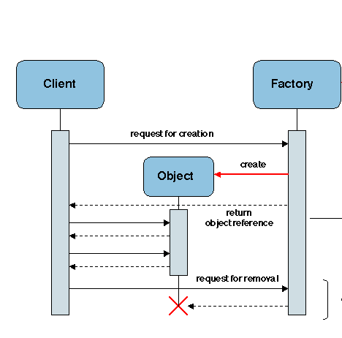
Patterns for Distributed Object Middleware - Factory

Slide 59
Patterns for Distributed Object Middleware - Adapter
Context. Service provision, in a distributed environment:
a service is defined by an interface;
clients request services;
servants located on remote servers, provide services.
Problem. Reuse an existing servant by providing a different interface for its functions in order to comply to the interface expected by a client (or class of clients).

Slide 60
Patterns for Distributed Object Middleware - Adapter
Desirable Properties.
The interface conversion mechanism should be run-time efficient.
It should also be easily adaptable, in order to respond to unanticipated changes in the requirements.
Constraints. No specific constraints.
Solution. Provide a component (the adapter, or wrapper) that screens the servant by intercepting method calls to its interface.
Each call is prefixed by a prologue and followed by an epilogue in the adapter.
Examples: Portable Object Adapter (POA) of CORBA
Java Connector Architecture (JCA).

Slide 61
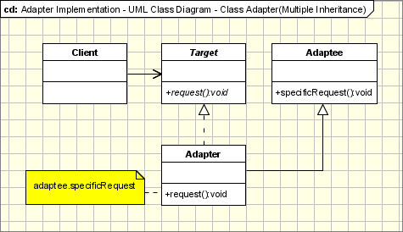
Patterns for Distributed Object Middleware - Adapter
Adapter Convert the interface of a class into another interface clients expect.
Adapter lets classes work together, that could not otherwise because of incompatible interfaces.
Target - defines the domain-specific interface that Client uses.
Adapter - adapts the interface Adaptee to the Target interface.
Adaptee - defines an existing interface that needs adapting.

Slide 62
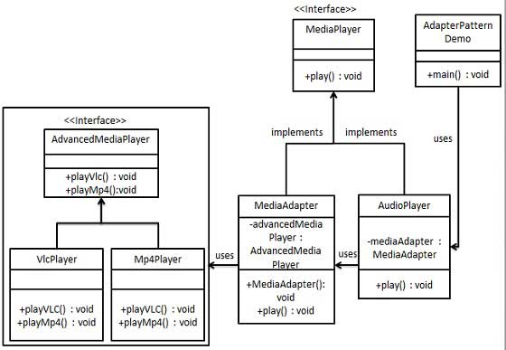
Patterns for Distributed Object Middleware - Adapter
We've an interface MediaPlayer interface and a concrete class AudioPlayer implementing theMediaPlayer interface. AudioPlayer can play mp3 format audio files by default.
We're having another interface AdvancedMediaPlayer and concrete classes implementing theAdvancedMediaPlayer interface. These classes can play vlc and mp4 format files.

Slide 63
Patterns for Distributed Object Middleware - Adapter
We want to make AudioPlayer to play other formats as well. To attain this, we've created an adapter class MediaAdapter which implements the MediaPlayer interface and uses AdvancedMediaPlayerobjects to play the required format.
AudioPlayer uses the adapter class MediaAdapter passing it the desired audio type without knowing the actual class which can play the desired format. AdapterPatternDemo, our demo class will useAudioPlayer class to play various formats.

Slide 64
Patterns for Distributed Object Middleware - Adapter

Slide 65
Patterns for Distributed Object Middleware - Adapter

Slide 66
Patterns for Distributed Object Middleware - Adapter

Slide 67
Patterns for Distributed Object Middleware - Adapter

Slide 68
Patterns for Distributed Object Middleware - Adapter

Slide 69
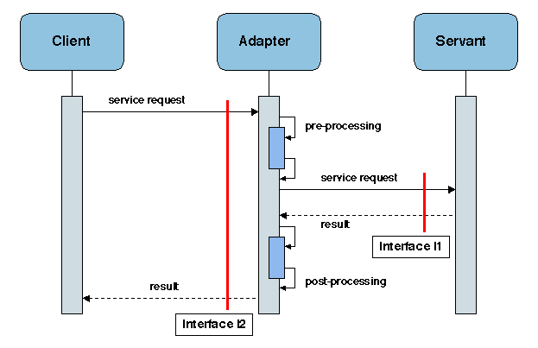
Patterns for Distributed Object Middleware - Adapter

Slide 70
References
Middleware Architecture with Patterns and Frameworks, Sacha Krakowiak
Designing Embedded Communications Software, by T. Sridhar, ISBN: 157820125x, CMP Books
IT Architectures and Middleware – 2nd edition. Chris Britton, Peter Bye. Addison-Wesley
Tanenbaum & van Steen Distributed Systems: Principles and Paradigms, 2nd ed. ISBN: 0-132-39227-5. [Schmidt et al. 2000]Schmidt, D. C., Stal, M., Rohnert, H., and Buschmann, F. (2000). Pattern-Oriented Software Architecture, Volume 2: Patterns for Concurrent and Networked Objects. John Wiley & Sons. 666 pp.
[Gamma et al. 1994]Gamma, E., Helm, R., Johnson, R., and Vlissides, J. (1994). Design Patterns: Elements of Reusable Object Oriented Software. Addison-Wesley.
[Buschmann et al. 1995]Buschmann, F., Meunier, R., Rohnert, H., Sommerlad, P., and Stal, M. (1995). Pattern-Oriented Software Architecture, Volume 1: A System of Patterns. John Wiley & Sons
http://www.tutorialspoint.com/java/java_inheritance.htm
http://www.tutorialspoint.com/java/java_interfaces.htm
http://www.tutorialspoint.com/design_pattern/factory_pattern.htm

