Slide 1
Distributed objects
CPE 545

Slide 2
Distributing Objects - Highlights
Application designers may take advantage of the expressiveness, abstraction, and flexibility of an object model.
Encapsulation allows an object's implementation to be placed on any site.
Legacy applications may be reused by encapsulating them in objects, using the “wrapper” pattern.
Scalability is enhanced by distributing processing power over a network of servers.

Slide 3
Distributing Objects
Local invocation: The calling and called objects are in the same process.
Out-of-process invocation: The calling and called objects are executed by different processes on the same site.
Remote invocation: The calling and called objects are on different nodes.

Slide 4
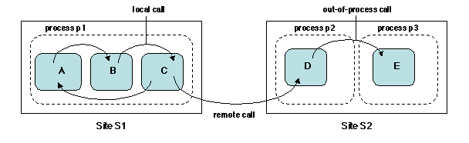
Distributing Objects

Slide 5
Models for distributing objects
The fragmented objects model, in which an object may be split in several parts, located on different nodes, and cooperating to provide the functionality of the object.
The replicated objects model, in which several copies of a given object may coexist to increase availability and to improve performance.
The migratory (or mobile) objects model, in which an object may move from one node to another one to improve performance through load balancing, and to dynamically adapt applications to changing environments.

Slide 6
Models for distributing objects
Non-local forms of invocation rely on an object request broker (ORB), a middleware that supports distributed objects.
An ORB has the following functions:
Identifying and locating objects.
Binding client to server objects.
Performing method calls on objects.
Managing objects' life cycle (creating, activating, deleting objects)

Slide 7
Remote Object Call: a First Outline
A client-server model: a process or thread executing a method of a client object sends a request to remote server object in order to execute a method of that object.
It relies on a stub-skeleton pair. In contrast with RPC, the stub and the skeleton are objects in their own right.

Slide 8
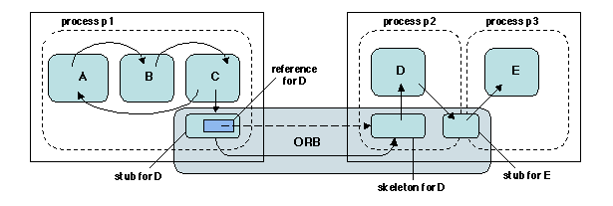
Remote Object Call: a First Outline
The stub for D, on client C's site has the same interface as D. It forwards the call to D's skeleton on D's site, which performs the actual method invocation and returns the results to C, via the stub.

Slide 9
Remote Object Call: a First Outline
In order to be able to forward the invocation, D's stub contains a reference to D's skeleton.
A reference to an object is a name that allows access to the object; it contains information allowing the object to be located (port, address).
An out-of-process call on the same node (e.g. from object D to object E) could in principle be performed as a remote invocation using shared memory.

Slide 10
Remote Object Call: a First Outline
The client process invokes the method on the local stub of the remote object
The stub marshalls the parameters and constructs a request,
Determines the location of the remote object using its reference,
Sends the request to the remote object's skeleton.

Slide 11
Remote Object Call: a First Outline
On the remote object's site:
The skeleton performs unmarshalling parameters,
Dispatching the call to the address of the invoked method
Marshalling returned values, and sending them back to the stub.
On the local site:
The stub unmarshalls the returned values and delivers them to the client process, thus completing the call.

Slide 12
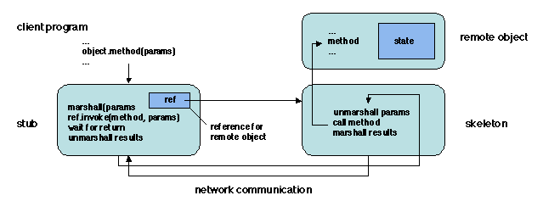
Remote Object Call: a First Outline
Important difference with RPC is that objects are dynamically created

Slide 13
The User's View
Remote object infrastructures attempt to hide distribution from the user, however, some aspects of distribution remain visible.
The main distribution-aware aspect is object creation and location.
Creating a remote object cannot be done through the usual object instantiation mechanism, which involves memory allocation and is not directly applicable to a remote node.

Slide 14
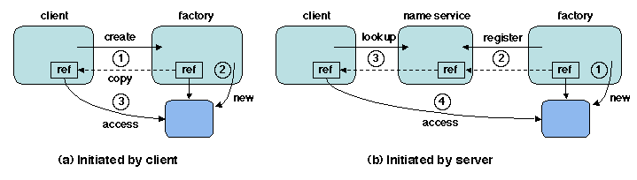
The User's View – Create Object
Creating a remote object is done through an object factory , which acts as a server that creates objects of a specified type.
The reference of the created object is returned to the client .

Slide 15
The User's View – Create Object
An object may also be created at the server's initiative. In that case the server usually registers a reference to the object in a name service, to be later retrieved by the client

Slide 16
The User's View – Access Object
A remote object may only be accessed by a client program through a reference
A reference may be obtained as through a name service.

Slide 17
The User's View – a closer view
What information should be contained in an object reference?
How is the remote object activated, i.e how is it associated with a process or thread that actually performs the call?
How are parameters passed, specially if the parameters include objects?

Slide 18
Object References
An object reference must refer to the object's interface.
The reference must provide all the information that is needed to perform a remote access to the object.

Slide 19
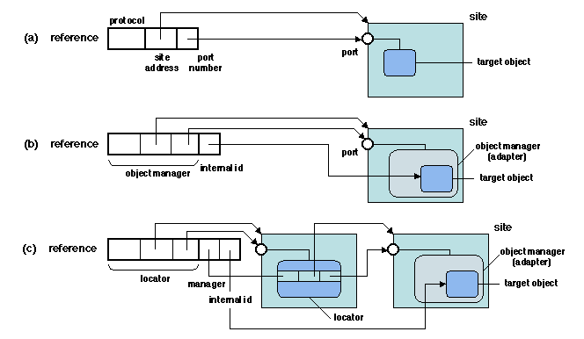
Object References
The reference may contain the network address of remote location. Lacks flexibility, since it does not allow the target object to be relocated without changing its reference.
Object creates the reference

Slide 20
Object References
The reference may contain the network address of an object adapter + an internal object identification on this adapter*
* We will use this model for references through out the lecture notes
Adaptor creates the object reference

Slide 21
Object References
The reference may contain the network address of a locator for the adapter + the identity of the adapter + the internal object identification. This allows the adapter to be transparently relocated on a different site, updating the locator information without changing the reference.
Adaptor creates the object reference which will be referenced by a locator

Slide 22
Object References

Slide 23
Remote Invocation – Server side Abstraction, portability & interoperability
The interface transformation between service and servant is done through a server delegate, as part of the skeleton.
The skeleton (and thus the servant) is located through an object adapter.
Delegates are part of the internal organization of a stub, and are never explicitly seen by a user,
Adapters are usually visible and may be directly used by applications.

Slide 24
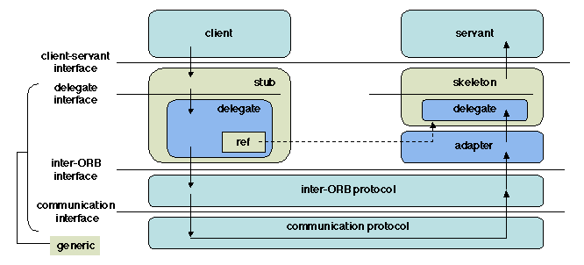
Remote Invocation – Client side Abstraction, portability & interoperability
Upper interface of the stub is application-specific.
Application interface to stub (Interface entry points and data format are standardized).
Delegate interface from Stub (not visible to users):
create_request() - constructing a invocation request in a standard form
Invoke() - actually performing the invocation.

Slide 25
Remote Invocation – Client side Abstraction, portability & interoperability
Lower interface of the stub, connects it to the network.
ORB Interface from Delegate (not visible to users):
SendRequest() – Parameters:
Reference of the called object,
the name of the method,
the description of the parameters of the called method.

Slide 26
Object Adapters - Functions
Registers servant objects when they are created (installed) on the server;
Creates object references for the servant objects (i.e. finds a servant object using its reference) – remember the string names (mp3, vlc, mp4,…) were used to find the correct object servant in media player example
Activates a servant object when it is called, (i.e. associates a process with it).
Creating/Installing Servant Object using object factory
Used when an existing (or legacy) application, not written in object style, must be reused in an object-oriented setting.
Passing parameters

Slide 27
Object Request Broker Standard
General Inter-ORB Protocol (GIOP), allow different CORBA implementations to interoperate
The GIOP specification covers three aspects.
A common format for the data being transmitted, called Common Data representation (CDR);
A format for the messages used for invoking remote objects;
Requirements on the underlying transport layer.

Slide 28
Object Invocation
A Request message includes:
a reference for the target object,
the name of the invoked operation,
the parameters (in marshalled form),
an identifier for a reply holder (if the reply is expected).
After sending the message, the calling thread is put to wait.
At the receiving end, the servant is located using the reference and the request is forwarded to it.

Slide 29
Object Invocation
A Reply message, only created if the invoked operation returns a value (in marshalled form), together with the reply holder.
When this message is received by the client, the waiting thread is activated and may retrieve the reply from the reply holder.

Slide 30
Object Invocation – Client side
The invocation path goes through a stub (at the client end) and a skeleton (at the server end).
The stub and the skeleton are separated into an (upper) application-specific part and a (lower) application-independent part called a delegate.

Slide 31
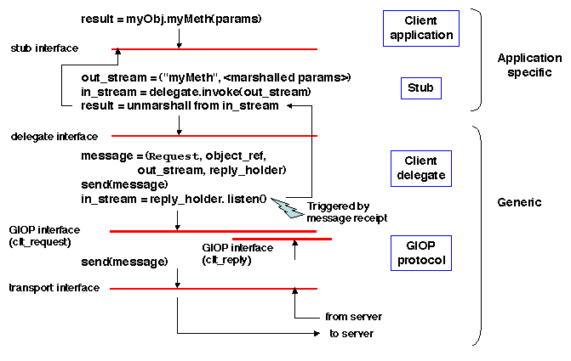
Object Invocation – Client side
Blocked here
Blocked here

Slide 32
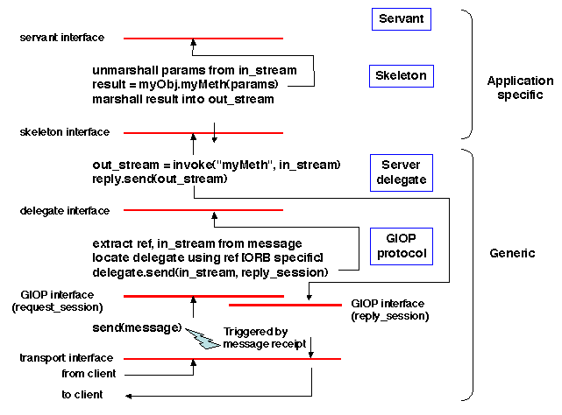
Object Invocation – Server side
Send Reply
Send Reply
Send Reply

Slide 33
References
Middleware Architecture with Patterns and Frameworks, Sacha Krakowiak
Designing Embedded Communications Software, by T. Sridhar, ISBN: 157820125x, CMP Books
IT Architectures and Middleware – 2nd edition. Chris Britton, Peter Bye. Addison-Wesley
Tanenbaum & van Steen Distributed Systems: Principles and Paradigms, 2nd ed. ISBN: 0-132-39227-5. [Schmidt et al. 2000]Schmidt, D. C., Stal, M., Rohnert, H., and Buschmann, F. (2000). Pattern-Oriented Software Architecture, Volume 2: Patterns for Concurrent and Networked Objects. John Wiley & Sons. 666 pp.
Gamma, E., Helm, R., Johnson, R., and Vlissides, J. (1994). Design Patterns: Elements of Reusable Object Oriented Software. Addison-Wesley.
Völter, M., Kircher, M., and Zdun, U. (2004). Remoting Patterns: Foundations of Enterprise, Internet, and Realtime Distributed Object Middleware. John Wiley & Sons.

