Slide 1
RMI (Remote Module Invocation)
CPE 545

Slide 2
Middleware layers
Applications, services
RMI and RPC
request-reply protocol marshalling and external data representation
Middleware layers
UDP and TCP

Slide 3
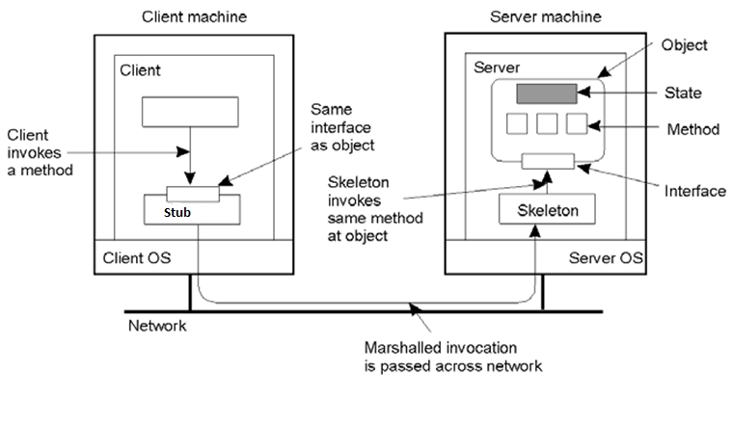
Distributed objects

Slide 4
Compile-time vs run-time objects
Objects can be implemented in many different ways
Compile-time objects- Instances of classes written in object-oriented languages like Java, C++
Systems like Java RMI support compile-time objects
Not possible or difficult in language-independent RMI middleware such as CORBA
Run-time objects- Implementations of object interfaces are registered at an object adapter, which acts as an intermediary between the client and object implementation

Slide 5
Static vs dynamic RMI
Static invocation
Typical way for writing code that uses RMI (similar to the process for writing RPC )
Declare the interface in IDL, compile the IDL file to generate client and server stubs, link them with client and server side code to generate the client and the server executables
Requires the object interface to be known when the client is being developed
Dynamic invocation
The method invocation is composed at run-time invoke(object, method, input_parameters, output_parameters)
Useful for applications where object interfaces are discovered at run-time, e.g. object browser, batch processing systems for object invocations, “agents”

Slide 6
Design Issues for RMI
Transparency
Should remote invocations be transparent to the programmer?
There are some differences between remote and local invocation:
Dealing with Partial failure, higher latency
Different semantics for remote objects, e.g. difficult to implement “cloning” in the same way for local and remote objects
Current consensus: remote invocations should be made transparent in the sense that syntax of a remote invocation is the same as the syntax of local invocation (access transparency) but programmers should be able to distinguish between remote and local objects by looking at their interfaces, e.g. in Java RMI, remote objects implement the Remote interface

Slide 7
Handling failures
Types of failure
Client unable to locate server
Request message lost
Reply message lost
Server crashes after receiving a request
Client crashes after sending a request
Invocation semantics
Maybe (no retransmission) , At-least-once (Re-execute procedure), At-most-once (Retransmit Reply)

Slide 8
Handling failures
Semantics | request retransmission (RT) | duplicate filtering (DF) | retransmission of results (RR)
Maybe | No | Not appl. | Not appl.
At-least-once | Yes | No | Re-execute procedure
At-most-once | Yes | Yes | Retransmit reply

Slide 9
Handling failures
Server crashes
At least once (keep trying till server comes up again)
At most once (return immediately)
Exactly once impossible to achieve
RPC
At least once semantics on successful call and maybe semantics if unsuccessful call
CORBA, Java RMI
At most once semantics

Slide 10
Handling failures
Lost request message
Retransmit a fixed number of times before throwing an exception
Lost reply message
Client resubmits request
Server choices
Re-execute procedure → service should be idempotent so that it can be repeated safely
Filter duplicates → server should hold on to results until acknowledged

Slide 11
Handling failures
Client crashes
If client crashes before RPC returns, we have an “orphan” computation at server
Wastes resources, could also start other computations
Orphan detection
Reincarnation (client broadcasts new “epoch” when it comes up again)
Expiration (RPC has fixed amount of time T to do work)

Slide 12
Distributed Garbage Collection
Java approach based on reference counting
Server maintains a list of clients that hold remote object references for its remote objects
When a client first retrieves a remote reference to an object, it makes an addRef() invocation to server before creating a proxy (client reference)
When a clients local garbage collector notices that a proxy is no longer reachable, it makes a removeRef() invocation to the server before deleting the proxy
When the local garbage collector on the server notices that the list of client processes that have a remote reference to an object is empty (reference count is zero), it will delete the object

Slide 13
Distributed Binding
Binding consists of two generic operations:
Export (server):
INPUT: Naming context and an object,
OUTPUT: A name for the object in the context.
Bind (client):
INPUT: Name of the object to be bound (object must have previously been exported).
OUTPUT: A handle that allows the object to be accessed.

Slide 14
Binding in an ORB
export:
Servant object is created (directly or through a factory)
Servant object is registered by the server (possibly using an adapter), thus providing a reference.
This reference is then registered in a name service.
Parts of the binding object (the skeleton and delegate instances ) are also created at this time
bind:
The client retrieves a reference for the servant, either through the name service
It uses this reference to generate an instance of the stub, and to set up the path from client to server by creating the end points of the communication path.

Slide 15
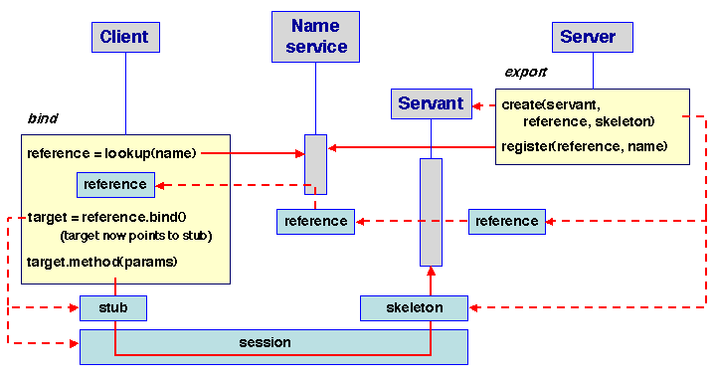
Binding in an ORB

Slide 16
Java RMI
A remote object system relies on a naming service. In Java RMI, this service is provided by a registry. The data that is registered is actually a reference for the remote object.
The registry is accessible on both the client and server node through a local interface called Naming.

Slide 17
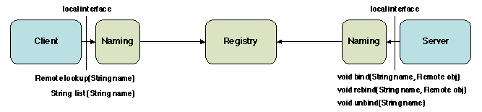
Java RMI
The symbolic names have the URL format of the form:
//[host name][:portname]/local name .
host is the host (remote or local) where the registry is located,
port is the port number on which the registry accepts calls,
name is a simple string uninterpreted by the registry.
Both host and port are optional. If host is omitted, the host defaults to the local host. If port is omitted, then the port defaults to 1099, the "well-known" port that RMI's registry, rmiregistry, uses
A server registers references in the registry using bind and rebind and unregisters them using unbind.
The client uses lookup to search the registry for a reference of a given name.
Export
Bind

Slide 18
Java RMI
Stub and skeleton classes are generated from a remote interface description, using a stub generator (rmi)
Programming with remote objects is subject to a few rules:
Remote interface is defined like an ordinary Java interface, except that it must extend the java.rmi.Remote interface.
A call to a method of a remote object must throw the predefined exception java.rmi.RemoteException.
Any class implementing a remote object must create a stub and skeleton for each newly created instance; the stub is used as a reference for the object.
This is usually done by making the class extend the predefined class java.rmi.server.UnicastRemoteObject, provided by the RMI implementation.

Slide 19
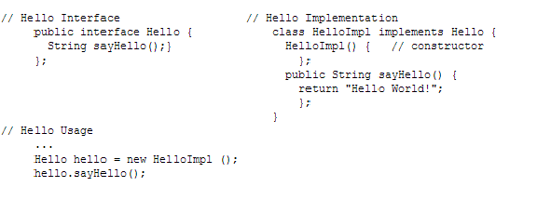
Java RMI – (centralized)

Slide 20

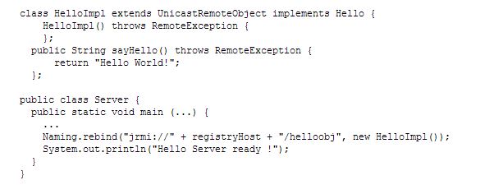
Java RMI – Interface
// extends java.rmi.remote
// extends the predefined class java.rmi.server.UnicastRemoteObject
// object instantiated from this class is used to create stub and skeleton

Slide 21
Java RMI – Server
// The server creates the target object and registers it
// under a symbolic name (rebind operation).
// Binds a url-formatted name (“jrmi://host/objectname”) to the remote object

Slide 22

Java RMI - Client
The client program looks up the symbolic name, and retrieves a stub for the target object, which allows it to perform the remote invocation.
stub
The client and server must agree on the symbolic name (how this agreement is achieved is not examined here).

Slide 23
Interface
import java.rmi.*;
public interface Hello extends java.rmi.Remote {
String sayHello() throws RemoteException;
}

Slide 24
Server
import java.rmi.Naming; import java.rmi.RemoteException; import java.rmi.server.UnicastRemoteObject;
public class HelloImpl extends UnicastRemoteObject implements Hello { public HelloImpl() throws RemoteException {}
public String sayHello() { return "Hello world!"; }
public static void main(String args[]) { try { HelloImpl obj = new HelloImpl(); // Bind this object instance to the name "HelloServer" Naming.rebind("HelloServer", obj); } catch (Exception e) { System.out.println("HelloImpl err: " + e.getMessage()); e.printStackTrace(); } } }

Slide 25
Client
import java.rmi.RMISecurityManager; import java.rmi.Naming; import java.rmi.RemoteException;
public class HelloClient { public static void main(String arg[]) { String message = "blank";
// I download server's stubs ==> must set a SecurityManager System.setSecurityManager(new RMISecurityManager());
try { Hello obj = (Hello) Naming.lookup( "//" + "lysander.cs.ucsb.edu" + "/HelloServer"); //objectname in registry System.out.println(obj.sayHello()); } catch (Exception e) { System.out.println("HelloClient exception: " + e.getMessage()); e.printStackTrace(); } } }
Set the security manager, so that the client can download the stub code.
Get a reference to the remote object implementation (advertised as
"HelloServer") from the server host's rmiregistry.
Invoke the remote sayHello method on the server's remote object
The constructed URL-string that is passed as a parameter to
the Naming.lookup method must include the server's hostname.

Slide 26
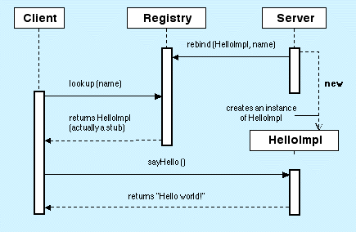
Java RMI

Slide 27
Agent Technologies
Requirements for the next generation Telecom network:
Allow users to navigate through the massive content and service offerings
Allow for the potential of large bandwidth access to multimedia content and services
Allow for security mechanisms to be built in intelligent telecommunication infrastructures.
Allow for scalability through self-organization and hand-over between different networks

Slide 28
Agent Technologies
The promise of agent technology in telecommunications is to provide:
Enabling more intelligence in service provision to allow value-added services and negotiation of QoS;
Dealing with the enlarging amount of information and functions, and allow self-organizing networks.

Slide 29
Agent Technologies
Examples:
Software agent at a newspaper website can learn about a user’s preferences by tracking the user's actions, and then custom tailor the news summaries that suit the needs of that user.
Agents technology is used also to automate ordering process according to pre-determined inventory levels
Agents technology is used to search for cheaper airline tickets on the internet
A bidding agent can monitor online exchange activity for the best time to buy a commodity or material, and then inform the person via phone, text message, or email.

Slide 30
Agent Technologies
An intelligent agent is “a computer system, situated in some environment, that is capable of flexible, autonomous action in order to meet its design objectives.
Computer programs that use AI technology to 'learn,' and automate certain procedures and processes.

Slide 31
Agent Technologies
Software agents are software components characterized by:
Autonomy - to act on their own
Reactiveness - to process external events
Proactiveness - to reach goals
Cooperation - to efficiently and effectively solve tasks
Adaptation - to learn by experience
Mobility - migration to new places

Slide 32
References
Middleware Architecture with Patterns and Frameworks, Sacha Krakowiak
Designing Embedded Communications Software, by T. Sridhar, ISBN: 157820125x, CMP Books
IT Architectures and Middleware – 2nd edition. Chris Britton, Peter Bye. Addison-Wesley
Tanenbaum & van Steen Distributed Systems: Principles and Paradigms, 2nd ed. ISBN: 0-132-39227-5. [Schmidt et al. 2000]Schmidt, D. C., Stal, M., Rohnert, H., and Buschmann, F. (2000). Pattern-Oriented Software Architecture, Volume 2: Patterns for Concurrent and Networked Objects. John Wiley & Sons. 666 pp.
[Gamma et al. 1994]Gamma, E., Helm, R., Johnson, R., and Vlissides, J. (1994). Design Patterns: Elements of Reusable Object Oriented Software. Addison-Wesley.
[Buschmann et al. 1995]Buschmann, F., Meunier, R., Rohnert, H., Sommerlad, P., and Stal, M. (1995). Pattern-Oriented Software Architecture, Volume 1: A System of Patterns. John Wiley & Sons

