Slide 1
Secure Programming
CPE 545

Slide 2
Buffer overflow
Buffer Overflow
Is an anomaly that occurs when a program reads or writes data beyond the boundary of a buffer.
Can be exploited to overwrite memory adjacent to a buffer, thus corrupting memory that may contain control flow information, passwords, cryptographic key, etc..

Slide 3
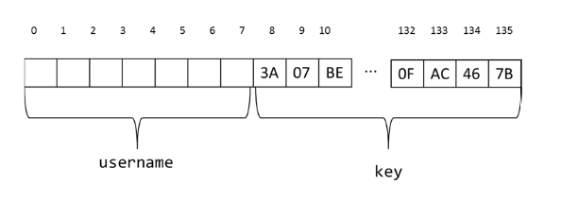
Buffer overflow
8 bytes username followed by cryptographic key stored in memory

Slide 4
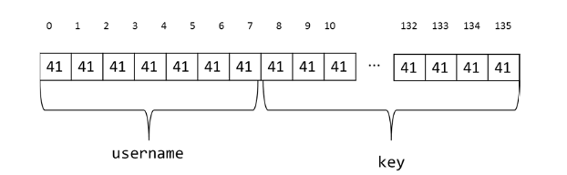
Buffer overflow
How can buffer overflow be exploited?
A function copies username onto stack using the length provided by user. If length is greater than 8 bytes, an attacker can exploit this vulnerability by providing input to overwrite the key.

Slide 5
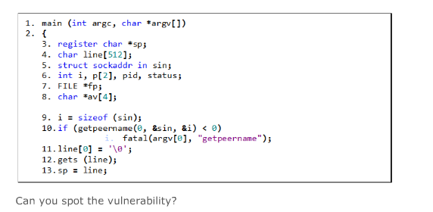
Buffer overflow

Slide 6
Buffer overflow
gets (line), does not check any length checking, so a user input longer than 512 bytes can cause buffer over overflow

Slide 7
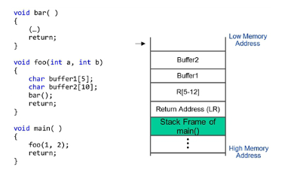
Stack-based buffer overflow

Slide 8
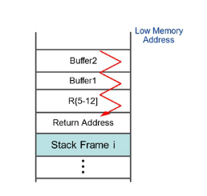
Stack-based buffer overflow
The input provided by attacker would corrupt the contents of buffer 1[] and overwrite the adjacent saved variable registers, the saved LR that stored the returned address.

Slide 9
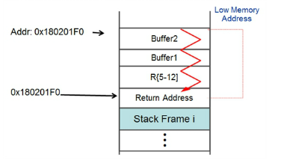
Stack-based buffer overflow
Attacker may embed malicious binary code inside her input and overwrite the saved returned address on stack with the address of her malicious code in buffer2.
When function foo() returns, it jumps to the attacker controlled address.

Slide 10
Stack Gap
Stack gap is a mitigation to address execution of malicious code in stack-based buffer overflow, by adding a random number to the base of stack.
Stack will be located at different location with each execution of program. This changes the address of the attacker controlled buffer, preventing him from reliably jumping to his code.

Slide 11
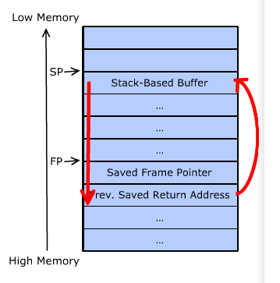
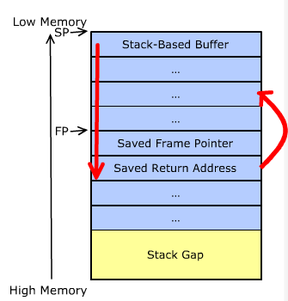
Stack Gap
07FFFCD0
07FFFDD0
0x07FFFF00
0x08000000
If the default stack base is 0x0800000 and the buffer address is at 0x07FFFDDo
With stack gap 0f 0x100, the new stack base will be 0x07FFFF00 and buffer will begin at 0x07FFFCD0

Slide 12
Stack Gap
07FFFCD0
07FFFDD0
0x07FFFF00
0x08000000
Can be circumvented by brute force approach, trying different offset until the attack succeeds

Slide 13
Stack Canaries
Canary is placed before the return address on the stack and is initialized with a known value
Before jumping to address pointed to by returned address, the value of canary is compared to the known value.
If the canary value is the same, the program continues execution from the saved return address.
Otherwise, if the canary value is changed, this indicates the return address is overwritten and program aborts

Slide 14
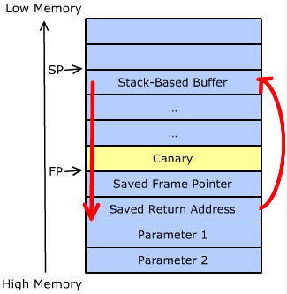
Stack Canaries
Terminator Canaries are composed of sequences of bytes that terminates writing to a buffer, e.g. 0x000a0dff (null, line feed, carriage return)
Random canaries are random sequence of bytes and harder to spoof.

Slide 15
Input validations
Verify that length fields match the amount of data provided
Restrict text input to certain characters
Restrict numeric data to acceptable range
Verify conformance to standards

Slide 16
Problem with pointers
Null pointers
Null pointer dereference of a function pointer in kernel.
If malicious user space process can map zero page, then it can put the address of a function such that when called by kernel module it will elevate the privilege of the process
Always check for NULL pointer

Slide 17
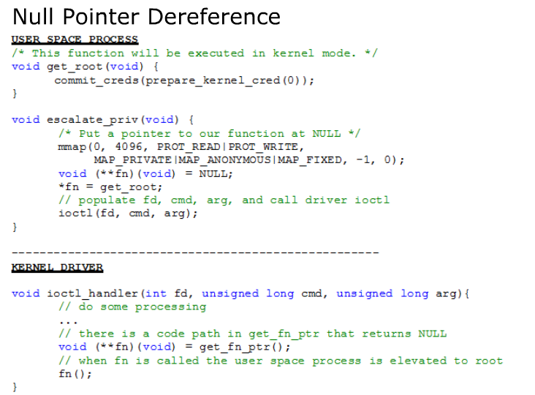
NULL pointers
0
fn
*fn
get_root

Slide 18
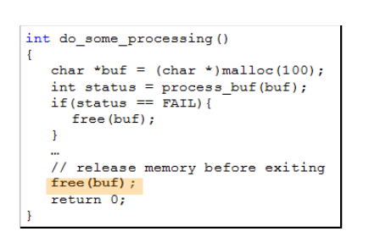
Double free
Can cause heap corruption and lead to exploitation of heap management routines
If attacker can place data of his choosing at the freed location, he can trick the program into executing malicious code.

Slide 19
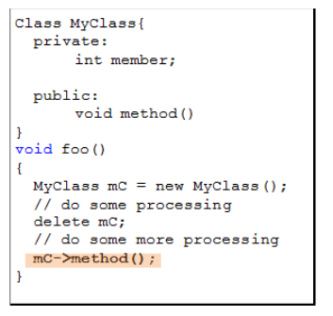
Double free – pointer arithmatic
In C++ the VTABLE of the malicious object could point to a location that contains functions controlled by attacker, so when freed pointer calls a function of the object, the program will not crash, but instead will call one of the functions from VTABLE.

Slide 20
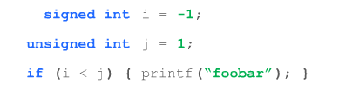
Sign conversion vulnerability
Rules of type conversion are complex and non-intuitive. When data type of variable is changed, the sign or value of the variable may change unexpectedly leading to vulnerability.
Implicit type conversion by compiler forces i to be promoted to unsigned

Slide 21
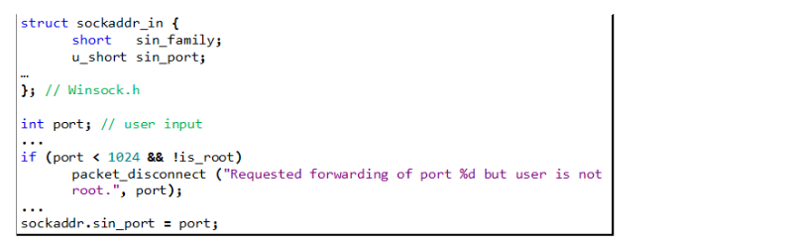
Sign conversion vulnerability
The first 1024 ports are privileged ports and normal users cannot run servers on privileged ports (HTTPS, POP, SMTP). So if you connect to a service on one of these ports, the service is a legitimate service.
In structure sockaddr_in, member sin_port is declared 16-bit unsigned integer (short).
Port is declared 32 bit integer
When port is assigned to sin_port, the two high-order bytes are truncated and port number is changed.
To exploit this code, an attacker might set the variable port to 0x000101bb. The expression in if statement is satisfied, and sin_port is set to 0x1BB (443), which is used for HTTPS traffic.

Slide 22
Denial of Service
Attacker forces you to deplete a resource, such as CPU cycles, memory, bandwidth, socket/port connections, battery, etc..
Example:
In a normal case, a decoded message will be acted upon, but in an unexpected state, the message is dropped but not freed (bug)
An attacker could exploit this scenario by keep sending messages of the same type until ran out of memory

Slide 23
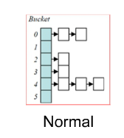
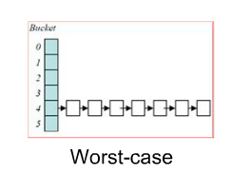
Denial of Service
Hashes are convenient data structure that offer O(n) average time for n insertions, but could degenerate to O(n²) time for n insertions.
An attacker could control or predict the input used by hash algorithms to always induce the worse-case behavior

Slide 24
Denial of Service
DoS countermeasures
Be careful about resource consumption (file handles, memory, etc..)
Perform input validation of all user-controlled data. Prefer whitelist over blacklist
Fail gracefully with least impact.
Keep time complexity attacks in mind (average v.s worst-case)

Slide 25
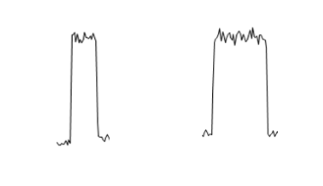
Side channels
Attacker can monitor the hardware for information that allows him to break into the system
Power, electromagnetic, timing
Attacker could use a high precision timer to time how long it takes to run

Slide 26
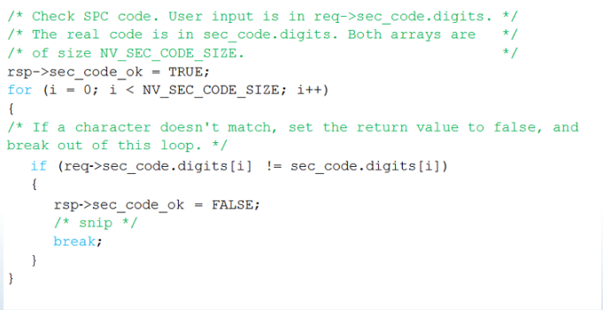
Side channels

Slide 27
Mitigations
Compartmentalization
Principle of least privilege
Process should have only the necessary privilege to perform their work and not more.
When privilege is no longer needed, it should be forfeited
Privilege separation
Memory virtualization
Secure by default
Keep it simple
Minimize the system entry points
Open sockets, named pipes, device driver nodes, config files
Fail securely
Log errors carefully, leave the system in a consistent state

