Slide 1
Security Layer in Communication Software
Madjid S. Mousavi
Dept of Electrical Engineering
Stevens Institute of Technology

Slide 2
Security Layer
Security on the Internet has been playing an ever-increasing role of importance in the past few years
It must provide data privacy for all the data transmitted data between parties and prevent programs that could view the network traffic from reading the sensitive data.

Slide 3
SSL/IPSec
Security can be implemented at different levels:
The security may be implemented at a layer between TCP/IP and application protocols, such as HTTP, LDAP, FTP, and Telnet (SSL).
The security May be implemented on top of the IP layer (IPSec)

Slide 4
Security Achieved by the Secure Sockets Layer (SSL)
Confidentiality
Encrypt data being sent between client and server, so that passive wiretappers cannot read sensitive data.
Integrity Protection
Protect against modification of messages by an active wiretapper.
Authentication
Verify that a peer is who they claim to be. Servers are usually authenticated, and clients may be authenticated if requested by servers.

Slide 5
SSL
Symmetric key algorithms
use a single secret key, which must be shared and kept private by both the sender and the receiver, for both encryption and decryption. To use a symmetric encryption scheme, the sender and receiver must securely share a key in advance.
Asymmetric key algorithms
A key used to encrypt a message is not the same as the key used to decrypt it.
The public encryption key is widely distributed, while the private decryption key. private decrypting-key is known only to its proprietor.
The keys are related mathematically, but the parameters are chosen so that calculating the private key from the public key is either impossible or prohibitively expensive.

Slide 6
TCP/IP Protocol Stack With SSL
TCP/IP Layer
Protocol
Application Layer
HTTP, IMAP, NNTP, Telnet, FTP, etc.
Secure Sockets Layer
SSL
Transport Layer
TCP
Internet Layer
IP

Slide 7
Cryptography
Cryptography makes it difficult for an unauthorized third party to access and understand private communication between two parties.
Private data can be made unintelligible to unauthorized parties through the process of encryption. Encryption uses complex algorithms to convert the original message, or cleartext, to an encoded message, called ciphertext. Decryption does the reverse.
A key is a bit string that is used by the algorithms for encryption or decryption.
Two types of Cryptography :
Symmetric (same key is used for both encryption and decryption)
Asymmetric ( Different but mathematically related keys are used for encryption and decryption)

Slide 8
symmetric cryptography
The same key is used for both encryption and decryption.
Stream Ciphers
Random stream with a known seed used for both encryption and decryption
Block Ciphers
Data Encryption Standard (DES) – 64 bits
Is no longer considered secure
Advanced Encryption Standard (AES)- 128, 192, 256

Slide 9
Symmetric Encryption
1
0
0
1
0
Key
(Pseudo-random bits
or Block Cypher)
Plain Text
XOR
Cipher Text
100111010101
001110000111

Slide 10
Symmetric Decryption
1
0
0
1
0
Key
(Pseudo-random bits
or Block Cypher)
Cipher Text
Plain Text
XOR
001110000111
100111010101

Slide 11
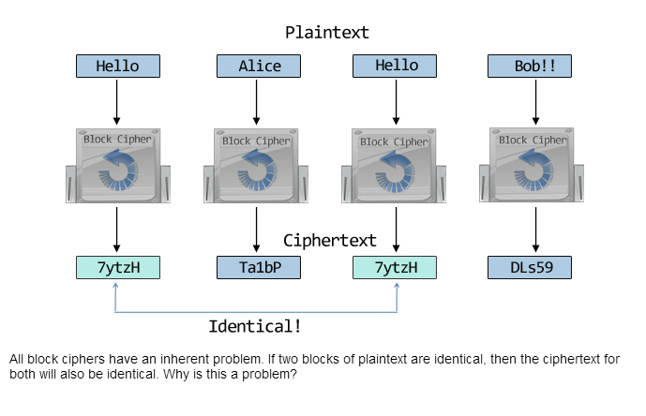
Symmetric Cryptographic Cipher

Slide 12
Cipher block chaining
Each plaintext block is XORed with the previous ciphertext block before being encrypted. CBC requires an initialization vector to XOR with the first plaintext block. CBC mode is very popular and is considered an industry best practice.
Examples of Block cipher
Data Encryption Standard (DES) – 64 bits
Advanced Encryption Standard (AES)- 128, 192, 256

Slide 13
Hash Functions
A hash function is a reproducible method for turning a long message into a concise fixed-length piece of data, known as hash code.
A hash is useful because it can serve as a ‘fingerprint’ that uniquely identifies the data from which it originated.

Slide 14
Hash Functions
The hash function must be one-way.
Given a message, it is easy to compute its hash;
Given a hash, it is very difficult to find a message that produces this hash.
The hash function must produce uncorrelated hashes.
Two similar messages must produce two unrelated hashes.
The good hash function must minimize collisions. A collision is when two distinct messages both produce the same hash.

Slide 15
Hash Functions
Widely used hash functions are
Message Digest 5 (MD5)
A widely-used hash function that produces 128-bit hashes. Collisions have been found with MD5 and thus this algorithm is no longer considered secure.
Secure Hash Algorithm (SHA).
SHA-1
Another popular hash function that produces 160-bit hashes. Collisions are expected to be found soon with SHA-1 thus its use is no longer recommended.
SHA-2
A collection of related hash functions that differ mainly in the size of their hashes. Have not undergone as much public scrutiny as SHA-1 or MD5, they are nonetheless considered secure by the industry.

Slide 16
Cryptographic Hash Functions
Q: How can we prevent Charlie from tampering with data that Alice sends to Bob?
A: Make any change in the data detectable.
A cryptographic hash function is like a checksum.
A one way transformation
A cryptographic hash function generates, a small string of bits, known as a hash, from a message. Any slight change to the message should make a change in the resulting hash.

Slide 17
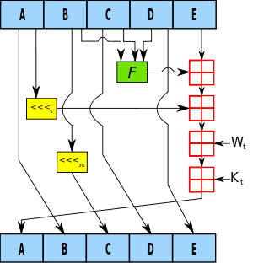
Cryptographic Hash Functions
One iteration within the SHA-1 compression function: A, B, C, D and E are 32-bit words of the state; F is a nonlinear function that varies; _{n} denotes a left bit rotation by n places; n varies for each operation; W_{t} is the expanded message word of round t; K_{t} is the round constant of round t; denotes addition modulo 2³².

Slide 18
Message Authentication Code
A message authentication code (MAC) is like a cryptographic hash, but it uses a secret key (symmetric cipher).
Including a secret key with the data processed by a cryptographic hash produces a hash called an HMAC (hashed message authentication code).
Shared secret key is also used to encrypt (for sender) and decrypt (for receiver)
A secure network is needed to share the secret key

Slide 19
Message Authentication Code
Here’s how we prevent Charlie from tampering with data that Alice sends to Bob.
Alice calculates an HMAC for her message and append the HMAC to her original message. She encrypts the message plus the HMAC using a secret key she shares with Bob.
Bob decrypts the message and recalculates the HMAC. If his HMAC differs from the one Alice sent then the message was modified in transit.

Slide 20
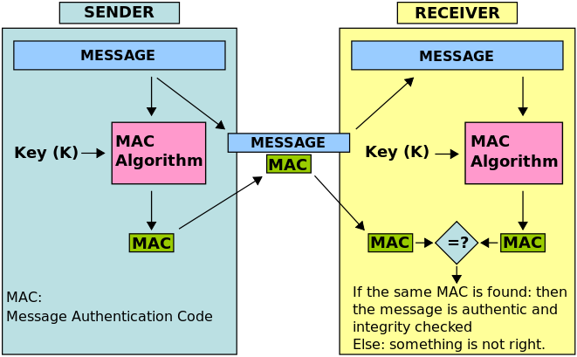
Message Authentication Code
Encrypt
Decrypt
Encrypted
HMAC
HMAC
HMAC
HMAC
HashFn(message + shared key) = HMAC

Slide 21
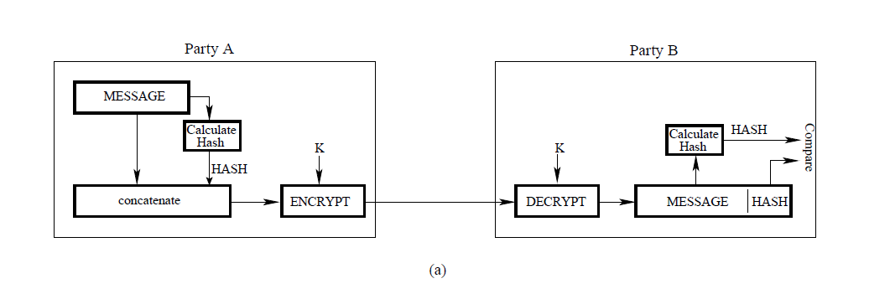
Message Authentication Code

Slide 22
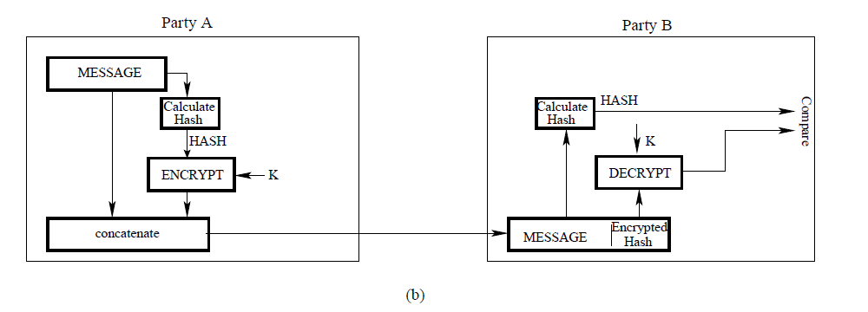
Message Authentication Code

Slide 23
Symmetric and Asymmetric usage
Use symmetric ciphers for message encryption.
Use HMAC (Hash Message Authentication Code) to provide tamper detection.
Use asymmetric ciphers for message encryption (Mathematically intensive and thus very slow).
Apply asymmetric ciphers to encrypt cryptographic keys.
Apply asymmetric cryptography to provide authentication.

Slide 24
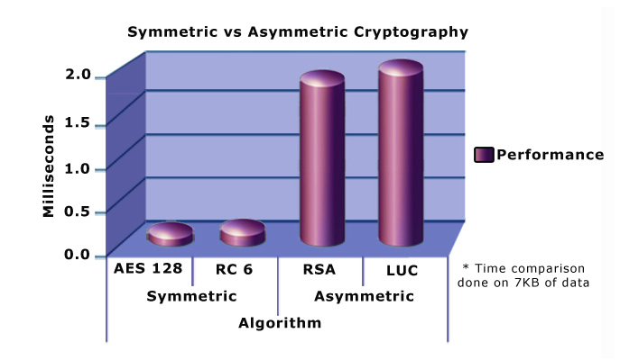
Symmetric and Asymmetric performance

Slide 25
Asymetric Cryptography
Asymmetric cryptography, or public-key cryptography, uses two separate keys.
One key is called the private key and is not shared with anyone.
The other key is called the public key and is publicly available to anyone who wants it.
A message encrypted with a public key can only be decrypted with the corresponding private key
A message encrypted with a private key can only be decrypted with the corresponding public key.

Slide 26
Mathematical Foundation of Asymmetric cryptography - RSA
The idea behind it is very simple. Public-key cryptography is possible because there exist mathematical transformations that are very easy to compute, but whose inverse transformations are very difficult to compute.
A common example is multiplying and factoring. It is very easy to algorithmically multiply two prime numbers together to form a large number, but it is much more difficult to factor that large number back down to the original two prime numbers.

Slide 27
Mathematical Foundation of Asymmetric cryptography - RSA
Another example: Z=X^Y mod(N).
Given X, Y, and N, it is very easy to algorithmically compute Z; this is the exponentiation problem.
On the other hand, given Z, Y, and N, it is very difficult to compute X; this is the logarithm problem. However, if the prime factors of N are known, then a shortcut exists to easily compute X.
So if N is specially chosen to be the product of two large primes, say P and Q, then only someone who knows P and Q will be able to calculate X given Z and Y.

Slide 28
Mathematical Foundation of Asymmetric cryptography - RSA
<P, Q> A pair of prime numbers are chosen as a “Private Key”
N = P.Q,
P and Q are the prime factors of N and know as “Private Key”
<N, Y> pair act as a “Public Key”
Only if you can factor N, or can solve the algorithm problem, you can decipher the encrypted text. Both extremely difficult to do without the knowledge of prime factors (private key) P and Q.

Slide 29
SSL
SSL has a notion of client and server. The client contacts the server and sends the first message.
The first message causes the client and server to exchange a few messages to negotiate the encryption algorithm and to pick an encryption key for this connection.
The server must have an SSL certificate (public key ) and the private key associated with that certificate.
This public key is sent to the client when it connects.
The client will use the public key to encrypt a value and send it to the server.
The server must then have the corresponding RSA private key so it can decode the client's message.
RSA is a public key cryptography algorithm ( Ron Rivest, Adi Shamir and Leonard Adleman)

Slide 30
Encryption Algorithms
Parties
Alice and Bob want to communicate.
Charlie, the unauthorized third party, is known as the attacker.
Secret key
Alice and Bob agree on an algorithm, and have the same secret key, which they use to encrypt plaintext and decrypt cyphertext.
Well-known secret key symmetric cryptographic algorithms include the Data Encryption Standard (DES), triple-strength DES (3DES), Rivest Cipher 2 (RC2), Rivest Cipher 4 (RC4) and the Advanced Encryption Standard (AES).

Slide 31
Encryption Algorithms (cont.)
Public key
Alice and Bob agree on an algorithm (RSA/DH), and Alice creates a pair of keys—public and private—and sends the public key to Bob and other people. Bob (or anyone else) encrypts with the public key, but only Alice can decrypt with the secret private key.
Well-known public key (asymmetric) algorithms include Rivest Shamir Adleman (RSA) and Diffie-Hellman (DH).
Because they require extensive computations, these algorithms run slowly. Therefore they’re only used for encrypting small pieces of data, such as secret keys or signatures.

Slide 32
Shared Key exchange RSA
Create a secret key
Based on information generated by the client with a secure random number generator
Use public keys to exchange the secret key (RSA)
The server sends its public key to the client
The client encrypts the secret key with the server's public key and sends it to the server
The server decrypts the secret key information with the server’s private key
Encrypt and decrypt data with the secret key
The client and server use the negotiated algorithm

Slide 33
Shared key exchange Diffie-Hellman (DH)
Generate the same shared key on both ends (DH)
Calculate a public key based on two known prime numbers (base and modulus)
Send the public key to the peer
Use the peer public key to calculate shared key
Note that shared itself key is not exchanged over non-secure channel.

Slide 34
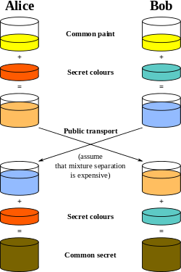
Mathematical Foundation of Asymmetric cryptography- DH
P, G
X_{b} is Bob’s DH private key
Y_{b} is Bob’s DH public key
P & G are two known primes
K_{b} is the DH shared key
X_{a} is Alice’s DH private key
Y_{a} is Alice’s DH public key
P & G are two known primes
K_{a} is the DH shared key
X
Y
Y_{b}=(G^X_{b}) mod P
Y_{a}=(G^X_{a}) mod P
X
K
K_{a}=(Y_{b}^X_{a}) mod P
K_{b}=(Y_{a}^X_{b}) mod P

Slide 35
Mathematical Foundation of Asymmetric cryptography- DH
Prove that Ka= Kb:
Ka = (Yb^Xa) mod P
substitute for Yb = (G^Xb) mod P
= (((G^Xb) mod P)^Xa) mod P
= (G^XaXb) mod P
= (((G^Xa) mod P)^Xb) mod P
But Ya = (G^Xa) mod P
so:
= (Ya^Xb) mod P = Kb
Ka = Kb

Slide 36
How SSL Achieves Integrity Protection
Client and server use their secret key, and an agreed-upon cryptographic hash function to attach an HMAC to each message sent.
The receiver checks that each message has not been altered.

Slide 37
Public Keys and Authentication
Q: How does Alice prove to Bob that she is Alice?
A: Demonstrate that she has her private key.
Protocol
Bob creates a random number, encrypts it with Alice’s public key and sends it to Alice.
Alice decrypts the random number with her private key, and sends the random number to Bob, proving she’s Alice.

Slide 38
Digital Signatures
Q: How does Alice prove to Bob that a message comes from her?
A: Demonstrate that she has her private key.
Protocol
As before, Alice creates her public and private keys, and distributes her public key with her name attached.
Alice encrypts a message (digital signature) using her private key and sends the message to Bob.
If Bob can decrypt the data with Alice's public key, the message must have been encrypted by Alice with her private key, since only Alice has her private key.
This is called a digital signature (a Certificate encrypted by CA’s private key)

Slide 39
Public Keys and Authentication (cont.)
Q: How do we prevent Charlie from pretending to be Alice by circulating a public key named ‘Alice’?
A: By having someone we trust verify that Alice is Alice.
Public Key Certificate
A digital ‘passport’ that is issued by a trusted organization and identifies the bearer.
A trusted organization is called a certificate authority (CA).
The CA digitally signs the certificate, thereby attesting to the validity of the certificate’s information.

Slide 40
Public Key Certificate
Contains the fields:
Subject’s public key
Subject
Information about the entity that the certificate represents.
Issuer
The CA that issued the certificate. If a user trusts the CA that issues a certificate, and if the certificate is valid, the user can trust the certificate.
Signature
The signature is created using the CA's private key and ensures the validity of the certificate.
Period of validity
The certificate’s expiration date.

Slide 41
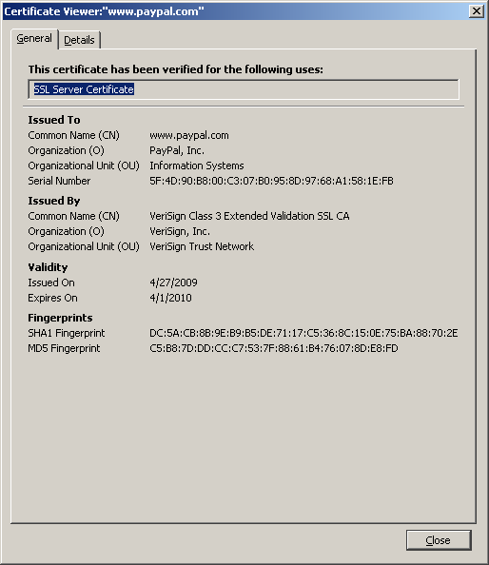
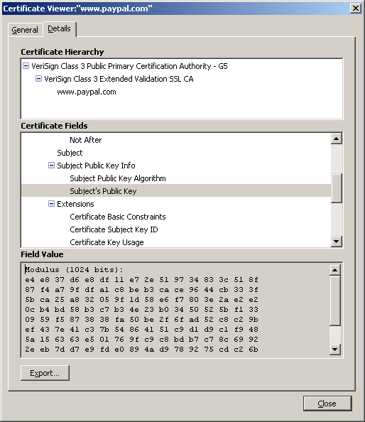
Certificates

Slide 42
Authentication with a Public Key Certificate
Q: How is a public key certificate used to help Alice prove to Bob that she is Alice?
Protocol
Bob obtains Alice’s public key certificate.
Bob also has a certificate for a trusted CA that supposedly signed Alice’s public key certificate.
Bob checks that the trusted CA signed Alice’s public key certificate by using the CA’s public key to decrypt the signature in Alice’s public key certificate.
Run the protocol for “Q: How does Alice prove to Bob that she is Alice?”

Slide 43
Certificate Chains
Multiple certificates may be linked in a certificate chain.
The first certificate is that of the sender.
The next is the certificate of the entity that issued the sender’s certificate.
If there are more certificates in the chain, each is that of the authority that signed the previous certificate.
The final certificate in the chain is the certificate for a root CA, a certificate authority that is widely trusted.
Well-known public CAs include VeriSign, Entrust, and GTE CyberTrust.

Slide 44
How SSL Achieves Authentication
Protocol
If the client wants to authenticate the server then they follow the protocol in “Authentication with a Public Key Certificate” with the client acting as Bob.
If the server wants to authenticate the client then they follow the protocol in “Authentication with a Public Key Certificate” with the server acting as Bob.

Slide 45
How SSL Works - Summary
Handshake
a negotiation process that creates or rejoins a session
If (Handshake succeeds) then
Encrypted data can be exchanged
Else
The connection is aborted

Slide 46
How SSL Works - Summary the Handshake
Negotiate the cipher suite
Authenticate identities (optional)
Exchange secret key

Slide 47
How SSL Works - Summary Negotiate the Cipher Suite
A cipher suite
A set of cryptographic algorithms
An algorithm for exchanging a secret key (asymmetric)
A secret key encryption algorithm and key length (symmetric)
A cryptographic hash function (HMAC)
The client tells the server which cipher suites it has available, and the server chooses the best mutually acceptable cipher suite.

Slide 48
The IPSec Security Model
Secure
Insecure

Slide 49
IPSec Architecture
ESP
AH
Encapsulating Security
Payload
Authentication Header
IPSec Security Policy
IKE
The Internet Key Exchange

Slide 50
IPsec Architecture
Transport Mode
Router
Router
Tunnel Mode

Slide 51
Various Packets
Original
IP header
TCP header
data
Transport
mode
IP header
IPSec header
TCP header
data
Tunnel
mode
IP header
IPSec header
IP header
TCP header
data

Slide 52
Authentication Header (AH)
Provides source authentication
Protects against source spoofing
Provides data integrity
Protects against replay attacks- (valid data transmission is maliciously or fraudulently repeated or delayed)
Use monotonically increasing sequence numbers
Protects against denial of service attacks
NO protection for confidentiality!

Slide 53
AH Packet Details
New IP header
Next
header
Payload
length
Reserved
Security Parameters Index (SPI)
Authenticated
Sequence Number
Encapsulated
TCP or IP packet
Old IP header (only in Tunnel mode)
TCP header
Hash of everything
else
Data
Authentication Data

Slide 54
Encapsulating Security Payload (ESP)
Provides all that AH offers, and
in addition provides data confidentiality
Uses symmetric key encryption

Slide 55
ESP Details
Same as AH:
Use 32-bit sequence number to counter replaying attacks
Use integrity check algorithms
Only in ESP:
Data confidentiality:
Uses symmetric key encryption algorithms to encrypt packets

Slide 56
ESP Packet Details
IP header
Next
header
Payload
length
Reserved
Security Parameters Index (SPI)
Sequence Number
Authenticated
Initialization vector
TCP header
Data
Encrypted TCP
packet
Pad
Pad length
Next
Authentication Data

Slide 57
Internet Key Exchange (IKE)
Exchange and negotiate security policies
Establish security sessions
Identified as Security Associations
Key exchange (use Diffie-Hellman key exchange to establish a shared key)
Key management (RSA)
Can be used outside IPsec as well

