Slide 1
Communication Software
Week Two

Slide 2
Host based communications
Workstations serve as the source or destination for communications
User and kernel mode
User mode refers to user space which typically serve as the application layer
Kernel mode is closest to the hardware and typically implements physical layer
Trade-off between memory protection and overall system performance
Network Interfaces

Slide 3
Host based communications
Memory Protected Operation Systems
User Application Processes
runs on user space and make no assumption on HW
Interacts with kernel using well defined system calls
Context of a process is its state, defined by its text, data, registers and entries in process table
The process table is a data structure maintained by the operating system to facilitate context switching and scheduling, etc..
Each entry in the table called a context block, contains information about a process such as: process name and state, priority, registers, and a semaphore it may be waiting on and an entry to the page table.
Kernel
Isolates user from HW idiosyncrasies
Kernel switches the context when it executes another process

Slide 4
Host based communications
Kernel and User Process Context
Moving between kernel mode and user mode is not context switch -- It is done usually via system calls or interrupts
When kernel services an interrupt, it does it in the context of executing process (it does not schedule a new process to handle interrupts)

Slide 5
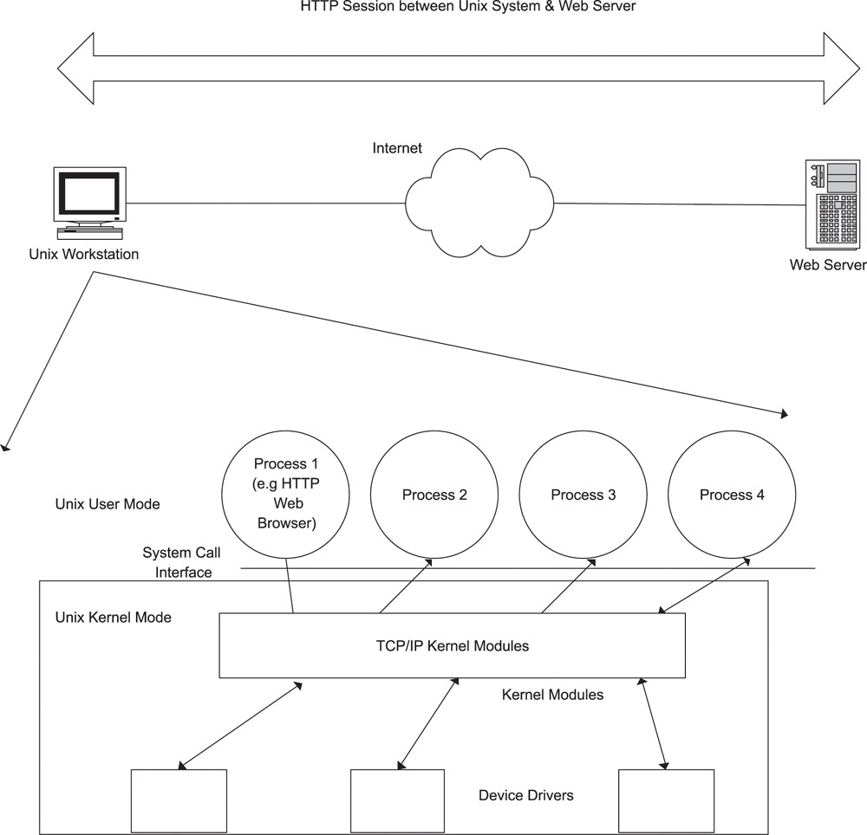
Host based communications

Slide 6
Streams Architecture
Used in several Unix hosts to implement network protocol stack
Provides flexibility by providing dynamic “add and drop” of functional modules
Set of kernel-resident system calls and resources to facilitate creation of data paths between kernel and user mode

Slide 7
Streams Architecture
Streams Messages
Each message consists of multiple message blocks… each block points to a data block
Multicasting of message blocks -> more than one message block can point to the same data block
Memory management of data blocks are controlled by a reference count for memory efficiency- when count is zero data block is released
Streams were the first host-based support for protocol stacks which could be dynamically loaded and unloaded (Kernel Loadable Modules)
Critical for systems that require kernel rebuild

Slide 8
Streams Architecture
Streams message and data block structures.
struct msgb *b_next; /* Ptr to next msg on queue */
struct msgb *b_prev; /* Ptr to prev msg on queue */
struct msgb *b_cont; /* Ptr to next message blk */
unsigned char *b_rptr; /* Ptr to first unread byte*/
unsigned char *b_wptr; /* Ptr to first byte to write*/
struct datab *b_datap; /* Ptr to data block */
unsigned char b_band; /* Message Priority */
unsigned short b_flag; /* Flag used by stream head */
The data block organization is as follows:
unsigned char *db_base; /* Ptr to first byte of buffer */
unsigned char *db_lim; /* Ptr to last byte (+1) of buffer*/
dbref_t db_ref; /*Reference count- i.e.# of ptrs*/
unsigned char db_type; /* message type */

Slide 9
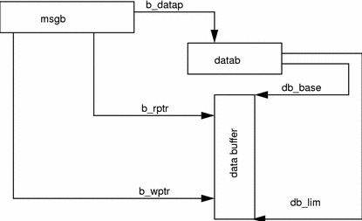
Streams Architecture

Slide 10
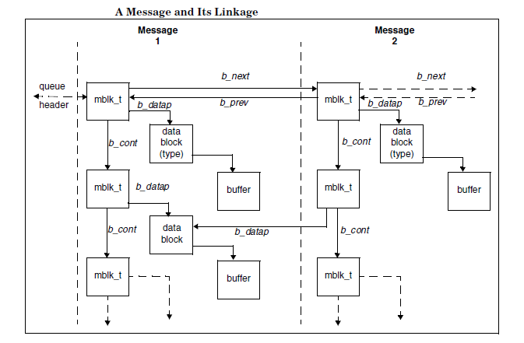
Streams Architecture

Slide 11
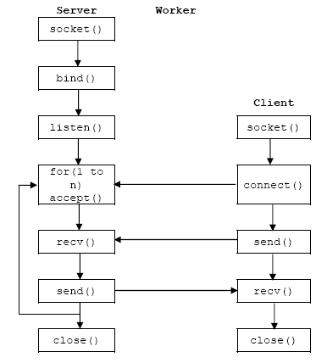
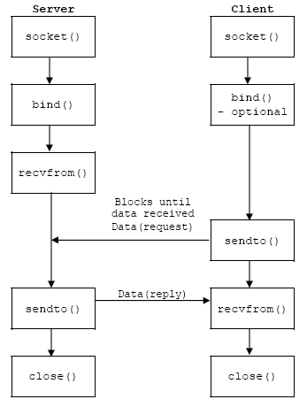
Streams Socket Types
TCP UDP

Slide 12
https://www.tutorialspoint.com/unix_sockets/socket_server_example.htm
https://www.tutorialspoint.com/unix_sockets/socket_client_example.htm

Slide 13
TCP
Communicating with TCP
The client and server can not know how many bytes are sent in each write.
Delivered chunks are not always the same size as in the original write.
Reads must be handled in a loop to cope with stream sockets.

Slide 14
TCP Retransmission
Seq=3 300 bytes sent
Ack 303
Seq=303
X Not delivered
300 bytes sent
Ack 303 Seq=603
300 bytes sent
Ack 303
Seq=303
Timeout
300 bytes sent Seq=603
300 bytes sent
Ack 903

Slide 15
UDP
Communicating with UDP
UDP data is always a complete message (datagram).
Receiver receives the complete datagram unless fewer bytes are read.
Reading in a loop for a single datagram is pointless with UDP

Slide 16
A Simple Client Call
To make a connection, a client must:
select UDP or TCP...
determine a server's IP address...
determine the proper port...
make the socket call...
make the connect call (TCP)...

Slide 17
Homework
Write a client and server program using TCP or UDP to perform the following:
Client program sends 2 numbers to the server
Server waits 15 seconds and replies with the sum of the two numbers
Server should handle servicing up to 4 clients

Slide 18
Issues with Host Based Systems
Not high performance
Very little scope for hardware acceleration
Inherent limitations of a host based OS
Software built for functionality and not performance
Can be mitigated by:
Moving performance critical functions to kernel
Re-tooling scheduler of host OS to meet real time performance criteria

Slide 19
Embedded Communications Software
An embedded communication device is a dedicated piece of hardware
Common characteristics:
Usually runs on a real time OS
Limited memory or flash based memory
Diskless or limited hard disk space
Provides terminal (RS-232) or Ethernet interface for control and configuration
Hardware acceleration facility

Slide 20
RTOS
Why RTOS?
RTOS vendors support complete lifecycle of the development environment
Vendors tune to RTOS for performance efficiency since they support the embedded processor as well
Has efficient and performance tuned infrastructure components for system software

Slide 21
RTOS
Board Support Package (BSP)
Package that contains all board H/W-specific code that conforms to a specific operating system
Boot loader
OEM adaptation layer
Device drivers for all devices on the board
Optional root file system

Slide 22
RTOS
Issue | Standard RTOS | Proprietary RTOS
Performance for a specific application | Less Optimized | More optimized
Maintenance | Responsibility of RTOS vendor | Responsibility of developer
Portability to multiple processors | Provided by RTOS vendor via separate packages | Has to be provided by developer for each processor
Support for standard Ethernet/serial devices | Provided as part of RTOS package for board | Has to be developed
Modifiability | Can be done only if RTOS vendor provides source code | Easily modifiable since source code is available internally
Tool Chain Support | Supported by RTOS vendor | Need to build using third-party development tools
Standard Interfaces, IPC mechanisms and APIs | Provided by RTOS vendor | Has to be designed in by the developer
Cost | High in dollar terms | Low in upfront dollar terms but could be high because of development effort/time and debugging

Slide 23
Memory
Embedded devices typically don’t have a disk drive and boot off a Programmable ROM or flash
RAM space is used by the software application and RTOS for data structures, dynamic buffering and memory requirements

Slide 24
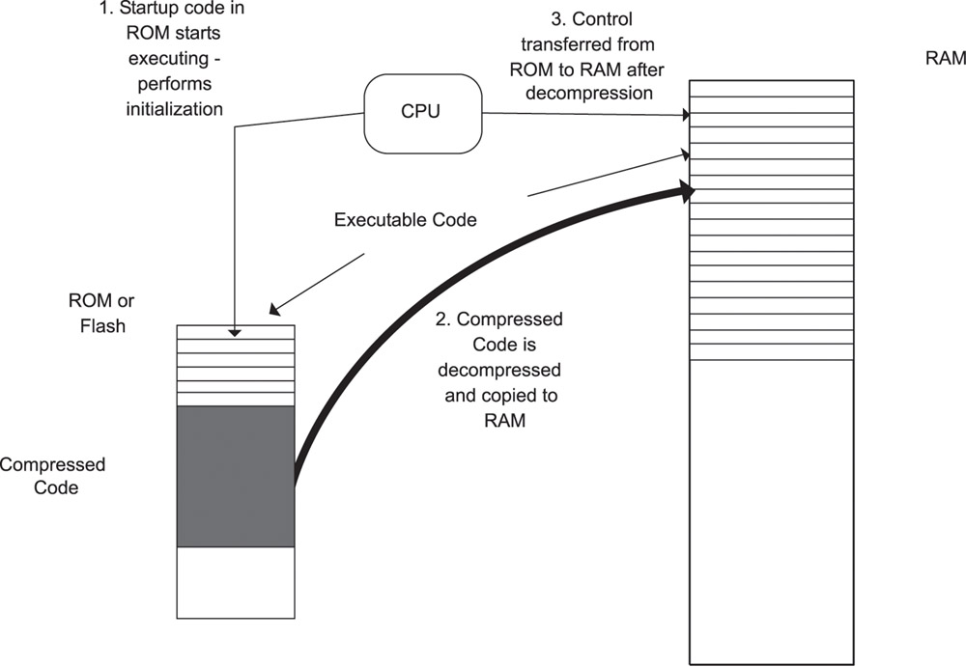
Memory

Slide 25
Memory
Unlike a host-system OS like Unix, RTOS does not have a defined kernel mode
Memory protection between tasks is therefore implemented only when appropriate
Memory corruption bugs are manifested in indirect ways. Hence:
Difficult to identify a reason for a system crash and to identify which function caused a memory crash
Therefore recommended to use memory protection if available in a Memory Management Unit (MMU) or the RTOS
.

Slide 26
EPROM Configuration and Image Download
Configuration is often stored in local non-volatile memory like an EEPROM or flash
Example: Router’s IP addresses of its interfaces; routing protocols timer values, peer information.
Permit the download of a new image to upgrade the existing image on the flash.
Field upgrades to avoid shipping the system back to the manufacturer for bug fixes and upgrades.
The new image is downloaded to a separate area of the flash so that the system can recover in case the download is unsuccessful or if the new image has problems

Slide 27
Device Issues
Embedded communications devices do not come with a monitor and a keyboard.
The only way to communicate with the embedded device is through a serial port or Ethernet.
The communications device typically has a Command Line Interface (CLI), which allows the user to type commands for configuring the device.
Ethernet port is typically used for communicating with the device for management purposes.
The TCP/IP stack runs over this Ethernet port, so that the network administrator can telnet to the device over this port to access the CLI. This facility is used by network administrators to manage the device from a remote location.

Slide 28
Device Drivers
Some RTOSes have their own communications stacks integrated or available as an additional package. These stacks interface to the hardware drivers through standard interfaces.
Function | Description
open () | causes the device to be made active
close () | results in the device being made inactive
read () | is used for reading data received by the device
write () | is used for writing data to the device
ioctl () | is used for configuring and controlling the device

Slide 29
HW/SW Partitioning Guidelines
Partitioning is driven by varying and often conflicting optimization constraints:
Size – Performance tradeoff
Minimize power, Minimize cost, Minimize computation time, Minimize communication time, etc…
Usage of memory and caching which is performance parameter
Fast and Slow Path
Path followed by most of the packets through the system is Fast while path taken by least number of packets is Slow path
Separation between fast and slow path serves as basis for hardware acceleration

Slide 30
HW/SW Partitioning Guidelines
Boot loader is usually in EEPROM or boot ROM or flash
DRAM is used to hold executable code and packets/buffer during transmission of packets
SRAM is usually used to store tables for caching, since it requires faster lookup but SRAM occupies more space and is more expensive than DRAM

Slide 31
HW/SW Partitioning Guidelines
Network software running on single processors are insufficient when:
Data rates to be supported are high and/or
A large number of interfaces are to be supported
Solution?

Slide 32
Hardware Acceleration
H/W acceleration used for FAST path processing
ASIC (Application Specific Integrated Circuit)
Allows designers to add specific functionality
Expensive to develop
Proprietary and allows for intellectual property protection
Network Processors (Vector Processor DSPs)
Is a programmable ASIC optimized for networking
Common functions required for packet processing are optimized and implemented using a reduced instruction set
Protocols evolve making programmable H/W an important tool in packet processing.

Slide 33
Control and Data Planes
Classical planar networking architecture partitioning - three planes:
Data: work required for basic operations
Control: communication with peers and tables for correct operation of data plane
Management: control and configuration of system
Hardware acceleration implemented in data plane’s fast path

Slide 34
HW and SW acceleration check list
Design the code to be modular
Separate the fast-path and slow-path implementation of the data plane
Maximize performance in the data plane
Handle all exception processing in software
Ensure that interrupt processing code is efficient
Do not restrict the design such that only certain parts of the data plane may be built in hardware. Network processor devices can move several data plane functions into software.

Slide 35
HW and SW acceleration check list
Ensure that performance calculations are made for the system both with and without hardware acceleration
This is also one way to determine the effectiveness of the partitioning.
When interfacing to hardware, use generic APIs instead of direct calls to manipulate registers on the controller.
This will ensure that only the API implementations need to be changed when a new hardware controller is used. Applications will see no change since the same API is used.

Slide 36
References
Designing Embedded Communications Software, by T. Sridhar,
IT Architectures and Middleware – 2nd edition. Chris Britton, Peter Bye. Addison-Wesley
Tanenbaum & van Steen Distributed Systems: Principles and Paradigms, 2nd ed.
Advanced Programming in Unix Environment , W. Richard Stevens & Stephen A. Rago
Middleware for Communications, Qusay H. Mahmoud
Middleware Architecture with Patterns and Frameworks, Sacha Krakowiak

