Slide 1
Software Partitioning
Week 3

Slide 2
Introduction
We discuss partitioning in communications software, both in terms of functionality and system implementation
We discuss the concepts of tasks and modules and how a typical communications system is implemented

Slide 3
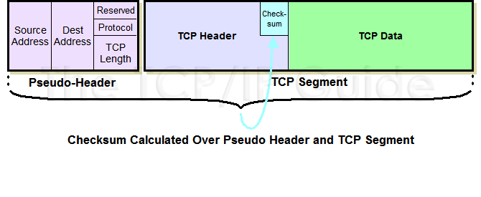
Software Partitioning Protocol Layers
Protocol Dependencies
The required knowledge of src/dst IP address in TCP pseudo-header for TCP checksum is violation of strict layering (RFC 793)

Slide 4
Software Partitioning Protocol Layers
Performance
The knowledge of exact size of downstream protocol headers can avoid copying the frames by starting the TCP packet at an offset from start of IP and Ethernet headers.

Slide 5
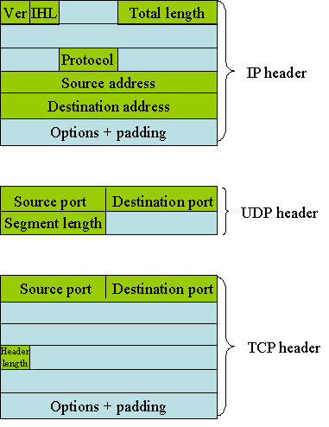
Software Partitioning Protocol Layers

Slide 6
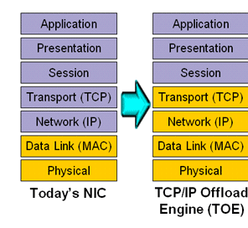
Software Partitioning Protocol Layers
Configuration of H/W and S/W
Layers may be implemented in HW -- TCP off-load engines

Slide 7
Task and Modules
Task and Module based partitioning
Task is a thread of execution while a module implements a specific function
A process in workstations can have multiple threads of execution. A thread is a lightweight process, which can share access to global data with other threads.
In embedded systems with no memory protection, a task is the equivalent of a thread—so we can consider the software for such an embedded system as one large process with multiple threads.

Slide 8
Task and Modules
Task Implementation
Independent functions and those that need to be scheduled at different times can be implemented as tasks
Subject to the performance issues related to context switching.
The need to keep the timers independent and flexible, can result in TCP and IP being separate tasks
TCP Timers: Connection-establishment timer, Retransmission timer, Delayed-acknowledgement timer, Keep-alive timer

Slide 9
Task and Modules
Task Scheduling
Pre-emptive priority based scheduling
Lower priority task is pre-empted only by a higher priority task
Not for novice programmers.
Non pre-emptive scheduling
A task relinquishes control to the scheduler
Less common in Embedded systems
Pre-emptive priority-based scheduling with a time slice for tasks of equal priority

Slide 10
Task and Modules
Guidelines for organizing the modules and tasks in a communications system
Each driver can be implemented as a task if there are one or more Interrupt Service Routines (ISRs) for each driver.
The drivers can be implemented as a module when it interfaces with a higher layer task for reception and transmission of data. This must be the single point of entry into the system for received frames (only one task can access the driver).

Slide 11
Task and Modules
Each protocol can be implemented as a task if it requires independent scheduling and handling of events (e.g. timers).
Control and data plane functions, along with fast/slow path considerations will be used for grouping tasks and modules.
SNMP agents and Command Line Interface (CLI) will need to have their own task(s).
The interfaces between the tasks will be via messages.

Slide 12
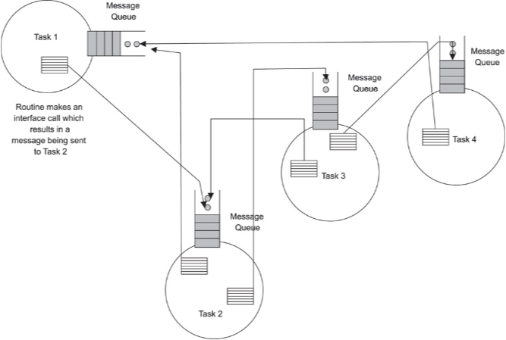
Messaging Mechanism Interface

Slide 13
Drivers
Frame Reception
Receive buffers are located in system memory so the controller (HW) can DMA (Direct Memory Access) the received frames to system memory.
Controller manages frames by utilizing a link list of fixed size buffers to handle data that exceeds the size of a single buffer
Multiple buffers and partial space buffer may be used to contain frames that exceeds the size of a single buffer

Slide 14
Driver – Received Frames
Handling Received Frames
Received frame is typically enqueued to the higher layer module by the driver without copying the frame into the module’s buffers.
An event notifies the higher layer task/module of the presence of the received frame, so that it can start processing the frame
If the driver and the higher layer are in two separate memory areas, the driver copies the frame into a common area or into the buffers of a system facility like an Inter-Process Communication (IPC) queue and signals the higher layer.
This approach uses an extra copy cycle—which can degrade performance.

Slide 15
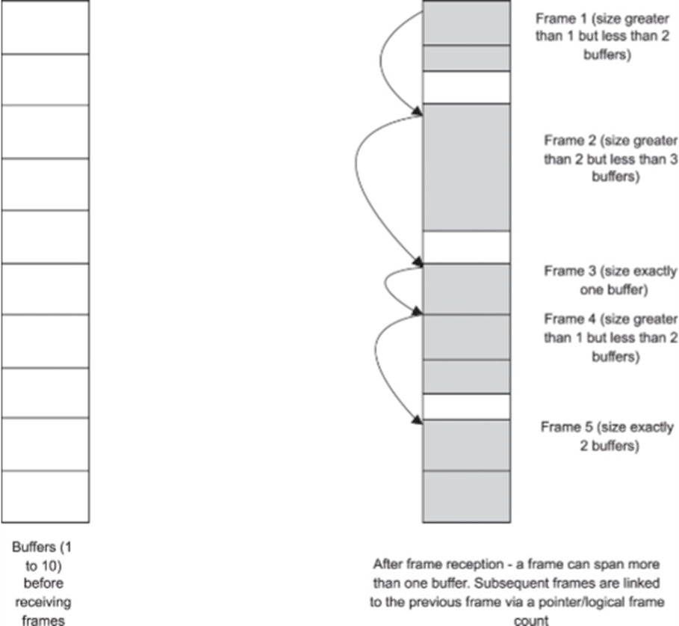
Driver – Buffer handling

Slide 16
Driver – Buffer handling
b_next
b_next
b_next
b_next
mblk_t
mblk_t
mblk_t
mblk_t
b_prev
b_prev
b_prev
b_prev
Buffer
Buffer
Buffer
Buffer
mblk_t
mblk_t
mblk_t
Buffer
Buffer
Buffer
mblk_t
Buffer

Slide 17
Driver – Buffer handling
Driver may copy the frames from the driver area to the specified area in memory or provide the buffers to the controller for zero-copy performance
When a frame is received (informed via interrupt), the driver moves the filled buffer into “received” queue and hands controller a new buffer from “free” queue.
It uses the received queue to pass the frames to the higher layer.
No additional copying of frames- received framed queued in link list of buffers can be processed while receiving the new frames.

Slide 18
Driver – Buffer handling
Ethernet Controller
Driver
Received Queue
IRQ
Controller Internal Buffer
Upper layer Protocols
DMA
Free Queue
Zero Copy

Slide 19
Driver – Transmitting Frames
Handling Transmitting Frames
Frame transmission also depends on memory and controller functions.
The driver can either poll the device or be interrupted on the completion of frame transmission to release the buffers with the data that was transmitted.
Alternatively, interrupts may be used only for transmission errors while a regular polling process is used for processing successful transmission completions.

Slide 20
Switching Task
Control Plane protocols (all) run as single “Switching Task”
Avoids context switching and reduced memory requirements
It complicates the controlling logic
Builds a forwarding table with frames information
Switching task needs to run at a rapid rate and is hence a high priority task

Slide 21
Switching Task – Demultiplexing
Demultiplexing
Implemented at a layer above the driver
Involves pre-processing of frame data from multiple ports and sending them to appropriate tasks
In Layer 2 Switch, Switching task performs the demux operation
Classified by the protocol type field in Ethernet frame (IP: 0x0800)
If no protocol to deliver, frame can be dropped.

Slide 22
Module and Task Interface
Consider the “switching task” calls a driver function SendFrame() to transmit a packet
The driver provides this routine as part of a driver interface library
The higher layer can use it to request the driver to transmit a packet on the Ethernet interface.
SendFrame() will execute the steps for queuing the packet to the controller, setting up the transmit registers of the controller

Slide 23
Synchronous and Asynchronous Interface
Synchronous operation is used when memory space or context is shared by all modules
Synchronous operation (call): Function blocks until all its operations have completed.
If the function returns immediately after queuing the frame to the controller, the calling function may not know the status of the transmission. Queuing the frames does not mean the transmission was completed.
Blocking is not desirable since it can hold up processing of the switching task
A solution could be for function to return immediately and for switching task to poll for status

Slide 24
Synchronous and Asynchronous Interface
Asynchronous operation (callback function):
Instead of polling, we could use interrupt mechanism
Call back function provides the driver with a function to call when full packet is received.
The callback routine, while implemented in the switching task, is called from the Interrupt Service Routine (ISR) by the driver.
Though this routine is 'owned' by the switching task, it is always called by the driver-a subtle distinction. The switching task's data is visible only inside ISR.

Slide 25
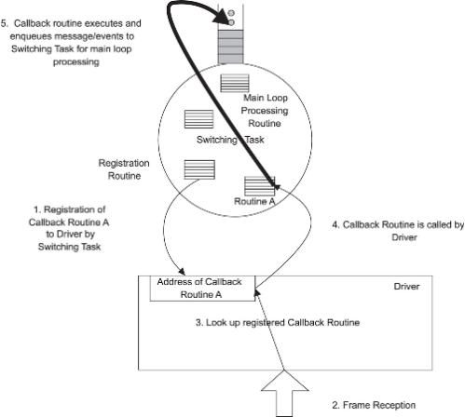
Functional Interface

Slide 26
Functional Interface
Key requirements of interrupt handlers:
ISR must complete their work and return quickly.
Since callback routines can be called from an interrupt handler, it is best to keep the callback routine very short.
To fulfill above requirement, the callback routine sends an event or notification to the switching task and exits immediately.

Slide 27
Functional Interface
The main loop of any task implemented in the communications system waits on events like message reception, timer expiration, inter-task communication, and so on.
Each event is identified by its type and additional parameters.
On event reception, the task will classify and process the events.

Slide 28
Functional Interface
Task Main Loop:
Do Forever
{
/* Hard Wait - call will block if there are no events */
Wait on Specific Events;
/* If we are here, one or more events have occurred */
Process Events;
}

Slide 29
Messaging Mechanism Interface
Used when memory space or context of modules are separate and not shared
Messaging systems are synonymous with implementing queuing mechanisms in modules
Every module maintains a queue to which other tasks can write to… and use it to transfer messages
Messaging systems fit well with multi-board and distributed architectures
An event is a special kind of message that includes additional information needed or used by a task
An event can also be used to communicate an effect

Slide 30
Messaging Mechanism Interface
Event processing in the main loop.
While (1)
{
Wait for any of the events ( …)
/* break out of the hard wait loop */
if (messageQueuing event)
Process MessageQueue
if (timer event)
Process TimerEvents
if (callBack event)
Process CallBackEvents; /* based on type + params */
Perform Housekeeping functions; /* Releasing buffers.. */
}

Slide 31
Standards-based Interfaces
IPC mechanisms can be implemented using Standard Operating System calls
Standards like POSIX (Portable Operating Systems Interface for Unix) help software to run on different operating systems as is without any changes
Standards help bring embedded applications to market faster with code that is proven… which in turn leads to prevalence of standards based code
developers from the desktop programming world can take up embedded programming faster if it’s standards based
In embedded communication systems, portability of protocols is critical since the hardware can transition from one platform to another

Slide 32
Proprietary Interfaces
Proprietary Interfaces are system specific
Biggest reason for their use is “performance”… since the interface implementation can be tweaked to meet the specifications of the underlying H/W
When designing proprietary software
Constantly review the tradeoff between performance and maintainability critical to any embedded communication system
Make every attempt to increase the shelf life of software
Make every attempt so migration to newer hardware platforms is as seamless as possible
Make every attempt to make it easy for new developers to understand the design and implementation of the application

Slide 33
Homework
Remember we said earlier:
Each driver can be implemented as a task if there are one or more Interrupt Service Routines (ISRs) for each driver. The drivers can also be implemented as a module when it interfaces with a higher layer task for reception and transmission of data.
Question:
How would you implement a receive frame driver using modules? What are the potential problems if this driver is not a task

Slide 34
Homework
If multiple tasks can use the same controller driver to transmit a packet, how and when would you check if it is safe to write the next packet to the controller’s transmit buffer in your driver?
What can you do to minimize a wait on ‘transmit done’ event? How would you implement this?

Slide 35
Layer 2 Switch - Drivers
Switches Ethernet frames between the ports
Components that constitute S/W architecture for the switch:
Device Driver
Protocol Functionality
System operation and Management

Slide 36
Layer 2 Switch - Drivers
Device Driver
Closest to H/W and responsible for transmission and reception
Reception of frames is either through Polling or Interrupt driven
Choice of Polling or Interrupt process is determined by the frequency of packet traffic
In Layer 2 Switch, a combination of polling and interrupt is used

Slide 37
Layer 2 Switch - Protocols
Control Plane protocols in Layer 2 implement control tasks
Spanning tree algorithm and protocol (STP)
Detects loops in the switching topology and avoids them by de-activating certain ports
Transmission of STP frames is initiated by a timer that is maintained by the STP task.
Generic VLAN Registration Protocol (GVRP)
VLAN (Virtual LAN) provides for a logical partitioning where nodes communicate without use of a router
GVRP provides the Layer 2 switch with knowledge of ports and VLAN membership so the nodes can communicate with each other

Slide 38
Management and Control
Layer 2 switches have full TCP/IP stack functionality to handle configuration, control and monitoring of the switch:
TCP over IP -- HTTP over TCP
Simple Network Management Protocol (SNMP) over UDP over IP to control, monitor and configure
Internet Control Message Protocol (ICMP) functionality like ping and traceroute
System and Management task
SNMP agent permits SNMP manager to control and configure the system
Health Monitor task ensures correct operation of H/W and S/W
Watchdog timer, port status

Slide 39
Layer 3 Switch
Layer 3 also termed as IP Switch performs Layer 3 switching
Forwarding frames based on layer 3 information
Control plane protocols implemented as separate tasks
Routing Information Protocol (RIP) task
Provides information required to build forwarding table
Runs on top of UDP
Open Shortest Path First (OSPF) Protocol Task
Consumes substantial amount of CPU time for SPF calculation
Border Gateway Protocol (BGP) task
BGP interfaces with TCP and runs on top of it to communicate with peer routers
Switch Operations more complex compared to Layer 2
Routers often built as multi-board systems with control card and line cards

