Slide 1
Buffer and Timer Management
CPE 545

Slide 2
Chapter Summary
A strategy for Buffer and Timer Management
Buffers are used for the interchange of data among modules in a communications system.
Timers are used for keeping track of:
Timeouts for messages to be sent,
Acknowledgements to be received,
Aging out of information in tables.

Slide 3
Buffer Management
Mechanisms to create and operate buffers with a focus on reducing data copying operations
Allocation - Reserving buffer from a global buffer memory pool
Manipulation of buffers - All operations affecting data stored in the buffer.
Copying, deleting, updating, concatenating two buffers etc.
Freeing buffers - Returning a buffer to the global buffer pool for re-use

Slide 4
Buffer Management
Global vs Local Buffer Management
Global uses a single buffer pool for the entire system with size determined apriori
ADV: Easy to manage memory DISADV: Lack of isolation between modules
Local is indicative of each module operating from it’s own buffer pool
ADV: Decentralized and flexible DISADV: No uniform view of buffer requirements
Global buffer management libraries offer the best of both worlds
Techniques and mechanisms are global but actual memory allocation is from local buffer pools

Slide 5
Buffer Management
Single vs Multiple buffer pools
In single scheme all buffers in the pool are of same size. In multiple scheme, buckets of varying sizes are created where all buffers in one bucket are of the same size
Multiple scheme allows designer flexibility in picking right size buffer and hence reduces memory wastage
How to determine the buffer size?
Most common frame data size to be used as buffer size
When frames exceed buffer size, buffer chain can be created to store all data (mbuf in UNIX )
No matter what the buffer size, not possible to eliminate internal fragmentation

Slide 6
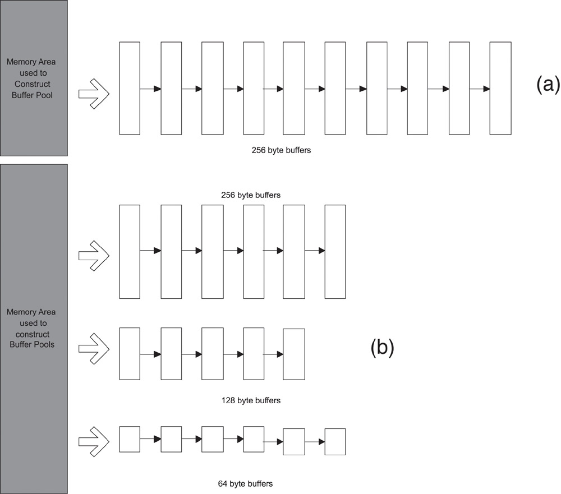
Buffer Management

Slide 7
Buffer Management
Example:
Received frame size is 300 bytes
buffer size 64 bytes:
Number of buffers required = 300/64 = 4 + 1 = 5 buffers
Size of data in the last buffer = Modulo 300/64 = 44 bytes
Unused data in the last buffer = 64 - 44 = 20 bytes

Slide 8
BSD Buffer Scheme
Berkeley Systems Distribution (BSD) buffer library is called mbuf
mbuf is a two level hierarchy scheme for buffer management
mbuf routines designed for scatter/gather operations
Data from a frame is scattered in different memory locations and has to be gathered to construct full packet
mbuf is 128 bytes long with 108 bytes for data
When data exceeds 108 bytes, mbuf points to an external data area called mbuf cluster.
Data is stored in the internal data area or external mbuf cluster but never in both areas.
mbuf and mbuf_cluster form the two levels of hierarchy.

Slide 9
BSD Buffer Scheme
mbuf uses m_data pointer to indicate valid data
which can be incremented to delete memory at the beginning of the buffer
Decrementing m_len deletes memory at end of the buffer
Manipulation of these pointers help eliminate the need for data copying (TCP->IP) or (IP->TCP)
Multiple mbuf’s can point to the same mbuf cluster
This helps to send same frame to different interfaces without the need to copy the data each time
mbuf library includes routines for allocation, freeing, copying of data and deleting data at beginning and end of buffer

Slide 10
BSD Buffer Scheme
An mbuf can be linked to another mbuf with the m_next pointer.
Multiple mbufs linked together constitute a chain, which can be a single message like a TCP packet.
Multiple TCP packets can be linked together in a queue using the m_nextpkt field in the mbuf.
Each mbuf has a pointer, m_data, indicating the start of "valid" data in the buffer.
The m_len field indicates the length of the valid data in the buffer.

Slide 11
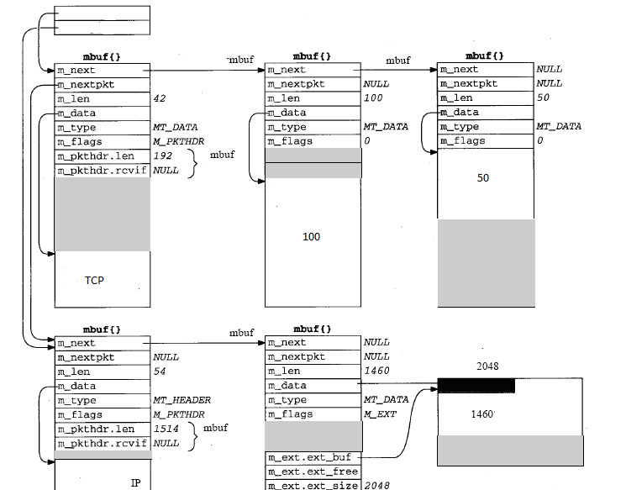
Buffer Management
Packet

Slide 12
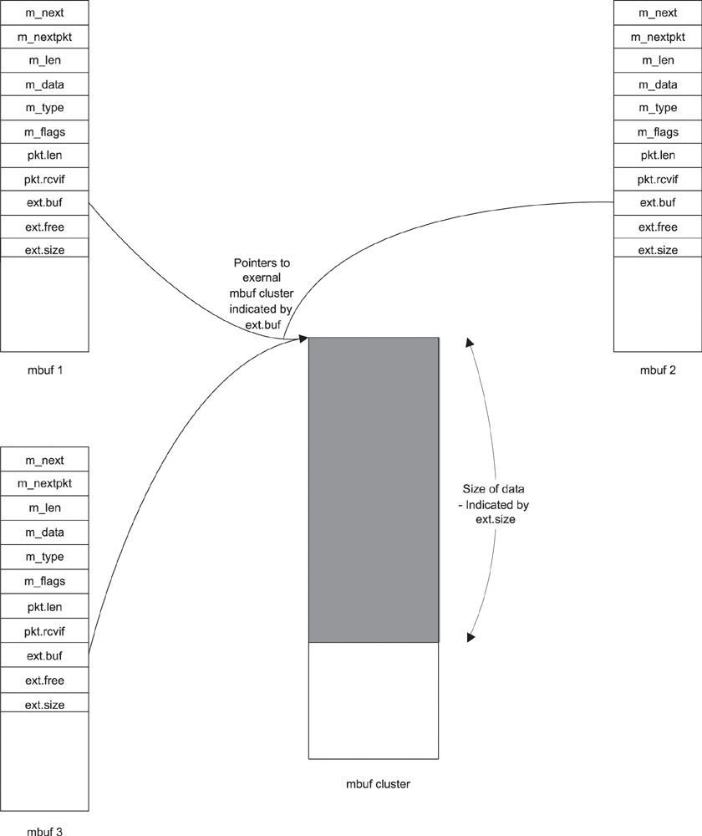
BSD Buffer Scheme – external cluster
Link multiple mbufs
to a single mbuf cluster

Slide 13
mbuf Library Routines
Function Name | Description and Use
m_get | To allocate an mbuf mptr = m_get (wait, type)
m_free | To free an mbuf m_free (mptr)
m_freem | To free an mbuf chain m_freem (mptr)
m_adj | To delete data from the front or end of the mbuf m_adj (mptr, count)
m_copydata | To copy data from an mbuf into a linear buffer m_copydata (mptr, startingOffset, count, bufptr)
m_copy | To make a copy of an mbuf mptr2 = m_copy (mptr1, startingOffset, count)
m_cat | To concatenate two mbuf chains m_cat (mptr1, mptr2)

Slide 14
Buffer Management
In 3-level hierarchy we have three types of structures
Message Block
Data Block
Data Buffer
Message Block
Allocated from DRAM and contains pointers to data block that changes dynamically during execution
Difference in number of allocations and releases indicates number of available memory blocks
LowWaterMark variable used to indicate low availability of memory blocks and is configurable

Slide 15
STREAMS Buffering scheme
STREAMS Buffering is a three level hierarchy scheme
In data block db_base and db_lim point to first and last byte of data and can be used just like mbuf to delete data from beginning or end of buffer
STREAMS uses linking to modify data without copy, concatenate or duplicate operations on the buffer

Slide 16
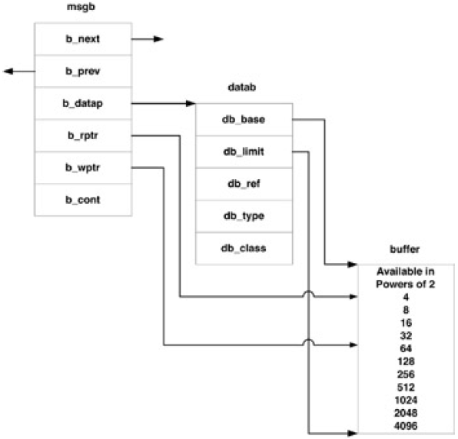
STREAMS Buffering scheme

Slide 17
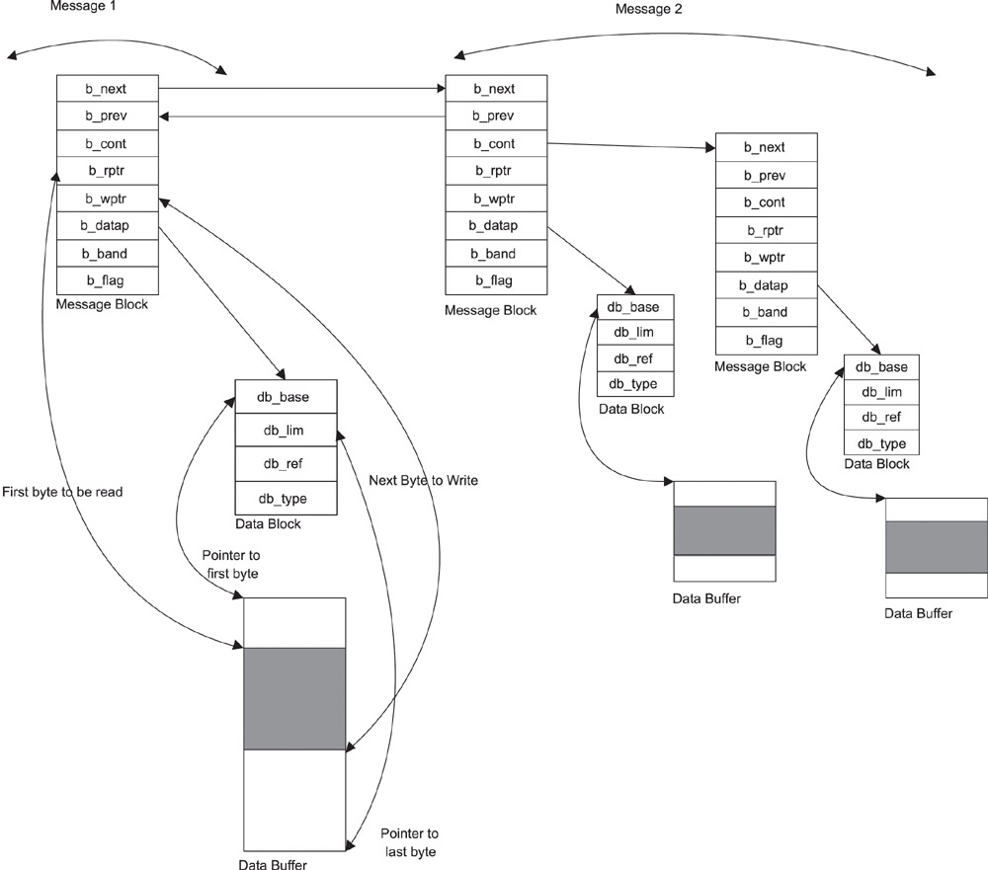
STREAMS Buffering scheme

Slide 18
STREAMS Buffering scheme
Comparison of 2-level and 3-level schemes
2-level is simple and just one level of indirection gets data but 3-level needs one more level of indirection
3-level needs more memory to store message blocks
In a three-level hierarchy, the message pointer (b_datap) does not need to change to add data at the beginning of the message. The message block now points to a new data block with the additional bytes.
This is transparent to the application since it continues to use the same pointer for the message block. With a two-level hierarchy, this could involve allocating a new mbuf at the head of the mbuf chain and ensuring that applications use the new pointer for the start of the message.

Slide 19
Buffer Management
EXCEPTION conditions in Buffer Management
Buffer pool empty: Modules slow in processing, memory leaks due to bad modules, data rate not in sync with system speed
Modules may be slow because their priority is low, processing logic is complex or other reasons and this could lead to buffers being held up
Errant modules are those that are buggy and cause memory leaks and the low water mark variable will help identify these issues
System not keeping up with data rates can lead to congestion. There are a variety of schemes to handle congestion implementable in software and hardware.

Slide 20
Timer Management
Three significant uses for timers
For periodic execution of certain tasks
Timeout of tasks waiting for messages
For tasks that need to be fired at a particular time (one-shot timers)

Slide 21
Timer Management
Timer management at task level
An RTOS typically offers facilities to manipulate timers based on system clock
Timeout routine is invoked when a timer finishes a count of N clock ticks
Timers require dynamic requirements and both table based implementation and linked list implementation have their drawbacks due to continual decrement operation.
Two types of timers:
Continuous timer: The value is reset and countdown to N is started again and the timeout routine invoked again.
One-shot timers: After the countdown has finished and timeout routine is called, the timer is removed from the tables

Slide 22
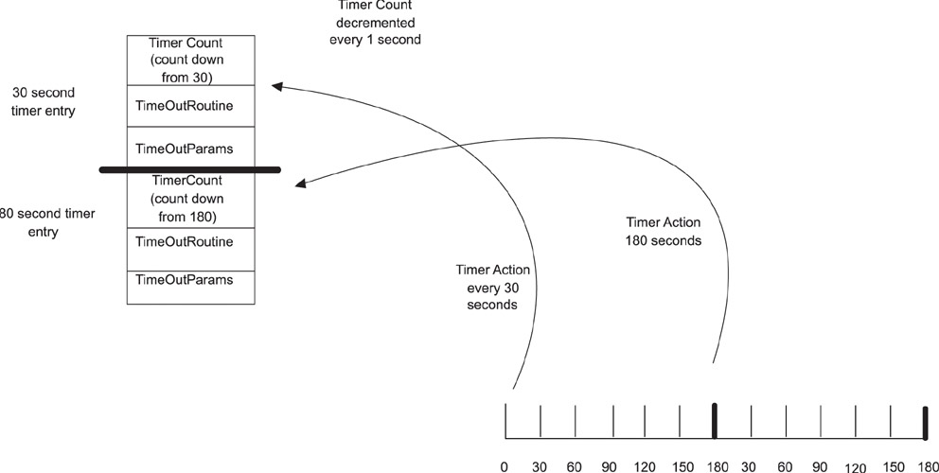
Timer Management

Slide 23
Ticker object
The Ticker interface is used to setup a recurring interrupt to repeatedly call a designated function at a specified rate.
Avoids the requirement for the main code to continuously analyze the timer to determine whether it was the right time to execute a specified function.

Slide 24
Timer Management – A simple implemenation
AppClock( ) { ………..
static unsigned long tickCount = 0;
tickCount++;
If (tickCount == N1)
{
tickCount = 0;
Notify (myTask);
}
}
myTask{
N1=100;
setTimer(N1);
While(1)
{
Wait_for_event()
if (event==TIMER)
processTimerExpired();
}
}
AppClock () is a routine which is called from the timer interrupt on each OS TICK
If OS TICK=10 ms, Task1 will be notified every 1s
Notify(myTask) sends a timer event to the myTask that schedules the timer.
Can get complex and cumbersome to manage if we have many tasks and many timers.

Slide 25
Better alternative
AppClock ( {
tickCount++;
TimerTaskNotify (); // send timer event message to timer task
}
AppClock () is a routine which is called from the timer interrupt on each OS TICK
A single timer management task called TimerTask() will manage all timers created by all tasks.

Slide 26
Challenges with timer interrupts
Be careful with the amount of code and how long it takes to execute.
If we need to run a task every 1 ms, that task must take less than 1 ms second to execute, otherwise the timing would overrun and the system would go out of sync.
We sometimes need to prioritize the tasks: e.g. does a 1ms task run before a 100ms task? (because after 100ms, both will want to run at the same time).
This also means that pause, wait or delays (i.e. timing control by ‘polling’) cannot be used within scheduled program designs.

Slide 27
Differential timers
Differential timers
In a differential timer scheme, the lowest timer count serves as the base and all other timers are stored with the incremental difference
The advantage here is the timer count is decremented only for the base timer and it automatically applies to all timers

Slide 28
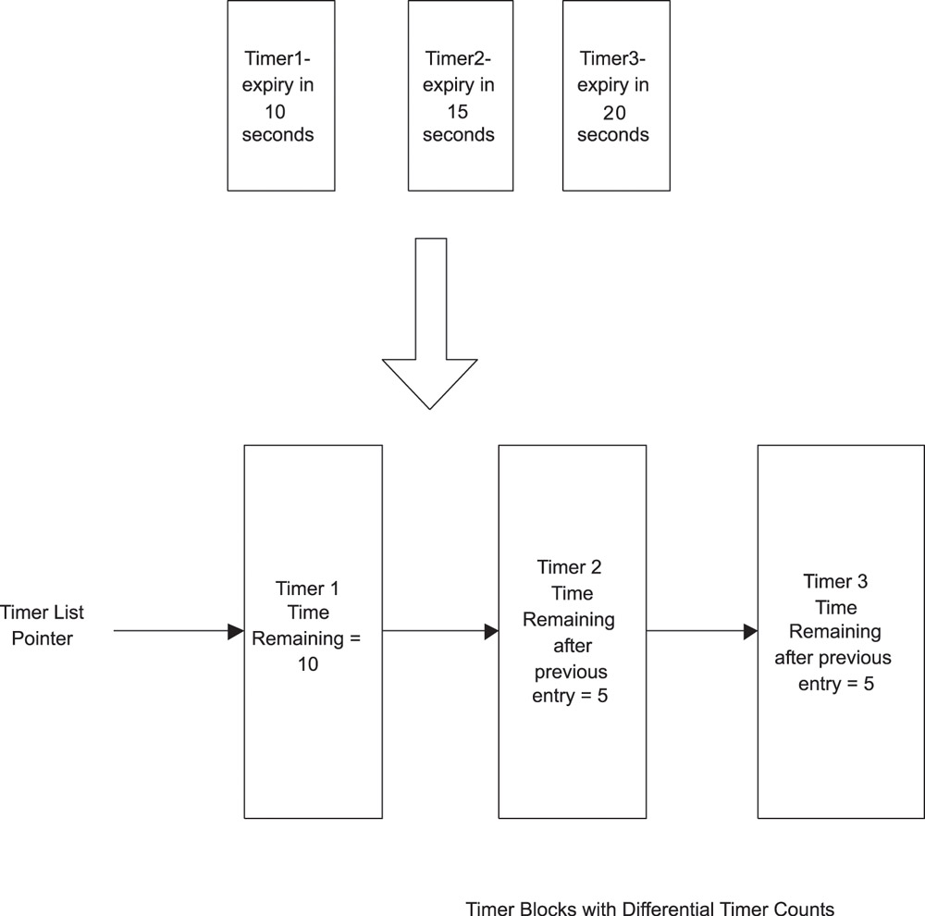
Differential timers
startTimer(10, task1Timer, param …);
startTimer(15, task1Timer, param …);
startTimer(20, task1Timer, param …);

Slide 29
Homework
Is there any drawback with using differential timers?
Can you come up with a rule for updating the time remaining for other timers already in the list when a timer is inserted in the list of differential timers?
Would task priority mater when you insert differential timers in the list?
Can you show an example to demonstrate your answers above?

Slide 30
Timer Management
This is done in task’s main loop every time task is scheduled
While(1)
{
Wait_for_event()
if (event==timer_expired)
processTimers();
}
ProcessTimers ()
{
Decrement the current timer count in the first entry of the timer list;
If the count is 0
{
For all the entries in the timer list whose current timer count is zero
{
Process timer expiry by calling the timeout
routine with context provided in the timer block;
Alternatively, it can send a timer signal event to
the task it created the timer with context provided in timer block
}
}

Slide 31
Timer Management Task
Timers may be created and used individually for each task
This is flexible but unmanageable with more tasks
Single timer management task (TMT) is scheduled after each timer tick interrupt
Timer tick interrupt is the shortest timer tick possible across all tasks as a base (e.g. 1 OSTICK).
It may maintain counters for simulating N* OSTICK timers. For each of these tick types, there are separate timer lists.
Tasks request a timer from the TMT which invokes the appropriate notification function when timer expires

Slide 32
Timer Management Task
Assume the need for a 1-millisecond tick, a 10-millisecond tick, and a 1-second tick.
The TMT will be notified of a 1-millisecond tick only.
It will maintain counters for simulating a 10-millisecond and 1-second timer.
For each of these tick types, there are separate timer lists.

Slide 33
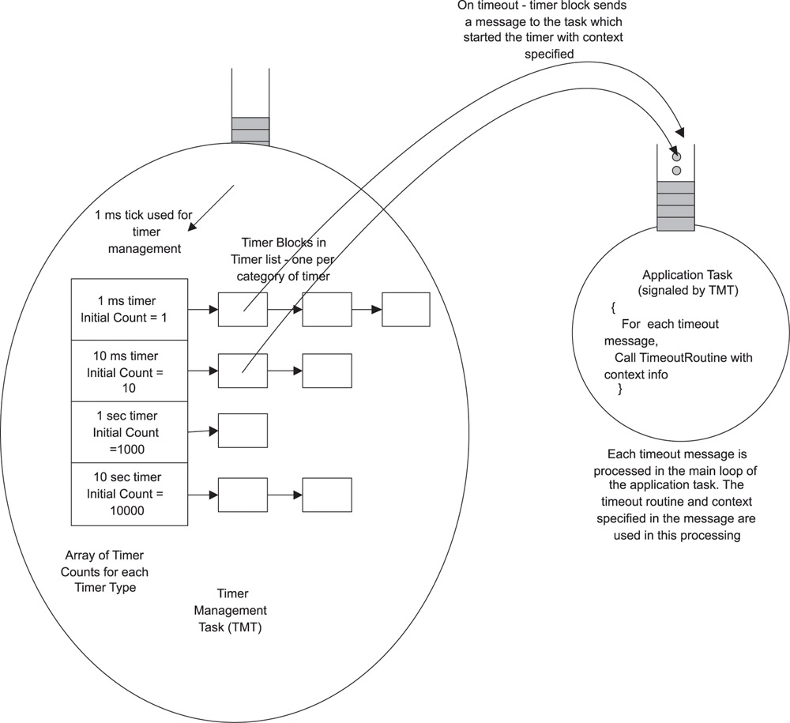
Timer Management Task

Slide 34
Timer Management Task
Individual timer management is flexible but each timer needs it’s own timer processing logic- Timer management is Task’s responsibility - Implementation of Tick counter management is OS’s responsibility call from Timer ISR
TMT centralizes timer tick management but needs a messaging scheme to interact with the tasks on timer expiration - Suitable if the granularity of a tick varies.

Slide 35
System Issues
Each timer management scheme can allocate and free large number of timer blocks that need space to store application context
Connection oriented protocols like TCP require a large number of timers and hence need significant amount of memory
Checklist for timer management strategy
Use RTOS timer ISR for notification of the smallest timer tick
Choose minimal number of application timer ticks
Implement a differential time scheme

