Slide 1
Protocol Software
CPE 545

Slide 2
Protocol Software
Specification involves:
Architectural relationship of communicating entities
Client/server, publisher/subscriber, node-to-node
Valid execution states for each entity
Initialized, connected, waiting for event, Listening , Message Sent, Message Received, disconnected, …
Actions to be taken when events (messages) are triggered (received)
Protocol Data Units for communication between entities
Message format
Timers used by the entities

Slide 3
Protocol Software
Defines the language used for communicating systems and can be defined at each layer of OSI
Protocol Implementation
Protocols can be standards based (IEEE, ANSI) or custom and proprietary
Two important reasons for proprietary protocols
Standards based protocol insufficient for application
Intellectual property protection for competitive advantage
Specification can be defined using protocol specification languages

Slide 4
Protocol Implementation: State Machines
Stateless protocol
Current state of protocol is independent of the actions in the previous state (IP Forwarding)
Stateful protocol
Current state of protocol depends on the previous state and the sequence of actions in that state (TCP)
Use state machines to specify various states, the transition events and actions to perform
Valid events can be protocol messages or timer events

Slide 5
Protocol Implementation: State Machines (TCP)
LISTEN
(server) represents waiting for a connection request from any remote TCP and port.
SYN-SENT
(client) represents waiting for a matching connection request after having sent a connection request.
SYN-RECEIVED
(server) represents waiting for a confirming connection request acknowledgment after having both received and sent a connection request.
ESTABLISHED
(both server and client) represents an open connection, data received can be delivered to the user. The normal state for the data transfer phase of the connection.
FIN-WAIT-1
(both server and client) represents waiting for a connection termination request from the remote TCP, or an acknowledgment of the connection termination request previously sent.
FIN-WAIT-2
(both server and client) represents waiting for a connection termination request from the remote TCP.

Slide 6
Protocol Implementation: State Machines (TCP)
CLOSE-WAIT
(both server and client) represents waiting for a connection termination request from the local user.
CLOSING
(both server and client) represents waiting for a connection termination request acknowledgment from the remote TCP.
LAST-ACK
(both server and client) represents waiting for an acknowledgment of the connection termination request previously sent to the remote TCP (which includes an acknowledgment of its connection termination request).
TIME-WAIT
(either server or client) represents waiting for enough time to pass to be sure the remote TCP received the acknowledgment of its connection termination request. [According to RFC 793 a connection can stay in TIME-WAIT for a maximum of four minutes known as a MSL (maximum segment lifetime).]
CLOSED
(both server and client) represents no connection state at all.

Slide 7
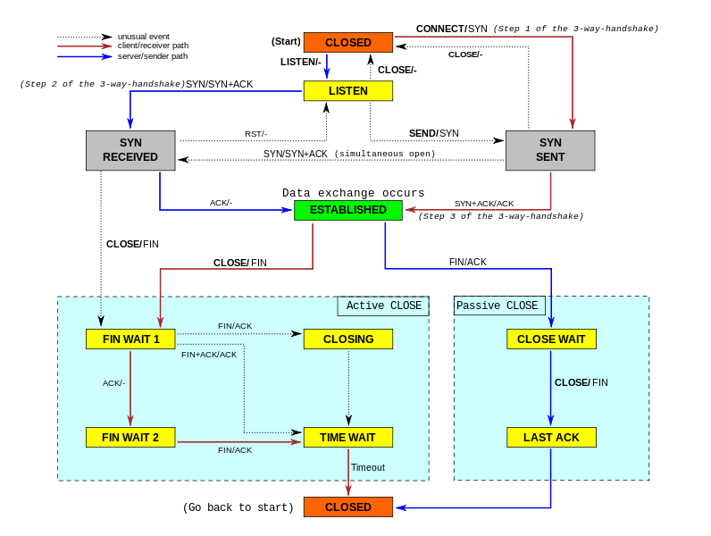
Protocol Implementation: State Machines (TCP)

Slide 8
Protocol Implementation: State Machines
State machine implementation
Simplest way is to use a switch-case statement construct
Difficult to implement when state machine is complex
State Event Table (SET) is an alternate method
Is a matrix where columns represent states and rows represent events
An individual entry in the matrix is a tuple {Action, Next State} indicates what action to perform and what state to move
are usually implemented as a library of functions that can be invoked by specific layers

Slide 9
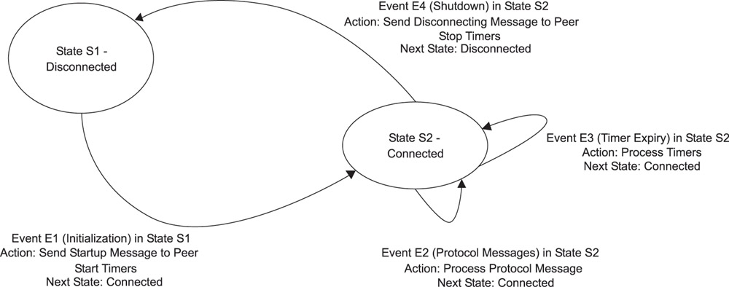
Protocol Implementation: State Machines

Slide 10
Protocol Implementation: State Machines – Switch statement
switch (event)
{
case E1: /* Initialize */
If (current_state == DISCONNECTED)
{
InitializeProtocol ();
current_state = CONNECTED;
} break;
case E2: /* Protocol Messages */
If (current_state == CONNECTED)
{
}
break;
case E3: /* Timer Event(s) */
If (current_state == CONNECTED)
{
ProcessTimers ();
}
break;
case E4: /* Disconnect Event */
If (current_state == CONNECTED)
{
ShutdownProtocol ();
current_state = DISCONNECTED;
}
break;
default:
logError ("Invalid Event, current_state, event);
break;
}

Slide 11
Protocol Implementation: State Machines – State Event Table (SET)
 | S1 | S2 | S3
E1 | {Action, Next State} | {Action, Next State} | {Action, Next State}
E2 | {Action, Next State} | {Action, Next State} | {Action, Next State}
E3 | {Action, Next State} | {Action, Next State} | {Action, Next State}
E4 | {Action, Next State} | {Action, Next State} | {Action, Next State}
E5 | {Action, Next State} | {Action, Next State} | {Action, Next State}

Slide 12
Protocol Implementation: State Machines – Set Tables
 | Disconnected | Connected
E1 (Initialize) | InitializeProtocol() CONNECTED | Invalid Event
E2 (Protocol Messages) | Invalid Event | ProcessMessages (); CONNECTED
E3 (Timer Events) | Invalid Event | ProcessTimers (); CONNECTED
E4 (Disconnect) | Invalid Event | ShutdownProtocol() DISCONNECTED;
protocol messages may be received from an external entity which may or may not be considered an error

Slide 13
State Machines – cont’d…
Typical Events
messages
timer events
max retransmission attempts
error conditions
user intervention conditions
Actions:
No-op or error routine action invoked when an event is invalid within the current state
All abnormal behavior of protocol should be identified and handled using actions upfront before system is deployed
Action routines can involve the construction of a new message for transmission (new event)

Slide 14
State Machines – cont’d…
Predicates (Additional entry in SET)
The tuple will now be {Action, New State, Predicate}
Serves as an input to the action routine to help determine the course of execution within the routine
Multiple State machines
Protocol can contain and often does contain multiple SET’s
Needs to be a clear separation between the SET’s

Slide 15
State Machines – cont’d…
While (1){
Wait for any of the events;
/* break out of the hard wait loop */
if (MessageQueuing event)
Process MessageQueue;
If (timerEvent)
Process TimerEvents
Perform Housekeeping functions; /* e.g. release
transmit buffers */
}

Slide 16
State Machines – cont’d…
ProcessMessageQueue ()
{
Determine type of message; // What Message – PDU pre-processing
Classify the message and set the event variable; // Map message to Event
Pass event through the SET ; /*state machine access function*/
}
ProcessTimers ()
{
Determine attributes of expired timers; // What timer
Classify the timer type and set the event variable; // Map timer to Event
Pass event through the SET; /*state machine access function*/
}

Slide 17
Homework
Describe what software components you would implement for an stateful protocol that employs multiple tasks in its design?

Slide 18
State Machines – contd…
Entry for current state and event is:
SET [Event][CurrentState]
Ret = PerformAction (SET [Event][CurrentState]);
CurrentState = NextState (SET [Event][CurrentState]) ;
// Define a pointer to a function which is taking two floats and returns an int
typedef int (*ActionFunction)(floats, floats);
typedef enum (STATE1, STATE2, ….} State;
typedef enum (EVENT1, EVENT2, ….} Event;
typedef struct
{
ActionFunction action;
State nextState;
} Tuple;

Slide 19
State Machines – contd…
Tuple setTable[EVENT_NUM][STATE_NUM] =
{{foo1(float,float}, STATE3},
foo2(float,float}, STATE1},
….
}
currentState = STATE1;
While (1)
{
//Wait for message
WaitForEvent(Msg * msg, ….)
setTable[msg->eventType][currentState].action(f1,f2)
currentState = setTable[msg->eventType][currentState].nextState;
}

Slide 20
Protocol Implementation
PDU processing
Memory management
Buffer management
Timer management
Event Management
IPC
protocol and driver interface
Protocol Management

Slide 21
Protocol Implementation: PDU Processing & Protocol Interfaces
PDU’s are typically pre-processed before being passed to SET. Preprocessing involves:
Syntax verification of a packet
Checksum validation
PDU’s are transmitted by the action routines of SET

Slide 22
Memory Management
Required for allocating and releasing memory for applications in system heap
Real time systems can have multiple memory partitions
Packet buffers can be maintained in DRAM partition while tables could be maintained in SRAM partition,
Each partition with their own memory management functions:
VxWorks™ RTOS, partitions can be created with the memPartCreate() call.
Individual blocks can be created out of these partitions with the routine memPartAlloc() and released with memPartFree().

Slide 23
Buffer Management
Includes initialization, allocation
Maintenance and release of buffers
There can be multiple buffer pools, each consisting of buffers of a specific size.
Memory management functions can be used for buffers
Buffer management libraries are provided along with the RTOS—like the mbuf and zbuf libraries available in VxWorks.

Slide 24
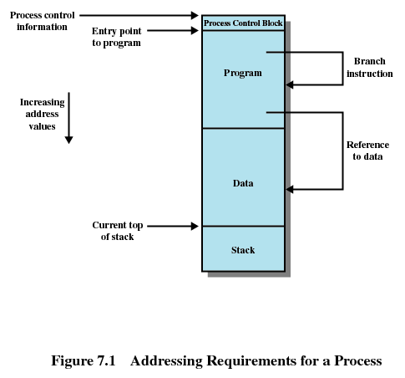

Slide 25
Memory Management Requirements
Protection
Processes should not be able to reference memory locations in another process without permission
Must be checked at run time
Memory protection requirement must be satisfied by the processor (hardware) rather than the operating system (software)
In embedded model, each process could be thought as the software on a single processor thus having multiple processors. Memory Protection is done by MPUs.

Slide 26
Memory Management Requirements
Sharing
Allow several processes to access the same portion of memory
Better to allow each process access to the same copy of the program rather than have their own separate copy

Slide 27
Memory Management Requirements
Logical Organization
Programs are written in modules
Modules can be written and compiled independently
Different degrees of protection given to modules (read-only, execute-only)
Share modules among processes

Slide 28
Fixed Partitioning
Equal-size partitions
Any process whose size is less than or equal to the partition size can be loaded into an available partition
If all partitions are full, the operating system can swap a process out of a partition
Main memory use is inefficient. Any program, no matter how small, occupies an entire partition. This is called internal fragmentation.

Slide 29
Dynamic Partitioning
Partitions are of variable length and number
Process is allocated exactly as much memory as required
Eventually get holes in the memory. This is called external fragmentation
Must use compaction to shift processes so they are contiguous and all free memory is in one block

Slide 30
Dynamic Partitioning Placement Algorithm
Best-fit algorithm
Chooses the block that is closest in size to the request
Worst performer overall
Since smallest block is found for process, the smallest amount of fragmentation is left

Slide 31
Dynamic Partitioning Placement Algorithm
First-fit algorithm
Scans memory form the beginning and chooses the first available block that is large enough
Fastest
More often allocate a block of memory at the front of memory

Slide 32
Dynamic Partitioning Placement Algorithm
Next-fit
Scans memory from the location of the last placement
More often allocate a block of memory at the end of memory where the largest block is found
The largest block of memory is broken up into smaller blocks

Slide 33
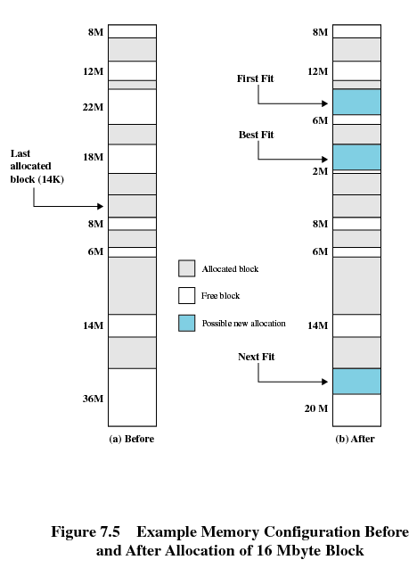

Slide 34
Buddy System
Entire space available is treated as a single block of 2^{U}
If a request of size s such that 2^{U-1} < s <= 2^{U}, entire block is allocated
Otherwise block is split into two equal buddies
Process continues until smallest block greater than or equal to s is generated

Slide 35
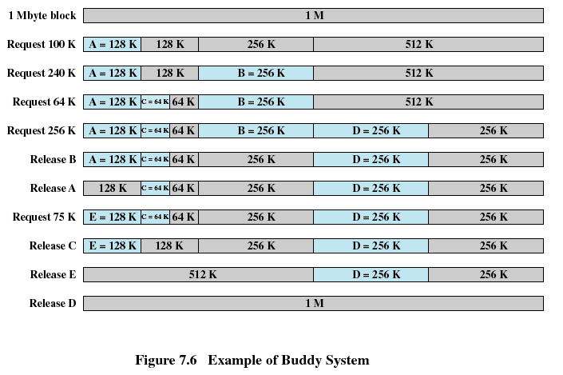
U=7
U=8
U=6

Slide 36
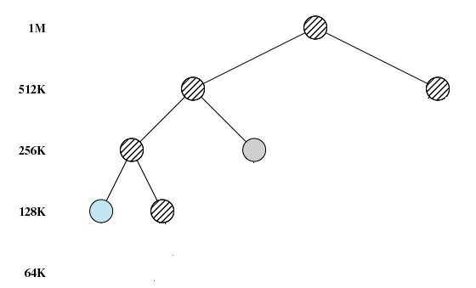

Slide 37
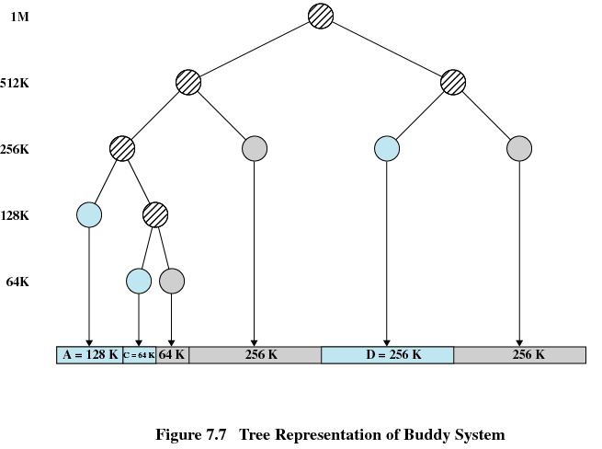
Tree representation of buddy system

Slide 38
Relocation
When program loaded into memory the actual (absolute) memory locations are determined by MMU
Without MMU it will be difficult to run multiple processes and we will soon have memory fragmentation
A process may occupy different partitions which means different absolute memory locations during execution (from swapping)
Compaction will also cause a program to occupy a different partition which means different absolute memory locations

Slide 39
Paging
Partition memory into small equal fixed-size chunks called pages
Operating system maintains a page table for each process
Memory address consist of a page number and offset within the page

Slide 40
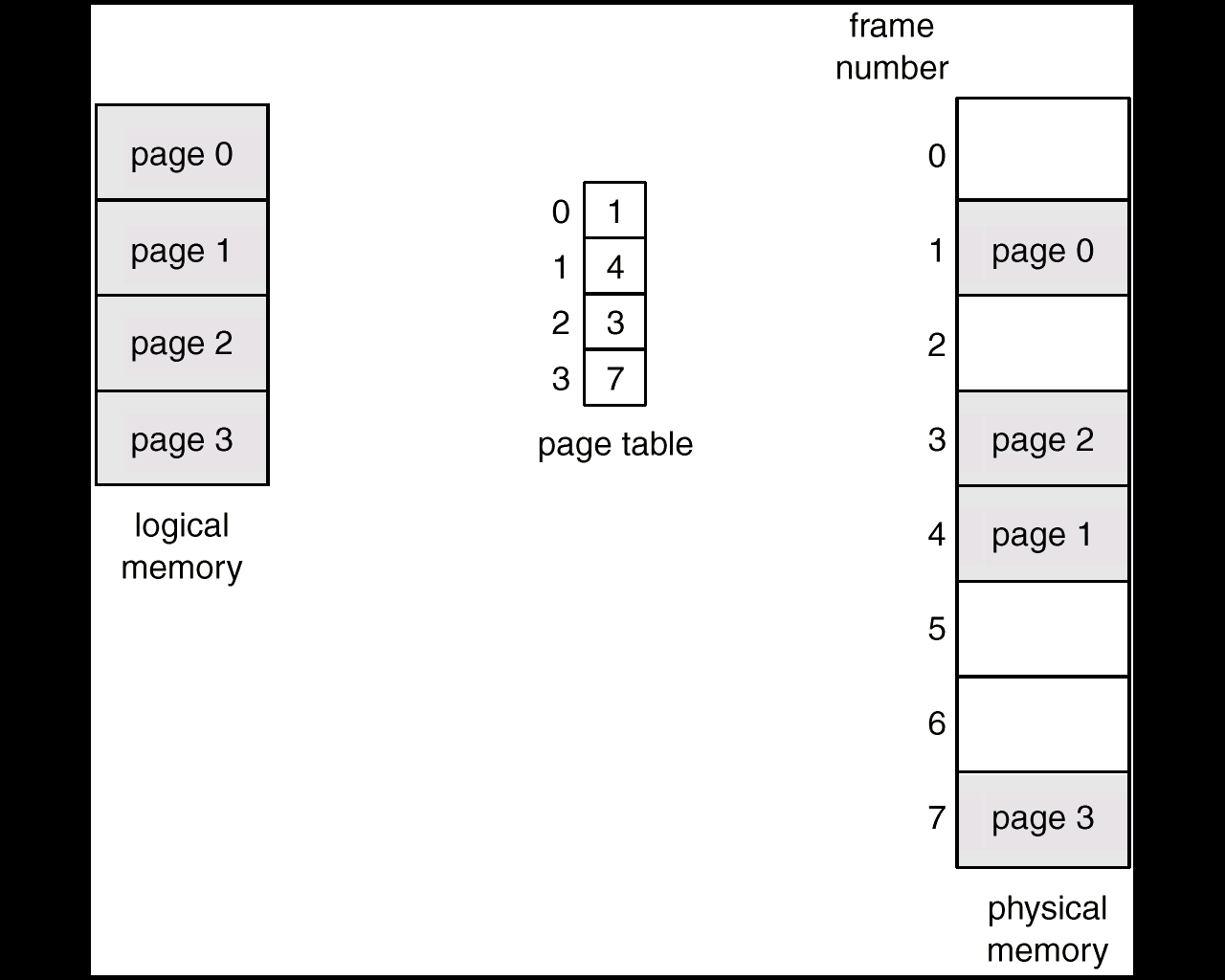
Page Table Definition
A page table is the data structure
used by a virtual memory system
in a computer operating system
to store the mapping between
virtual addresses and physical
addresses

Slide 41
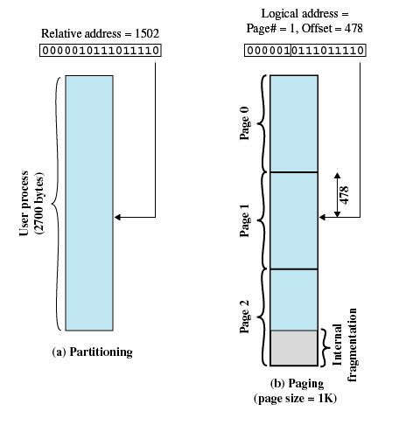

Slide 42
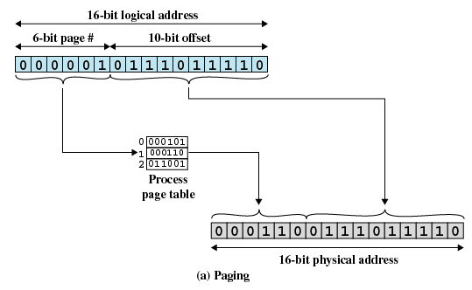

Slide 43
Timer and Event Management
Timer Management
Initialization, allocation, management and use of timers
Timer management library can be part of RTOS or developed independently
Event Management
Involves use of event library for events like timer expiration, queuing buffers etc.
Event library ensures selective reception of signals by tasks
Select(): bit mask indicates the events that will signal a task
Main loop processing of events means single point of entry for all events
Access to SET is protected against an ISR accessing it directly

Slide 44
Homework
How would you Implement a timer manager for an RTOS
How would you implement an event manager for an RTOS

Slide 45
IPC
Inter-Process Communication (IPC)
Communication mechanisms provided by RTOS:
Message Queues,
Semaphores for mutual exclusion,
Shared memory,
Mailboxes,
Signals / Events

Slide 46
Protocol and Driver interface
Protocol Interfaces to multiple subsystems:
RTOS
Memory and Buffer Management
Timer and Event management
IPC
Device driver components
Configuration and control components
Driver Interfaces
Device driver interface is at lowest level of OSI
Layering of driver for reusability and modularity
Device Adaptation layer → provides uniform access to higher layers (DAL)
Hardware Adaptation Layer (HAL)

Slide 47
Configuration and Control
External Manager used for configuration, control, status and statistics
Protocol task communicates to Manager through an agent
Agent is a software entity on the embedded device which processes and responds to manager requests
Manager-agent communication is through a standard protocol (SNMP)
Command Line interface is special case of manager-agent interface

Slide 48
Protocol Management
Enabling and disabling the protocol
Enabling and disabling the protocol on a specific port
Addressing a specific interface (e.g., the IP address on a port)
Setting maximum frame size
Managing protocol message timeouts
Timing out peer entities (keep-alives)
Authenticating security information (e.g., passwords, security keys)
Managing traffic parameters (packet loss, window size, etc)
Encapsulation information (IP- tunnel, IPv6, IP-Sec, TCP/IP)

