Slide 1
Tables & Data Structures Management
CPE 545

Slide 2
Chapter Summary
This chapter details some of the tables and other data structures typically used in communications systems and discusses the related design aspects.

Slide 3
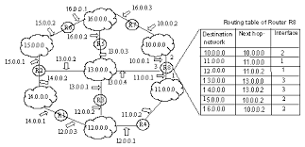
Tables and Data Structures
Issues with tables
Are referenced for reading and writing frequently and hence storage and access methods have to be optimized
Can be stored in different parts of memory -> DRAM, SRAM,…
Can be organized according to the access method
Layer 3: Radix tree for variable length prefix
IP routing lookups must find the routing entry with the longest matching prefix
Layer 2: hashing for fixed-length index

Slide 4
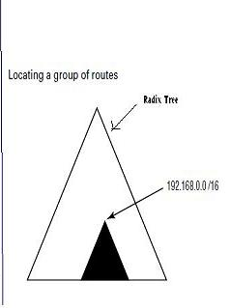
Radix tree
192.168.0.0/16
0
1
192.168.128.0/17
192.168.0.0/17
0
1
0
1
192.168.0.0/18
192.168.64.0
192.168.128.0
192.168.192.0
0
1
0
1
0
192.168.160.0
0
1
192.168.32.0
192.168.64.0
192.168.224.0
192.168.0.0/19
0
192.168.96.0
1
0
1
0
192.168.0.0/20

Slide 5
Tables and Data Structures
Tables for management are used for:
Configuration -> info used to set parameters
Control -> read/write info to change behavior of communication
Status -> details about current state of operation
Statistics -> read only monitored counters (e.g. received packets)

Slide 6
Partitioning Tables - Design Approach
Information in tables can be global or per port
Root data structure of a protocol or system module is called a control block (CB)
CB serves as anchor block to access other blocks like config block
CB points to config, control, status and statistic variables
This scheme allows for more flexibility in memory partitioning

Slide 7
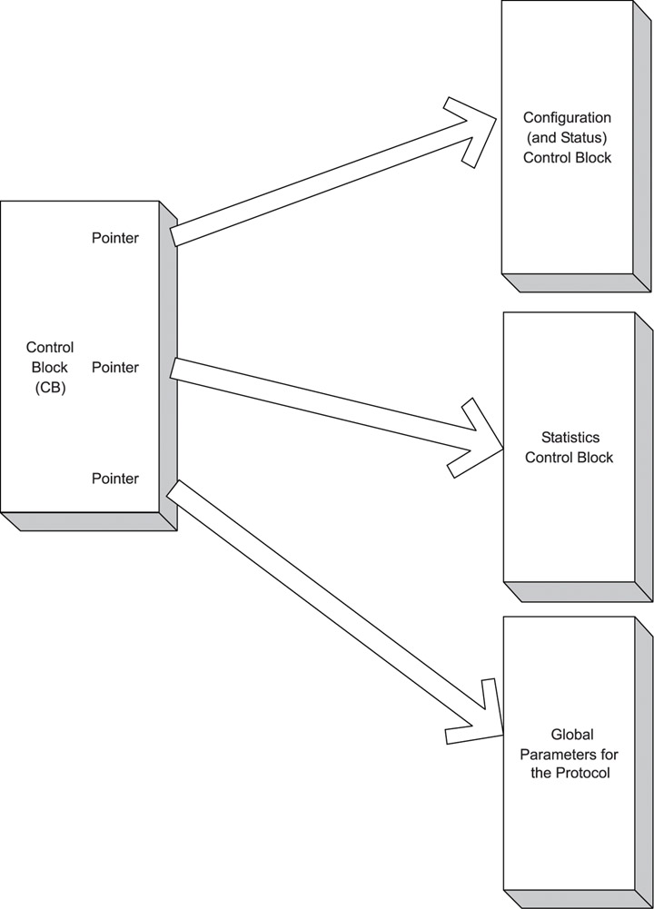
Partitioning Tables - Design Approach

Slide 8
Protocol control block and related blocks for IP.
typedef struct ControlBlock {
BOOLEAN IPInitialized;
BOOLEAN IPBufferInterfaceInitialized;
BOOLEAN IPTimerInterfaceIntialized;
IPConfigBlock *pConfig;
IPStatsBlock *pStats;
}IPControlBlock;
typedef struct _IPConfigBlock {
BOOLEAN ipForwardingEnabled;
/* to insert in IP packet */
UINT2 u2TTLValue;
/* which ICMP messages to respond to*/
UINT2 icmpMask;
………
………
} IPConfigBlock;
typedef struct _IPStatsBlock {
UINT4 ipInReceives;
UINT4 ipInHdrErrors;
UINT4 ipInAddrErrors;
………
………
UINT4 ipOutDiscards;
UINT4 ipOutNoRoutes;
………
………
………
………
} IPStatsBlock;

Slide 9
Partitioning Tables - Design Approach
Logical Interfaces
Protocols need interface specific configuration and Interface Control Block (ICB) handles this information – (e.g. number of OSPF packets recv’ed)
Two types of ICB’s
H/W interface control block (HICB) - Physical Interface
Protocol interface control block (PICB) – Logical Interface
HICB represents control, status, of a hardware port while PICB represents control, status, statistics of a protocol on the specific interface
Two types of ICB provide for flexibility since:
More than one protocol can be enabled on a hardware port
More than one logical interface can be specified on a physical interface

Slide 10
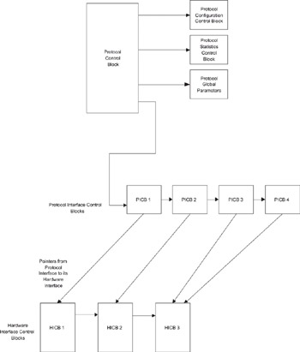
Partitioning Tables - Design Approach
There is one HICB per physical port
There is one PICB per logical interface
for the protocol.
Each PICB has a pointer to its related
HICB and is also linked to the next PICB
for the same protocol

Slide 11
CB allocation and initialization
Protocol software allocates a PICB, links it to the Ethernet interface's HICB,
PICB contains basic parameters for protocol
gets allocated when the SNMP manager configures parameters for the protocol (e.g. IP address)
If and only if all basic parameters in PICB are set, is the protocol ready and enabled

Slide 12
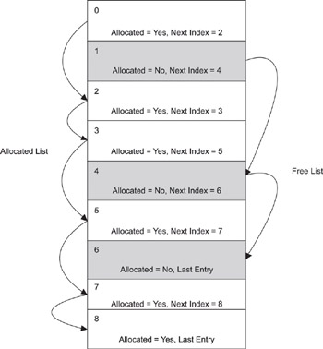
ICB Implementation - Array

Slide 13
Speeding up Access
Three methods for speed up
Optimized access mechanisms
Hardware support
Caching

Slide 14
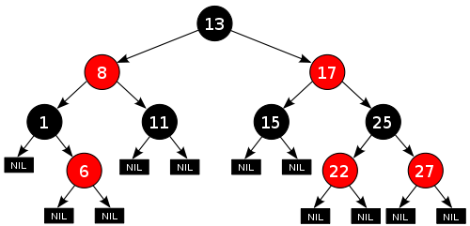
Speeding up Access
Optimized Access Methods
Tree structure is more efficient for access than a linked list structure
Allows access to routing table entries stored in leaf nodes in much shorter hops than traversing the entire linked list ( O(log n))
Red and black tree (Self balancing binary search tree)
A node is either red or black.
Every red node must have two black child nodes and vise versa.
Every path from a given node to any of its descendant leaves contains the same number of black nodes.
Hashing tables also allow for efficient storage
Hardware support
Ethernet controller can contain hardware hashing mechanism to match destination MAC address
Content addressable memory (CAM) provides for parallel searches of a table or other data structure which leads to faster access

Slide 15
Homework
How do you handle the situation when a hash algorithm does not create a unique hash for all the keys?

Slide 16
Speeding up Access
Caching
Caching provides for storing a subset of large data structure in a high speed memory module for fast access
Subset determination algorithm is critical to success of caching for faster access
Cache most recently seen destination addresses
An entry is accessed more than once in last few transactions
Static configuration (fixed tables)
Different techniques exist for replacing cache entries
Timing out entries - if a cache entry is not used for a period of time, it is replaced
Removal of entries can be active or on demand
Priority of entries (set priority for removal from cache at the time of caching)
LRU (Least Recently Used) scheme can be used when cache is full

Slide 17
Caching
Copy a data block (cache line) of 64 bytes from memory into cache.
We need 6bits to specify each of the 64 bytes.
Suppose you want to access address A₃₁₋₀ 0x3F80260A
We copy the data in addresses A₃₁₋₆ 0x3F802600: A₃₁₋₆ 0x3F80263F from RAM to the cache :
The upper 26 bits is called tag. The lower 6 bits considered the offset into the cache line.
Given the tag and the offset, we know what address the data at a given offset is.

Slide 18
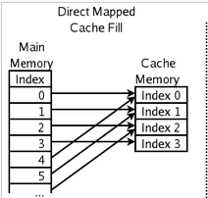
Caching
If we have a cache memory of size 128KB, where each cache line is 64 bytes, we will have a total of 128k/64 = 2048 cache lines
To index 2048 cache lines we need 11 bits
11 bits used for index (identifies the cache line within the cache)
The upper 15 bits used for tag (matches the decoded address in RAM if data is in cache).
The lower 6 bits considered the offset into the cache line.
Every cache block has associated with a tag address
tag
index
offset

Slide 19
Caching management
For each cache line there is a:
Valid bit: Indicating whether the slot holds valid data. If V = 1, then the data is valid. If V = 0, the data is not valid. Initially, it's invalid. Once data is placed into the slot, it's valid.
Dirty bit: This bit only has meaning if V = 1. This indicates that the data in the slot has been modified (written to) or not. If D = 1, the data has been modified since being in the cache.
Every cache line has associated with it at least the Dirty and Valid bits, and a tag address

Slide 20
Caching management
Cache Hits and Cache Misses
When you look for data at a given address, and find it stored in cache, then you have a cache hit. If you don't find the data, then it's a cache miss.
You want to maximize cache hits, because then you have much improved performance (speed).
What Happens in a Cache Miss
If the address (and its contents) are NOT in the cache, then you must access it from main memory. This means that you must copy the data from memory to the cache.
Since the cache is a small subset of main memory, there may be data that you need to remove from the cache

Slide 21
Caching types
Suppose you need to modify data in the cache. There are two ways to do this:
write-back This says that you update main memory only when the cache line is evicted. Otherwise, only update the cache.
write-through This says that you update main memory at the same time you update cache.

Slide 22
Caching types
write-back
This approach creates an inconsistency between cache and memory. Cache has one view of memory (which is accurate), while main memory does not have the latest updates.
Problematic if you had more than one CPU and cached data is in shared memory.
Write-back is convenient because you don't have to access main memory, which can be slow.
write-through
The disadvantage occurs when there are many writes to memory. This can cause a backlog waiting for the writes to occur.
The key is to avoid waiting for the write to memory to complete by writing to memory in the background.
The advantage of write-through is that you don't have to worry about memory consistency, since cache and memory should have the same values.

Slide 23
Homework
In the cache example above, how many bits of the address line is required to map the data in cache line to the memory blocks in the RAM?
How many 32 bit registers you would need in the cache controller to manage this 128KB cache. i.e:
Determine if it is a cache hit or miss, valid or invalid, dirty or clean

Slide 24
Table Resizing
Dynamic resizing not recommended because it often requires re-allocation of new array and copying the data for contiguity:
Reference modification
Refers to change in memory pointers during execution
Peak memory requirements
Refers to memory needed to move data from old to new table
Recommend approach -> Table size is a boot parameter and a change in size takes effect only when system is re-booted

Slide 25
Table Access Routines
Not recommended that tables be accessed globally by all modules
Parameters within a table should not be accessed directly and instead use routines to encapsulate the data
For this reason, the access routines should protect critical sections using mechanisms like semaphores
Another benefit of these access routines is producing reentrant code
Code is reentrant if it can be called by multiple callers and yet maintain memory consistency across each individual context
Reentrant code is extremely useful in designing embedded systems

Slide 26
Router Management
SNMP Management
Agent’s front end is used for PDU processing while back-end performs validation and determines actions to be performed
CLI based Management
Inputs acquired from user and verification performed by the agent
HTTP based management
Uses an embedded web server to receive and send HTML data that contains management information
All three methods have common back-end processes but different at the front-end

Slide 27
CLI
CLI or Command Line Interface
Command line Interface is either text string based or character key based.
Can be accessed via Serial port or Telnet session
Provides direct access to the directory structure of the file management system and hence used by power users

Slide 28
SNMP
SNMP or Simple Network Management Protocol
Most Dominant protocol in network management
Most routers and switches implement CLI and SNMP agent
Model assumes the existence of Managers and Agents
Agent is a program which communicates with the Manager on one side and with Device or Application on the other side.
The SNMP manager monitors and controls the managed device via the access provided by agent .

Slide 29
SNMP
SNMP facilitates communication between a managed device (a device with an SNMP agent) and an SNMP Manager .
Communication is via SNMP Protocol Data Units (PDUs) and are encapsulated in UDP packets
A management information exchange can be initiated by the manager (via polling) or by the agent (via a trap)
Agent listens for requests and replies to them over UDP port 161 and reports asynchronous traps on UDP port 162

Slide 30
SNMP
Operations permitted between managers and managed device:
GET: Operation performed by manager to obtain information from the agent about an attribute of a managed object.
GET-NEXT: : Operation performed by manager to obtain information on the next object in the tree of objects on the managed device.
GET-BULK: : Operation performed by manager to obtain information about a group of data from the agent. This is not possible in the case of SNMP V1.
SET: : Operation performed by manager to set (or write) the value of an attribute of a managed object.
TRAP: An asynchronous notification sent by the agent to the manager; telling it about some event on the managed device.

Slide 31
SNMP
What is MIB (Management Information Base)
MIB is a document about the device (or application).
Allows for a remote management of a device (or application) and defines a set of variables that should be published outside (to the Manager).
Each variable is assigned a unique identifier in SNMP that is called an object identifier (OID).
The uniqueness is maintained all over the world.
The format of OID is a sequence of numbers with dots in between.

Slide 32
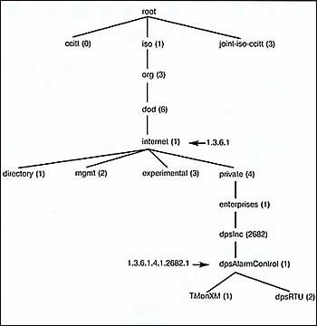
SNMP
The branch of the MIB object identifier tree that represents managed elements used by DPS Telecom equipment

Slide 33
MIB
Management Information Base
Specified by bodies like IETF and define management variables
RFC 1213 is an MIB for IP forwarding and also called MIB-II and can be managed by an external SNMP manager
Configuration variables can be stand-alone (scalar) or part of a table
Always use SNMP MIB table as a checklist when implementing data structures

Slide 34
MIB Example
Management information base (e.g. ipAddr table)
ipAddrEntry OBJECT-TYPE
SYNTAX IpAddrEntry
ACCESS not-accessible
STATUS mandatory
DESCRIPTION
"The addressing information for one of this
entity's IP addresses."
INDEX { ipAdEntAddr }
::= { ipAddrTable 1 }
IpAddrEntry ::=
SEQUENCE {
ipAdEntAddr
IpAddress, // IP address of interface
ipAdEntIfIndex
INTEGER, //Interface Identifier
ipAdEntNetMask
IpAddress, //Net mask for interface
ipAdEntBcastAddr
INTEGER, //Broadcast address used on interface
ipAdEntReasmMaxSize
INTEGER (0..65535) //Max Size of reassembled IP
//packet
}

Slide 35
Management Table Example
Address table (Interface table).
Addr IfIndex NetMask ReasmMaxSize
10.0.0.1 1 255.0.0.0 10.255.255.255 15000
20.0.0.1 2 255.0.0.0 20.255.255.255 18000
30.0.0.1 3 255.0.0.0 30.255.255.255 15000
The Addr field is the IP address for the specific interface (identified by an ifIndex).
The NetMask, BcastAddr and ReasmMaxSize are configurable fields in a table entry.
These variables are also known as "Read–Write" variables as opposed to "Read Only" variables, which cannot be configured by the manager.

Slide 36
Agent to Protocol Interface
Low level routines provide access to data structures maintained by the protocol task
But executed under the context of agent task which leads to a couple of related issues:
Priority of the agent task is the lowest within the protocol implementation
Because management operations are considered secondary to the main function of the system which is switching and routing
Therefore the low level routines execute at a priority lower than the protocol task.
Therefore simultaneous access of data structures by protocol task and low level routine creates conflicts.

Slide 37
Agent to Protocol Interface
Solution 1: Mutual exclusion using semaphores
Requires significant modifications to protocol code
Susceptible to bounded and unbounded priority inversion and possible deadlock
Solution 2: Lock agent task during execution, so it is not preempted by protocol task
Can also be realized by temporarily raising priority of agent task during access
Priority inheritance

Slide 38
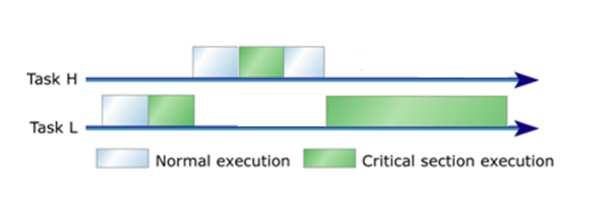
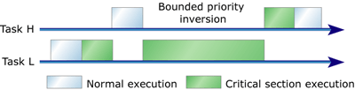
Bounded Priority Inversion
The task makes a request for Resource A.
Ideally
In Reality

Slide 39
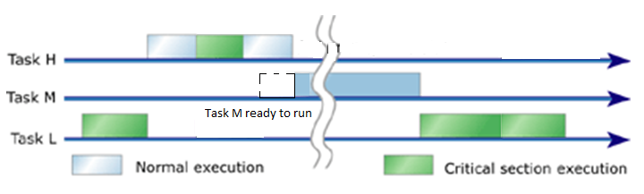
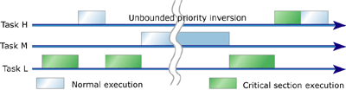
Unbounded Priority Inversion
Ideally
In Reality

Slide 40
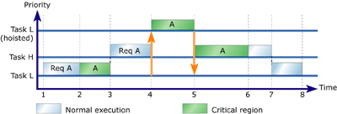
Priority Inversion
Less significant when there are only two tasks fighting for a resource
Simple priority inheritance

Slide 41
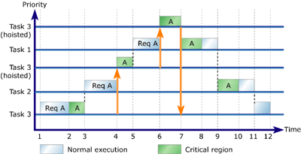
Priority Inversion
Three-task, one-resource priority inheritance
Advantage is more visible when there are three or more tasks
are fighting to get the same resource

Slide 42
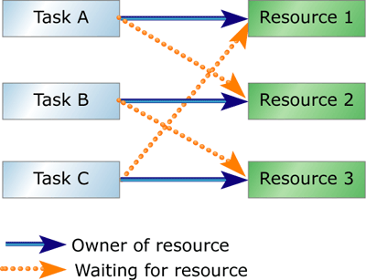
Dead lock

Slide 43
Agent-Protocol Interface contd…
Ideal Solution: Provide for agent task operation within the main processing loop of the protocol task
Prevents lateral access to data structures
Only one thread of execution eliminates need for mutual exclusion
Example of implementation
Invoke low level routine within protocol task from the Agent task
Low level routine identifies type of operation and sends an EVENT to the protocol task
This event is an internal event specific to a task queue
Since message is queued, protocol task can process it within the main loop without worrying about access conflicts to the data structure

Slide 44
Agent-Protocol Interface contd…
Memory separation between Agent and Protocol
If Agent task and Protocol task live in separate memory spaces, we HAVE TO USE a message-based interface
WHY? Because the agent task will NOT HAVE ACCESS to the low level routines provided by the protocol task
If Agent and Protocol tasks live in the same memory space, we could use a message-based or procedure-based interface

Slide 45
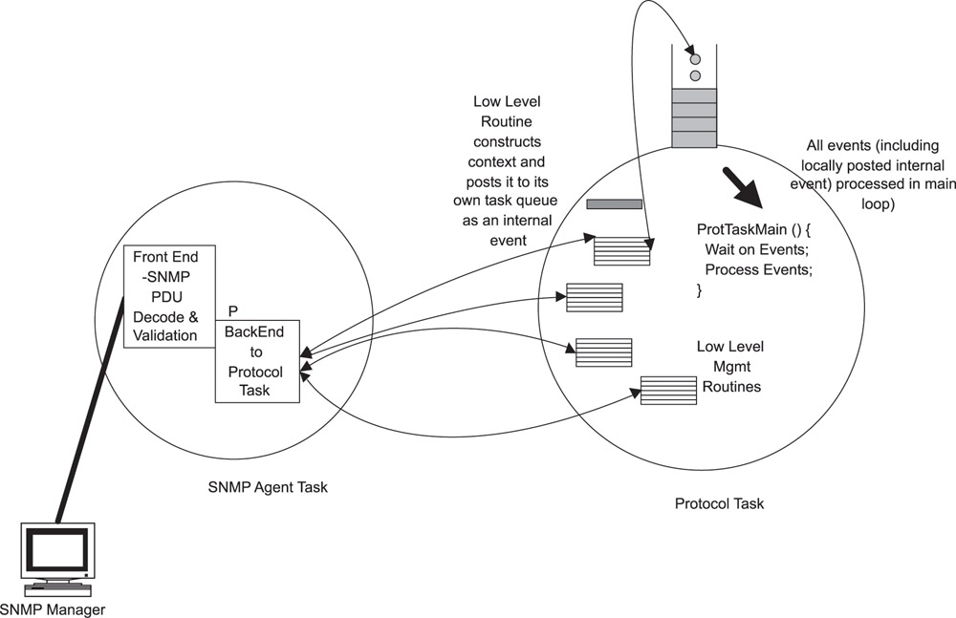
SNMP

Slide 46
Trap: Device->Manager Communication
This communication channel is used to capture information that affect the operation of the embedded device
Example: Traffic on a port exceeds the threshold, a port is abruptly shut down. Manager must be Alerted.
This is an important part of management model and requires different mechanisms for capture
SNMP uses a mechanism called “trap”
In CLI, the alerts are displayed on the user console

Slide 47
Trap: Device->Manager Communication
Issues to watch for:
Protocol task uses a shared queue for both alerts and normal response to GET requests to the agent which in turn determines when to forward them
Too many traps or alerts can become unmanageable
Categorizing traps/alerts into critical and non-critical at the protocol level and sending critical alerts before it’s too late will help the manager shut down the system gracefully

Slide 48
System Setup and Configuration
Boot parameter configuration
Typical boot parameters include: Ethernet IP address, boot file name, user name and password, flags, etc.
Support for additional parameters will require reprogramming the boot ROM
Actual configuration is performed using a command line interface
SNMP or HTTP protocols CANNOT be used for the configuration because device will not have an IP address until it is boot configured
Post boot configuration
After boot ROM image has been downloaded, the boot parameters can be changed using SNMP or other protocols
After a change, the changed parameters can be saved in EEPROM or flash and the device on re-boot picks up the new parameter values

Slide 49
Saving & Restoring Configuration
Manager based approach
SNMP (or any protocol) manager uses GET operation to obtain a record of device configuration variables and stores it
On reboot, a configuration restoration request is made to manager, which then uses SET operations to restore configuration
Provides a centralized approach where no work is required of the device
No concern about running out of storage space
Device based approach
Manager instructs device to save current configuration
The device determines how to categorize and store basic and non-basic configuration parameters efficiently
Relies on the master source of data kept locally on the target in non-volatile memory

Slide 50
Operation & Saving process
Restoring the configuration
Restoration happens at boot time
Configuration file is downloaded from a local or remote location and decompressed
Simple changing the value of a variable is not sufficient. it is essential that, when restoring configuration, we mimic the effects of the steps to initialize the modules.
System is not fully initialized until the restore process has completed

Slide 51
Operation & Saving process
Saving the Configuration
Basic and non-basic parameters are stored at a temp location in the RAM
TLV encoding is commonly used-> contains type, length and actual value of parameter
The RAM entries are then compressed and a checksum added at end for error detection
This compressed entry which resembles a binary file can then be stored in the local flash or a remote location
Good design principle is to provide for both local and remote storing since the size may exceed the local flash capacity

Slide 52
