Slide 1


Antidepressant PRESCRIBING NHS DATA ANALYSIS REPORT March 2025 By Joseph Okeke

Slide 2
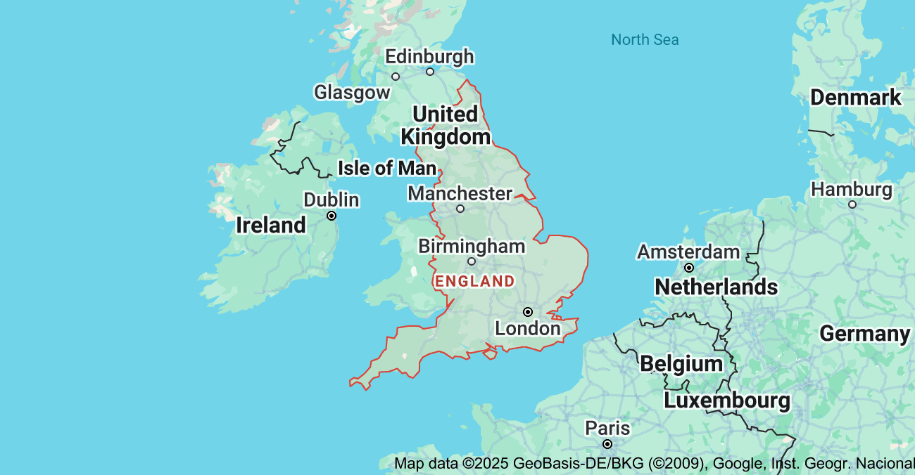
INTRODUCTION
Antidepressants are prescription medications used in the treatment of mental conditions like depression.
Antidepressants functions by influencing brain chemicals (neurotransmitters) to regulate mood.
Examples: Sertraline, Fluoxetine, Mirtazapine e.t.c

Slide 3

AIM AND OBJECTIVES
The aim of this study is to analyze national antidepressants prescribing trend using NHS data to uncover observations that can inform healthcare and aid data-driven recommendations and decision making.
Objectives:
To uncover the most common prescribed antidepressant across NHS regions in December 2024.
To estimate quantity and cost associated with antidepressant prescriptions.
To balance regional prescribing patterns and cost
To provide data-driven recommendations that aid mental health.

Slide 4
ANALYSIS
Visualization: Top 5 Drugs Prescribed
Chart Type: Bar Chart
Insights: Sertraline hydrochloride usage dominates with 2,082,084 prescription, the antidepressant is the most commonly prescribed which suggests that the drug is widely accepted and possibly the first-line recommendation in the treatment of depression.
Amitriptyline hydrochloride being the second most prescribed antidepressant with a volume of 1,376,002.
Mirtazapine with 1,122,486 and Citalopram hydrobromide with 1,108,471 indicating almost equal prescribing quantity.
Fluoxetine hydrochloride with 632,157 being the least prescribed in the top 5 most prescribed drugs in this study.

Slide 5
ANALYSIS
Visualization: Top 3 Prescribing Cost
Chart: Pie Chart
Insights: Venlafaxine accounts for the highest prescribing cost with a total of 3,830,014. Its financial impact is large despite the antidepressant not being among the top 5 prescribed by volume. This suggests high cost per drug which can be as a result of expensive formulations.
Sertraline hydrochloride with a total cost of 3,543,376 given that the antidepressant is the most prescribed by volume its overall cost is expected. Furthermore it delivers high usage at a relatively modest per-unit price compared to venlafaxine.
Amitriptyline hydrochloride with a total cost of 1,355,255 is way lower than venlafaxine and sertraline hydrochloride , showing cost effectiveness or cheaper formulations.

Slide 6
ANALYSIS and insights
Visualization: Regions by Cost and quantity filtered by drugs
Table: Pivot Table
Insights: Top Regions by Cost
Midlands: 3,253,374
South-East: 2,777,756
North-East and Yorkshire: 2,7399,985
The midlands tops in both volume and cost, while south-east has lower volume but a high total cost, indicating expensive prescriptions.
DRUG | (All)
Regions | Total Cost | Sum of ITEMS
MIDLANDS | 3,253,374 | 1,514,514
SOUTH EAST | 2,777,756 | 1,055,045
NORTH EAST AND YORKSHIRE | 2,739,985 | 1,560,096
NORTH WEST | 2,376,889 | 1,193,699
EAST OF ENGLAND | 2,046,936 | 941,432
SOUTH WEST | 1,765,128 | 798,044
LONDON | 1,674,195 | 758,802
UNIDENTIFIED | 1,072 | 345
Grand Total | 16,635,334 | 7,821,977

Slide 7
ANALYSIS
Visualization: Regions by Cost and quantity filtered by drugs
Table: Pivot Table
Insights: Top Regions by Quantity of Items Prescribed
North-East and Yorkshire:1,560,096,
Midlands: 1,514,514
North-West 1,193,699
These regions indicates the highest demand suggesting large populations, high prevalence of depression or good accessibility to prescriptions.
DRUG | (All)
Regions | Total Cost | Sum of ITEMS
MIDLANDS | 3,253,374 | 1,514,514
SOUTH EAST | 2,777,756 | 1,055,045
NORTH EAST AND YORKSHIRE | 2,739,985 | 1,560,096
NORTH WEST | 2,376,889 | 1,193,699
EAST OF ENGLAND | 2,046,936 | 941,432
SOUTH WEST | 1,765,128 | 798,044
LONDON | 1,674,195 | 758,802
UNIDENTIFIED | 1,072 | 345
Grand Total | 16,635,334 | 7,821,977

Slide 8
RECOMMENDATIONS
Review high cost drugs like venlafaxine. Check for its clinical justification for the high cost.
Normalize prescribing practices across regions, share best practices across regions and support evidence-based choices.
Improve the usage of high volume drugs like Sertraline hydrochloride and ensure it is being prescribed appropriately.
Implement cost-efficiency education, effectiveness of different treatments and regional standards to encourage better prescriptions.
Conduct further analysis and reviews on the clinical indications of drugs with low usage and also ensure prescribing is based on evidence and alternatives are been considered.

Slide 9
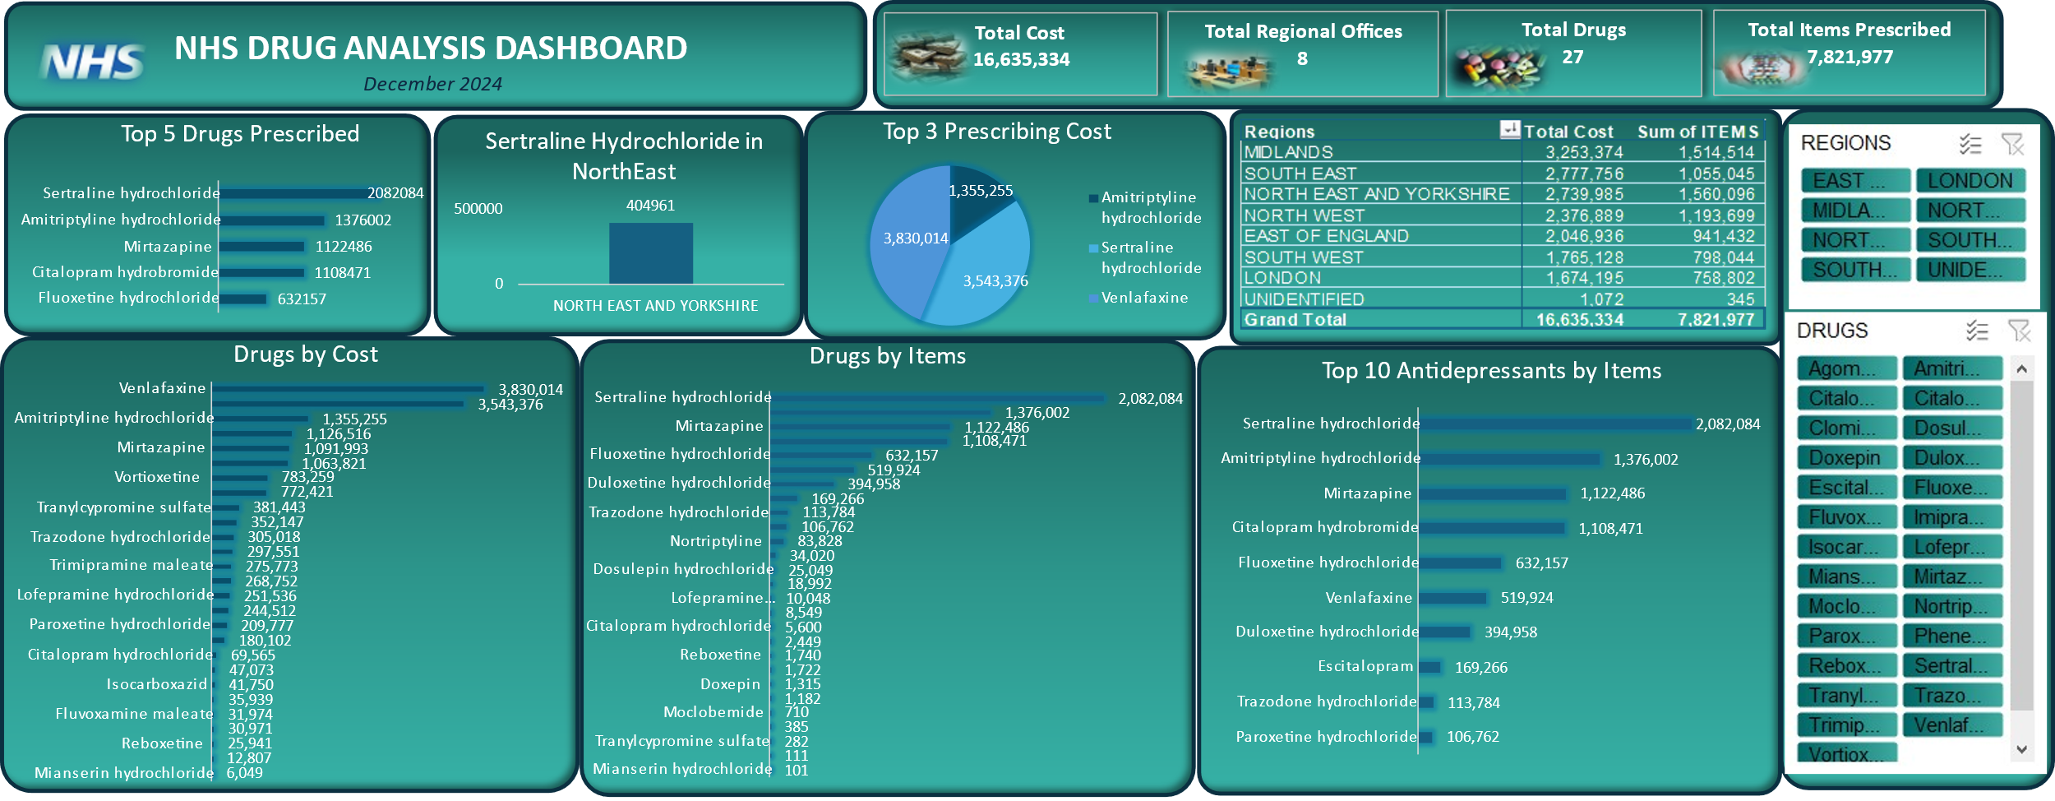
Dashboard

Slide 10
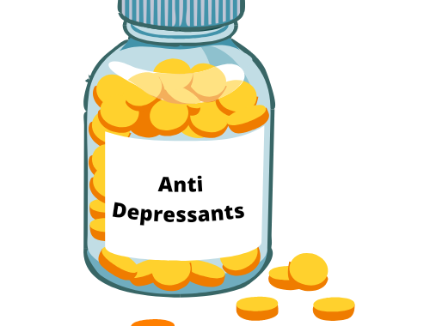
Thank you
Joseph Okeke

