Slide 1

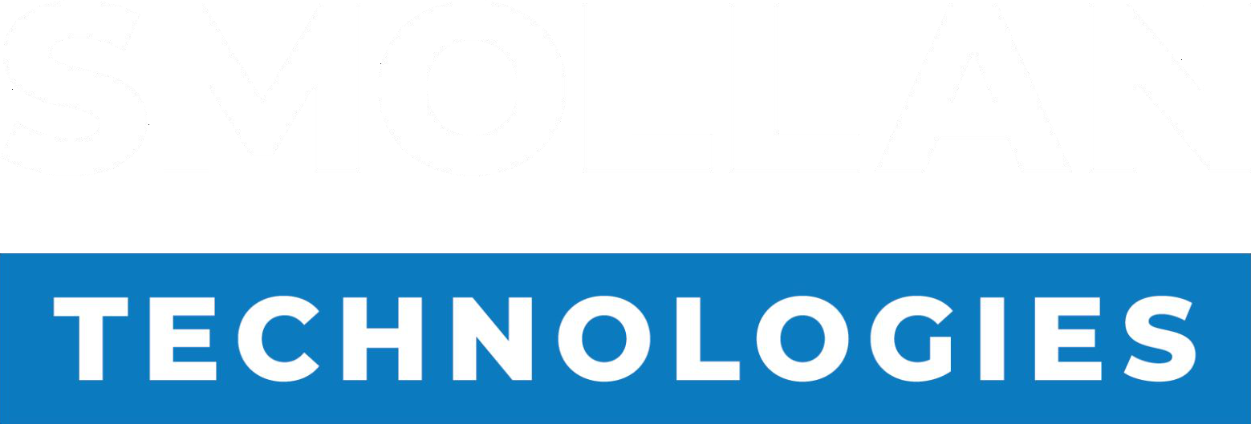
Unilever Presentation
Pasta & Noodles Category Review
South Africa | 12 months to June 2026
Updated: 18/08/2026
A SMOLLAN COMPANY

Slide 2

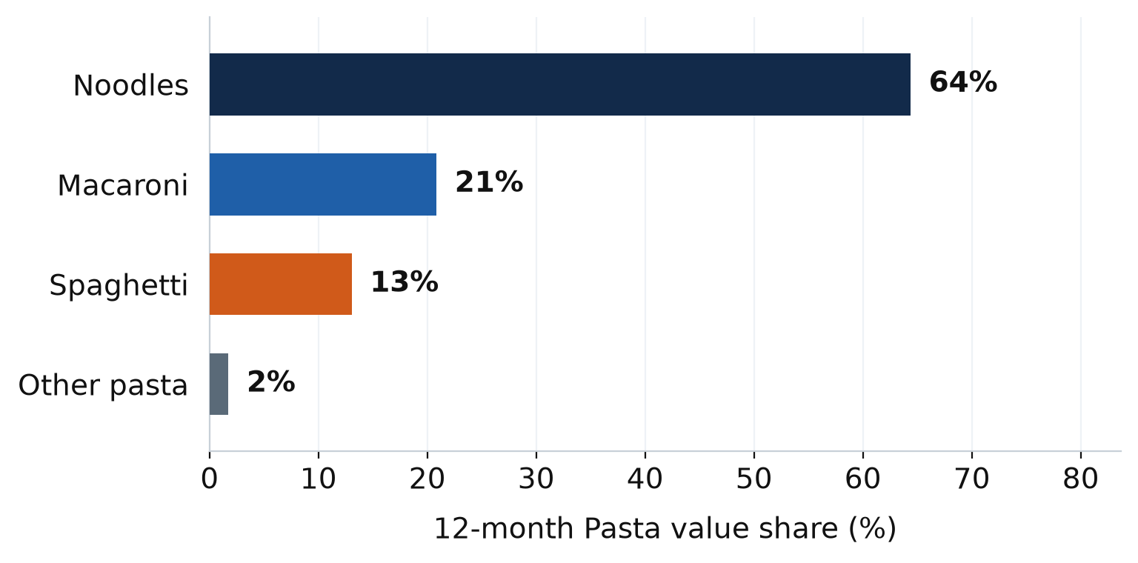
Pasta: 12-month view to June 2026
12-MONTH VALUE
JUNE 2026
NOODLES SHARE
CATEGORY PRICE
R3.3bn
R337.1m
64% of Pasta
R58/kg
+5.2% value · vol -0.7%
+7.7% vs Jun 25
+1.8pp vs YA
Noodles R96 · dry ~R32–35
Where the value sits
Key players — winning and losing
Manufacturer | Share | vs YA | Value | R/kg
Kellogg's | 29.4% | +2.1pp | +13.1% | R87
Nestlé | 18.5% | -2.7pp | -8.2% | R100
Tiger Brands | 13.8% | -1.5pp | -4.8% | R35
Private Label | 9.1% | +0.0pp | +5.6% | R31
Mr Pasta | 5.9% | -2.0pp | -21.6% | R36
Indofood | 4.4% | +1.4pp | +55.7% | R99
Roka | 4.1% | -0.2pp | +1.5% | R69
Noodles is the Pasta category (64% of value, growing faster than dry pasta). Kellogg's and Indomie are taking share. Nestlé, Mr Pasta and Tiger Brands are losing it. Unilever does not appear in Pasta until Noodles, and only in June.
South Africa Pasta · 12 months Jul 25–Jun 26 vs YA · latest month Jun 26 · price = value ÷ volume
2 / 6

Slide 3
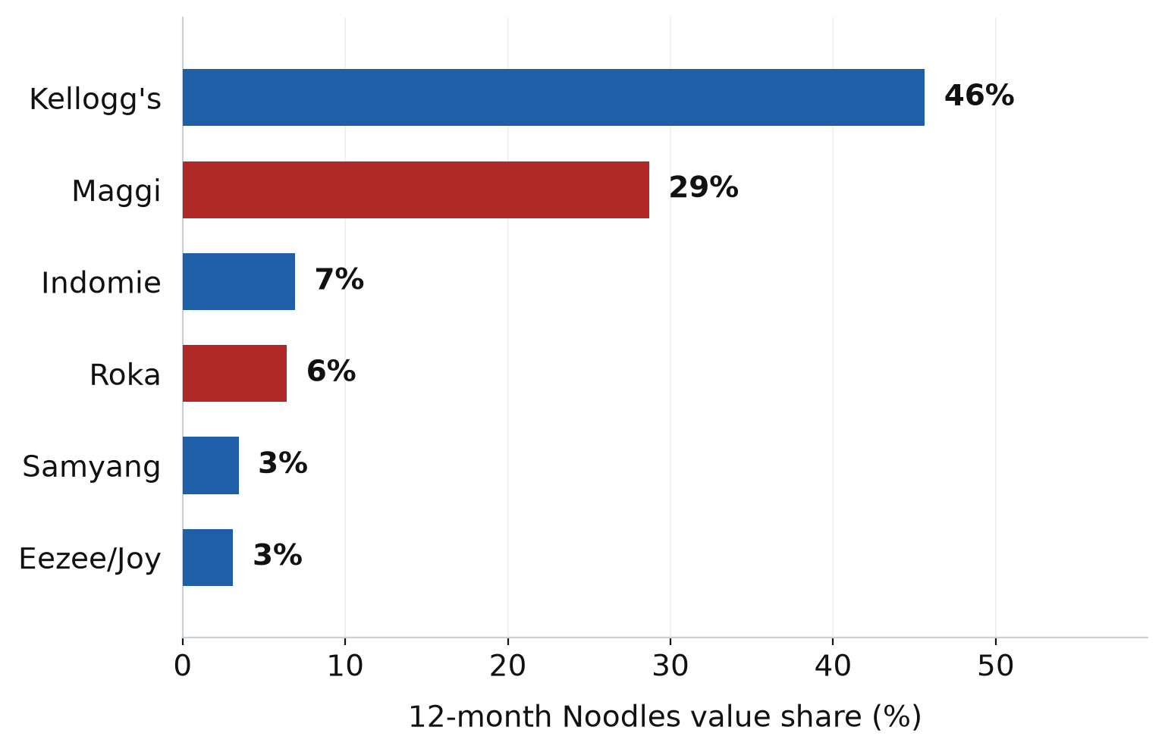
Noodles: who is winning and losing
12-MONTH VALUE
JUNE 2026
MASS PRICE
UNILEVER (JUN)
R2.1bn
R221.5m
R5–8 sachet
0.56% share
+8.2% · vol +5.0%
+10.0% vs Jun 25
86% of noodles value
R1.24m · 3 Pasta Pots
12-month Noodles value share
12-month vs June scorecard
Brand | 12m | Jun | vs YA | Value | R/kg
Kellogg's | 45.6% | 44.3% | +2.0pp | +13.1% | R87
Maggi | 28.7% | 28.2% | -5.1pp | -8.2% | R100
Indomie | 6.9% | 7.8% | +2.1pp | +55.7% | R99
Roka | 6.4% | 5.1% | -0.4pp | +1.5% | R69
Samyang | 3.4% | 3.3% | +1.8pp | +122.3% | R302
Knorr | 0.1% | 0.6% | +0.1pp | n/a | R790
South Africa Pasta · 12 months Jul 25–Jun 26 vs YA · latest month Jun 26 · price = value ÷ volume
3 / 6

Slide 4
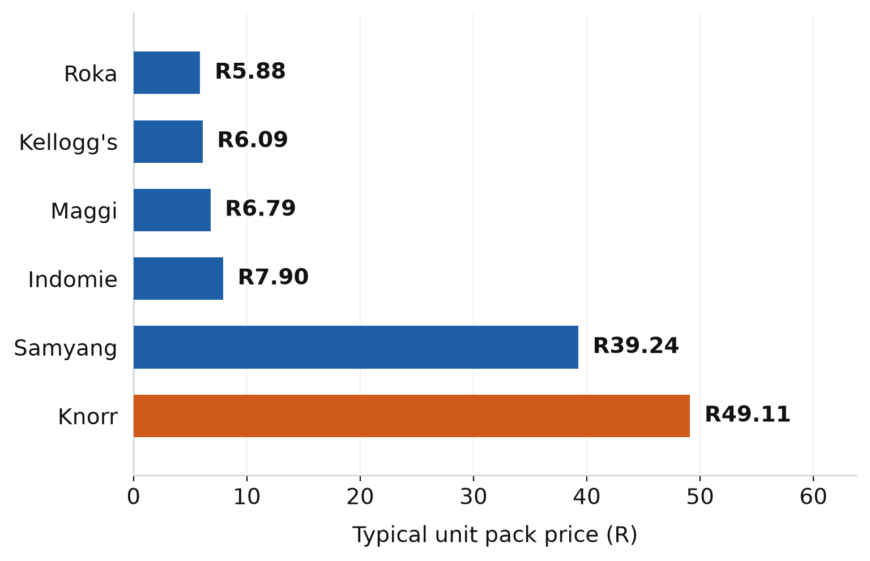
Noodles price point — and where Unilever sits
Typical unit pack price
Unilever SKUs — June 2026 only
Pasta Pots are not a sachet
86% of noodles value is R5–8 a pack. Knorr Pasta Pots are R49 a pot / ~R790/kg, 0.56% of Noodles in June (R1.24m). Hold R49; do not promo into the R6 band.
SKU | Value | Mix | R/pot
Carbonara | R603k | 49% | R49.05
Tomato & Mozzarella | R368k | 30% | R49.22
Mushroom | R269k | 22% | R49.08
Not in the file before June. Carbonara is 49% of the line. The three SKUs compete with each other first. Samyang (~R39) is the nearer competitor, not Maggi or Kellogg's.
Typical unit = volume-weighted R/kg × pack size. Sachets sit at R5.88–R7.90. Knorr is ~8× that.
South Africa Pasta · 12 months Jul 25–Jun 26 vs YA · latest month Jun 26 · price = value ÷ volume
4 / 6

Slide 5
So what: Unilever is not in the sachet game
Noodles runs Pasta
1
Noodles is 64% of Pasta value and growing +8.2%. Dry pasta (Tiger, private label, Mr Pasta at ~R32–35/kg) is a different business. Unilever is absent there.
Kellogg's is winning, Maggi is losing
2
Kellogg's 46% of Noodles (+2.0pp). Maggi 29% (−5.1pp). Indomie and Samyang are the other gainers. That is the competitive frame, not Knorr vs Maggi on the same pack.
The category price point is ~R6
3
86% of noodles value is a R5–8 sachet (Roka R5.88, Kellogg's R6.09, Maggi R6.79, Indomie R7.90). Samyang sits at ~R39 as a ramen/cup play.
Pasta Pots are a different occasion
4
Knorr Pasta Pots appear only in June: R1.24m, 0.56% of Noodles, ~R49 a pot / ~R790/kg — about 8× the mass sachet. Carbonara is 49% of the line. The three SKUs compete with each other first. Hold R49; do not promo into the R6 band.
South Africa Pasta · 12 months Jul 25–Jun 26 vs YA · latest month Jun 26 · price = value ÷ volume
5 / 6

Slide 6

Thank You!
Joseph Hlongwane
A SMOLLAN COMPANY

