Slide 1
Ai’s present and future
PRESENTATION
By Joenard Armijo CS131

Slide 2
Artificial intelligence (a.i)
WHAT IS IT?

Slide 3
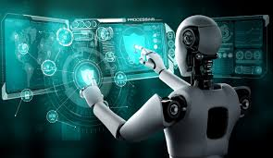

Slide 4
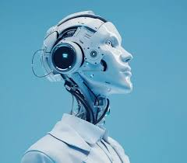

Slide 5
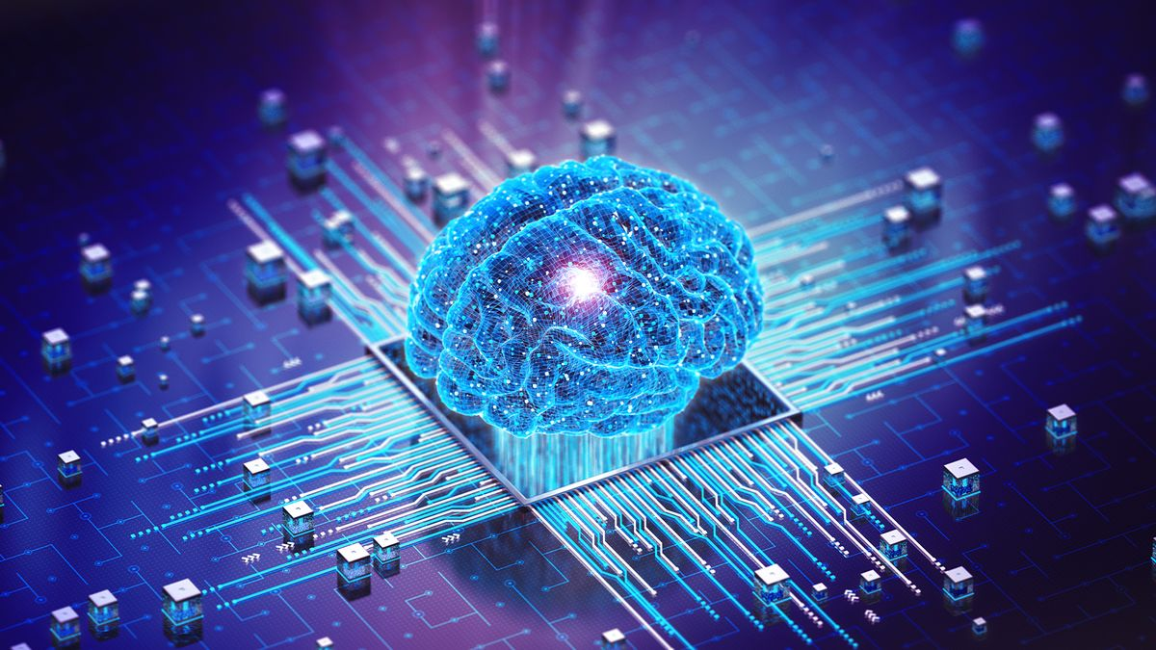

Slide 6
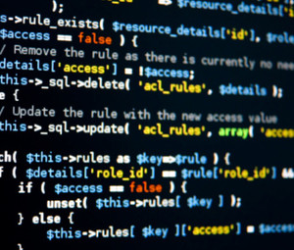

Slide 7
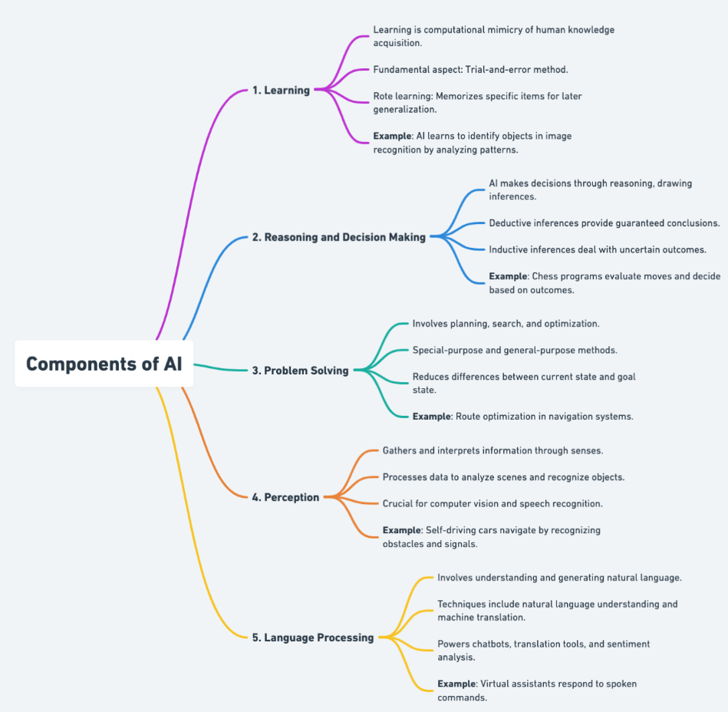

ARTIFICIAL INTELLIGENCE (A.I)
refers to the simulation of human intelligence in machines that are designed to perform tasks that typically require human cognition.
These tasks include learning, reasoning, problem-solving, understanding natural language, and recognizing patterns.
AI systems can analyze data, adapt to new inputs, and perform specific functions with minimal human intervention.

Slide 8
Artificial intelligence (a.i)
Pros and cons

Slide 9
Pros of ai
Increased efficiency on complex work
Personalization
Tool for creativity
Tool for education
Better development on Healthcare

Slide 10
How about its
Cons?

Slide 11
Cons of ai
Job Displacement
Privacy and Security Risks
Over-dependency
Misinformation
Adapting of the “AI mindset”

Slide 12
But what can we do
To move in the right direction?

Slide 13
The question
To ask ourselves….

Slide 14
Will we treat a.i as a threat to our society? A savior? Or a tool?

Slide 15
THANK YOU
Joenard Armijo
CS131 – Discrete Structure
Section #16399
FALL 2024
Professor Yuen Y.

