Slide 2
Index
Linearity
Shift
Symmetry
Convolution
Notes:
In this first part we will go through the following Fourier properties
....

Slide 3
Linearity:
Notes:
Linearity is a very convenient property of many mathematical operations, in this case of the DFT.
It basically means that it is a well behaved operation.
...

Slide 4
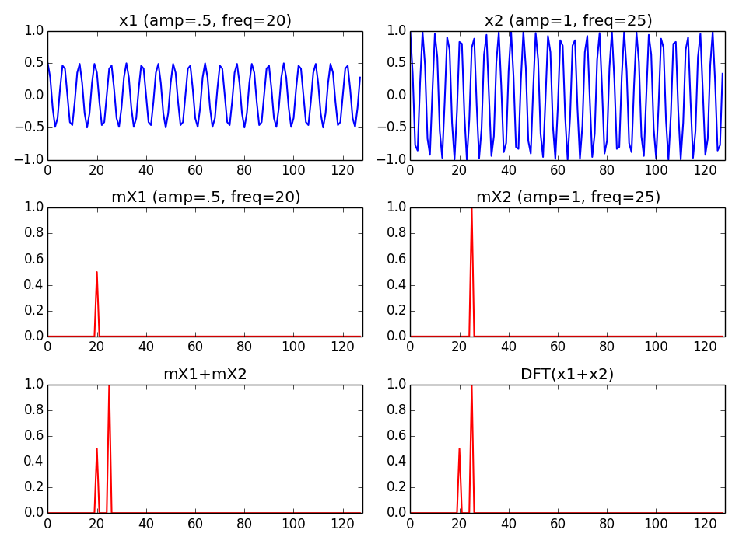
Notes:
To exemplify the linearity of the DFT let's consider two sinusoids.
...

Slide 5
Shift:
Notes:
Shifting means displacing the samples of a signal.
...

Slide 6
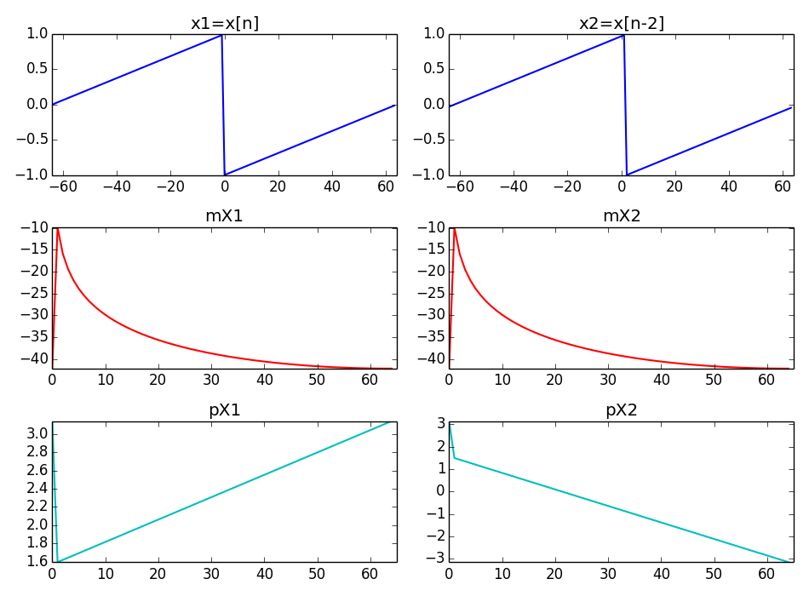
Notes:
频域幅度不变，改变相位。

Slide 7
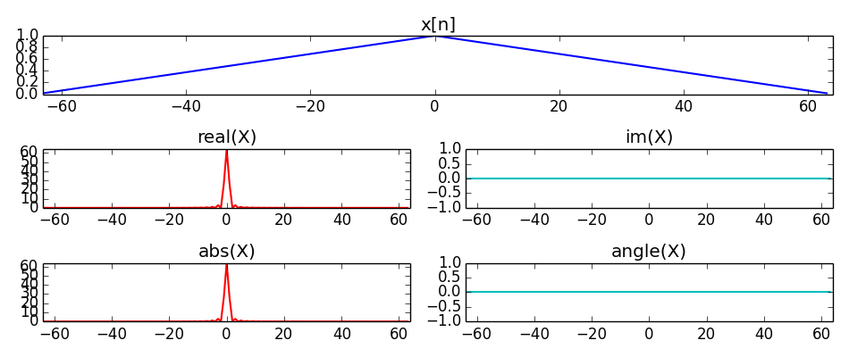
Symmetry:
Notes:
There are a lot of possible symmetries when dealing with the DFT, and that is good!!
For example, if one signal is real, its transform will have an even symmetry for the real part, or for the magnitude, and an odd symmetry for the imaginary part, or for the phase.
...

Slide 8
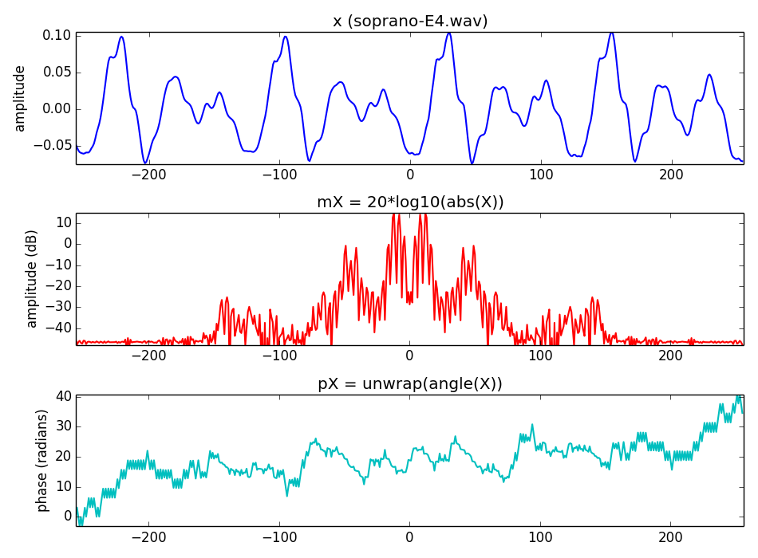
Notes:
Since we work with real signals, their DFT will always have the even-odd symmetry.
...

Slide 9
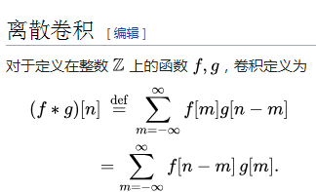
Convolution:
Notes:
The final property I will mention in this lecture is the one related to convolution.
...
Like most of the properties, this is reversible, that is, if we multiply two signals in the time domain it corresponds to convolve the spectrum of the signals in the frequency domain.

Slide 10
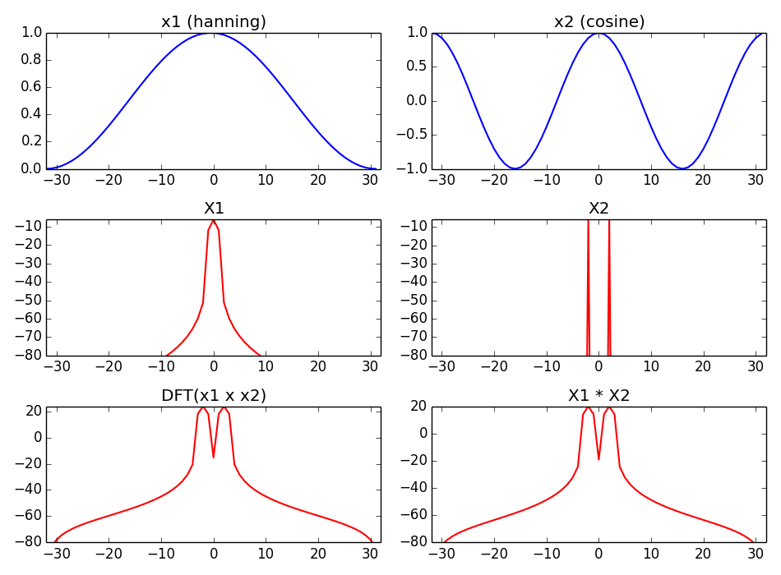
Notes:
时域卷积等于频域乘机

Slide 11
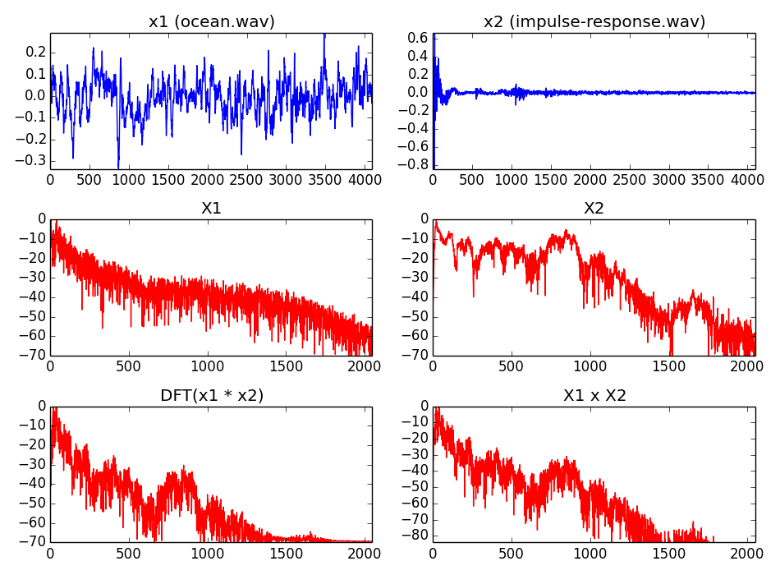
Notes:
This is an example of a common audio signal processing operation, filtering.
...

Slide 12
References and credits
More information in:
  https://en.wikipedia.org/wiki/Discrete_Fourier_transform
Reference on the DFT by Julius O. Smith: https://ccrma.stanford.edu/~jos/mdft/
Sounds from: http://www.freesound.org/people/xserra/packs/13038/
Slides released under CC Attribution-Non Commercial-Share Alike license and code under Affero GPL license; available from https://github.com/MTG/sms-tools
Notes:
You can find presentations of these properties in wikipedia and in Julius Smith web.
...

