Slide 1
A₁
A₂
A₁
A₂
A₃
A₃

Slide 2

Linear Regression Logistic Regression
∈ R
W1
W2 … Wd
W1
W2 … Wd
σ
X1
X2
…
Xd
X⋅W
X⋅W
X1
X2
…
Xd
x ∈ [0,1]

Slide 3
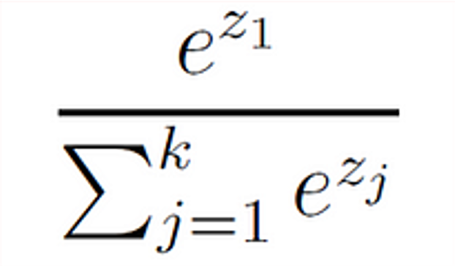
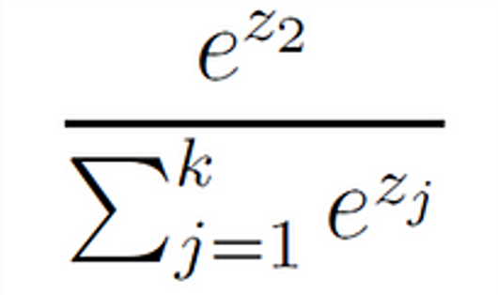
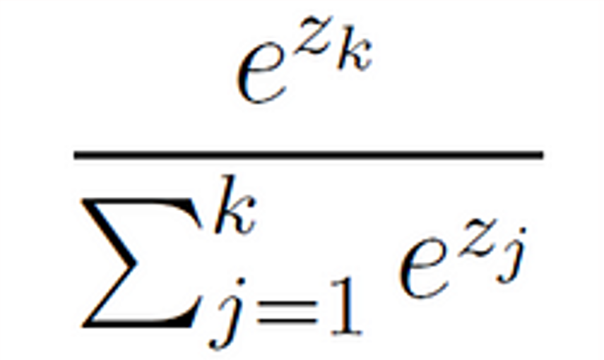
softmax
class
probabilities
X1
W1 ⋅ X
P1
X2
W2 ⋅ X
P2
.
.
.
X3
.
.
.
.
.
.
Wk ⋅ X
P3
Xm

Slide 4
Linear Layer
X1
X1
X2
X2
X3
X3
.
.
.
.
.
.
W ⊆ R ^{d' X d}
d
d'

Slide 5
Convolution (1D)
X1
Y1
(X1*Y1) + (X2 * Y2)
Z1
X2
Y2
(X2*Y1) + (X3 * Y2)
Z2
X3
W ⊆ R^{w'}
(X3*Y1) + (X4 * Y2)
Z3
X4
KERNEL
d'
d

Slide 6

X1
X2
w1
w2
X3
X4
w3
w4
IMAGE
Kernel (w' x w')
Y1
Y matrix
(d' x d')
Convolution (2D)
Pixel
X matrix
(d x d)

Slide 7
X1
X2
w1
w2
X3
X4
w3
w4
IMAGE
Kernel (w' x w')
Y1
S
S
Y matrix
(d' x d')
X matrix
(d x d)

Slide 8
0
0
w1
w2
0
X2
w3
w4
IMAGE
0 | 0 | 0 | 0 | 0 | 0 | 0 | 0 | 0 | 0 | 0
0 |  |  |  |  |  |  |  |  |  | 0
0 |  |  |  |  |  |  |  |  |  | 0
0 |  |  |  |  |  |  |  |  |  | 0
0 |  |  |  |  |  |  |  |  |  | 0
0 |  |  |  |  |  |  |  |  |  | 0
0 |  |  |  |  |  |  |  |  |  | 0
0 |  |  |  |  |  |  |  |  |  | 0
0 | 0 | 0 | 0 | 0 | 0 | 0 | 0 | 0 | 0 | 0
Y1
Y matrix
(d' x d')
(Size increases due to padding)
X matrix (d + p x d + p)

Slide 9
X1
X2
w1
w2
X3
X4
w3
w4
IMAGE
Kernel (w' x w')
Y1
Y matrix
(d' x d')
X matrix
(d x d, dilated across multiple pixels)

Slide 10
f
g
ENCODER
DECODER
Z
Channels of Image

Slide 11
Z₂
collisions
Z₁

Slide 12
μ
ENCODER
DECODER
σ
Z
Z = μ + σε
Where:
ε~ N(σ, I)
Z ~ N(μ, diag(σ²))

