Slide 1
A₁
A₂
A₁
A₂
A₃
A₃

Slide 2

Linear Regression Logistic Regression
∈ R
W1
W2 … Wd
W1
W2 … Wd
σ
X1
X2
…
Xd
X⋅W
X⋅W
X1
X2
…
Xd
x ∈ [0,1]

Slide 3
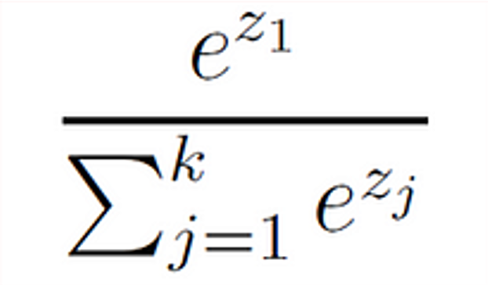
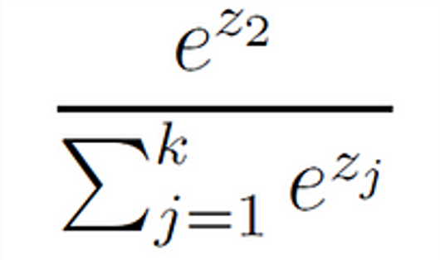
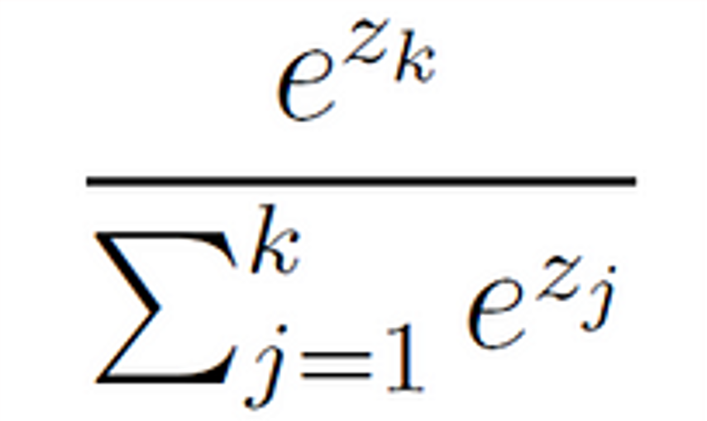
softmax
class
probabilities
X1
W1 ⋅ X
P1
X2
W2 ⋅ X
P2
.
.
.
X3
.
.
.
.
.
.
Wk ⋅ X
P3
Xm

Slide 4









Linear Layer
$$X_{1}$$
$$X_{1}$$
$$X_{2}$$
$$X_{2}$$
$$X_{3}$$
$$X_{3}$$
.
.
.
.
.
.
$$W ⊆ ℝ^{d^{′} x d}$$
$$d$$
$d$’

Slide 5












Convolution (1D)
$$X_{1}$$
$$Y_{1}$$
$${(X}_{1}∗ Y_{1})+(X_{2}∗Y_{2})$$
Z₁
$$X_{2}$$
$$Y_{2}$$
$${(X}_{2}∗ Y_{1})+(X_{3}∗Y_{2})$$
Z₂
$$X_{3}$$
$$W ⊆ ℝ^{w′}$$
$${(X}_{3}∗ Y_{1})+(X_{4}∗Y_{2})$$
Z₃
$$X_{4}$$
KERNEL
$$d′$$
$$d$$

Slide 6





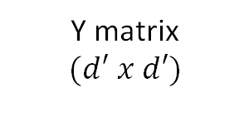




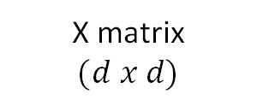


$$X_{11}$$
$$X_{21}$$
$$w_{11}$$
$$w_{21}$$
$$X_{12}$$
$$X_{22}$$
$$w_{12}$$
$$w_{22}$$
IMAGE
Kernel $(w′ x w′)$
$$Y_{11}$$
Y matrix
$$(d′ x d′)$$
Pixel
X matrix
$$(d x d)$$
Convolution (2D)

Slide 7


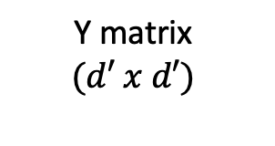








$$X_{11}$$
$$X_{12}$$
$$w_{11}$$
$$w_{12}$$
$$X_{12}$$
$$X_{22}$$
$$w_{21}$$
$$w_{22}$$
IMAGE
$$Y_{11}$$
S
S
Y matrix
$$(d′ x d′)$$
X matrix
$$(d x d)$$

Slide 8


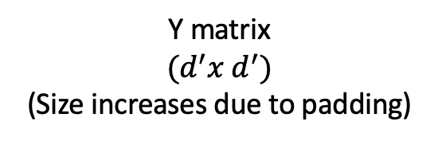


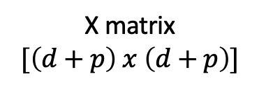





$$0$$
$$0$$
$$w_{11}$$
$$w_{12}$$
$$0$$
$$X_{22}$$
$$w_{21}$$
$$w_{22}$$
IMAGE
0 | 0 | 0 | 0 | 0 | 0 | 0 | 0 | 0 | 0 | 0
0 |  |  |  |  |  |  |  |  |  | 0
0 |  |  |  |  |  |  |  |  |  | 0
0 |  |  |  |  |  |  |  |  |  | 0
0 |  |  |  |  |  |  |  |  |  | 0
0 |  |  |  |  |  |  |  |  |  | 0
0 |  |  |  |  |  |  |  |  |  | 0
0 |  |  |  |  |  |  |  |  |  | 0
0 | 0 | 0 | 0 | 0 | 0 | 0 | 0 | 0 | 0 | 0
$$Y_{11}$$
Y matrix
$$(d^{′}x d^{′})$$
(Size increases due to padding)
X matrix
$$[\left(d+p\right) x \left(d+p\right)]$$

Slide 9


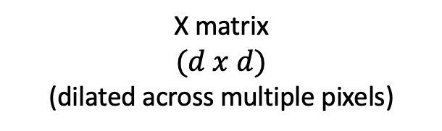






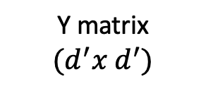

$$X_{11}$$
$$X_{13}$$
$$w_{11}$$
$$w_{13}$$
$$X_{31}$$
$$X_{33}$$
$$w_{31}$$
$$w_{33}$$
IMAGE
$$Y_{11}$$
Y matrix
$$(d^{′}x d^{′})$$
X matrix
$$(d x d)$$
(dilated across multiple pixels)

Slide 10
f
g
ENCODER
DECODER
Z
Channels of Image

Slide 11
Z₂
collisions
Z₁

Slide 12
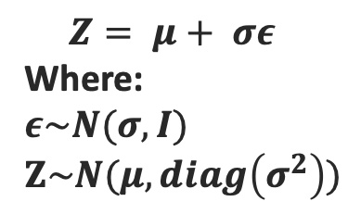
IMAGE
μ
ENCODER
DECODER
σ
Z
$$Z= μ+ σε$$
Where:
$ε\sim N(σ, I)$
$$Z\sim N(μ, diag\left(σ^{2}\right))$$

