Slide 1
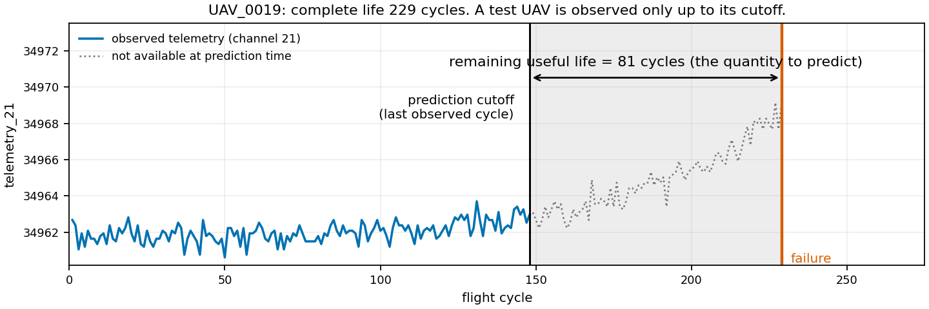
How we reached a public R² of 0.87652
Estimating remaining useful life from a partial UAV telemetry history
Joest Homann
University of Stuttgart · 9 September 2026
Figure: generated for this talk from data/train.csv · claims C01-C04
Notes:
A fleet of inspection UAVs records twenty-eight anonymous telemetry channels once per flight cycle. We are given a UAV we have never seen, observed up to some cutoff, and asked how many cycles it has left.
This is a real training UAV: two hundred and twenty-nine cycles to failure. Cut it at cycle one hundred and forty-eight, the median test length, and everything right of the line is unknown. Those eighty-one cycles are what we predict.
Our best submitted model scores zero point eight seven six five two. This talk answers one question: which decisions produced that number. Most were made before any model was trained.
----- speaker reference, not spoken -----
Planned duration: 0.75 min
Figure: generated for this talk from data/train.csv · claims C01-C04

Slide 2
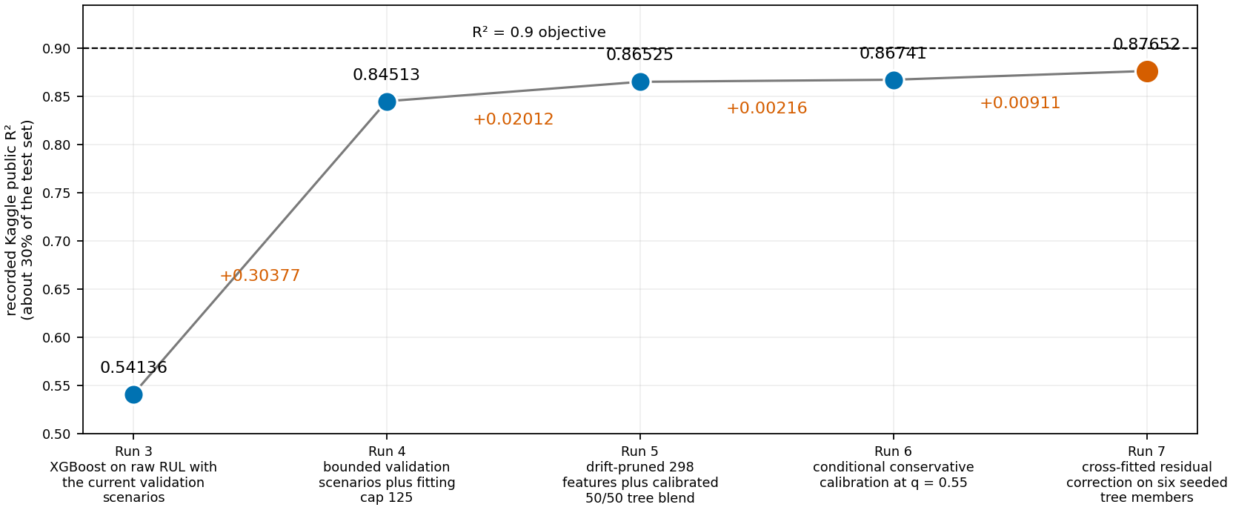
Five submissions, five decisions
Each point is a submitted model; the label names the decision that run introduced
Figure: generated from kaggle_scores.csv and pipeline_experiments.md · claims C05-C12
Notes:
Here is the whole answer on one axis.
Run three: a tuned XGBoost on the raw remaining-life target under our original scenarios, zero point five four. Run four changed the validation scenarios and capped the fitting target at a hundred and twenty-five: zero point eight four five. Run five brought the drift-pruned features and a calibrated tree blend. Run six added conditional calibration, run seven a cross-fitted residual correction: zero point eight seven six five.
Two qualifications. Each point is a submission, not an isolated ablation, so a run can carry more than one change. And the deltas shrink by two orders of magnitude: one decision is worth three tenths of R squared, everything after it about three hundredths. That first decision is about the data and the evaluation, not the model. So we start there.
----- speaker reference, not spoken -----
Planned duration: 1.00 min
Figure: generated from kaggle_scores.csv and pipeline_experiments.md · claims C05-C12

Slide 3
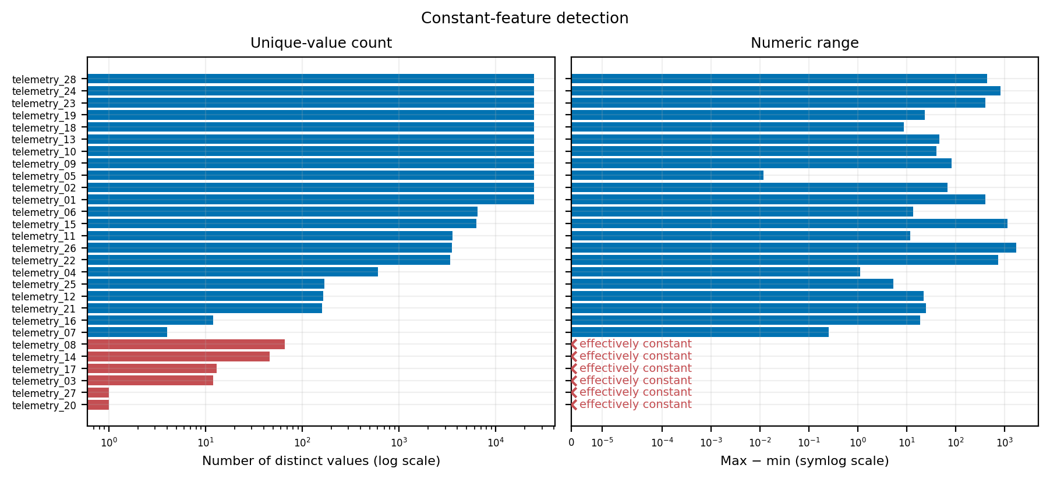
Six of twenty-eight channels carry no information
Red: unique-value count and numeric range at the effectively-constant threshold
Figure: repository script re-run at slide size · 0_data_analysis/broad_data_review/plot_constant_features.py · claims C13-C18
Notes:
Phase 0 is a reproducible audit of the data before any model exists. Its first job is subtraction.
Two channels, twenty and twenty-seven, take exactly one value in the whole training set. Four more — three, eight, fourteen and seventeen — vary only at machine precision: between ninety-three and ninety-eight percent of their rows sit inside a flatline run of at least five identical cycles. All six fail the effectively-constant test.
Twenty-eight channels become twenty-two, and the six never enter any feature set. That decision comes from the data, not from a model score.
----- speaker reference, not spoken -----
Planned duration: 0.75 min
Figure: repository script re-run at slide size · 0_data_analysis/broad_data_review/plot_constant_features.py · claims C13-C18

Slide 4
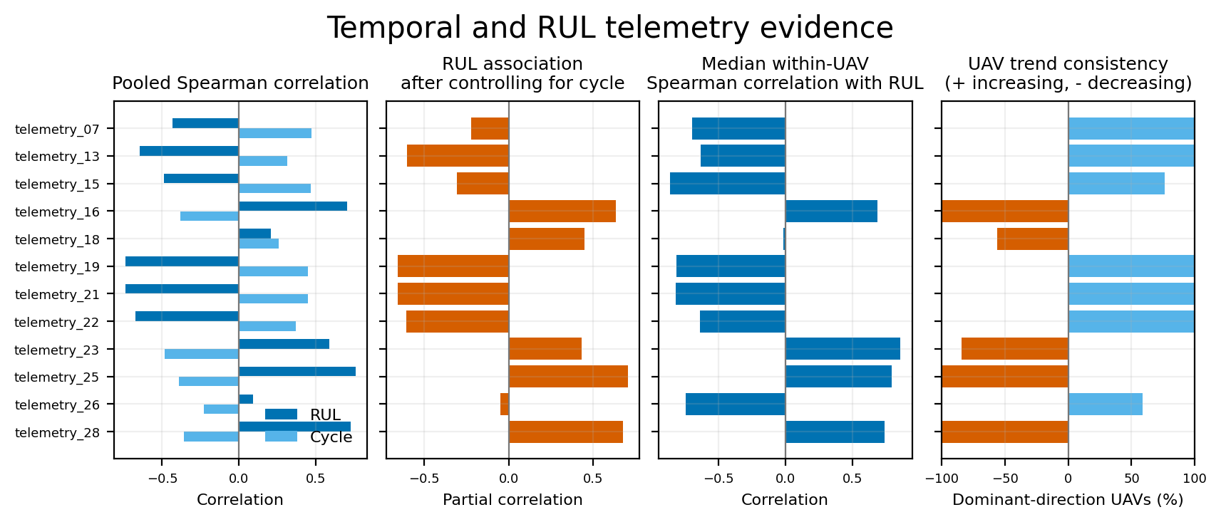
Ten channels move with age inside every UAV
Twelve of the twenty-two channels: the ten degradation candidates, plus telemetry_18 and 26
Figure: repository script re-run on a channel subset · 0_data_analysis/core_data_analysis/temporal_rul_analysis.py · claims C19-C27
Notes:
The second job is to find which of the twenty-two remaining channels track degradation. Four views, one per panel.
The left panel pools every row — the weakest evidence, because it mixes UAVs of different ages. The second controls for flight cycle. The third computes the correlation inside each UAV separately, and the fourth gives the share of UAVs trending the same way.
The declared threshold is a within-UAV correlation of at least zero point three, with the same direction in at least seventy percent of UAVs. Ten channels pass. Seven, thirteen, nineteen, twenty-one and twenty-two increase in one hundred percent of UAVs; sixteen, twenty-five and twenty-eight decrease in one hundred percent.
Now telemetry eighteen. Visible age-controlled association in the second panel; essentially nothing in the third, at minus zero point zero one nine. A pooled analysis would have promoted it as a degradation signal. Inside a single UAV it does not move with remaining life at all.
A correlation is still not predictive value. These ten are candidates; whether they help is settled later by grouped validation.
----- speaker reference, not spoken -----
Planned duration: 1.50 min
Figure: repository script re-run on a channel subset · 0_data_analysis/core_data_analysis/temporal_rul_analysis.py · claims C19-C27

Slide 5
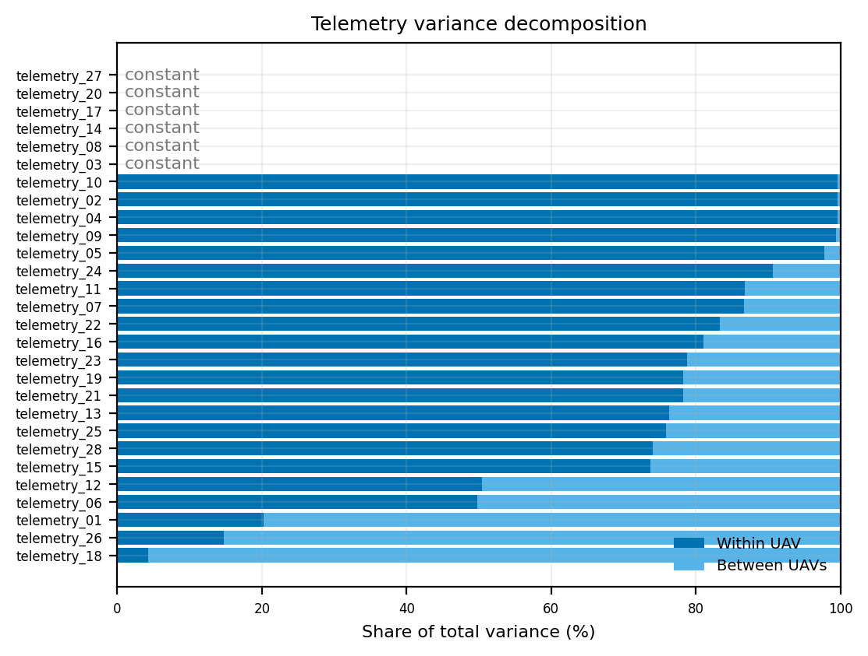
Variance decomposition assigns each channel its role
Dark: variation inside one UAV over time. Light: persistent differences between UAVs.
Within-UAV dominated → sequence features
· Seventeen channels, including all ten degradation candidates (74-87% within).
· Get slope, rolling statistics, recent change and deviation from the UAV's own early-life baseline.
Between-UAV dominated → context features
· telemetry_18 (95.7% between), 26 (85.3%), 01 (79.8%), 06 (50.2%).
· Kept as level and baseline descriptions only. Their relationship must be shown to generalise to unseen UAVs.
What the plot does not settle
· Within-UAV variation may be degradation, operating state or noise; between-UAV variation may be useful context or UAV identity. Only grouped validation separates them.
Figure: repository script re-run at slide size · 0_data_analysis/broad_data_review/plot_within_between_variance.py · claims C28-C34
Notes:
The previous slide asked whether a channel moves with age. This one asks where its variation lives, and the answer decides what kind of feature it should become.
Each bar splits a channel's total variance into the part that happens inside one UAV over time, dark blue, and the part that is a persistent difference between UAVs, light blue.
Seventeen channels are within-UAV dominated, including all ten degradation candidates, at seventy-four to eighty-seven percent. Those get temporal features: slope, rolling statistics, recent change, deviation from the UAV's own baseline.
Four are between-UAV dominated. Telemetry eighteen is the extreme case: ninety-six percent of its variance is simply that different UAVs sit at different levels. With the previous slide that is a coherent story — eighteen describes the UAV, not its degradation — so it is kept only as a baseline and level description.
The six removed channels appear as constant, with no bar at all: the same conclusion by a different route.
----- speaker reference, not spoken -----
Planned duration: 1.25 min
Figure: repository script re-run at slide size · 0_data_analysis/broad_data_review/plot_within_between_variance.py · claims C28-C34

Slide 6
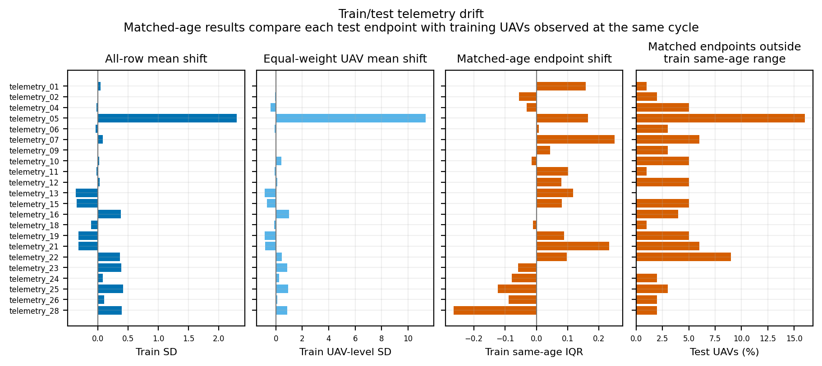
Train and test differ in age, not in distribution
Left two panels: raw shift. Right two: the same comparison at matched flight cycle.
Figure: repository script re-run at slide size · 0_data_analysis/core_data_analysis/train_test_drift.py · claims C35-C41
Notes:
Before trusting any of it, one question: are the test UAVs the same kind of object as the training UAVs?
The two left panels compare raw distributions and look alarming. The two right panels compare each test endpoint only against training UAVs observed at the same flight cycle. Almost all of the apparent shift disappears: the median age-matched shift is below zero point two seven training interquartile ranges for every channel.
So test UAVs are younger, not different. That is a statement about validation design, and it is the bridge into Phase 1.
Two channels stay on a watch list: telemetry five, with sixteen percent of its endpoints outside the same-age training range, and twenty-two with nine. Neither was removed on that evidence.
----- speaker reference, not spoken -----
Planned duration: 1.00 min
Figure: repository script re-run at slide size · 0_data_analysis/core_data_analysis/train_test_drift.py · claims C35-C41

Slide 7
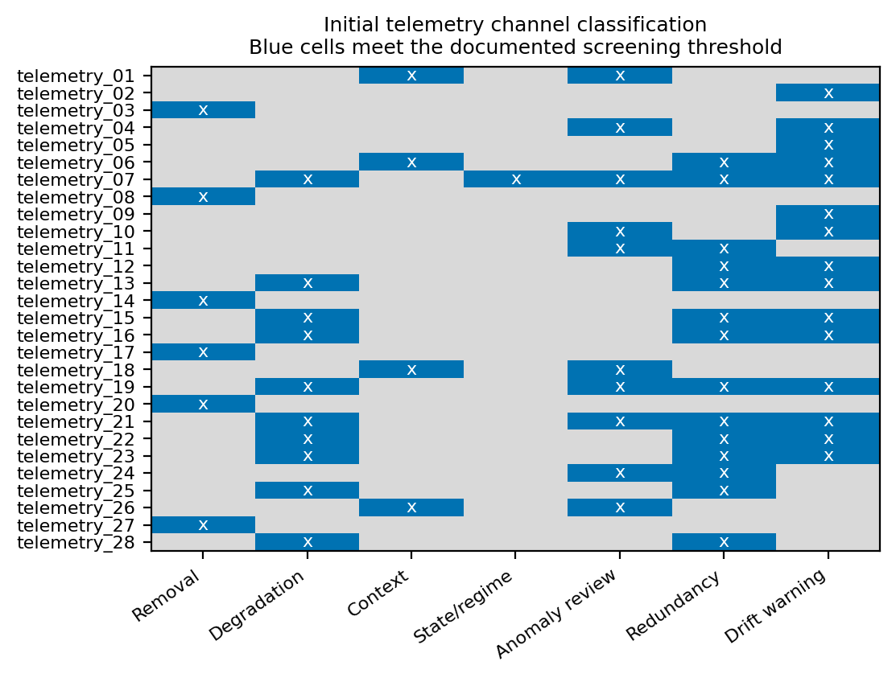
The screening matrix that Phase 1 inherited
A blue cell means the channel meets that documented threshold. Roles are not exclusive.
What Phase 0 handed over
· 6 removal · 10 degradation · 4 context · 1 state/regime
· 10 flagged for anomaly review, 14 for redundancy, 15 for a train/test drift warning.
Warnings, not removal rules
· Four redundancy groups: 19/21, 15/23, 13/16/22/25/28 and 06/07/11/12/24. telemetry_19 and 21 correlate at r ≈ 1.00 between UAVs.
· No channel was dropped for redundancy, anomalies or drift here. Those are questions for grouped validation.
telemetry_07 meets five criteria at once
· Degradation, state, anomaly, redundancy and drift. It is treated as an operating state with transition and dwell features, not as a smooth sensor.
Figure: repository script re-run at slide size · 0_data_analysis/core_data_analysis/channel_classification.py · claims C42-C50
Notes:
Everything Phase 0 found, in one matrix. Each row is a channel, each column a documented threshold, each blue cell a channel that meets it. The roles are deliberately not exclusive.
Six removal candidates, ten degradation candidates, four context channels, one state channel. On top of that, ten channels flagged for anomaly review, fourteen for redundancy, fifteen for drift.
The important point is what we did not do with the last three columns. Nothing was removed for being correlated, for containing extreme readings, or for drifting. Telemetry nineteen and twenty-one correlate almost perfectly at UAV level and both were kept. A screening matrix summarises statistical evidence; it does not measure predictive value. Every warning became an experiment later, and several were answered with no.
Telemetry seven is the interesting row: it meets five criteria at once, so it is represented as a discrete operating state rather than a continuous sensor.
----- speaker reference, not spoken -----
Planned duration: 1.25 min
Figure: repository script re-run at slide size · 0_data_analysis/core_data_analysis/channel_classification.py · claims C42-C50

Slide 8
Phase 1 fixed what every later number is measured against
Whole-UAV nested cross-validation, and ten automated assertions that must pass
100 training UAVs · 5 outer folds, balanced by terminal lifetime
Ten assertions re-checked automatically
· Outer folds disjoint: 5 x 20 UAVs.
· Outer-validation UAVs absent from every inner fold.
· Development and locked cutoffs reproduce the exact test history-length multiset.
· Feature tables finite; no target or future term in any feature name.
· Prefix causality: replacing all post-cutoff telemetry with extreme values leaves the prefix features unchanged.
· Saved scaler parameters match a fresh recomputation.
· Baseline predictions carry each UAV's own held-out fold.
fold 1
20 UAVs
fold 2
20 UAVs
fold 3
20 UAVs
fold 4
20 UAVs
fold 5
20 UAVs
Outer round 1: fold 1 held out, folds 2-5 are the 80 training UAVs. Every UAV is held out exactly once.
Inside those 80 UAVs · 4 inner folds select everything
inner 1
60 train / 20 val
inner 2
60 train / 20 val
inner 3
60 train / 20 val
inner 4
60 train / 20 val
Features, hyperparameters, early stopping and blend weights. 5 x 4 = 20 inner rounds.
Rules that follow from splitting by UAV
· Every prefix of one UAV stays inside one fold.
· Features use only cycles at or before the cutoff.
· Scalers are refitted inside each training partition.
· Each UAV carries a total training weight of 1.
· Uncertainty resamples whole UAVs, never rows.
verification_report.json · status: passed · 2,000 training rows · 500 development and 2,000 locked validation rows · 100 test rows · 606 features
Sources: 1_dataset_construction/2_UAV_grouped_validation_folds and 10_automated_leakage_checks/artifacts/verification_report.json · claims C51-C59
Notes:
Phase 1 turns a hundred complete run-to-failure histories into something we can honestly measure a model on.
The split is by UAV, never by row. A hundred training UAVs become five outer folds of twenty, balanced by terminal lifetime. Inside each outer round the eighty training UAVs split again into four inner folds. Features, hyperparameters, early stopping and blend weights are all selected on the inner folds; the twenty outer UAVs only ever evaluate the selected procedure. Twenty inner rounds in total, and every UAV held out exactly once.
Why nest rather than take one eighty-twenty split? With a hundred UAVs and large UAV-to-UAV differences, one split is not a measurement.
None of this is trusted on faith. Ten assertions are re-checked automatically. The one to point at is prefix causality: the checker recomputes features for ten prefixes after replacing every post-cutoff telemetry value with extreme artificial numbers, and requires the features to come out unchanged. The status is passed.
----- speaker reference, not spoken -----
Planned duration: 1.25 min
Sources: 1_dataset_construction/2_UAV_grouped_validation_folds and 10_automated_leakage_checks/artifacts/verification_report.json · claims C51-C59

Slide 9
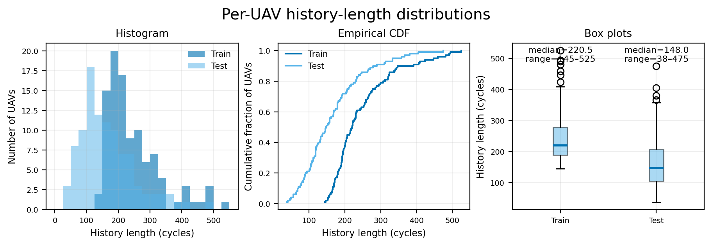
Cutoffs are drawn from the observed test history lengths
Test UAVs are younger than training UAVs, so training samples must be truncated the same way
What the distributions say
· Train 145-525 cycles, median 220.5.
· Test 38-475, median 148.0.
· About 47% of test UAVs end before cycle 145, the shortest complete training lifetime.
How a training sample is made
· 20 distinct cutoffs per UAV, sampled without replacement from the empirical test lengths, eligible ones only.
· Each prefix uses cycles 1..cutoff and carries weight 1/20, so every UAV has total training weight 1.
What that produces
· 2,000 training rows, 5 development scenarios and 20 locked scenarios of 100 UAVs each.
· Every scenario reproduces the exact multiset of test history lengths; the check is one of the ten assertions.
Figure: repository script re-run at slide size · 0_data_analysis/broad_data_review/plot_history_length_distributions.py · claims C60-C68
Notes:
This is the single most consequential slide in Phase 1.
Training histories run from a hundred and forty-five to five hundred and twenty-five cycles, median two hundred and twenty. Test histories run from thirty-eight to four hundred and seventy-five, median a hundred and forty-eight. Read the empirical CDF at a hundred and forty-five: about forty-seven percent of test UAVs stop before the shortest complete training lifetime begins.
So a model trained on complete run-to-failure sequences is asked to do something it has never seen. The fix is to truncate: every training UAV gets twenty distinct cutoffs, drawn from the actual test history lengths and shorter than its own life.
Each of a UAV's twenty prefixes carries weight one twentieth, so a five-hundred-cycle UAV and a hundred-and-fifty-cycle one influence training equally; otherwise long-lived UAVs would dominate simply by having more rows.
One honest weakness: the cutoffs come from the test length distribution, which is information from the test inputs. No label is used, and the audit checks that, but it is worth naming.
----- speaker reference, not spoken -----
Planned duration: 1.25 min
Figure: repository script re-run at slide size · 0_data_analysis/broad_data_review/plot_history_length_distributions.py · claims C60-C68

Slide 10
606 prefix features, and four sets to compare them with
Every feature is computed from cycles at or before the cutoff, and scaled inside each fold
27 features per channel, from the prefix only
· current and first value
· baseline mean of the first 10 cycles, and the deviation from it
· history mean, SD, minimum, maximum, slope
· latest change, mean and maximum absolute change
· mean, SD, slope, net change and latest-value deviation over the last 5, 20 and 50 cycles
feature set | count | contents | question it answers
age_only | 2 | flight cycle and log(1 + cycle) | is age alone predictive?
last_values | 24 | age plus the latest value of each channel | does the current snapshot help?
screened | 310 | all temporal features of the 10 degradation channels, 7 level statistics of the 4 context channels | do the Phase 0 roles help?
all_nonconstant | 606 | every generated feature of all 22 channels | did screening discard something useful?
22 x 27 + 10 + 2 = 606 candidates
· 10 state features for telemetry_07 and 16
· 2 age features
· no feature may reference terminal lifetime or any post-cutoff cycle
Fold-fitted scaling: value minus the training-fold median, divided by IQR / 1.349. 4,405 features scaled by IQR, 293 by a standard-deviation fallback, 12 by unit fallback.
The final set is not chosen here. It is chosen on the inner folds.
Sources: 1_dataset_construction steps 5-7 · feature_catalog.csv and preprocessing_config.json · claims C69-C77
Notes:
A prefix is a variable-length sequence, and the models we intend to use need a fixed-width row. So each prefix becomes twenty-seven summaries per channel.
Five groups: where the channel is now, where it started, how far it has moved from its own baseline, how the whole history behaves, and what happened over the last five, twenty and fifty cycles. Comparing those windows lets a tree see acceleration, not only level.
Twenty-two channels times twenty-seven, plus ten state features, plus flight cycle and its logarithm, is six hundred and six.
Rather than pick one set, four nested sets were declared in advance, each answering a different question — is age alone predictive, does the current snapshot add anything, do the Phase 0 roles help, did the screening discard something useful.
Scaling is median and interquartile range, refitted for every fold and feature set on the training UAVs alone. Twelve of the four thousand seven hundred and ten fitted scales fell back to unit scale, and they are recorded rather than silently dropped.
----- speaker reference, not spoken -----
Planned duration: 1.25 min
Sources: 1_dataset_construction steps 5-7 · feature_catalog.csv and preprocessing_config.json · claims C69-C77

Slide 11
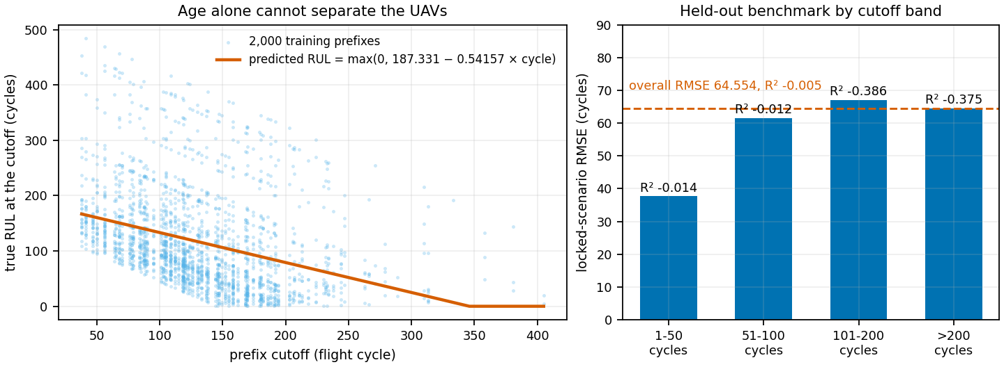
The benchmark: age alone predicts nothing
A weighted linear fit on the cutoff cycle, evaluated on the same 20 locked scenarios
Locked-scenario result
· R² −0.005 · RMSE 64.554 · MAE 51.912 cycles
· Bias +17.712 cycles: age alone systematically overpredicts.
· 95% UAV-bootstrap interval for R²: [−0.153, +0.129].
Why it is worth the compute
· It is the only number that makes a later RMSE interpretable.
· A complex model failing to beat it points at leakage control, weak features or an implementation fault, not at the data.
How the interval is built
· 1,000 resamples of whole UAVs, never of rows, because each UAV appears in 20 scenarios and those rows are not independent.
· Seed 20260814, as for the folds and cutoffs.
Figure: generated from 1_dataset_construction/9_cycle_only_baseline artifacts · claims C78-C86
Notes:
The last thing Phase 1 builds is the simplest model that could work: predicted remaining life is a hundred and eighty-seven point three minus zero point five four two times the cutoff cycle, floored at zero. No telemetry at all.
On the left is why it fails. At any cutoff the true remaining life spans hundreds of cycles, because UAVs do not all live the same length. Age tells you almost nothing about which one you hold.
R squared of minus zero point zero zero five — slightly worse than the mean predictor — RMSE sixty-four and a half cycles, bias plus seventeen point seven, bootstrap interval minus zero point one five to plus zero point one three.
This is the reference for everything after it. An RMSE of eleven cycles means nothing alone; eleven against sixty-four and a half on the same locked scenarios means the engineered features carry real information. The interval resamples whole UAVs, because each UAV appears in twenty scenarios and resampling rows would be falsely narrow.
----- speaker reference, not spoken -----
Planned duration: 1.25 min
Figure: generated from 1_dataset_construction/9_cycle_only_baseline artifacts · claims C78-C86

Slide 12
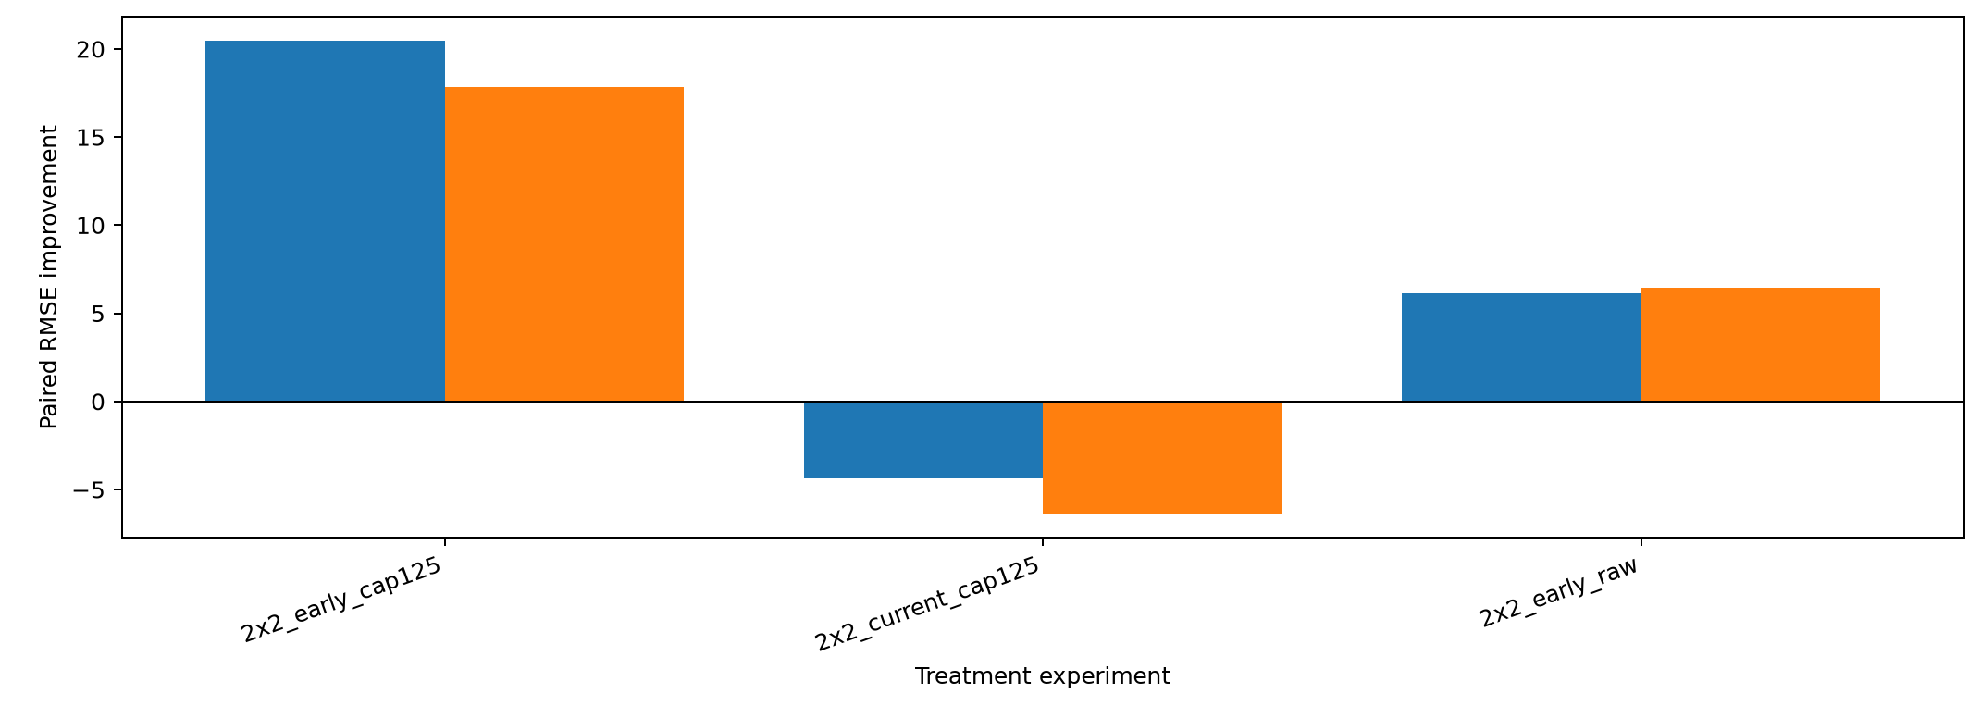
Decision 1: bounded scenarios and a fitting cap at 125
PE_2 paired RMSE improvement, mean-fold, blue ExtraTrees and orange XGBoost. Public: +0.30377
Figure: lower panel of the generated PE_2 figure · experiments/PE_2/runs/run_1 · claims C87-C94
Notes:
With the protocol fixed, the first experiment crossed two choices: which validation scenarios to score on, and whether to cap the fitting target.
Capping means fitting against remaining life truncated at a hundred and twenty-five cycles, while evaluation still uses the raw label. A UAV with four hundred cycles left and one with two hundred look identical, so forcing the model to separate them wastes capacity on a region nobody scores. Bounding the scenarios means concentrating validation cutoffs on the bands the test set actually contains — the Phase 1 history-length finding, applied.
Both help, and they help together. The four cells are not on a common R squared scale — changing the evaluation target changes the denominator — so this is paired RMSE improvement within each fold.
Run four carried both changes and moved the public score from zero point five four to zero point eight four five. Three tenths of R squared from deciding what to fit and what to measure. No new model, no new feature.
----- speaker reference, not spoken -----
Planned duration: 1.25 min
Figure: lower panel of the generated PE_2 figure · experiments/PE_2/runs/run_1 · claims C87-C94

Slide 13
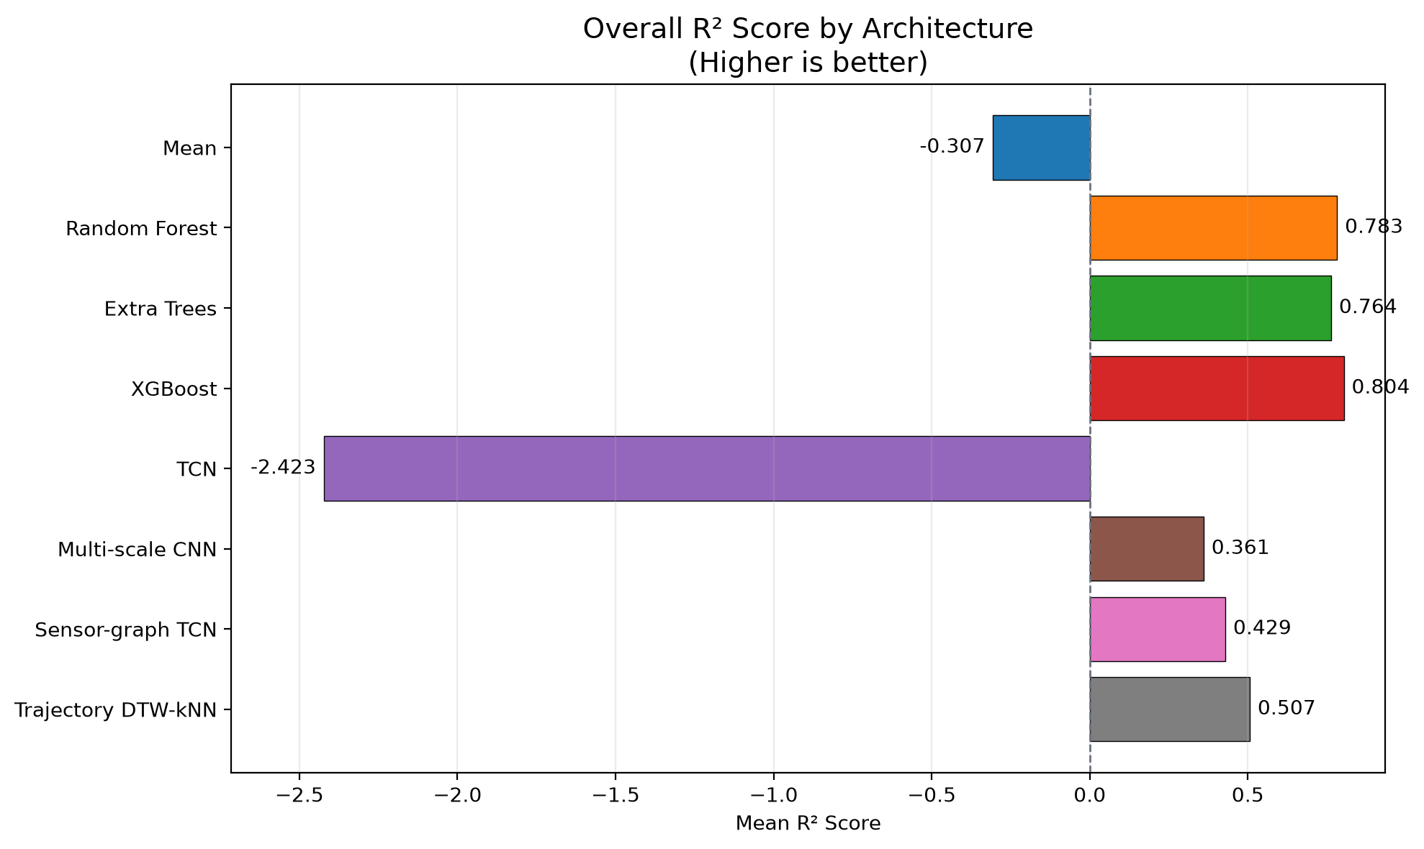
Decision 2: pruned features and a calibrated tree blend
Locked architecture comparison, architecture study run 5, five held-out UAV folds. Public: +0.02012
Figure: repository figure, unchanged · 2_model_architecture_study/runs/run_5 · claims C95-C103
Notes:
Two things changed between run four and run five, and both trace back to Phase 0.
The feature set became the drift-pruned screened set: two hundred and ninety-eight features, taking the Phase 0 screened definition and removing features whose train-test behaviour did not hold up. That is the drift-warning column being acted on at last — by experiment, not assumption.
The model family was chosen here, under one locked protocol, with every architecture given the same folds, the same cutoffs and the same features. The two tree families come out ahead and, more usefully, they make different mistakes, so a fifty-fifty blend beats either alone. The blend weight is selected on training-side data only.
Public score: zero point eight six five two five. Two hundredths. Notice the ratio — the model family, what people usually call the modelling decision, was worth about a fifteenth of the target and scenario decision.
----- speaker reference, not spoken -----
Planned duration: 1.25 min
Figure: repository figure, unchanged · 2_model_architecture_study/runs/run_5 · claims C95-C103

Slide 14
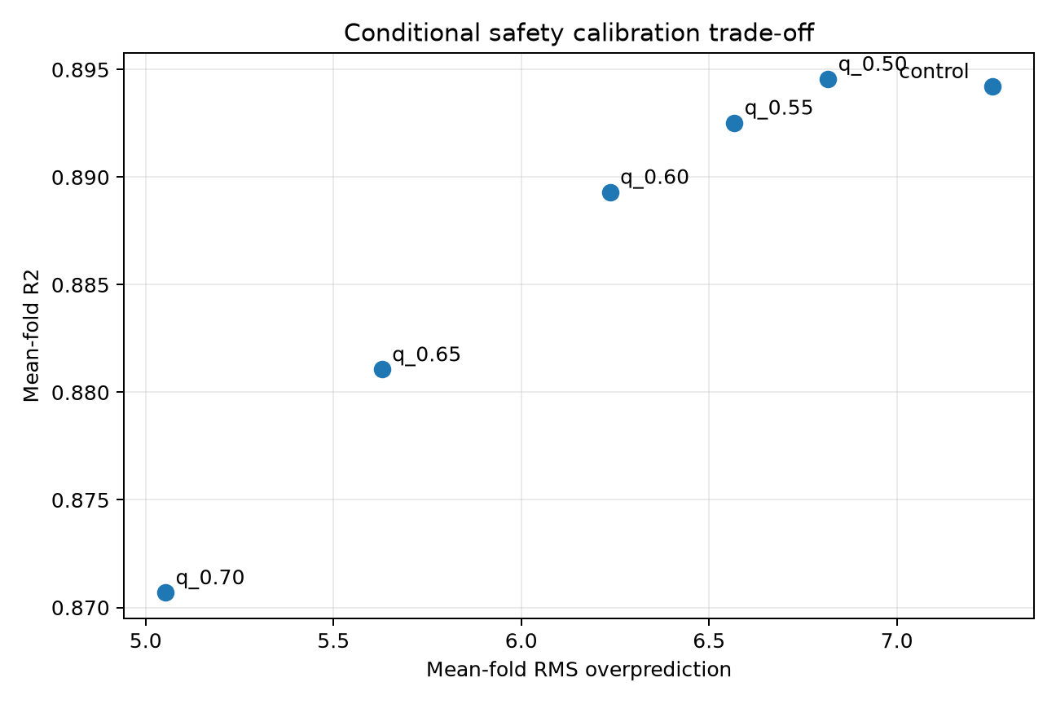
Decision 3: conditional conservative calibration
PE_4: a quantile shift applied only where the model is likely to overpredict. Public: +0.00216
Figure: repository figure, unchanged · experiments/PE_4/runs/run_1 · claims C104-C108
Notes:
Run seven's predecessor overpredicts remaining life more often than it underpredicts, and in maintenance an overprediction is the expensive direction.
PE_4 swept a conservative quantile shift and measured the cost. Shifting everything hurts accuracy. Applying the shift only conditionally, at quantile zero point five five, and only where the model's own signals say overprediction is likely, keeps almost all of the accuracy and removes part of the bias.
It is worth two thousandths of public R squared. I show it because it is the one decision in the chain taken partly for a reason other than the score.
----- speaker reference, not spoken -----
Planned duration: 0.75 min
Figure: repository figure, unchanged · experiments/PE_4/runs/run_1 · claims C104-C108

Slide 15
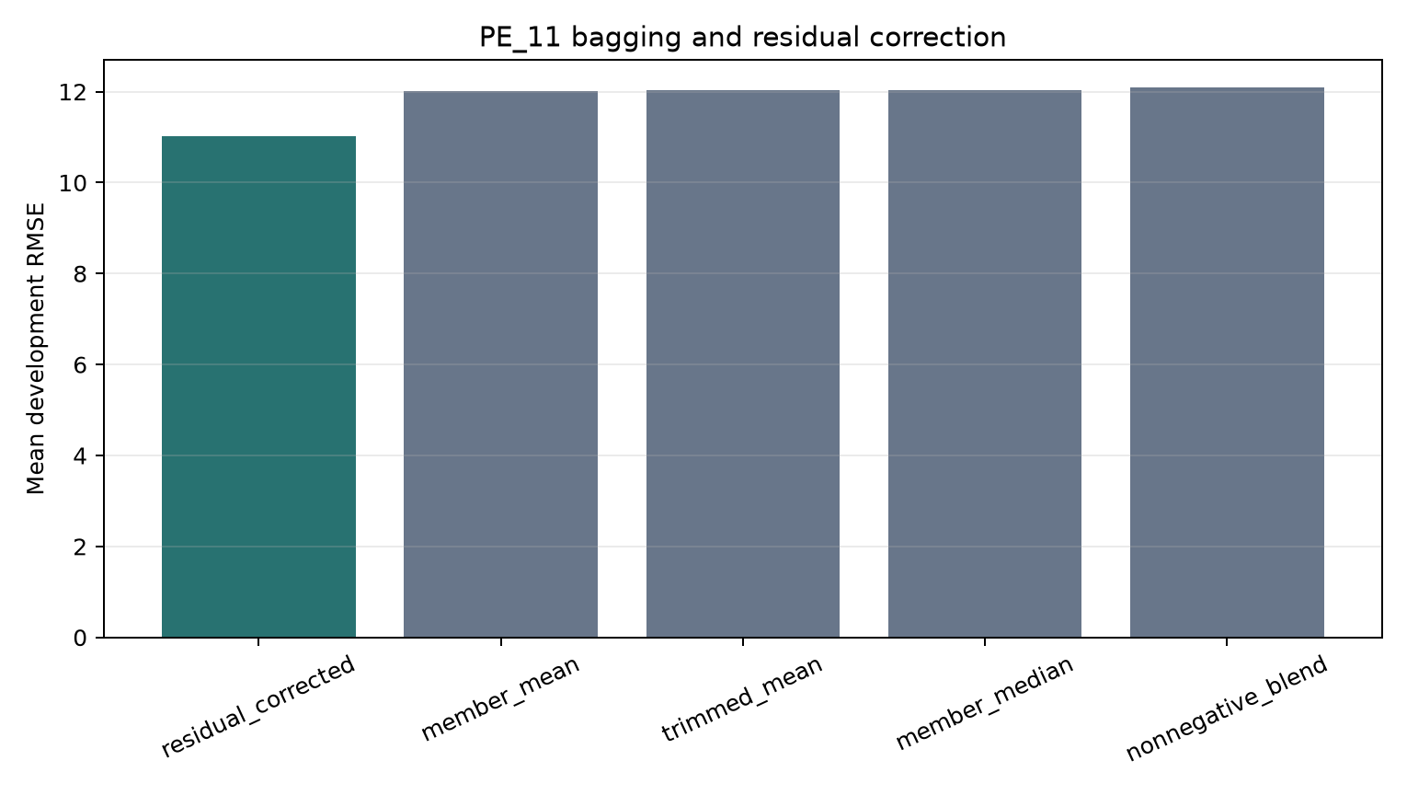
Decision 4: a cross-fitted residual correction
PE_11: a small model that predicts the ensemble's own error from its disagreement. Public: +0.00911
3 × XGBoost
seeds 13/37/73
3 × ExtraTrees
seeds 13/37/73
average
average
family blend weight selected on
training-side data only
base prediction
residual model (7 leaves, 100 iterations)
inputs: base prediction · observed history length · member spread and range · family disagreement · 8 sensor baseline-deltas and slopes
final RUL = max(0, base − residual)
Out-of-fold calibration predictions come from models that excluded that UAV; calibration endpoints are filtered to training UAVs. The true future RUL is never an input.
11.5080 → 11.0243 cycles, 4.20% better, 5 of 5 fold wins. Refitted by the Phase 3 Run 7 adapter on all 100 training UAVs.
Figure: repository figure, unchanged · experiments/PE_11/runs/run_1 · claims C109-C116
Notes:
The last retained decision. Six tree members — three XGBoost and three ExtraTrees at seeds thirteen, thirty-seven and seventy-three — are averaged within family and then blended.
A small histogram gradient model, seven leaves and a hundred iterations, then predicts that base prediction's residual. Its inputs are the base prediction, the observed history length, how much the six members disagree, and a few baseline deltas and slopes. Member disagreement is a usable signal about where the ensemble is unreliable.
The leakage question matters here, so: the out-of-fold predictions that fit the residual model come from models which excluded that UAV, and calibration endpoints are restricted to training UAVs. True future remaining life is never an input.
Development effect: eleven point five one down to eleven point zero two cycles, four point two percent better, winning in all five folds. Public score zero point eight seven six five two.
----- speaker reference, not spoken -----
Planned duration: 1.25 min
Figure: repository figure, unchanged · experiments/PE_11/runs/run_1 · claims C109-C116

Slide 16
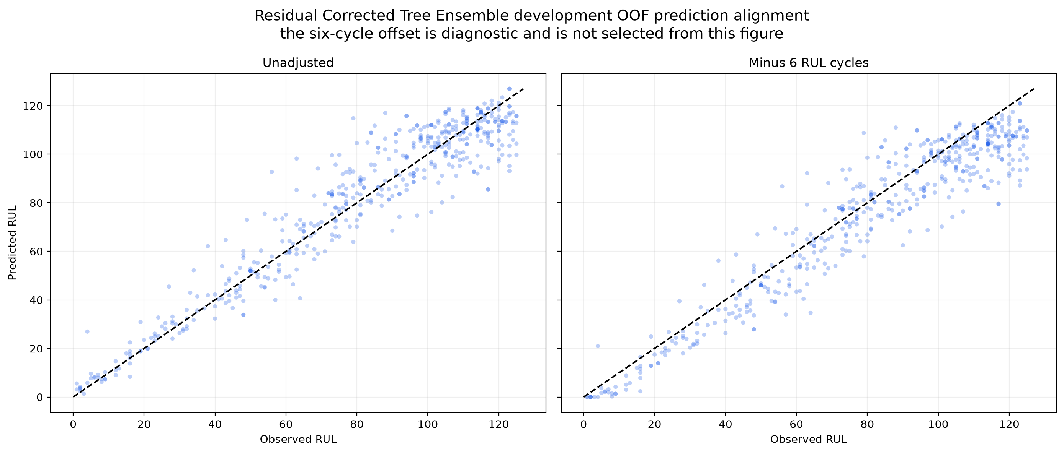
Why the chain stops at 0.87652
Run 7 development out-of-fold predictions, and every candidate evaluated since
After Run 7: six candidates, all gated
candidate | mean RMSE | wins | outcome
PE_20 nested refit | +1.56% worse | 2/5 | rejected
PE_18 TabPFN blend | −1.30% | 4/5 | to confirm
PE_21 two new seeds | −1.12% | 6/10 | rejected
PE_24 regime gate | −1.90% | 11/15 | rejected
PE_26 short history | −0.39% | 6/15 | rejected
PE_27 UAV subsets | screen only | 3/5 | stopped
Every promotion gate is declared before the run. Nothing passed, so nothing was submitted, so the public score is still 0.87652.
Run 7 development out-of-fold predictions: the error is systematic, not random
Figures and tables: run_7/7_post_run_reporting and experiments/PE_15-PE_28 · claims C117-C127
Notes:
Where the remaining error is, and why we stopped.
On the left are the out-of-fold development predictions. The structure is systematic, not random: the model compresses towards the middle, so long remaining lives are underpredicted and short ones overpredicted. That is what the fitting cap buys us, and it is also the ceiling it imposes.
On the right, six candidates tried after run seven, each with a promotion gate declared beforehand. A full nested refit of the most promising screen came back one point six percent worse. Extra seeds, a regime gate and a short-history specialist all failed. One TabPFN blend is promising and unconfirmed.
So nothing was promoted, nothing was submitted, and the public score is still zero point eight seven six five two. I would rather report that than a number obtained by submitting until something stuck.
----- speaker reference, not spoken -----
Planned duration: 1.25 min
Figures and tables: run_7/7_post_run_reporting and experiments/PE_15-PE_28 · claims C117-C127

Slide 17
How we reached 0.87652
Ordered by the submission that carried each decision
phase | decision | submissions | public R² change
Phase 1 + 2 | Bounded validation scenarios with a fitting cap at 125 | Run 3 → 4 | +0.30377
Phase 0 + 2 | Drift-pruned 298 features, calibrated 50/50 tree blend | Run 4 → 5 | +0.02012
Phase 2 | Conditional conservative calibration at q = 0.55 | Run 5 → 6 | +0.00216
Phase 2 | Cross-fitted residual correction on six seeded members | Run 6 → 7 | +0.00911
Each row is a submission-to-submission difference, not an isolated ablation: a run can carry more than one change. Evaluation and target design dominated model choice.
What we do not claim
Development mean-fold R² is 0.90041; the recorded public score is 0.87652. Closing that needs about 10.0% lower RMSE on the same scored set, and no candidate after Run 7 passed a nested confirmation.
Sources: kaggle_scores.csv, pipeline_experiments.md, phase_0 and phase_1 artifacts · claims C128-C132
Notes:
The answer to the question in the title.
Three tenths of R squared came from deciding what to fit and what to measure it on — and both halves of that decision were read off Phase 0 and Phase 1 evidence: the history-length distributions and the age-matched drift comparison. Two hundredths came from the feature set and the model family. Roughly one hundredth came from calibration and the residual correction together.
If there is one thing to take away, it is that the audit and the dataset construction were not preliminaries to the modelling. They were the modelling.
----- speaker reference, not spoken -----
Planned duration: 0.75 min
Sources: kaggle_scores.csv, pipeline_experiments.md, phase_0 and phase_1 artifacts · claims C128-C132

Slide 18
Backup slides
Not part of the 20-minute talk. Held for questions.
Notes:
End of the main deck. Nine backup slides follow: the complete Phase 0 broad review, redundancy and anomaly evidence, the Phase 1 feature derivation, the cycle-only baseline group by group, the full locked architecture table, the sequence and hybrid studies, the complete cap/scenario matrix, residual-correction and calibration detail, and rejected experiments with score provenance.

Slide 19
Backup: the complete Phase 0 broad review
Nine analyses, and the decision each one contributed
analysis | what it showed | what it decided
Cycle-wise fleet trends | 6 channels flat across all cycles; late cycles have few surviving UAVs | removal shortlist; treat late-cycle trends cautiously
Descriptive statistics | channel medians span about 11 to about 50,000 | robust scaling for scale-sensitive models; trees need none
Tukey extreme-value screen | ~97% of extremes in 04/10/11 are isolated single cycles; 01 and 18 form long runs in 8-9 UAVs | spike flags vs regime flags; bounds fitted inside each fold
Row-level statistics | asymmetry concentrated in 07, 16, 18, 23, 25 | robust scaling or Yeo-Johnson for linear and neural models
UAV-level statistics | 01, 06, 12, 18, 26 differ strongly between UAVs | candidates for context and baseline features
Age-band statistics | 14 channels change monotonically across the 1-50 / 51-100 / 101-200 / >200 bands | prioritised for temporal features; report metrics by band
Histograms and box plots | 05, 07, 16, 18 are discrete or regime-like | operating-state features rather than smooth sensors
Flatline duration | 20 and 27 are 100% flatlined; 03/08/14/17 above 92%; 07 at 96.5% | removal for the six; state features for 07 and 16
No channel was removed on distribution evidence alone. Skewness, extremes, flatlines and regimes are reasons to represent a channel differently; only UAV-grouped validation decides whether it earns its place.
Source: literature_and_planning/development_documentation/phase_0_dataAnalysis.md
Notes:
Use if asked what else Phase 0 looked at, or why a particular preprocessing choice was made.

Slide 20
Backup: redundancy, anomalies, and what was not removed
The strongest correlated pairs and the anomaly rates; every warning became an experiment
Strongest correlated pairs
Anomaly diagnostics, training split
pair | row r | UAV r | group
telemetry_19 / 21 | 0.963 | 0.999 | 1
telemetry_06 / 12 | -0.839 | -0.999 | 4
telemetry_13 / 28 | -0.744 | -0.995 | 3
telemetry_25 / 28 | 0.853 | 0.993 | 3
telemetry_16 / 22 | -0.677 | -0.992 | 3
telemetry_15 / 23 | -0.954 | -0.983 | 2
channel | extreme rows | UAVs | jump rows | UAVs
telemetry_26 | 8.45% | 48 | 2.02% | 8
telemetry_18 | 7.25% | 9 | 19.48% | 84
telemetry_01 | 5.28% | 8 | 0.00% | 0
telemetry_24 | 4.63% | 99 | 3.54% | 99
telemetry_10 | 1.80% | 99 | 3.43% | 99
telemetry_04 | 1.80% | 99 | 3.41% | 99
Groups: 1 = 19/21 · 2 = 15/23 · 3 = 13/16/22/25/28 · 4 = 06/07/11/12/24.
Fourteen of the twenty-two channels have a peer above 0.90 in at least one correlation view. None was removed here.
Nothing was deleted
Extremes in 04, 10 and 24 occur in almost every UAV, which reads as normal operating behaviour. Those in 01 and 18 sit in 8 and 9 UAVs, so they read as UAV-specific regimes. Persistent shifts appear only in 19 and 21, five UAVs each, and became candidate change-point features.
Source: 0_data_analysis/core_data_analysis/figures/feature_redundancy and figures/anomalies
Notes:
Use if asked why highly correlated channels were kept, or whether anomalous rows were deleted. The repository's four correlation heat maps are 28 x 28 and are not readable at projection size, so the strongest pairs are tabulated instead.

Slide 21
Backup: the 27 features derived from every channel
All computed from cycles at or before the cutoff; verified by the prefix-causality assertion
group | features | what it tells the model
Age | c, log(1 + c) | accumulated operating time
Level | x_1, x_c | start level and value at prediction time
Baseline | mean(x_1..x_10), x_c − baseline | movement from the UAV's own starting level
History | mean, SD, min, max, OLS slope | typical level, spread and long-term direction
Change | x_c − x_(c−1), mean and max |Δx| | abrupt change and typical volatility
Recent 5 / 20 / 50 | mean, SD, slope, net change, deviation | short, medium and longer-term behaviour
State (07, 16) | unique values, transitions, transition rate, run length, time since change | operating mode, dwell time, flatlining
How causality is enforced
· Only cycles 1..cutoff enter any calculation.
· The raw files are never truncated; the cutoff is applied while computing.
· Feature names may not contain RUL, target, terminal, lifetime, final or future.
How it is verified
· 10 prefixes are recomputed after every post-cutoff telemetry value is replaced by an extreme artificial number.
· The prefix features must come out identical.
· Repeated for training, development, locked and test tables; all four are also checked for missing and non-finite values.
Source: 1_dataset_construction/5_prefix_feature_engineering and 6_feature_sets/artifacts/feature_catalog.csv
Notes:
Use if asked exactly what a feature is, or how the causality check works.

Slide 22
Backup: the cycle-only baseline, group by group
The same held-out predictions, reported by cutoff band, outer fold and terminal-lifetime quintile
By cutoff band
By terminal-lifetime quintile
band | rows | R² | RMSE | bias
1-50 | 80 | -0.014 | 37.683 | +4.980
51-100 | 340 | -0.012 | 61.567 | +11.320
101-200 | 1,020 | -0.386 | 67.131 | +38.872
>200 | 560 | -0.375 | 64.577 | -15.128
quintile | R² | RMSE | MAE | bias
1 shortest | -3.274 | 74.727 | 72.359 | +72.359
2 | -0.783 | 56.301 | 52.649 | +52.649
3 | +0.330 | 40.994 | 35.108 | +33.089
4 | +0.746 | 31.938 | 26.764 | +1.286
5 longest | -0.059 | 96.859 | 72.680 | -70.821
By outer fold (20 UAVs each)
fold | R² | RMSE | MAE | bias
1 | +0.040 | 55.570 | 46.943 | +30.498
2 | +0.032 | 57.025 | 49.669 | +22.117
3 | -0.068 | 76.307 | 59.860 | +11.177
4 | +0.020 | 70.106 | 53.041 | +5.375
5 | -0.055 | 61.306 | 50.046 | +19.395
What the quintiles show
A cycle-only fit cannot be right for both short- and long-lived UAVs at once: it overpredicts the shortest by 72 cycles and underpredicts the longest by 71. Fold R² alone ranges from -0.068 to +0.040, which is why a single 80/20 split would not have been a measurement.
Source: 1_dataset_construction/9_cycle_only_baseline/artifacts/metrics/
Notes:
Use if asked whether the benchmark is weak only on average, or how much it varies across UAV groups.

Slide 23
Backup: full locked architecture comparison
Architecture study run 5, five held-out UAV folds, identical folds and cutoffs for every entry
architecture | seeds | R² mean | RMSE mean | R² seed SD | R² 95% UAV-bootstrap interval
XGBoost | 3 | 0.8041 | 28.4989 | 0.0055 | 0.7528 - 0.8437
Random Forest | 3 | 0.7827 | 30.0138 | 0.0030 | 0.7058 - 0.8348
Extra Trees | 3 | 0.7640 | 31.2779 | 0.0027 | 0.6671 - 0.8372
Trajectory DTW-kNN | 1 | 0.5067 | 45.2239 | 0 | 0.3804 - 0.6106
Sensor-graph TCN | 3 | 0.4294 | 48.2278 | 0.1487 | 0.1602 - 0.6359
Multi-scale CNN | 3 | 0.3607 | 51.4209 | 0.0622 | 0.2317 - 0.4691
Mean baseline | 1 | -0.3066 | 73.6023 | 0 | -0.4848 - -0.1758
TCN | 3 | -2.4231 | 111.2088 | 2.1691 | -9.7147 - 0.6382
Sequence models were given the same protocol, the same prefixes and a tuned budget.
Source: 2_model_architecture_study/runs/run_5/7_architecture_comparison/architecture_comparison.csv
Notes:
Use if asked whether the sequence models were given a fair chance, or about seed stability.

Slide 24
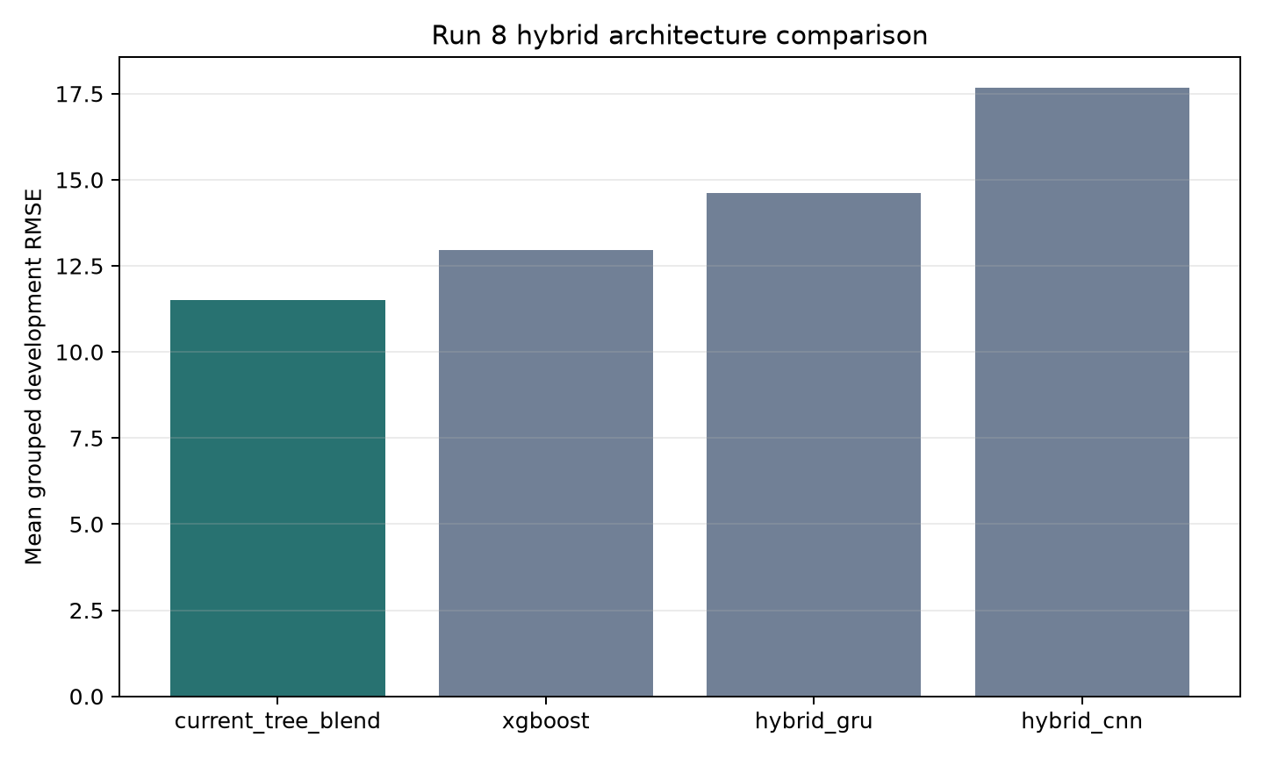
Backup: sequence and hybrid models, in full
Architecture study run 8: hybrid combinations of a tree ensemble with a sequence encoder
Dedicated temporal study (run 7)
model | mean R² | mean RMSE
LSTM | 0.6531 | 19.570
GRU | 0.6424 | 19.832
TCN | 0.5969 | 21.084
Multi-scale CNN | 0.5325 | 22.712
Its own frozen sampling policy and lookback 20, so these values are not on a common scale with the left panel. The gate it had to clear was about R² 0.89 and RMSE 10.7.
State the finding for the architectures, representations and budgets tested here — not as a claim about deep learning and RUL in general.
Architecture study run 8, early/middle scenarios and cap-125 target. Neither hybrid won a single fold out of five.
Source: 2_model_architecture_study/runs/run_8
Notes:
Use if challenged that trees were preferred without a fair rematch. The hybrid models receive the raw window and all 298 engineered features.

Slide 25
Backup: the complete cap and scenario matrix
PE_2, all four cells, with the target policy of each cell stated explicitly
scenarios | fitting target | model | inner RMSE | fold SD | inner R² | bias | overpred. rate
current | raw | XGBoost | 29.8059 | 1.7513 | 0.7708 | +5.2165 | 67.35%
current | raw | ExtraTrees | 32.7578 | 2.6545 | 0.7264 | +4.4906 | 66.00%
current | cap 125 | XGBoost | 36.2141 | 2.5645 | 0.6690 | -10.8488 | 46.70%
current | cap 125 | ExtraTrees | 37.1100 | 2.5884 | 0.6525 | -10.7370 | 50.95%
early/middle | raw | XGBoost | 23.3667 | 1.5326 | 0.4867 | +11.4973 | 71.35%
early/middle | raw | ExtraTrees | 26.6406 | 2.9202 | 0.2703 | +10.6021 | 67.60%
early/middle | cap 125 | XGBoost | 11.9746 | 0.9418 | 0.8661 | -0.9007 | 47.30%
early/middle | cap 125 | ExtraTrees | 12.2693 | 0.8427 | 0.8598 | -1.0864 | 47.15%
Cells with different evaluation targets are not on a common R² scale. Fitting cap, evaluation support and prediction clipping are three different things.
Source: experiments/PE_2/runs/run_1/reporting
Notes:
Use if challenged on the claim that the 2x2 cells are not on a common scale, or on the difference between fitting cap, evaluation support and prediction clipping.

Slide 26
Backup: residual correction, calibration and the safety table
PE_11 and PE_4 in detail, with the nested-calibration guarantee stated in full
What the Run 7 adapter does
· Splits training UAVs internally into four groups.
· Fits the six tree members without the held group.
· Predicts it; repeats, so no UAV is seen by its own model.
· Filters calibration endpoints to training UAVs and balances weight per UAV.
· Fits the residual head there, then predicts the external held-out UAVs once.
· The earlier PE_11 report is not a fully nested estimate of its own stack; the Run 7 adapter does not share that dependency.
· Its remaining limitation: configurations and the workflow were chosen on development data now examined many times.
Conditional calibration policies (PE_4)
policy | mean-fold R² | RMSE | RMS overpred.
control | 0.89422 | 10.5306 | 7.255
q = 0.50 | 0.89456 | 10.5354 | 6.817
q = 0.55 | 0.89253 | 10.6430 | 6.567
q = 0.60 | 0.88931 | 10.8144 | 6.236
q = 0.65 | 0.88106 | 11.2152 | 5.629
q = 0.70 | 0.87070 | 11.6989 | 5.053
Rule declared in advance: only policies within 0.005 mean-fold R² of the best are eligible; among those, minimise RMS overprediction, then overprediction rate, then RMSE.
A later uncertainty-scaled variant improved near-failure RMS overprediction by 11.31% but raised RMSE by 1.71% and was rejected.
Source: experiments/PE_11 and PE_4, runs/run_1/reporting
Notes:
Use if asked how the residual head avoids leaking, or what the calibration cost.

Slide 27
Backup: representation experiments that were rejected
Every row is a matched development comparison whose control was retained
representation tested | matched development result | decision
Signal compression (median / PCA indices) | R² fell by roughly 0.09-0.11 in both families | keep individual features
Dense training prefixes (stride 5) | R² -0.0338 XGBoost, -0.0362 ExtraTrees; lost every fold | keep 20 test-like cutoffs
Per-UAV robust normalisation | combined set: +0.0051 XGBoost, -0.0065 ExtraTrees | keep raw features
Failure-cycle target instead of RUL | ΔR² -0.4002 XGBoost, -0.5073 ExtraTrees; 0/5 folds | keep RUL target
Personalised degradation-onset targets | XGBoost RMSE 12.15 → 19.59-19.69 | keep cap 125
Drift-feature pruning | domain AUC 0.8565, but no treatment passed the accuracy gate | keep all features
Population degradation features | mean RMSE +2.5% (HGB) and +11.8% (ridge) | keep control
PE_28 now revisits the representation question deliberately: ten feature sets from 50 to 310 features crossed with two model recipes, varying sensor coverage, summary complexity, baseline averaging and window length one factor at a time. Screening uses grouped seed 20270107; confirmation uses seeds 20270117 and 20270127 on the same UAV population, so it is a robustness check rather than an untouched holdout.
Source: experiments/PE_5, PE_6, PE_7, PE_9, PE_13, PE_22, PE_28
Notes:
Use if asked what else was tried on the feature side. Every row is a matched development comparison whose control was retained.

Slide 28
Backup: uncertainty, endpoint duplication and score provenance
How the intervals are built, what the repeated endpoints do, and where each score comes from
What the bootstrap covers
· 1,000-3,000 resamples of whole UAVs, never of rows.
· Run 7 pooled R² interval 0.87779 - 0.92772.
· Run 7 minus Run 6 RMSE interval -1.252 to +0.446 cycles.
· It resamples fixed saved predictions, so it excludes training and model-selection uncertainty.
· A positive mean with an interval crossing zero is uncertain evidence, not proof of no effect.
Repeated endpoints
· 500 development rows contain 444 distinct (UAV, cutoff) pairs.
· Removing duplicates changes pooled R² only from 0.90446 to 0.90494.
· Duplication therefore does not explain the headline number, but it does affect weighting and precision.
· The UAV, not the endpoint, stays the resampling unit.
Public-score provenance
· Public scores were transcribed from user-supplied Kaggle screenshots recorded on 7 September 2026, not from a live lookup.
· The public leaderboard uses about 30% of the test data; the final standing uses the other 70%.
· The 0.87877 figure for the alternative script is user-reported and has no submission artifact in this repository.
Source: r2_research_2026_09_07/ and kaggle_scores.csv
Notes:
Use for methodological questions about the intervals, the repeated endpoints, or where the public scores come from.

