Slide 1
Statistical Analysis of Pull Requests in Open-Source GitHub Repositories
Joevita Faustina Doss Felix Anthony Raj
INFO 6105 – Data Science engineering tools and methods
Northeastern University

Slide 2

Problem Statement & Research Questions
Why PR Review Time Matters
Impact on Developer Productivity
Research Motivation
Pull Request (PR) review time is a major bottleneck in collaborative software development. Delays in review can slow releases and disrupt development workflows.
Understanding what drives PR review time enables teams to design more efficient review processes and improve collaboration outcomes.
Extended review cycles reduce developer productivity and morale, as contributors must wait for their work to be reviewed and merged, lowering overall project velocity.
1
Does collaboration activity affect PR review time?
2
Do Contributors and Members differ in average review time?
3
Does PR size interact with author association to influence review time?

Slide 3
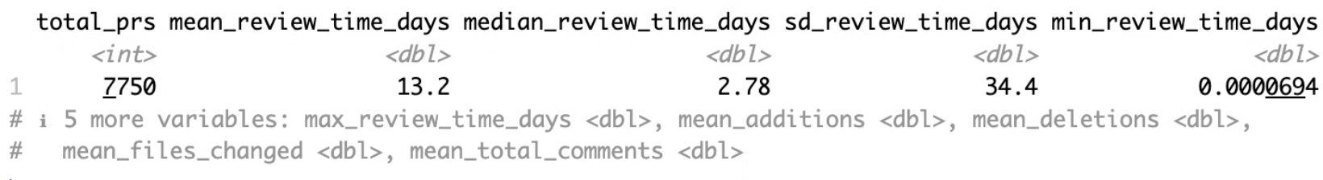
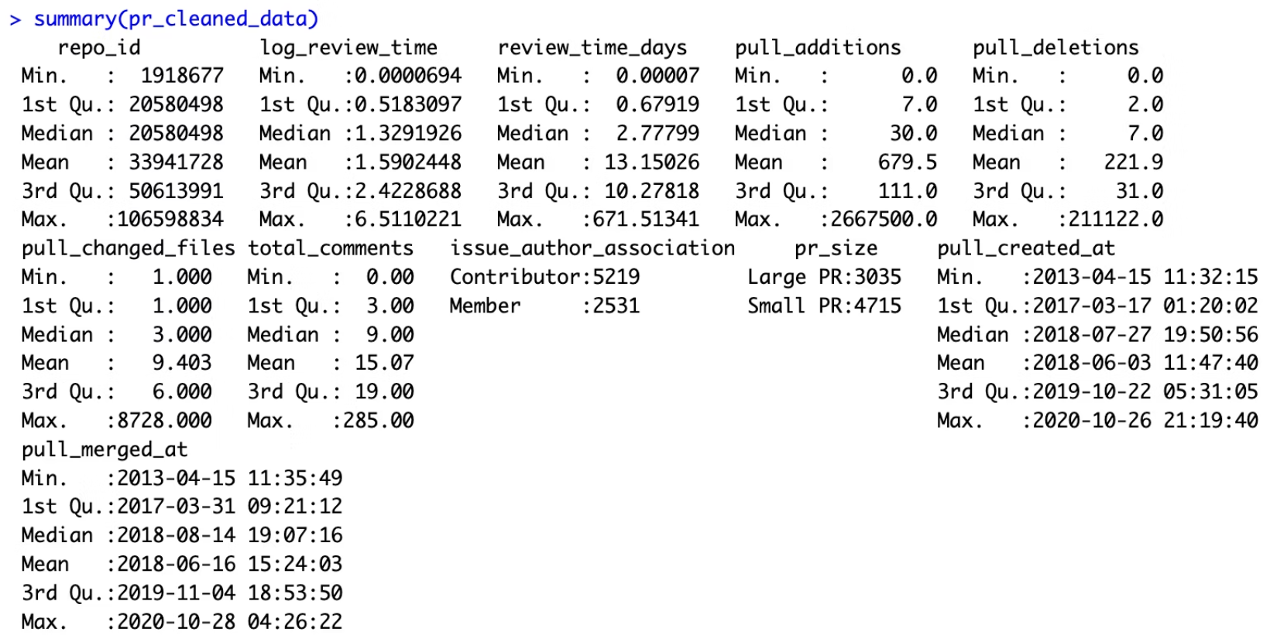
Dataset and Analytical Approach
Dataset Overview
Public GitHub Pull Request (GHPR) dataset, focusing exclusively on merged PRs.
Key variables analysed include review time, various code size metrics (lines added/deleted, files changed), comment activity, and author association.
Methods Utilised
Multiple Linear Regression: Employed to assess continuous predictors of PR review time.
One-Way ANOVA: Used to compare review times between different author groups (Contributors vs. Members).
Two-Way ANOVA: Applied to investigate the combined effects of PR size and author association on review time.
This methodological approach ensures both individual variable effects and complex interaction patterns are thoroughly examined.

Slide 4
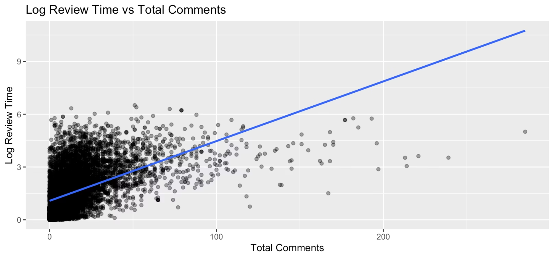
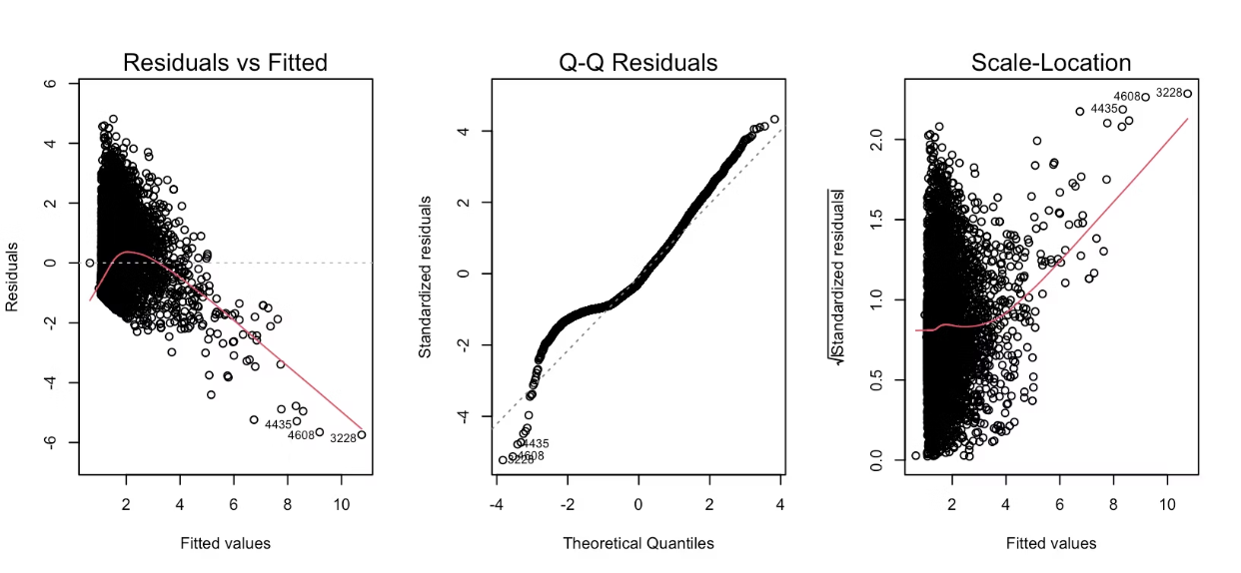
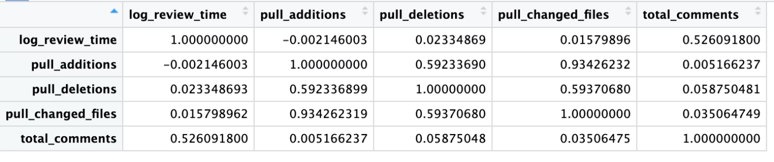
Multiple Linear Regression Results
Key Findings
Total comments are the strongest and statistically significant predictor of PR review time.
Increased discussion activity is associated with longer review durations.
Code size metrics (lines added, lines deleted, files changed) are not statistically significant once comment activity is controlled for.
Insight: Collaboration intensity has a greater impact on review time than the volume of code changes.

Slide 5
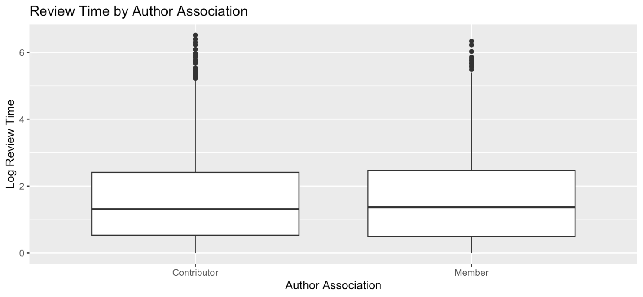
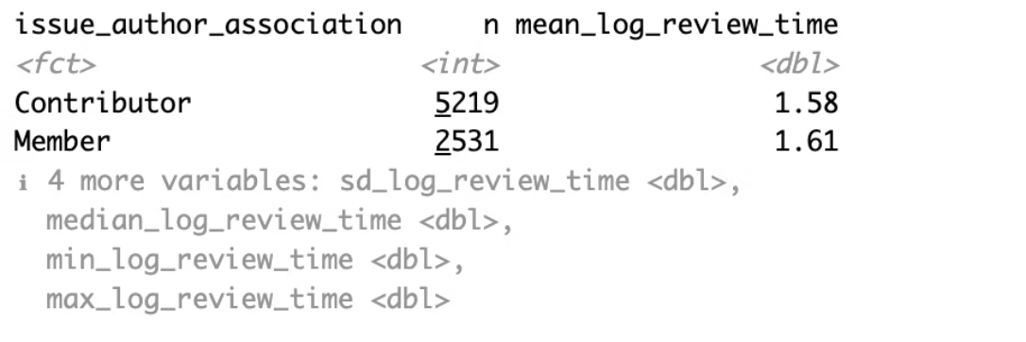
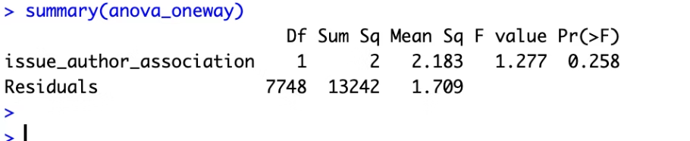

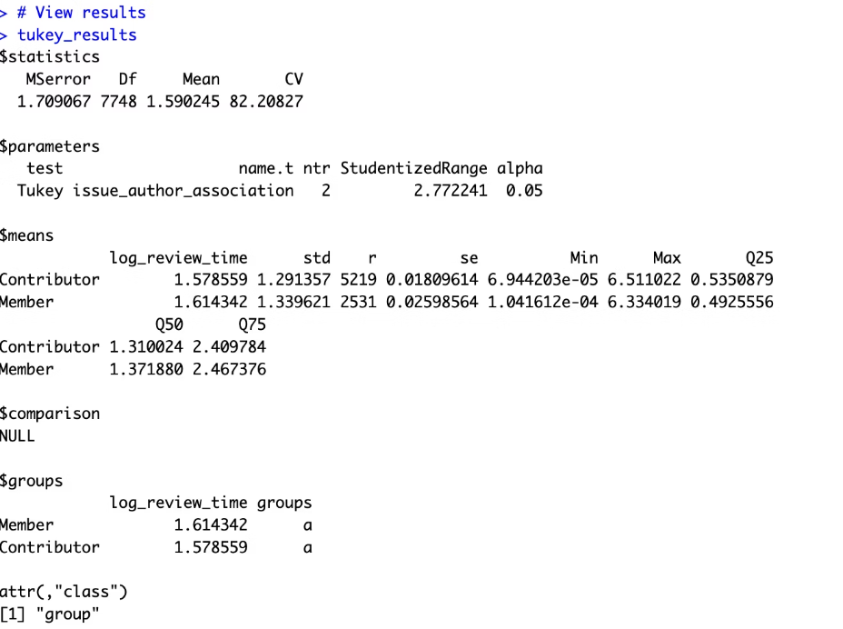
One-Way ANOVA Results
Key Findings
No statistically significant difference in mean log review time between Contributors and Members (ANOVA: F(1, 7748), p = 0.258).
Effect size is extremely small (η² ≈ 0.00016), indicating a negligible practical impact.
Tukey’s HSD showed no meaningful group differences, with both groups assigned the same comparison category.
Insight: Author association alone does not meaningfully influence PR review time.

Slide 6
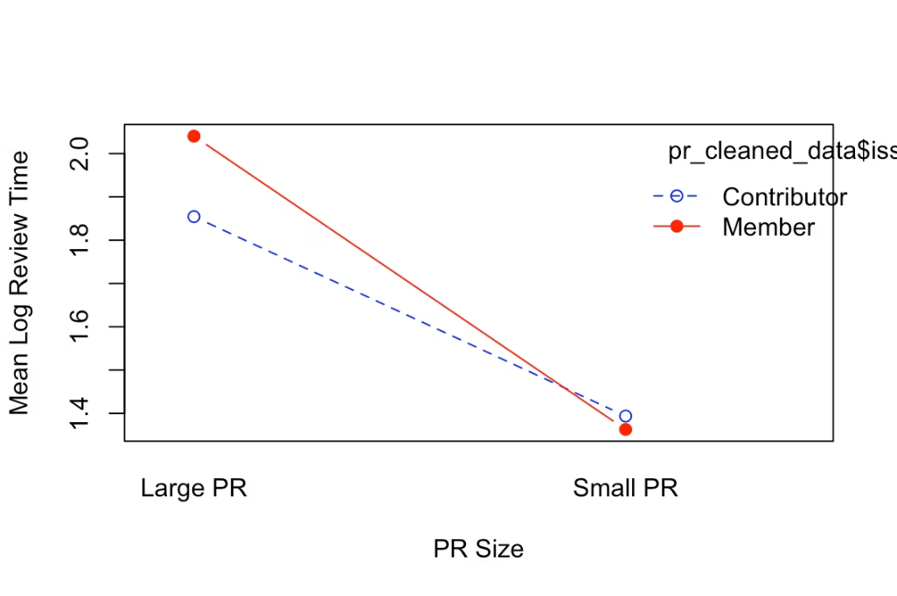
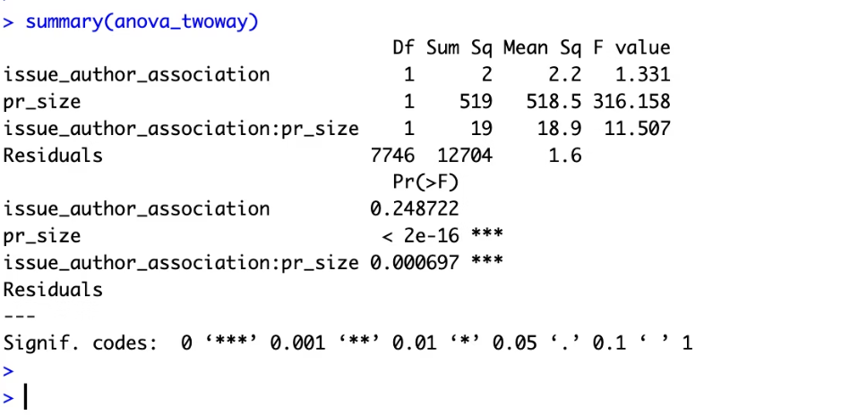
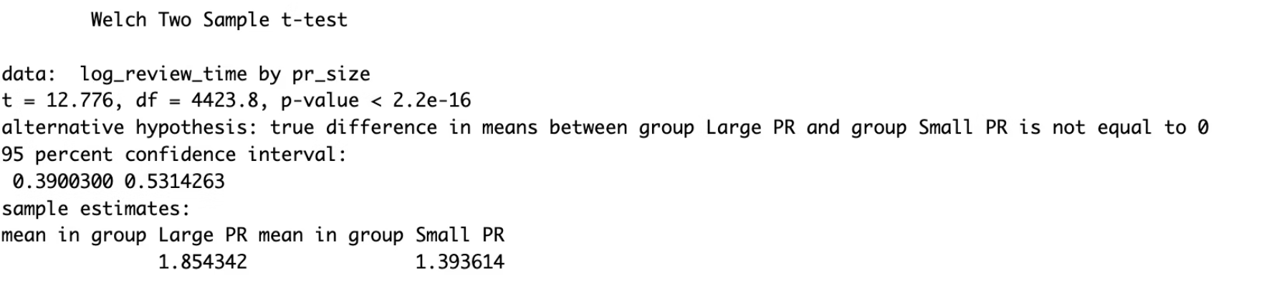
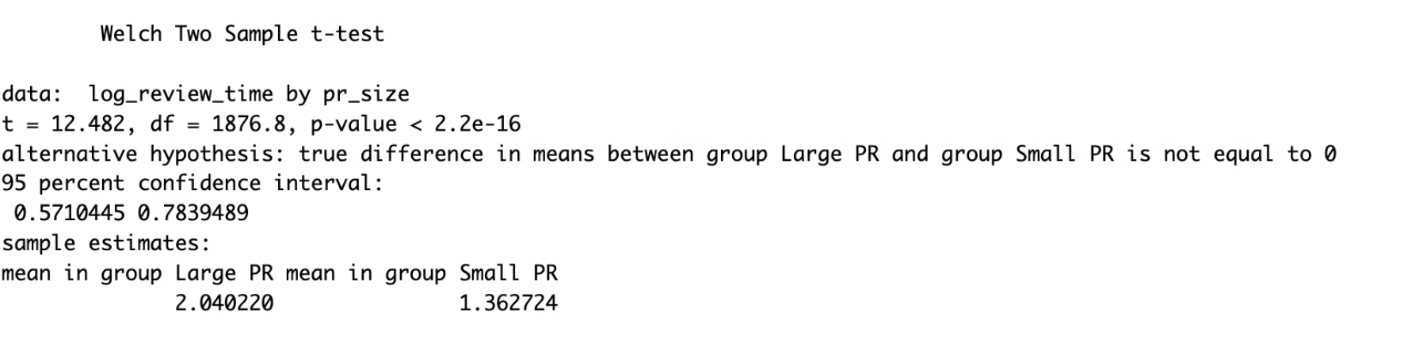
Two-Way ANOVA Results
Key Findings
PR size has a strong main effect on review time, with large PRs taking significantly longer to review (F(1, 7746) = 316.16, p < 2e−16).
Author association alone is not significant, indicating no average difference between Contributors and Members (F(1, 7746) = 1.33, p = 0.249).
A statistically significant interaction exists between PR size and author association (F(1, 7746) = 11.51, p = 0.000697).
Follow-up tests show that large PRs increase review time for both groups, but the magnitude of the increase differs between Contributors and Members.
Insight: PR size strongly influences review duration, and its effect varies by author association.

Slide 7
Key Takeaways:
Collaboration Activity
Pull Request Size
Interaction Effects
The intensity of collaboration, particularly the volume of comments exchanged during the review, is a primary driver of PR review duration.
The overall size of a pull request, measured by lines of code changed and files affected, also significantly impacts the time required for review.
Complex interaction effects, especially between PR size and author association, reveal deeper dynamics often overlooked by simpler univariate analyses.
Understanding these factors is crucial for optimising software development workflows and accelerating project delivery.

Slide 8
Practical Recommendations for Optimisation
Improve PR Clarity
Encourage Smaller PRs
Use clear descriptions and coding standards to limit unnecessary discussion.
Submit focused, incremental pull requests to reduce review time.
Streamline Workflows
Prioritise Large PRs
Optimize review processes and collaboration tools to remove bottlenecks.
Allocate extra review resources to large PRs, especially from core Members.

Slide 9
Future Research Directions
1
2
3
Impact of Automation
Reviewer Expertise
Cross-Project Analysis
Study how automated testing and static analysis impact review time.
Examine how reviewer experience influences review efficiency.
Compare findings across diverse open-source projects.
Conclusion
PR review time is driven more by collaboration intensity and PR size than author role alone. By managing discussion, encouraging smaller PRs, and optimizing review workflows, teams can significantly improve review efficiency and project velocity.

