Slide 1
Computer Programming Internship Project Presentation
Created by Joey Pekar 7/29/2020

Slide 3
Portfolio Site
Build with React, React-Bootstrap, and React-Router

Slide 4
Portfolio Site
Code done in JavaScript.
React Framework was used, along with React-Bootstrap for Bootstrap Components and React-Router for pages.
Sass Stylesheets
Hosted on Github Pages.

Slide 5
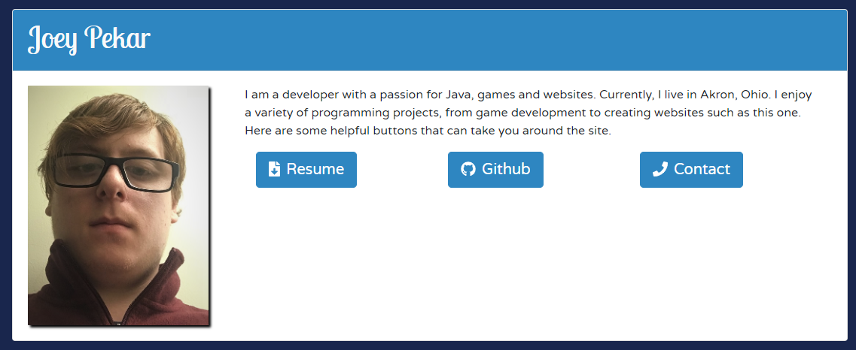
Portfolio Site: Main Page
The main page contains a small description about me, along with useful links to important portions of the site.
The Resume button automatically downloads a PDF document of my Resume.
Github links to my Github profile.
Contact leads to the contact page.

Slide 6
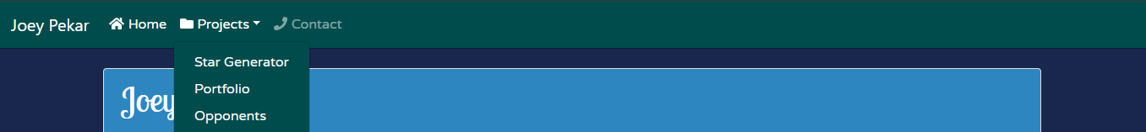
Portfolio Site: Navbar
The Navbar is built to dynamically add projects to the Navbar based on a projects.json file that the site has.

Slide 7
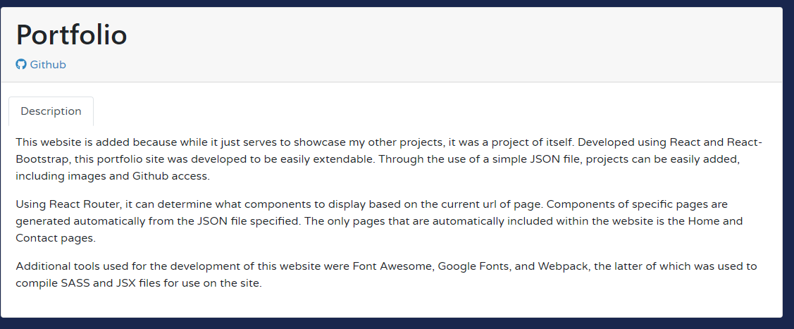
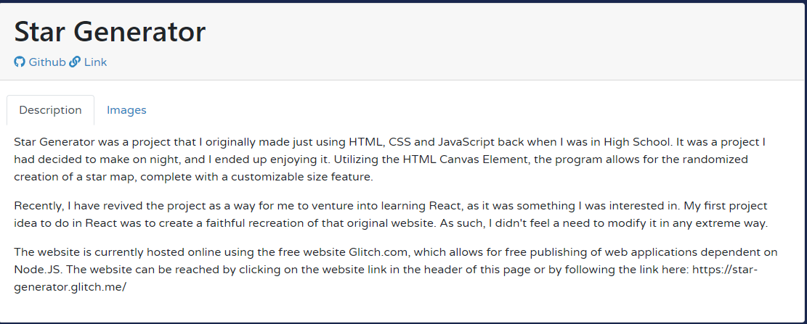
Portfolio Site: Projects Page
This is an example of a Project page. The project page automatically generates that block with a spot for the Github link, and a tab for description. Additional options for other pages include a link to the site, an images tab, and a video tab.

Slide 8
Scorekeeper
Developed in Java. Demo Application developed with JavaFX. Developed in IntelliJ with the database made in MariaDB.

Slide 9
Scorekeeper
API for tracking a player’s statistics for a game. It can be eased to easily create tables based on Java code in a MySQL database.
Utilized Reflection to read classes and create columns based on fields.
Dependencies handled in Maven.

Slide 10
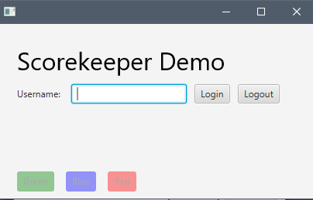
Scorekeeper Demo Application
To demonstrate the API, I built a sample application utilizing JavaFX to demonstrate some basic functionality. This application has three buttons that can be selected.

Slide 11
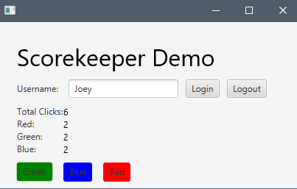
Scorekeeper Demo Application
The user can enter their name to login in. They can then click the buttons to add clicks to their totals. This will save to the database once the user logs out or closes the program.

Slide 12
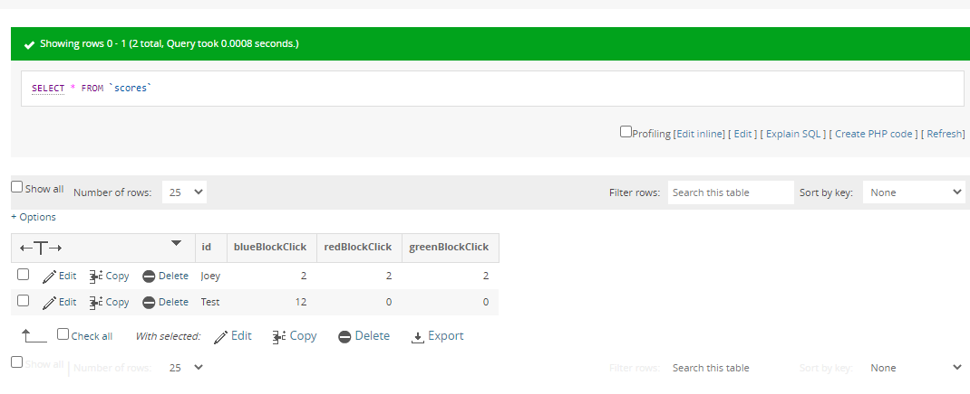
Scorekeeper Demo Application
Here is a screenshot of PHP My Admin showing the content of the generated scores table within the program.

Slide 13
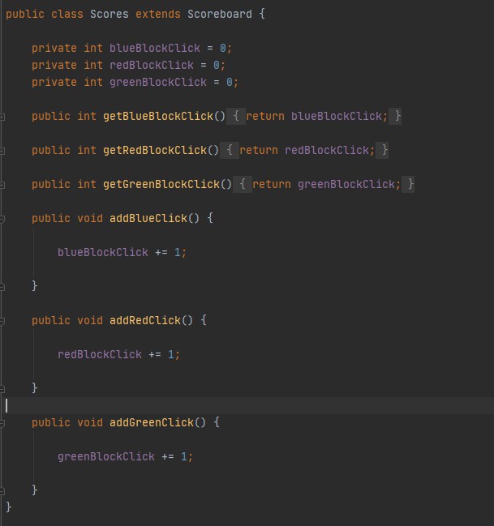
Scorekeeper Demo Application
Here is the class used. It extends Scoreboard, which is a class used as a template, that contains the id property.

Slide 14
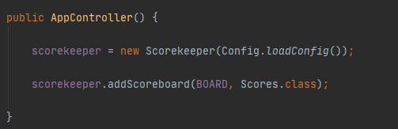
Scorekeeper Demo Application
The constructor for the app controller is where I have the Scorekeeper start up. To create the Scorekeeper, you simply create a new instance of it. To add a table to track, you simply do the scorekeeper.addScoreboard and give it a string as a name and the class the table will be based on.

Slide 15
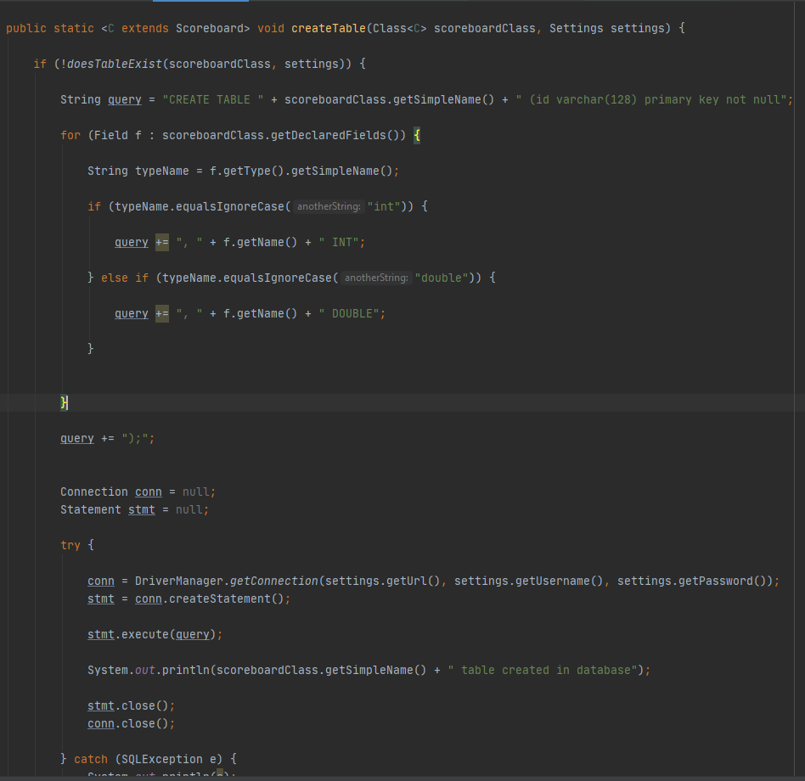
Scorekeeper
Here is a snippet of the Create Table class, that uses reflection to create the table based on the properties within it. It supports integers and doubles for scores.

Slide 16
Genesys Item Collection
Developed using C# and ASP.Net. Database done in MongoDB. Developed with Visual Studio and MongoDB Compass. API tested using Postman.

Slide 17
Genesys Item Collection
This website was built in C# using ASP.Net. It provides to means of accessing the data. There is the website, featuring tables and the ability to create new items. The other means is an API.
Database used was originally going to be SQL Server but was switched to MongoDB to be able to keep it free and online.
Website uses Bootstrap and SASS stylesheets.

Slide 18
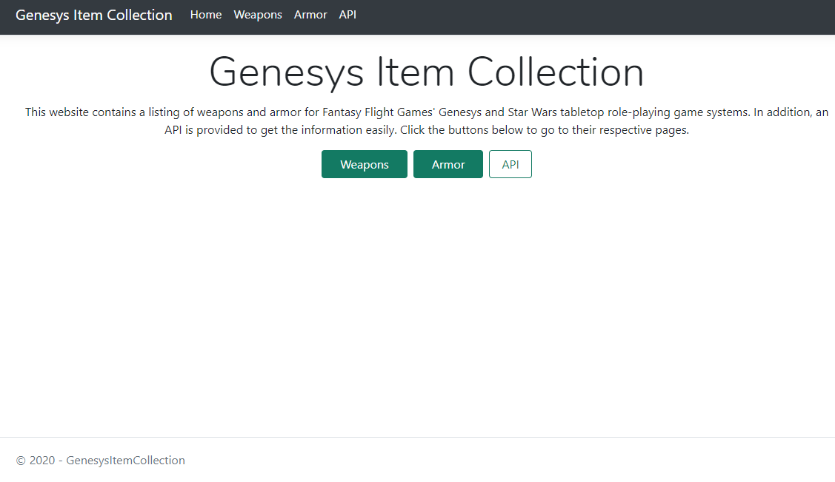
Genesys Item Collection
The main page provides access to Weapons, Armor and a page detailing the API.

Slide 19
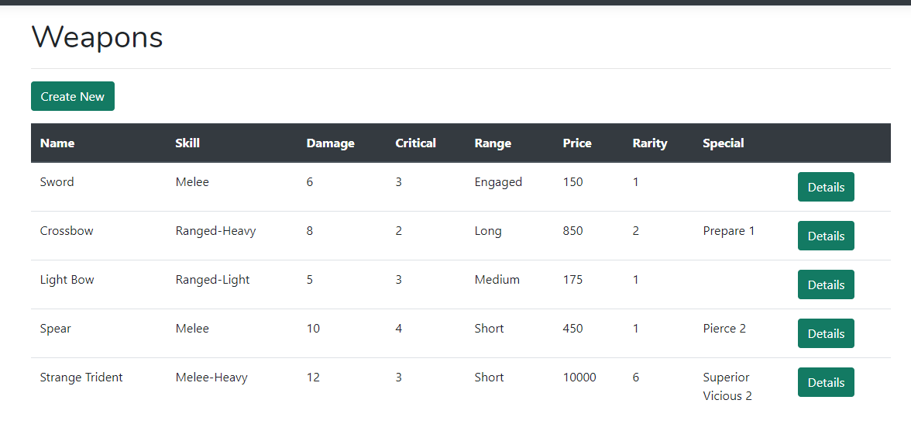
Genesys Item Collection
The weapons list is formatted to be easily view all of the important properties of a weapon. The only information not shown on this page are its encumbrance and the ID, which will be used later.

Slide 20
Genesys Item Collection
The weapons list is formatted to be easily view all of the important properties of a weapon. The only information not shown on this page are its encumbrance and the ID, which will be used later. These pages were generated using Entity Framework.

Slide 21
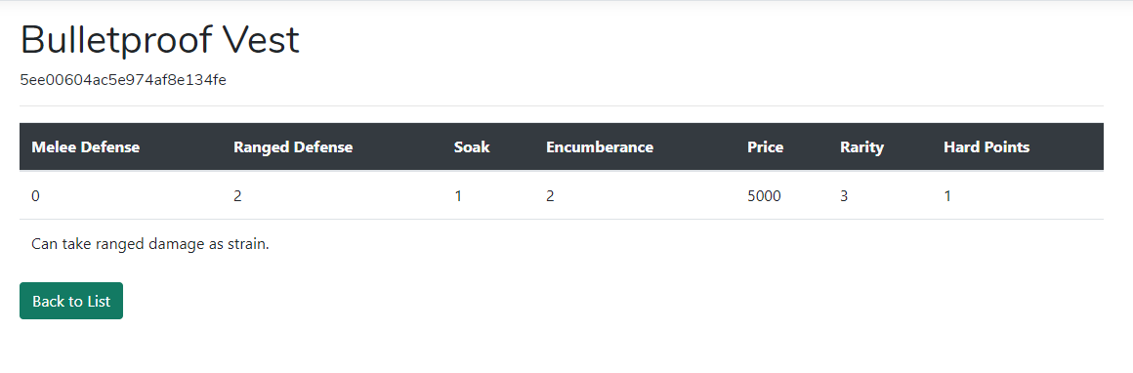
Genesys Item Collection
The armor pages are similar, containing relevant fields for armor items. This is a fully shown details page for the Bulletproof Vest item, which includes a special note at the bottom. Both weapons and armor include a notes section.

Slide 22
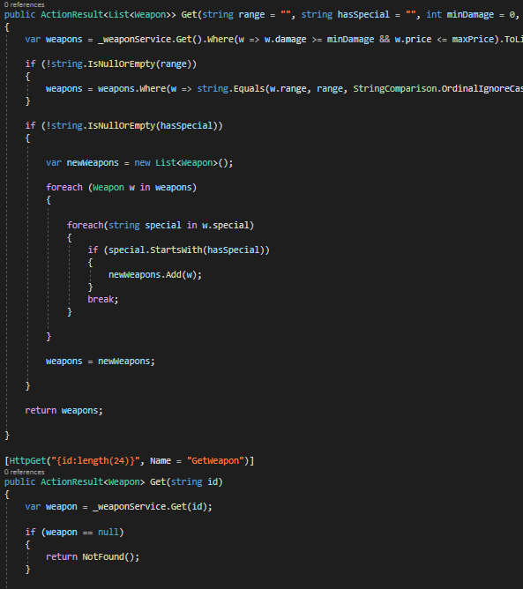
Genesys Item Collection
This is the code for the first two GET actions in the API portion. The first one returns a list of weapons and includes optional arguments to specify certain criteria.

Slide 23
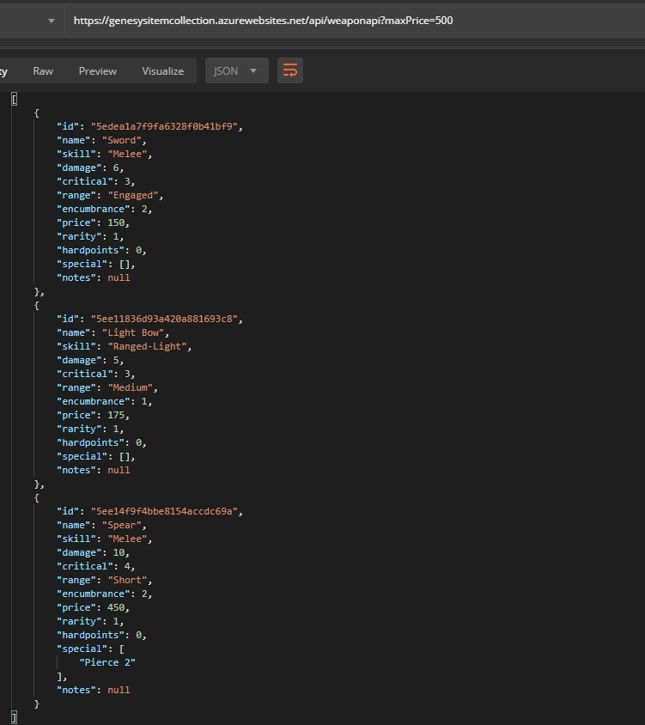
Genesys Item Collection
Utilizing the following request to get a list of weapons with a max price of 500, it returns three weapons, the Sword, the Light bow and the Spear.

Slide 24
Genesys Item Collection
Utilizing the following request to get a list of weapons with a max price of 500, it returns three weapons, the Sword, the Light bow and the Spear.

Slide 25
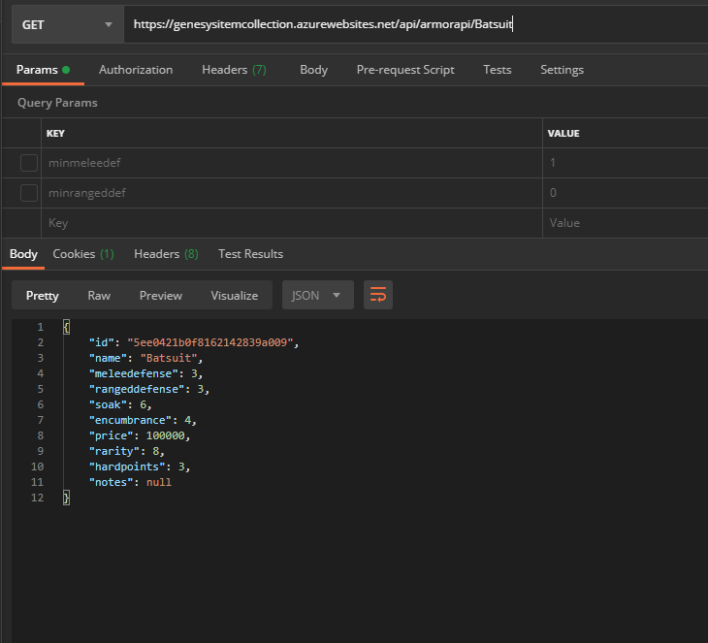
Genesys Item Collection
Using the API for the Armor, this request gets an armor named the “Batsuit”, which will return JSON for the Batsuit armor.

Slide 26
Opponents
Developed using React. Coded in Visual Studio Code.

Slide 27
Opponents
Developed using React, similar to the Portfolio site.
React Bootstrap was used for Bootstrap controls.
React-PDF was utilized for generating a final PDF.
This provides an enemy stat block generator for the Genesys Tabletop Game.

Slide 28
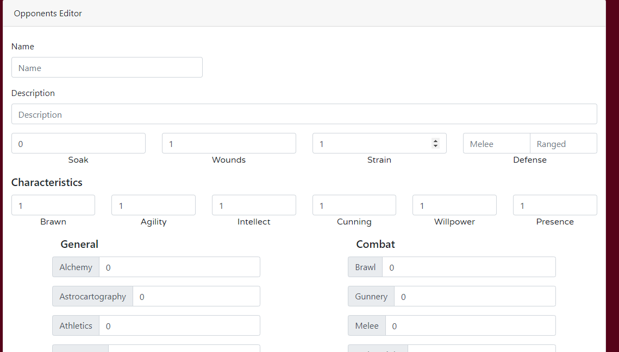
Opponents
This editor was made to quickly create statblocks for Genesys enemies and be able to save them. It uses React-Bootstrap forms to save the state of the opponent in the form. All of the skills in Genesys are shown, being able to be easily selected.

Slide 29
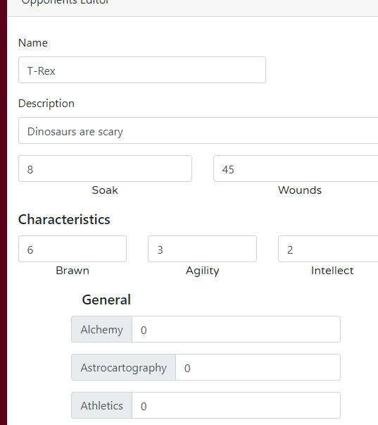
Opponents
All numeric boxes allow the user to increment them, or type in the number. The Characteristics have a set to maximum to prevent illegal values in the system from being entered, with the valid numbers being 1-6.

Slide 30
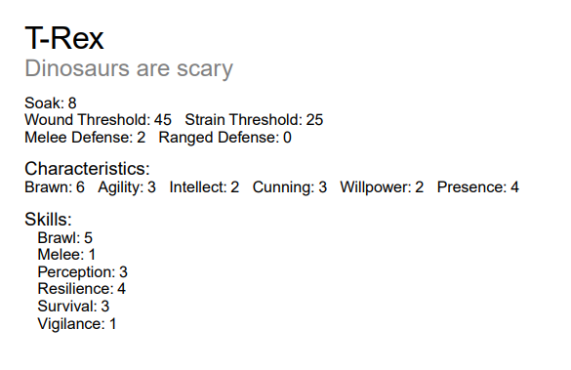
Opponents
After pressing a Download button at the button of the page, it will prompt to save a PDF of the new statblock to your computer. The PDF will look like this:

Slide 31
Opponents
The way the site handles data is utilizing React hooks to save the state. State was used rarely in the Portfolio site but is critical to this App. When the app is first loaded, it loads up a JSON file with empty values into the State. Whenever a value is changed on the form, it updates the corresponding JSON property. The State is then passed down to the PDF generator when the button is pressed, to create the PDF file.

Slide 32
Reflections

Slide 33
Reflections: Scorekeeper
Scorekeeper was the first project I thought of. Utilizing some stuff that I had used sparingly in the past, I wanted to make a tool that would be useful for other programs, rather than a program by itself. Using Reflection to take a class taught me a lot on how I should make the classes, being that I would have to carefully take that class and create a table out of it, instead of having a pre-built table in a database. Of the three projects, this ended up being the second most difficult to create.

Slide 34
Reflections: Genesys Item Collection
For this project, I went in intending to make an addition to the Scorekeeper application. However, the way I had to pull off Scorekeeper made the original concept hard to do. However, I still wanted to make an HTTP API, and so I thought of a new set of data to do that with. Creating a tool I could use when I play tabletop RPGs, I wanted to not only make the API, but a website for easy editing. I enjoyed doing this project a lot, and I feel that, even though I didn’t take it in any extreme direction, it turned out the best of the bunch and is easily my favorite. Figuring out how to adapt to using MongoDB instead for the free database was also a cool opportunity.

Slide 35
Reflections: Opponents
I have mixed feelings with how this one turned out. The way I originally envisioned it, was much different. However, developing it was the most fun out of any of the projects, being able to work with brand new code and techniques. Using JavaScript and React felt fresh and new and gave me new ways to develop a website. However, problems in the creation of this made parts of it dreadful to make, and what should have been a simple solution to a problem resulted in several hours of struggling just to manage to accidently stumble upon the answer, only from putting in a hyphen in a place in the IDE showing an alternative.

Slide 36
Works Cited
Khandelwal, P., & Addie, S. (2019, August 17). Create a web API with ASP.NET Core and MongoDB. Retrieved June 5, 2020, from https://docs.microsoft.com/en-us/aspnet/core/tutorials/first-mongo-app?view=aspnetcore-3.1&tabs=visual-studio
React-Bootstrap. (n.d.). Retrieved June 17, 2020, from https://react-bootstrap.github.io/
React-pdf. (n.d.). Retrieved June 19, 2020, from https://react-pdf.org/

