Slide 1
GPGPU in Film Production
Laurence Emms
Pixar Animation Studios

Slide 2
Outline
GPU computing at Pixar
Demo overview
Simulation on the GPU
CUDA with OpenGL
Future work

Slide 3

GPU Computing at Pixar
GPUs have been used for real-time preview of assets
Emphasis on matching GPU with CPU results
GPGPU allows us to speed up more stages of the asset pipeline
Notes:
One great way of taming render times is to avoid doing renders! We substitute GPU preview time for lengthy CPU render times, reducing render times in our asset pipeline.
Artists and TDs use GPUs early in development but later fall back to CPU farm renders because of GPU limitations
If GPU results match PRMan results closely, we can postpone the switch from CPU to GPU
And now onto some highlights of GPU use at Pixar.

Slide 4
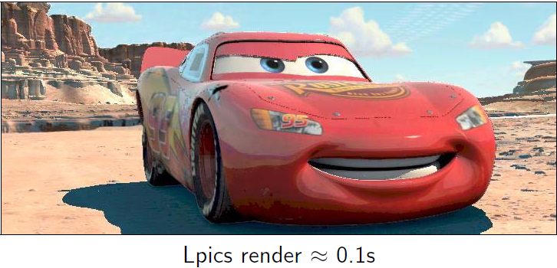
LPics
Interactive relighting engine
RenderMan surface shaders generate image space caches
Caches loaded onto GPU
Light shaders run on GPU hardware
Notes:
LPics was developed on Cars to improve lighting times and allow real-time feedback for lighters.
LPics system has similarities to G-Buffers, a commonly used screen space rendering technique which I will talk about later in the demo.

Slide 5
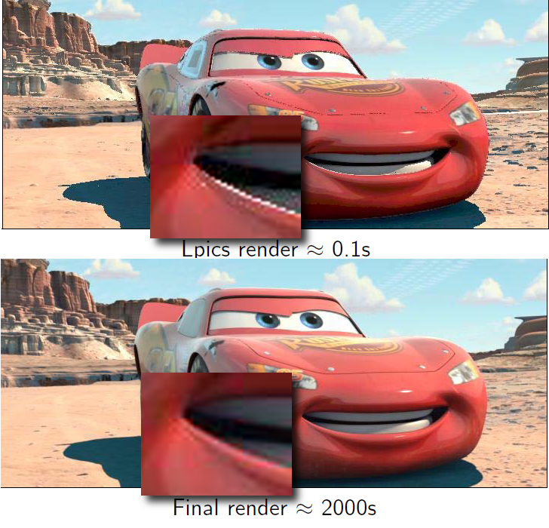
Floating Point Precision
Shader Model 2.0 introduced IEEE single precision floating point accuracy (2005)
Idea: Substitute GPU programs for some stages of the asset pipeline
Notes:
In order for GPUs to be useful to us, we need single precision results on the CPU and GPU to match.
If the results between the CPU and GPU don’t match, GPU based tools won’t be useful as a preview for our artists.
We run tests on standard shots to unsure that CPU and GPU results match.
Shader Model 3.0 made IEEE single precision float standard.
Caveat: Storage for floating point numbers on the GPU is IEEE compliant, computations are not necessarily the same.
Exceptions include denormalized numbers, NaN and Inf.
CUDA shares the same limitations on its floating point computations.
In practice, GPU computed results for stable and well conditioned algorithms have been acceptable for us.
Matching precision means that we can use GPU based tools on user desktops to substitute for render farm renders for preview renders in the asset pipeline.

Slide 6
Floating Point Textures
Rendering to the default framebuffer clamps values from 0.0 to 1.0
Request floating point textures with GL_RGBA32F and GL_FLOAT:
glTexImage2D(GL_TEXTURE_2D, 0, GL_RGBA32F, _image_width, _image_height, 0, GL_RGBA, GL_FLOAT, NULL)
Notes:
An important extension to OpenGL is floating point texture support, this is now a part of the OpenGL core profile.
Normal textures use integer values to approximate floating point numbers, use float textures instead for accuracy!

Slide 7
Modern OpenGL
Modern OpenGL pipeline is similar to RenderMan pipeline
Supports tessellation, screen space effects and displacement
Allows us to use OpenGL as a preview tool until later in the pipeline
Notes:
Recent changes to the OpenGL pipeline have led to more common ground between OpenGL and RenderMan.
There are still limitations to OpenGL as a preview tool:
-Doesn’t do ray-tracing very well
-Limited GPU memory and PCI-E bus bandwidth
-Limited anti-aliasing techniques
In general, real-time performance makes up for these shortcomings.

Slide 8
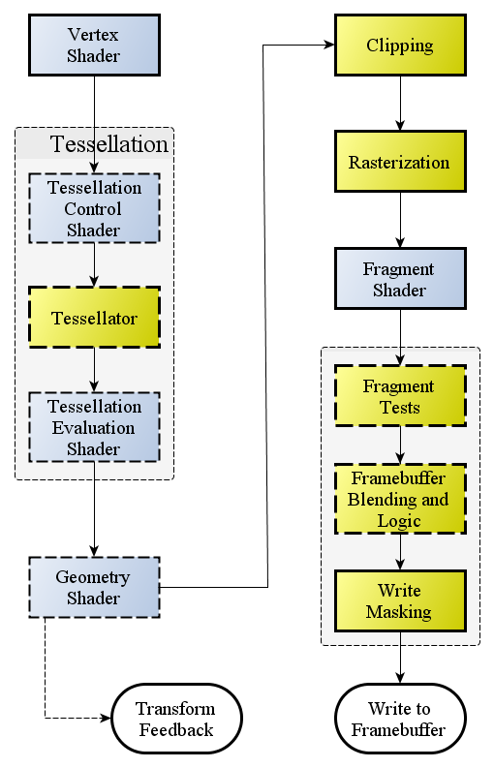
Modern OpenGL Pipeline
Source: OpenGL.org wiki Rendering Pipeline Overview
http://www.opengl.org/wiki/Rendering_Pipeline_Overview
Notes:
For us, tessellation unit is approximately the same as RenderMan subdivision.
Geometry shaders are similar to RenderMan procedurals.

Slide 9
Geometry Shaders
Take an OpenGL primitive passed in from a vertex or tessellation shader
Generate new geometry
Used for hair, particles, etc.
Notes:
Geometry shaders are another technology which have opened up new avenue for GPU computing at Pixar.

Slide 10
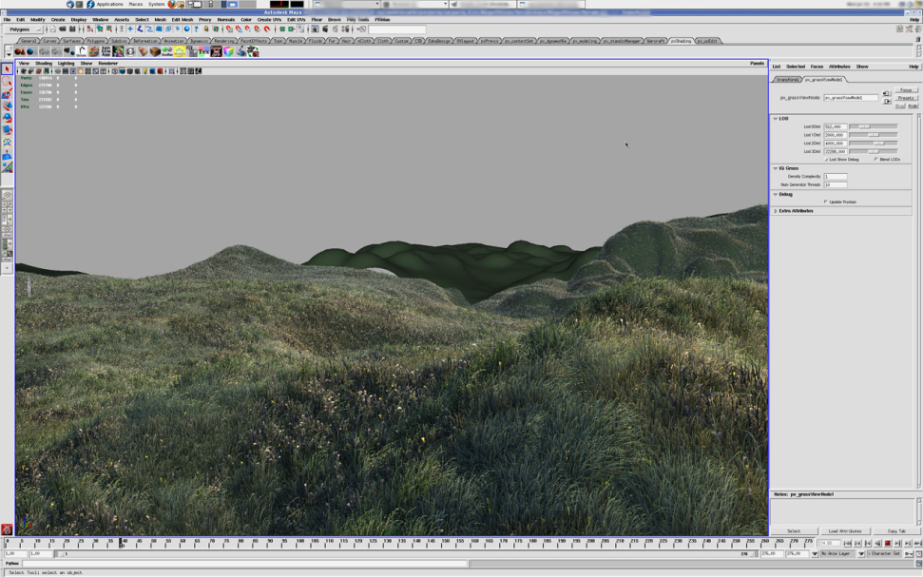
Vegetation Preview
Artists want a grass representation in Presto
Upload CPU procedural result onto GPU
Render with OpenGL Vertex Buffer Objects (VBO) and Geometry Shaders
Notes:
Artists wanted a grass representation on Presto
Note: Presto is the name of our animation tool
Grass preview used for location scouting by layout TDs
Avoids grass covering camera view
Later used as an authoring tool for vegetation
Process:
1. Bucket faces of a mesh into volumes
2. Run CPU procedural
3. Store result in Vertex Buffer Object (VBO)
4. Render VBO using geometry shader
Implementation notes:
VBO contains one vertex per blade of grass for performance reasons
Geometry shader expands grass blade from surface into actual blades of grass
This generates the exact same geometry as a PRMan render

Slide 11
Tessellation Shaders
Takes a GL_PATCH primitive from a vertex shader
Hardware tessellation unit subdivides the patch based on Tessellation Control Shader (TCS)
Tessellation Evaluation Shader follows (TES)
Notes:
Tessellation shaders are a very significant development for us at Pixar, we’re still exploring the potential of tessellation shaders in our pipeline.
TES ~= Displacement after subdivision, use this for displacement mapping

Slide 12
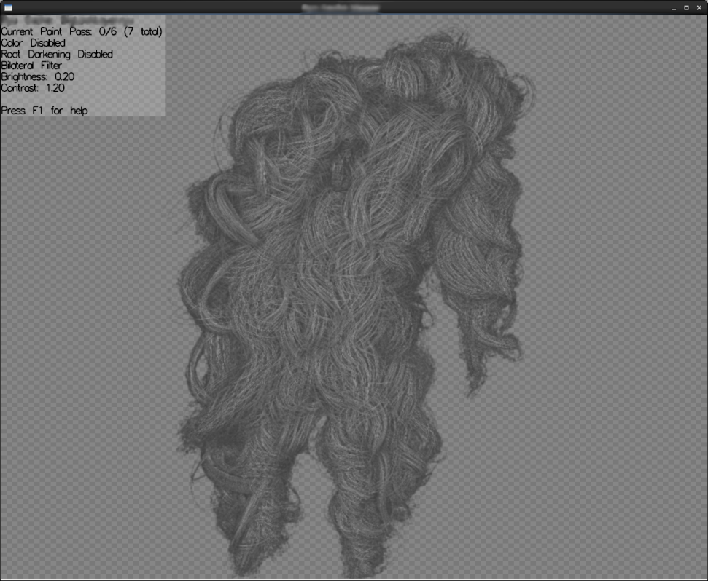
Hair Style Preview
Grooming TDs want to see hair styles as they work
Upload hairs to VBO
Tessellation shaders to match curves
SSAO to show volume
Notes:
On Monsters University, we have LOTS and LOTS of hair, including hairy crowds.
Due to the huge numbers of hairy characters, we needed a real-time preview tool to assist our TDs in generating hair styles for characters.
Key requirements:
-Matching GPU renderer widths with RenderMan renders
-Separating hairs visually
-Seeing volumes of hairs
Re: separation - Hairs are lit as if they are cylinders to enhance shaping of the hairstyle.
Re: volumes - SSAO = screen space ambient occlusion - darkens corners which receive less light than flat surfaces.
Without SSAO it’s hard to see which hairs are in-front of one another.

Slide 13
Deferred Shading
2 passes:
Render varying attributes to texture
Render onto screen quad using framebuffer textures
Notes:
In the hair preview, SSAO is computed using deferred shading.
A common technique in modern real-time graphics is screen space rendering.
Also known as screen space shading.
Allows you to sample pixel values of neighboring pixels.
Benefit that pixels are culled by depth buffer algorithm before expensive pixel shaders.
Cost is that anti-aliasing is difficult without super sampling at higher resolutions.
Common algorithms:
Screen Space Ambient Occlusion (SSAO), Depth of Field (DoF), Bloom/HDR, Screen Space Motion Blur

Slide 14
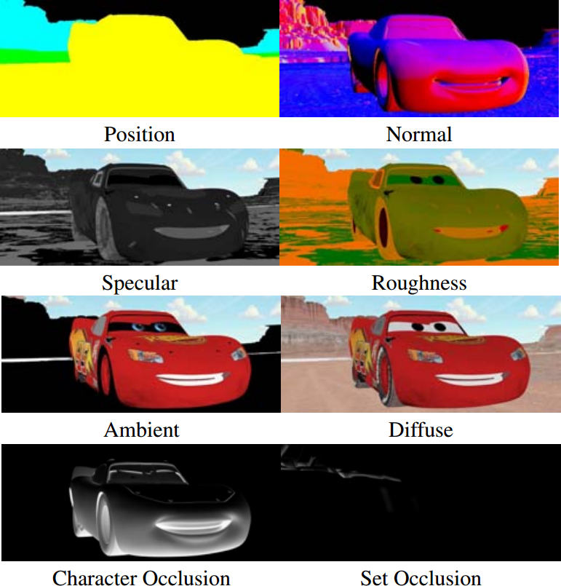
Geometry Buffers
Render multiple data channels into textures
Position, normal, velocity, specular, diffuse, etc…
Frame Buffer Objects (FBO) with multiple render targets in OpenGL
SetRenderTarget in Direct3D
Notes:
This idea is very similar to Lpics, only here we generate buffers on the GPU as well.

Slide 15

OpenSubdiv
Open source subdivision surface libraries
Hybrid CPU/GPU libraries
https://github.com/PixarAnimationStudios/OpenSubdiv
Notes:
We have open sourced our proprietary subdivision libraries
The OpenSubdiv project is free for commercial and non-commercial use
Exactly matches Pixar’s in-house subdiv technology, including creases and matching edge cases that our algorithm handles.
OpenSubdiv : Open Source GPU Rendering of Subdivision Surfaces
Thursday, 29 November | 10:00 - 10:45 | Conference Hall K

Slide 16
Modern OpenGL Pipeline
Subdivision
Surfaces
Procedurals
Source: OpenGL.org wiki Rendering Pipeline Overview
http://www.opengl.org/wiki/Rendering_Pipeline_Overview
Notes:
So, that just about covers the most recent hightlights of GPU computing at Pixar.
Relating this back to OpenGL pipeline advances, you can think of the tessellation shader as being equivalent to Renderman Subdivision and the geometry shader as equivalent to Renderman procedurals.

Slide 17
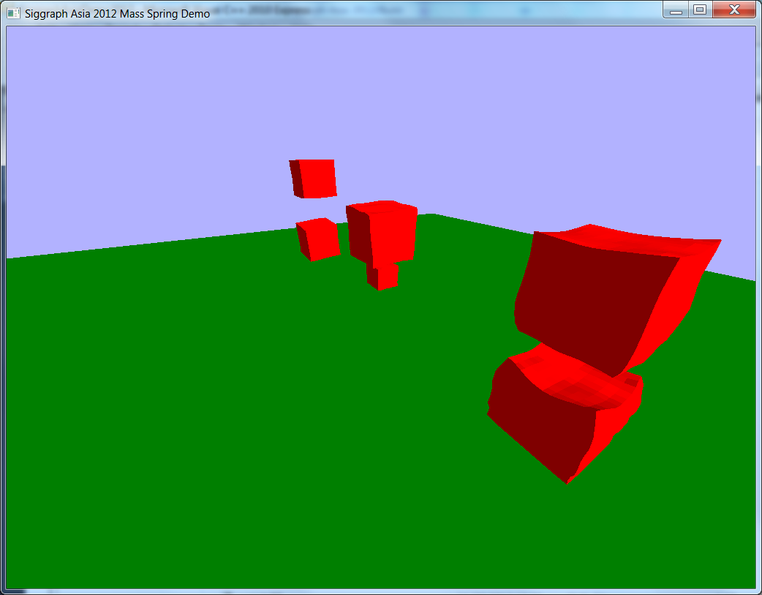
Demo Overview
Simple Mass-Spring Simulation on the GPU
Combines CUDA with OpenGL
Render a set of Jelly Cubes
Notes:
Intended to show how to write a tool that can work in a film production environment.
Including: abstraction of interfaces and objects, support for easily adding and removing objects from the simulation and altering parameters in real-time

Slide 18
Demo
Open source GPU mass spring simulation
https://github.com/lemms/SiggraphAsiaDemo2012
GNU GPL License
https://github.com/lemms/SiggraphAsiaDemo2012
Notes:
Run the demo!
The repository is out of date.
This will be updated tomorrow with the source currently on my machine.
The simulation is explicit which means that it won’t run with large time steps. As a result it won’t scale to real-time on a laptop GPU.
QR code of URL on next slide.

Slide 19


Slide 20
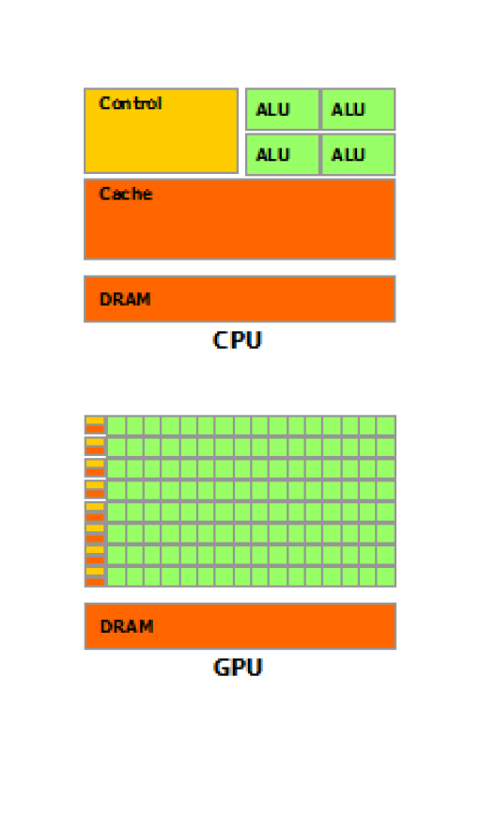
CUDA
General purpose GPU programming
CPU = Host
GPU = Device
Good for data parallel algorithms
Run on Streaming Multiprocessors (SM) in GPU.
Source: NVIDIA CUDA C Programming Guide
Notes:
In data parallel computing we assign each parallel processor to perform computations on a subset of the data.
Ideally, we want to avoid sharing data between threads but if we have to, we want to do so in a very structured pattern.
Idea: Take a set of data and compute on it in several batches, called blocks in CUDA, which are able to share data using shared memory.
A note for OpenCL developers, we have explored using OpenCL to help generate our assets but we have found that CUDA currently has
better performance and a better tool-set. I’ll be talking about some of these tools later.

Slide 21
Setup
Install the CUDA Toolkit
https://developer.nvidia.com/cuda-downloads
CUDA programs use the nvcc compiler
In Visual Studio, right click project name, then click Build Customizations…, then select the CUDA Toolkit version you installed
https://developer.nvidia.com/cuda-downloads
Notes:
The actual demo also requires GLEW, FreeGLUT, GLM but this is all documented with the source code.
Also, CUDA getting started guide has excellent instructions on testing your installation.

Slide 22
Kernels
Execute on device (GPU), called from the host (CPU):
Declaration:
__global__ void device_func(…) {…}
Call:
device_func <<< threads_per_block, blocks >>> (…);
Notes:
Requirements for a kernel:
Kernels must have void return type.
Can not access host memory directly (must allocate memory for the device explicitly).
Fixed number of arguments.
No recursion on pre-Kepler architecture (CUDA 5).
No static variables.
Idea for people who know shaders: parameters = uniforms.

Slide 23
Kernels Example
C++
call:
for (int i = 0; i < n; i++) {
a[i] = b[i] + c[i];
}
CUDA
definition:
__global__
void sum(int n, int *a, int*b, int *c) {
int i = blockID.x * blockDim.x + threadID.x;
if (i < n)
a[i] = b[i] + c[i];
}
call:
sum<<< blocks, threads>>>
(n, a, b, c);
cudaThreadSynchronize();
Notes:
Note the check if(i < n) prevents out of bounds memory accesses.
cudaThreadSynchronize() blocks until all threads running the kernel are completed.
Without this, the kernel will continue asynchronously with the CPU.

Slide 24
Threads and Blocks
Multiple threads are grouped into blocks of fixed size.
Blocks are assigned to one SM each.
Blocks share resources.
Notes:
There is a maximum number of threads per block, which depends on the compute capability of the GPU.
Blocks share registers, caches and shared memory.

Slide 25
Kernel Calls with Threads and Blocks
int tpb = 256; // threads per block
int n = a.size(); // a, b, c are the same size
sum<<<(n+tpb-1)/tpb, tpb>>>(n, a, b, c);
This creates just enough blocks to process n items with 256 threads per block.
Notes:
A lot of the time you want to divide up a large array of N elements into a particular set of threads per block.
Sometimes N won’t be an exact multiple of the threads per block, this is how you deal with it.
Make sure that you still check that your thread ID while using this.

Slide 26
GPU Memory
Allocate:
cudaMalloc(void **devPtr, size_t size)
Free:
cudaFree(void *devPtr)
Copy to/from device:
cudaMemcpy(void *dst, const void *src,
size_t count, enum cudaMemcpyKind kind)
kind = cudaMemcpyHostToDevice or cudaMemcpyDeviceToHost
Notes:
These are the three most useful memory operations in CUDA, they allow you to upload a buffer from the CPU to the GPU.
Allocate a CPU array
cudaMalloc a GPU array
cudaMemcpy host to device
Work…
To get data back to the CPU:
cudaMemCpy device to host
cudaFree when you’re done with the GPU array.

Slide 27
STL Vectors on the GPU
Idea: Manage CPU memory with std::vector and upload to GPU.
std::vector<T> cpu_data;
cudaMalloc((void**)&gpu_data, cpu_data.size()*sizeof(T));
cudaMemcpy(gpu_data,
&cpu_data[0],
cpu_data.size()*sizeof(T),
cudaMemcpyHostToDevice);
…
Notes:
Makes managing data on the GPU more friendly, which is important if you’re using CUDA in a production system.
Allows you to push/pop from data to go onto the GPU.

Slide 28
GPU Array Management
CPU Writable
GPU Uploaded
(CPU read-only)
GPU Computing
Notes:
It’s very important that you manage your GPU memory carefully to avoid incorrectness due to GPU memory overwriting CPU memory on a cudaMemcpy.
Prevents GPU computations from overriding computations on the CPU if computing asynchronously.
Enforce this with barriers and constant functions on the CPU.

Slide 29
Mass Spring Simulation
Masses simulated using explicit RK4
Spring forces using Hooke’s Law
Simulate using very small timesteps
dt = 1e-5
Notes:
Now for more details about the way the mass spring algorithm works under the hood.
Simulate using very small time steps to get around needing to do an implicit simulation, which is much more complex.

Slide 30
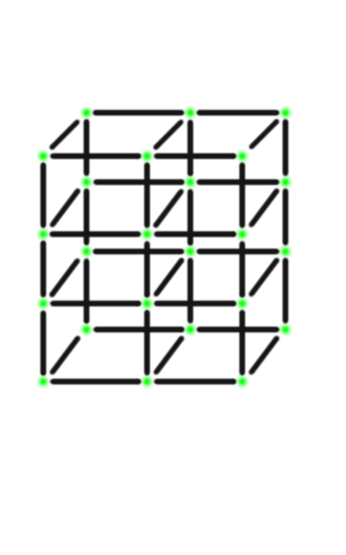
Masses
Masses in axis aligned cartesian grid
Form a grid of cubes with one mass on each vertex

Slide 31
Mass Simulation
Each mass is a structure:
struct Mass {
public:
Mass(…);
// data
float _mass;
float _x; float _y; float _z;
float _vx; float _vy; float _vz;
float _fx; float _fy; float _fz;
…
float _radius;
// states:
// 0 - unconstrained
// 1 - held
int _state;
};
Notes:
On the GPU, you can still access the fields of this data structure as if you were calling C++ code.

Slide 32
Mass Simulation
Each kernel call represents one RK4 increment.
masses.startFrame();
masses.clearForces();
springs.applySpringForces(masses);
masses.evaluateK1(dt, ground_collision);
…
masses.clearForces();
springs.applySpringForces(masses);
masses.evaluateK4(dt, ground_collision);
masses.update(dt, ground_collision);
masses.endFrame();
Notes:
Essentially, RK4 is a weighted average of 4 steps with Euler’s method.
Euler’s method is probably how you formulated Newton’s laws of motion in Physics class
U = v + at
X = s + ut
startFrame sets up computing state.
clearForces sets each mass force vector to 0.
applySpringForces sums and applies spring forces to each mass.
evaluateK* updates a RK4 step.
update performs RK4 weighted sum
endFrame

Slide 33
Springs
Simplified linear springs.
F = -k_s*(dx/l_0 -1) - k_d*dv
F = force on right mass
k_s = Young’s modulus
k_d = linear damping constant
dx = length of spring
l_0 = resting length of spring
dv = relative velocity of right mass to left mass
Notes:
Note: Make sure that the relative velocity is projected onto the axis of the spring.

Slide 34
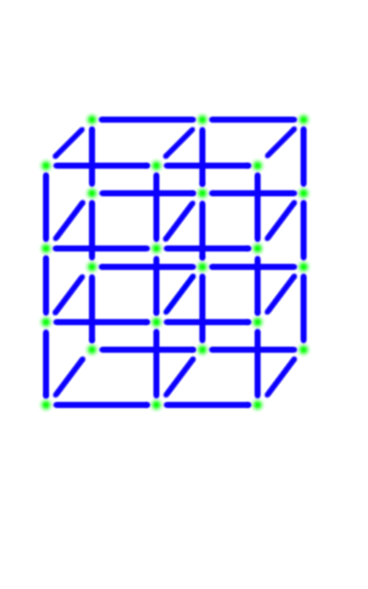
Structural Springs
Cartesian axis aligned springs connecting masses
Prevent collapsing along edges

Slide 35
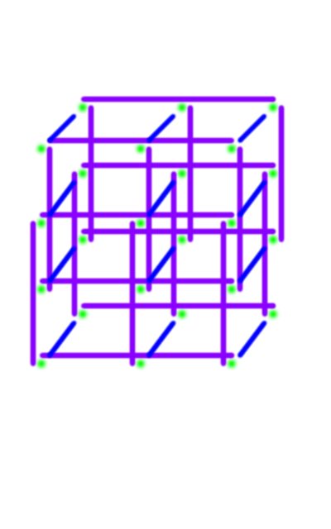
Bending Springs
Axis aligned springs between every second neighbor
Prevent edges bending
Simplification of axial bending springs
[Selle, A., Lentine, M., G., Fedkiw, R., A Mass Spring Model for Hair Simulation, ACM TOG 27, 64.1-64.11 (2008)]
Notes:
I have left in some blue structural springs in to help with depth perception.
Each spring connects two masses separated by one other mass.

Slide 36
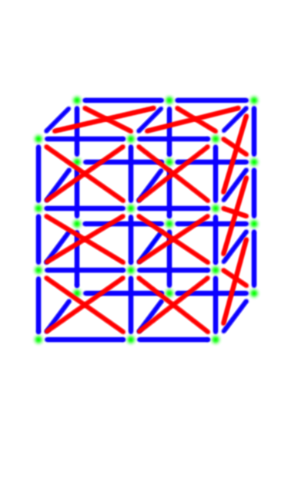
Shear Springs
Diagonal springs
Prevents planar shearing and twisting
Two diagonal springs per face and 4 interior springs per cube
Notes:
Removed back-face springs and interior-face springs for clarity.

Slide 37
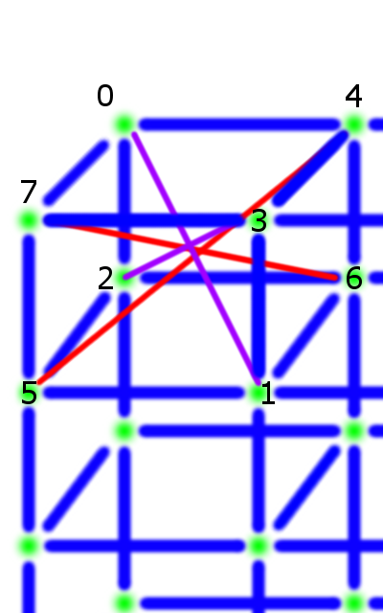
Interior Springs
4 interior springs per cube
connecting diagonally opposite vertices
Notes:
Interior shear springs connect 0 to 1, 2 to 3, 4 to 5, and 6 to 7

Slide 38
Springs
Each spring is a structure:
class Spring {
public:
Spring(
MassList &masses,
unsigned int mass0,
unsigned int mass1);
// data
unsigned int _mass0; // mass 0 index
unsigned int _mass1; // mass 1 index
float _l0; // resting length
// force applied to mass 0
float _fx0; float _fy0; float _fz0;
// force applied to mass 1
float _fx1; float _fy1; float _fz1;
};
Notes:
Note that you can refer to values in other GPU arrays using indices, e.g. _mass0 and _mass1 here.

Slide 39
Spring Forces
Spring forces calculated once per RK4 increment.
Two stages:
deviceComputeSpringForces() computes the force for each spring.
deviceApplySpringForces() sums forces from each spring attached to a mass.
Notes:
Spring forces calculated once per RK4 increment, which means they are evaluated 4 times each frame.
Note: On the CPU, we construct a mapping from masses to springs, so that we know which springs are attached to a given mass.
deviceComputeSpringForces() computes the force for each spring, storing results inside the spring struct.
-One thread per spring.
deviceApplySpringForces() sums forces from each spring attached to a mass, storing results inside the mass struct.
-One thread per mass, simply has a loop over each spring which indexes the mass.

Slide 40
Collisions
Bounding boxes are calculated around each object on the CPU.
Impulses from virtual springs push nearby particles apart.
O(n²) but still fast on the GPU.
Notes:
Impulses used because collisions act outside of the force computation loop and also, forces propagate too slowly through-out the network of masses.

Slide 41
CUDA to OpenGL
CUDA arrays can be shared with OpenGL buffers.
cudaGLSetGLDevice(int device)
cudaGraphicsGLRegisterBuffer(struct cudaGraphicsResource **resource,
GLuint buffer, unsigned int flags)
Notes:
You can directly transfer data from CUDA to OpenGL without having to transfer back and forth to the CPU.
This is not used in the demo but is generally useful for combining CUDA with GPU in tools.
Set the CUDA OpenGL device.
Register GL buffer for CUDA use.
A CUDA graphics resource is a handle for the OpenGL buffer in CUDA, we will use this handle to fill the buffer from a CUDA array.
Now the simulation is complete!

Slide 42
CUDA to OpenGL
cudaGraphicsMapResources(int count, cudaGraphicsResource_t *resources, cudaStream_t stream)
cudaGraphicsResourceGetMappedPointer(
void **devPtr, size_t *size, cudaGraphicsResource_t resource)
cudaGraphicsUnmapResources(int count, cudaGraphicsResource_t *resources,
cudaStream_t stream)
Notes:
Map CUDA resource (roughly equivalent to binding in OpenGL).
Get device pointer for buffer.
Unmap CUDA resource.

Slide 43
CUDA Debugging and Profiling
Parallel NSight debugger and profiler in Visual Studio and Eclipse
cuda-gdb and nvvp on Linux
Notes:
nvvp = NVIDIA Visual Profiler.
Visual Profiler is also available on Windows as a stand-alone application.
Demo visual profiler.

Slide 44
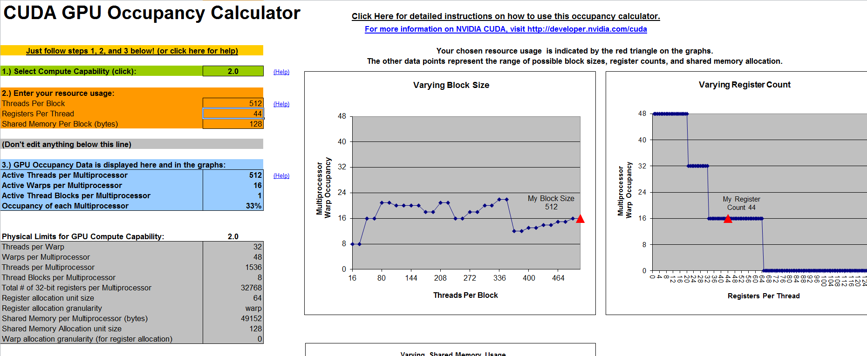
Occupancy Calculator
CUDA_Occupancy
Calculator.xls
Use this to determine threads-per-block
Get registers per thread from Visual Profiler

Slide 45
Performance
Runs at 30 fps on a Geforce 670M with 140k springs
Creates a plausible real-time simulation with 50k springs
Performance based on:
Occupancy
Coalesced memory access
Potential optimizations:
Compute bounding boxes on the GPU
Shared memory spring force accumulation
Structure of arrays (SOA)
Notes:
Runs interactively on this laptop but is much faster on a desktop GPU, around 50 fps, due to more cores and better memory bandwidth.
Occupancy is the number of currently active threads on a GPU vs the maximum number of active threads on a GPU.
Occupancy is determined by the number of threads assigned to a block (max 1536 on Fermi) and the number of blocks per streaming multiprocessor (max 8 on Fermi).
Performance is also limited by the number of registers required by a kernel, causing register spills.
Remember the occupancy calculator, use it!
Global memory accesses are slow, make accesses to global memory predictable and try to access each global memory array with the thread ID as your index.
Prefer SOA over AOS, it helps coalesce memory accesses!
Keep your kernels as simple and short as possible in terms of temporary results, focus on floating point calculations.
Important: registers spill to local memory (GPU memory), which is very slow. Minimize register spills!
Shared memory is accessible by multiple threads in a block, allows for more complex data-parallel algorithms such as parallel prefix and parallel sorting.

Slide 46
Future Work
Convert general purpose data-parallel tools to run on the GPU
Simulation, deformers, procedurals, etc.
Dynamic Parallelism
Notes:
NVIDIA’s Kepler architecture will allow for dynamic parallelism, where kernels will be able to call other kernels recursively.
We’re very excited about this because it allows for us to implement tree based algorithms and recursive algorithms more efficiently on the GPU.

Slide 47
Questions

Slide 48
Contact Info
Laurence Emms – lemms@pixar.com

