Slide 1
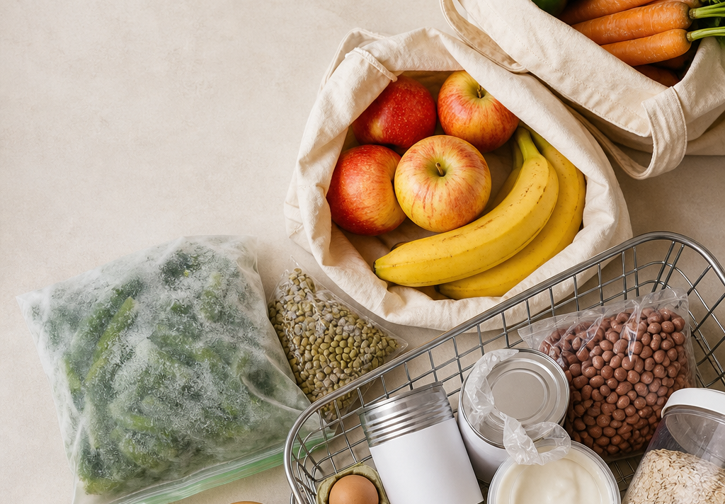

Mindful Diabetes Free Guides
501(c)(3) nonprofit health education
FREE GUIDE
The Grocery Store Survival Guide
How to Make Practical, Blood Sugar-Conscious Choices Without Feeling Overwhelmed
A warm, practical shopping guide for building a cart that fits your life, budget, schedule, and health needs.
Inside
Planning, cart formula, aisle strategies, product comparisons, label reading, backup meals, and a printable grocery list.
Published July 30, 2026 | Medical review pending
mindfuldiabetes.org
Notes:
[Sources]
- [1] U.S. Food and Drug Administration, How to Understand and Use the Nutrition Facts Label: https://www.fda.gov/food/nutrition-facts-label/how-understand-and-use-nutrition-facts-label
- [2] U.S. Food and Drug Administration, Daily Value on the Nutrition and Supplement Facts Labels: https://www.fda.gov/food/nutrition-facts-label/daily-value-nutrition-and-supplement-facts-labels
- [3] U.S. Food and Drug Administration, Added Sugars on the Nutrition Facts Label: https://www.fda.gov/food/nutrition-facts-label/added-sugars-nutrition-facts-label
- [4] Centers for Disease Control and Prevention, Counting Carbohydrates: https://www.cdc.gov/diabetes/healthy-eating/carb-counting.html
- [5] American Diabetes Association, What is the Diabetes Plate?: https://diabetesfoodhub.org/blog/what-diabetes-plate
- [6] U.S. Department of Agriculture, MyPlate: Fruits and Vegetables: https://www.myplate.gov/eat-healthy/fruits
- [7] U.S. Department of Agriculture, MyPlate: Dairy: https://www.myplate.gov/eat-healthy/dairy
- [8] U.S. Department of Agriculture, MyPlate: Protein Foods: https://www.myplate.gov/eat-healthy/protein-foods
- [9] U.S. Food and Drug Administration, Sodium in Your Diet: https://www.fda.gov/food/nutrition-education-resources-materials/sodium-your-diet

Slide 2
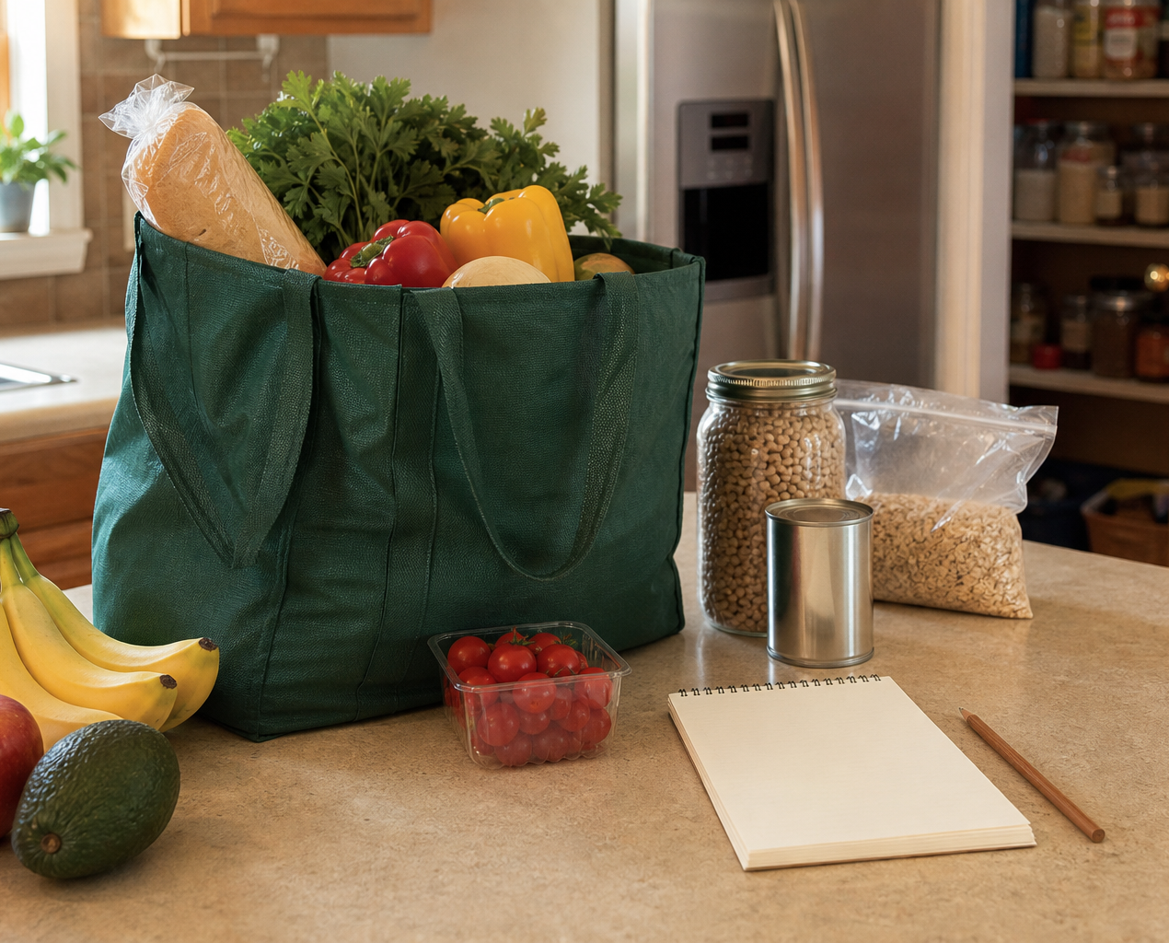
Grocery Store Survival Guide
Before you shop
BEFORE YOU SHOP
A short list you use beats an ideal list left at home
Start with what is already in your kitchen, then choose a few realistic meals for the week.
1
Check the refrigerator, freezer, and pantry.
2
Choose two or three meals.
3
Pick one or two backup meals.
4
Check the household schedule.
5
Write a short list.
6
Bring bags, coupons, mobility tools, or reminders.
Kind shopping rule
The goal is not a perfect cart. The goal is food you can use before it spoils, on days that are busy, tired, or unpredictable.
Mindful Diabetes Inc.
mindfuldiabetes.org
2
Notes:
[Sources]
- [1] U.S. Food and Drug Administration, How to Understand and Use the Nutrition Facts Label: https://www.fda.gov/food/nutrition-facts-label/how-understand-and-use-nutrition-facts-label
- [2] U.S. Food and Drug Administration, Daily Value on the Nutrition and Supplement Facts Labels: https://www.fda.gov/food/nutrition-facts-label/daily-value-nutrition-and-supplement-facts-labels
- [3] U.S. Food and Drug Administration, Added Sugars on the Nutrition Facts Label: https://www.fda.gov/food/nutrition-facts-label/added-sugars-nutrition-facts-label
- [4] Centers for Disease Control and Prevention, Counting Carbohydrates: https://www.cdc.gov/diabetes/healthy-eating/carb-counting.html
- [5] American Diabetes Association, What is the Diabetes Plate?: https://diabetesfoodhub.org/blog/what-diabetes-plate
- [6] U.S. Department of Agriculture, MyPlate: Fruits and Vegetables: https://www.myplate.gov/eat-healthy/fruits
- [7] U.S. Department of Agriculture, MyPlate: Dairy: https://www.myplate.gov/eat-healthy/dairy
- [8] U.S. Department of Agriculture, MyPlate: Protein Foods: https://www.myplate.gov/eat-healthy/protein-foods
- [9] U.S. Food and Drug Administration, Sodium in Your Diet: https://www.fda.gov/food/nutrition-education-resources-materials/sodium-your-diet

Slide 3
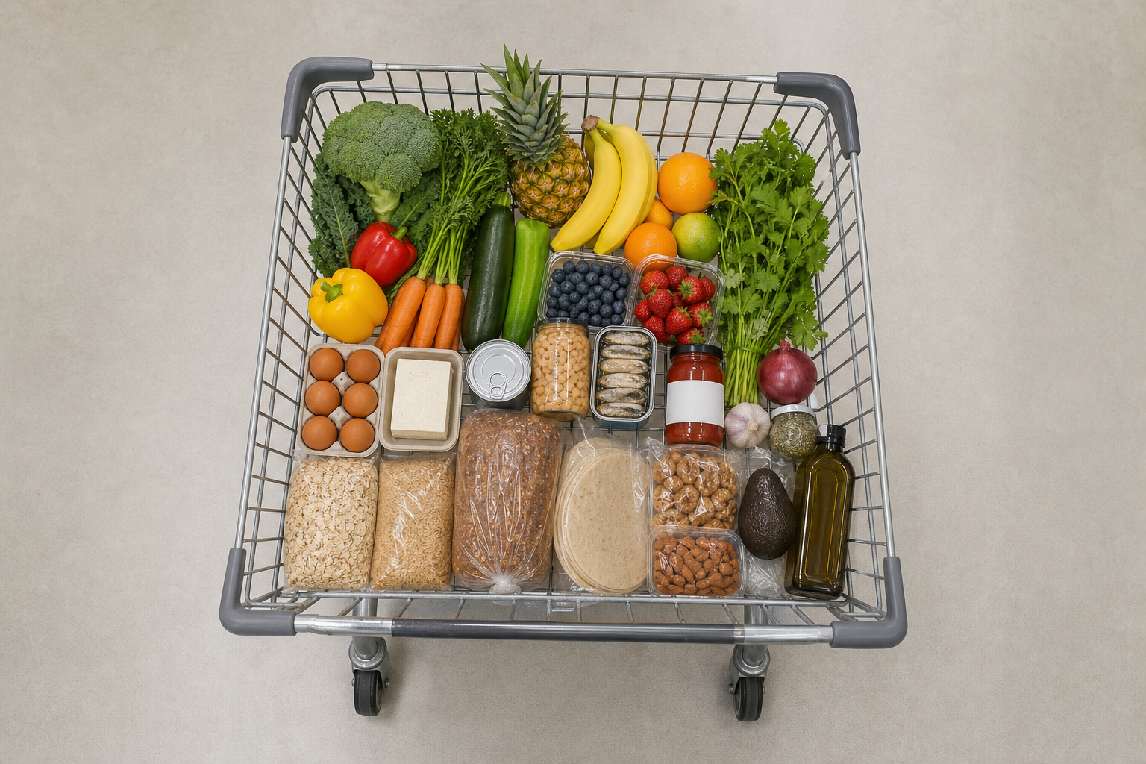
Grocery Store Survival Guide
Five-part cart
FIVE-PART CART
Use five flexible categories, not a perfect grocery script
The categories help you build meals. They do not need equal space in the cart, and fresh, frozen, canned, dried, and shelf-stable foods can all fit. [5]
Vegetables and fruit
fresh, frozen, canned
Protein
animal or plant
Fiber-rich carbs
Healthy fats
beans, oats, grains, fruit
nuts, seeds, oils
Flavor builders
spices, salsa, herbs
Use what works
Perimeter-only shopping can miss useful budget foods such as beans, oats, canned tomatoes, frozen vegetables, lentils, and shelf-stable fish.
Mindful Diabetes Inc.
mindfuldiabetes.org
3
Notes:
[Sources]
- [1] U.S. Food and Drug Administration, How to Understand and Use the Nutrition Facts Label: https://www.fda.gov/food/nutrition-facts-label/how-understand-and-use-nutrition-facts-label
- [2] U.S. Food and Drug Administration, Daily Value on the Nutrition and Supplement Facts Labels: https://www.fda.gov/food/nutrition-facts-label/daily-value-nutrition-and-supplement-facts-labels
- [3] U.S. Food and Drug Administration, Added Sugars on the Nutrition Facts Label: https://www.fda.gov/food/nutrition-facts-label/added-sugars-nutrition-facts-label
- [4] Centers for Disease Control and Prevention, Counting Carbohydrates: https://www.cdc.gov/diabetes/healthy-eating/carb-counting.html
- [5] American Diabetes Association, What is the Diabetes Plate?: https://diabetesfoodhub.org/blog/what-diabetes-plate
- [6] U.S. Department of Agriculture, MyPlate: Fruits and Vegetables: https://www.myplate.gov/eat-healthy/fruits
- [7] U.S. Department of Agriculture, MyPlate: Dairy: https://www.myplate.gov/eat-healthy/dairy
- [8] U.S. Department of Agriculture, MyPlate: Protein Foods: https://www.myplate.gov/eat-healthy/protein-foods
- [9] U.S. Food and Drug Administration, Sodium in Your Diet: https://www.fda.gov/food/nutrition-education-resources-materials/sodium-your-diet

Slide 4
Grocery Store Survival Guide
Produce
PRODUCE
Fresh, frozen, and canned all count
Choose vegetables and fruit you will actually use. Fresh can be wonderful, but it is not morally superior to frozen or canned options. [6]
Fresh
Frozen
Canned
Useful when it will be eaten before spoiling.
Helpful for convenience and reducing waste.
Useful for low-energy days and shelf stability.
Leafy greens
Broccoli
Tomatoes
Peppers
Mixed vegetables
Peaches in water or juice
Carrots
Berries
Carrots
Tomatoes
Greens
Vegetable mixes
What to check
For canned fruit, check syrup versus water or juice. For vegetables, compare sodium when practical. For frozen produce, check sauces and added sugars.
Mindful Diabetes Inc.
mindfuldiabetes.org
4
Notes:
[Sources]
- [1] U.S. Food and Drug Administration, How to Understand and Use the Nutrition Facts Label: https://www.fda.gov/food/nutrition-facts-label/how-understand-and-use-nutrition-facts-label
- [2] U.S. Food and Drug Administration, Daily Value on the Nutrition and Supplement Facts Labels: https://www.fda.gov/food/nutrition-facts-label/daily-value-nutrition-and-supplement-facts-labels
- [3] U.S. Food and Drug Administration, Added Sugars on the Nutrition Facts Label: https://www.fda.gov/food/nutrition-facts-label/added-sugars-nutrition-facts-label
- [4] Centers for Disease Control and Prevention, Counting Carbohydrates: https://www.cdc.gov/diabetes/healthy-eating/carb-counting.html
- [5] American Diabetes Association, What is the Diabetes Plate?: https://diabetesfoodhub.org/blog/what-diabetes-plate
- [6] U.S. Department of Agriculture, MyPlate: Fruits and Vegetables: https://www.myplate.gov/eat-healthy/fruits
- [7] U.S. Department of Agriculture, MyPlate: Dairy: https://www.myplate.gov/eat-healthy/dairy
- [8] U.S. Department of Agriculture, MyPlate: Protein Foods: https://www.myplate.gov/eat-healthy/protein-foods
- [9] U.S. Food and Drug Administration, Sodium in Your Diet: https://www.fda.gov/food/nutrition-education-resources-materials/sodium-your-diet

Slide 5

Grocery Store Survival Guide
Frozen foods
FROZEN FOODS
The freezer section can reduce waste and rescue dinner
Frozen foods can be affordable, fast, and useful. The package details matter more than the freezer aisle itself.
Frozen greens
Frozen berries
Soups, eggs, bowls, sauces.
Yogurt, oats, smoothies.
Mixed vegetables
Frozen fish
Fast side or stir-fry base.
Protein backup for busy weeks.
Check the package
Look for sauce, added sugar, sodium, serving size, protein, and vegetables. A simple frozen meal can still be supplemented with extra vegetables or protein.
Mindful Diabetes Inc.
mindfuldiabetes.org
5
Notes:
[Sources]
- [1] U.S. Food and Drug Administration, How to Understand and Use the Nutrition Facts Label: https://www.fda.gov/food/nutrition-facts-label/how-understand-and-use-nutrition-facts-label
- [2] U.S. Food and Drug Administration, Daily Value on the Nutrition and Supplement Facts Labels: https://www.fda.gov/food/nutrition-facts-label/daily-value-nutrition-and-supplement-facts-labels
- [3] U.S. Food and Drug Administration, Added Sugars on the Nutrition Facts Label: https://www.fda.gov/food/nutrition-facts-label/added-sugars-nutrition-facts-label
- [4] Centers for Disease Control and Prevention, Counting Carbohydrates: https://www.cdc.gov/diabetes/healthy-eating/carb-counting.html
- [5] American Diabetes Association, What is the Diabetes Plate?: https://diabetesfoodhub.org/blog/what-diabetes-plate
- [6] U.S. Department of Agriculture, MyPlate: Fruits and Vegetables: https://www.myplate.gov/eat-healthy/fruits
- [7] U.S. Department of Agriculture, MyPlate: Dairy: https://www.myplate.gov/eat-healthy/dairy
- [8] U.S. Department of Agriculture, MyPlate: Protein Foods: https://www.myplate.gov/eat-healthy/protein-foods
- [9] U.S. Food and Drug Administration, Sodium in Your Diet: https://www.fda.gov/food/nutrition-education-resources-materials/sodium-your-diet

Slide 6
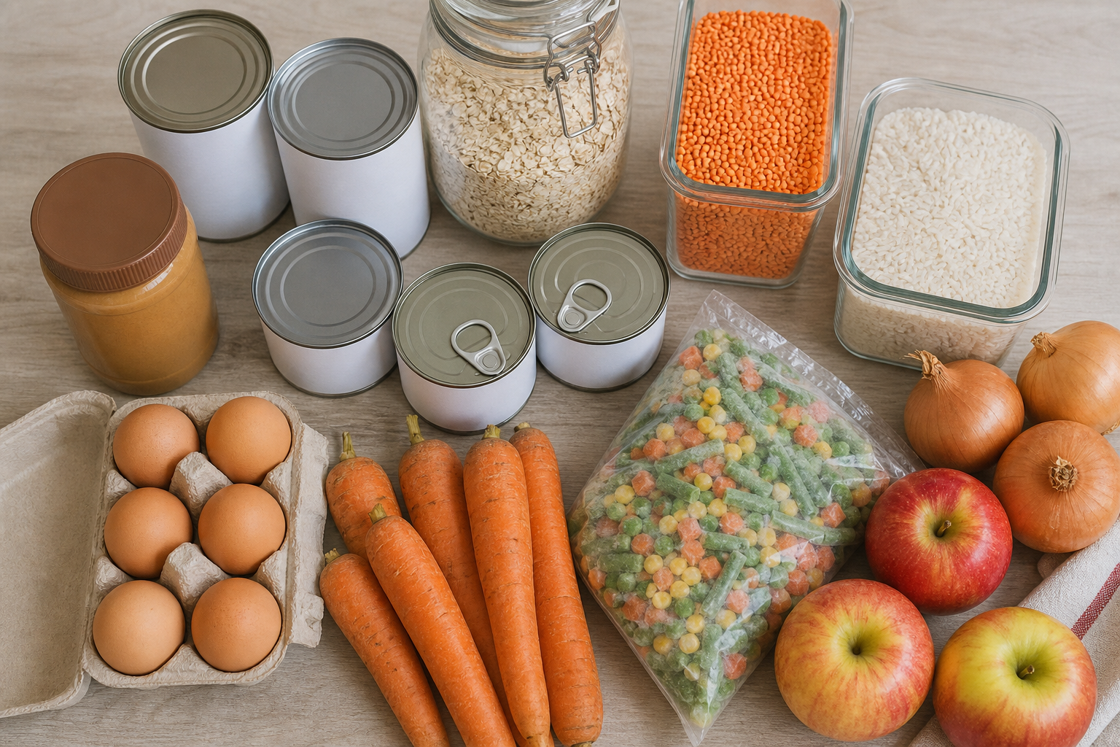
Grocery Store Survival Guide
Canned and shelf-stable
CANNED AND SHELF-STABLE
Pantry foods are not a fallback failure
Canned, dried, and shelf-stable foods can make useful emergency meals. Oats belong with pantry grains, not canned foods.
Canned beans
Canned tomatoes
Rinsing may reduce some sodium; draining changes the final contents.
Useful for soups, stews, sauces, and shakshuka-style meals.
Tuna, salmon, or chicken
Canned vegetables or fruit
Shelf-stable protein; compare sodium and serving size.
Look for sodium, syrup, water, or juice as needed.
Dried lentils
Oats
Quick-cooking pantry protein plus carbohydrate and fiber.
A pantry grain, useful for breakfast or baking, not canned food.
Backup meal idea
Keep one meal you can make when energy is low: beans plus tomatoes plus frozen vegetables, or soup plus extra protein and a whole-grain side.
Mindful Diabetes Inc.
mindfuldiabetes.org
6
Notes:
[Sources]
- [1] U.S. Food and Drug Administration, How to Understand and Use the Nutrition Facts Label: https://www.fda.gov/food/nutrition-facts-label/how-understand-and-use-nutrition-facts-label
- [2] U.S. Food and Drug Administration, Daily Value on the Nutrition and Supplement Facts Labels: https://www.fda.gov/food/nutrition-facts-label/daily-value-nutrition-and-supplement-facts-labels
- [3] U.S. Food and Drug Administration, Added Sugars on the Nutrition Facts Label: https://www.fda.gov/food/nutrition-facts-label/added-sugars-nutrition-facts-label
- [4] Centers for Disease Control and Prevention, Counting Carbohydrates: https://www.cdc.gov/diabetes/healthy-eating/carb-counting.html
- [5] American Diabetes Association, What is the Diabetes Plate?: https://diabetesfoodhub.org/blog/what-diabetes-plate
- [6] U.S. Department of Agriculture, MyPlate: Fruits and Vegetables: https://www.myplate.gov/eat-healthy/fruits
- [7] U.S. Department of Agriculture, MyPlate: Dairy: https://www.myplate.gov/eat-healthy/dairy
- [8] U.S. Department of Agriculture, MyPlate: Protein Foods: https://www.myplate.gov/eat-healthy/protein-foods
- [9] U.S. Food and Drug Administration, Sodium in Your Diet: https://www.fda.gov/food/nutrition-education-resources-materials/sodium-your-diet

Slide 7
Grocery Store Survival Guide
Protein choices
PROTEIN CHOICES
Choose by use, budget, culture, storage, and medical needs
Protein foods can be animal-based or plant-based. Beans and lentils provide protein, carbohydrate, and fiber, so they may matter in glucose planning. [8]
Quick fridge proteins
Freezer proteins
Eggs, yogurt, cottage cheese, tofu, tempeh.
Fish, poultry, lean meats, edamame, cooked beans.
Pantry proteins
Meal context
Beans, lentils, canned fish or chicken, nuts, seeds.
Tacos, soup, stir-fry, bowls, sandwiches, salads.
No moral ranking
The best protein option is the one that fits the meal, the household, allergies, taste, storage, preparation time, and medical needs.
Mindful Diabetes Inc.
mindfuldiabetes.org
7
Notes:
[Sources]
- [1] U.S. Food and Drug Administration, How to Understand and Use the Nutrition Facts Label: https://www.fda.gov/food/nutrition-facts-label/how-understand-and-use-nutrition-facts-label
- [2] U.S. Food and Drug Administration, Daily Value on the Nutrition and Supplement Facts Labels: https://www.fda.gov/food/nutrition-facts-label/daily-value-nutrition-and-supplement-facts-labels
- [3] U.S. Food and Drug Administration, Added Sugars on the Nutrition Facts Label: https://www.fda.gov/food/nutrition-facts-label/added-sugars-nutrition-facts-label
- [4] Centers for Disease Control and Prevention, Counting Carbohydrates: https://www.cdc.gov/diabetes/healthy-eating/carb-counting.html
- [5] American Diabetes Association, What is the Diabetes Plate?: https://diabetesfoodhub.org/blog/what-diabetes-plate
- [6] U.S. Department of Agriculture, MyPlate: Fruits and Vegetables: https://www.myplate.gov/eat-healthy/fruits
- [7] U.S. Department of Agriculture, MyPlate: Dairy: https://www.myplate.gov/eat-healthy/dairy
- [8] U.S. Department of Agriculture, MyPlate: Protein Foods: https://www.myplate.gov/eat-healthy/protein-foods
- [9] U.S. Food and Drug Administration, Sodium in Your Diet: https://www.fda.gov/food/nutrition-education-resources-materials/sodium-your-diet

Slide 8
Grocery Store Survival Guide
Plant proteins
PLANT PROTEINS
Canned beans count
You do not need to begin with dried beans. Start where your time, tools, digestion, and budget are today.
Beans
Lentils
Tacos, soups, bowls, salads.
Dal, soup, curry, salad.
Tofu
Tempeh
Stir-fry, bowls, scramble.
Skillet meals, sandwiches.
Edamame
Seasoning
Snacks, sides, bowls.
Cumin, garlic, ginger, curry, salsa, herbs.
Glucose planning note
Beans, lentils, and edamame are often filling because they bring protein and fiber, but they also contain carbohydrate. Use your own plan if you count carbs.
Mindful Diabetes Inc.
mindfuldiabetes.org
8
Notes:
[Sources]
- [1] U.S. Food and Drug Administration, How to Understand and Use the Nutrition Facts Label: https://www.fda.gov/food/nutrition-facts-label/how-understand-and-use-nutrition-facts-label
- [2] U.S. Food and Drug Administration, Daily Value on the Nutrition and Supplement Facts Labels: https://www.fda.gov/food/nutrition-facts-label/daily-value-nutrition-and-supplement-facts-labels
- [3] U.S. Food and Drug Administration, Added Sugars on the Nutrition Facts Label: https://www.fda.gov/food/nutrition-facts-label/added-sugars-nutrition-facts-label
- [4] Centers for Disease Control and Prevention, Counting Carbohydrates: https://www.cdc.gov/diabetes/healthy-eating/carb-counting.html
- [5] American Diabetes Association, What is the Diabetes Plate?: https://diabetesfoodhub.org/blog/what-diabetes-plate
- [6] U.S. Department of Agriculture, MyPlate: Fruits and Vegetables: https://www.myplate.gov/eat-healthy/fruits
- [7] U.S. Department of Agriculture, MyPlate: Dairy: https://www.myplate.gov/eat-healthy/dairy
- [8] U.S. Department of Agriculture, MyPlate: Protein Foods: https://www.myplate.gov/eat-healthy/protein-foods
- [9] U.S. Food and Drug Administration, Sodium in Your Diet: https://www.fda.gov/food/nutrition-education-resources-materials/sodium-your-diet

Slide 9
Grocery Store Survival Guide
Breads and grains
BREADS, GRAINS, CEREALS, AND TORTILLAS
Front-package claims are only the first sentence
Compare similar products by serving size, total carbohydrate, fiber, added sugar, saturated fat when relevant, ingredients, and what you enjoy.
Front claim
Useful next check
Why it matters
Multigrain
Ingredient list
May not mean whole grain
Whole grain
Fiber + carbs
Still compare serving sizes
Keto
Saturated fat + fiber
Claim alone is not enough
High-fiber
Serving size + tolerance
More is not always better
No added sugar
Total carbohydrate
May still contain starch
Store-shelf method
Pick two similar items, then compare the label. One number does not decide the best choice; the food has to fit your meal, taste, budget, and glucose plan.
Mindful Diabetes Inc.
mindfuldiabetes.org
9
Notes:
[Sources]
- [1] U.S. Food and Drug Administration, How to Understand and Use the Nutrition Facts Label: https://www.fda.gov/food/nutrition-facts-label/how-understand-and-use-nutrition-facts-label
- [2] U.S. Food and Drug Administration, Daily Value on the Nutrition and Supplement Facts Labels: https://www.fda.gov/food/nutrition-facts-label/daily-value-nutrition-and-supplement-facts-labels
- [3] U.S. Food and Drug Administration, Added Sugars on the Nutrition Facts Label: https://www.fda.gov/food/nutrition-facts-label/added-sugars-nutrition-facts-label
- [4] Centers for Disease Control and Prevention, Counting Carbohydrates: https://www.cdc.gov/diabetes/healthy-eating/carb-counting.html
- [5] American Diabetes Association, What is the Diabetes Plate?: https://diabetesfoodhub.org/blog/what-diabetes-plate
- [6] U.S. Department of Agriculture, MyPlate: Fruits and Vegetables: https://www.myplate.gov/eat-healthy/fruits
- [7] U.S. Department of Agriculture, MyPlate: Dairy: https://www.myplate.gov/eat-healthy/dairy
- [8] U.S. Department of Agriculture, MyPlate: Protein Foods: https://www.myplate.gov/eat-healthy/protein-foods
- [9] U.S. Food and Drug Administration, Sodium in Your Diet: https://www.fda.gov/food/nutrition-education-resources-materials/sodium-your-diet

Slide 10
Grocery Store Survival Guide
Dairy and alternatives
DAIRY AND ALTERNATIVES
The cooler section is not one category nutritionally
Milk and yogurt often contain carbohydrate. Cheese usually has little carbohydrate, but can add saturated fat and sodium. Fortified soy milk differs from many other plant beverages. [7]
Milk
Plain yogurt
Check serving size, carbohydrate, and how you use it.
Check protein and added sugar; add fruit if desired.
Flavored yogurt
Cheese
Check added sugar and total carbohydrate.
Often lower carb; compare sodium and saturated fat.
Fortified soy milk
Other plant drinks
Often closer to dairy milk for protein than many alternatives.
Almond, oat, coconut, and rice beverages vary widely.
Comparison prompts
Is it sweetened? How much protein? Is it fortified? Does it fit allergies, preferences, kidney needs, or other medical considerations?
Mindful Diabetes Inc.
mindfuldiabetes.org
10
Notes:
[Sources]
- [1] U.S. Food and Drug Administration, How to Understand and Use the Nutrition Facts Label: https://www.fda.gov/food/nutrition-facts-label/how-understand-and-use-nutrition-facts-label
- [2] U.S. Food and Drug Administration, Daily Value on the Nutrition and Supplement Facts Labels: https://www.fda.gov/food/nutrition-facts-label/daily-value-nutrition-and-supplement-facts-labels
- [3] U.S. Food and Drug Administration, Added Sugars on the Nutrition Facts Label: https://www.fda.gov/food/nutrition-facts-label/added-sugars-nutrition-facts-label
- [4] Centers for Disease Control and Prevention, Counting Carbohydrates: https://www.cdc.gov/diabetes/healthy-eating/carb-counting.html
- [5] American Diabetes Association, What is the Diabetes Plate?: https://diabetesfoodhub.org/blog/what-diabetes-plate
- [6] U.S. Department of Agriculture, MyPlate: Fruits and Vegetables: https://www.myplate.gov/eat-healthy/fruits
- [7] U.S. Department of Agriculture, MyPlate: Dairy: https://www.myplate.gov/eat-healthy/dairy
- [8] U.S. Department of Agriculture, MyPlate: Protein Foods: https://www.myplate.gov/eat-healthy/protein-foods
- [9] U.S. Food and Drug Administration, Sodium in Your Diet: https://www.fda.gov/food/nutrition-education-resources-materials/sodium-your-diet

Slide 11
Grocery Store Survival Guide
Snacks
SNACKS
A planned snack can be useful, and some people may not need one
Snacking is not a character test. If snacks help your schedule, medication plan, activity, or hunger, make them practical.
Fruit + nuts
Yogurt + berries
Portable, filling, easy to repeat.
Protein plus fruit; check added sugar.
Hummus + vegetables
Egg + fruit
Fiber, flavor, and crunch.
Simple protein plus carbohydrate.
Crackers + tuna
Roasted chickpeas
Shelf-stable option with protein.
Crunchy, portable, contains carbs and fiber.
Nut butter + apple
Popcorn + another food
Satisfying; portion as needed.
May need protein or fat if it does not last.
Medication safety
If you use insulin or medicines that can cause low blood sugar, ask your care team how snacks, activity, and low-glucose treatment should be handled.
Mindful Diabetes Inc.
mindfuldiabetes.org
11
Notes:
[Sources]
- [1] U.S. Food and Drug Administration, How to Understand and Use the Nutrition Facts Label: https://www.fda.gov/food/nutrition-facts-label/how-understand-and-use-nutrition-facts-label
- [2] U.S. Food and Drug Administration, Daily Value on the Nutrition and Supplement Facts Labels: https://www.fda.gov/food/nutrition-facts-label/daily-value-nutrition-and-supplement-facts-labels
- [3] U.S. Food and Drug Administration, Added Sugars on the Nutrition Facts Label: https://www.fda.gov/food/nutrition-facts-label/added-sugars-nutrition-facts-label
- [4] Centers for Disease Control and Prevention, Counting Carbohydrates: https://www.cdc.gov/diabetes/healthy-eating/carb-counting.html
- [5] American Diabetes Association, What is the Diabetes Plate?: https://diabetesfoodhub.org/blog/what-diabetes-plate
- [6] U.S. Department of Agriculture, MyPlate: Fruits and Vegetables: https://www.myplate.gov/eat-healthy/fruits
- [7] U.S. Department of Agriculture, MyPlate: Dairy: https://www.myplate.gov/eat-healthy/dairy
- [8] U.S. Department of Agriculture, MyPlate: Protein Foods: https://www.myplate.gov/eat-healthy/protein-foods
- [9] U.S. Food and Drug Administration, Sodium in Your Diet: https://www.fda.gov/food/nutrition-education-resources-materials/sodium-your-diet

Slide 12
Grocery Store Survival Guide
Drinks
DRINKS
Change one frequent drink before changing everything
Sweet drinks can add sugar quickly, but the next step can be gradual. Juice is not universally forbidden; context and portion matter.
Water
Sparkling water
Tea or coffee
Smaller sweet drink
default
unsweetened
watch add-ins
step-down option
Soda
Sweet tea
Juice
Energy/sports drinks
sugar quickly adds up
sugar varies
portion and purpose matter
check sugar and caffeine
Alcohol safety
Alcohol can interact with diabetes medicines and can affect glucose decisions. Ask your clinician what is safe for you, especially if you use insulin or medicines that can cause lows.
Mindful Diabetes Inc.
mindfuldiabetes.org
12
Notes:
[Sources]
- [1] U.S. Food and Drug Administration, How to Understand and Use the Nutrition Facts Label: https://www.fda.gov/food/nutrition-facts-label/how-understand-and-use-nutrition-facts-label
- [2] U.S. Food and Drug Administration, Daily Value on the Nutrition and Supplement Facts Labels: https://www.fda.gov/food/nutrition-facts-label/daily-value-nutrition-and-supplement-facts-labels
- [3] U.S. Food and Drug Administration, Added Sugars on the Nutrition Facts Label: https://www.fda.gov/food/nutrition-facts-label/added-sugars-nutrition-facts-label
- [4] Centers for Disease Control and Prevention, Counting Carbohydrates: https://www.cdc.gov/diabetes/healthy-eating/carb-counting.html
- [5] American Diabetes Association, What is the Diabetes Plate?: https://diabetesfoodhub.org/blog/what-diabetes-plate
- [6] U.S. Department of Agriculture, MyPlate: Fruits and Vegetables: https://www.myplate.gov/eat-healthy/fruits
- [7] U.S. Department of Agriculture, MyPlate: Dairy: https://www.myplate.gov/eat-healthy/dairy
- [8] U.S. Department of Agriculture, MyPlate: Protein Foods: https://www.myplate.gov/eat-healthy/protein-foods
- [9] U.S. Food and Drug Administration, Sodium in Your Diet: https://www.fda.gov/food/nutrition-education-resources-materials/sodium-your-diet

Slide 13
Grocery Store Survival Guide
Nutrition Facts label
NUTRITION FACTS LABEL
Start with serving size, then scan what matters for your meal
The label is a comparison tool, not a personal portion prescription. Use it alongside your own plan and the way you will eat the food. [1,2]
Nutrition Facts
1
Serving size describes the label.
Serving size
1 cup
1
Servings per container
2
2
2
Servings per container can change the math.
Calories
240
Total Fat
12g 15%
3
Total carbohydrate is the main carb line.
Saturated Fat
4g 20%
6
4
Fiber is included in total carbohydrate.
Sodium
480mg 21%
7
Total Carbohydrate
34g 12%
3
5
Added sugar is separate from total sugars.
Dietary Fiber
4g 14%
4
Total Sugars
12g
6
Saturated fat helps compare similar foods.
Added Sugars
8g 16%
5
7
Sodium and %DV help with comparison.
Fast rule of thumb
For many nutrients, 5% Daily Value or less is low and 20% Daily Value or more is high. The amount is per labeled serving. [2]
Mindful Diabetes Inc.
mindfuldiabetes.org
13
Notes:
[Sources]
- [1] U.S. Food and Drug Administration, How to Understand and Use the Nutrition Facts Label: https://www.fda.gov/food/nutrition-facts-label/how-understand-and-use-nutrition-facts-label
- [2] U.S. Food and Drug Administration, Daily Value on the Nutrition and Supplement Facts Labels: https://www.fda.gov/food/nutrition-facts-label/daily-value-nutrition-and-supplement-facts-labels
- [3] U.S. Food and Drug Administration, Added Sugars on the Nutrition Facts Label: https://www.fda.gov/food/nutrition-facts-label/added-sugars-nutrition-facts-label
- [4] Centers for Disease Control and Prevention, Counting Carbohydrates: https://www.cdc.gov/diabetes/healthy-eating/carb-counting.html
- [5] American Diabetes Association, What is the Diabetes Plate?: https://diabetesfoodhub.org/blog/what-diabetes-plate
- [6] U.S. Department of Agriculture, MyPlate: Fruits and Vegetables: https://www.myplate.gov/eat-healthy/fruits
- [7] U.S. Department of Agriculture, MyPlate: Dairy: https://www.myplate.gov/eat-healthy/dairy
- [8] U.S. Department of Agriculture, MyPlate: Protein Foods: https://www.myplate.gov/eat-healthy/protein-foods
- [9] U.S. Food and Drug Administration, Sodium in Your Diet: https://www.fda.gov/food/nutrition-education-resources-materials/sodium-your-diet

Slide 14
Grocery Store Survival Guide
Carbs and added sugar
CARBS AND ADDED SUGAR
Added sugar is one clue; total carbohydrate is still the main carb line
Total carbohydrate includes starch, sugars, added sugars, and fiber. It can matter for carbohydrate-counting or glucose-management plans. [3,4]
Total carbohydrate includes
Ingredient words
Still check
Syrup, dextrose, sucrose
Total carbohydrate
Starches
Honey, agave, molasses
Added sugars + serving size
Sugars
Juice concentrate
Total carbs and portion
Added sugars
No sugar added
May not be low carbohydrate
Fiber
Sugar-free
May not be carbohydrate-free
Plain-English takeaway
Ingredient names can help you notice added sweeteners. They do not replace the Nutrition Facts label or your portion.
Mindful Diabetes Inc.
mindfuldiabetes.org
14
Notes:
[Sources]
- [1] U.S. Food and Drug Administration, How to Understand and Use the Nutrition Facts Label: https://www.fda.gov/food/nutrition-facts-label/how-understand-and-use-nutrition-facts-label
- [2] U.S. Food and Drug Administration, Daily Value on the Nutrition and Supplement Facts Labels: https://www.fda.gov/food/nutrition-facts-label/daily-value-nutrition-and-supplement-facts-labels
- [3] U.S. Food and Drug Administration, Added Sugars on the Nutrition Facts Label: https://www.fda.gov/food/nutrition-facts-label/added-sugars-nutrition-facts-label
- [4] Centers for Disease Control and Prevention, Counting Carbohydrates: https://www.cdc.gov/diabetes/healthy-eating/carb-counting.html
- [5] American Diabetes Association, What is the Diabetes Plate?: https://diabetesfoodhub.org/blog/what-diabetes-plate
- [6] U.S. Department of Agriculture, MyPlate: Fruits and Vegetables: https://www.myplate.gov/eat-healthy/fruits
- [7] U.S. Department of Agriculture, MyPlate: Dairy: https://www.myplate.gov/eat-healthy/dairy
- [8] U.S. Department of Agriculture, MyPlate: Protein Foods: https://www.myplate.gov/eat-healthy/protein-foods
- [9] U.S. Food and Drug Administration, Sodium in Your Diet: https://www.fda.gov/food/nutrition-education-resources-materials/sodium-your-diet

Slide 15
Grocery Store Survival Guide
Fiber
FIBER
Compare similar foods, then increase gradually
Fiber-rich foods can support fullness, digestive health, overall dietary quality, cholesterol management, and more balanced meals. Individual glucose and digestive responses vary.
Vegetables
Beans
Lentils
Oats
Whole grains
Berries
Nuts
Seeds
Nutrition Facts
Nutrition Facts
Option 1
Option 2
Serving size
1 bar
Serving size
1 bar
Total carb
28g
Total carb
29g
Dietary fiber
2g 7%
Dietary fiber
6g 21%
Added sugars
9g 18%
Added sugars
5g 10%
Sodium
120mg 5%
Sodium
150mg 7%
Comfort note
Increase fiber gradually, drink fluids, and adjust for digestive conditions, kidney needs, medications, and your care team's advice.
Mindful Diabetes Inc.
mindfuldiabetes.org
15
Notes:
[Sources]
- [1] U.S. Food and Drug Administration, How to Understand and Use the Nutrition Facts Label: https://www.fda.gov/food/nutrition-facts-label/how-understand-and-use-nutrition-facts-label
- [2] U.S. Food and Drug Administration, Daily Value on the Nutrition and Supplement Facts Labels: https://www.fda.gov/food/nutrition-facts-label/daily-value-nutrition-and-supplement-facts-labels
- [3] U.S. Food and Drug Administration, Added Sugars on the Nutrition Facts Label: https://www.fda.gov/food/nutrition-facts-label/added-sugars-nutrition-facts-label
- [4] Centers for Disease Control and Prevention, Counting Carbohydrates: https://www.cdc.gov/diabetes/healthy-eating/carb-counting.html
- [5] American Diabetes Association, What is the Diabetes Plate?: https://diabetesfoodhub.org/blog/what-diabetes-plate
- [6] U.S. Department of Agriculture, MyPlate: Fruits and Vegetables: https://www.myplate.gov/eat-healthy/fruits
- [7] U.S. Department of Agriculture, MyPlate: Dairy: https://www.myplate.gov/eat-healthy/dairy
- [8] U.S. Department of Agriculture, MyPlate: Protein Foods: https://www.myplate.gov/eat-healthy/protein-foods
- [9] U.S. Food and Drug Administration, Sodium in Your Diet: https://www.fda.gov/food/nutrition-education-resources-materials/sodium-your-diet

Slide 16
Grocery Store Survival Guide
Sodium
SODIUM
Compare similar products before deciding
The FDA Daily Value for sodium is 2,300 mg per day. The %DV is per labeled serving, and individual recommendations may differ. [2,9]
Nutrition Facts
Nutrition Facts
Option 1 canned soup
Option 2 canned soup
Serving size
1 cup
Serving size
1 cup
Servings/container
2
Servings/container
2
Sodium
520mg 23%
Sodium
760mg 33%
Total carb
24g 9%
Total carb
23g 8%
Protein
9g
Protein
10g
How to compare
First compare the same serving size. Then ask how much you will actually eat, how often you buy it, and what else is in the meal.
Daily Value cue
For many nutrients, 5% DV or less is generally low and 20% DV or more is generally high. One label line does not make a food universally good or bad.
Mindful Diabetes Inc.
mindfuldiabetes.org
16
Notes:
[Sources]
- [1] U.S. Food and Drug Administration, How to Understand and Use the Nutrition Facts Label: https://www.fda.gov/food/nutrition-facts-label/how-understand-and-use-nutrition-facts-label
- [2] U.S. Food and Drug Administration, Daily Value on the Nutrition and Supplement Facts Labels: https://www.fda.gov/food/nutrition-facts-label/daily-value-nutrition-and-supplement-facts-labels
- [3] U.S. Food and Drug Administration, Added Sugars on the Nutrition Facts Label: https://www.fda.gov/food/nutrition-facts-label/added-sugars-nutrition-facts-label
- [4] Centers for Disease Control and Prevention, Counting Carbohydrates: https://www.cdc.gov/diabetes/healthy-eating/carb-counting.html
- [5] American Diabetes Association, What is the Diabetes Plate?: https://diabetesfoodhub.org/blog/what-diabetes-plate
- [6] U.S. Department of Agriculture, MyPlate: Fruits and Vegetables: https://www.myplate.gov/eat-healthy/fruits
- [7] U.S. Department of Agriculture, MyPlate: Dairy: https://www.myplate.gov/eat-healthy/dairy
- [8] U.S. Department of Agriculture, MyPlate: Protein Foods: https://www.myplate.gov/eat-healthy/protein-foods
- [9] U.S. Food and Drug Administration, Sodium in Your Diet: https://www.fda.gov/food/nutrition-education-resources-materials/sodium-your-diet

Slide 17
Grocery Store Survival Guide
Claims and ingredients
INGREDIENT LISTS AND MARKETING CLAIMS
Front labels can be useful, but they are not the whole story
Claims may be helpful clues. They do not replace the Nutrition Facts label, ingredient list, serving size, and your health needs. [1,3]
No sugar added
Sugar-free
Natural
Multigrain
Front
Front
Front
Front
Keto
Low-fat
High-protein
Organic
Front
Front
Front
Front
Back-of-package checks
Serving size, total carbohydrate, fiber, added sugar, saturated fat, sodium, and ingredient list. Net carbs is not one of the standard Nutrition Facts lines. [1]
Mindful Diabetes Inc.
mindfuldiabetes.org
17
Notes:
[Sources]
- [1] U.S. Food and Drug Administration, How to Understand and Use the Nutrition Facts Label: https://www.fda.gov/food/nutrition-facts-label/how-understand-and-use-nutrition-facts-label
- [2] U.S. Food and Drug Administration, Daily Value on the Nutrition and Supplement Facts Labels: https://www.fda.gov/food/nutrition-facts-label/daily-value-nutrition-and-supplement-facts-labels
- [3] U.S. Food and Drug Administration, Added Sugars on the Nutrition Facts Label: https://www.fda.gov/food/nutrition-facts-label/added-sugars-nutrition-facts-label
- [4] Centers for Disease Control and Prevention, Counting Carbohydrates: https://www.cdc.gov/diabetes/healthy-eating/carb-counting.html
- [5] American Diabetes Association, What is the Diabetes Plate?: https://diabetesfoodhub.org/blog/what-diabetes-plate
- [6] U.S. Department of Agriculture, MyPlate: Fruits and Vegetables: https://www.myplate.gov/eat-healthy/fruits
- [7] U.S. Department of Agriculture, MyPlate: Dairy: https://www.myplate.gov/eat-healthy/dairy
- [8] U.S. Department of Agriculture, MyPlate: Protein Foods: https://www.myplate.gov/eat-healthy/protein-foods
- [9] U.S. Food and Drug Administration, Sodium in Your Diet: https://www.fda.gov/food/nutrition-education-resources-materials/sodium-your-diet

Slide 18
Grocery Store Survival Guide
Budget strategies
BUDGET STRATEGIES
Let budget be part of the plan, not a source of shame
A realistic plan uses what is already available and avoids buying aspirational foods that will not be eaten.
Shop the kitchen first.
Plan meals around what is already available.
Compare unit prices.
Use store brands.
Use frozen vegetables.
Use canned beans.
Buy seasonal produce when useful.
Freeze leftovers.
Build pantry backup meals.
Reduce waste before adding more variety.
Useful question
Will I actually eat this before it spoils? That question can protect both your budget and your energy.
Mindful Diabetes Inc.
mindfuldiabetes.org
18
Notes:
[Sources]
- [1] U.S. Food and Drug Administration, How to Understand and Use the Nutrition Facts Label: https://www.fda.gov/food/nutrition-facts-label/how-understand-and-use-nutrition-facts-label
- [2] U.S. Food and Drug Administration, Daily Value on the Nutrition and Supplement Facts Labels: https://www.fda.gov/food/nutrition-facts-label/daily-value-nutrition-and-supplement-facts-labels
- [3] U.S. Food and Drug Administration, Added Sugars on the Nutrition Facts Label: https://www.fda.gov/food/nutrition-facts-label/added-sugars-nutrition-facts-label
- [4] Centers for Disease Control and Prevention, Counting Carbohydrates: https://www.cdc.gov/diabetes/healthy-eating/carb-counting.html
- [5] American Diabetes Association, What is the Diabetes Plate?: https://diabetesfoodhub.org/blog/what-diabetes-plate
- [6] U.S. Department of Agriculture, MyPlate: Fruits and Vegetables: https://www.myplate.gov/eat-healthy/fruits
- [7] U.S. Department of Agriculture, MyPlate: Dairy: https://www.myplate.gov/eat-healthy/dairy
- [8] U.S. Department of Agriculture, MyPlate: Protein Foods: https://www.myplate.gov/eat-healthy/protein-foods
- [9] U.S. Food and Drug Administration, Sodium in Your Diet: https://www.fda.gov/food/nutrition-education-resources-materials/sodium-your-diet

Slide 19
Grocery Store Survival Guide
Ten-minute meals
TEN-MINUTE MEAL FORMULAS
Build from a base, a protein, a vegetable or fruit, and flavor
These are flexible formulas, not prescriptions. Swap based on culture, budget, appetite, allergies, tools, and what is already in the kitchen.
Taco or tortilla meal
Rice bowl
Tortilla + beans or protein + cabbage or frozen vegetables + salsa or avocado
Rice + tofu, egg, fish, or chicken + frozen stir-fry vegetables + sauce
Pantry plate
Soup upgrade
Crackers or bread + tuna, hummus, or beans + cucumber, carrots, or fruit
Canned soup + extra vegetables + beans, chicken, tofu, or egg + whole-grain side
Backup meal line
Write one formula on your grocery list. Repeating a meal that works is not boring; it is a way to lower decision fatigue.
Mindful Diabetes Inc.
mindfuldiabetes.org
19
Notes:
[Sources]
- [1] U.S. Food and Drug Administration, How to Understand and Use the Nutrition Facts Label: https://www.fda.gov/food/nutrition-facts-label/how-understand-and-use-nutrition-facts-label
- [2] U.S. Food and Drug Administration, Daily Value on the Nutrition and Supplement Facts Labels: https://www.fda.gov/food/nutrition-facts-label/daily-value-nutrition-and-supplement-facts-labels
- [3] U.S. Food and Drug Administration, Added Sugars on the Nutrition Facts Label: https://www.fda.gov/food/nutrition-facts-label/added-sugars-nutrition-facts-label
- [4] Centers for Disease Control and Prevention, Counting Carbohydrates: https://www.cdc.gov/diabetes/healthy-eating/carb-counting.html
- [5] American Diabetes Association, What is the Diabetes Plate?: https://diabetesfoodhub.org/blog/what-diabetes-plate
- [6] U.S. Department of Agriculture, MyPlate: Fruits and Vegetables: https://www.myplate.gov/eat-healthy/fruits
- [7] U.S. Department of Agriculture, MyPlate: Dairy: https://www.myplate.gov/eat-healthy/dairy
- [8] U.S. Department of Agriculture, MyPlate: Protein Foods: https://www.myplate.gov/eat-healthy/protein-foods
- [9] U.S. Food and Drug Administration, Sodium in Your Diet: https://www.fda.gov/food/nutrition-education-resources-materials/sodium-your-diet

Slide 20
Grocery Store Survival Guide
Checklist
PRINTABLE GROCERY CHECKLIST
Make one list that works for your household
Use this as a starting point. Add what fits your family, budget, culture, medical needs, and schedule.
Shop my kitchen first: refrigerator
Qty
Flavor builders
Qty
Shop my kitchen first: freezer
Qty
Dairy or alternatives
Qty
Shop my kitchen first: pantry
Qty
Drinks
Qty
Produce
Qty
Snacks
Qty
Protein
Qty
Pantry and freezer backups
Qty
Fiber-rich carbohydrates
Qty
Household or non-food items
Qty
Healthy fats
Qty
Meals planned
Backup meals
Already have
Need to buy / budget
Store or household notes
Mindful Diabetes Inc.
mindfuldiabetes.org
20
Notes:
[Sources]
- [1] U.S. Food and Drug Administration, How to Understand and Use the Nutrition Facts Label: https://www.fda.gov/food/nutrition-facts-label/how-understand-and-use-nutrition-facts-label
- [2] U.S. Food and Drug Administration, Daily Value on the Nutrition and Supplement Facts Labels: https://www.fda.gov/food/nutrition-facts-label/daily-value-nutrition-and-supplement-facts-labels
- [3] U.S. Food and Drug Administration, Added Sugars on the Nutrition Facts Label: https://www.fda.gov/food/nutrition-facts-label/added-sugars-nutrition-facts-label
- [4] Centers for Disease Control and Prevention, Counting Carbohydrates: https://www.cdc.gov/diabetes/healthy-eating/carb-counting.html
- [5] American Diabetes Association, What is the Diabetes Plate?: https://diabetesfoodhub.org/blog/what-diabetes-plate
- [6] U.S. Department of Agriculture, MyPlate: Fruits and Vegetables: https://www.myplate.gov/eat-healthy/fruits
- [7] U.S. Department of Agriculture, MyPlate: Dairy: https://www.myplate.gov/eat-healthy/dairy
- [8] U.S. Department of Agriculture, MyPlate: Protein Foods: https://www.myplate.gov/eat-healthy/protein-foods
- [9] U.S. Food and Drug Administration, Sodium in Your Diet: https://www.fda.gov/food/nutrition-education-resources-materials/sodium-your-diet

Slide 21
Make the store easier next time
Save one list that worked, one backup meal, and one product comparison. The next grocery trip gets easier when you do not start from scratch.
Explore the Guide
mindfuldiabetes.org/guide/
Visit Health Tools
mindfuldiabetes.org/health-tools/
Try JEIR
mindfuldiabetes.org/research/
Support free education
mindfuldiabetes.org/donation/
Medical disclaimer
This guide is general education, not medical advice, diagnosis, or treatment. Do not change medication, insulin, glucose targets, or a prescribed medical diet based on this guide.
Mindful Diabetes Inc. | 501(c)(3) nonprofit | Free to share for education
Notes:
[Sources]
- [1] U.S. Food and Drug Administration, How to Understand and Use the Nutrition Facts Label: https://www.fda.gov/food/nutrition-facts-label/how-understand-and-use-nutrition-facts-label
- [2] U.S. Food and Drug Administration, Daily Value on the Nutrition and Supplement Facts Labels: https://www.fda.gov/food/nutrition-facts-label/daily-value-nutrition-and-supplement-facts-labels
- [3] U.S. Food and Drug Administration, Added Sugars on the Nutrition Facts Label: https://www.fda.gov/food/nutrition-facts-label/added-sugars-nutrition-facts-label
- [4] Centers for Disease Control and Prevention, Counting Carbohydrates: https://www.cdc.gov/diabetes/healthy-eating/carb-counting.html
- [5] American Diabetes Association, What is the Diabetes Plate?: https://diabetesfoodhub.org/blog/what-diabetes-plate
- [6] U.S. Department of Agriculture, MyPlate: Fruits and Vegetables: https://www.myplate.gov/eat-healthy/fruits
- [7] U.S. Department of Agriculture, MyPlate: Dairy: https://www.myplate.gov/eat-healthy/dairy
- [8] U.S. Department of Agriculture, MyPlate: Protein Foods: https://www.myplate.gov/eat-healthy/protein-foods
- [9] U.S. Food and Drug Administration, Sodium in Your Diet: https://www.fda.gov/food/nutrition-education-resources-materials/sodium-your-diet

Slide 22
Grocery Store Survival Guide
References and safety
REFERENCES AND SAFETY
References and medical disclaimer
Every numbered citation in this guide appears here.
Medical disclaimer
This guide provides general health education. It is not medical advice, diagnosis, treatment, nutrition therapy, or a medication plan. Do not change insulin, diabetes medication, cholesterol medication, glucose targets, pregnancy care, kidney-disease care, or any prescribed medical diet because of this guide. For urgent symptoms, seek medical care.
References
1. U.S. Food and Drug Administration. How to Understand and Use the Nutrition Facts Label. FDA; 2024. https://www.fda.gov/food/nutrition-facts-label/how-understand-and-use-nutrition-facts-label
2. U.S. Food and Drug Administration. Daily Value on the Nutrition and Supplement Facts Labels. FDA; 2024. https://www.fda.gov/food/nutrition-facts-label/daily-value-nutrition-and-supplement-facts-labels
3. U.S. Food and Drug Administration. Added Sugars on the Nutrition Facts Label. FDA; 2026. https://www.fda.gov/food/nutrition-facts-label/added-sugars-nutrition-facts-label
4. Centers for Disease Control and Prevention. Counting Carbohydrates. CDC; 2024. https://www.cdc.gov/diabetes/healthy-eating/carb-counting.html
5. American Diabetes Association. What is the Diabetes Plate?. ADA; 2026. https://diabetesfoodhub.org/blog/what-diabetes-plate
6. U.S. Department of Agriculture. MyPlate: Fruits and Vegetables. USDA MyPlate; 2026. https://www.myplate.gov/eat-healthy/fruits
7. U.S. Department of Agriculture. MyPlate: Dairy. USDA MyPlate; 2026. https://www.myplate.gov/eat-healthy/dairy
8. U.S. Department of Agriculture. MyPlate: Protein Foods. USDA MyPlate; 2026. https://www.myplate.gov/eat-healthy/protein-foods
9. U.S. Food and Drug Administration. Sodium in Your Diet. FDA; 2024. https://www.fda.gov/food/nutrition-education-resources-materials/sodium-your-diet
Publication information
Published July 30, 2026 | Medical review pending | Next scheduled review July 2027 | Accessibility review: basic visual QA completed; PDF/UA tagging not completed.
Mindful Diabetes Inc.
mindfuldiabetes.org
22
Notes:
[Sources]
- [1] U.S. Food and Drug Administration, How to Understand and Use the Nutrition Facts Label: https://www.fda.gov/food/nutrition-facts-label/how-understand-and-use-nutrition-facts-label
- [2] U.S. Food and Drug Administration, Daily Value on the Nutrition and Supplement Facts Labels: https://www.fda.gov/food/nutrition-facts-label/daily-value-nutrition-and-supplement-facts-labels
- [3] U.S. Food and Drug Administration, Added Sugars on the Nutrition Facts Label: https://www.fda.gov/food/nutrition-facts-label/added-sugars-nutrition-facts-label
- [4] Centers for Disease Control and Prevention, Counting Carbohydrates: https://www.cdc.gov/diabetes/healthy-eating/carb-counting.html
- [5] American Diabetes Association, What is the Diabetes Plate?: https://diabetesfoodhub.org/blog/what-diabetes-plate
- [6] U.S. Department of Agriculture, MyPlate: Fruits and Vegetables: https://www.myplate.gov/eat-healthy/fruits
- [7] U.S. Department of Agriculture, MyPlate: Dairy: https://www.myplate.gov/eat-healthy/dairy
- [8] U.S. Department of Agriculture, MyPlate: Protein Foods: https://www.myplate.gov/eat-healthy/protein-foods
- [9] U.S. Food and Drug Administration, Sodium in Your Diet: https://www.fda.gov/food/nutrition-education-resources-materials/sodium-your-diet

