Slide 1




Future & Technology
The
Star Wars
PRESENTED BY B10707112 Yoann Yen

Slide 2

Introduction – How to Play
Program Explains
Program Exhibition
COVERED TODAY
MAIN POINTS OF PRESENTATION
Yoann Yen

Slide 3

FOR INSPIRATION
Today's science fiction is tomorrow's science fact.
Isaac Asimov

Slide 4
HOW TO PLAY?
Controller
PlayerA
Left - q
Right - e
Shoot - w
PlayerB
Left - u
Right - o
Shoot - i
Drop out - p
Yoann Yen

Slide 5
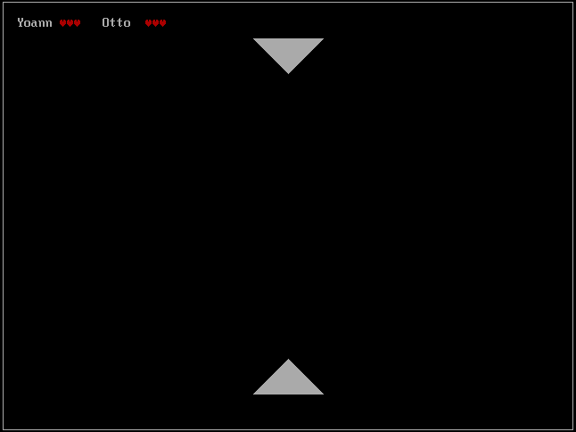
Print Tringle
Using ”WrPixel dx,cx,07h” to
make a Grey Tringle
Delete Tringle
Using ”WrPixel dx,cx,00h” to
make a Black Tringle

