Slide 1
Welcome to the PowerHour
Brief overview of the the problem (10 mins)
Discussion in small groups (challenges and solutions) (3:10 – 3:45)
Report back (3:45 – 4:00)
Keep the discussions and solutions going (4:00 till Friday and beyond!)
Notes:
I want to acknowledge that there are many pressing issues of underrepresentation and biases to discus the relate to race, gender identity, and sexuality. Basically, issues that directly impact anyone who is not white, straight and gender conforming.
We are leading a discussion about women in science today from our own perspective, as straight white women.

Slide 2
Presentation Overview
Women are leaving Academia
Why? – Implicit Biases
Why? – Unique challenges
Let’s discuss!

Slide 3
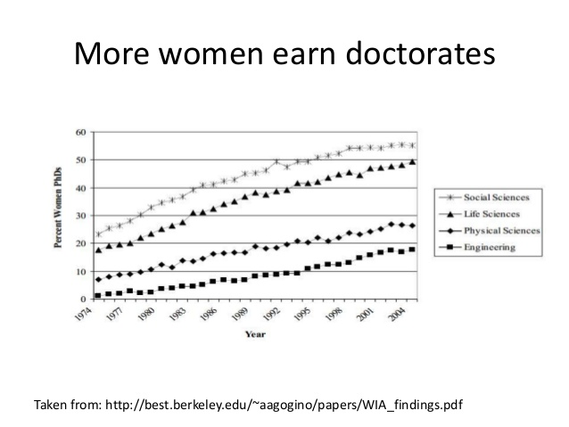
1- Women Are Leaving Academia

Slide 4
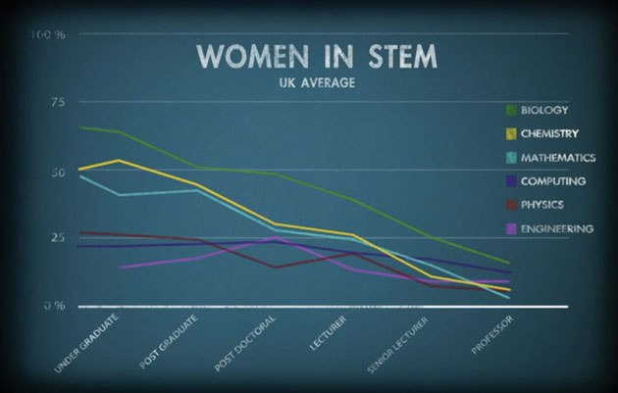
Image from https://www.chemicalimbalance.ed.ac.uk/

Slide 5
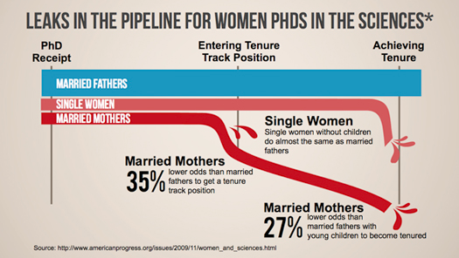
There are problems:
Women are not retained in academia in proportion to their abundance in the educational pipeline
Research suggests the reasons for this are largely related to social perceptions and their institutional manifestations
Notes:
https://blogs.sjsu.edu/sciencepolicy/files/2014/07/thumb-pipeline_sci-155jw4q.jpg

Slide 6
The Gender Penalty
Decreased Salary
Shen et al. 2010. Why women earn less: Just two factors explain post-PhD pay gap. Nature
Decreased Funding (4%)
Van der lee & Ellemers. 2015. Gender contributes to personal research funding success in The Netherlands. PNAS.
Decreased Awards and Prizes
Lincoln et al. 2012. The Matilda Effect in science: Awards and prizes in the US, 1990s and 2000s. Social Studies of Science.
Decreased in Hiring and Mentoring
Moss-Rascusin et al. 2012. Science faculty’s subtle gender biases favor male students. PNAS
Decreased Publication (8%)
Budden et al. 2008. Double-blind review favours increased representation of female authors. Trends in Ecology and Evolution
=> These differences are not associated with differences in productivity or performance

Slide 7
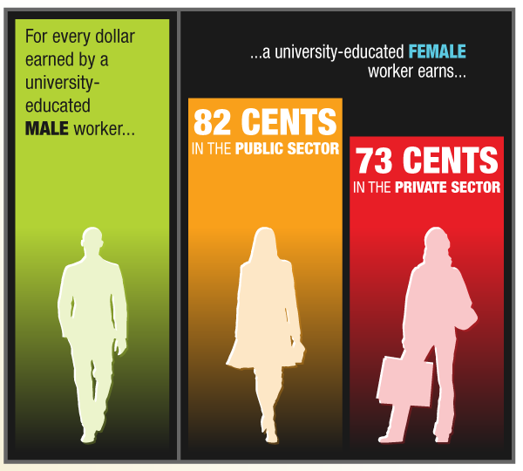
The Gender pay gap
Faculty at McMaster University, same rank: $3515
Faculty at UBC, same rank: $3000
Canadian universities in 2006, same rank: $4,000-5,000 gap.
All jobs in Canada: $8000 gap

Slide 8
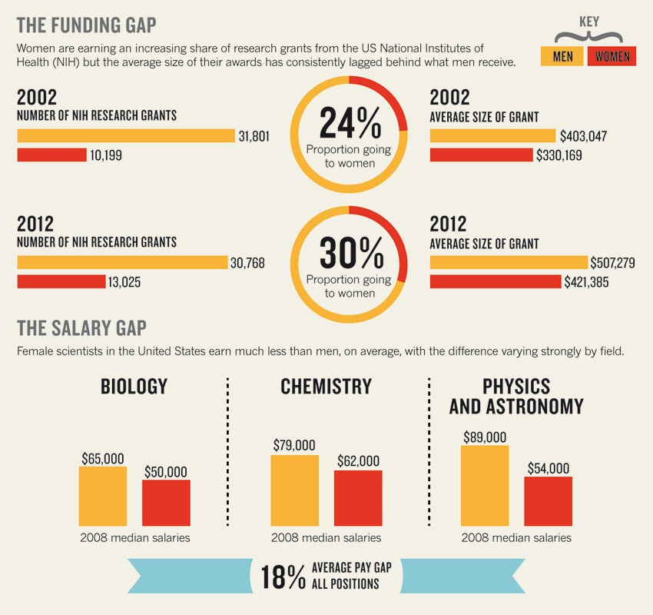
Shen. Nature. 2013. vol.495

Slide 9
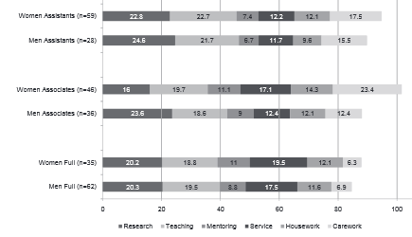
The time gap: Women faculty do more service and mentoring and men faculty do more research
research
teaching
grad
service
+ 2 hours teaching, service, mentoring
- 2 hours research
+ 8 hours teaching, service, mentoring
- 8 hours research
+ 5 hours teaching, service, mentoring
- 0 hours research

Slide 10
The time gap: Women faculty have less time for research also because they spend 4-14 hours more on “chores” at home
research
teaching
grad
service
domestic

Slide 11
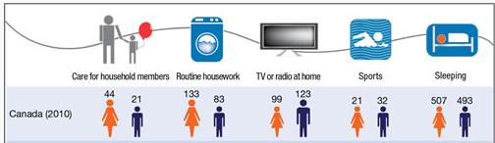
Canadian women do 70% more domestic chores (>1 hour per day) than men, and have 30% less leisure time as a result.

Slide 12
2- Why? Unconscious/Implicit Bias
Unconscious bias refers to the assumptions and conclusions we jump to without thinking
We all have them!
These biases do not indicate hostility towards certain groups; they reflect how the individual has been socialized.

Slide 13
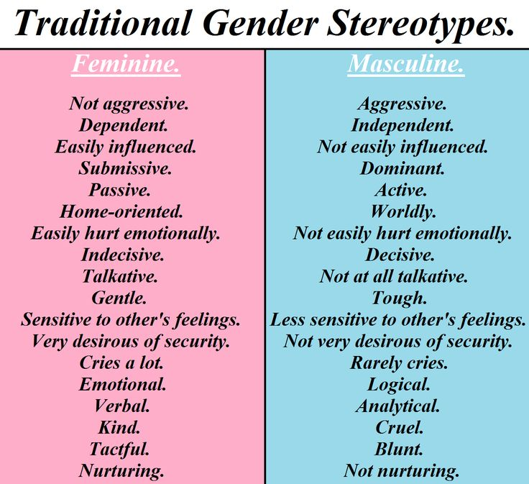
These are also qualities we look for in scientists,
So the idea of a woman scientist clashes with our implicit biases.
At work, women are expected to put the good of the group ahead of themselves
But that’s not how one advances their scientific career!
Yet women exhibiting these behaviors can be perceived as “Bossy”

Slide 14
Leading to extra hurdles
Prove-it-Again. Two-thirds of the women interviewed, and two-thirds of the women surveyed, reported having to prove themselves over and over again – their successes discounted, their expertise questioned.
The Tightrope. Women need to behave in masculine ways in order to be seen as competent—but women are also expected to be feminine. So women find themselves walking a tightrope between being seen as too feminine to be competent.
https://hbr.org/2015/03/the-5-biases-pushing-women-out-of-stem
http://www.uchastings.edu/news/articles/2015/01/double-jeopardy-report.pdf

Slide 15
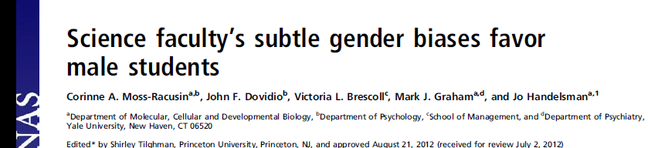
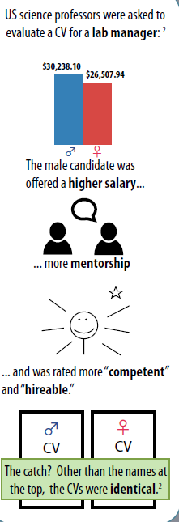
“female and male faculty were equally likely to exhibit bias against the female student”

Slide 16
3 – Group Discussion
Form sub-groups by career stage now- 3h45pm
Grads / PostDocs / Pre-Tenured Profs / Post-Tenured Profs
Identify the main challenges for minorities in science at your career stage
Identify potential solutions
Share with larger group 3h45-4h00pm

Slide 18
The little things that add up
Women are less likely to promote themselves
Women feel like they have less time to mentor
Women suffer more from imposter syndrome
Saying things in meetings and other people getting credit for their ideas
Not being viewed as an expert in outreach contexts
Not thinking of women when nominating women as reviewers, award recipients etc.

Slide 19
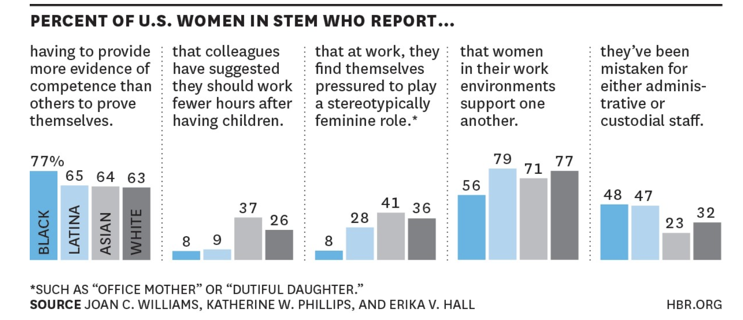

Slide 20

Pattern 1: Prove-it-Again. Two-thirds of the women interviewed, and two-thirds of the women surveyed, reported having to prove themselves over and over again – their successes discounted, their expertise questioned. “People just assume you’re not going to be able to cut it,” a statistician told us, in a typical comment.
Pattern 2: The Tightrope. Women need to behave in masculine ways in order to be seen as competent—but women are expected to be feminine. So women find themselves walking a tightrope between being seen as too feminine to be competent, and too masculine to be likable.
Pattern 3: The Maternal Wall. When professional women have children, they often find themselves running into a wall: their commitment and competence are questioned, and opportunities start drying up.
Pattern 4: Tug-of-War. Studies show that women who have encountered discrimination early in their careers often distance themselves from other women; gender bias against women fuels conflict among women
Pattern 5: Isolation. “A lot of times,” said a microbiologist, “There are things that people exclude me from because they say, ‘Oh, she’s going to be the only black person there… just don’t invite her, she won’t feel comfortable.’”

Slide 21
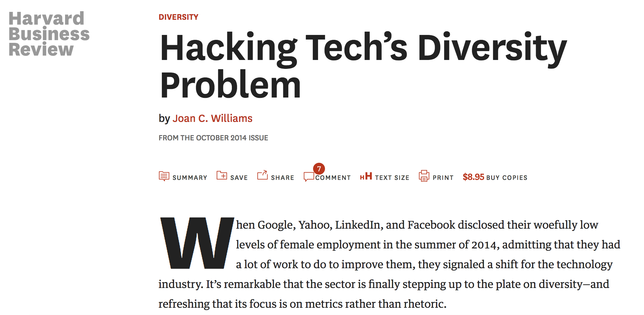

Slide 22
Solutions
When nominating people for seminar speakers, awards, working groups, etc: think about it, and consult lists (https://diversifyeeb.wordpress.com/about/)
Perceived competitiveness: promote your colleagues and recognize their success
Do implicit bias training
Recommendation letters
Mentoring programs

Slide 23
Grad student strategies
-Have open discussions involving all members of their dept about bias, microagressions, inappropriate behavior and harassment
-Have elected grad student liasons and identified allies in the faculty to facilitate these conversations
-Greater transparency about how bias would be dealt with, for example in a handbook, so that it was clear how reporting and enforcement would work

Slide 24
Postdoc strategies
-Establish contact people for postdocs among the faculty
-Build a postdoc network to allow easy exchange among postdocs and actively recruit postdocs into this network
-Provide a support network and raise awareness for issues related to pregnancy leave and childcare
-Establish formalized networking opportunities at conferences, e.g. apps at meetings, poster previews as part of talks

Slide 25
Assistant Professors
-Enforce mandatory unconscious bias training for all committees, especially for all members of search committees
-Try to mutually reinforce each other during committee discussions; work as allies to have a stronger voice. If you see something, say something.
- If presence on committees is required, provide relief from other departmental responsibilities; permit selection of which committees to serve on and mentorship on which committees to prioritize

Slide 26
Associate professors
-Provide mentorship for promotion to full
-Hire more women and underrepresented scientists: have interview pool reflect diversity of applicant or current PhD pool in the field
-Letter writing: are you using gender-biased vocabulary?
-Be aware of unrealistic expectations of who should be on committees. If women are not equally rep'd among faculty, expecting 50% rep'n on committees creates an undue service burden
-Reminder at the beginning of committee meetings that unconscious bias exists to limit effects

Slide 27
Full professors
-Communicate positive messages about our profession
-Seminars: Increase representation of women and other underrepresented groups as speakers to illustrate positive role models
-Create opportunities for yourself; e.g. invite yourself to give seminars and nominate yourself or ask someone to nominate you for awards

