Slide 1
Welcome to the power hour
Brief overview of the the problem (5 mins)
Discussion in small groups (challenges and solutions) (3:10 – 3:40)
Report back (3:40 – 4:00)
Keep the discussions and solutions going (4:00 till Friday and beyond!)

Slide 2
Overview
Women are leaving Academia
Why? – Implicit Biases
Why? – Unique challenges
Let’s discuss!
Notes:
I want to acknowledge that there are many pressing issues of underrepresentation and biases to discus the relate to race, gender identity, and sexuality. Basically, issues that directly impact anyone who is not white, straight and gender conforming.
We are leading a discussion about women in science today from our own perspective, as straight white women.
White women are not the answer to diversity in science.

Slide 3
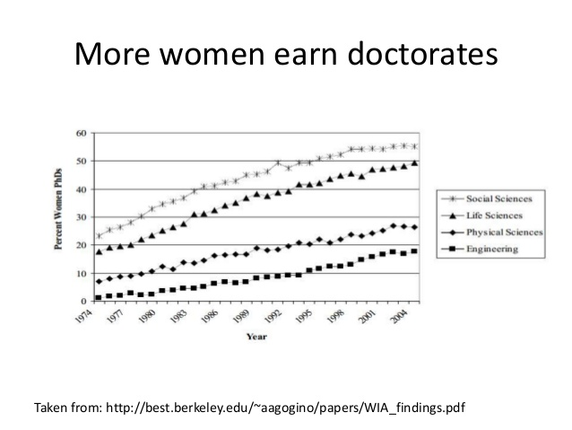
1- Women Are Leaving Academia

Slide 4
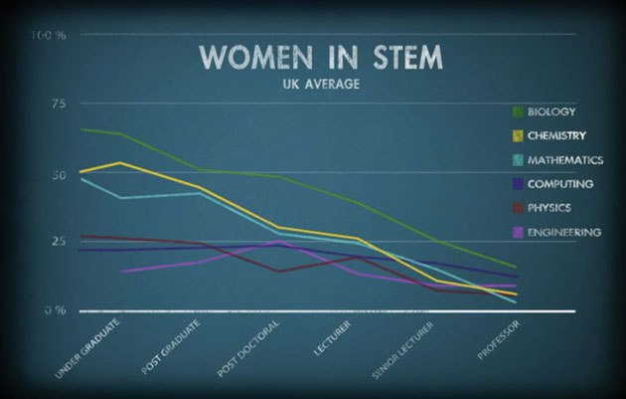
After that…
Image from https://www.chemicalimbalance.ed.ac.uk/

Slide 5
The Gender Penalty
Decreased Salary
Shen et al. 2010. Why women earn less: Just two factors explain post-PhD pay gap. Nature
Decreased in Hiring and Mentoring
Moss-Rascusin et al. 2012. Science faculty’s subtle gender biases favor male students. PNAS
Decreased Funding (4%)
Van der lee & Ellemers. 2015. Gender contributes to personal research funding success in The Netherlands. PNAS.
Decreased Awards and Prizes
Lincoln et al. 2012. The Matilda Effect in science: Awards and prizes in the US, 1990s and 2000s. Social Studies of Science.
Decreased Publication (8%)
Budden et al. 2008. Double-blind review favours increased representation of female authors. Trends in Ecology and Evolution
=> These differences are not associated with differences in productivity or performance

Slide 6
Differences in recommendation letters
Qualities mentioned in recommendation letters for women differ sharply from those for men.
Female candidates described in more communal (social or emotive) terms
Male candidates in more agentic (active or assertive) terms
The more communal characteristics mentioned, the lower the evaluation of the candidate
Madera et al. 2009. Gender and Letters of Recommendation for Academia: Agentic and communal differences. Journal of Applied Psychology

Slide 7
2- Why? Unconscious/Implicit Bias
Unconscious bias refers to the assumptions and conclusions we jump to without thinking
We all have them!
These biases do not indicate hostility towards certain groups; they reflect how the individual has been socialized.

Slide 8
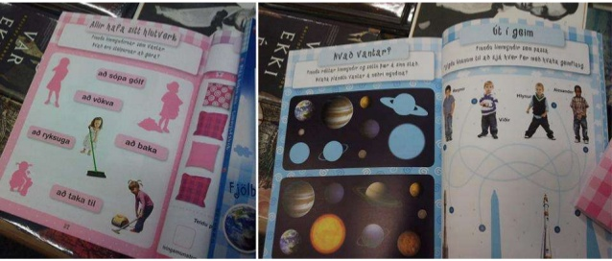
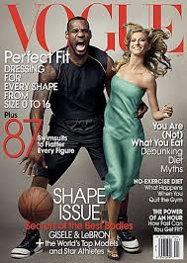
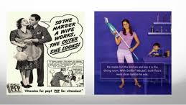
Different social standards for adequate male/female behavior

Slide 9
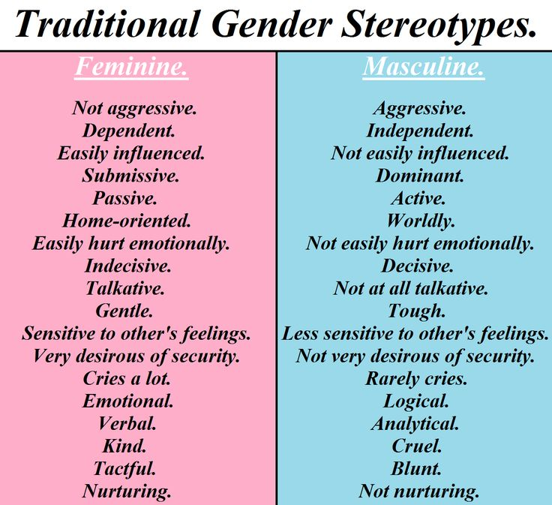
These are also qualities we look for in scientists,
So the idea of a woman scientist clashes with our implicit biases.
At work, women are expected to put the good of the group ahead of themselves
But that’s not how one advances their scientific career!
Yet women exhibiting these behaviors can be perceived as “Bossy”

Slide 10
Leading to extra hurdles
Prove-it-Again. Two-thirds of the women interviewed, and two-thirds of the women surveyed, reported having to prove themselves over and over again – their successes discounted, their expertise questioned.
The Tightrope. Women need to behave in masculine ways in order to be seen as competent—but women are also expected to be feminine. So women find themselves walking a tightrope between being seen as too feminine to be competent.
https://hbr.org/2015/03/the-5-biases-pushing-women-out-of-stem
http://www.uchastings.edu/news/articles/2015/01/double-jeopardy-report.pdf

Slide 11
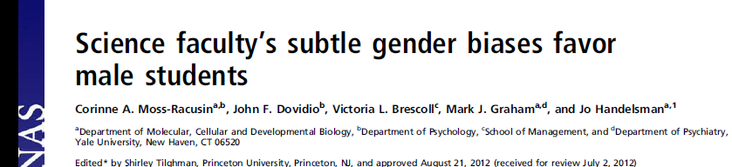
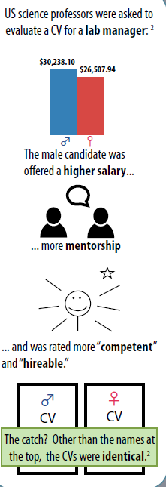
“female and male faculty were equally likely to exhibit bias against the female student”

Slide 12

Am I biased?
https://implicit.harvard.edu/implicit/
Thinking one is bias-free is particularly harmful
“ In the present studies, priming a sense of personal objectivity increased gender discrimination”
Uhlmann & cohen. 2006. “I think therefore it’s true”: Effects of self-perceived objectivity on hiring discrimination. Organisational Behavior and human decision Processes.

Slide 13
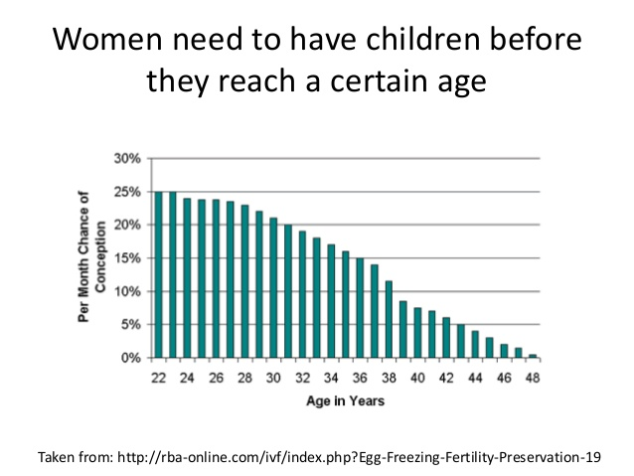
3 - Unique Challenges
Academic career timelines are elongating.
Average age for tenure in the science in 1985: 36
Average age for tenure in the science in 2003: 39

Slide 14
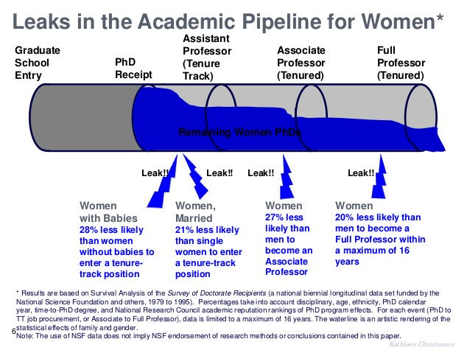

Slide 15
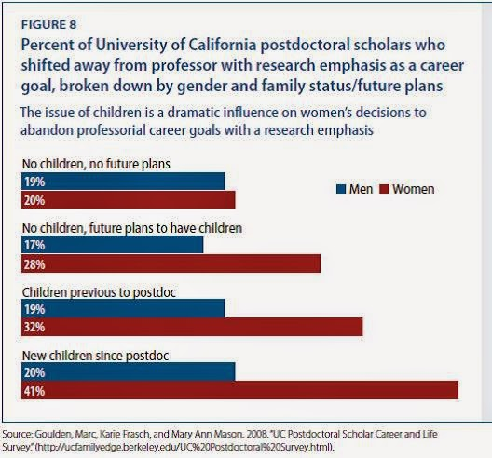
Choosing between family and career
“Marriage and Childbirth accounts for the largest leaks in the pipeline between Ph.D. receipt and the acquisition of tenure for women in the sciences”
https://cdn.americanprogress.org/wp-content/uploads/issues/2009/11/pdf/women_and_sciences.pdf

Slide 16
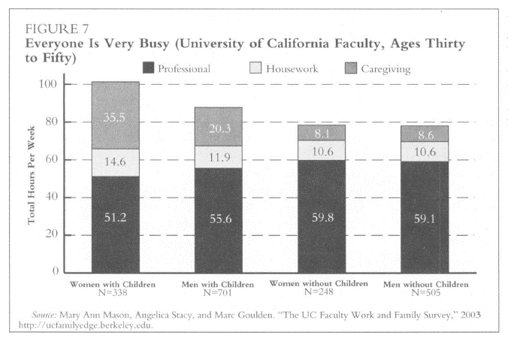
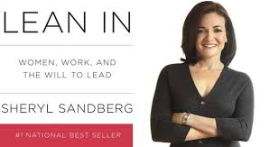
Uneven HouseWork sharing
Women tend to spend more hours caregiving than man
“Make your partner a real partner”
Mason & Goulden. 2004. Do Babies Matter (Part II). Closing the Baby Gap. Academe

Slide 17
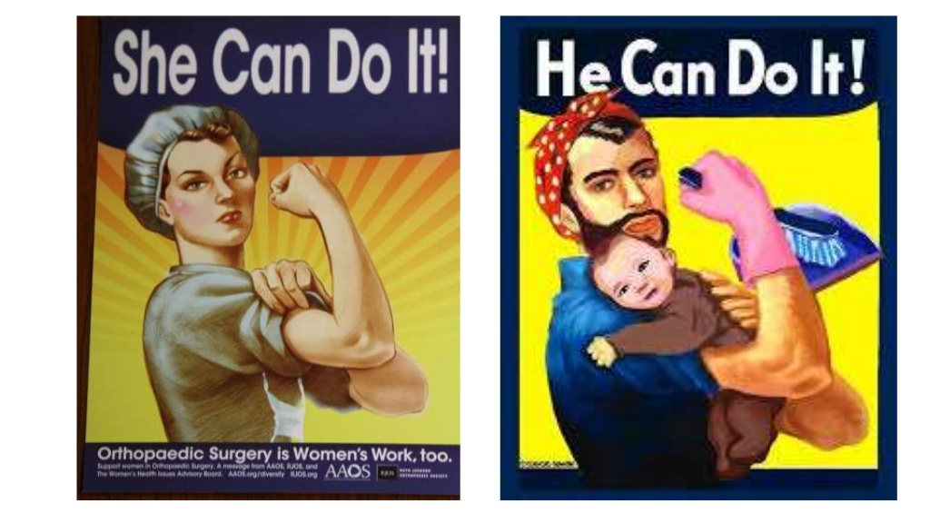

Slide 18
Not being heard
- Saying things in meetings and other people getting credit for your ideas
Not being viewed as an expert in outreach contexts
Not thinking of women when nominating women as reviewers, award recipients etc.

Slide 19
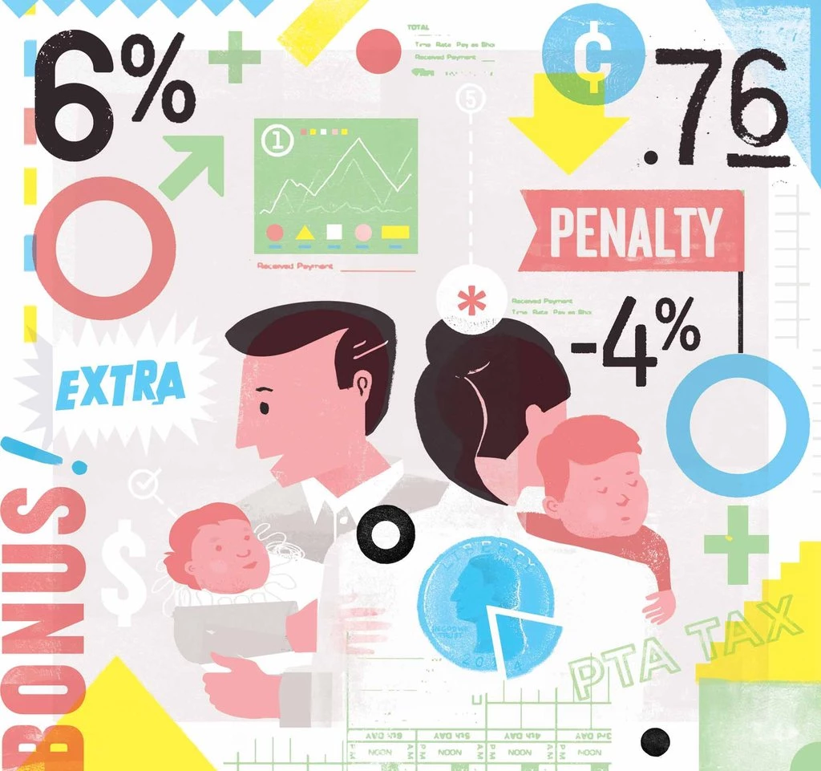
The parenthood pay gap
Marriage and children are associated with higher earnings among men, but lower earnings among women.
https://www.west-info.eu/children-boost-fathers-career-but-damage-mothers/next_-_fatherhood_motherhood/
Women are less likely to be hired if they belont to a parent-teacher association, but not men
Correll et al. 2007. Getting a job: Is there a motherhood penalty?” American Journal of Sociology

Slide 20
3 – Group Discussion
Form sub-groups by career stage now- 3h40pm
Grads / PostDocs / Pre-Tenured Profs / Post-Tenured Profs
Identify the main challenges for Women in Science at your career stage
Identify Potential Solutions (including what men can do to help)
Any advice you wish you had received when you entered this career stage?
Share with larger group 3h40-4h00pm

Slide 21
Supplementary Slides

Slide 22
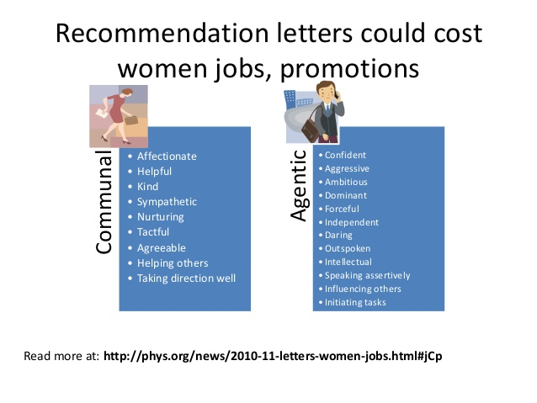

Slide 23
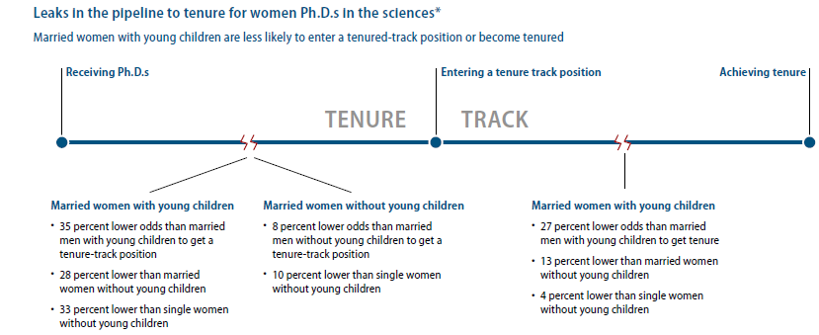

Slide 24
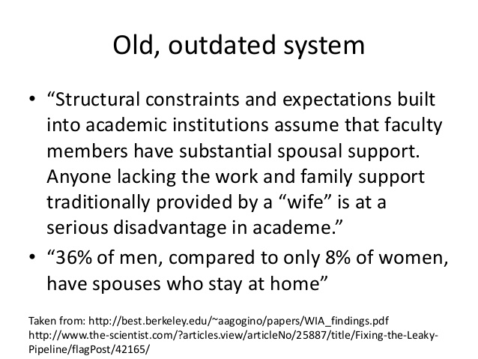

Slide 25
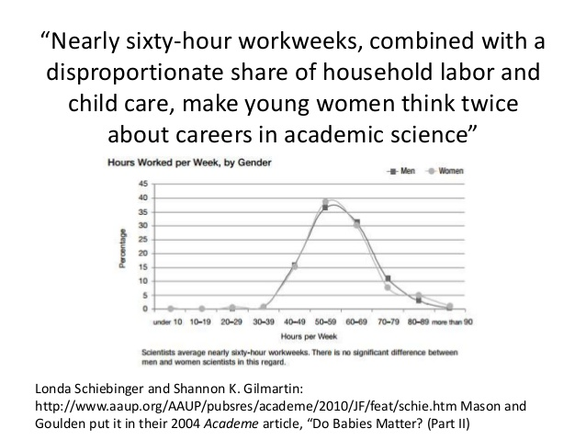

Slide 26
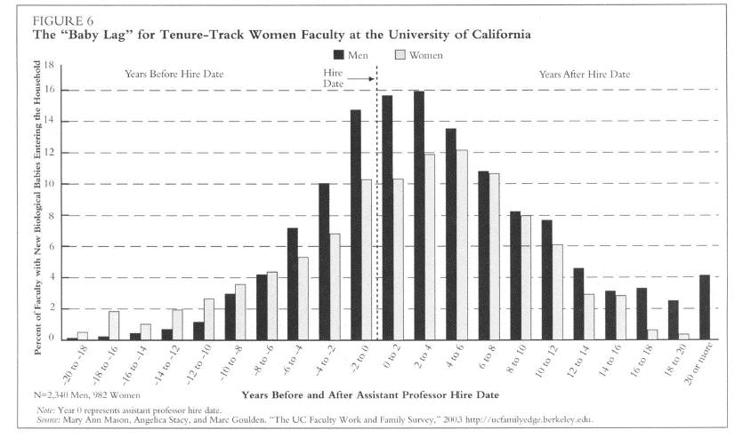

Slide 27
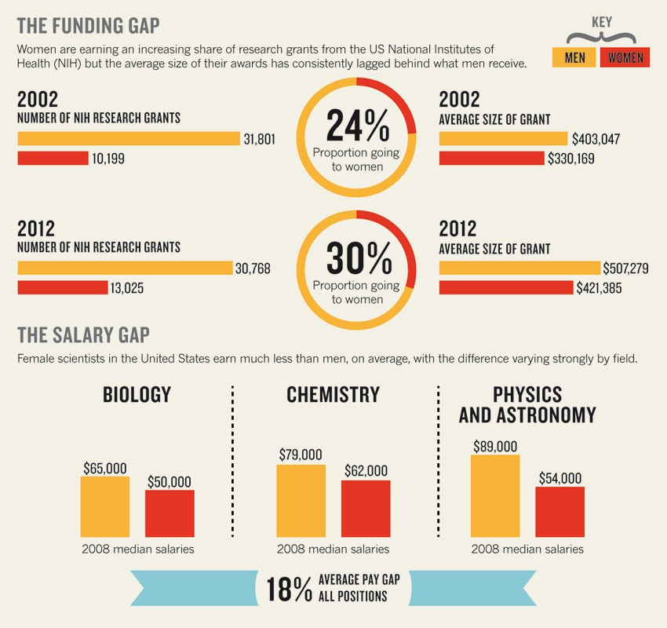
Shen. Nature. 2013. vol.495

