Slide 2
Welcome to the power hour
Brief overview of the the problem (5 mins)
Discussion in small groups (challenges and solutions) (3:10 – 3:40)
Report back (3:40 – 4:00)
Keep the discussions and solutions going (4:00 till Friday and beyond!)

Slide 3
Overview
Women are leaving Academia
Why? – Implicit Biases
Why? – Unique challenges
Let’s discuss!
Notes:
I want to acknowledge that there are many pressing issues of underrepresentation and biases to discus the relate to race, gender identity, and sexuality. Basically, issues that directly impact anyone who is not white, straight and gender conforming.
We are leading a discussion about women in science today from our own perspective, as straight white women.
White women are not the answer to diversity in science.

Slide 4
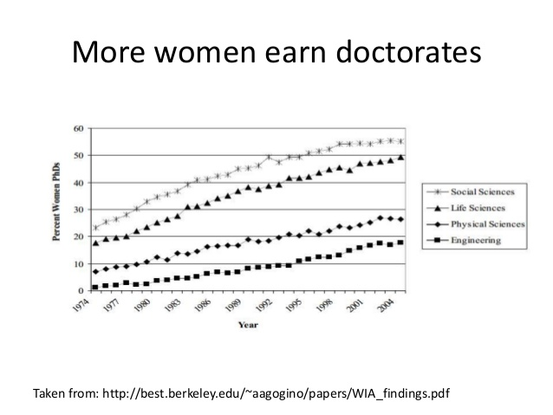
1- Women Are Leaving Academia

Slide 5
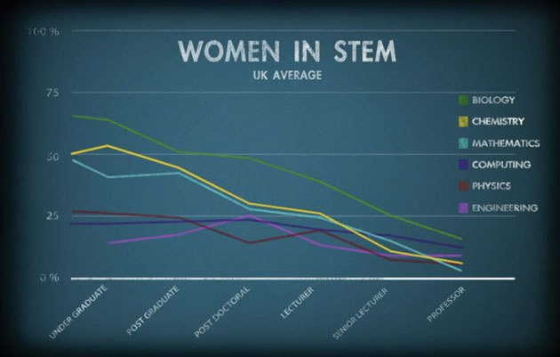
Image from https://www.chemicalimbalance.ed.ac.uk/

Slide 6
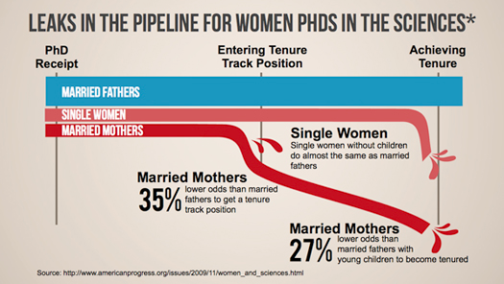
There are problems:
Women are not retained in academia in proportion to their abundance in the educational pipeline
Research suggests the reasons are largely related to social perceptions and their institutional manifestations.
These are solvable problems.
Notes:
https://blogs.sjsu.edu/sciencepolicy/files/2014/07/thumb-pipeline_sci-155jw4q.jpg

Slide 7
The Gender Penalty
Decreased Salary
Shen et al. 2010. Why women earn less: Just two factors explain post-PhD pay gap. Nature
Decreased in Hiring and Mentoring
Moss-Rascusin et al. 2012. Science faculty’s subtle gender biases favor male students. PNAS
Decreased Funding (4%)
Van der lee & Ellemers. 2015. Gender contributes to personal research funding success in The Netherlands. PNAS.
Decreased Awards and Prizes
Lincoln et al. 2012. The Matilda Effect in science: Awards and prizes in the US, 1990s and 2000s. Social Studies of Science.
Decreased Publication (8%)
Budden et al. 2008. Double-blind review favours increased representation of female authors. Trends in Ecology and Evolution
=> These differences are not associated with differences in productivity or performance

Slide 8
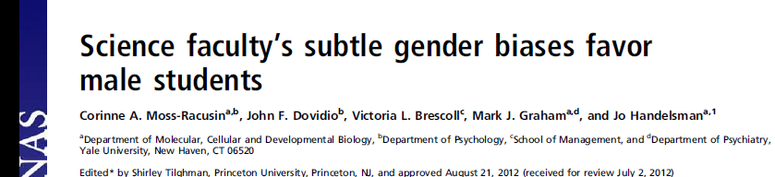
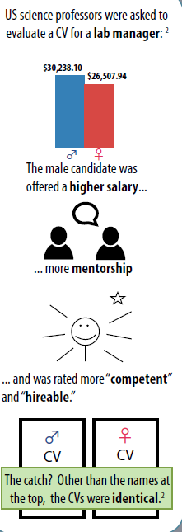
“female and male faculty were equally likely to exhibit bias against the female student”

