Slide 1
Constant
DTR 12
DTR 9
Lifetime egg production
Lifespan (days)
Bite rate (per day)
These parameter estimates look wrong… come back to fix
Notes:
Check on the credible intervals – make sure the fits and parameter values
Come back to sensitivity analyses
Re-think the fit the bite-rate date
What I still need to go are the ST estimates – those require me to estimate gamma, and I haven’t had a chance to do that yet.

Slide 2
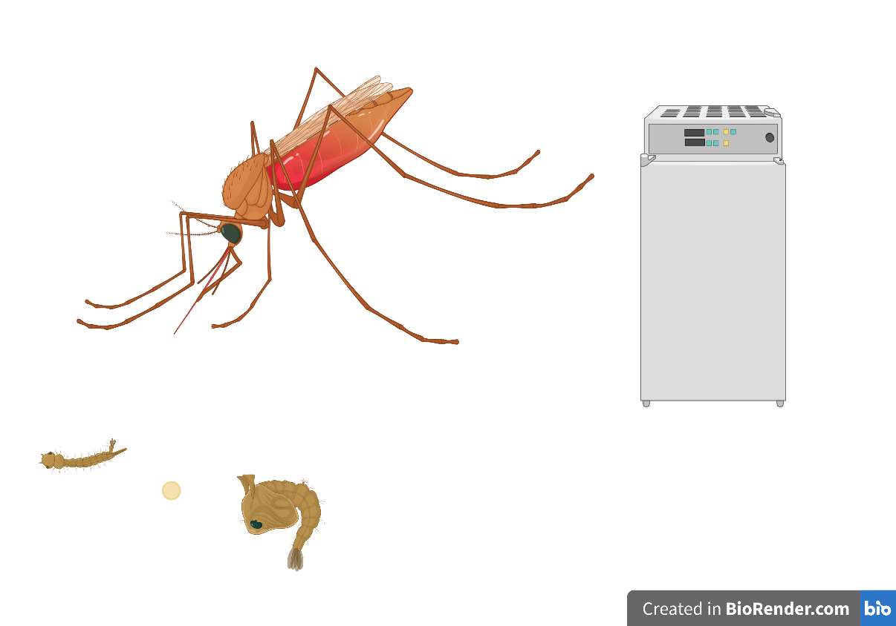

Slide 3
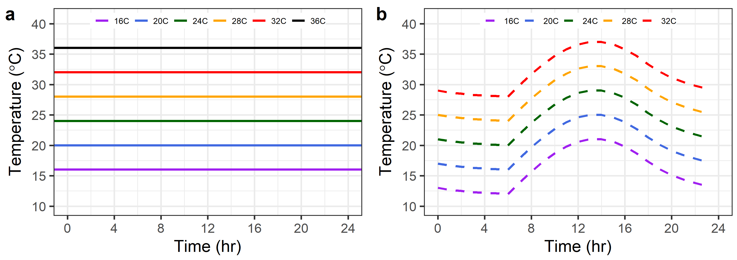
Constant temperatures
Fluctuating temperatures
Estimate mosquito performance traits under constant conditions (a)
Fit thermal performance curves (TPCs) to mosquito traits under constant conditions
Use rate summation (Equation X) to make predictions for mosquito traits and TPC parameters under fluctuating conditions (b; DTR 9 and DTR 12)
Estimate mosquito traits under fluctuating conditions and fit thermal performance curves
Compare observations from step 4 to predictions from step 3
Does rate summation work? Test the hypothesis that performance under fluctuating conditions is predictable based on performance in constant conditions (i.e. there are no time lags, carryover effects, no time-dependent effects of thermal experience).
How do we know whether rate summation works?
Notes:
For the ST, I think we decided that the best way to go about it was to use the parameters that we didn’t measure under fluctuating conditions (pea, mdr etc) at constant temps.
Apply rate summation to the individual traits and to ST

