Slide 1
VectorBiTE Temperature Variation Working Group
Update for 2019 Meeting in Trento Italy
Joey Bernhardt & Marta Shocket

Slide 2
Outline
Changes to set of studies (some added, some dropped)
Results for Y/X studies:
TPCs fit for constant temperatures using unimodal, asymmetrical Norberg thermal response function
Used rate summation to calculated predicted value at varying temperatures
Compared visually with observed value at varying temperatures
Next steps / questions

Slide 3
Excluded studies
Study ID | Citation | Successful Extraction? | Organism | Reason for exclusion
55 | Resilva & Pereira 2014 | No | 12 tephritid fruit fly spp. | No way to get temp profiles for varying temp treatments (naturally varying outdoor temps across locations and dates; MS followed up with author & they did not collect temp data)
86 | Klepsatel et al. 2013 | No | Drosophila melanogaster | No constant temperatures, only varying temperatures
90 | Duncan et al. 2011 | Yes | Paramecium | The reported traits are not the kinds of traits we’d expect rate summation to work for (population-level emergent properties of many traits, e.g., population size, infection prevalence, probability of exinction), nor does rate summation come close to working based on visual inspection (bigger differences between varying vs. constant treatments than across mean temperatures).
91 | Radmacher & Strohm 2011 | Yes | bee | None of the 3 fluctuating temperature treatments (10-15, 15-30, 20-35) were within the range of the 3 constant temperature treatments (17.5, 22.5, 27.5)
124 | Seuffert et al. 2010 | Yes | freshwater snail | Traits measured differently at constant and varying temperatures (proportion of time active vs. proportion of snails active); trait at varying temperatures not suitable for rate summation approach (proportion of snails)

Slide 4
Studies to include? See ExtractedDataNewStudies_MS.csv for corrected + subsetted data
Study ID | Citation | Successful Extraction? | Organism | Notes for inclusion / temp profiles
58 | Peng et al. 2014 | Yes | fish | I think we can use a subset of the data (only 3 traits reflect processes averaged over time at the varying temperatures vs. instantaneous traits for fish acclimated at varying temperatures) Temp profile: 8 hours at 15, 4 hours transition up, 8 hours at 25, 4 hours transition down – I think we can assume something like: 8 hours at 15, 1 hour at 17, 1 hour at 19, 1 hour at 21, 1 hour at 23, 8 hours at 25, 1 hour at 23, 1 hour at 21, 1 hour at 19, 1 hour at 17.
67 | Foray et al. 2014 | Yes | 2 parasitic wasp strains | I think we can use a subset of the data (1 out of the 3 fluctuating temp treatments) Temp profile: 3 hours at 25, 3 hours at 27, 3 hours at 29, 3 hours at 27, 3 hours at 25, 3 hours at 23, 3 hours at 21, 3 hours at 23.
165 | Hilbeck & Kennedy 1998 | Yes | beetle | It’s not ideal that they didn’t measure constant temp at the same mean temp as the variable treatment, but we can still test rate summation for dev. rate – we don’t even need to fit reaction norms, we can just use the values for 30 and 22. Temp profile: 8 hours at 30, 16 hours at 22

Slide 5
Studies Marta is still working on
Study ID | Citation | Successful Extraction? | Organism | Reason for exclusion
61 | Zhao et al. 2014 | Yes | aphid | We might be able to use this one – it depends on finding and digitizing the original constant temperature traits (from other publications) instead of the predicted model
NA | KM/CM unpublished | NA | An. stephensi
NA | Paaijmans et al. 2010 | ? | An. stephensi
NA | Paaijmans et al. 2013 | ? | An. stephensi

Slide 6
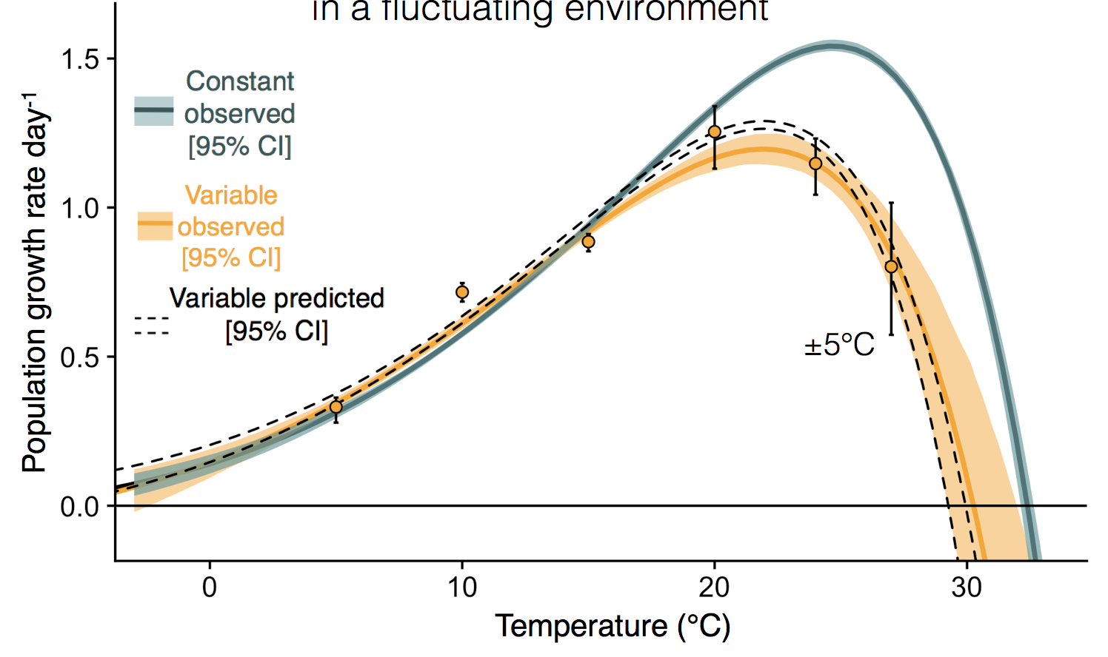
Study #102: Bernhardt et al. 2018, green algae

Slide 7
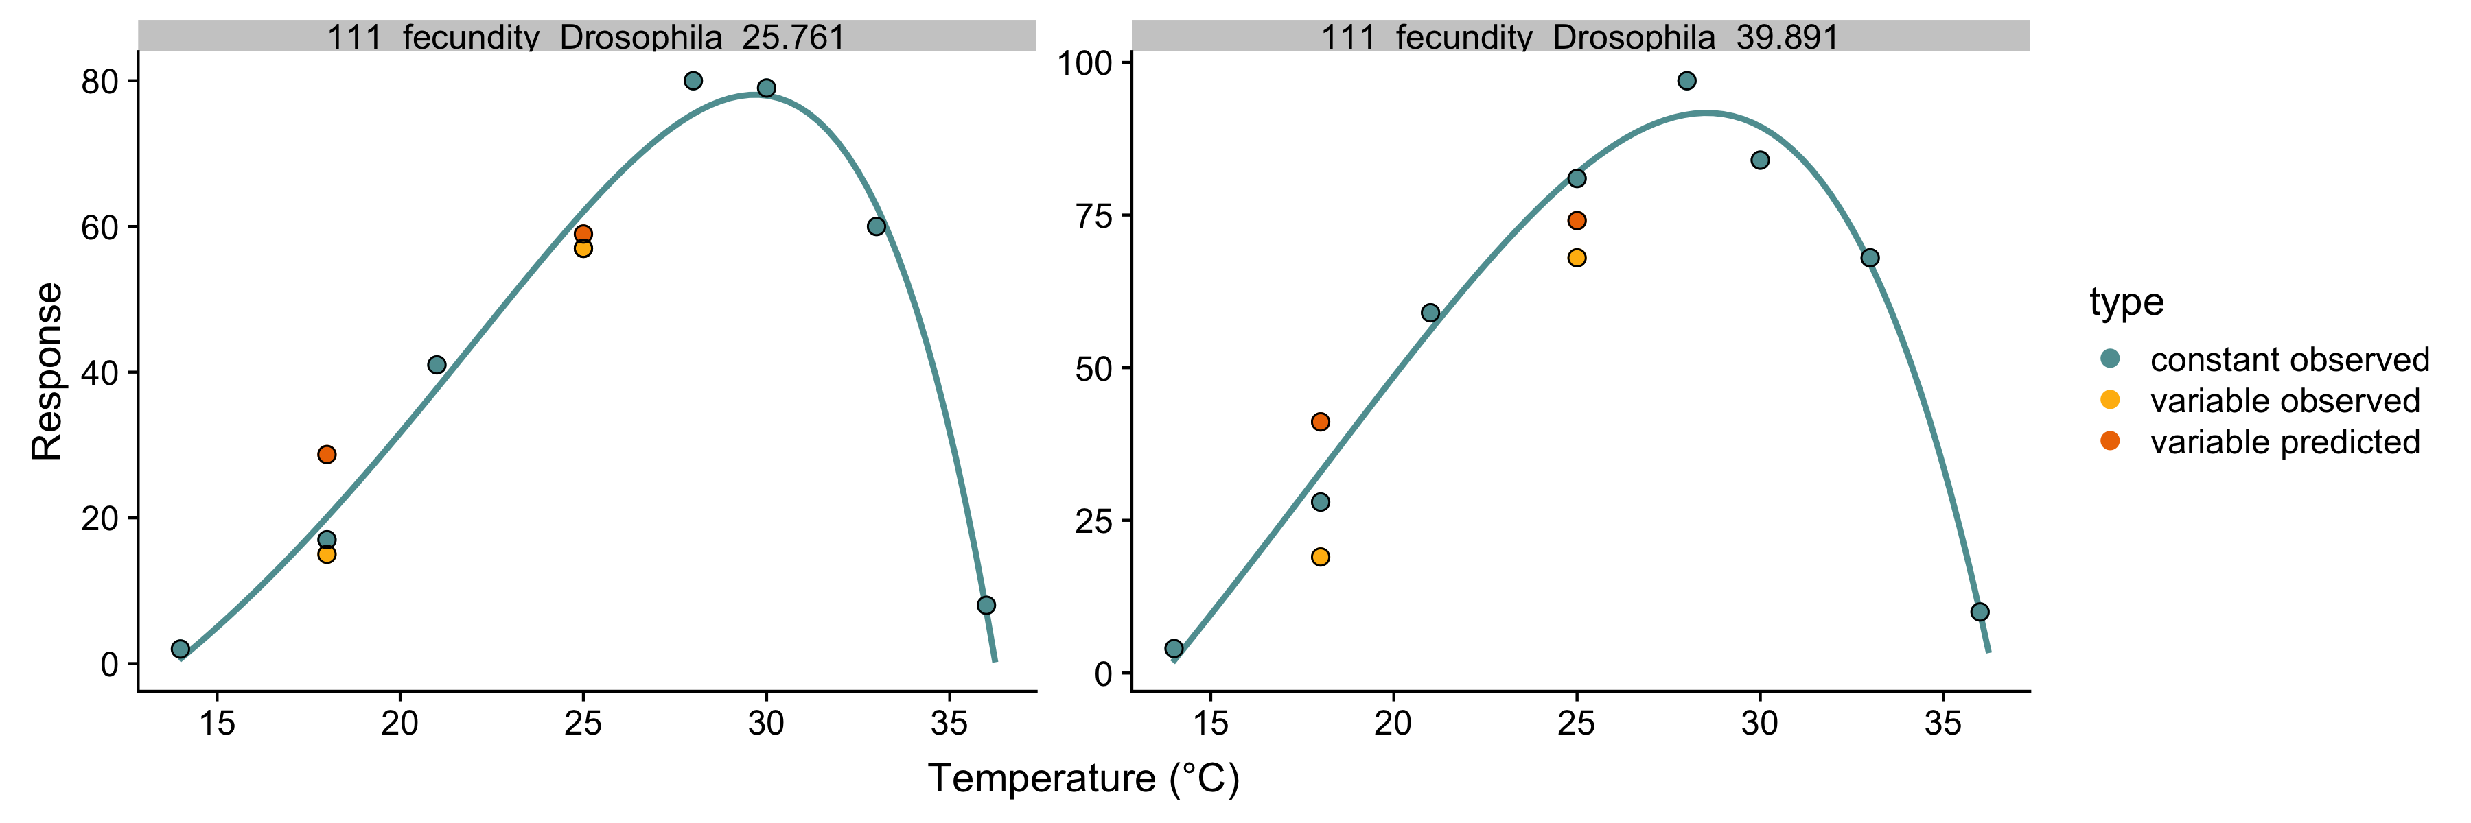
Study #111: Cooper et al. 2010, fruit fly (D. melanogaster)

Slide 8
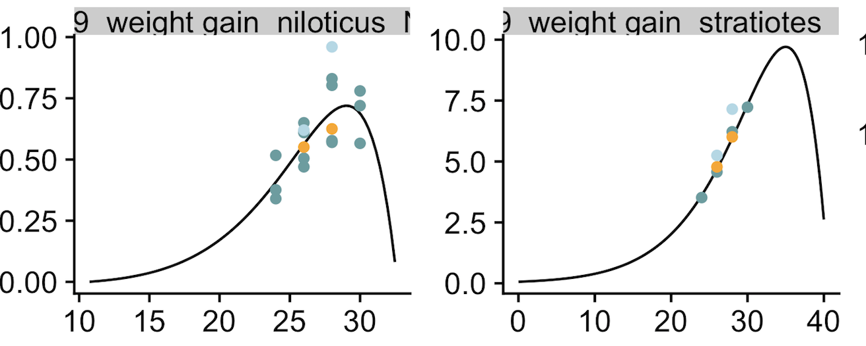
Study #119: Pushkar et al. 2010, tilapia & water lettuce

Slide 9
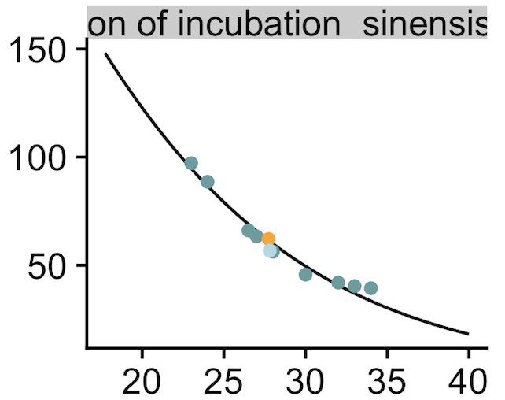
Study #150: Du & Ji 2003, turtle

Slide 10
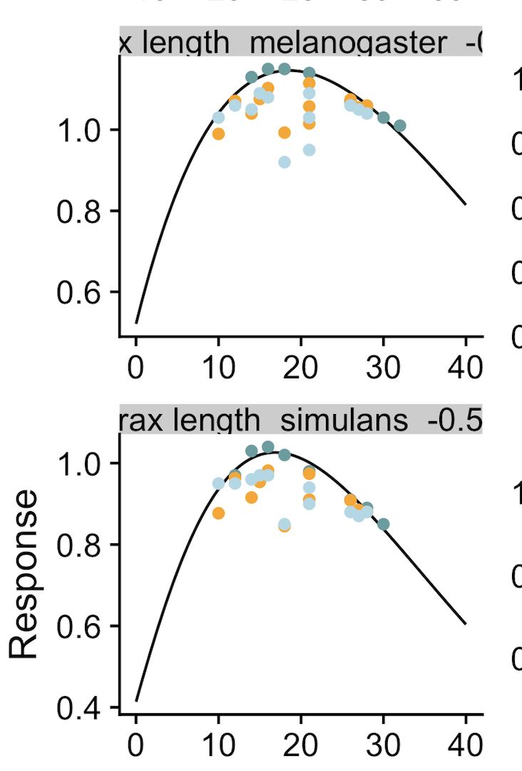
Study #159: Petavy et al. 2001, fruit flies (2 D. species)

Slide 11
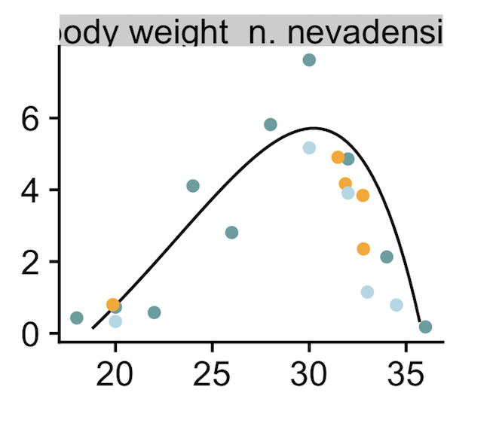
Study #168: Shrode & Gerking 1977, fish

Slide 12
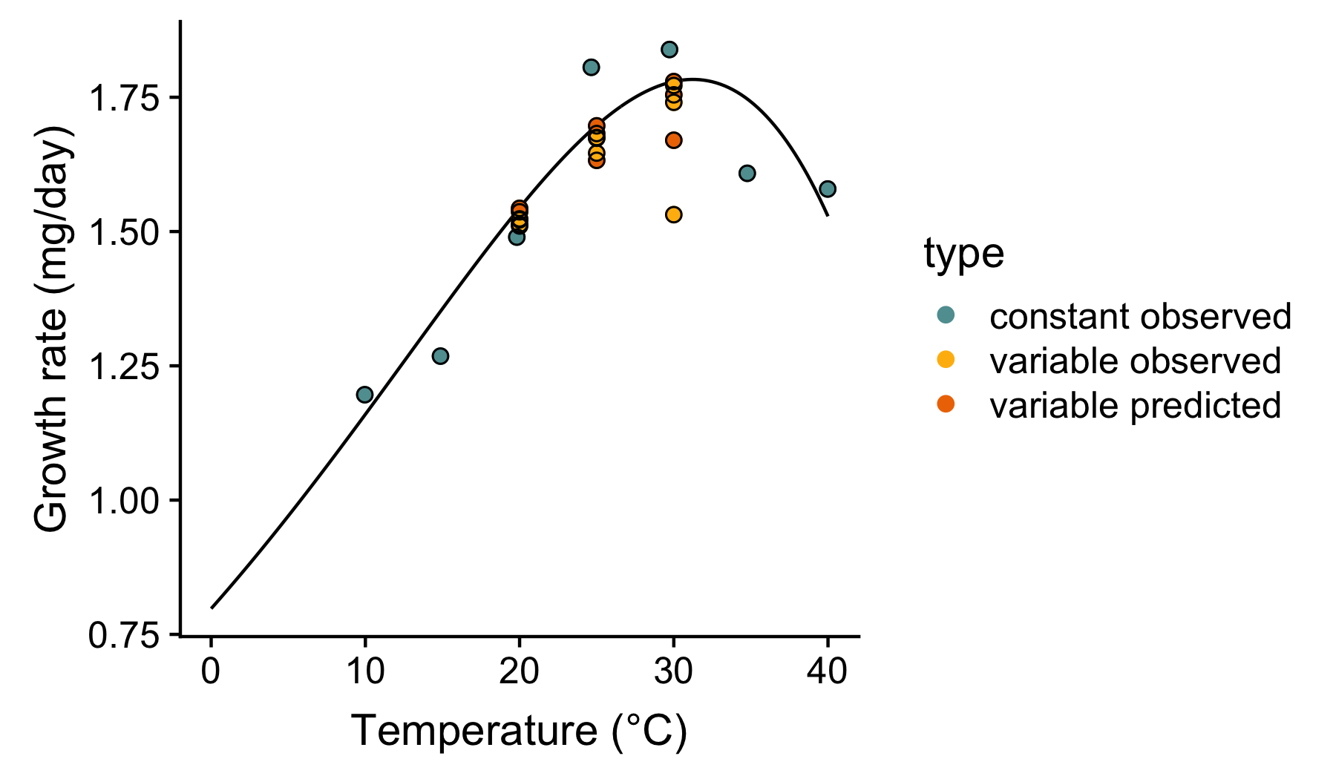
Study #NA: Kingsolver ?, ?

