Slide 1
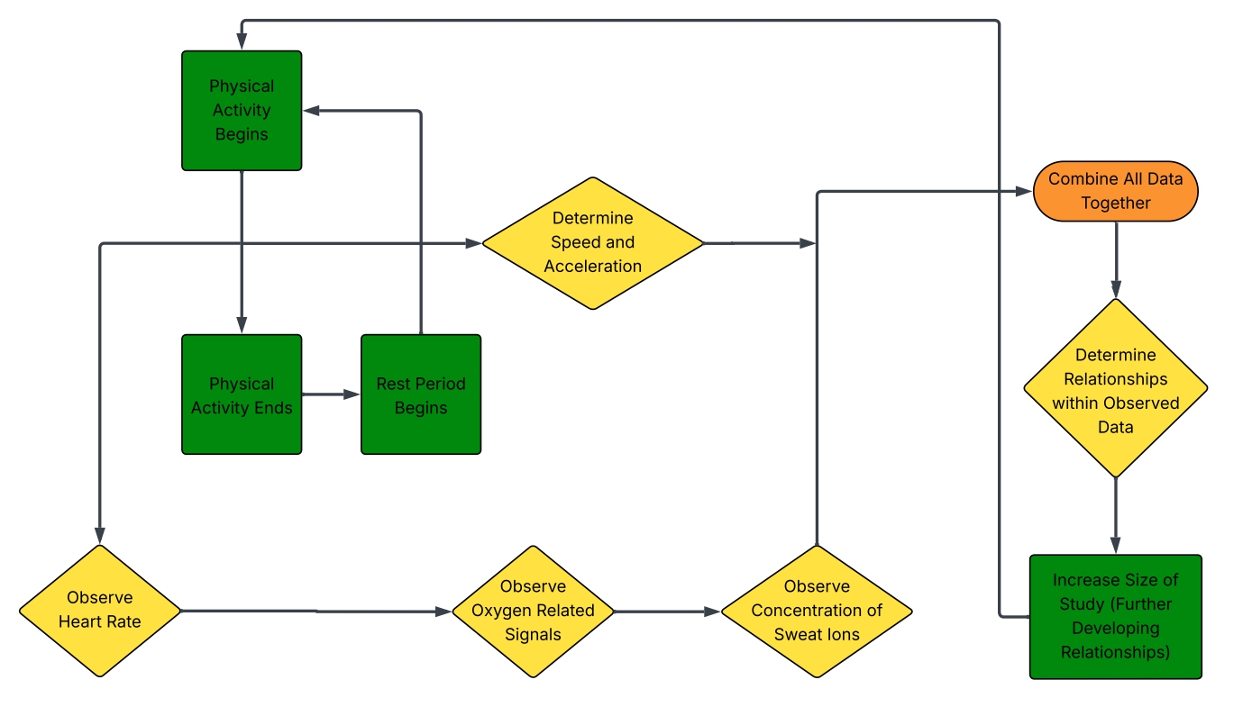
Data Perspective Chart

