Slide 1
Existential Consistency: Measuring and Understanding Consistency at Facebook
Haonan Lu*†, Kaushik Veeraraghavan†,
Philippe Ajoux†, Jim Hunt†,
Yee Jiun Song†, Wendy Tobagus†,
Sanjeev Kumar†, Wyatt Lloyd*†
*University of Southern California, †Facebook

Slide 2
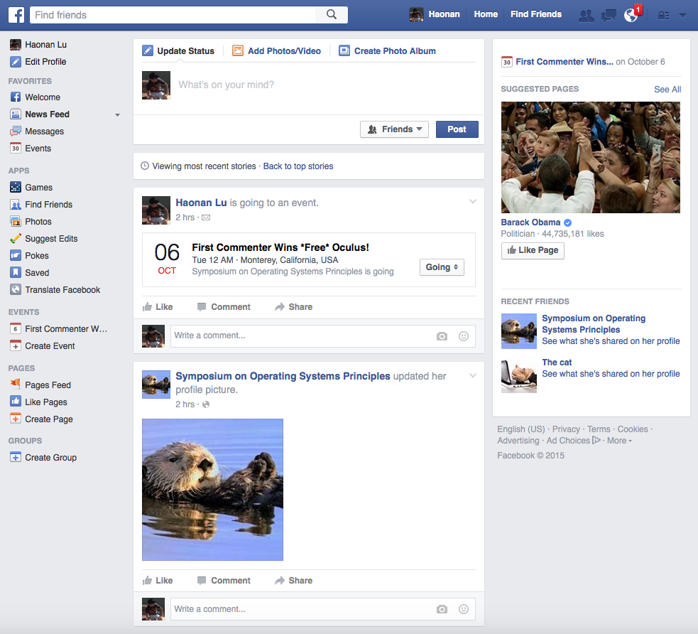
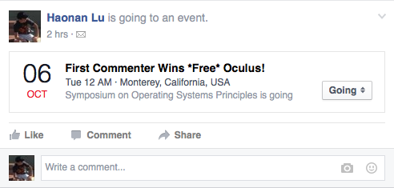

Slide 3
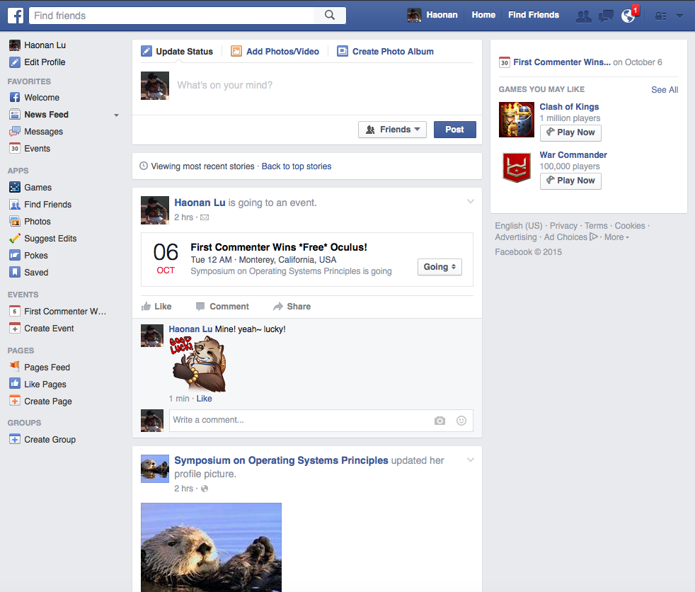
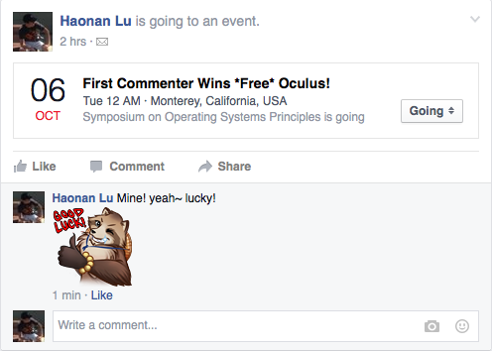

Slide 4
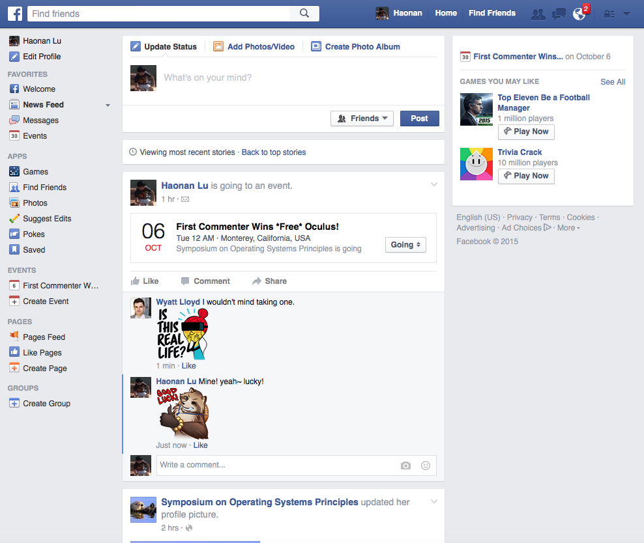

Consistency
Performance

Slide 5

Fundamental Tension
Consistency
Performance
Eliminates anomalies (Oculus example)
Lower latency
Makes systems easier to program
Higher throughput
Difficult to quantify
Simple to quantify
First study of consistency in a large-scale, production system – Facebook TAO

Slide 6



Anomaly: Unexpected Behavior
Post Example
“Hey, I mentioned
you in a post”
New post “@Wyatt,
you should check out this game!”
Read friend’s timeline
Old posts

Slide 7

Anomaly: Unexpected Behavior
Oculus Example
1. “Mine! yeah~ lucky!”
1. “I wouldn’t mind…”
1. “I wouldn’t mind…”
2. “Mine! yeah~ lucky!”

Slide 8
Does Facebook have consistency anomalies?
How many?
What type?

Slide 9
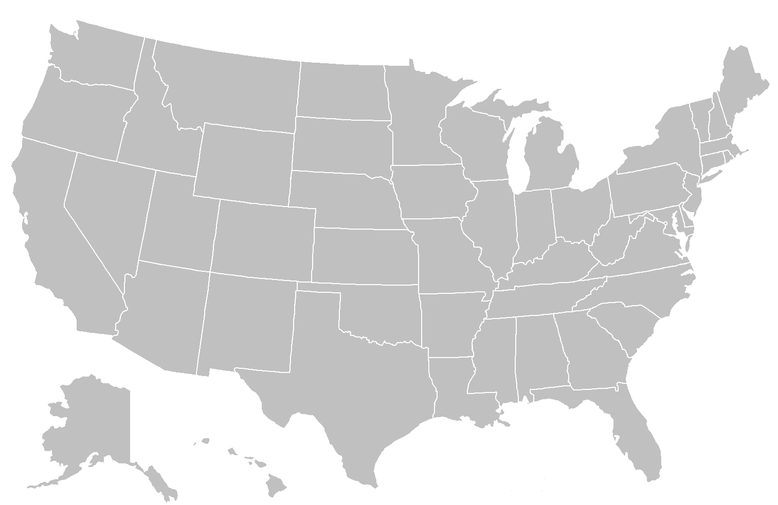
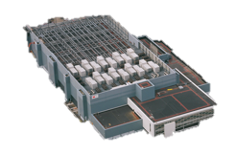

TAO: Eventually Consistent Cache
Vulnerability window: time during asynchronous replication when anomalies can happen
new
post
B
read
done
value
A
C
old post
M

Slide 10
Quantifying Anomalies
How often do anomalies occur?
Collect trace of requests to TAO
What consistency would prevent them?
Run anomaly checkers on the trace

Slide 11
Trace Collection
Collect trace on web servers
Challenges in tracing production system
Volume of requests
Time skew between web servers
Missing requests

Slide 12
Challenge: Volume of Requests
Billions of requests per second [ATC ’13]
Too many to log
Sample on objects
Object: vertex in social graph
Log all requests to objects in sample
Sufficient for local consistency models

Slide 13
Local Property Enables Sampling
“… the system as a whole satisfies P whenever each individual object satisfies P.”^{[1]}
Local
Linearizability
Per-Object Sequential
Read-After-Write
Local consistency models can be
checked on a per object basis
[1] M. P. Herlihy and J. M. Wing “Linearizability: A Correctness Condition for Concurrent Objects.” ACM TOPLAS, 1990

Slide 14
Challenge: Time Skew
Time skew across web servers
99.9 percentile for 1 week: 35ms
Add time skew to request’s duration
More overlapped requests
Eliminates false positives

Slide 15
Logging Details
Start time
Finish time
Read or write
Value: match read with write
Logged information:
Start time
Finish time
Read or write
Value: match read with write
Sampling rate: 1 out of 1 million objects
~ 100% of requests to sampled objects
Determine real time
ordering of requests
Post
(new)

Slide 16
Trace Statistics
12 days (8/20 – 8/31)
17 million objects
3 billion requests

Slide 17
Check Trace for Anomalies
Linearizability checker
Paxos provides
Per-Object Sequential checker
PNUTS provides
Read-After-Write checker
TAO provides within a cluster

Slide 18
Linearizability
Strongest non-transactional consistency
Real-time constraint
Post example
Total order constraint
Oculus example!
Should return “new”
Post (old)
Post (new)
Read (old)
Haonan
Haonan
Wyatt

Slide 19
Linearizability Checker
Graph captures state transitions
Vertex: write operations
Edge: real-time order
Merge read with its write
Captures state transitions seen by users
Anomaly if merge causes a cycle
Cycle indicates user’s view ≠ system view

Slide 20
Linearizability Checker
Captures real-time constraint
Read should return new post instead
Post (old)
Post (new)
Read (old)
Haonan
Haonan
Wyatt
Should return new post
Post (old)
Post
(new)
Read (old)
Anomaly

Slide 21
More Complex Cases
http://tinyurl.com/sosp15-demo
w(0)
r(1)
w(1)
w(2)
w(3)
2 Anomalies
r(2)
r(3)
r(3)
r(2)
r(1)

Slide 22
Result Overview
Linearizability
Per-Object Sequential
Read-After-Write
Bounds on non-local consistency models
Anomalies found for all consistency models
– adopting them would have benefits

Slide 23
Linearizability Results
5 anomalies per million reads
Prevented by Paxos-based implementation
Upper bound on TAO anomalies
Strongest consistency we checked
TAO is highly consistent

Slide 24

Linearizability Results Real-Time Constraint Violations
4 per million reads
Post (new)
Read
Post (new)
starts
Post (new)
finishes
A
B
Replica A:
M
Master M:
Vulnerable!
Replica B:
Read (old)

Slide 25
Linearizability Results Total Order Constraint Violations
1 per million reads
Comment(H)
Comment(W)
A
B
H starts
H finishes
Read (H)
M
Replica A:
Master M:
Vulnerable!
W
H
Replica B:
W starts
W finishes
Read (W)

Slide 26
Per-Object Sequential Results
1 anomaly per million reads
Total order constraint
User session constraint (1 per 10 million)
Users should see their writes
Post(new)
Read
A
B
Old
M

Slide 27
Infer Bounds on Causal
Linearizability
5 per million reads
Superset of causal anomalies
≤ 5 per million reads
Causal
≥ 1 per million reads
Per-Object Sequential
1 per million reads
Subset of causal anomalies

Slide 28
Lower Bounds on Transactions
Strict Serializability
> 5 per million reads
Future research should
provide transactions
Linearizability
5 per million reads
Causal
Causal with Transactions
> 1 per million reads
Per-Object Sequential
1 per million reads

Slide 29
Real-Time Consistency Monitor
Checkers cannot run in real-time
Φ-consistency
Measure convergence of replicas
A real-time health monitor
Alarms when a replica falls behind

Slide 30
Conclusion
Benefits of consistency are hard to quantify
First study of a large-scale production system
Measure Facebook’s TAO system
Collect trace and run anomaly checkers
Real-world challenges
Results
TAO is highly consistent
Benefits of adopting stronger consistency exist
Research should provide transactions

