Slide 1



Don’t Settle for Eventual: Scalable Causal Consistency for Wide-Area Storage with COPS
Wyatt Lloyd*
Michael J. Freedman*
Michael Kaminsky†
David G. Andersen‡
*Princeton, †Intel Labs, ‡CMU

Slide 2



Wide-Area Storage
Stores:
Status Updates
Likes
Comments
Photos
Friends List
Stores:
Tweets
Favorites
Following List
Stores:
Posts
+1s
Comments
Photos
Circles

Slide 3
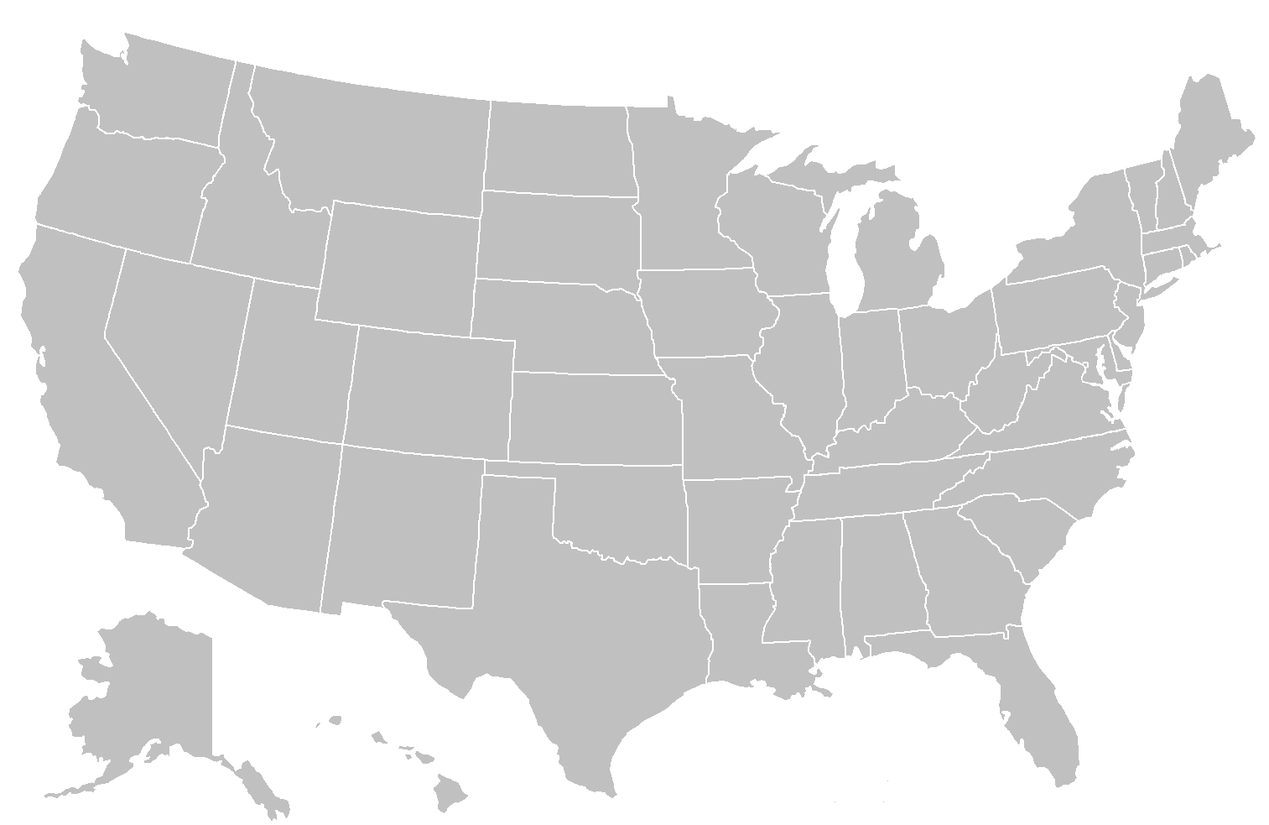
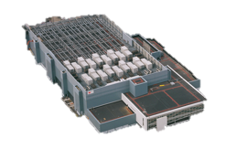
Wide-Area Storage
Serves Requests Quickly

Slide 4

Inside the Datacenter
Web Tier
Storage Tier
A-F
Replication
Remote DC
G-L
Web Tier
Storage Tier
A-F
M-R
G-L
M-R
S-Z
S-Z

Slide 5

Desired Properties: ALPS
Availability
Low Latency
Partition Tolerance
Scalability
“Always On”

Slide 6
Scalability
Increase capacity and throughput in each datacenter
A-C
A-Z
A-Z
A-F
A-F
A-L
A-C
A-L
D-F
G-L
G-L
M-Z
D-F
M-Z
G-J
M-R
M-R
G-J
K-L
S-Z
S-Z
K-L
M-O
M-O
P-S
P-S
T-V
T-V
W-Z
W-Z

Slide 7
Desired Property: Consistency
Restricts order/timing of operations
Stronger consistency:
Makes programming easier
Makes user experience better

Slide 8

Consistency with ALPS
Strong
Sequential
Causal
Eventual
Impossible [Brewer00, GilbertLynch02]
Impossible [LiptonSandberg88, AttiyaWelch94]
COPS
Amazon LinkedIn Facebook/Apache
Dynamo Voldemort Cassandra

Slide 9
System | A | L | P | S | Consistency
Scatter | ✖ | ✖ | ✖ | ✔ | ✔ Strong
Walter | ✖ | ✖ | ✖ | ? | PSI + Txn
COPS | ✔ | ✔ | ✔ | ✔ | Causal+
Bayou | ✔ | ✔ | ✔ | ✖ | Causal+
PNUTS | ✔ | ✔ | ? | ✔ | Per-Key Seq.
Dynamo | ✔ | ✔ | ✔ | ✔ | ✖ Eventual

Slide 10



Causality By Example
Causality ( )
Thread-of-Execution
Gets-From
Transitivity
Remove boss from
friends group
Post to friends:
“Time for a new job!”
Friend reads post
Friends
Boss
New Job!

Slide 11





Causality Is Useful
For Users:
For Programmers:
Friends
Boss
Photo Upload
Add to album
New Job!
Employment Integrity
Referential Integrity

Slide 12
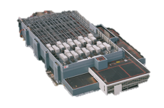
Conflicts in Causal
K=1
K=1
K=1
K=2
K=2
K=2

Slide 13
Conflicts in Causal
Causal + Conflict Handling = Causal+
K=2
K=3
K=2
K=3
K=2
K=3

Slide 14
Previous Causal+ Systems
Bayou ‘94, TACT ‘00, PRACTI ‘06
Log-exchange based
Log is single serialization point
Implicitly captures and enforces causal order
Limits scalability OR
No cross-server causality

Slide 15
Scalability Key Idea
Dependency metadata explicitly captures causality
Distributed verifications replace single serialization
Delay exposing replicated puts until all dependencies are satisfied in the datacenter

Slide 16
COPS
Key-Value Store
All
Data
Local Datacenter
Causal+
Replication
All
Data
Client Library
All
Data

Slide 17
Get
Key-Value Store
Local Datacenter
Client Library
get
get

Slide 18
Put
put
+
ordering
metadata
put
after
=
Key-Value Store
?
Local Datacenter
?
Client Library
put
put_after
K:V
Replication Q
put
after

Slide 19
Dependencies
Dependencies are explicit metadata on values
Library tracks and attaches them to put_afters

Slide 20
Dependencies
Dependencies are explicit metadata on values
Library tracks and attaches them to put_afters
Client 1
put_after(Key,Val,deps)
put(Key, Val)
deps
. . .
K_{version}
version
(Thread-Of-Execution Rule)

Slide 21
Dependencies
Dependencies are explicit metadata on values
Library tracks and attaches them to put_afters
Client 2
get(K)
get(K)
value,version,deps'
value
deps
. . .
K_{version}
L₃₃₇
M₁₉₅
(Gets-From Rule)
deps'
L₃₃₇
M₁₉₅
(Transitivity Rule)

Slide 22
Causal+ Replication
Key-Value Store
put_after(K,V,deps)
K:V,deps
Replication Q
put
after

Slide 23
Causal+ Replication
put_after(K,V,deps)
dep_check(L₃₃₇)
K:V,deps
deps
L₃₃₇
M₁₉₅
dep_check(M₁₉₅)
Exposing values after dep_checks return ensures causal+

Slide 24
Basic COPS Summary
Serve operations locally, replicate in background
“Always On”
Partition keyspace onto many nodes
Scalability
Control replication with dependencies
Causal+ Consistency

Slide 25

Gets Aren’t Enough
My
Operations
Remote
Datacenter
You’re Fired!!
Remote
Progress
Boss
Remote
Progress
Boss
Boss
Boss
New Job!
Remote
Progress
Portugal!
Portugal!
Boss
New Job!
New Job!

Slide 26
Gets Aren’t Enough
My
Operations
Remote
Datacenter
You’re Fired!!
Boss
Boss
Boss
Boss
Boss
Boss
New Job!
Remote
Progress
Portugal!
Portugal!
New Job!
New Job!
New Job!
Boss
Portugal!
Portugal!
Remote
Progress
Boss
Remote
Progress

Slide 27
Get Transactions
Provide consistent view of multiple keys
Snapshot of visible values
Keys can be spread across many servers
Takes at most 2 parallel rounds of gets
No locks, no blocking
Low Latency

Slide 28
Get Transactions
My
Operations
Remote
Datacenter
Remote
Progress
Boss
Could Get
Remote
Progress
Boss
Boss
Boss
Boss
Boss
Boss
Portugal!
New Job!
Remote
Progress
Boss
Portugal!
Portugal!
Portugal!
New Job!
New Job!
Portugal!
Portugal!
Boss
New Job!
Remote
Progress
Never
Boss
Portugal!
Boss
Remote
Progress
Boss
New Job!
Boss
Portugal!

Slide 29
System So Far
ALPS and Causal+, but …
Proliferation of dependencies reduces efficiency
Results in lots of metadata
Requires lots of verification
We need to reduce metadata and dep_checks
Nearest dependencies
Dependency garbage collection

Slide 30
Many Dependencies
Dependencies grow with client lifetime
Put
Put
Get
Put
Get
Put

Slide 31
Nearest Dependencies
Transitively capture all ordering constraints

Slide 32
The Nearest Are Few
Transitively capture all ordering constraints

Slide 33
The Nearest Are Few
Only check nearest when replicating
COPS only tracks nearest
COPS-GT tracks non-nearest for transactions
Dependency garbage collection tames metadata in COPS-GT

Slide 34
Extended COPS Summary
Get transactions
Provide consistent view of multiple keys
Nearest Dependencies
Reduce number of dep_checks
Reduce metadata in COPS

Slide 35
Evaluation Questions
Overhead of get transactions?
Compare to previous causal+ systems?
Scale?

Slide 36
Experimental Setup
Local Datacenter
Clients
COPS Servers
Replication
Remote DC
COPS
N
N
N

Slide 37
COPS & COPS-GT Competitive for Expected Workloads
All Put Workload – 4 Servers / Datacenter
High per-client write rates result in 1000s of dependencies
Low per-client
write rates expected
People tweeting 1000 times/sec
People tweeting 1 time/sec

Slide 38
COPS & COPS-GT Competitive for Expected Workloads
Varied Workloads – 4 Servers / Datacenter
Pathological
Expected
Workload

Slide 39
COPS Low Overhead vs. LOG
COPS – dependencies ≈ LOG
1 server per datacenter only
COPS and LOG achieve very similar throughput
Nearest dependencies mean very little metadata
In this case dep_checks are function calls

Slide 40
COPS Scales Out

Slide 41
Conclusion
Novel Properties
First ALPS and causal+ consistent system in COPS
Lock free, low latency get transactions in COPS-GT
Novel techniques
Explicit dependency tracking and verification with decentralized replication
Optimizations to reduce metadata and checks
COPS achieves high throughput and scales out

