Slide 1
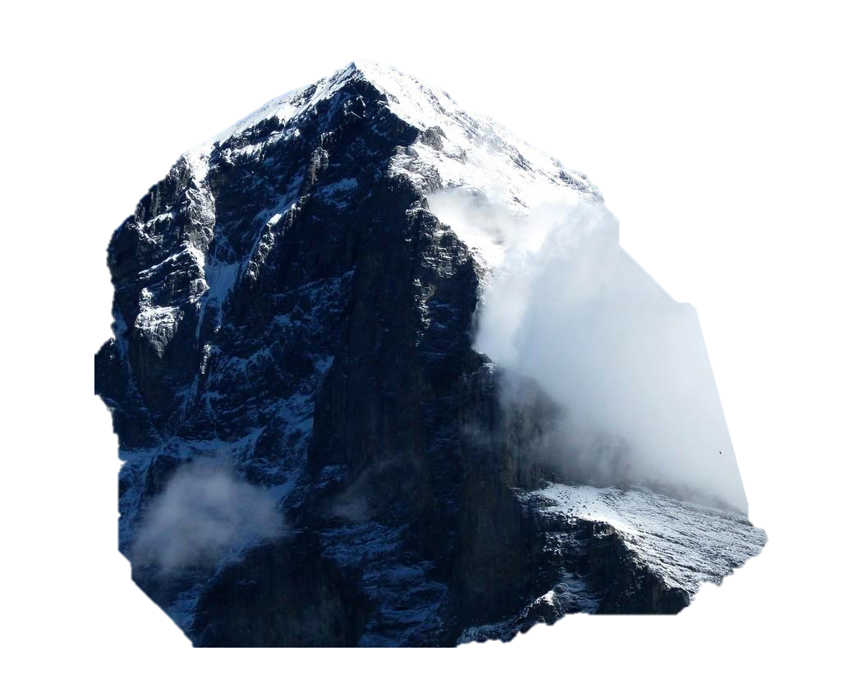
Eiger: Stronger Semantics for Low-Latency Geo-Replicated Storage
Wyatt Lloyd*
Michael J. Freedman*
Michael Kaminsky†
David G. Andersen‡
*Princeton, †Intel Labs, ‡CMU

Slide 2

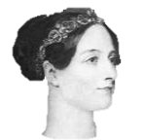

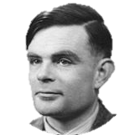

Geo-Replicated Storage
is the backend of massive websites
Like
“Halting is Undecidable”
FriendOf
FriendOf
Status

Slide 3
Storage Dimensions
Shard Data Across Many Nodes
Like
A-F
G-L
FriendOf
M-R
FriendOf
“Halting is Undecidable”
S-Z
Status

Slide 4
Storage Dimensions
Shard Data Across Many Nodes
Data Geo-Replicated In Multiple Datacenters
A-F
A-F
G-L
G-L
M-R
S-Z
M-R
A-F
G-L
S-Z
M-R
S-Z

Slide 5

Sharded, Geo-Replicated Storage
A-F
A-F
G-L
G-L
M-R
S-Z
M-R
A-F
G-L
S-Z
M-R
S-Z

Slide 6
Strong Consistency or Low Latency
Low Latency
Improves user experience
Correlates with revenue
Strong Consistency
Obey user expectations
Easier for programmers
Fundamentally in Conflict
[LiptonSandberg88, AttiyaWelch94]

Slide 7
Strong Consistency or Low Latency
Megastore [SIGMOD ‘08]
Spanner [OSDI ‘12] →.
Gemini [OSDI ‘12] →.
Walter [SOSP ’11] →.
Dynamo [SOSP ’07]
COPS [SOSP ’11]
Eiger
Obey user expectations
Easier for programmers
Causal+ Consistency
Rich Data Model
Read-only Txns
Write-only Txns

Slide 8
Eiger Ensures Low Latency
Keep All Ops Local
A-F
A-F
G-L
G-L
M-R
S-Z
M-R
A-F
G-L
S-Z
M-R
S-Z

Slide 9




Causal+ Consistency Across DCs
If A happens before B
Everyone sees A before B
Obeys user
expectations
Simplifies
programming
Friends
Boss
Then
Then
New Job!
Then

Slide 10
Causal For Column Families
Profile
Friends
Count
Age
Town
Church
Lovelace
Turing
Friends
Key₁
Val
Lovelace
197
London
-
-
1/1/54
631
Key₂
Val
Turing
100
Princeton
9/1/36
1/1/54
-
457
Operations update/read many columns
Range query columns concurrent w/ deletes
Counter columns
See paper for details

Slide 11
Viewing Data Consistently Is Hard
Asynchronous requests + distributed data = ?????
2
A
Update A
1
3
???
Update B
5
B
6
4
C
Update C

Slide 12
Read-Only Transactions
Logical time gives a global view of data store
Clocks on all nodes, carried with all messages
Insight: Store is consistent at all logical times
0
2
A
A₁
A₂
0
3
B
B₁
B₂
0
5
C
C₁
C₂
Logical Time

Slide 13
Read-Only Transactions
Extract consistent up-to-date view of data
Across many servers
Challenges
Scalability
Decentralized algorithm
Guaranteed low latency
At most 2 parallel rounds of local reads
No locks, no blocking
High performance
Normal case: 1 round of reads

Slide 14
Read-Only Transactions
Round 1: Optimistic parallel reads
Calculate effective time
Round 2: Parallel read_at_times
Client
Distributed Storage
0
1
0
2
A₁
A₂
A
A₁
A₂
3
5
0
3
B₂
B
B₁
B₂
4
6
0
5
C₂
C
C₁
C₂
Logical Time

Slide 15
Transaction Intuition
Read-only transactions
Read from a single logical time
Write-only transactions
Appear at a single logical time
Bonus:
Works for Linearizability
2
A
A₂
A₃
3
B
B₂
B₃
5
C
C₂
C₃
Logical Time

Slide 16
Eiger Provides
√ Low latency
√ Rich data model
√ Causal+ consistency
√ Read-only transactions
√ Write-only transactions
But what does all this cost?
Does it scale?

Slide 17
Eiger Implementation
Fork of open-source Cassandra
+5K lines of Java to Cassandra’s 75K
Code Available:
https://github.com/wlloyd/eiger

Slide 18
Evaluation
Cost of stronger consistency & semantics
Vs. eventually-consistent Cassandra
Overhead for real (Facebook) workload
Overhead for state-space of workloads
Scalability

Slide 19
Experimental Setup
Local Datacenter (Stanford)
A-F
Remote DC (UW)
Replication
G-L
A-F
G-L
M-R
M-R
S-Z
S-Z
8
8
8

Slide 20
Facebook Workload Results
6.6% Overhead

Slide 21
Eiger Scales
Facebook Workload
Scales out
384 Machines!

Slide 22
Improving Low-Latency Storage
COPS → Eiger
Data model Key-Value → Column-Family
Read-only Txns Causal stores → All stores
Write-only Txns None → Yes
Performance Good → Great
DC Failure Throughput → Resilient
degradation

Slide 23
Eiger
Low-latency geo-replicated storage
Causal+ for column families
Read-only transactions
Write-only transactions
Demonstrated in working system
Competitive with eventual
Scales to large clusters
https://github.com/wlloyd/eiger

Slide 24
Eiger: Stronger Semantics for Low-Latency Geo-Replicated Storage
Wyatt Lloyd*
Michael J. Freedman*
Michael Kaminsky†
David G. Andersen‡
*Princeton, †Intel Labs, ‡CMU

