Slide 1
Propositional Equality for Gradual Dependently Typed Programming
Joseph Eremondi, University of British Columbia
Ronald Garcia, University of British Columbia
Éric Tanter, University of Chile

Slide 2

Research Questions
Gradual Propositional Equality
Can gradual typing be used to move equational specification checking between compile time and run time?
Family of refl constructors - dynamic consistency info
Can propositional equality be included in a gradual language without breaking the metatheory?

Slide 3
Motivation: Dynamically Checked Specifications

Slide 4

A Buggy Quicksort
sort : List Nat -> List Nat
sort Nil = Nil
sort (Cons h t) =
let
lower = sort (filter (< h) t)
higher = sort (filter (> h) t)
in lower ++ [h] ++ higher
sort [9, 8, 9]
= [8,9]
Removes duplicates!
Silently incorrect

Slide 5
Adding the Spec To the Types (with the magic of dependent types)
Length index
Fixed-length Lists:
FList : Type -> Nat -> Type
FList a n =
(lst : List a) × (length lst = n)
Propositional equality: length matches index
Dependent pair
Underlying list

Slide 6
Dependent Types Catch the Bug?
To run, must prove:
length
(lower
++ [h]
++ higher)
= 1 + length t
sort : FList n Nat -> FList n Nat
sort : List Nat -> List Nat
sort Nil = Nil
sort (Cons h t) =
let
lower = sort (filter (< h) t)
higher = sort (filter (> h) t)
in lower ++ [h] ++ higher
sort (Nil , pf) = Nil (Nil , pf)
sort (Cons h t , pf) =
vs
“Sort accidentally removes duplicates”
in (lower ++ [h] ++ higher , …)
Notes:
Can dependent type help identify this bug?
…modify code
Now, because this is a fixed-length list, the programmer needs to supply a proof that the result length is the same as the input length,
a goal that looks like this. The problem is that there is a conceptual gap between the type of this goal, which is what the programmer sees,
and the actual problem, which is that sort deletes duplicates. The statement is false, so the programmer can never prove the goal, but
the only hint they have is that the difficulty they experience proving the goal.

Slide 7
Difficulty proving a goal should NOT be the only feedback to the programmer

Slide 8
Alternatives to Proof-Writing
sort : FList n Nat -> FList n Nat
sort (Nil , pf) = Nil (Nil , pf)
sort (Cons h t , pf) =
let
lower = sort (filter (< h) t)
higher = sort (filter (> h) t)
in (lower ++ [h] ++ higher , …)
Blocks reduction, doesn’t check error
Can’t run code
hole
axiom

Slide 9
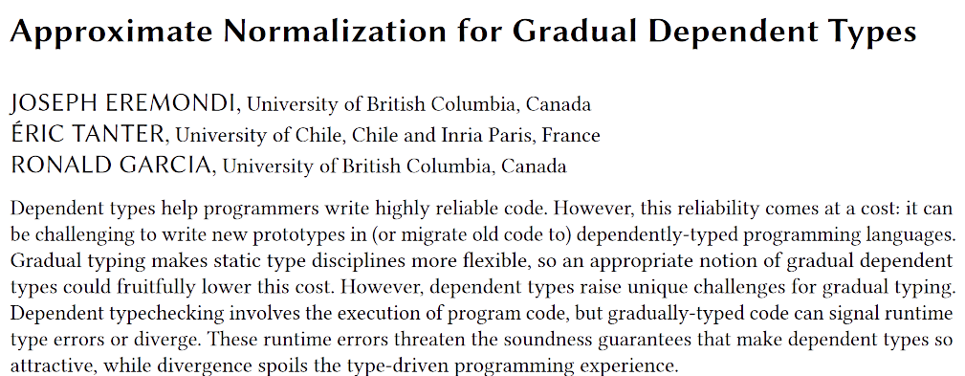
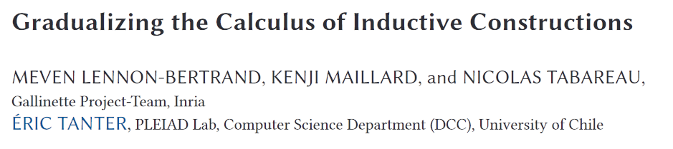
Gradual Types To The Rescue?
sort : FList n Nat -> FList n Nat
sort (Nil , pf) = Nil (Nil , pf)
sort (Cons h t , pf) =
let
lower = sort (filter (< h) t)
higher = sort (filter (> h) t)
in (lower ++ [h] ++ higher , …)
The imprecise term
?

Slide 10


Imprecision has Dynamic Semantics
The
run time should see that this is absurd
sort ([9, 8, 9] , refl)
Gradual run-time checks
? : 2 = 3
No errors: safe but incorrect
Same silent failure!
([8, 9] , ?)

Slide 11
Propositional Equality Using Dynamic Information

Slide 12
Review: Threesomes and Middle Types (Siek and Wadler 2010)
〈 B ⇐ A_{n} 〉…〈 A₂ ⇐ A₁ 〉
〈 B ⇐ A 〉
≡〈 B ⇐ (A & B) ⇐ A 〉
≡〈 B ⇐ (A₁ & … & A_{n} & B) ⇐ A₁ 〉
Cast from
A to B
Cast through
Middle Type: lower bound
A & B ⊑ A
A & B ⊑ B
Middle type remembers multiple casts

Slide 13
Static
Gradual
Single constructor
refl : x = x
Family of constructors
refl(w) : x = y
for any consistent x, y
space of possible witnesses
⊑ x
w ∈
⊑ y

Slide 14
Creating Equality Proofs
Fully static
refl(x) : x = x
Initial Witness
? : x = y
≡ refl(x & y)
x & y
…

Slide 15
Transforming Equality Proofs
〈 x = y ⇐ x’ = y’ 〉refl(w)
≡ refl(w & x & y)
Cast between equality types
Remembers x’, y’, and all previous constraints
x & y
x & y & z
…
⊑

Slide 16
Every time an equality is cast, the witness retains all info from before

Slide 17
Inconsistent Values
Collapse to single value
Only witness is error
=
x ≇ y
x & y
…
error
x & y
error
⊑
=
⊑

Slide 18
Back To Our Example
sort [9, 8, 9]
Goal was impossible to prove
lower := [8]
upper := []
returns ([8, 9], ?)
? : 2 = 3
refl(2 & 3)
refl(error)

Slide 19
Eliminating Equality
transport(eq : x = y)
P(x)
P(y)
Static
Gradual
transport(refl)
transport(refl(w))
P(x)
P(x)
P(x)
P(y)
Retains
info from witness
Cast
Cast
P(w)

Slide 20
Challenge: Extensional Equality
f & f = f
Should be statically distinguishable
f := (λx. λy. x + x )
Should be dynamically indistinguishable
f_{diff} :=(λx. λy. y + y )
f_{same} := (λx. λy. 2 × x)
f & f_{same} = …

Slide 21
Composing Functions
& is operation in language
f & f_{same} = λx. λy. (f x) & (f_{same} x)
Blocked by neutral
Witness that f and f_{diff} are consistent?
f & f_{diff} = λx. λy. (f x) & (f_{diff} x)
Static consistency (syntactic equality
up to ?)
Dynamic consistency
(compose to non-error)
for conversion check
valid refl witnesses

Slide 22
Goodies in the Paper
Design of precision to accommodate composition
Safety, weak consistency, conservative extension
Identify relationship between composition and precision needed for these properties
Extensions : inductive types, empty types, Axiom K

Slide 23
Gradual Propositional Equality
Unifies static equality types and dynamic assertions
Witnesses of consistency dynamically track type information
Composition operator plays nicely with function types

