Slide 1
Coverage Semantics for Dependent Pattern Matching
Joseph Eremondi, Ohad Kammar
University of Edinburgh

Slide 2
Overview
WIP, leaving Scotland
Denotational Semantics for Pattern Matching
Top Level
Non-overlapping
Experiment - abstract over:
What’s a pattern
What matches are total
Language of sheaves / topologies / coverages
New viewpoint, not new result
Has this all been done? Tell us!

Slide 3
Dependent Pattern Matching
Return type depends on value given for n
repeat : (n : Nat) -> A -> Vec A n
repeat zero x = nil
repeat (suc n) x = cons x (repeat n x)
(x : A)
---------------
Vec A zero
(n : Nat)
(x : A)
---------------
Vec A (suc n)

Slide 4
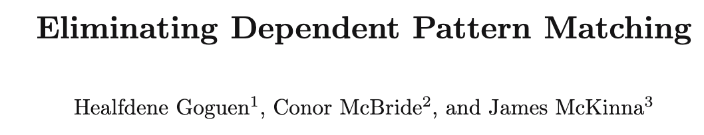
The Usual Way
natElim : (P : Nat -> Type)
-> P zero
-> ((n : Nat) -> P n -> P (suc n))
-> (n : Nat) -> P n
Primitive eliminator
Semantics by e.g. initial algebra of polynomial functor
Patterns -> Eliminators

Slide 5
Something A Little Crazier
repeat’ : (n : Nat) -> A -> Vec A n
repeat’ 0
= nil
repeat’ (2 + n + n) x
= let t = repeat’ n x
in [x,x] ++ t ++ t
repeat’ (1 + n + n) x
= cons x (repeat’ (n + n) x)
Every Nat is 0, even>0, or odd

Slide 6


Does It Make Sense?
Could we internalize views?
More generally:
Criteria for when “new” pattern matching makes sense?

Slide 7
What Goes On The Left?
General Idea: Abstract notion of coverage
Which sets of patterns can form the LHS of a pattern match
Model pattern matching without eliminators?
Research question: Which coverages lead to a language that:
We can give denotational semantics
is logically consistent

Slide 8
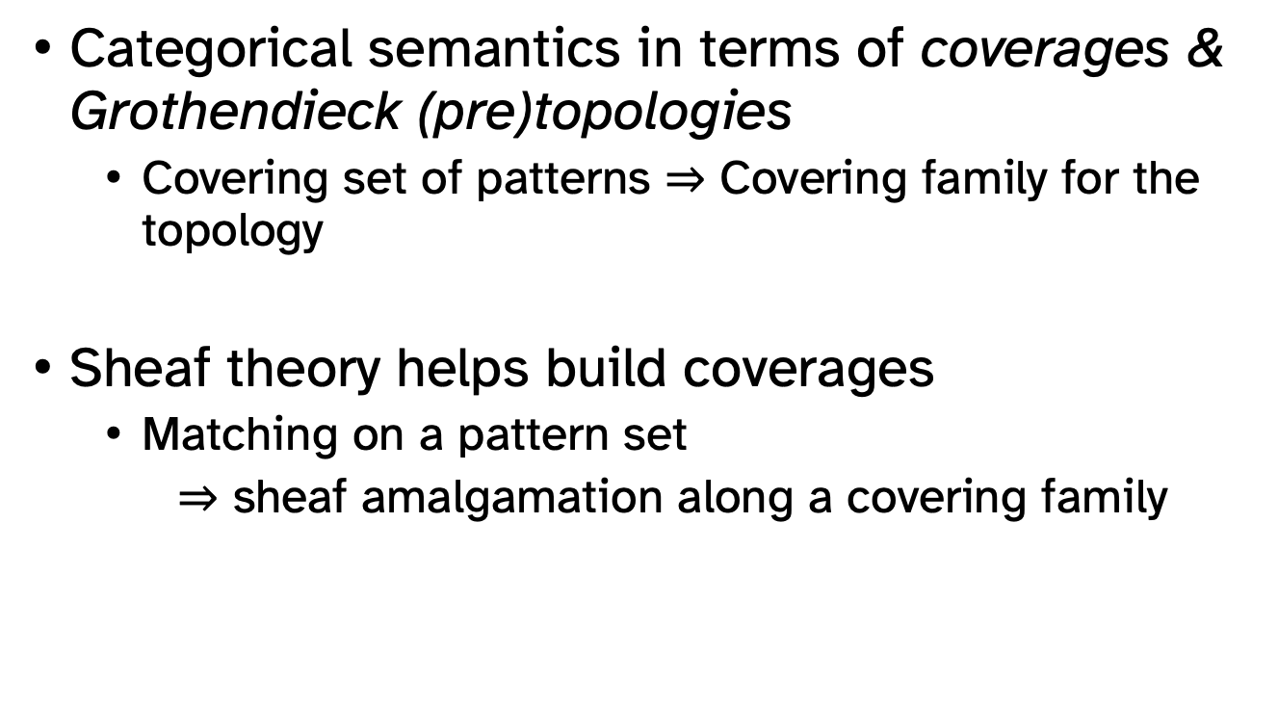
Main Idea
Categorical semantics in terms of coverages & Grothendieck (pre)topologies
Covering set of patterns $⇒$ Covering family for the topology
Sheaf theory helps build coverages
Matching on a pattern set
$⇒$ sheaf amalgamation along a covering family

Slide 9






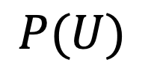

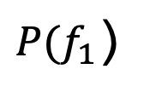


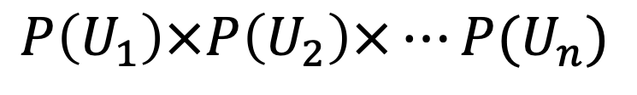

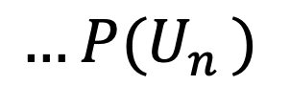






What’s a Sheaf Anyways?
$$U_{1}$$
$$U_{2}$$
$${…U}_{n}$$
$${P(U}_{1})$$
$${P(U}_{2})$$
$${…P(U}_{n})$$
presheaf
$$P$$
$$f_{2}$$
$$…$$
$$…$$
$$f_{1}$$
$$f_{n}$$
$${P(f}_{2})$$
$${P(f}_{n})$$
${P(f}_{1}$)
$$π_{1}$$
$$π_{n}$$
$$U$$
$$P(U)$$
$$g!$$
Assuming non-overlapping
$$P\left(U_{1}\right)×P\left(U_{2}\right)×…P(U_{n})$$

Slide 10


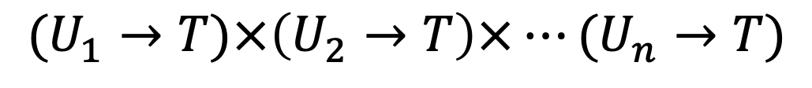

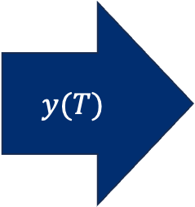

Representable Sheaf
$$U_{1}$$
$$U_{2}$$
$${…U}_{n}$$
$$U_{1}→T$$
$$U_{2}→T$$
$${…U}_{n}→T$$
$$y(T)$$
$$f_{2}$$
$$…$$
$$…$$
$$f_{1}$$
$$f_{n}$$
$$π_{1}$$
$$π_{n}$$
$$U$$
$$U→T$$
$$g!$$
$$(U_{1}→T)×\left(U_{2}→T\right)×…(U_{n}→T)$$
🤔

Slide 11



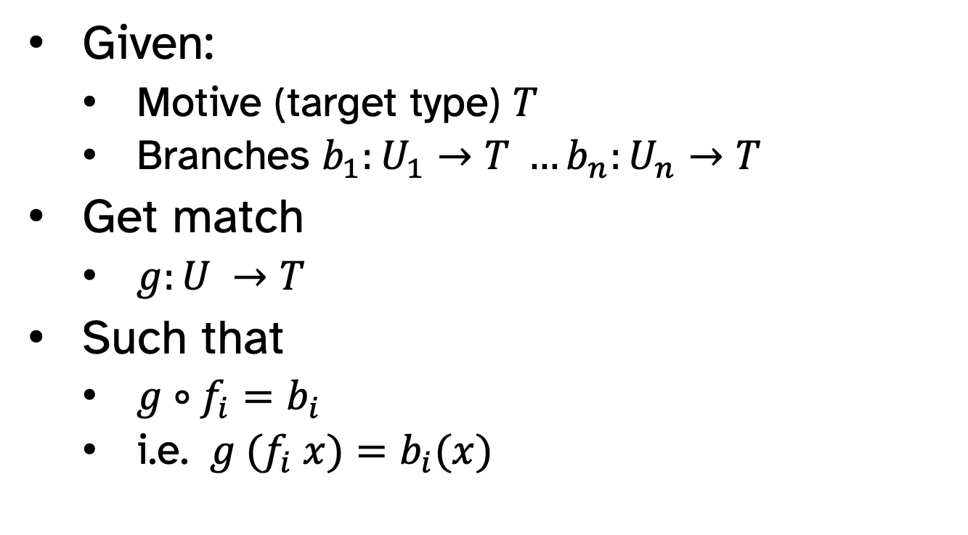





Simple Pattern Matching
Given:
Motive (target type) $T$
Branches $b_{1}:U_{1}→T …b_{n}:U_{n}→T$
Get match
$g:U →T$
Such that
${g∘f}_{i}=b_{i}$
i.e. ${ g (f}_{i} x)=b_{i}(x)$
$$U_{1}$$
$$U_{2}$$
$${…U}_{n}$$
$$f_{2}$$
$$…$$
$$f_{1}$$
$$f_{n}$$
$$U$$

Slide 12
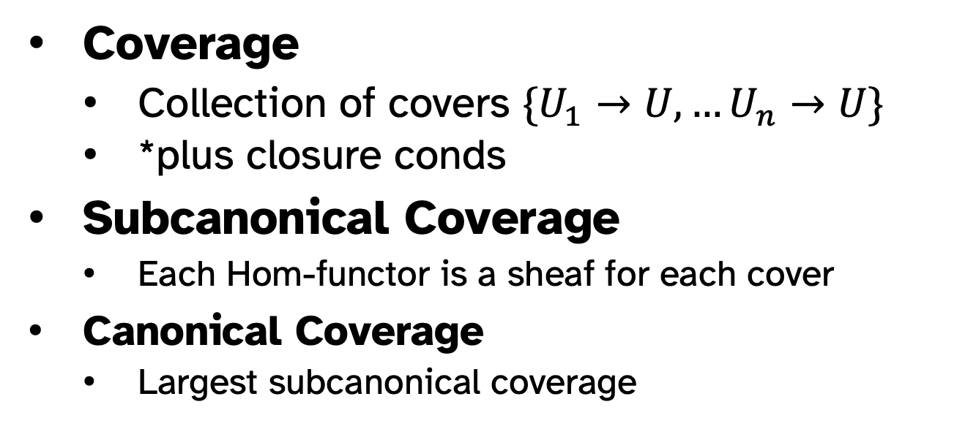
Canonical Coverage
Coverage
Collection of covers $\{U_{1}→U,…U_{n}→U\}$
*plus closure conds
Subcanonical Coverage
Each Hom-functor is a sheaf for each cover
Canonical Coverage
Largest subcanonical coverage

Slide 13
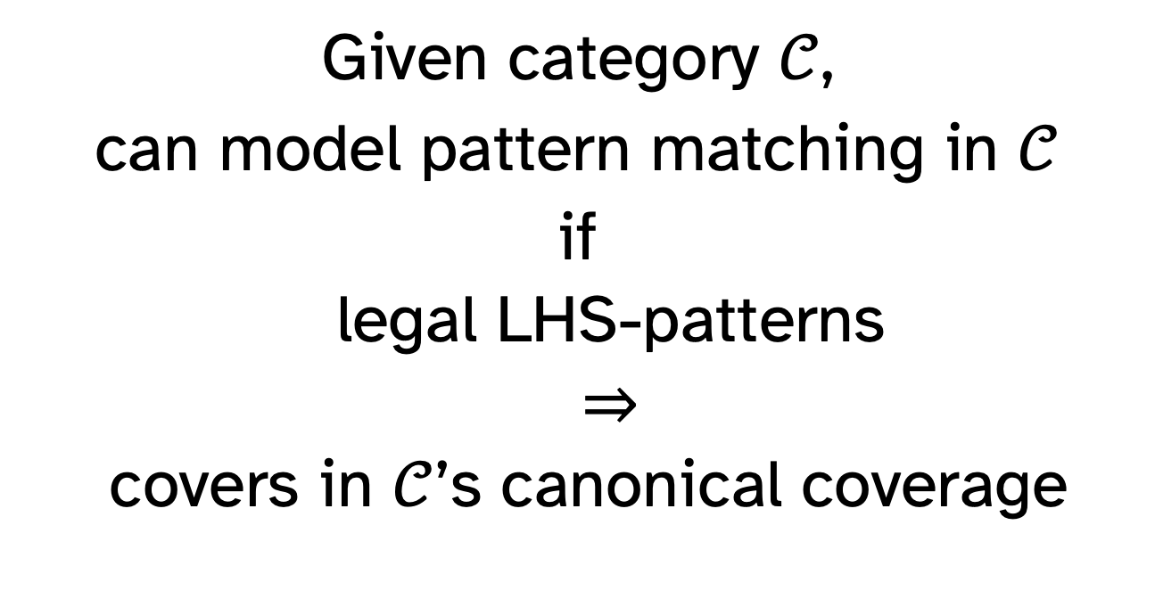
Central Claim
Given category $𝒞$,
can model pattern matching in $𝒞$
if
legal LHS-patterns
$⇒$
covers in $𝒞$’s canonical coverage

Slide 14
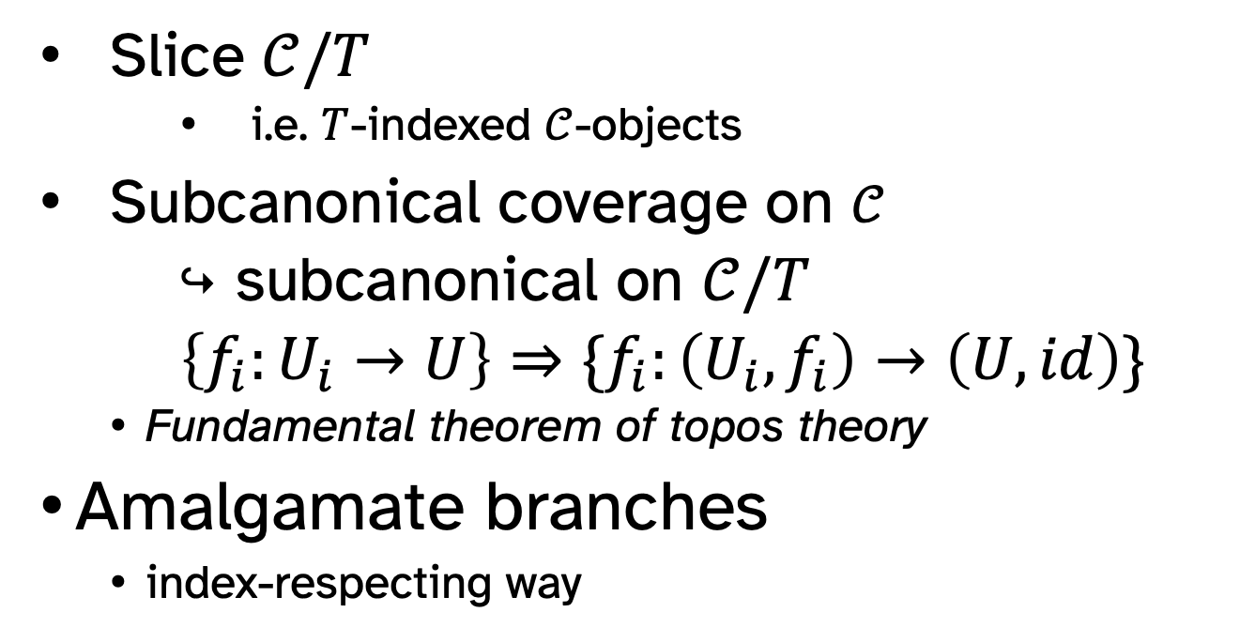
Dependent Matching
Slice $𝒞/T$
i.e. $T$-indexed $𝒞$-objects
Subcanonical coverage on $𝒞$
$↪$ subcanonical on $𝒞/T$
$\left\{f_{i}:U_{i}→U\right\}⇒\{f_{i}:\left(U_{i},f_{i}\right)→\left(U,id\right)\}$
Fundamental theorem of topos theory
Amalgamate branches
index-respecting way

Slide 15

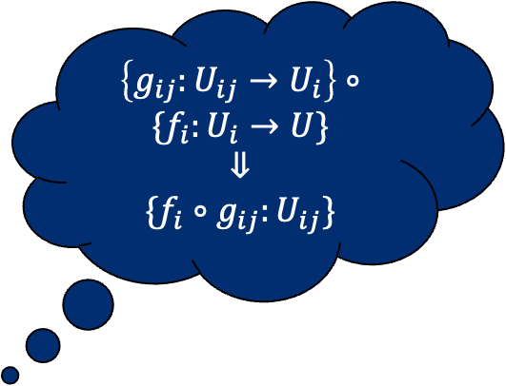
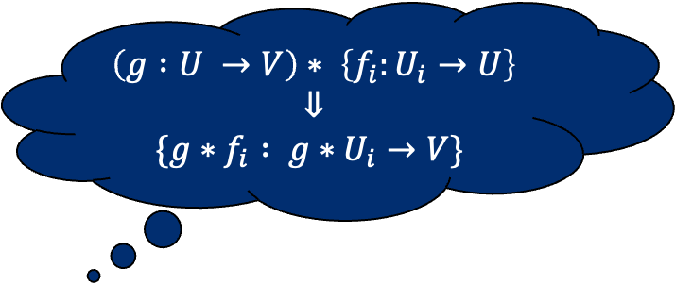
Saturation Conditions
Operations on coverages
Sheaves invariant under op
Canonical coverage
Must contain results of saturation
$\left\{g_{ij}:U_{ij}→U_{i}\right\}$ $∘\{f_{i}:U_{i}→U\}$
$$⇓$$
$\{{f_{i}∘g}_{ij}:U_{ij}\}$
$$\left(g :U →V\right)∗ \left\{f_{i}:U_{i}→U\right\}$$
$$⇓$$
$$\{{g∗f}_{i} : {g∗U}_{i}→V\}$$
$$\left\{ι:B≅A\right\}$$
Examples:
Adding all isomorphisms
Composing coverages
Pulling back by any arrow

Slide 16


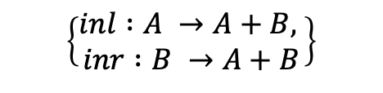
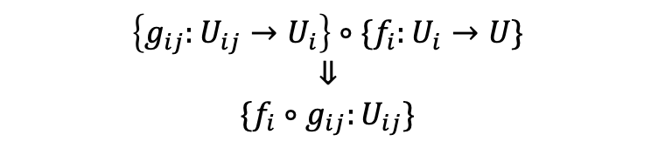

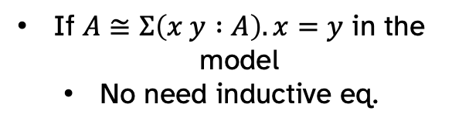
Recreating Pattern Matching
case x of
y => f y
$$\left\{ι:B≅A\right\}$$
$id$ is isomorphism
case x y (eq : x = y) of
x x refl => …
If $A≅Σ\left(x y :A\right).x=y$ in the model
No need inductive eq.
$$\left\{ι:B≅A\right\}$$
If sums stable under pullback (e.g. LCCC)
No need to be constructors
case x of
(inl y) => f y
(inr z) => g z
$\left\{\begin{aligned}inl :A →A+B, \\ inr :B →A+B\end{aligned}\right\}$
case x of
(inl y) => f y
(inr (inl z)) => g z
(inr (inr w)) => h w
$\left\{g_{ij}:U_{ij}→U_{i}\right\}$ $∘\{f_{i}:U_{i}→U\}$
$$⇓$$
$\{{f_{i}∘g}_{ij}:U_{ij}\}$

Slide 17






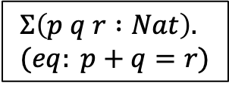

Equality And Pullbacks
case (p q r : Nat)(pf : p + q = r) of
p q (p+q) refl => …
$$(p+q)$$
Singleton cover
$$\left(p,q\right): Nat×Nat$$
$$x:Nat$$
$$(p,q,p+q,refl)$$
$$(x,x,refl)$$
Semantic unification/
dot patterns
$$Σ\left(p q r :Nat\right). \\ (eq: p+q=r)$$
$$Σ\left(x y :Nat\right).x=y$$
$$(p+q,r,eq)$$

Slide 18
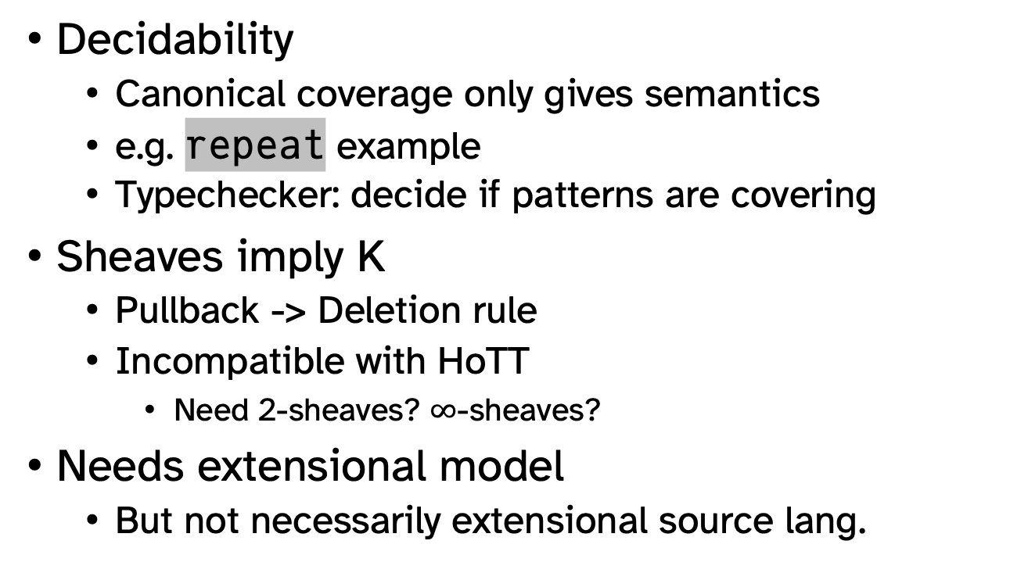
Limitations
Decidability
Canonical coverage only gives semantics
e.g. repeat example
Typechecker: decide if patterns are covering
Sheaves imply K
Pullback -> Deletion rule
Incompatible with HoTT
Need 2-sheaves? $∞$-sheaves?
Needs extensional model
But not necessarily extensional source lang.

Slide 19
What’s Next?
Recursion/termination
With-patterns, open contexts
Relation to pullbacks?
Modelling overlap
e.g. wildcards _
Framework for making patterns disjoint
Differentiable Programming
smoothness, agree on overlap
Deeper connections with Topos Theory

Slide 20
Thank You!

Slide 21

Basic Coverages: Identity
In canonical coverage:
All objects covered by identity
i.e. variable as LHS of pattern
Also covers wildcards
*if no overlap
$$\left\{id:A →A\right\}$$
case x of
y => f y

Slide 22
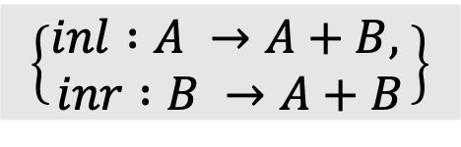
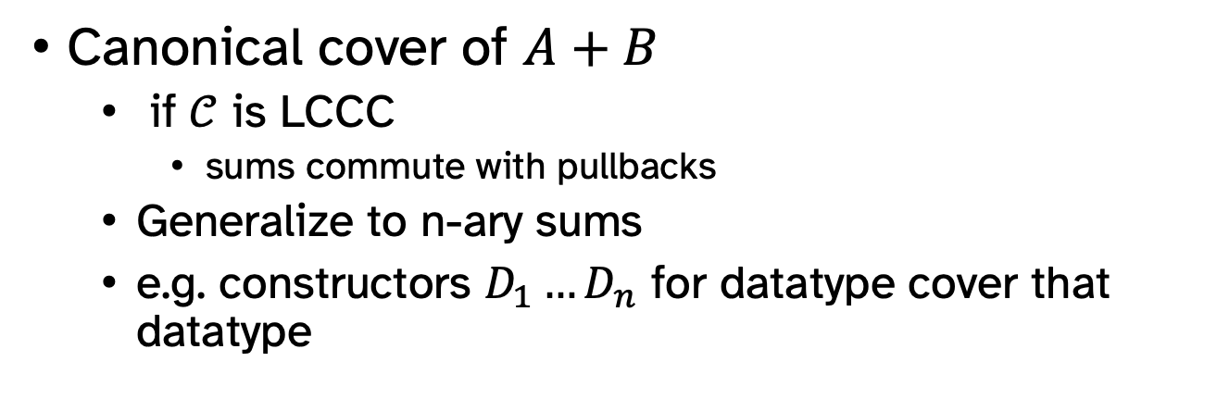
Basic Coverages: Sums
case x of
(inl y) => f y
(inr z) => g z
$\left\{\begin{aligned}inl :A →A+B, \\ inr :B →A+B\end{aligned}\right\}$
Canonical cover of $A+B$
if $𝒞$ is LCCC
sums commute with pullbacks
Generalize to n-ary sums
e.g. constructors $D_{1}…D_{n}$ for datatype cover that datatype

Slide 23

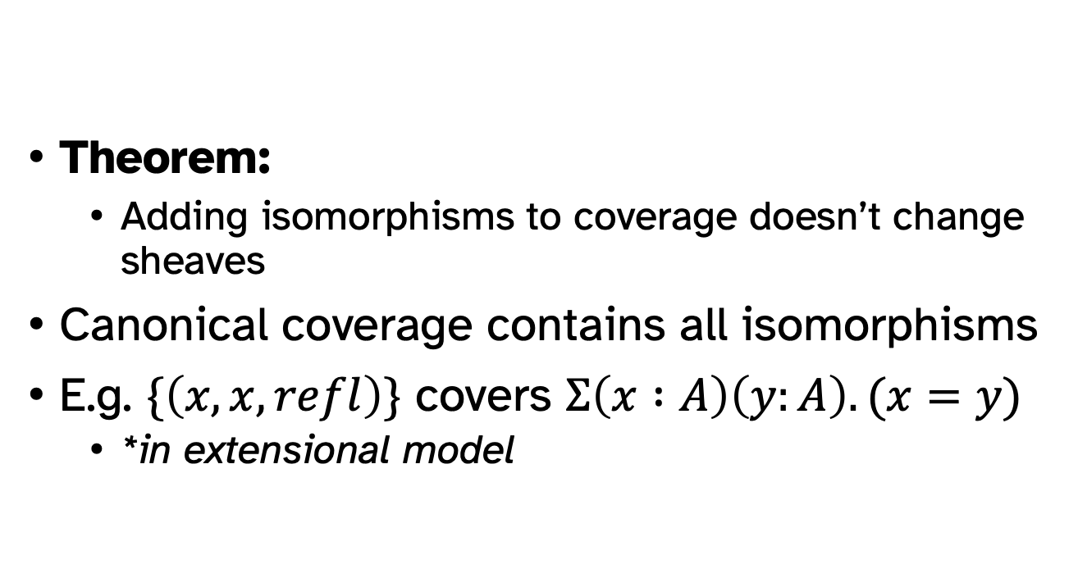
New Coverages: Isomorphism
Theorem:
Adding isomorphisms to coverage doesn’t change sheaves
Canonical coverage contains all isomorphisms
E.g. $\{\left(x,x,refl\right)\}$ covers $Σ\left(x :A\right)\left(y:A\right).(x=y)$
*in extensional model
$$\left\{ι:B≅A\right\}$$
case x of
i y => f y

Slide 24
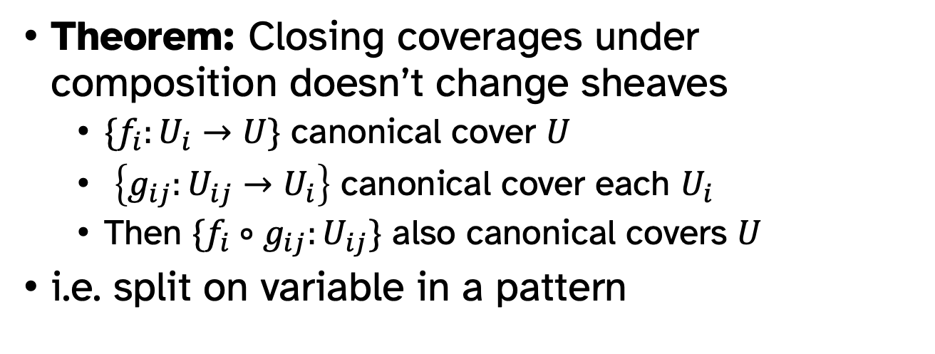
Combining Coverages: Nesting
case x of
(inl y) => f y
(inr (inl z)) => g z
(inr (inr w)) => h w
Theorem: Closing coverages under composition doesn’t change sheaves
$\{f_{i}:U_{i}→U\}$ canonical cover $U$
$\left\{g_{ij}:U_{ij}→U_{i}\right\}$ canonical cover each $U_{i}$
Then $\{{f_{i}∘g}_{ij}:U_{ij}\}$ also canonical covers $U$
i.e. split on variable in a pattern

Slide 25
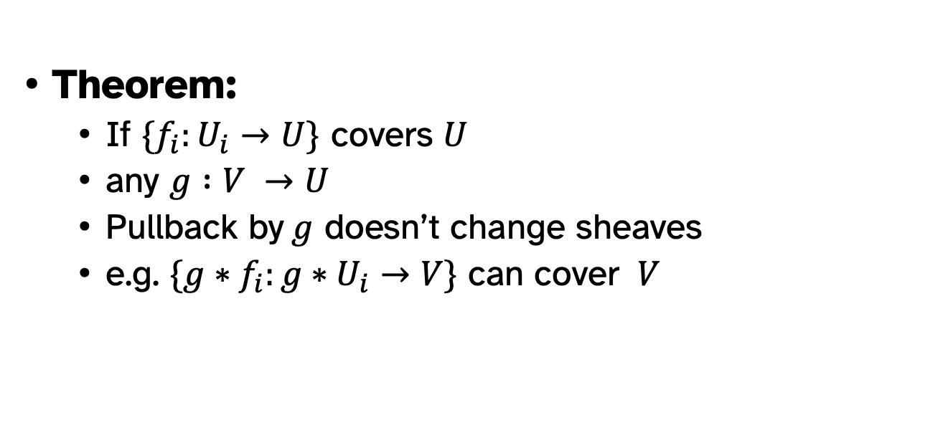
Base Change
Theorem:
If $\{f_{i}:U_{i}→U\}$ covers $U$
any $g :V →U$
Pullback by$g$ doesn’t change sheaves
e.g. $\{{g∗f}_{i}:{g∗U}_{i}→V\}$ can cover $V$

Slide 26
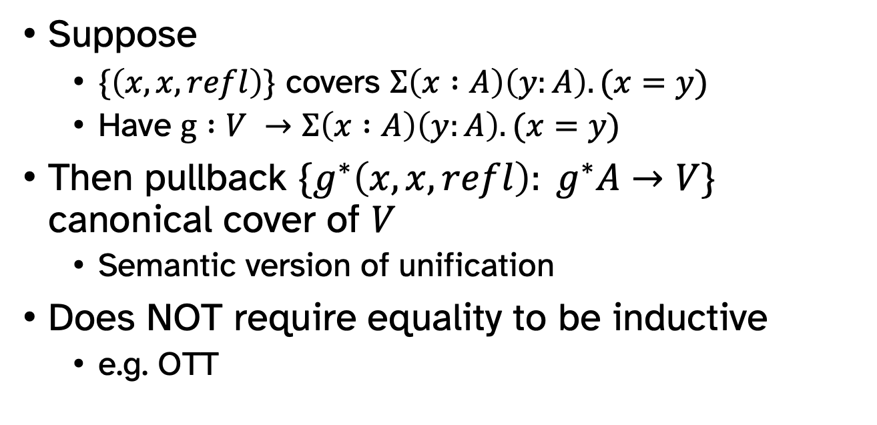
Equality and Pullbacks
Suppose
$\{\left(x,x,refl\right)\}$ covers $Σ\left(x :A\right)\left(y:A\right).(x=y)$
Have $g :V →Σ\left(x :A\right)\left(y:A\right).(x=y)$
Then pullback $\{g^{∗}\left(x,x,refl\right):{ g}^{∗}A→V\}$ canonical cover of $V$
Semantic version of unification
Does NOT require equality to be inductive
e.g. OTT

