Slide 1
On The Design of a Gradual Dependently Typed Language for Programming
Joey Eremondi
Strathclyde MSP 101
June 30, 2023
Joint work with Ron Garcia and Éric Tanter

Slide 2




Goal 1: Migration
There’s a lot of non-dependently typed code in the world
Want smooth migration of libraries from non-dependent to dependent
Easier for beginners
Less tedious for experts
Principled FFI when migration not feasible
Typed boundary
Check if types lie

Slide 3
Goal 2: Dynamic Holes
Dependent type programming is already gradual-ish
Partially specified Terms/Types
Typed Holes!
Wouldn’t it be nice if we had a dynamic semantics for programs with holes?
Run/test code
Humans: test a conjecture
Hypothesis: Dynamic information is useful in the construction of types & proofs
Machine: aid proof search

Slide 4
Types are Specifications
Unified language for program specification
Can be checked
At compile-time (proof)
At run-time
Like an assert
But without duplicating the spec
Eventually checked statically
Getting there is the hard part

Slide 5

A Buggy Quicksort
sort : List Nat -> List Nat
sort Nil = Nil
sort (Cons h t) =
let
lower = sort (filter (< h) t)
higher = sort (filter (> h) t)
in lower ++ [h] ++ higher
sort [9, 8, 9]
= [8,9]
Removes duplicates!
Silently incorrect

Slide 6
Adding the Spec To the Types (with the magic of dependent types)
Length index
Fixed-length Lists:
FList : Type -> Nat -> Type
FList a n =
(lst : List a) × (length lst = n)
Propositional equality: length matches index
Dependent pair
Underlying list

Slide 7
Dependent Types Catch the Bug?
To run, must prove:
length
(lower
++ [h]
++ higher)
= 1 + length t
sort : FList n Nat -> FList n Nat
sort : List Nat -> List Nat
sort Nil = Nil
sort (Cons h t) =
let
lower = sort (filter (< h) t)
higher = sort (filter (> h) t)
in lower ++ [h] ++ higher
sort (Nil , pf) = Nil (Nil , pf)
sort (Cons h t , pf) =
vs
“Sort accidentally removes duplicates”
in (lower ++ [h] ++ higher , …)
Notes:
Can dependent type help identify this bug?
…modify code
Now, because this is a fixed-length list, the programmer needs to supply a proof that the result length is the same as the input length,
a goal that looks like this. The problem is that there is a conceptual gap between the type of this goal, which is what the programmer sees,
and the actual problem, which is that sort deletes duplicates. The statement is false, so the programmer can never prove the goal, but
the only hint they have is that the difficulty they experience proving the goal.

Slide 8
Unblocking Development
? as value not type
sort : FList n Nat -> FList ? Nat
sort : List Nat -> List Nat
sort Nil = Nil
sort (Cons h t) =
let
lower = sort (filter (< h) t)
higher = sort (filter (> h) t)
in (lower ++ [h] ++ higher , refl)
sort (Nil , pf) = Nil (Nil , pf)
sort (Cons h t , pf) =
Actual length is consistent with ?
Notes:
Can dependent type help identify this bug?
…modify code
Now, because this is a fixed-length list, the programmer needs to supply a proof that the result length is the same as the input length,
a goal that looks like this. The problem is that there is a conceptual gap between the type of this goal, which is what the programmer sees,
and the actual problem, which is that sort deletes duplicates. The statement is false, so the programmer can never prove the goal, but
the only hint they have is that the difficulty they experience proving the goal.

Slide 9
Going Further: Catching Bugs
Keep desired invariant in types
sort : FList n Nat -> FList n Nat
sort : List Nat -> List Nat
sort Nil = Nil
sort (Cons h t) =
let
lower = sort (filter (< h) t)
higher = sort (filter (> h) t)
in (lower ++ [h] ++ higher , ?)
sort (Nil , pf) = Nil (Nil , pf)
sort (Cons h t , pf) =
? as proof
Track at runtime to catch error
Notes:
Can dependent type help identify this bug?
…modify code
Now, because this is a fixed-length list, the programmer needs to supply a proof that the result length is the same as the input length,
a goal that looks like this. The problem is that there is a conceptual gap between the type of this goal, which is what the programmer sees,
and the actual problem, which is that sort deletes duplicates. The statement is false, so the programmer can never prove the goal, but
the only hint they have is that the difficulty they experience proving the goal.

Slide 10
Non-dependent Gradual Types

Slide 11






Type Imprecision
$$∼$$
$$Nat→Nat$$
$$?→Nat$$
$$∼$$
$$Bool→Nat$$
$$∼$$
$$(Bool→Nat)→Nat$$
Unknown type
Replace any part of type
Values allowed in any context
Compare types by consistency ~
Equality up to ?

Slide 12



Consistency Replaces Equality
$Γ⊢t∈S$ $S=T$
$$S \sim T$$
$$Γ⊢t∋T$$
Use term in any consistently typed context
Types plausibly equal i.e. modulo ?
Dynamic checks ensure safety
Static
Types must be visibly equal
Gradual
Types cannot be visibly unequal

Slide 13


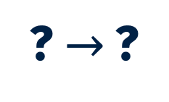


Semilattice of Types: Precision
$$Bool→Nat$$
$$⊑$$
$Bool→$?
$$⊑$$
? $→$?
$$⊑$$
?
Order by precision
⊤ ≜ ?
“Could be anything”
Term Precision:
Order by precision of type annotations
⊥ if result in error

Slide 14

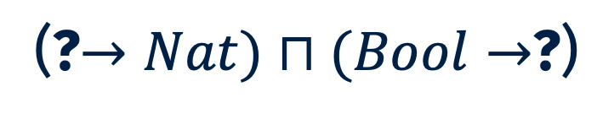

Semilattice of Types: Meet
(?$→Nat)⊓(Bool→$?)
= $Bool→Nat$
Most general type as precise as both
Unify up to ?
Combine two pieces of type info
E.g. run-time checks
S ~ T iff S $⊓$ T ≠ ⊥

Slide 15
Gradual Guarantees
Fully Dynamic
Fully Static
More ?
Fewer ?
Fewer static errors
More static errors
Fewer dynamic errors
More dynamic errors
Reducing precision causes no new static or dynamic errors
Contrapositive - error means
two program types are wrong
solution is never "more types"

Slide 16
Gradual Dependent Types

Slide 17
Degrees of Imprecision
? As a type
Types containing ?-typed terms
Affects type-checking computations
? As a term in a type
Need semantics for ?
? As a term in at run time

Slide 18
Static-Dynamic Tension
Dependent (Rigid)
Gradual (Flexible)
Well-typed at each step
Possibility of dynamic type errors
Approximate Normalization
Normalize for decidable type checking
Allows non-termination
Dynamic vs static consistency
Syntactic compile-time type comparison
Run-time type comparison

Slide 19


Effectful Nature of Gradual Types
$$\left(λ\left(x:\text{?}\right).x x\right)(λ\left(x:\text{?}\right).x x)$$
$$1+\left(true:\text{?}\right)$$
Non-termination
Dynamic errors
During type checking

Slide 20
Approximate Normalization

Slide 21
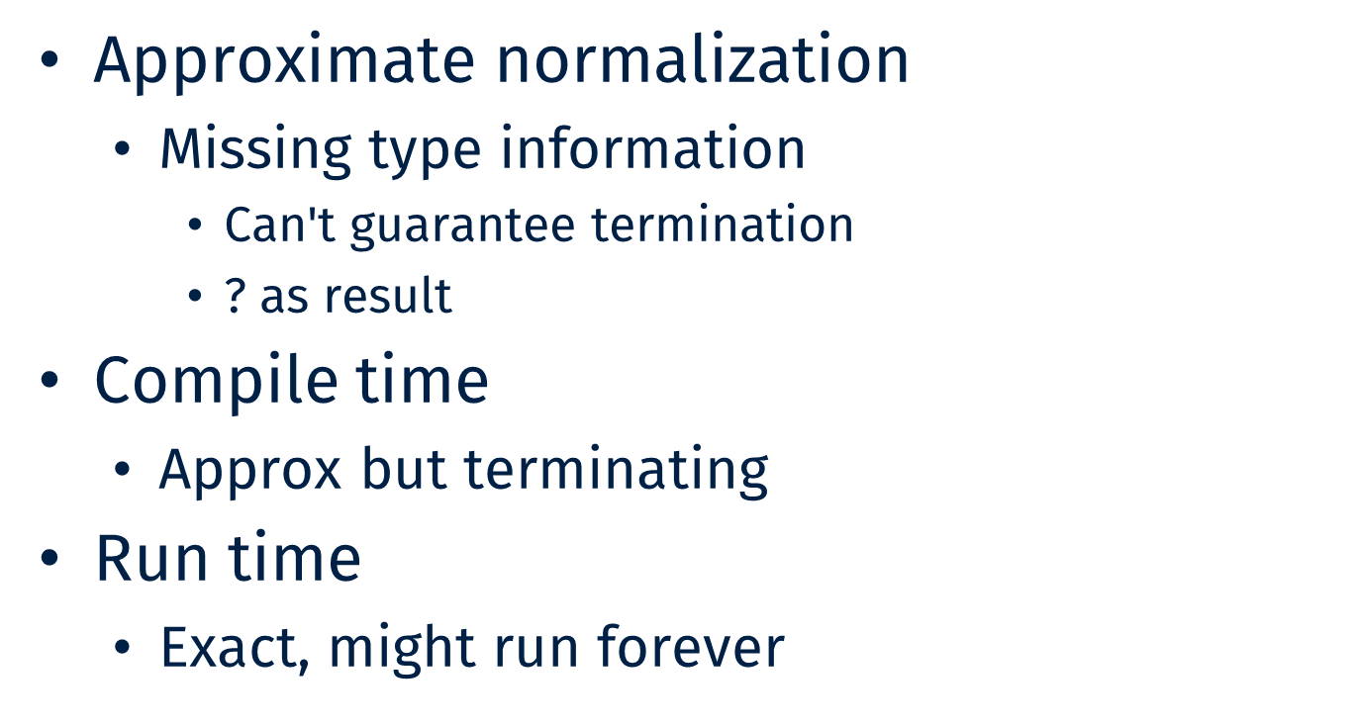
Managing non-termination
Approximate normalization
Missing type information
Can't guarantee termination
$\text{?}$ as result
Compile time
Approx but terminating
Run time
Exact, might run forever

Slide 22
The Idea
(? → ?) embedded in ?
? contains values of any type
Essentially “non-positive”
Idea:
Approx functions as bound
(λ x . f[x]) becomes (λ x . f[?])
When converting to ?
Compile time:
Only embed 𝟙 →?

Slide 23
Why Bother?
Is undecidable checking that bad?
Transparency
Non-termination in run-time check
Hard to debug code that the programmer didn’t write
Semantics/Implementation
Translate to static dependent types

Slide 24
Gradual Propositional Equality

Slide 25

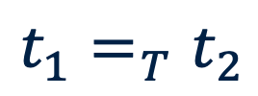
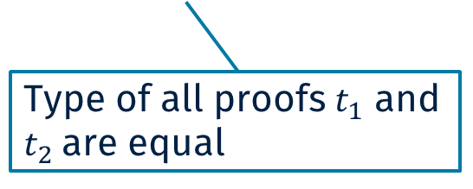
Propositional Equality
$$t_{1}=_{T}t_{2}$$
$$refl:x=_{T}x$$
Type of all proofs $t_{1}$ and $t_{2}$are equal
Only proof: x equal to self
Pre- and post-conds
Prove branch unreachable
Rewrite goal type

Slide 26
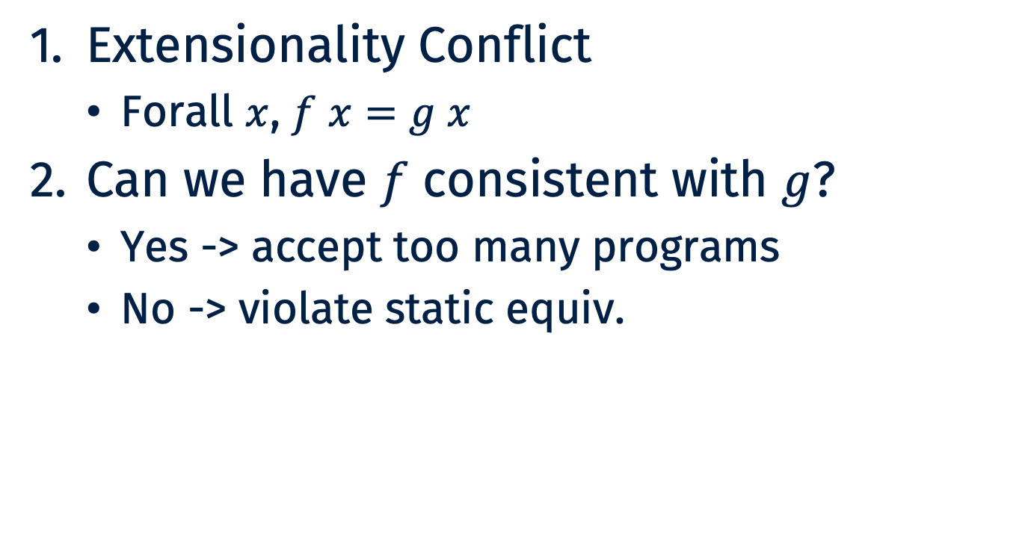
Gradual Propositional Woes
Extensionality Conflict
Forall $x$, $f x=g x$
Can we have $f$ consistent with $g$?
Yes -> accept too many programs
No -> violate static equiv.

Slide 27
Extensional Tension
Should be statically distinguishable
f := (λx. λy. x + x )
Should be dynamically indistinguishable
f_{diff} :=(λx. λy. y + y )
f_{same} := (λx. λy. 2 × x)

Slide 28


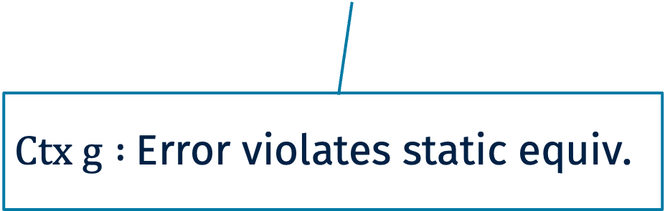

Distinguishing Context
$$\operatorname{zeroes}{ :\left(n :Nat\right)→Vec Nat n}$$
$$f=λn.n+n$$
Statically indistinguishable
$$g=λn.2∗n$$
$$Ctx= λh. (((Refl : \left(f≡f\right)∷ ?)∷(f≡h))$$
$Ctx g :$Error violates static equiv.

Slide 29

Problematic Consequence
Lennon-Bertrand et al 2022
$refl$ is the only constructor
Gradual guarantees
+
=
Make refl NOT the only constructor!
distinguish some observationally equivalent programs

Slide 30
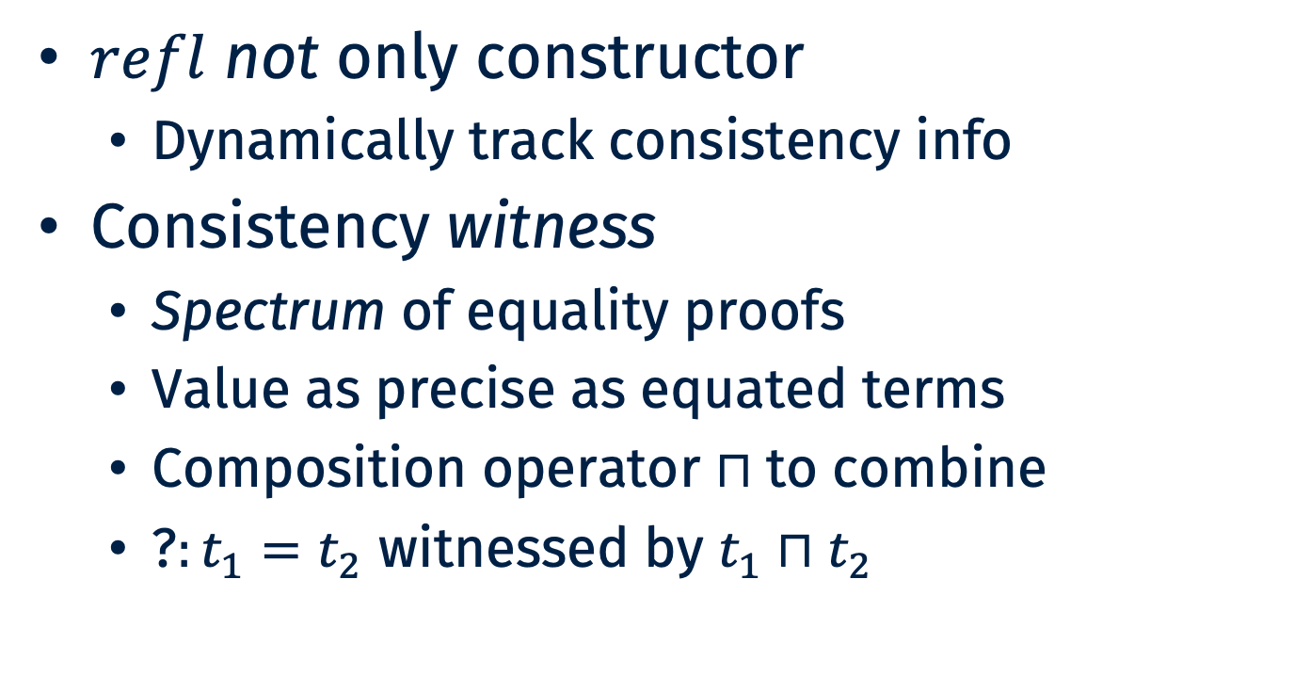
Equality Witnesses
$refl$ not only constructor
Dynamically track consistency info
Consistency witness
Spectrum of equality proofs
Value as precise as equated terms
Composition operator $⊓$to combine
$\text{?}:t_{1}=t_{2}$ witnessed by $t_{1}⊓t_{2}$

Slide 31
Key Idea
Static
Gradual
Single constructor
refl : x = x
Family of constructors
refl(w) : x = y
for any consistent x, y
space of possible witnesses
⊑ x
w ∈
⊑ y

Slide 32
Creating Equality Proofs
Fully static
refl(x) : x = x
Initial Witness
? : x = y
⤳ refl(x ⊓ y)
x ⊓ y
…

Slide 33
Transforming Equality Proofs
refl(w) :: x ≡ y
⤳ refl(w ⊓ x ⊓ y)
Cast between equality types
Remembers x’, y’, and all previous constraints
x ⊓ y
x ⊓ y ⊓ z
…
⊑

Slide 34
Eliminating Equality
transport(eq : x = y)
P(x)
P(y)
Static
Gradual
transport(refl)
transport(refl(w))
P(x)
P(x)
P(x)
P(y)
Retains
info from witness
Cast
Cast
P(w)

Slide 35
OTT Again?
“Dynamic” version of Observational Type Theory
transport has computational content
Type-directed defn. of equality
Gradual version of K, funext
Hope to make connection deeper in future

Slide 36
Back to Our Example
Keep desired invariant in types
sort : FList n Nat -> FList n Nat
sort : List Nat -> List Nat
sort Nil = Nil
sort (Cons h t) =
let
lower = sort (filter (< h) t)
higher = sort (filter (> h) t)
in (lower ++ [h] ++ higher , ?)
sort (Nil , pf) = Nil (Nil , pf)
sort (Cons h t , pf) =
? as proof
Track at runtime to catch error
Notes:
Can dependent type help identify this bug?
…modify code
Now, because this is a fixed-length list, the programmer needs to supply a proof that the result length is the same as the input length,
a goal that looks like this. The problem is that there is a conceptual gap between the type of this goal, which is what the programmer sees,
and the actual problem, which is that sort deletes duplicates. The statement is false, so the programmer can never prove the goal, but
the only hint they have is that the difficulty they experience proving the goal.

Slide 37
Back To Our Example
sort [9, 8, 9]
Goal was impossible to prove
lower := [8]
higher := []
returns ([8, 9], ?)
? : 2 = 3
refl(2 ⊓ 3)
refl(error)

Slide 38
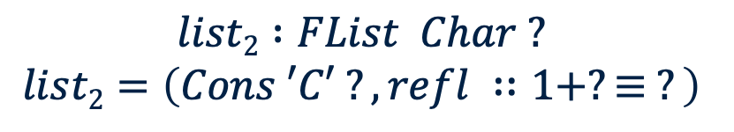
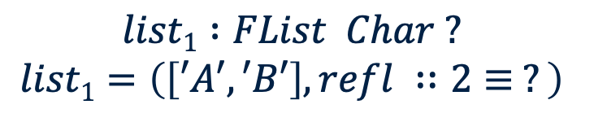
Not Just Safety
$$zip : (n : N) → FList A n → FList A n → FList (A × A) n$$
$$take : (n : N) → (m : N) → FList B (n + m) → FList B n$$
$$list1 :FList Char ?$$
$$list1=\left(\left[′A′,′B′\right], refl ∷2≡ ?\right)$$
$$list2 :FList Char ?$$
$$list2=\left(Cons ′C′ ?, refl ∷1+?≡ ?\right)$$

Slide 39





Not Just Safety ctd.
$$take 3 (zip ?list1 list2)$$
$$take 3 (zip ?(\left[A,B\right], refl(2)) (Cons C ?,refl(1+?)) )$$
$$take 3 (Cons (A,C) ?,refl(2⊓1+?))$$
From cast, transport
$$take 3 (Cons (A,C) ?,refl(2))$$
Code was safe but wrong!
$$(Cons (A,C) ?,refl(3⊓2))$$
$$(Cons (A,C) ?,refl(ERROR))$$

Slide 40


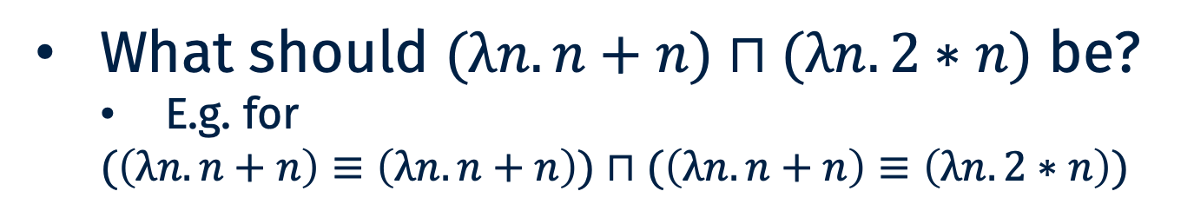
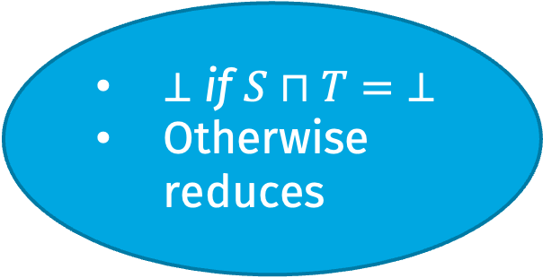
Importance of Composition
Term type T,
Ascribed type S
$$t:T$$
$$t∷S$$
$⊥$ if $S⊓T=$ $⊥$
Otherwise reduces
What should $(λn.n+n)⊓(λn.2∗n)$ be?
E.g. for
$$(\left(λn.n+n\right)≡\left(λn.n+n\right))⊓(\left(λn.n+n\right)≡\left(λn.2∗n\right))$$

Slide 41
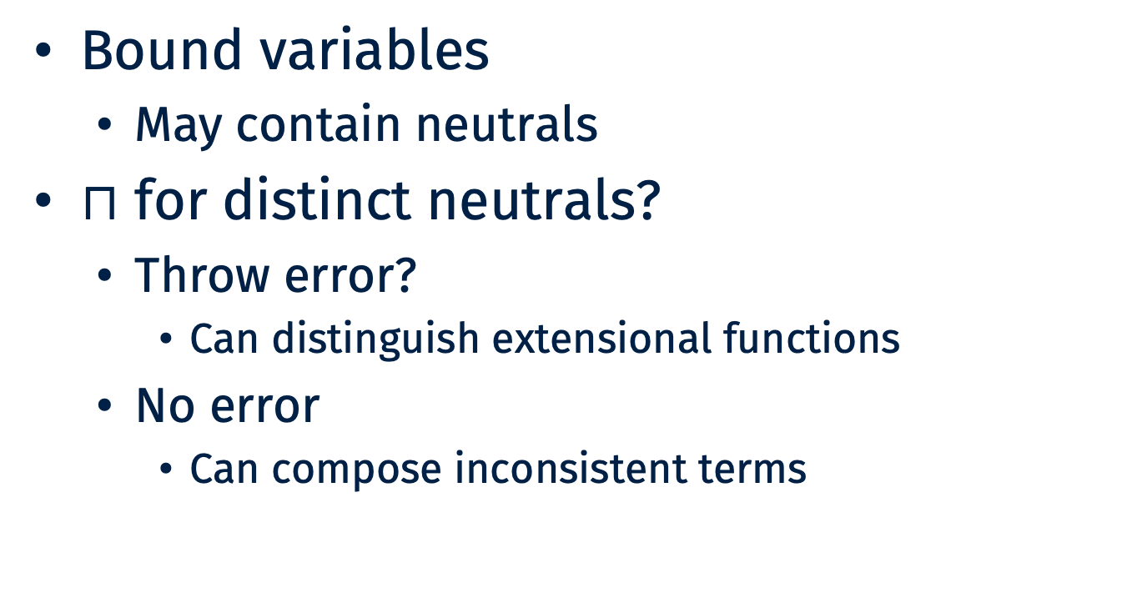
Meet for Functions
Bound variables
May contain neutrals
$⊓$ for distinct neutrals?
Throw error?
Can distinguish extensional functions
No error
Can compose inconsistent terms

Slide 42
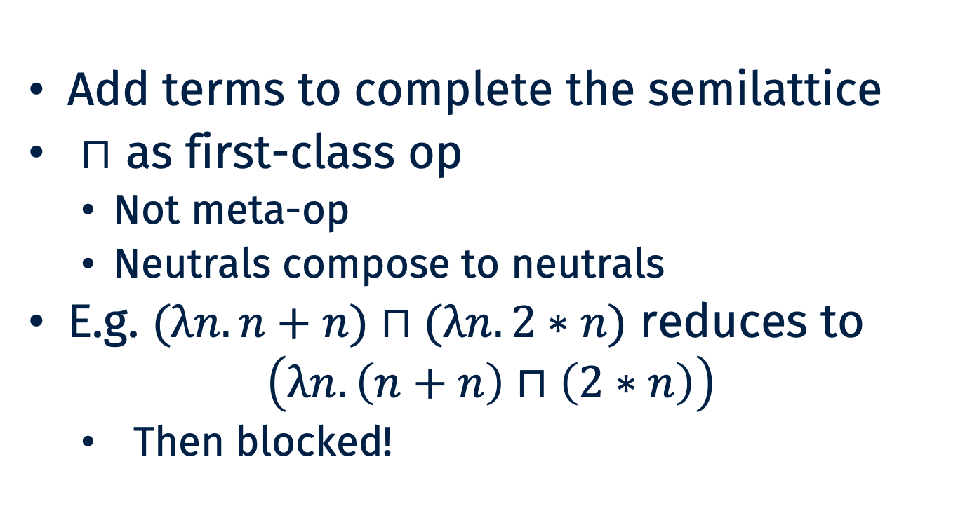
Completing the Semilattice
Add terms to complete the semilattice
⊓ as first-class op
Not meta-op
Neutrals compose to neutrals
E.g. $(λn.n+n)⊓(λn.2∗n)$ reduces to
$$\left(λn.\left(n+n\right)⊓\left(2∗n\right)\right)$$
Then blocked!

Slide 43
Resolving the tension
Static vs Dynamic Consistency
Static:
Distinct neutrals inconsistent
Prevents typing too many programs
Dynamic:
compose to non-error
all neutrals dynamically consistent
Respects static equivalences

Slide 44
Semantics

Slide 45
General Approach
Syntactic model/shallow embedding
Translate gradual to static dependent types
Termination via simulation
Model types using codes
Universe ala Tarski
Modelling exact execution
Guarded type theory
Logically consistent model of non-termination

Slide 46
Modelling the Uknown Type
Recursive sum
Constructor for Pi, Sigma, Eq, inductive, etc.
Strictly positive due to approx. norm.
Hard part: including *all* inductives
WANTED: Parameter-aware version of Containers/W-Types/Descriptions
Separate + and – parameter uses

Slide 47
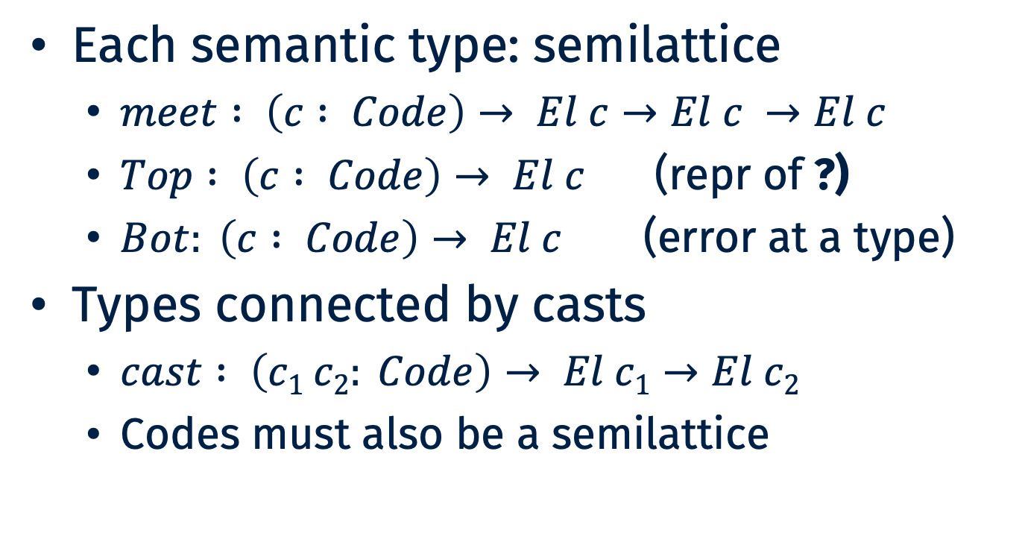
Gradual Operation
Each semantic type: semilattice
$meet : \left(c : Code\right)→ El c→El c →El c$
$Top : \left(c : Code\right)→ El c$ (repr of ?)
$Bot: \left(c : Code\right)→ El c$ (error at a type)
Types connected by casts
$cast : \left(c1 c2: Code\right)→ El c1→El c2$
Codes must also be a semilattice

Slide 48

Mutual Dependency
Mutual ops
$\text{?}$ Uses$⊓$
Equality witnesses
$⊓$ uses cast
Cast uses $\text{?}$

Slide 49
Ordinals for Termination
Custom Brouwer trees
Strictly-monotone idempotent max
a < b and c < d implies (max a c) < (max b d)
Closed under limits over arbitrary codes
Lim c f for any (c : Code) and (f : El c -> Ord)
Trickery to ensure idempotence
Ensure limits are always max-ed with themselves an infinite number of times

Slide 50
Decreasing Metric
Ordinal for each code
Lim needed for Pi/Sigma types
Meet and ?
Decreasing in size of code
Code meet and cast
Decreasing in size of max(c1, c2)

Slide 51
Future Work

Slide 52
Model metatheory
Current proofs:
Simulations
Syntactic, complicated
Guarded Type Theory
Prove semantically in model
Prove in GTT itself

Slide 53
Inductive families
Equality
Way to model indexed types
Doesn't propagate constraints right
Over time, not over space
Monotone references
Shared mutable witnesses
Run-time unification

Slide 54
Implementation
Idris 2
Dependent types
Programming-focused
Escape hatch for non-termination
Syntactic model
Same translation
Gradual surface -> Idris core
Challenges
Type classes
Implicits/unification

