Slide 1
itCoin Core
Bitcoin core architecture
Cisc322 IKUN-FAMILY architecture project

Slide 2

Our Team Work
Leader
Jinyang Chen. (19jc66@queensu.ca): Web design, Slide design, Abstract
Zehan Wang.(19zw37@queensu.ca): Introduction, Architecture analysis
Rundong Yu.(18ry16@queensu.ca): Introduction, Architecture analysis
Chiyu Wang.(19cw33@queensu.ca): Use case, Body of Report
Yuxuan Cai.(18yc33@queensu.ca): Use case, Body of Report
Gaoyuan Bao.(19gb20@queensu.ca): Use case, Body of Report
Presenter
John Doe
Roy Ricardo
Steven Wiliam
CEO MARKETING
BUSINESSMAN
DIRECTION
INVESTOR

Slide 3

About BitCoin
Bitcoin is an innovative payment network and a new kind of money. It is a cryptocurrency based on decentralization, using peer-to-peer network with consensus initiative, open source, and blockchain as the underlying technology. Bitcoin was published by Satoshi Nakamoto (screen name) on October 31, 2008, and the Genesis block was born on January 3, 2009. In some countries, central banks, government agencies, and academia view Bitcoin as a virtual commodity and not as a currency.

Slide 4


Accessible Nodes Diagram
55.3%
Bitcoin's relative size is estimated for all accessible nodes of the peer-to-peer network in global.
12.4%
9.1%
3%
1.9%
1.5%
N/A
U.S
Germany
France
Canada
U.K

Slide 5
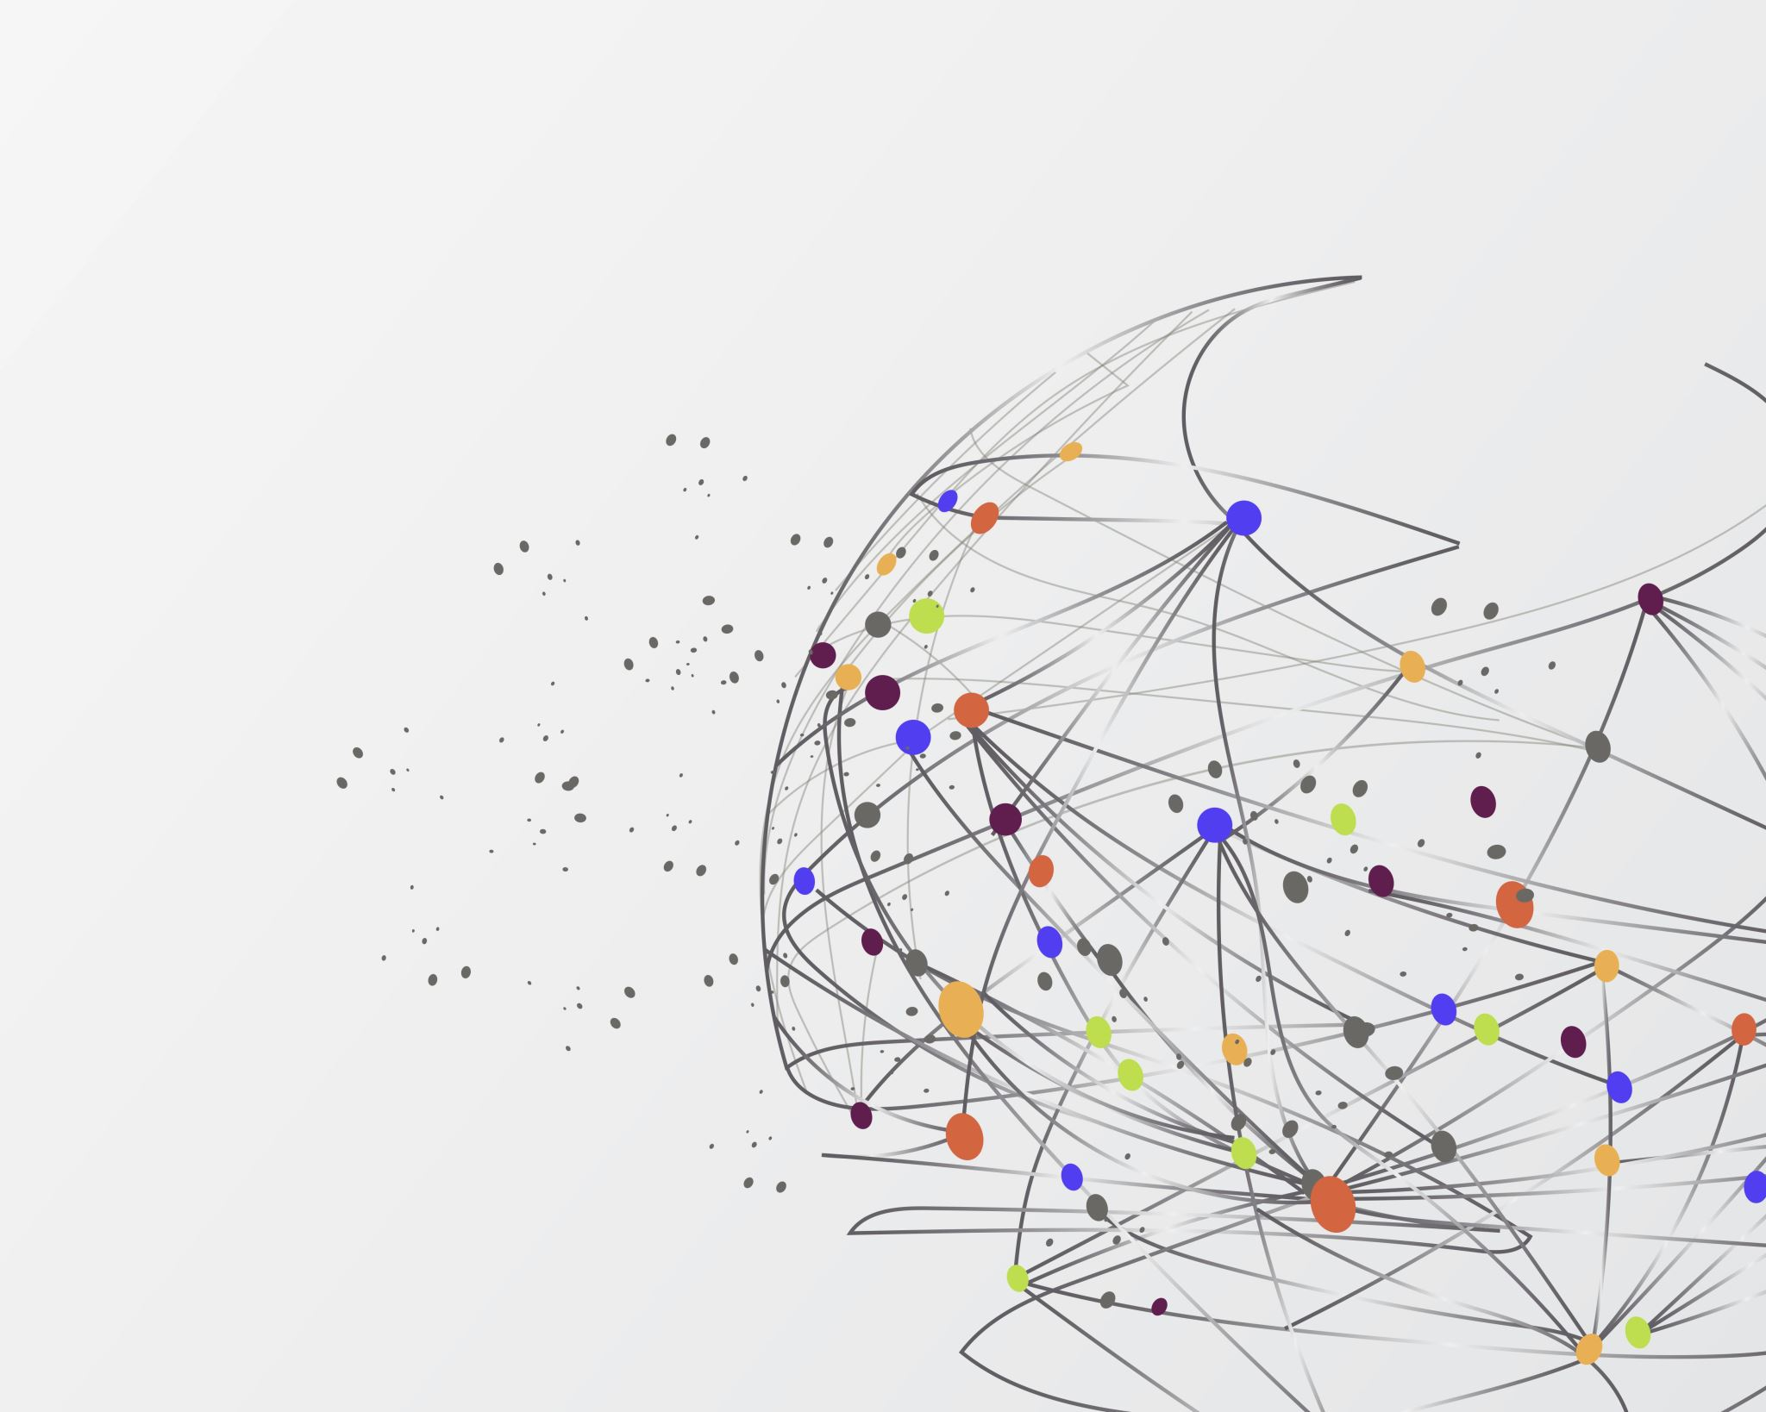
Architecture style
Distributed system architecture style
Peer - to - Peer style
Client - server style

Slide 6
System composition
The storage layer is mainly used to store log data and blockchain metadata during the operation of the Bitcoin system.
RPC layer
The RPC layer implements RPC services and provides a JSON API for clients to access the underlying blockchain services.
1
Network layer
Storage layer
The network layer is used to build the underlying P2P network of Bitcoin, providing basic network support services.
5
6
3
Application layer
The application layer mainly hosts various bitcoin applications, such as the bitcoin client provided in the bitcoin open source code, bitcoin wallets and derivative applications are set up on this layer.
Data layer
2
The data layer packages the data into blocks, maintains the blocks into a chain structure, encrypts and hashes the content of the blocks, digitally signs the content of the blocks and adds timestamps, builds the transaction data into a Merkle tree, and calculates the hash values of the nodes.
4
Consensus layer
The consensus layer mainly uses the PoW (Proof Of Work) consensus algorithm.

Slide 7
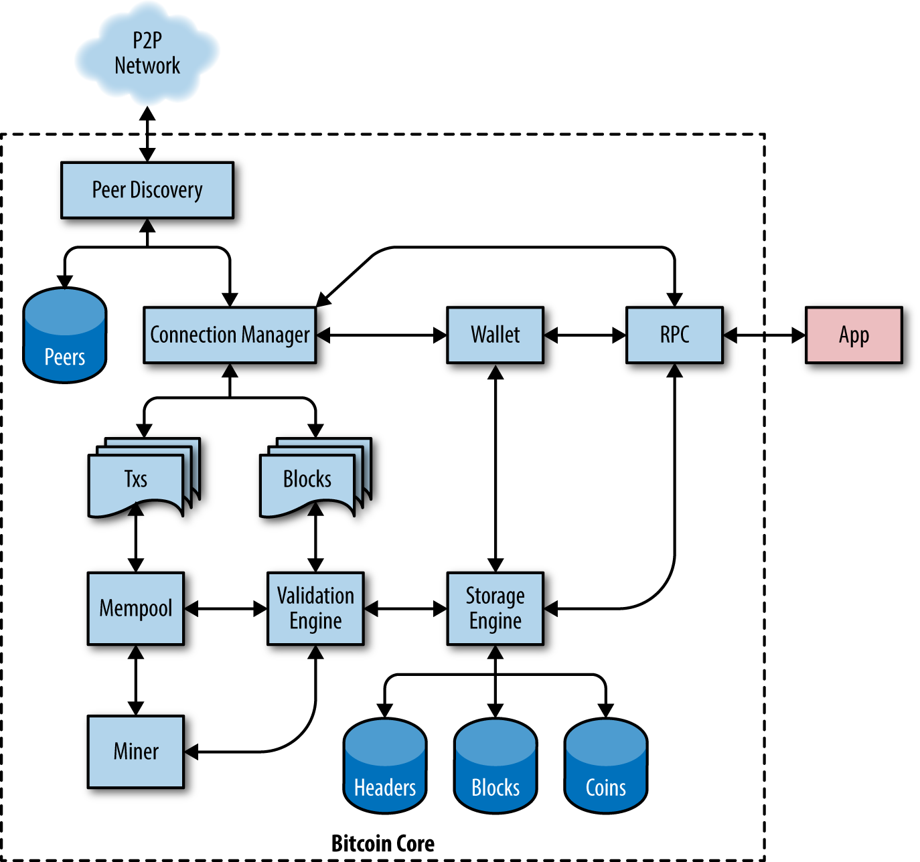


Data Flow

Slide 8
Strengths
Bitcoin's decentralised decision structure has advantages. First, users of paper currency would prefer that it not be inflated, but the government issuing the currency may decide to inflate it in order to increase the revenue it earns from putting money into circulation ("seigniorage").
Another example is the company's open-source software. A large enough consensus of users can maintain and improve open-source software, and these decisions are transparent. In contrast, with a central decision maker, software can be changed or even removed at the discretion of this decision maker, with little recourse for the software's users.

Slide 9

Weaknesses
Bitcoin's slow transaction times and high transaction costs make it unsuitable for many everyday transactions.
The high energy consumption required by Bitcoin mining, as well as the potential environmental effects, are common detractors' criticisms of the project.
A changing regulatory environment may have unanticipated consequences for Bitcoin's future.

Slide 10
Thanks You All.
Bitcoin template

