Slide 1

Concrete Architecture of Bitcoin
Cisc 322 Group 3

Slide 2
Group Members intro
Leader:
Jinyang Chen 19jc66@queensu.ca
Presenter:
Rundong Yu 18ry16@queensu.ca
Gaoyuan Bao 19gb20@queensu.ca
Members:
Chiyu Wang 19cw33@queensu.ca

Slide 3
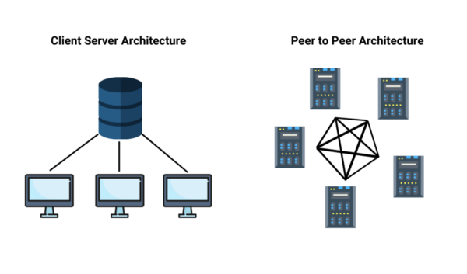

Slide 4
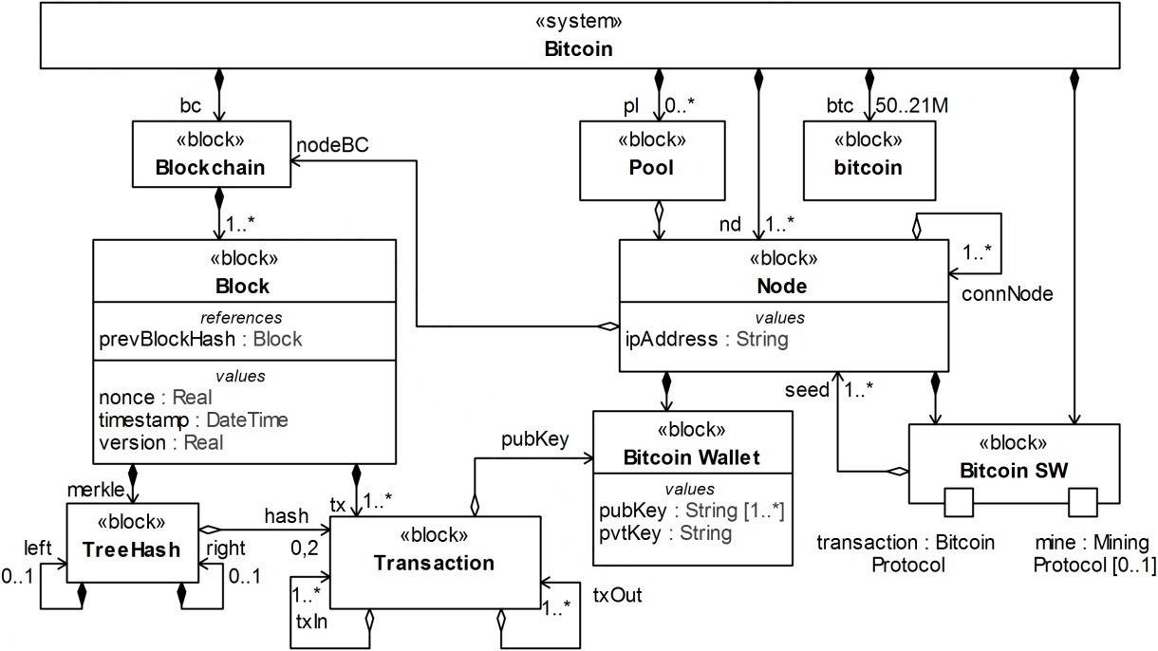
Concrete Architecture
Each block contains a timestamp. This chain of blocks is known as a blockchain, which is a distributed ledger. A unique hash is then generated for each block, which can only have come from that specific block, and is widely distributed across the network.
The block includes a tree hash of the composed transactions as well as the previous block's hash. The hashing function, together with a reference to a specific bitcoin wallet, records the transaction between payer and payee in the blockchain history.

Slide 5
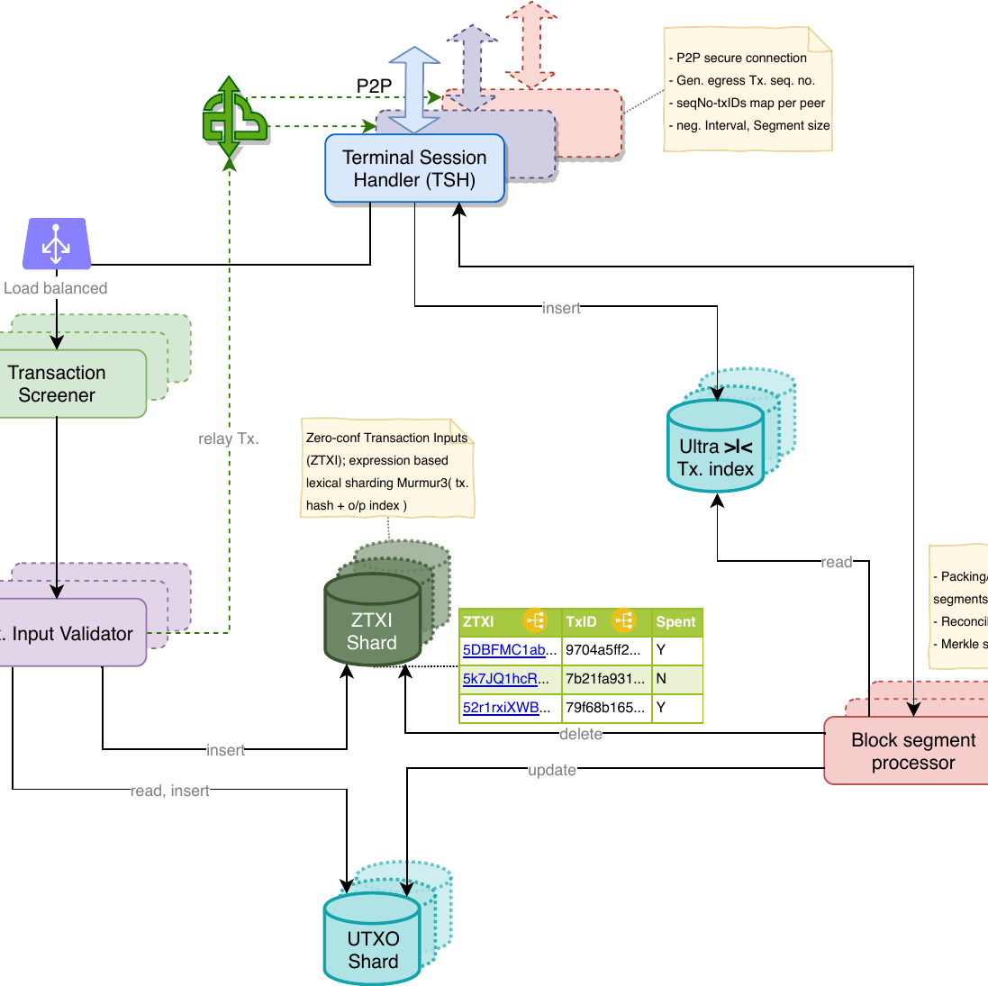
Logical Architecture

Slide 6

The 2nd-level Subsystem of BITCOIN
Bitcoin wallets
mining of blocks
Validation of transactions and blocks
Mempool
Peer discovery/connection management
Storage of the blockchain and other data

Slide 7
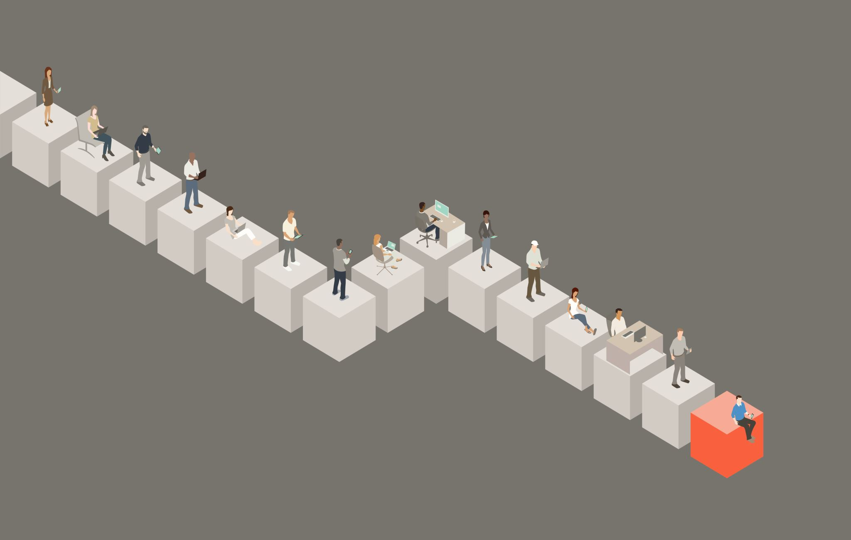
Bitcoin Wallets Subsystem
Definition: store private keys and public addresses
Types of wallets: Software: desktop, mobile, web. (Hot wallets)
Hardware: physical devices, extra security. (Cold wallets)
Paper: printed private keys and addresses
Private keys: ownership and control of Bitcoin
Public addresses: used to receive Bitcoin Wallet security and backup
Encryption and password protection
Seed phrases for recovery

Slide 8

Major components
A Bitcoin wallet's architecture consists of three major components: the user interface, the backend server, and the blockchain network.
- Users can interact with the wallet through the user interface by creating new wallets, viewing their balance, and making transactions.
- The backend server is in charge of managing the user's wallet, which includes creating new addresses, storing private keys, and broadcasting transactions to the blockchain network.
- The blockchain network is the distributed ledger that records all Bitcoin transactions.

Slide 9
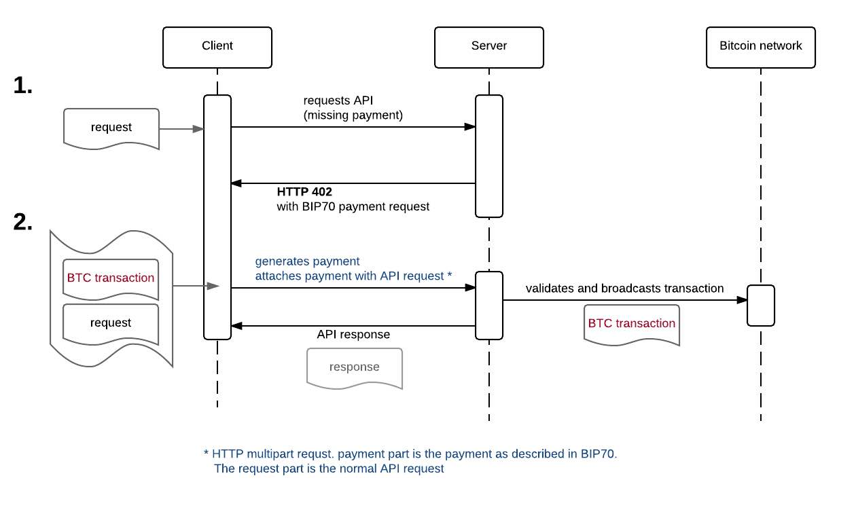
Bitcoin Wallet Use Case1

Slide 10
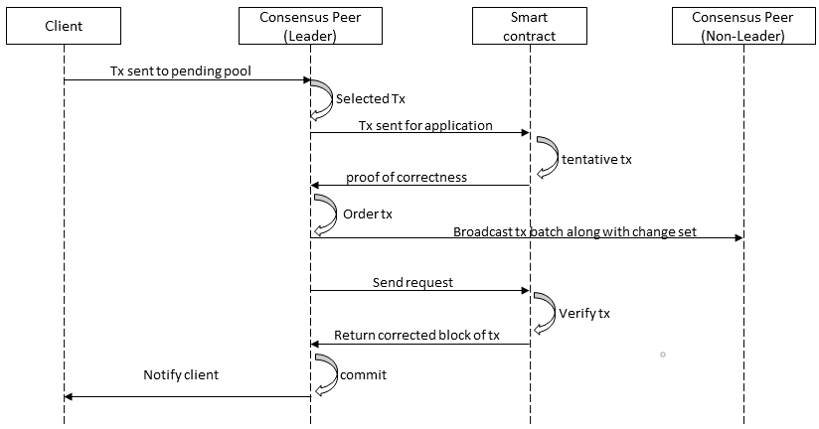
Use Case 2

Slide 11
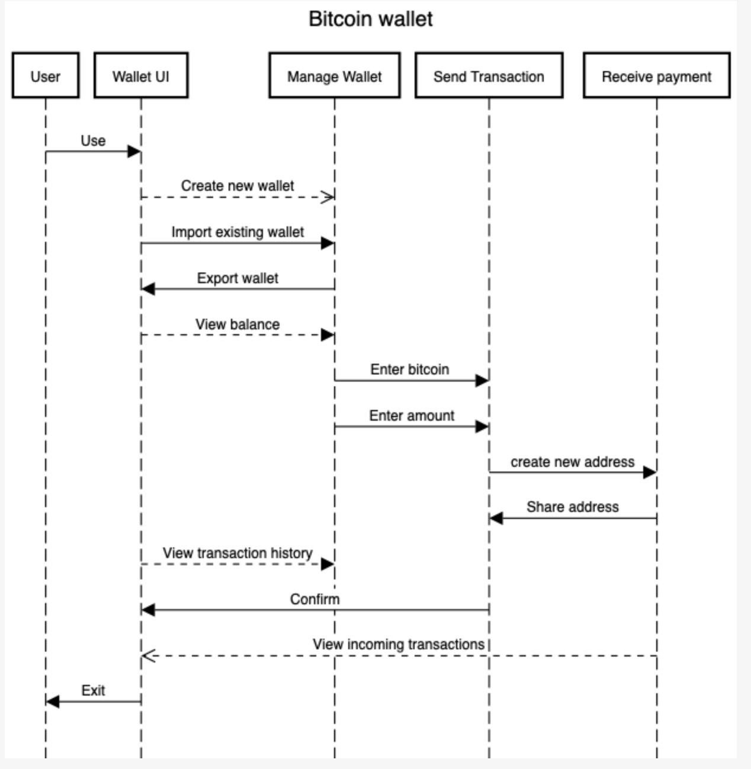
Use case 3

Slide 12
Challenges & Limitations
Scalability issues
Limited transaction throughput
Layer 2 solutions like Lightning Network
Energy consumption and environmental concerns
Proof of Work mining requires significant energy
Regulatory and legal challenges
Government regulations and restrictions
Legal compliance and tax implications
Security risks and vulnerabilities
Wallet security, potential hacks

Slide 13
Conclusion
A Bitcoin wallet's architecture is intended to provide users with secure and convenient access to their Bitcoin holdings while also ensuring the integrity and reliability of the underlying blockchain network. A Bitcoin wallet's architecture can vary depending on the specific implementation and the needs of the user base.

Slide 14
Thank you!

