Slide 1
MXN→USD Route Launch
Performance Analysis & Recommendations
Q1 2024

Slide 2
Executive Summary
KEY FINDING
New users drive 62.7% of volume but convert at 18.6% vs 38.2% for Existing users (19.6pp gap)
ROOT CAUSE
IMPACT
DECISION
Payment step (Created→Funded)
New: 34.9%
Existing: 60.9%
26pp gap
Improving payment from 34.9% to 47.9%
+1,678 transfers
+15.9% volume
Route is viable
Focus: New user payment experience optimization

Slide 3
Demand Estimation
PRE-LAUNCH METHODOLOGY
Top-Down Market Sizing
Bottom-Up Validation
TAM: $60B Mexico→US corridor
Digital SAM: $6.6B addressable
Target share: 1.5% Year 1
Estimate: ~$90M TPV Year 1
Key signals (require internal data):
• MXN users blocked from USD
• Reverse-flow patterns
• Existing MXN base
• LatAm route benchmarks
DECISION: PROCEED

Slide 4
Q1 2024 Results
OVERALL FUNNEL
40,223
→
18,195
→
10,557
Created
Funded (45.2%)
Completed (26.2%)
⚠ Conversion Rate Opportunity
What's driving this number?

Slide 5
The Answer: New User Conversion Gap
New Users
Existing Users
18.6%
38.2%
conversion rate
conversion rate
62.7% of volume
37.3% of volume
19.6pp GAP

Slide 6
Root Cause: Payment Step Friction
FUNNEL STEP BREAKDOWN
Stage
New Users
Existing Users
Gap
Created → Funded
34.9%
60.9%
26pp
Funded → Transferred
51.0%
64.3%
13pp
BOTTLENECK IDENTIFIED
Payment step has 2x larger gap than payout step. This is where New users drop off.

Slide 7
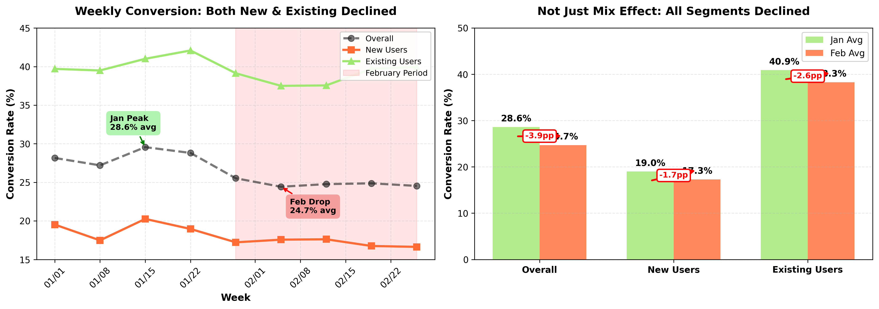
February Performance Decline
KEY TAKEAWAYS
Both New (-1.7pp) and Existing (-2.6pp) segments declined
Not just mix effect — suggests product or market change
CRITICAL FINDING

Slide 8
Business Impact Scenarios
IMPROVE PAYMENT STEP ONLY
Assumption: Payout step remains constant. Focus on Created→Funded for New users.
Scenario
Payment Rate
Overall Conv.
Add'l Transfers
Impact
Conservative (30%)
42.9%
21.9%
+1,007
+9.5%
Base Case (50%)
48.3%
24.6%
+1,678
+15.9%
Optimistic (70%)
53.6%
27.4%
+2,350
+22.3%
Best Case (100%)
61.6%
31.4%
+3,357
+31.8%

Slide 9
Recommendations
1
Optimize New User Payment Experience
• Investigate friction: Session replays, user interviews
• Test solutions: Simplified UX, trust signals, local payment methods
• Target: Improve Created→Funded from 34.9% to 47.9% (+50% gap closure)
2
Address February Conversion Decline
• Review product changes from late Jan/early Feb
• Check for seasonal patterns or competitive activity

Slide 10
Thank You
Questions?

