Slide 1
V[ɛ]ry v[e]ried vowel mergers
in the Pacific Northwest
Joey Stanley
University of Georgia
joeystan@uga.edu @joey_stan
joeystanley.com
Diversity and Variation in Language Conference (DiVar1)
Emory University Conference Center, Atlanta, Georgia
February 11, 2017

Slide 2
The West
“low homogeneity” and “low consistency”
(Labov, Ash, Boberg 2006:277)
cot-caught merger
fronting of /u/
lack of Southern, Midland, and Canadian features

Slide 3
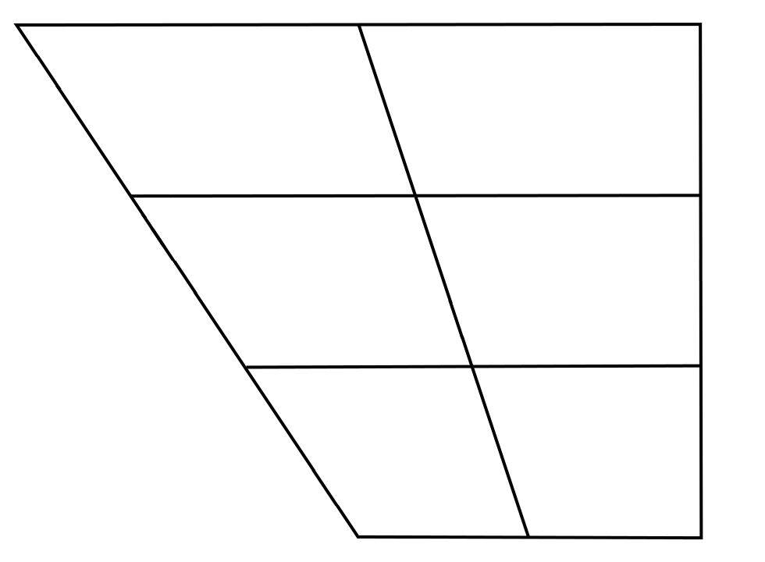
Pacific Northwest English
u
ʊ
(Ward 2003, Becker et al. 2013,
McLarty & Kendall 2014,
Becker et al. 2016, etc.)
(vague, flagrant, Reagan)
eg
o
(leg, egg, beg)
ɛg
(bag, dragon, snag)
æg
(Wassink et al. 2009, Freeman 2014,
Riebold 2015, Wassink 2016, etc.)

Slide 4
Same Vowels: Other Mergers
mary-merry-marry
variable in New England
(Labov, Ash, & Boberg 2006, Nagy 2001,
Coye 2009, Bauman 2013)
ANAE: “This query was not pursued in most areas of the West and Midwest.”
(Labov, Ash, & Boberg 2006:54, note 6)
Merging in PNW 1960s, but merged today
(Reed 1961, Wassink 2016)
cool, school, rule, stool, who’ll, fool
pool-pull, pull-pole, pull-pulp, etc.
ANAE: “deserve further study” (Labov, Ash, & Boberg 2006:73)
variable in Maryland (Bowie 2000), Ohio (Arnold 2014), Missouri (Strelluf 2016), and Utah (Baker & Bowie 2010)
Variable in PNW 1960s
(Reed 1961)
ul
fulcrum, pulpit, wool, bull, full
ʊl
dairy, hairy,
fairy, vary
erV
ol
stroll, whole, stole,
bowl, goal, foal
heritage, numeric,
sheriff, ferry,
terrible
ʌl
ɛrV
adult, cultprit, vulture, gull, cult, skull, hull
arrow, carry,
narrate, parrot,
sparrow, parish,
Harry
ærV

Slide 5
Overview
mary-merry-marry historically variable, but likely merged today
Status of pre-lateral mergers is unknown, though impressionistically less clear cut
Hypothesis 1: complete mary-merry-marry merger
Hypothesis 2: separation of pool, pull, pole, and pulp

Slide 6
Methodology

Slide 7
Data Collection
40 natives of Cowlitz County, ages 18–70s
word list (23) and minimal pairs (14)
list in appendix slides
intuition of own minimal pairs
forced aligned with DARLA (Reddy & Stanford 2015), which uses ProsodyLab (Gorman, Howell, & Wagner, 2011) and FAVE (Rosenfelder, Fruehwald, Evanini, & Yuan 2011)
hand-corrected boundaries and extracted formants myself
Number of tokens
 | word list | minimal pairs | total
pre-laterals | 376 | 842 | 1,218
pre-rhotics | 342 | 509 | 851
total | 718 | 1,351 | 2,069

Slide 8
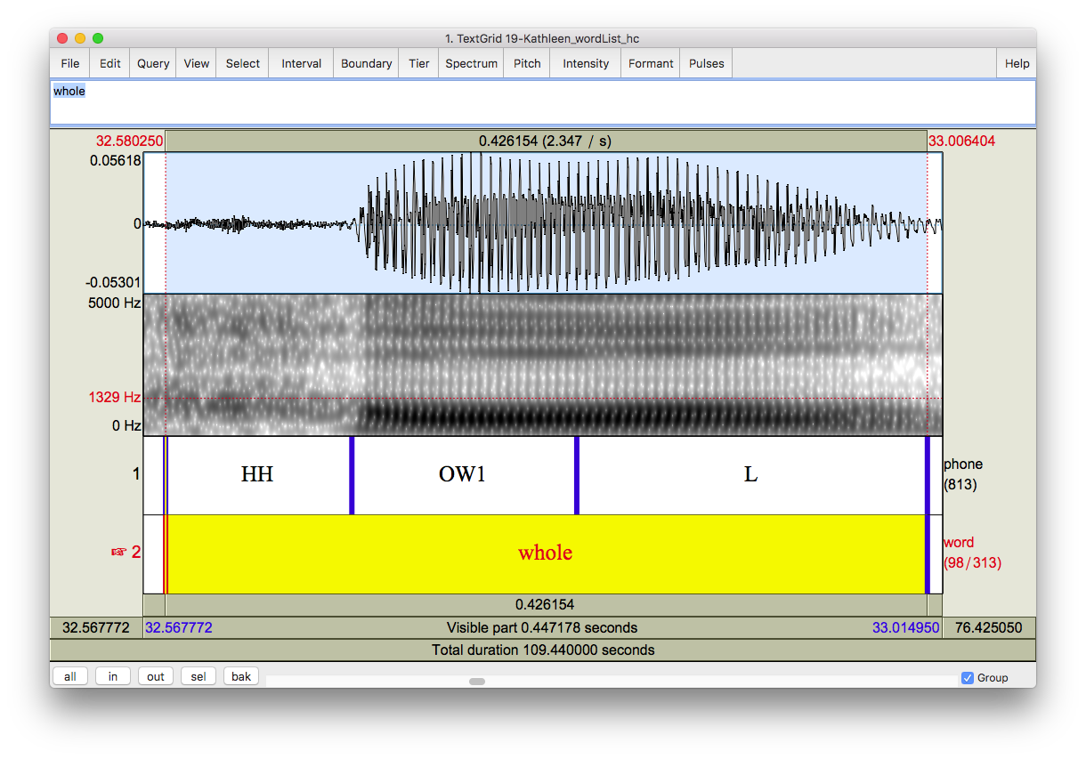
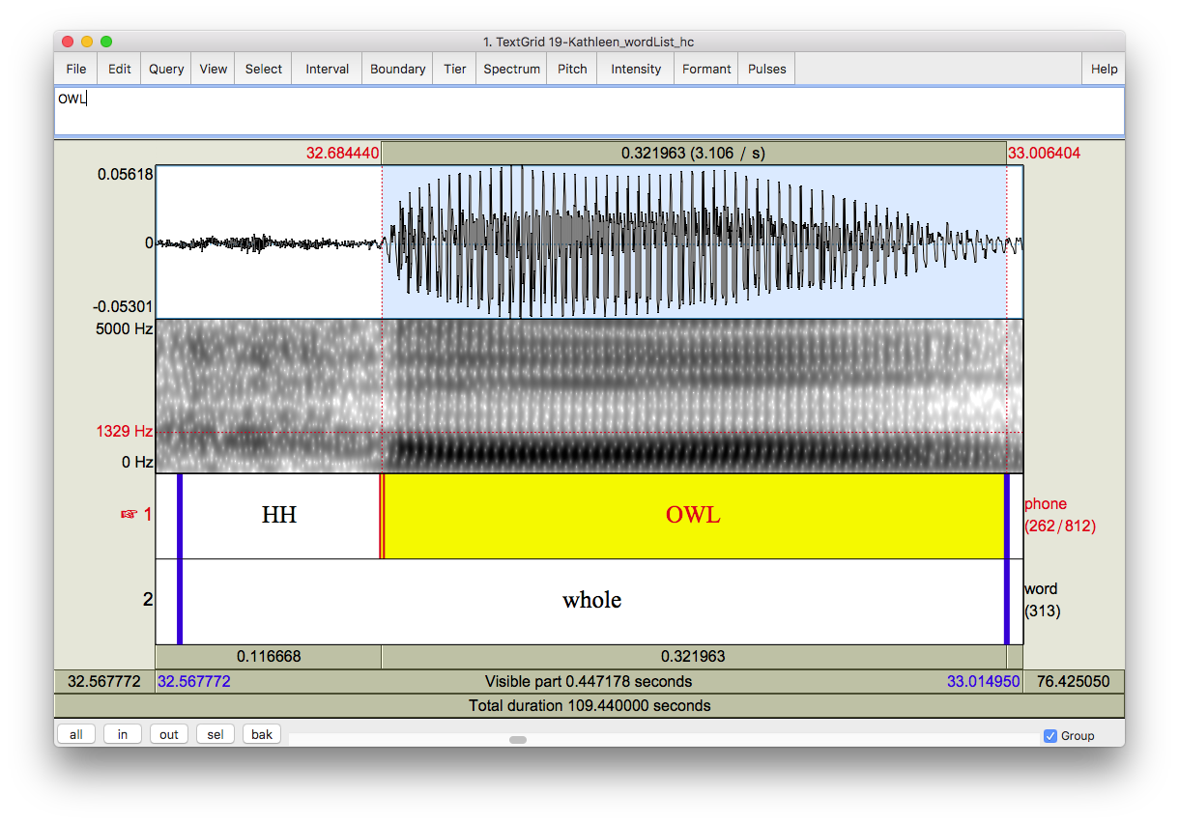
Formant Extraction
boundaries can be arbitrary
formants extracted at 25% into the vowel+liquid duration
(cf. Arnold 2015)
Bark normalized
(Traunmüller 1997)
Lobanov not ideal since not all vowels are present
(Thomas & Kendall 2015)
?
?
?

Slide 9
Analysis
Mixed-effects models (Baayen 2008, Levshina 2015)
lme() in R package nlme (Pinheiro et al. 2016)
glmer() in the R package lme4 (Bates et al. 2015)
Overlap measured with Pillai scores (Hay, Warren & Drager 2006; Hall-Lew 2010; Nycz & Hall-Lew 2013)
Effects are reported significant if p<0.01.
Appendix slides:
more detailed explanation of statistical methods
all model outputs
interpretation of each mode.

Slide 10
Results

Slide 11
Pre-Laterals: Means
pool significantly higher
pulp significantly lower and fronter
pull fronter than pole in word list, but higher than pole in minimal pairs
Generation and sex not significant
Notes:
pool, school, cool
fulcrum, pulpi
control, holster
adult, dull, skull

Slide 12
Pre-Laterals: Overlap
pool converging with pull, pole, and pulp while
pull, pole, and pulp are becoming more distinct from each other in apparent time.

Slide 13
Pre-Laterals: Speaker Intuition
hesitation, deliberation, uncertainty
pull-pole (23.4% reported merged)
(bull-bowl > pull-pole > full-foal)
pole-pulp (13.9% reported merged)
(goal-gull > colt-cult, hole-hull)
slight correlation between degree of merger and reported merger
pool-pull (16.7%), pool-pole (3.3%), pool-pulp (2.6%)—no correlation with production

Slide 14
Pre-Laterals in other Regions
Cowlitz County, WA
pull-pole most common
more overlap over time
Youngstown, OH (Arnold 2015)
pool-pull receding over time
pull-pole merging over time
Pittsburg area
(Labov et al. 2006)
pool=pull
Utah County, UT
(Baker & Bowie 2010)
pool-pull-pole
and pull-pulp
more merged among Mormons
Waldorf, MD (Bowie 2000)
pool-pull, pull-pole
distinct in production
merged in perception (esp. for younger speakers)
Kansas City, MO (Strelluf 2016)
pull-pole, pole-pulp most common
no change in production over time
increased perceptual merging over time
Texas (Bailey et al. 1991)
pool=pull

Slide 15
Pre-Rhotics: Production
merry = marry in the word list
mary higher than merry and marry in the word list
three-way split in the minimal pairs

Slide 16
Pre-Rhotics: Speaker Intuition
quick, confident, no hesistation
mary-merry (98% reported merged)
(vary-very, fairy-ferry, Mary-merry)
mary-marry (99% reported merged)
(hairy-Harry, Mary-merry)
merry-marry (97% reported merged)
(perish-parish, merry-marry)
No correlation between production and speaker intuition.

Slide 17
Pre-Rhotics in other Regions
New Hampshire (Nagy 2001)
generally merged, with stable variation
Vermont (Stanford et al. 2012)
all merged
Cowlitz County, WA
mary higher / all distinct
merged in perception
no change over time
Massachusetts (Nagy 2001)
generally distinct
New Jersey (Coye 2009)
3 patterns: all merged, all distinct, and mary=merry or marry
mary
merry marry
East and South (scattered) (Labov et al. 2006)
mary=merry, marry different

Slide 18
Conclusion

Slide 19
Conclusion
✗ Hypothesis 1: complete mary-merry-marry merger
Not only distinct, but unusual pattern of mary being the different one
✗ Hypothesis 2: separation of pool, pull, pole, and pulp
pull-pole most merged, and pool becoming less distinct in apparent time
Vowel mergers are indeed v[ɛ]ry v[e]ried in the Pacific Northwest
Not all of the Pacific Northwest is the same (urban/rural divide)
Don’t make assumptions about a community’s spech

Slide 20
References
Arnold, Lacey. 2015. Multiple Mergers: Production and Perception of Three Pre-/l/Mergers in Youngstown, Ohio. University of Pennsylvania Working Papers in Linguistics 21(2). 2.
Baayen, R. H. 2008. Analyzing Linguistic Data: A Practical Introduction to Statistics using R. Cambridge: Cambridge University Press.
Bailey, Guy, Tom Wikle & Lori Sand. 1991. The focus of linguistic innovation in Texas. English World-Wide 12(2). 195–214.
Baker, Wendy & David Bowie. 2010. Religious affiliation as a correlate of linguistic behavior. University of Pennsylvania Working Papers in Linguistics 15(2). 2.
Bates, Douglas, Martin Maechler, Ben Bolker & Steve Walker. 2015. Fitting Linear Mixed-Effects Models Using lme4. Journal of Statistical Software 67(1). 1–48. doi:doi:10.18637/jss.v067.i01.
Bauman, Carina. 2013. An acoustic study of the MARY-MERRY-MARRY vowels in the Mid-Atlantic United States. Proceedings of Meetings on Acoustics 19(1). 60255. doi:10.1121/1.4800989.
Bowie, David. 2000. The Effect of Geographic Mobility on the Retention of a Local Dialect. Philadelphia: University of Pennsylvannia Dissertation.
Becker, Kara, Anna Aden, Katelyn Best, Rena Dimes, Juan Flores & Haley Jacobson. 2013. Keep Portland weird: Vowels in Oregon English. Paper presented at the New Ways of Analyzing Variation (NWAV) 42, Pittsburgh.
Becker, Kara, Anna Aden, Katelyn Best & Haley Jacobson. 2016. Variation in West Coast English: The case of Oregon. In Valerie Fridland, Betsy E. Evans, Tyler Kendall & Alicia Beckford Wassink (eds.), Speech in the Western States, Vol. 1: The Pacific Coast, 107–134. (Publication of the American Dialect Society 101). Durham, NC: Duke University Press. doi: 10.1215/00031283-3772923.
Coye, Dale F. 2009. Dialect Boundaries in New Jersey. American Speech 84(4). 414–452. doi:10.1215/00031283-2009-032.
Freeman, Valerie. 2014. Bag, beg, bagel: Prevelar raising and merger in Pacific Northwest English. University of Washington Working Papers in Linguistics 32.
Gorman, Kyle, Jonathan Howell & Michael Wagner. 2011. Prosodylab-Aligner: A Tool for Forced Alignment of Laboratory Speech. Canadian Acoustics 39(3). 192–193.
Hall-Lew, Lauren. 2010. Improved representation of variance in measures of vowel merger. Paper presented at the 159th Meeting Acoustical Society of America/NOISE-CON 2010, Baltimore, MD.
Hay, Jennifer, Paul Warren & Katie Drager. 2006. Factors influencing speech perception in the context of a merger-in-progress. Journal of Phonetics 34(4). (Modelling Sociophonetic Variation). 458–484. doi:10.1016/j.wocn.2005.10.001.
Labov, William, Sharon Ash & Charles Boberg. 2006. The Atlas of North American English: Phonetics, Phonology and Sound Change. Walter de Gruyter.
Levshina, Natalia. 2015. How to do Linguistics with R: Data exploration and statistical analysis. Amsterdam: John Benjamins Publishing Company.
McLarty, Jason & Tyler Kendall. 2014. The relationship between the high and mid back vowels in Oregonian English. Paper presented at the New Ways of Analyzing Variation (NWAV) 43, Chicago.
Nagy, Naomi. 2001. “Live Free or Die” as a Linguistic Principle. American Speech 76(1). 30–41. doi:10.1215/00031283-76-1-30.
Nycz, Jennifer & Lauren Hall-Lew. 2013. Best practices in measuring vowel merger. Proceedings of Meetings on Acoustics 20(1). 60008. doi:10.1121/1.4894063.
Pinheiro, J., D. Bates, S. DebRoy, D. Sarkar & R Core Team. 2016. nlme: Linear and Nonlinear Mixed Effects Models. http://CRAN.R-project.org/package=nlme.
Reed, Carroll E. 1961. The Pronunciation of English in the Pacific Northwest. Language 37(4). 559–564. doi:10.2307/411357.
Reddy, Sravana & James N. Stanford. 2015. Toward completely automated vowel extraction: Introducing DARLA. Linguistics Vanguard 0(0). doi:10.1515/lingvan-2015-0002
Riebold, John Matthew. 2015. The Social distribution of a regional change: /æg, ɛg, eg/ in Washington State. Seattle: University of Washington PhD dissertation.
Rosenfelder, Ingrid; Fruehwald, Joe; Evanini, Keelan and Jiahong Yuan. 2011. FAVE (Forced Alignment and Vowel Extraction) Program Suite. http://fave.ling.upenn.edu.
Strelluf, Christopher. 2016. Overlap among back vowels before /l/ in Kansas City. Language Variation and Change 28(3). 379–407. doi:10.1017/S0954394516000144.
Thomas, Erik R. & Tyler Kendall (2015). “NORM's Vowel Normalization Methods (v. 1.1)” Webpage. Accessed November 16, 2016. http://lingtools.uoregon.edu/norm/ norm1_methods.php.
Traunmüller, Hartmut. 1997. Auditory scales of frequency representation. Stockholms universitet: Instituionen för lingvistik. http://www2.ling.su.se/staff/hartmut/bark.htm.
Wassink, Alicia Beckford. 2016. The Vowels of Washington State. In Betsy Evans, Valerie Fridland, Tyler Kendall & Alicia Wassink (eds.), Speech in the Western States: Volume 1: The Coastal States, 77–105. (Publication of the American Dialect Society 101). Durham, NC: Duke University Press. 10.1215/00031283-3772912.
Ward, Michael. 2003. Portland dialect study: The fronting of/ow, u, uw/ in Portland, Oregon. Portland State University Master’s Thesis.
Wassink, Alicia Beckford, Robert Squizzero, Mike Scanlon, Rachel Schirra & Jeff Conn. 2009. Effects of Style and Gender on Fronting and Raising of /æ/, /e:/ and /ε/ before /ɡ/ in Seattle English. Paper presented at the New Ways of Analyzing Variation (NWAV) 38, Ottawa.

Slide 21
Joey Stanley
University of Georgia
joeystan@uga.edu @joey_stan
joeystanley.com
Special thanks to Cathy Jones for invaluable help in finding research participants,
to the University of Georgia Graduate School Dean’s Award for funding the fieldwork,
and to both the UGA Linguistics Program and the UGA Graduate School for travel funding.
These slides available at
joeystanley.com/divar1

Slide 22
Appendix A: Word List and Minimal Pairs

Slide 23
Word List Items
These were embedded psuedorandomly in a 160-item word list, with words targeting other research questions acting as fillers.
Participants often commented on how random the words seemed, so they likely did not catch on to the research questions these words targeted.
/er/ | dairy, hairy, vary
/ɛr/ | heritage, numeric, sheriff
/ær/ | arrow, carry, narrate, parrot, sparrow
/ul/ | cool, school
/ʊl/ | fulcrum, pulpit, wool
/ol/ | control, holster, stroll, whole
/ʌl/ | adult, culprit, vulture
The following words were excluded because they did not satisfy the required syllable type for their particular merger (open syllables for Mary-merry-marry and closed syllables for the pre-laterals), which was only learned after data-collection:
bullet, (Coca-)Cola, gullible, hooligan, polar (bear), pulley, sullen, tulips, yuletide,

Slide 24
Minimal Pairs & Triplets
/er/ | /ɛr/ | /ær/
fairy | ferry
 | perish | parish
vary | very
 | terrible
hairy |  | Harry
Mary | merry | marry
/ul/ | /ʊl/ | /ol/ | /ʌl/
rule |  | role
stool |  | stole
 | bull | bowl
 |  | goal | gull
 |  | colt | cult
 | whole/hole
 | bolder/boulder
school |  |  | skull
who’ll |  | hole | hull
pool | pull | pole
fool | full | foal
The pairs bear~bare, hair~hare, and stares~stairs were excluded because the targeted vowel was not before an intervocalic /r/.
The word terrible was paird with the invented word “tear-able” (as in ’able to be torn’), but participants didn’t respond well to that, and it was excluded.
Pairs from the same class are assumed to be homophonous for all speakers and were included to test speakers’ attention.

Slide 25
Appendix B: Statistical Tests

Slide 26
Analysis
Restricted maximum liklihood (REML) mixed-effects model (Levshina 2015) using the function lme() in R package nlme (Pinheiro et al. 2016) for predicting categorical variables (i.e. vowel class distinctions).
Generalized linear mixed-effects model (Baayen 2008) using the function glmer() in the R package lme4 (Bates et al. 2015) for predicting continuous variables (degree of height/backness). Generation, sex, place of articulation (aveolar/non-alveolar), and vowel class as fixed effects.
Speaker as random effect in these models. If adding this random effect did not improve the model, a simple linear regression was used instead.
Overlap measured with Pillai scores, an output of MANOVA tests (Hay, Warren & Drager 2006; Hall-Lew 2010; Nycz & Hall-Lew 2013)
Effects are reported significant if p<0.01.
All model outputs are in appendix slides.

Slide 27
(1) Linear mixed-effects model fit by REML of bark-normalized height of all pre-lateral vowels (both styles) with variable (pool*, pull, pole, pulp), sex (F, M), generation (61+, 40–60, <40), and previous place of articulation (alveolar, non-alveolar) as fixed effects and speaker as a random effect.
Random effect
 | (Intercept) | Residual
StdDev: | 0.493 | 0.650
Fixed effects
 | Value | Std.Error | DF | t-value | p-value
(Intercept) | 10.510 | 0.204 | 1170 | 51.575 | < 0.001
variable: pull | -0.494 | 0.059 | 1170 | -8.366 | < 0.001
variable: pulp | -1.159 | 0.056 | 1170 | -20.779 | < 0.001
variable: pole | -0.590 | 0.049 | 1170 | -12.122 | < 0.001
sex: M | -0.312 | 0.165 | 36 | -1.888 | 0.067
generation: 40–60 | 0.219 | 0.225 | 36 | 0.975 | 0.336
generation: <40 | 0.269 | 0.239 | 36 | 1.124 | 0.268
prevPlace: non-alveolar | 0.339 | 0.049 | 1170 | 6.987 | < 0.001
Interpretation: pool significantly higher than pull, pole, and pulp with sex and generation as non-significant factors.
* Underlined values are the reference levels

Slide 28
(2) Linear mixed-effects model fit by REML of bark-normalized height of all pre-lateral vowels (both styles) with variable (pool, pull, pole, pulp*), sex (F, M), generation (61+, 40–60, <40), and previous place of articulation (alveolar, non-alveolar) as fixed effects and speaker as a random effect.
(3) Linear mixed-effects model fit by REML of bark-normalized backness of all pre-lateral vowels (both styles) with variable (pool, pull, pole, pulp), sex (F, M), generation (61+, 40–60, <40), and previous place of articulation (alveolar, non-alveolar) as fixed effects and speaker as a random effect.
Random effect
 | (Intercept) | Residual
StdDev: | 0.493 | 0.650
Random effect
 | (Intercept) | Residual
StdDev: | 0.558 | 0.761
Fixed effects
 | Value | Std.Error | DF | t-value | p-value
(Intercept) | 9.350 | 0.206 | 1170 | 45.424 | < 0.001
variable: pool | 1.159 | 0.056 | 1170 | 20.779 | < 0.001
variable: pull | 0.666 | 0.060 | 1170 | 11.047 | < 0.001
variable: pole | 0.570 | 0.052 | 1170 | 10.922 | < 0.001
sex: M | -0.312 | 0.165 | 36 | -1.888 | 0.067
generation: 40–60 | 0.219 | 0.225 | 36 | 0.975 | 0.336
generation: <40 | 0.269 | 0.239 | 36 | 1.124 | 0.268
prevPlace: non-alveolar | 0.339 | 0.049 | 1170 | 6.987 | < 0.001
Interpretation: pulp significantly lower than pool, pull, and pole with sex and generation as non-significant factors.
Fixed effects
 | Value | Std.Error | DF | t-value | p-value
(Intercept) | 6.019 | 0.234 | 1170 | 25.704 | < 0.001
variable: pool | 0.599 | 0.065 | 1170 | 9.177 | < 0.001
variable: pull | 0.807 | 0.071 | 1170 | 11.441 | < 0.001
variable: pole | 1.060 | 0.061 | 1170 | 17.356 | < 0.001
sex: M | -0.283 | 0.187 | 36 | -1.509 | 0.140
generation: 40–60 | 0.270 | 0.255 | 36 | 1.059 | 0.297
generation: <40 | 0.367 | 0.271 | 36 | 1.355 | 0.184
prevPlace: non-alveolar | 0.879 | 0.057 | 1170 | 15.476 | < 0.001
Interpretation: pulp significantly fronter than pool, pull, and pole with sex and generation as non-significant factors.
* Underlined values are the reference levels

Slide 29
(4) Linear mixed-effects model fit by REML of bark-normalized height of pre-lateral vowels in the word list with variable (pool, pull*, pole, pulp), sex (F, M), generation (61+, 40–60, <40), and previous place of articulation (alveolar, non-alveolar) as fixed effects and speaker as a random effect.
(5) Linear mixed-effects model fit by REML of bark-normalized backness of pre-lateral vowels in the word list with variable (pool, pull, pole, pulp), sex (F, M), generation (61+, 40–60, <40), and previous place of articulation (alveolar, non-alveolar) as fixed effects and speaker as a random effect.
Random effect
 | (Intercept) | Residual
StdDev: | 0.505 | 0.653
Random effect
 | (Intercept) | Residual
StdDev: | 0.545 | 0678
Fixed effects
 | Value | Std.Error | DF | t-value | p-value
(Intercept) | 9.945 | 0.296 | 336 | 33.642 | < 0.001
variable: pool | 0.567 | 0.107 | 336 | 5.300 | < 0.001
variable: pole | 0.117 | 0.101 | 336 | 1.157 | 0.248
variable: pulp | -0.479 | 0.101 | 336 | -4.752 | < 0.001
sex: M | -0.187 | 0.202 | 28 | -0.927 | 0.362
generation: 40–60 | -0.117 | 0.303 | 28 | -0.387 | 0.701
generation: <40 | 0.014 | 0.314 | 28 | 0.044 | 0.965
prevPlace: non-alveolar | 0.565 | 0.091 | 336 | 6.203 | < 0.001
Interpretation: pull not significantly different in height from pole in the word list, with sex and generation as non-significant factors.
Fixed effects
 | Value | Std.Error | DF | t-value | p-value
(Intercept) | 6.879 | 0.316 | 336 | 21.777 | < 0.001
variable: pool | -0.146 | 0.111 | 336 | -1.316 | 0.189
variable: pole | 0.572 | 0.105 | 336 | 5.464 | < 0.001
variable: pulp | -0.690 | 0.105 | 336 | -6.598 | < 0.001
sex: M | -0.056 | 0.217 | 28 | -0.257 | 0.799
generation: 40–60 | -0.243 | 0.325 | 28 | -0.747 | 0.461
generation: <40 | -0.270 | 0.336 | 28 | -0.803 | 0.429
prevPlace: non-alveolar | 1.115 | 0.095 | 336 | 11.782 | < 0.001
Interpretation: pull is significantly fronter than pole, though it’s not different from pool. Sex and generation are not significant factors.
* Underlined values are the reference levels

Slide 30
(6) Linear mixed-effects model fit by REML of bark-normalized height of pre-lateral vowels in the minimal pairs with variable (pool, pull*, pole, pulp), sex (F, M), generation (61+, 40–60, <40), and previous place of articulation (alveolar, non-alveolar) as fixed effects and speaker as a random effect.
(7) Linear mixed-effects model fit by REML of bark-normalized backness of pre-lateral vowels in the minimal pairs with variable (pool, pull, pole, pulp), sex (F, M), generation (61+, 40–60, <40), and previous place of articulation (alveolar, non-alveolar) as fixed effects and speaker as a random effect.
Random effect
 | (Intercept) | Residual
StdDev: | 0.489 | 0.644
Random effect
 | (Intercept) | Residual
StdDev: | 0.571 | 0.766
Fixed effects
 | Value | Std.Error | DF | t-value | p-value
(Intercept) | 10.186 | 0.214 | 798 | 47.658 | < 0.001
variable: pool | 0.381 | 0.073 | 798 | 5.198 | < 0.001
variable: pole | -0.202 | 0.069 | 798 | -2.929 | 0.004
variable: pulp | -0.749 | 0.076 | 798 | -9.799 | < 0.001
sex: M | -0.313 | 0.166 | 36 | -1.890 | 0.067
generation: 40-–60 | 0.251 | 0.225 | 36 | 1.116 | 0.272
generation: <40 | 0.298 | 0.239 | 36 | 1.248 | 0.220
prevPlace: non-alveolar | 0.234 | 0.061 | 798 | 3.814 | < 0.001
Interpretation: pull significantly higher than pole in the minimal pairs, with sex and generation as non-significant factors.
Fixed effects
 | Value | Std.Error | DF | t-value | p-value
(Intercept) | 7.023 | 0.251 | 798 | 28.026 | < 0.001
variable: pool | -0.346 | 0.087 | 798 | -3.961 | < 0.001
variable: pole | 0.085 | 0.082 | 798 | 1.028 | 0.304
variable: pulp | -0.852 | 0.091 | 798 | -9.355 | < 0.001
sex: M | -0.322 | 0.194 | 36 | -1.663 | 0.105
generation: 40–60 | 0.326 | 0.263 | 36 | 1.237 | 0.224
generation: <40 | 0.498 | 0.280 | 36 | 1.779 | 0.084
prevPlace: non-alveolar | 0.756 | 0.073 | 798 | 10.347 | < 0.001
Interpretation: pull is not significantly different in backness with pole, with sex and generation as non-significant factors.
* Underlined values are the reference levels

Slide 31
(8) Linear regression model of the overlap between pool and pull (measured by individuals’ Pillai scores) in both styles with number of pairs reported merged (0*, 1), generation (61+, 40–60, <40), and sex (F, M) as predictor variables.
(9) Linear regression model of the overlap between pool and pole (measured by individuals’ Pillai scores) in both styles with number of pairs reported merged (0, 1, 2), generation (61+, 40–60, <40), and sex (F, M) as predictor variables.
(10) Linear regression model of the overlap between pool and pulp (measured by individuals’ Pillai scores) in both styles with number of pairs reported merged (0, 1), generation (61+, 40–60, <40), and sex (F, M) as predictor variables.
Coefficients
 | Estimate | Std. Error | t value | Pr(>|t|)
(Intercept) | 0.701 | 0.016 | 44.503 | < 0.001
pairs merged: 1 | 0.047 | 0.021 | 2.233 | 0.026
generation: 40–60 | -0.053 | 0.018 | -2.929 | 0.003
generation: <40 | -0.121 | 0.018 | -6.636 | < 0.001
sex: M | 0.050 | 0.014 | 3.69 | 0.000
Adjusted R² = 0.06171
F(4, 1153) = 20.04
p < 0.001
Interpretation: The overlap between pool and pull increases with each successive generation, with women leading the change. Reporting more merged pairs did not mean there was more overlap.
Coefficients
 | Estimate | Std. Error | t value | Pr(>|t|)
(Intercept) | 0.676 | 0.016 | 42.52 | < 0.001
pairs merged: 1 | 0.082 | 0.019 | 4.389 | < 0.001
pairs merged: 2 | -0.176 | 0.028 | -6.304 | < 0.001
generation: 40-60 | -0.022 | 0.018 | -1.197 | 0.232
generation: <40 | -0.130 | 0.019 | -6.999 | < 0.001
sex: M | 0.090 | 0.014 | 6.273 | < 0.001
Adjusted R² = 0.1629
F(5, 1152) = 46.03
p < 0.001
Interpretation: The overlap between pool and pole is the same for the oldest and middle generation, but significantly increases in the youngest group, with women leading the change. Speakers who reported one pair as merged actually had greater separation than those who reported none, but speakers who reported two merged pairs did have greater overlap.
Coefficients
 | Estimate | Std. Error | t value | Pr(>|t|)
(Intercept) | 0.800 | 0.014 | 56.594 | < 0.001
pairs merged: 1 | 0.004 | 0.034 | 0.133 | 0.895
generation: 40-60 | -0.051 | 0.016 | -3.196 | 0.001
generation: <40 | -0.178 | 0.017 | -10.394 | < 0.001
sex: M | 0.051 | 0.012 | 4.328 | < 0.001
Adjusted R² = 0.1225
F(4, 1153) = 41.37
p < 0.001
Interpretation: The overlap between pool and pulp increases with each successive generation, with women leading the change. Reporting more merged pairs did not mean there was more overlap.
* Underlined values are the reference levels

Slide 32
(11) Linear regression model of the overlap between pull and pole (measured by individuals’ Pillai scores) in both styles with number of pairs reported merged (0*, 1, 2, 3), generation (61+, 40–60, <40), and sex (F, M) as predictor variables.
(12) Linear regression model of the overlap between pull and pulp (measured by individuals’ Pillai scores) in both styles with generation (61+, 40–60, <40), and sex (F, M) as predictor variables.
(13) Linear regression model of the overlap between pole and pulp (measured by individuals’ Pillai scores) in both styles with number of pairs reported merged (0, 1, 2), generation (61+, 40–60, <40), and sex (F, M) as predictor variables.
Coefficients
 | Estimate | Std. Error | t value | Pr(>|t|)
(Intercept) | 0.318 | 0.015 | 21.326 | < 0.001
pairs merged: 1 | -0.216 | 0.028 | -7.666 | < 0.001
pairs merged: 2 | -0.123 | 0.019 | -6.576 | < 0.001
pairs merged: 3 | -0.108 | 0.020 | -5.342 | < 0.001
generation: 40-60 | 0.089 | 0.017 | 5.306 | < 0.001
generation: <40 | 0.074 | 0.018 | 4.220 | < 0.001
sex: M | 0.031 | 0.012 | 2.626 | 0.009
Adjusted R² = 0.1278
F(6, 1151) = 29.06
p < 0.001
Interpretation: The overlap between pull and pole increases with each successive generation, with women leading the change. If speakers reported one or more pairs merged, there was more overlap in their production.
Coefficients
 | Estimate | Std. Error | t value | Pr(>|t|)
(Intercept) | 0.618 | 0.017 | 35.441 | < 0.001
generation: 40-60 | 0.057 | 0.020 | 2.88 | 0.004
generation: <40 | -0.019 | 0.021 | -0.908 | < 0.001
sex: M | 0.095 | 0.014 | 6.733 | < 0.001
Adjusted R² = 0.0577
F(3, 1210) = 25.74
p < 0.001
Interpretation: The middle generation had the greatest overlap between pull and pulp, followed by the oldest group, and then the youngest, with women having more overlap overall. Since there are no known minimal pairs contrasting these vowels in English, speaker intuition was not included.
Coefficients
 | Estimate | Std. Error | t value | Pr(>|t|)
(Intercept) | 0.371 | 0.019 | 19.721 | < 0.001
pairs merged: 1 | -0.124 | 0.021 | -5.777 | < 0.001
pairs merged: 2 | 0.060 | 0.029 | 2.066 | 0.0391
generation: 40-60 | 0.165 | 0.021 | 7.736 | < 0.001
generation: <40 | 0.028 | 0.023 | 1.215 | 0.2245
sex: M | -0.003 | 0.016 | -0.166 | 0.8685
Adjusted R² = 0.1188
F(5, 1175) = 32.81
p < 0.001
Interpretation: There is less overlap between pole and pulp in the middle generation compared to the oldest and youngest groups. People who reported one merged pair had greater overlap. There was not difference between the sexes.
* Underlined values are the reference levels

Slide 33
(14) Linear mixed-effects model fit by REML of bark-normalized height of all pre-rhotic vowels in the word list with variable (mary, merry*, marry), sex (F, M), and generation (61+, 40–60, <40) as fixed effects and speaker as a random effect.
(15) Linear mixed-effects model fit by REML of bark-normalized height of all pre-rhotic vowels in the minimal pairs with variable (mary, merry, marry), sex (F, M), and generation (61+, 40–60, <40) as fixed effects and speaker as a random effect.
Random effect
 | (Intercept) | Residual
StdDev: | 0.517 | 0.704
Random effect
 | (Intercept) | Residual
StdDev: | 0.554 | 0.731
Fixed effects
 | Value | Std.Error | DF | t-value | p-value
(Intercept) | 8.186 | 0.292 | 303 | 28.014 | < 0.001
variable: Mary | 0.878 | 0.105 | 303 | 8.344 | < 0.001
variable: marry | 0.164 | 0.094 | 303 | 1.751 | 0.081
generation: 40-60 | 0.029 | 0.314 | 28 | 0.093 | 0.927
generation: <40 | 0.352 | 0.325 | 28 | 1.083 | 0.288
sex: M | -0.144 | 0.209 | 28 | -0.687 | 0.498
Interpretation: mary is significantly higher than merry and there’s no difference in height between merry and marry, with sex and generation as non-significant factors.
Fixed effects
 | Value | Std.Error | DF | t-value | p-value
(Intercept) | 8.732 | 0.232 | 467 | 37.560 | < 0.001
variable: Mary | 0.379 | 0.076 | 467 | 5.014 | < 0.001
variable: marry | -0.305 | 0.083 | 467 | -3.675 | < 0.001
generation: 40-60 | -0.107 | 0.262 | 36 | -0.408 | 0.686
generation: <40 | 0.174 | 0.278 | 36 | 0.625 | 0.536
sex: M | -0.333 | 0.192 | 36 | -1.734 | 0.092
Interpretation: There is a three-way split in the height of mary, merry, and marry, but there is no difference between the generations or the sexes.
* Underlined values are the reference levels

