Slide 1
Brother Bell’s Audience Design
Forms of Address among Latter-day Saints
Joey Stanley
February 27, 2015

Slide 2
Introduction
Language varies
Sociolinguistics tries to explain that variation is systematic
T-V distinction
English Forms of Address
First Name (FN) or Title + Last Name (TLN)
Only exists in communities where potentially everyone has a title
Teachers, military, doctors, politicians, police, etc.
Slowly on the decline everywhere else in the US
Goal: Show that forms of address in LDS communities are determined by many factors
Outline: Literature review, methodology, results, discussion, conclusion, future work

Slide 3
T-V distinction
Many languages have what is labeled a T and a V form.
Originated from Latin tu (2.sing) and vos (2.pl)
V is used for people with a greater perceived status
Age, wealth, birth, power, profession
Also used to merely indicate a difference between people
T is used everywhere else
Equal or lower status, same age or younger
Examples
Morphology—Romance languages
Register—Korean and Japanese honorifics
Titles—English
First Name (FN) vs. Title + Last Name (TLN)
Notes:
In 4th century, the Roman empire had two emperors (Constantinople and Rome). When referring to one, you referred to both.
Indicate a difference—two lawyers with equally prestigious education and employment will use V form.
I’ll be referring to FN and TLN form now on.

Slide 4
Literature Review
Power, solidarity, intimacy, status, etc. determine T-V forms (Brown & Gilman 1960, Brown & Ford 1961, Slobin et al 1968 )
Titles aren’t used as much in the general population. (Murray 2002)
Female professors received more FN. Female students used more FN with professors. (Rubin 1981; Takiff, Sanchez & Stewart 2001)
Hillary Clinton often called FN in the media. (Uscinski & Goren 2010)
Different talking to or talking about people (Dickey 1997)
Lots of messy things with newlyweds and in-laws (Jorgenson 1994)

Slide 5
Social Dyads (Brown & Ford 1961)
Non-reciprocal relationship
One person receives TLN, the other receives FN
Employer-employee
Age difference
Adult-child
+15 years for adults
Service occupations (butlers, waiters, etc.)
Teacher-student
Reciprocal Relationship ( T )
Mutual FN
Friends, equals, colleagues, etc.
Reciprocal Relationship ( V )
Mutual TLN
People with potentially equal status, but who don’t know each other well
Notes:
Literature shows that basically the only variable here is status.

Slide 6
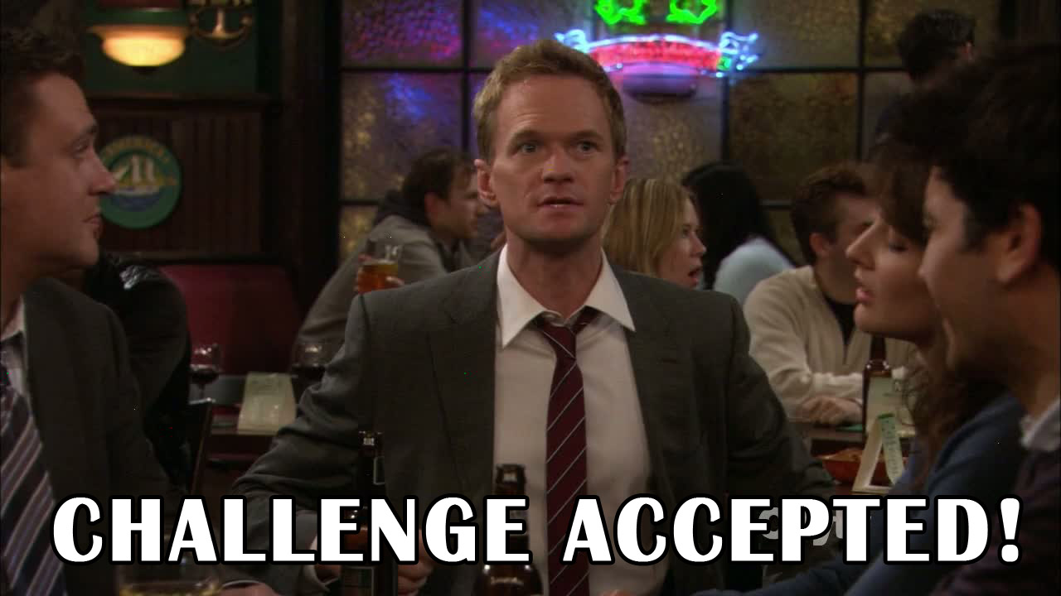
Transition Phase
“It seems likely that the two reciprocal patterns are on a dimension that ranges from acquaintance to intimacy. However, in modern American English the distance between the two points is small with the Mutual FN usually representing only a very small increment of intimacy over the Mutual TLN; as small sometimes as 5 minutes of conversation.
Because the segment of the line that lies between the two patterns is usually so very short, it is not easy to make out its exact character.”
Brown & Ford (1961:377)
(emphasis added)

Slide 7
Research Questions
What factors influence forms of address between two people who are of roughly equal status?

Slide 8
Why Latter-day Saints?
Brother or Sister + last name.
Cultural norms
Strong and active but largely below the radar
Interaction with general tendency of FN with familiarity
Ward organization and composition
Congregations (aka “wards”) have strict delineated boundaries
People only share one feature: where they live
Roughly 100–150 people
Interaction with anyone from strangers to close friends/family on a weekly basis
Address forms go from mutual TLN to mutual FN over the course of months or years

Slide 9
Address forms among Mormons (Fogg 1990)
Observed 6 congregations in Utah
No observer’s effect, but no metadata
Did not include 3rd person reference terms and dismisses them as irrelevant
Marked 3 levels of formality: “over the pulpit,” Sunday school, and casual
more formal = more TLN
His strongest predictor.
“Status” determined by >15 year age difference (Brown & Ford 1961:377)
More FN towards younger people
Gender of speaker and addressee
A hint of more FN between women

Slide 10
Methodology

Slide 11
Target Population
21 married couples from the Athens 1st Ward
White, heterosexual
Ages 20–36 (mean=28); therefore all the same “status”
From high school education to Ph.D.
Roughly half are from Georgians and half are transplants.
Minimum of 7 years in the church, though most were raised Mormon.
Roughly 1/3 of the congregation
No singles were included
Divorcees or otherwise unmarried individuals
Most attend another congregation for single members
Anecdotal evidence suggests marital status is an important factor and I didn’t want my data spread too thin.

Slide 12
Survey
____________ | Situation 1 |  |  | Situation 2 |  |  | Situation 3 |  |  | Situation 4 |  |  | How well do you know this person?
Your Age (optional) | First | Bro/Sis | Other | First | Bro/Sis | Other | First | Bro/Sis | Other | First | Bro/Sis | Other
Mitt Romney | X |  |  |  | X |  |  | X |  |  | X |  | 1 2 3 4 5
Ken Jennings |  | X |  |  | X |  |  | X |  |  | X |  | 1 2 3 4 5
Gladys Knight |  | X |  |  | X |  |  |  | FULL |  |  | FULL | 1 2 3 4 5
David Archuleta | X |  |  | X |  |  | X |  |  | X |  |  | 1 2 3 4 5
Glenn Beck |  | X |  |  | X |  |  | X |  |  | X |  | 1 2 3 4 5
26
O
O
O
O
O
* Names have (obviously) been changed.
42 names down the side, 4 situations across the top
Asks how well participant knows the person
31 participants returned the survey
5147 forms of address, 1270 relationship data points

Slide 13
Audience Design
4 Situations based on Audience Design (Bell 1984)
Speakers design their style based on who they are talking to.
Audience Design proposes that they also vary in who else is listening.
Implicational hierarchy: variation with one presupposes variation with Types closer to the speaker.
Speaker
Addressee
Auditor
Overhearer
Eavesdropper
Adapted from Bell (1984:159)
Notes:
Overhearers: “innocent earshot of the conversation”
Eavesdroppers: intentionally or unintentionally out-of-sight hearers
Many studies in code-switching and the media

Slide 14
auditor
• known
• ratified
• not addressed
addressee
speaker
• known
• ratified
• addressed
eavesdropper
• not addressed
• not ratified • unknown
overhearer
• known
• not ratified
• not addressed
Notes:
Ratified: “licensed to participate”

Slide 15
Why Audience Design?
Not used much in studying Address Forms
Fogg (1990) dismisses it “by logical analysis”
Bell says it affects every aspect of language (Bell 2013)

Slide 16
Terminology
Borrowed from social network theory
Ego: the person talking
Alter: the person the ego is talking to or about (i.e. whoever’s name is used)
When the ego is talking to someone, the alter is the addressee
When the ego is talking about someone, the alter is that 3rd person, who is different from the addressee.
(Hopefully) avoids ambiguity

Slide 17
The Four Situations
(Exact descriptions of each refer to a lot of Mormon culture that would be tangential for the purposes of this presentation.)
Four situations puts the other person in each of the four Audience Types
Situation 1 (Addressee): Direct address
Situation 2 (Auditor): Small committee meeting
Situation 3 (Overhearer): Talking to spouse about them at church
Situation 4 (Eavesdropper): Talking to spouse about them while driving home
Situations 3 and 4 control for the addressee.

Slide 18
Independent Variables
Familiarity
Prediction: very significant. The closer the two, the more likely FN is used (Brown and Gilman 1960)
4 Situations
Prediction: significant (Fogg 1990)
Familiarity between spouse and 3rd person
Prediction: significant. Accommodation to addressee’s familiarity (Dickey 1997)
Age difference
Prediction: slightly significant. < 7 year age difference = more FN (Brown and Ford 1961)
Sex
Prediction: women use more FN (Fogg 1990).
Parenthood
Prediction: parenthood is seen as a higher status
Notes:
Age difference < 7 years because teenagers.

Slide 19
Analysis
Some quantitative
Rbrul
Shows which factors are significant
Mostly qualitative
Observation of graphs created in Excel
Significance often not clear

Slide 20
Results
Familiarity between the two
Very significant.
4 Situations
Auditors were deviant and received less FN.
Familiarity between spouse and 3rd person
Depends on the difference.
Age difference
< 6 year difference showed more FN.
Sex
Slightly more FN with women and to women.
Number of children
Significant. Parenthood is perceived as a higher status

Slide 21
Results (Rbrul)
Familiarity | FW | % | N
5 | 0.864 | 0.91 | 659
4 | 0.77 | 0.808 | 583
3 | 0.577 | 0.595 | 746
2 | 0.271 | 0.272 | 592
1 | 0.085 | 0.077 | 1964
Range | 77.9
Sexes
Woman → Woman | 0.672 | 0.538 | 1105
Man → Man | 0.475 | 0.691 | 1155
Women → Man | 0.473 | 0.492 | 1118
Man → Woman | 0.375 | 0.181 | 1166
Range | 29.7
Spouse-3rd Person Relationship
5 | 0.653 | 0.806 | 654
4 | 0.583 | 0.691 | 586
3 | 0.484 | 0.492 | 754
2 | 0.396 | 0.289 | 596
1 | 0.382 | 0.181 | 1954
Range | 27.1
Situation | FW | % | N
Addressee | 0.61 | 0.453 | 1185
Eavesdropper | 0.54 | 0.426 | 1079
Overhearer | 0.521 | 0.412 | 1112
Auditor | 0.334 | 0.319 | 1168
Range | 27.6
Children
Yes → No | 0.535 | 0.327 | 1133
Yes→ Yes | 0.519 | 0.494 | 589
Yes → Yes | 0.519 | 0.472 | 1742
No → Yes | 0.427 | 0.319 | 1080
Range | 10.8

Slide 22
Familiarity
Clearly the most significant factor.
However, the extremes are not categorical.
Quite a level slope.
Notes:
I’ve heard people call their spouses by TLN in some situations.
Level slope implies a gradual transition.
One person didn’t know someone’s last name.

Slide 23
Male/Female
Women use FN with other women more at all levels of familiarity.
There’s an unexpected leveling off for Man-to-Woman Level 5 relationships.

Slide 24
Spouse–3rd Person Relationship
The better the spouse knows a person, the more likely they will use FN.
This may be a a function of how well the speaker knows the person since couples often hang out in pairs.
Overlaid graph suggests some influence in both directions.

Slide 25
Situation
Situations 1, 3, 4 generally the same.
Situation 2 surprisingly showed less FN, even among close relation-ships.
Notes:
Either by itself, this variable is not significant, or I can’t find the right test to prove it.

Slide 26
Situation
Women use more FN towards addressees.
Men use less FN towards auditors.

Slide 27
Children
Children were statistically significant in predicting FN.
However, this may be just a result of social networking.
Parents are friends with parents; non-parents are friends with non-parents.
Children
Yes → No | 0.535 | 0.327 | 1133
Yes→ Yes | 0.519 | 0.494 | 589
Yes → Yes | 0.519 | 0.472 | 1742
No → Yes | 0.427 | 0.319 | 1080
Range | 10.8
Notes:
Maybe I just can’t find the right graph.
YN, NN, YY, NY
I don’t have the statistical know-how to support this social network

Slide 28
Age
FN is used more with people within a certain age range.
Overlay average relationship however, and we see that this reflects social networks, not age.
Conclusion: Age is not a significant predictor of address forms.

Slide 29
Discussion/Summary
Familiarity is easily the strongest factor
Perhaps influences other factors as well
People use FN more with others of the same sex, especially women.
Camaraderie among LDS women (Fogg 1990)
Speaker accommodates to Spouse–3rd Person relationship
Men are influenced by the presence of an Auditor.
Possibly because of more leadership meetings
Parents and non-parents are considered slightly different.
Age is not a factor, contrary to other studies

Slide 30
Audience Design
This research challenges the implicational hierarchy of Audience Design.
If variation occurs with one Audience Type, it is expected to occur with Types closer to the speaker.
Yet, for men, Auditors are different while Addressees are not affected.

Slide 31
Conclusions
Forms of Address between equals is determined by many factors: familiarity, audience, situation, gender, and parenthood
Bell’s Audience Design may be different for men and women.
Parenthood may be considered a higher “status.”
There exists a robust address form system, despite a general decline in the US.

Slide 32
Future Research
Future Research:
More congregations = more data + geographic trends
Parenthood > Married > Unmarried
Observed data instead of reported data
More statistics
More situations (other auditor situations, etc.)
Does this spread to non-LDS communities?
and…

Slide 33
Social Network Analysis

Slide 34
References
Bell, Allan. 1984. Language style as audience design. Language in Society 13(02). 145–204.
Bell, Allan. 2013. The guidebook to sociolinguistics. John Wiley & Sons.
Brown, Roger & Marguerite Ford. 1961. Address in American English. The Journal of Abnormal and Social Psychology 62(2). 375.
Brown, Roger & Albert Gilman. 1960. The pronouns of power and solidarity. In T. A. Sebeok (ed.), Style in Language, 253–76. Cambridge: MIT Press.
Dickey, Eleanor. 1997. Forms of address and terms of reference. Journal of Linguistics 33(2). 255–274.
Jorgenson, Jane. 1994. Situated address and the social construction of “in‐law” relationships. Southern Communication Journal 59(3). 196–204.
Labov, William. 1964. The social stratification of English in New York City. Columbia university.
Murray, Thomas E. 2002. A new look at address in American English: The rules have changed. Names 50(1). 43–61.
Rubin, Rebecca B. 1981. Ideal traits and terms of address for male and female college professors. Journal of Personality and Social Psychology 41(5).
Takiff, Hilary A., Diana T. Sanchez & Tracie L. Stewart. 2001. What’s in a name? The status implications of students’ terms of address for male and female professors. Psychology of Women Quarterly 25(2). 134–144.
Uscinski, Joseph E. & Lily J. Goren. 2010. What’s in a Name? Coverage of Senator Hillary Clinton during the 2008 Democratic Primary. Political Research Quarterly 64(4). 884–896.

