Slide 1
An EWP model of Quechua agreement: Further evidence against DM
Joey Stanley
Tiny Talks
September 15, 2016

Slide 2
Quechua Morphology
A prototypical agglutinating language
suffixes are easily divisible
the few allomorphs are easily explained
one meaning per morpheme
many, many inflectional and derivational morphemes
Except…

Slide 3
Quechua Agreement
past present future | 1sg obj | 1pl.excl obj | 1pl.incl obj | 2sg obj | 2pl obj | 3sg obj | 3pl obj
1sg subj | kurqani |  |  | rqayki | rqaykichis | rqani | rqani
 | kuni |  |  | yki | ykichis | ni | ni
 | kursaq |  |  | s(q)ayki | sqaykiku | saq | saqku
1pl.excl subj |  | kurqayku |  | rqaykiku | rqaykiku | rqayku | rqayku
 |  | kuyku |  | ykiku | ykichis | yku | yku
 |  | kusayku |  | s(q)aykiku | sqaykichis | sayku | sayku
1pl.incl subj |  |  | kurqanchis |  |  | rqanchis | rqanchis
 |  |  | kunchis |  |  | nchis | nchis
 |  |  | kusunchis |  |  | sunchis | sunchis
2sg subj | warqanki | warqankichis |  | kurqanki |  | rqanki | rqanki
 | wanki | wankiku |  | kunki |  | nki | nki
 | wanki | wankiku |  | kunki |  | nki | nki
2pl subj | warqankichis | warqankichis |  |  | kurqankichis | rqankichis | rqankichis
 | wankichis | wankichis |  |  | kunkichis | nkichis | nkichis
 | wankichis | wankichis |  |  | kunkichis | nkichis | nkichis
3sg subj | warqa | warqaku | warqanchis | rqasunki | rqasunkichis | rqa | rqa
 | wan | wanku | wanchis | sunki | sunkichis | n | n
 | wanqa | wanqaku | wasunchis | sunki | sunkichis | nqa | nqa
3pl subj | warqaku | warqaku | warqanchis | rqasunki | rqasunkichis | rqaku | rqaku
 | wanku | wanku | wanchis | sunkiku | sunkichis | nku | nku
 | wanqaku | wanqaku | wasunchis | sunkiku | sunkichis | nqaku | nqaku

Slide 4
Quechua Agreement
past present future | 1sg obj | 1pl.excl obj | 1pl.incl obj | 2sg obj | 2pl obj | 3sg obj | 3pl obj
1sg subj |  |  |  | rqayki | rqaykichis | rqani | rqani
 |  |  |  | yki | ykichis | ni | ni
 |  |  |  | s(q)ayki | sqaykiku | saq | saqku
1pl.excl subj |  |  |  | rqaykiku | rqaykiku | rqayku | rqayku
 |  |  |  | ykiku | ykichis | yku | yku
 |  |  |  | s(q)aykiku | sqaykichis | sayku | sayku
1pl.incl subj |  |  |  |  |  | rqanchis | rqanchis
 |  |  |  |  |  | nchis | nchis
 |  |  |  |  |  | sunchis | sunchis
2sg subj | warqanki | warqankichis |  |  |  | rqanki | rqanki
 | wanki | wankiku |  |  |  | nki | nki
 | wanki | wankiku |  |  |  | nki | nki
2pl subj | warqankichis | warqankichis |  |  |  | rqankichis | rqankichis
 | wankichis | wankichis |  |  |  | nkichis | nkichis
 | wankichis | wankichis |  |  |  | nkichis | nkichis
3sg subj | warqa | warqaku | warqanchis | rqasunki | rqasunkichis | rqa | rqa
 | wan | wanku | wanchis | sunki | sunkichis | n | n
 | wanqa | wanqaku | wasunchis | sunki | sunkichis | nqa | nqa
3pl subj | warqaku | warqaku | warqanchis | rqasunki | rqasunkichis | rqaku | rqaku
 | wanku | wanku | wanchis | sunkiku | sunkichis | nku | nku
 | wanqaku | wanqaku | wasunchis | sunkiku | sunkichis | nqaku | nqaku
Notes:
Conjugates for subjects and objects
147 possible cells, 51 are reflexive , leaving 96
"68" unique forms to work with
Data taken from a native speaker

Slide 5
Quechua Agreement
–wa
past present future | 1sg obj | 1pl.excl obj | 1pl.incl obj | 2sg obj | 2pl obj | 3sg obj | 3pl obj
1sg subj |  |  |  | rqayki | rqaykichis | rqani | rqani
 |  |  |  | yki | ykichis | ni | ni
 |  |  |  | s(q)ayki | sqaykiku | saq | saqku
1pl.excl subj |  |  |  | rqaykiku | rqaykiku | rqayku | rqayku
 |  |  |  | ykiku | ykichis | yku | yku
 |  |  |  | s(q)aykiku | sqaykichis | sayku | sayku
1pl.incl subj |  |  |  |  |  | rqanchis | rqanchis
 |  |  |  |  |  | nchis | nchis
 |  |  |  |  |  | sunchis | sunchis
2sg subj | warqanki | warqankichis |  |  |  | rqanki | rqanki
 | wanki | wankiku |  |  |  | nki | nki
 | wanki | wankiku |  |  |  | nki | nki
2pl subj | warqankichis | warqankichis |  |  |  | rqankichis | rqankichis
 | wankichis | wankichis |  |  |  | nkichis | nkichis
 | wankichis | wankichis |  |  |  | nkichis | nkichis
3sg subj | warqa | warqaku | warqanchis | rqasunki | rqasunkichis | rqa | rqa
 | wan | wanku | wanchis | sunki | sunkichis | n | n
 | wanqa | wanqaku | wasunchis | sunki | sunkichis | nqa | nqa
3pl subj | warqaku | warqaku | warqanchis | rqasunki | rqasunkichis | rqaku | rqaku
 | wanku | wanku | wanchis | sunkiku | sunkichis | nku | nku
 | wanqaku | wanqaku | wasunchis | sunkiku | sunkichis | nqaku | nqaku

Slide 6
Quechua Agreement
–wa
–rqa
past present future | 1sg obj | 1pl.excl obj | 1pl.incl obj | 2sg obj | 2pl obj | 3sg obj | 3pl obj
1sg subj |  |  |  | rqayki | rqaykichis | rqani | rqani
 |  |  |  | yki | ykichis | ni | ni
 |  |  |  | s(q)ayki | sqaykiku | saq | saqku
1pl.excl subj |  |  |  | rqaykiku | rqaykiku | rqayku | rqayku
 |  |  |  | ykiku | ykichis | yku | yku
 |  |  |  | s(q)aykiku | sqaykichis | sayku | sayku
1pl.incl subj |  |  |  |  |  | rqanchis | rqanchis
 |  |  |  |  |  | nchis | nchis
 |  |  |  |  |  | sunchis | sunchis
2sg subj | warqanki | warqankichis |  |  |  | rqanki | rqanki
 | wanki | wankiku |  |  |  | nki | nki
 | wanki | wankiku |  |  |  | nki | nki
2pl subj | warqankichis | warqankichis |  |  |  | rqankichis | rqankichis
 | wankichis | wankichis |  |  |  | nkichis | nkichis
 | wankichis | wankichis |  |  |  | nkichis | nkichis
3sg subj | warqa | warqaku | warqanchis | rqasunki | rqasunkichis | rqa | rqa
 | wan | wanku | wanchis | sunki | sunkichis | n | n
 | wanqa | wanqaku | wasunchis | sunki | sunkichis | nqa | nqa
3pl subj | warqaku | warqaku | warqanchis | rqasunki | rqasunkichis | rqaku | rqaku
 | wanku | wanku | wanchis | sunkiku | sunkichis | nku | nku
 | wanqaku | wanqaku | wasunchis | sunkiku | sunkichis | nqaku | nqaku

Slide 7
Quechua Agreement
–wa
–rqa
–ki
past present future | 1sg obj | 1pl.excl obj | 1pl.incl obj | 2sg obj | 2pl obj | 3sg obj | 3pl obj
1sg subj |  |  |  | rqayki | rqaykichis | rqani | rqani
 |  |  |  | yki | ykichis | ni | ni
 |  |  |  | s(q)ayki | sqaykiku | saq | saqku
1pl.excl subj |  |  |  | rqaykiku | rqaykiku | rqayku | rqayku
 |  |  |  | ykiku | ykichis | yku | yku
 |  |  |  | s(q)aykiku | sqaykichis | sayku | sayku
1pl.incl subj |  |  |  |  |  | rqanchis | rqanchis
 |  |  |  |  |  | nchis | nchis
 |  |  |  |  |  | sunchis | sunchis
2sg subj | warqanki | warqankichis |  |  |  | rqanki | rqanki
 | wanki | wankiku |  |  |  | nki | nki
 | wanki | wankiku |  |  |  | nki | nki
2pl subj | warqankichis | warqankichis |  |  |  | rqankichis | rqankichis
 | wankichis | wankichis |  |  |  | nkichis | nkichis
 | wankichis | wankichis |  |  |  | nkichis | nkichis
3sg subj | warqa | warqaku | warqanchis | rqasunki | rqasunkichis | rqa | rqa
 | wan | wanku | wanchis | sunki | sunkichis | n | n
 | wanqa | wanqaku | wasunchis | sunki | sunkichis | nqa | nqa
3pl subj | warqaku | warqaku | warqanchis | rqasunki | rqasunkichis | rqaku | rqaku
 | wanku | wanku | wanchis | sunkiku | sunkichis | nku | nku
 | wanqaku | wanqaku | wasunchis | sunkiku | sunkichis | nqaku | nqaku

Slide 8
Quechua Agreement
–wa
–rqa
–ki
–su
past present future | 1sg obj | 1pl.excl obj | 1pl.incl obj | 2sg obj | 2pl obj | 3sg obj | 3pl obj
1sg subj |  |  |  | rqayki | rqaykichis | rqani | rqani
 |  |  |  | yki | ykichis | ni | ni
 |  |  |  | s(q)ayki | sqaykiku | saq | saqku
1pl.excl subj |  |  |  | rqaykiku | rqaykiku | rqayku | rqayku
 |  |  |  | ykiku | ykichis | yku | yku
 |  |  |  | s(q)aykiku | sqaykichis | sayku | sayku
1pl.incl subj |  |  |  |  |  | rqanchis | rqanchis
 |  |  |  |  |  | nchis | nchis
 |  |  |  |  |  | sunchis | sunchis
2sg subj | warqanki | warqankichis |  |  |  | rqanki | rqanki
 | wanki | wankiku |  |  |  | nki | nki
 | wanki | wankiku |  |  |  | nki | nki
2pl subj | warqankichis | warqankichis |  |  |  | rqankichis | rqankichis
 | wankichis | wankichis |  |  |  | nkichis | nkichis
 | wankichis | wankichis |  |  |  | nkichis | nkichis
3sg subj | warqa | warqaku | warqanchis | rqasunki | rqasunkichis | rqa | rqa
 | wan | wanku | wanchis | sunki | sunkichis | n | n
 | wanqa | wanqaku | wasunchis | sunki | sunkichis | nqa | nqa
3pl subj | warqaku | warqaku | warqanchis | rqasunki | rqasunkichis | rqaku | rqaku
 | wanku | wanku | wanchis | sunkiku | sunkichis | nku | nku
 | wanqaku | wanqaku | wasunchis | sunkiku | sunkichis | nqaku | nqaku

Slide 9
Quechua Agreement
–wa
–rqa
–ki
–su
–n
past present future | 1sg obj | 1pl.excl obj | 1pl.incl obj | 2sg obj | 2pl obj | 3sg obj | 3pl obj
1sg subj |  |  |  | rqayki | rqaykichis | rqani | rqani
 |  |  |  | yki | ykichis | ni | ni
 |  |  |  | s(q)ayki | sqaykiku | saq | saqku
1pl.excl subj |  |  |  | rqaykiku | rqaykiku | rqayku | rqayku
 |  |  |  | ykiku | ykichis | yku | yku
 |  |  |  | s(q)aykiku | sqaykichis | sayku | sayku
1pl.incl subj |  |  |  |  |  | rqanchis | rqanchis
 |  |  |  |  |  | nchis | nchis
 |  |  |  |  |  | sunchis | sunchis
2sg subj | warqanki | warqankichis |  |  |  | rqanki | rqanki
 | wanki | wankiku |  |  |  | nki | nki
 | wanki | wankiku |  |  |  | nki | nki
2pl subj | warqankichis | warqankichis |  |  |  | rqankichis | rqankichis
 | wankichis | wankichis |  |  |  | nkichis | nkichis
 | wankichis | wankichis |  |  |  | nkichis | nkichis
3sg subj | warqa | warqaku | warqanchis | rqasunki | rqasunkichis | rqa | rqa
 | wan | wanku | wanchis | sunki | sunkichis | n | n
 | wanqa | wanqaku | wasunchis | sunki | sunkichis | nqa | nqa
3pl subj | warqaku | warqaku | warqanchis | rqasunki | rqasunkichis | rqaku | rqaku
 | wanku | wanku | wanchis | sunkiku | sunkichis | nku | nku
 | wanqaku | wanqaku | wasunchis | sunkiku | sunkichis | nqaku | nqaku

Slide 10
Quechua Agreement
–wa
–rqa
–ki
–su
–n
–chis
past present future | 1sg obj | 1pl.excl obj | 1pl.incl obj | 2sg obj | 2pl obj | 3sg obj | 3pl obj
1sg subj |  |  |  | rqayki | rqaykichis | rqani | rqani
 |  |  |  | yki | ykichis | ni | ni
 |  |  |  | s(q)ayki | sqaykiku | saq | saqku
1pl.excl subj |  |  |  | rqaykiku | rqaykiku | rqayku | rqayku
 |  |  |  | ykiku | ykichis | yku | yku
 |  |  |  | s(q)aykiku | sqaykichis | sayku | sayku
1pl.incl subj |  |  |  |  |  | rqanchis | rqanchis
 |  |  |  |  |  | nchis | nchis
 |  |  |  |  |  | sunchis | sunchis
2sg subj | warqanki | warqankichis |  |  |  | rqanki | rqanki
 | wanki | wankiku |  |  |  | nki | nki
 | wanki | wankiku |  |  |  | nki | nki
2pl subj | warqankichis | warqankichis |  |  |  | rqankichis | rqankichis
 | wankichis | wankichis |  |  |  | nkichis | nkichis
 | wankichis | wankichis |  |  |  | nkichis | nkichis
3sg subj | warqa | warqaku | warqanchis | rqasunki | rqasunkichis | rqa | rqa
 | wan | wanku | wanchis | sunki | sunkichis | n | n
 | wanqa | wanqaku | wasunchis | sunki | sunkichis | nqa | nqa
3pl subj | warqaku | warqaku | warqanchis | rqasunki | rqasunkichis | rqaku | rqaku
 | wanku | wanku | wanchis | sunkiku | sunkichis | nku | nku
 | wanqaku | wanqaku | wasunchis | sunkiku | sunkichis | nqaku | nqaku

Slide 11
Quechua Agreement
–wa
–rqa
–ki
–su
–n
–chis
–ku
past present future | 1sg obj | 1pl.excl obj | 1pl.incl obj | 2sg obj | 2pl obj | 3sg obj | 3pl obj
1sg subj |  |  |  | rqayki | rqaykichis | rqani | rqani
 |  |  |  | yki | ykichis | ni | ni
 |  |  |  | s(q)ayki | sqaykiku | saq | saqku
1pl.excl subj |  |  |  | rqaykiku | rqaykiku | rqayku | rqayku
 |  |  |  | ykiku | ykichis | yku | yku
 |  |  |  | s(q)aykiku | sqaykichis | sayku | sayku
1pl.incl subj |  |  |  |  |  | rqanchis | rqanchis
 |  |  |  |  |  | nchis | nchis
 |  |  |  |  |  | sunchis | sunchis
2sg subj | warqanki | warqankichis |  |  |  | rqanki | rqanki
 | wanki | wankiku |  |  |  | nki | nki
 | wanki | wankiku |  |  |  | nki | nki
2pl subj | warqankichis | warqankichis |  |  |  | rqankichis | rqankichis
 | wankichis | wankichis |  |  |  | nkichis | nkichis
 | wankichis | wankichis |  |  |  | nkichis | nkichis
3sg subj | warqa | warqaku | warqanchis | rqasunki | rqasunkichis | rqa | rqa
 | wan | wanku | wanchis | sunki | sunkichis | n | n
 | wanqa | wanqaku | wasunchis | sunki | sunkichis | nqa | nqa
3pl subj | warqaku | warqaku | warqanchis | rqasunki | rqasunkichis | rqaku | rqaku
 | wanku | wanku | wanchis | sunkiku | sunkichis | nku | nku
 | wanqaku | wanqaku | wasunchis | sunkiku | sunkichis | nqaku | nqaku

Slide 12
Quechua Agreement
–wa
–rqa
–ki
–su
–n
–chis
–ku
…plus about 5 more
past present future | 1sg obj | 1pl.excl obj | 1pl.incl obj | 2sg obj | 2pl obj | 3sg obj | 3pl obj
1sg subj |  |  |  | rqayki | rqaykichis | rqani | rqani
 |  |  |  | yki | ykichis | ni | ni
 |  |  |  | s(q)ayki | sqaykiku | saq | saqku
1pl.excl subj |  |  |  | rqaykiku | rqaykiku | rqayku | rqayku
 |  |  |  | ykiku | ykichis | yku | yku
 |  |  |  | s(q)aykiku | sqaykichis | sayku | sayku
1pl.incl subj |  |  |  |  |  | rqanchis | rqanchis
 |  |  |  |  |  | nchis | nchis
 |  |  |  |  |  | sunchis | sunchis
2sg subj | warqanki | warqankichis |  |  |  | rqanki | rqanki
 | wanki | wankiku |  |  |  | nki | nki
 | wanki | wankiku |  |  |  | nki | nki
2pl subj | warqankichis | warqankichis |  |  |  | rqankichis | rqankichis
 | wankichis | wankichis |  |  |  | nkichis | nkichis
 | wankichis | wankichis |  |  |  | nkichis | nkichis
3sg subj | warqa | warqaku | warqanchis | rqasunki | rqasunkichis | rqa | rqa
 | wan | wanku | wanchis | sunki | sunkichis | n | n
 | wanqa | wanqaku | wasunchis | sunki | sunkichis | nqa | nqa
3pl subj | warqaku | warqaku | warqanchis | rqasunki | rqasunkichis | rqaku | rqaku
 | wanku | wanku | wanchis | sunkiku | sunkichis | nku | nku
 | wanqaku | wanqaku | wasunchis | sunkiku | sunkichis | nqaku | nqaku
Notes:
There are 12 chunks of phonetic material.
Mutual exclusivity, and same order.
Up to 5 suffixes per form.

Slide 13
Quechua Morphology
Affix ordering (Muysken 1988) and evidentials (Nuckolls 2008)
More theoretical descriptions
disjunctive ordering of suffixes (Kerke 1996)
a hierarchichal-based paradigm (Lakämper & Wunderlich 1998)
Many varieties
Dialect continuum with at least 42 varieties (Pearce & Heggarty 2011, Lewis, Simons & Fennig 2016)
I’ve seen at 10 paradigms
Some varieties don’t even have object agreement (Swanson 2011, Bateman p.c.)
Variability within a single town
No mention of the (ir)regularities (Howard 2014, Castillo-Collado 2012, Wonderly 1952, Yakoyama 1951, Zariqueiey & Córdova 2008)
tl;dr—It’s hard to compare Quechua research.
Notes:
Move the theoretical descriptions up

Slide 14
Theoretical Models

Slide 15
Distributed Morphology (DM)
Theoretical framework by Halle & Marantz (1993)
There is no divide between morphology and syntax
No Lexicon
Lexical functions are distributed among other parts of the grammar.
Instead of the Lexicon, three lists:
Syntactic Terminals: roots and functional morphemes (without phonological content)
Vocabulary: a list of Vocabulary Items that insert phonological content into functional morphemes
Encyclopedia: unpredictable stuff

Slide 16
Vocabulary Items
[±α, ±β, …] ⟷ –x
Hupa Agreement Morphemes
p/n | subj. | object
1s | W– | Wi–
2s | n– | ni–
1p | di– | noh–
2p | oh– | noh–
Features
[+1 –2 –pl] | = | ‘1st person singular’
[–1 +2 –pl] | = | ‘2nd person singular’
[+1 –2 +pl] | = | ‘1st person plural’
[–1 +2 +pl] | = | ‘2nd person plural’
Vocabulary Items
[+1 +pl +subj] | ⟷ | di–
[+2 +pl +subj] | ⟷ | oh–
[+1 –pl] | ⟷ | W–
[+2 –pl] | ⟷ | n–
[+pl +obj] | ⟷ | noh–
from Embick (2015)
Notes:
Vocabulary Items are competing for insertion.
More specific rules apply first.
If same number of parameters, a hierarchy of features
Underspecification!
Impoverishment rules

Slide 17
Anderson’s EWP
Extended Word and Paradigm (EWP) a.k.a. A-Morphous Morphology (Anderson 1982 and Thomas-Flinders 1981, see also Spencer 1991 and Anderson 1992)
Morphological rules are organized in an ordered set of blocks.
As a word passes from one block to the next, it acquires morphology.
Georgian*
objects
subjects
1sg 2sg 3sg
1sg — g-xedav v-xedav
1pl — g-xedav-t v-xedav-t
2sg m-xedav — xedav
2pl m-xedav-t — xedav-t
3sg m-xedav-s g-xedav-s xedav-s
3pl m-xedav-en g-xedav-en xedav-en
“Prefix block”
1) [X [1st sg]]
/X/ → /m + X/
2) [X [1st]]
/X/ → /gv + X/
3) [X [2nd]]
/X/ → /g + X/
4) [1st]
/X/ → /v + X/
“Suffix block”
5) [3rd pl]
/X/ → /X + en/
6) [X [2nd pl]]
/X/ → /X + t/
7) [pl]
/X/ → /X + t/
8) [3rd sg]
/X/ → /X + s/
objects
1pl 2pl 3pl
1sg — g-xedav-t v-xedav
1pl — g-xedav-t v-xedav-t
2sg gv-xedav — xedav
2pl gv-xedav-t — xedav-t
3sg gv-xedav-s g-xedav-t xedav-s
3pl gv-xedav-en g-xedav-en xedav-en
subjects
*corrected version of Spencer (1992) by Langston (2016)
…which is just a handout from class last year
I don’t think Dr. Langston is publishing on an outdated theoretical model of Georgian morphology. He would know better.
Notes:
I never thought I’d say this, but I wish Quechua were as easy as Georgian!

Slide 18
Paradigms in EWP and DM
Both have been used for irregular paradigms
EWP: Italian, Georgian, and Potawatomi (Spencer 1991; Anderson 1992)
DM: Classical Arabic, Tamazight Berber, Ugaritic, and German Sign Language (Noyer 1997; Harley & Noyer 1999; Glück & Pfau 1999)
Both are capable of handling even the most irregular paradigms
simply have one rule for each cell
The question is which can handle them better

Slide 19
Methodology
I wrote a computer program to help me out
It basically goes through all the cells, runs them through the rules, and compares them to the output
I basically sat there and figured the rules out.

Slide 20
Results
Disclaimer: Lots of information ahead.

Slide 21
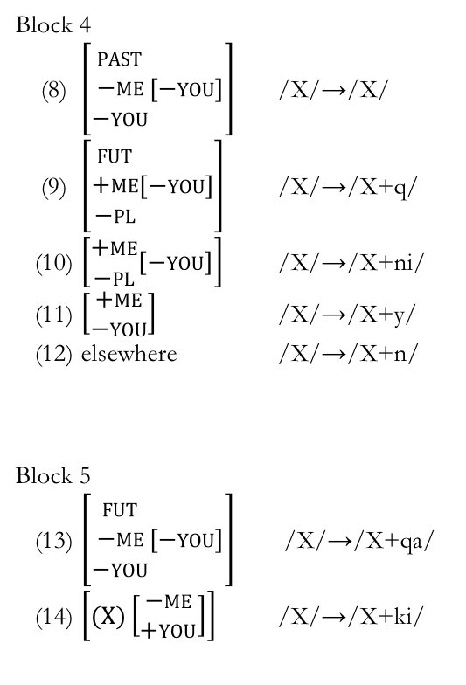
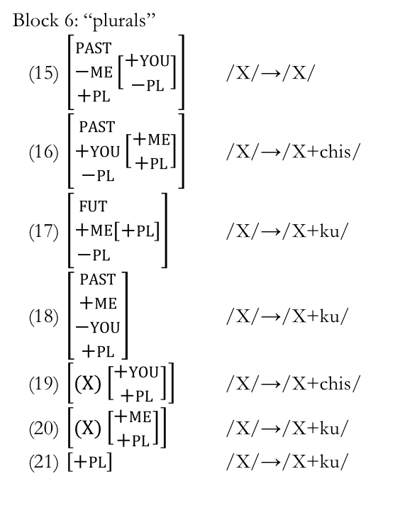
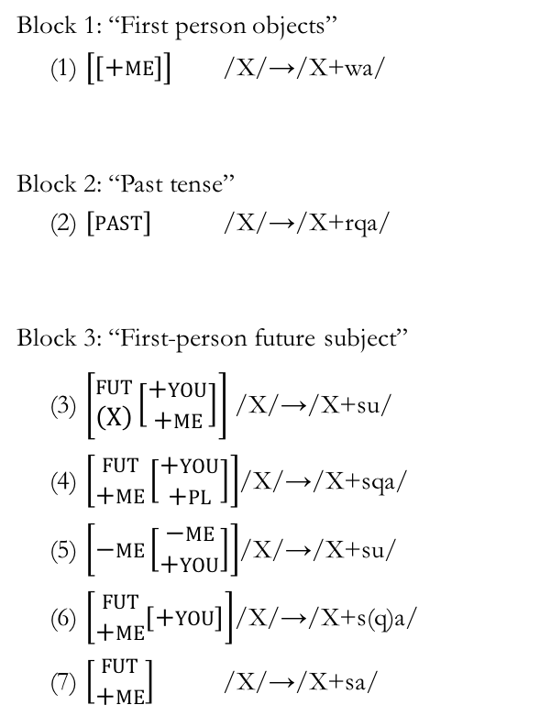
EWP Rules
Block 1: “First person objects”
(1) $\left[\left[+me\right]\right]$ /X/→/X+wa/
Block 2: “Past tense”
(2) $\left[past\right]$ /X/→/X+rqa/
Block 3: “First-person future subject”
(3) $\left[\begin{aligned}fut \\ \left(X\right)\end{aligned}\left[\begin{aligned}+you \\ +me\end{aligned}\right]\right]$ /X/→/X+su/
(4) $\left[\begin{aligned}fut \\ +me\end{aligned}\left[\begin{aligned}+you \\ +pl\end{aligned}\right]\right]$/X/→/X+sqa/
(5) $\left[−me\left[\begin{aligned}−me \\ +you\end{aligned}\right]\right]$/X/→/X+su/
(6) $\left[\begin{aligned}fut \\ +me\end{aligned}\left[+you\right]\right]$/X/→/X+s(q)a/
(7) $\left[\begin{aligned}fut \\ +me\end{aligned}\right]$ /X/→/X+sa/
Block 4
(8) $\left[\begin{aligned}past \\ −me \\ −you\end{aligned}\left[−you\right]\right]$ /X/→/X/
(9) $\left[\begin{aligned}fut \\ +me \\ −pl\end{aligned}\left[−you\right]\right]$ /X/→/X+q/
(10) $\left[\begin{aligned}+me \\ −pl\end{aligned}\left[−you\right]\right]$ /X/→/X+ni/
(11) $\left[\begin{aligned}+me \\ −you\end{aligned}\right]$ /X/→/X+y/
(12) elsewhere /X/→/X+n/
Block 5
(13) $\left[\begin{aligned}fut \\ −me \\ −you\end{aligned}\left[−you\right]\right]$ /X/→/X+qa/
(14) $\left[(X)\left[\begin{aligned}−me \\ +you\end{aligned}\right]\right]$ /X/→/X+ki/
Block 6: “plurals”
(15) $\left[\begin{aligned}past \\ −me \\ +pl\end{aligned}\left[\begin{aligned}+you \\ −pl\end{aligned}\right]\right]$ /X/→/X/
(16) $\left[\begin{aligned}past \\ +you \\ −pl\end{aligned}\left[\begin{aligned}+me \\ +pl\end{aligned}\right]\right]$ /X/→/X+chis/
(17) $\left[\begin{aligned}fut \\ +me \\ −pl\end{aligned}\left[+pl\right]\right]$ /X/→/X+ku/
(18) $\left[\begin{aligned}past \\ +me \\ −you \\ +pl\end{aligned}\right]$ /X/→/X+ku/
(19) $\left[(X)\left[\begin{aligned}+you \\ +pl\end{aligned}\right]\right]$ /X/→/X+chis/
(20) $\left[(X)\left[\begin{aligned}+me \\ +pl\end{aligned}\right]\right]$ /X/→/X+ku/
(21) $\left[+pl\right]$ /X/→/X+ku/

Slide 22
DM Vocabulary Items
(1) | [+pl.acc] | → Ø / | [–me.nom –me.acc –you.acc]
(2) | [+pl.acc] | → Ø / | [–me.nom –you.acc +pl.nom]
(3) | [+pl.acc] | → Ø / | [–me.acc –you.acc –fut]
(4) | [+ fut] | → Ø / | [–me.nom +you.nom]
(5) | [+pl.acc] | → Ø / | [–me.nom +you.nom +pl.nom –past]
(6) | [+pl.nom] | → Ø / | [–me.nom –you.nom +you.acc +past]
(7) | [+pl.acc] | → Ø / | [–me.nom +you.nom +pl.nom +past]
(8) | [+pl.nom] | → Ø / | [–me.nom +me.acc –you.nom +pl.acc]
(9) | [+fut] | → Ø / | [–me.nom –me.acc –you.nom +you.acc]
(10) | [+pl.acc] | → Ø / | [+me.nom +pl.nom +past]
(11) | [+pl.nom] | → Ø / | [+me.nom +pl.acc –past –fut]
(9) | +me.nom –you.acc –pl.nom (–you.nom) | ⟷ | –q
(10) | +pl.nom (+me.nom +you.nom) | ⟷ | –Ø
(11) | (+me.acc) | ⟷ | –wa
(12) | +past | ⟷ | –rqa
(13) | +me.nom –you.nom –you.acc –pl.nom | ⟷ | –ni
(14) | +me.nom –you.nom | ⟷ | –y
(15) | +me.nom | ⟷ | –n
(16) | –me.nom –you.nom –you.acc –pl.nom (+past) | ⟷ | –Ø
(17) | –me.nom –me.acc +you.acc | ⟷ | –sunki
(18) | –me.nom +you.acc +fut | ⟷ | –sun
(19) | –me.nom +you.acc | ⟷ | –n
(20) | –me.nom +you.nom | ⟷ | –nki
(21) | +you.acc (+me.nom) | ⟷ | –ki
(22) | –me.nom –you.nom –past +fut | ⟷ | –nqa
(23) | –me.nom –you.nom –past | ⟷ | –n
(24) | +pl.acc +pl.acc (+you.acc) | ⟷ | –chis
(25) | +pl.acc (+you.acc) | ⟷ | –chis
(26) | +pl.acc | ⟷ | –ku
(27) | +pl.nom (+you.nom) | ⟷ | –chis
(28) | +you.nom +pl.nom | ⟷ | –chis
(29) | +pl.nom | ⟷ | –ku
(1) | +me.acc +you.nom –pl.nom +pl.acc +past | ⟷ | –warqankichis
(2) | +me.nom –you.nom +you.acc –pl.nom +pl.acc +fut | ⟷ | –sqaykiku
(3) | +me.nom –you.nom +you.acc +pl.acc +fut | ⟷ | –sqaykichis
(4) | +me.nom –you.nom +you.acc +pl.nom +fut | ⟷ | –sqaykiku
(5) | +me.nom –you.nom +you.acc +fut | ⟷ | –sqayki
(6) | +me.nom –you.nom +pl.nom +fut | ⟷ | –sayku
(7) | +me.nom –you.nom +fut | ⟷ | –sa
(8) | +me.nom +fut | ⟷ | –sun

Slide 23
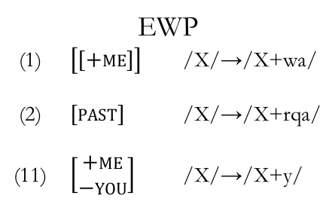
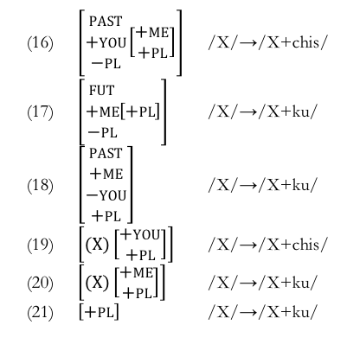
Discussion
Lots of overlap in the rules.
Several rules/Vocabulary Items specifically target certain cells.
EWP
(1) $\left[\left[+me\right]\right]$ /X/→/X+wa/
(2) $\left[past\right]$ /X/→/X+rqa/
(11) $\left[\begin{aligned}+me \\ −you\end{aligned}\right]$ /X/→/X+y/
DM
(11) (+me.acc) ⟷ –wa
(12) +past ⟷ –rqa
(14) +me.nom –you.nom ⟷ –y
past present future | 1sg obj | 1pl.excl obj | 1pl.incl obj | 2sg obj | 2pl obj | 3sg obj | 3pl obj
1sg subj |  |  |  | rqayki | rqaykichis | rqani | rqani
 |  |  |  | yki | ykichis | ni | ni
 |  |  |  | s(q)ayki | sqaykiku | saq | saqku
1pl.excl subj |  |  |  | rqaykiku | rqaykiku | rqayku | rqayku
 |  |  |  | ykiku | ykichis | yku | yku
 |  |  |  | s(q)aykiku | sqaykichis | sayku | sayku
1pl.incl subj |  |  |  |  |  | rqanchis | rqanchis
 |  |  |  |  |  | nchis | nchis
 |  |  |  |  |  | sunchis | sunchis
2sg subj | warqanki | warqankichis |  |  |  | rqanki | rqanki
 | wanki | wankiku |  |  |  | nki | nki
 | wanki | wankiku |  |  |  | nki | nki
2pl subj | warqankichis | warqankichis |  |  |  | rqankichis | rqankichis
 | wankichis | wankichis |  |  |  | nkichis | nkichis
 | wankichis | wankichis |  |  |  | nkichis | nkichis
3sg subj | warqa | warqaku | warqanchis | rqasunki | rqasunkichis | rqa | rqa
 | wan | wanku | wanchis | sunki | sunkichis | n | n
 | wanqa | wanqaku | wasunchis | sunki | sunkichis | nqa | nqa
3pl subj | warqaku | warqaku | warqanchis | rqasunki | rqasunkichis | rqaku | rqaku
 | wanku | wanku | wanchis | sunkiku | sunkichis | nku | nku
 | wanqaku | wanqaku | wasunchis | sunkiku | sunkichis | nqaku | nqaku
Several are needed for –ku and –chis
(16) $\left[\begin{aligned}past \\ +you \\ −pl\end{aligned}\left[\begin{aligned}+me \\ +pl\end{aligned}\right]\right]$ /X/→/X+chis/
(17) $\left[\begin{aligned}fut \\ +me \\ −pl\end{aligned}\left[+pl\right]\right]$ /X/→/X+ku/
(18) $\left[\begin{aligned}past \\ +me \\ −you \\ +pl\end{aligned}\right]$ /X/→/X+ku/
(19) $\left[(X)\left[\begin{aligned}+you \\ +pl\end{aligned}\right]\right]$ /X/→/X+chis/
(20) $\left[(X)\left[\begin{aligned}+me \\ +pl\end{aligned}\right]\right]$ /X/→/X+ku/
(21) $\left[+pl\right]$ /X/→/X+ku/
(24) | +pl.acc +pl.acc (+you.acc) | ⟷ | –chis
(25) | +pl.acc (+you.acc) | ⟷ | –chis
(26) | +pl.acc | ⟷ | –ku
(27) | +pl.nom (+you.nom) | ⟷ | –chis
(28) | +you.nom +pl.nom | ⟷ | –chis
(29) | +pl.nom | ⟷ | –ku

Slide 24
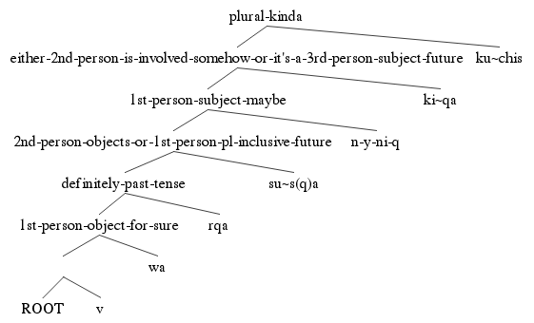
Discussion
DM nicely accounts for the syncretism in the paradigm.
However, there were some cells where impoverishment rules were not sufficient.
EWP nicely accounts for the fixed order of the morphemes
I know DM has a way of handling this, but I haven’t been able to work it in yet
past present future | 1sg obj | 1pl.excl obj | 1pl.incl obj | 2sg obj | 2pl obj | 3sg obj | 3pl obj
1sg subj |  |  |  | rqayki | rqaykichis | rqani | rqani
 |  |  |  | yki | ykichis | ni | ni
 |  |  |  | s(q)ayki | sqaykiku | saq | saqku
1pl.excl subj |  |  |  | rqaykiku | rqaykiku | rqayku | rqayku
 |  |  |  | ykiku | ykichis | yku | yku
 |  |  |  | s(q)aykiku | sqaykichis | sayku | sayku
1pl.incl subj |  |  |  |  |  | rqanchis | rqanchis
 |  |  |  |  |  | nchis | nchis
 |  |  |  |  |  | sunchis | sunchis
2sg subj | warqanki | warqankichis |  |  |  | rqanki | rqanki
 | wanki | wankiku |  |  |  | nki | nki
 | wanki | wankiku |  |  |  | nki | nki
2pl subj | warqankichis | warqankichis |  |  |  | rqankichis | rqankichis
 | wankichis | wankichis |  |  |  | nkichis | nkichis
 | wankichis | wankichis |  |  |  | nkichis | nkichis
3sg subj | warqa | warqaku | warqanchis | rqasunki | rqasunkichis | rqa | rqa
 | wan | wanku | wanchis | sunki | sunkichis | n | n
 | wanqa | wanqaku | wasunchis | sunki | sunkichis | nqa | nqa
3pl subj | warqaku | warqaku | warqanchis | rqasunki | rqasunkichis | rqaku | rqaku
 | wanku | wanku | wanchis | sunkiku | sunkichis | nku | nku
 | wanqaku | wanqaku | wasunchis | sunkiku | sunkichis | nqaku | nqaku
Notes:
Superior is mispelled.
black boxes instead of red

Slide 25
Comparison
EWP has fewer rules
Superficially, EWP wins
But 20 more rules is probably okay
EWP can account for the limit of five suffixes on a single verb.
In irregular forms, EWP captures what regularity that is there, while DM needs rules to target the entire form individually.
Ordering is not resolved adequately in DM
Universal hierarchy of features determines the order
But the tense would to be much higher than in other languages
Bottom line: the EWP model is suprior.

Slide 26
References!
Anderson, Stephen R. 1982. Where’s morphology? Linguistic inquiry 13(4). 571–612.
Anderson, Stephen R. 1992. A-Morphous morphology. (Cambridge Studies in Linguistics 62). Cambridge: Cambridge University Press.
Bateman, Bethany. Personal communication. September 12, 2016.
Collado, Martin Castillo Willkaruna. 2012. Qichwa Yachay Yanapaq Qillqa. Unpublished. Bolivia, ms.
Embick, David. 2015. The Morpheme: A theoretical introduction. (Interface Explorations 31). De Gruyter Mouton.
Glück, Susanne & Roland Pfau. 1999. A Distributed Morphology account of verbal inflection in German Sign Language. Proceedings of ConSOLE, vol. 7, 65–80.
Halle, Morris & Alec Marantz. 1993. Distributed morphology and the pieces of inflection. In K. Hale & S. Keyser (eds.), The View from Building 20: Essays in Linguistics in Honor of Sylvian Bromberger, 111–176. Cambridge: MIT Press.
Harley, Heidi & Rolf Noyer. 1999. Distributed morphology. Glot international 4(4). 3–9.
Howard, Rosaleen. 2014. Kawsay Vida: A Multimedia Quechua Course for Beginners and Beyond. (Recovering Languages and Literacies of the Americas). Austin: University of Texas Press.
Kerke, Simon van de. 1996. Agreement in Quechua: evidence against Distributed Morphology. In Crit Cremers & Marcel den Dikken (eds.), Linguistics in the Netherlands 1996, 121–131. (AVI Publications 13). John Benjamins Publishing Company.
Lakämper, Renate & Dieter Wunderlich. 1998. Person marking in Quechua—A constraint-based minimalist analysis. Lingua 105(3). 113–148.
Langston, Keith. 2016. Stephen Anderson’s “A-Morphous Morphology”/Extended Word-and-Paradigm (EWP) theory. Handout for LING 8120 at the University of Georgia.
Lewis, M. Paul, Gary F. Simons & Charles D. Fennig (eds.). 2016. Ethnologue: Languages of the World. 19th ed. Dallas, Texas: SIL International. Online version: http://www.ethnologue.com (3 May, 2016).
Muysken, Pieter. 1988. Affix order and interpretation: Quechua. Morphology and modularity. 259–279.
Noyer, Rolf. 1997. Features, positions and affixes in autonomous morphological structure. New York: Garland.
Nuckolls, Janis B. 2008. Deictic Selves and Others in Pastaza Quichua Evidential Usage. Anthropological Linguistics 50(1). 67–89.
Pearce, Adrian J. & Paul Heggarty. 2011. “Mining the Data” on the Huancayo-Huancavelica Quechua Frontier. In Paul Heggarty & Adrian J. Pearce (eds.), History and Language in the Andes, 87–109. (Studies of the Americas). Palgrave Macmillan US.
Spencer, Andrew. 1991. Morphological Theory: An Introduction to Word Structure in Generative Grammar. 1st ed. (Blackwell Textbooks in Linguistics). Oxford: Basil Blackwell.
Swanson, Tod. 2011. Napo Runa Shimi: Introduction to the Kichwa Language of the Napo Headwaters. Unpublished. Tena, Ecuador, ms.
Thomas-Flinders, Tracy Georgia. 1981. Inflectional morphology: Introduction to the extended word-and-paradigm theory. UCLA Publications.
Wonderly, William L. 1952. Semantic Components in Kechua Person Morphemes. Language 28(3). 366–376. doi:10.2307/410107.
Yokoyama, Masako. 1951. Outline of Kechua Structure I: Morphology. Language 27(1). 38–67. doi:10.2307/410250.
Zariqueiey, Roberto & Gavina Córdova. 2008. Qayna, Kunan, Paqarin: Una introducción práctica al quechua chanca. San Miguel, Peru: Estudios Generales Letras - Pontificia Universidad Católica del Peru.

Slide 27
Thanks!
Special thanks to Dr. Langston and Bethany Bateman for help with theories, data, and feedback and stuff.

