Slide 1
An EWP model of Quechua agreement
Further evidence against DM
3rd Annual Linguistics Conference at the University of Georgia
Athens, GA
August 8, 2016

Slide 2
Quechua Morphology
A prototypical agglutinating language
Suffixes are easily divisible
The few allomorphs are easily explained
One meaning per morpheme
Many, many inflectional and derivational morphemes
Except…

Slide 3
Quechua Agreement
past present future | 1sg obj | 1pl.excl obj | 1pl.incl obj | 2sg obj | 2pl obj | 3sg obj | 3pl obj
1sg subj |  |  |  | rqayki | rqaykichis | rqani | rqani
 |  |  |  | yki | ykichis | ni | ni
 |  |  |  | s(q)ayki | sqaykiku | saq | saqku
1pl.excl subj |  |  |  | rqaykiku | rqaykiku | rqayku | rqayku
 |  |  |  | ykiku | ykichis | yku | yku
 |  |  |  | s(q)aykiku | sqaykichis | sayku | sayku
1pl.incl subj |  |  |  |  |  | rqanchis | rqanchis
 |  |  |  |  |  | nchis | nchis
 |  |  |  |  |  | sunchis | sunchis
2sg subj | warqanki | warqankichis |  |  |  | rqanki | rqanki
 | wanki | wankiku |  |  |  | nki | nki
 | wanki | wankiku |  |  |  | nki | nki
2pl subj | warqankichis | warqankichis |  |  |  | rqankichis | rqankichis
 | wankichis | wankichis |  |  |  | nkichis | nkichis
 | wankichis | wankichis |  |  |  | nkichis | nkichis
3sg subj | warqa | warqaku | warqanchis | rqasunki | rqasunkichis | rqa | rqa
 | wan | wanku | wanchis | sunki | sunkichis | n | n
 | wanqa | wanqaku | wasunchis | sunki | sunkichis | nqa | nqa
3pl subj | warqaku | warqaku | warqanchis | rqasunki | rqasunkichis | rqaku | rqaku
 | wanku | wanku | wanchis | sunkiku | sunkichis | nku | nku
 | wanqaku | wanqaku | wasunchis | sunkiku | sunkichis | nqaku | nqaku
Notes:
Conjugates for subjects and objects
147 possible cells, 51 are reflexive , leaving 96
"68" unique forms to work with
Data taken from a native speaker

Slide 4
Quechua Agreement
–wa
past present future | 1sg obj | 1pl.excl obj | 1pl.incl obj | 2sg obj | 2pl obj | 3sg obj | 3pl obj
1sg subj |  |  |  | rqayki | rqaykichis | rqani | rqani
 |  |  |  | yki | ykichis | ni | ni
 |  |  |  | s(q)ayki | sqaykiku | saq | saqku
1pl.excl subj |  |  |  | rqaykiku | rqaykiku | rqayku | rqayku
 |  |  |  | ykiku | ykichis | yku | yku
 |  |  |  | s(q)aykiku | sqaykichis | sayku | sayku
1pl.incl subj |  |  |  |  |  | rqanchis | rqanchis
 |  |  |  |  |  | nchis | nchis
 |  |  |  |  |  | sunchis | sunchis
2sg subj | warqanki | warqankichis |  |  |  | rqanki | rqanki
 | wanki | wankiku |  |  |  | nki | nki
 | wanki | wankiku |  |  |  | nki | nki
2pl subj | warqankichis | warqankichis |  |  |  | rqankichis | rqankichis
 | wankichis | wankichis |  |  |  | nkichis | nkichis
 | wankichis | wankichis |  |  |  | nkichis | nkichis
3sg subj | warqa | warqaku | warqanchis | rqasunki | rqasunkichis | rqa | rqa
 | wan | wanku | wanchis | sunki | sunkichis | n | n
 | wanqa | wanqaku | wasunchis | sunki | sunkichis | nqa | nqa
3pl subj | warqaku | warqaku | warqanchis | rqasunki | rqasunkichis | rqaku | rqaku
 | wanku | wanku | wanchis | sunkiku | sunkichis | nku | nku
 | wanqaku | wanqaku | wasunchis | sunkiku | sunkichis | nqaku | nqaku

Slide 5
Quechua Agreement
–wa
–rqa
past present future | 1sg obj | 1pl.excl obj | 1pl.incl obj | 2sg obj | 2pl obj | 3sg obj | 3pl obj
1sg subj |  |  |  | rqayki | rqaykichis | rqani | rqani
 |  |  |  | yki | ykichis | ni | ni
 |  |  |  | s(q)ayki | sqaykiku | saq | saqku
1pl.excl subj |  |  |  | rqaykiku | rqaykiku | rqayku | rqayku
 |  |  |  | ykiku | ykichis | yku | yku
 |  |  |  | s(q)aykiku | sqaykichis | sayku | sayku
1pl.incl subj |  |  |  |  |  | rqanchis | rqanchis
 |  |  |  |  |  | nchis | nchis
 |  |  |  |  |  | sunchis | sunchis
2sg subj | warqanki | warqankichis |  |  |  | rqanki | rqanki
 | wanki | wankiku |  |  |  | nki | nki
 | wanki | wankiku |  |  |  | nki | nki
2pl subj | warqankichis | warqankichis |  |  |  | rqankichis | rqankichis
 | wankichis | wankichis |  |  |  | nkichis | nkichis
 | wankichis | wankichis |  |  |  | nkichis | nkichis
3sg subj | warqa | warqaku | warqanchis | rqasunki | rqasunkichis | rqa | rqa
 | wan | wanku | wanchis | sunki | sunkichis | n | n
 | wanqa | wanqaku | wasunchis | sunki | sunkichis | nqa | nqa
3pl subj | warqaku | warqaku | warqanchis | rqasunki | rqasunkichis | rqaku | rqaku
 | wanku | wanku | wanchis | sunkiku | sunkichis | nku | nku
 | wanqaku | wanqaku | wasunchis | sunkiku | sunkichis | nqaku | nqaku

Slide 6
Quechua Agreement
–wa
–rqa
–ki
past present future | 1sg obj | 1pl.excl obj | 1pl.incl obj | 2sg obj | 2pl obj | 3sg obj | 3pl obj
1sg subj |  |  |  | rqayki | rqaykichis | rqani | rqani
 |  |  |  | yki | ykichis | ni | ni
 |  |  |  | s(q)ayki | sqaykiku | saq | saqku
1pl.excl subj |  |  |  | rqaykiku | rqaykiku | rqayku | rqayku
 |  |  |  | ykiku | ykichis | yku | yku
 |  |  |  | s(q)aykiku | sqaykichis | sayku | sayku
1pl.incl subj |  |  |  |  |  | rqanchis | rqanchis
 |  |  |  |  |  | nchis | nchis
 |  |  |  |  |  | sunchis | sunchis
2sg subj | warqanki | warqankichis |  |  |  | rqanki | rqanki
 | wanki | wankiku |  |  |  | nki | nki
 | wanki | wankiku |  |  |  | nki | nki
2pl subj | warqankichis | warqankichis |  |  |  | rqankichis | rqankichis
 | wankichis | wankichis |  |  |  | nkichis | nkichis
 | wankichis | wankichis |  |  |  | nkichis | nkichis
3sg subj | warqa | warqaku | warqanchis | rqasunki | rqasunkichis | rqa | rqa
 | wan | wanku | wanchis | sunki | sunkichis | n | n
 | wanqa | wanqaku | wasunchis | sunki | sunkichis | nqa | nqa
3pl subj | warqaku | warqaku | warqanchis | rqasunki | rqasunkichis | rqaku | rqaku
 | wanku | wanku | wanchis | sunkiku | sunkichis | nku | nku
 | wanqaku | wanqaku | wasunchis | sunkiku | sunkichis | nqaku | nqaku

Slide 7
Quechua Agreement
–wa
–rqa
–ki
–su
past present future | 1sg obj | 1pl.excl obj | 1pl.incl obj | 2sg obj | 2pl obj | 3sg obj | 3pl obj
1sg subj |  |  |  | rqayki | rqaykichis | rqani | rqani
 |  |  |  | yki | ykichis | ni | ni
 |  |  |  | s(q)ayki | sqaykiku | saq | saqku
1pl.excl subj |  |  |  | rqaykiku | rqaykiku | rqayku | rqayku
 |  |  |  | ykiku | ykichis | yku | yku
 |  |  |  | s(q)aykiku | sqaykichis | sayku | sayku
1pl.incl subj |  |  |  |  |  | rqanchis | rqanchis
 |  |  |  |  |  | nchis | nchis
 |  |  |  |  |  | sunchis | sunchis
2sg subj | warqanki | warqankichis |  |  |  | rqanki | rqanki
 | wanki | wankiku |  |  |  | nki | nki
 | wanki | wankiku |  |  |  | nki | nki
2pl subj | warqankichis | warqankichis |  |  |  | rqankichis | rqankichis
 | wankichis | wankichis |  |  |  | nkichis | nkichis
 | wankichis | wankichis |  |  |  | nkichis | nkichis
3sg subj | warqa | warqaku | warqanchis | rqasunki | rqasunkichis | rqa | rqa
 | wan | wanku | wanchis | sunki | sunkichis | n | n
 | wanqa | wanqaku | wasunchis | sunki | sunkichis | nqa | nqa
3pl subj | warqaku | warqaku | warqanchis | rqasunki | rqasunkichis | rqaku | rqaku
 | wanku | wanku | wanchis | sunkiku | sunkichis | nku | nku
 | wanqaku | wanqaku | wasunchis | sunkiku | sunkichis | nqaku | nqaku

Slide 8
Quechua Agreement
–wa
–rqa
–ki
–su
–n
past present future | 1sg obj | 1pl.excl obj | 1pl.incl obj | 2sg obj | 2pl obj | 3sg obj | 3pl obj
1sg subj |  |  |  | rqayki | rqaykichis | rqani | rqani
 |  |  |  | yki | ykichis | ni | ni
 |  |  |  | s(q)ayki | sqaykiku | saq | saqku
1pl.excl subj |  |  |  | rqaykiku | rqaykiku | rqayku | rqayku
 |  |  |  | ykiku | ykichis | yku | yku
 |  |  |  | s(q)aykiku | sqaykichis | sayku | sayku
1pl.incl subj |  |  |  |  |  | rqanchis | rqanchis
 |  |  |  |  |  | nchis | nchis
 |  |  |  |  |  | sunchis | sunchis
2sg subj | warqanki | warqankichis |  |  |  | rqanki | rqanki
 | wanki | wankiku |  |  |  | nki | nki
 | wanki | wankiku |  |  |  | nki | nki
2pl subj | warqankichis | warqankichis |  |  |  | rqankichis | rqankichis
 | wankichis | wankichis |  |  |  | nkichis | nkichis
 | wankichis | wankichis |  |  |  | nkichis | nkichis
3sg subj | warqa | warqaku | warqanchis | rqasunki | rqasunkichis | rqa | rqa
 | wan | wanku | wanchis | sunki | sunkichis | n | n
 | wanqa | wanqaku | wasunchis | sunki | sunkichis | nqa | nqa
3pl subj | warqaku | warqaku | warqanchis | rqasunki | rqasunkichis | rqaku | rqaku
 | wanku | wanku | wanchis | sunkiku | sunkichis | nku | nku
 | wanqaku | wanqaku | wasunchis | sunkiku | sunkichis | nqaku | nqaku

Slide 9
Quechua Agreement
–wa
–rqa
–ki
–su
–n
–chis
past present future | 1sg obj | 1pl.excl obj | 1pl.incl obj | 2sg obj | 2pl obj | 3sg obj | 3pl obj
1sg subj |  |  |  | rqayki | rqaykichis | rqani | rqani
 |  |  |  | yki | ykichis | ni | ni
 |  |  |  | s(q)ayki | sqaykiku | saq | saqku
1pl.excl subj |  |  |  | rqaykiku | rqaykiku | rqayku | rqayku
 |  |  |  | ykiku | ykichis | yku | yku
 |  |  |  | s(q)aykiku | sqaykichis | sayku | sayku
1pl.incl subj |  |  |  |  |  | rqanchis | rqanchis
 |  |  |  |  |  | nchis | nchis
 |  |  |  |  |  | sunchis | sunchis
2sg subj | warqanki | warqankichis |  |  |  | rqanki | rqanki
 | wanki | wankiku |  |  |  | nki | nki
 | wanki | wankiku |  |  |  | nki | nki
2pl subj | warqankichis | warqankichis |  |  |  | rqankichis | rqankichis
 | wankichis | wankichis |  |  |  | nkichis | nkichis
 | wankichis | wankichis |  |  |  | nkichis | nkichis
3sg subj | warqa | warqaku | warqanchis | rqasunki | rqasunkichis | rqa | rqa
 | wan | wanku | wanchis | sunki | sunkichis | n | n
 | wanqa | wanqaku | wasunchis | sunki | sunkichis | nqa | nqa
3pl subj | warqaku | warqaku | warqanchis | rqasunki | rqasunkichis | rqaku | rqaku
 | wanku | wanku | wanchis | sunkiku | sunkichis | nku | nku
 | wanqaku | wanqaku | wasunchis | sunkiku | sunkichis | nqaku | nqaku

Slide 10
Quechua Agreement
–wa
–rqa
–ki
–su
–n
–chis
–ku
past present future | 1sg obj | 1pl.excl obj | 1pl.incl obj | 2sg obj | 2pl obj | 3sg obj | 3pl obj
1sg subj |  |  |  | rqayki | rqaykichis | rqani | rqani
 |  |  |  | yki | ykichis | ni | ni
 |  |  |  | s(q)ayki | sqaykiku | saq | saqku
1pl.excl subj |  |  |  | rqaykiku | rqaykiku | rqayku | rqayku
 |  |  |  | ykiku | ykichis | yku | yku
 |  |  |  | s(q)aykiku | sqaykichis | sayku | sayku
1pl.incl subj |  |  |  |  |  | rqanchis | rqanchis
 |  |  |  |  |  | nchis | nchis
 |  |  |  |  |  | sunchis | sunchis
2sg subj | warqanki | warqankichis |  |  |  | rqanki | rqanki
 | wanki | wankiku |  |  |  | nki | nki
 | wanki | wankiku |  |  |  | nki | nki
2pl subj | warqankichis | warqankichis |  |  |  | rqankichis | rqankichis
 | wankichis | wankichis |  |  |  | nkichis | nkichis
 | wankichis | wankichis |  |  |  | nkichis | nkichis
3sg subj | warqa | warqaku | warqanchis | rqasunki | rqasunkichis | rqa | rqa
 | wan | wanku | wanchis | sunki | sunkichis | n | n
 | wanqa | wanqaku | wasunchis | sunki | sunkichis | nqa | nqa
3pl subj | warqaku | warqaku | warqanchis | rqasunki | rqasunkichis | rqaku | rqaku
 | wanku | wanku | wanchis | sunkiku | sunkichis | nku | nku
 | wanqaku | wanqaku | wasunchis | sunkiku | sunkichis | nqaku | nqaku

Slide 11
Quechua Agreement
–wa
–rqa
–ki
–su
–n
–chis
–ku
…plus about 5 more
past present future | 1sg obj | 1pl.excl obj | 1pl.incl obj | 2sg obj | 2pl obj | 3sg obj | 3pl obj
1sg subj |  |  |  | rqayki | rqaykichis | rqani | rqani
 |  |  |  | yki | ykichis | ni | ni
 |  |  |  | s(q)ayki | sqaykiku | saq | saqku
1pl.excl subj |  |  |  | rqaykiku | rqaykiku | rqayku | rqayku
 |  |  |  | ykiku | ykichis | yku | yku
 |  |  |  | s(q)aykiku | sqaykichis | sayku | sayku
1pl.incl subj |  |  |  |  |  | rqanchis | rqanchis
 |  |  |  |  |  | nchis | nchis
 |  |  |  |  |  | sunchis | sunchis
2sg subj | warqanki | warqankichis |  |  |  | rqanki | rqanki
 | wanki | wankiku |  |  |  | nki | nki
 | wanki | wankiku |  |  |  | nki | nki
2pl subj | warqankichis | warqankichis |  |  |  | rqankichis | rqankichis
 | wankichis | wankichis |  |  |  | nkichis | nkichis
 | wankichis | wankichis |  |  |  | nkichis | nkichis
3sg subj | warqa | warqaku | warqanchis | rqasunki | rqasunkichis | rqa | rqa
 | wan | wanku | wanchis | sunki | sunkichis | n | n
 | wanqa | wanqaku | wasunchis | sunki | sunkichis | nqa | nqa
3pl subj | warqaku | warqaku | warqanchis | rqasunki | rqasunkichis | rqaku | rqaku
 | wanku | wanku | wanchis | sunkiku | sunkichis | nku | nku
 | wanqaku | wanqaku | wasunchis | sunkiku | sunkichis | nqaku | nqaku
Notes:
There are 12 chunks of phonetic material.
Mutual exclusivity, and same order.
Up to 5 suffixes per form.

Slide 12
wa
rqa
n
ki
chis
rqa
su
n
ki
wa
n
qa
ku
wa
su
n
chis
rqa
ni
saq
rqa
y
ki
ku
sqa
y
ki
chis
sqa
y
ku
wa
rqa
ku
n
wa
chis
rqa
y
ki
chis
su
n
ki
ku
saq
ku
n
qa
3

Slide 13
wa
rqa
n
ki
chis
rqa
su
n
ki
wa
n
qa
ku
wa
su
n
chis
rqa
ni
saq
rqa
y
ki
ku
sqa
y
ki
chis
sqa
y
ku
wa
rqa
ku
wa
rqa
n
chis
y
ki
chis
su
n
ki
ku
saq
ku
n
qa
3

Slide 14
wa
rqa
n
ki
chis
rqa
su
n
ki
wa
n
qa
ku
wa
su
n
chis
rqa
ni
saq
rqa
y
ki
ku
sqa
y
ki
chis
sqa
y
ku
wa
rqa
ku
wa
rqa
n
chis
y
ki
chis
su
n
ki
ku
saq
ku
n
qa
3

Slide 15
Quechua Morphology
Affix ordering (Muysken 1988) and evidentials (Nuckolls 2008)
More theoretical descriptions (Kerke 1996, Lakämper & Wunderlich 1998)
No mention of the (ir)regularities (Howard 2014, Castillo-Collado 2012, Wonderly 1952, Yakoyama 1951, Zariqueiey & Córdova 2008)
Many varieties
Dialect continuum with at least 42 varieties (Pearce & Heggarty 2011, Lewis, Simons & Fennig 2016)
Some varieties don’t even have object agreement (Swanson 2011, Bateman p.c.)
Lots of variation, Spanish influence
tl;dr—It’s hard to compare Quechua research.
4
Notes:
Move the theoretical descriptions up

Slide 16
Theoretical Models
5

Slide 17
Distributed Morphology (DM)
Theoretical framework by Halle & Marantz (1993)
There is no divide between morphology and syntax
Lexical functions are distributed among other parts of the grammar.
Instead of the Lexicon: syntactic terminals, vocabulary, encyclopedia
6

Slide 18
Vocabulary Items
[±α, ±β, …] ⟷ –x
Hupa Agreement Morphemes
p/n | subj. | object
1s | W– | Wi–
2s | n– | ni–
1p | di– | noh–
2p | oh– | noh–
Features
[+1 –2 –pl] | = | ‘1st person singular’
[–1 +2 –pl] | = | ‘2nd person singular’
[+1 –2 +pl] | = | ‘1st person plural’
[–1 +2 +pl] | = | ‘2nd person plural’
Vocabulary Items
[+1 +pl +subj] | ⟷ | di–
[+2 +pl +subj] | ⟷ | oh–
[+1 –pl] | ⟷ | W–
[+2 –pl] | ⟷ | n–
[+pl +obj] | ⟷ | noh–
from Embick (2015)
7
Notes:
Vocabulary Items are competing for insertion.
More specific rules apply first.
If same number of parameters, a hierarchy of features
Underspecification!
Impoverishment rules

Slide 19
Anderson’s EWP
Extended Word and Paradigm (EWP) a.k.a. A-Morphous Morphology (Anderson 1982 and Thomas-Flinders 1981, see also Spencer 1991 and Anderson 1992)
Morphological rules are organized in an ordered set of blocks.
Georgian*
objects
1sg 2sg 3sg
1sg — g-xedav v-xedav
1pl — g-xedav-t v-xedav-t
2sg m-xedav — xedav
2pl m-xedav-t — xedav-t
3sg m-xedav-s g-xedav-s xedav-s
3pl m-xedav-en g-xedav-en xedav-en
subjects
“Prefix block”
1) [X [1st sg]]
/X/ → /m + X/
2) [X [1st]]
/X/ → /gv + X/
3) [X [2nd]]
/X/ → /g + X/
4) [1st]
/X/ → /v + X/
“Suffix block”
5) [3rd pl]
/X/ → /X + en/
6) [X [2nd pl]]
/X/ → /X + t/
7) [pl]
/X/ → /X + t/
8) [3rd sg]
/X/ → /X + s/
objects
1pl 2pl 3pl
1sg — g-xedav-t v-xedav
1pl — g-xedav-t v-xedav-t
2sg gv-xedav — xedav
2pl gv-xedav-t — xedav-t
3sg gv-xedav-s g-xedav-t xedav-s
3pl gv-xedav-en g-xedav-en xedav-en
subjects
*corrected version of Spencer (1992) by Langston (2016)
8
Notes:
I never thought I’d say this, but I wish Quechua were as easy as Georgian!

Slide 20
Paradigms in EWP and DM
EWP: Italian, Georgian, and Potawatomi (Spencer 1991; Anderson 1992)
DM: Classical Arabic, Tamazight Berber, Ugaritic, and German Sign Language (Noyer 1997; Harley & Noyer 1999; Glück & Pfau 1999)
Any paradigm is theoretically possible in both
The question is which can handle them better
9

Slide 21
Methodology
I wrote a computer program to help.
I basically had to sit there and figure the rules out.
10

Slide 22
Results
Disclaimer: Lots of information ahead.
11

Slide 23
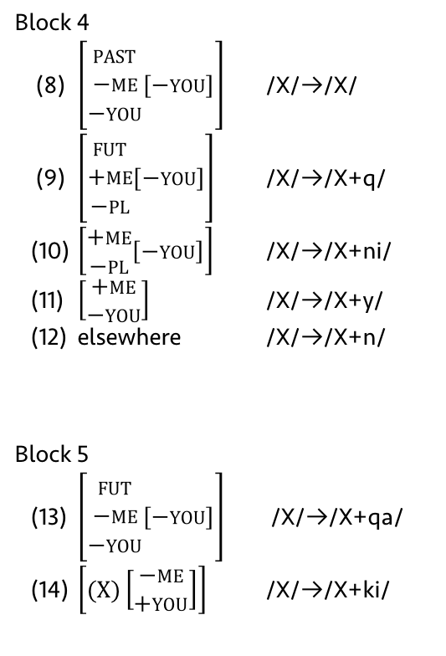
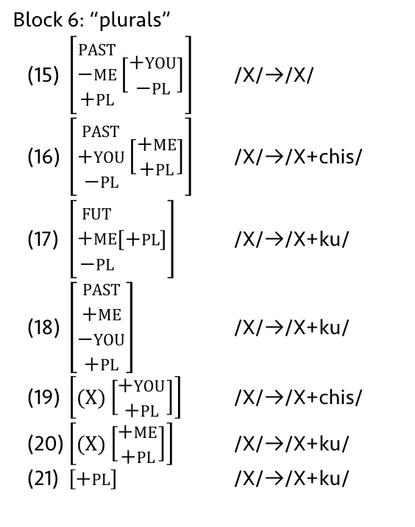
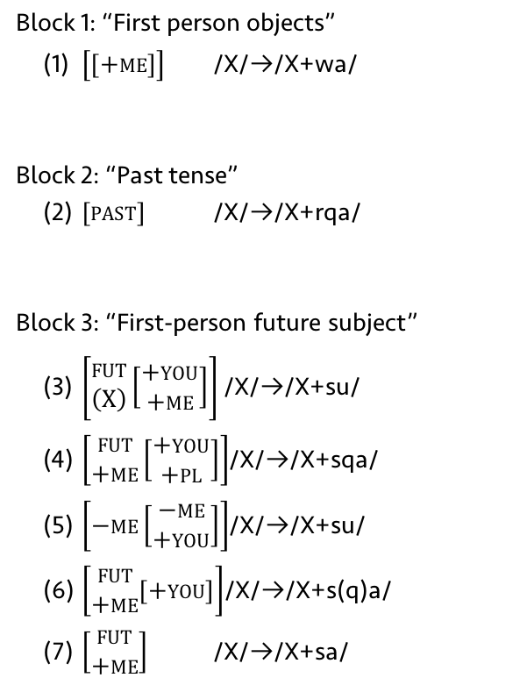
EWP Rules
Block 1: “First person objects”
(1) $\left[\left[+me\right]\right]$ /X/→/X+wa/
Block 2: “Past tense”
(2) $\left[past\right]$ /X/→/X+rqa/
Block 3: “First-person future subject”
(3) $\left[\begin{aligned}fut \\ \left(X\right)\end{aligned}\left[\begin{aligned}+you \\ +me\end{aligned}\right]\right]$ /X/→/X+su/
(4) $\left[\begin{aligned}fut \\ +me\end{aligned}\left[\begin{aligned}+you \\ +pl\end{aligned}\right]\right]$/X/→/X+sqa/
(5) $\left[−me\left[\begin{aligned}−me \\ +you\end{aligned}\right]\right]$/X/→/X+su/
(6) $\left[\begin{aligned}fut \\ +me\end{aligned}\left[+you\right]\right]$/X/→/X+s(q)a/
(7) $\left[\begin{aligned}fut \\ +me\end{aligned}\right]$ /X/→/X+sa/
Block 4
(8) $\left[\begin{aligned}past \\ −me \\ −you\end{aligned}\left[−you\right]\right]$ /X/→/X/
(9) $\left[\begin{aligned}fut \\ +me \\ −pl\end{aligned}\left[−you\right]\right]$ /X/→/X+q/
(10) $\left[\begin{aligned}+me \\ −pl\end{aligned}\left[−you\right]\right]$ /X/→/X+ni/
(11) $\left[\begin{aligned}+me \\ −you\end{aligned}\right]$ /X/→/X+y/
(12) elsewhere /X/→/X+n/
Block 5
(13) $\left[\begin{aligned}fut \\ −me \\ −you\end{aligned}\left[−you\right]\right]$ /X/→/X+qa/
(14) $\left[(X)\left[\begin{aligned}−me \\ +you\end{aligned}\right]\right]$ /X/→/X+ki/
Block 6: “plurals”
(15) $\left[\begin{aligned}past \\ −me \\ +pl\end{aligned}\left[\begin{aligned}+you \\ −pl\end{aligned}\right]\right]$ /X/→/X/
(16) $\left[\begin{aligned}past \\ +you \\ −pl\end{aligned}\left[\begin{aligned}+me \\ +pl\end{aligned}\right]\right]$ /X/→/X+chis/
(17) $\left[\begin{aligned}fut \\ +me \\ −pl\end{aligned}\left[+pl\right]\right]$ /X/→/X+ku/
(18) $\left[\begin{aligned}past \\ +me \\ −you \\ +pl\end{aligned}\right]$ /X/→/X+ku/
(19) $\left[(X)\left[\begin{aligned}+you \\ +pl\end{aligned}\right]\right]$ /X/→/X+chis/
(20) $\left[(X)\left[\begin{aligned}+me \\ +pl\end{aligned}\right]\right]$ /X/→/X+ku/
(21) $\left[+pl\right]$ /X/→/X+ku/
12

Slide 24
DM Vocabulary Items
(1) | [+pl.acc] | → Ø / | [–me.nom –me.acc –you.acc]
(2) | [+pl.acc] | → Ø / | [–me.nom –you.acc +pl.nom]
(3) | [+pl.acc] | → Ø / | [–me.acc –you.acc –fut]
(4) | [+ fut] | → Ø / | [–me.nom +you.nom]
(5) | [+pl.acc] | → Ø / | [–me.nom +you.nom +pl.nom –past]
(6) | [+pl.nom] | → Ø / | [–me.nom –you.nom +you.acc +past]
(7) | [+pl.acc] | → Ø / | [–me.nom +you.nom +pl.nom +past]
(8) | [+pl.nom] | → Ø / | [–me.nom +me.acc –you.nom +pl.acc]
(9) | [+fut] | → Ø / | [–me.nom –me.acc –you.nom +you.acc]
(10) | [+pl.acc] | → Ø / | [+me.nom +pl.nom +past]
(11) | [+pl.nom] | → Ø / | [+me.nom +pl.acc –past –fut]
(9) | +me.nom –you.acc –pl.nom (–you.nom) | ⟷ | –q
(10) | +pl.nom (+me.nom +you.nom) | ⟷ | –Ø
(11) | (+me.acc) | ⟷ | –wa
(12) | +past | ⟷ | –rqa
(13) | +me.nom –you.nom –you.acc –pl.nom | ⟷ | –ni
(14) | +me.nom –you.nom | ⟷ | –y
(15) | +me.nom | ⟷ | –n
(16) | –me.nom –you.nom –you.acc –pl.nom (+past) | ⟷ | –Ø
(17) | –me.nom –me.acc +you.acc | ⟷ | –sunki
(18) | –me.nom +you.acc +fut | ⟷ | –sun
(19) | –me.nom +you.acc | ⟷ | –n
(20) | –me.nom +you.nom | ⟷ | –nki
(21) | +you.acc (+me.nom) | ⟷ | –ki
(22) | –me.nom –you.nom –past +fut | ⟷ | –nqa
(23) | –me.nom –you.nom –past | ⟷ | –n
(24) | +pl.acc +pl.acc (+you.acc) | ⟷ | –chis
(25) | +pl.acc (+you.acc) | ⟷ | –chis
(26) | +pl.acc | ⟷ | –ku
(27) | +pl.nom (+you.nom) | ⟷ | –chis
(28) | +you.nom +pl.nom | ⟷ | –chis
(29) | +pl.nom | ⟷ | –ku
(1) | +me.acc +you.nom –pl.nom +pl.acc +past | ⟷ | –warqankichis
(2) | +me.nom –you.nom +you.acc –pl.nom +pl.acc +fut | ⟷ | –sqaykiku
(3) | +me.nom –you.nom +you.acc +pl.acc +fut | ⟷ | –sqaykichis
(4) | +me.nom –you.nom +you.acc +pl.nom +fut | ⟷ | –sqaykiku
(5) | +me.nom –you.nom +you.acc +fut | ⟷ | –sqayki
(6) | +me.nom –you.nom +pl.nom +fut | ⟷ | –sayku
(7) | +me.nom –you.nom +fut | ⟷ | –sa
(8) | +me.nom +fut | ⟷ | –sun
12

Slide 25
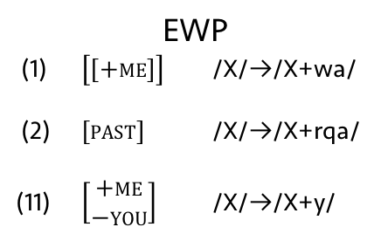
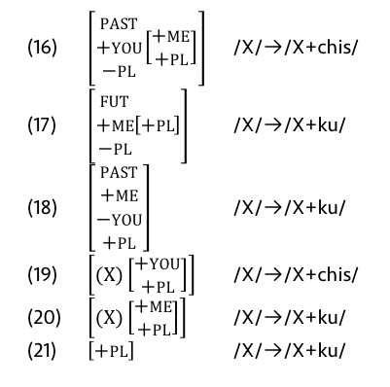
Comparison
Lots of overlap in the rules.
EWP
(1) $\left[\left[+me\right]\right]$ /X/→/X+wa/
(2) $\left[past\right]$ /X/→/X+rqa/
(11) $\left[\begin{aligned}+me \\ −you\end{aligned}\right]$ /X/→/X+y/
DM
(11) (+me.acc) ⟷ –wa
(12) +past ⟷ –rqa
(14) +me.nom –you.nom ⟷ –y
past present future | 1sg obj | 1pl.excl obj | 1pl.incl obj | 2sg obj | 2pl obj | 3sg obj | 3pl obj
1sg subj |  |  |  | rqayki | rqaykichis | rqani | rqani
 |  |  |  | yki | ykichis | ni | ni
 |  |  |  | s(q)ayki | sqaykiku | saq | saqku
1pl.excl subj |  |  |  | rqaykiku | rqaykiku | rqayku | rqayku
 |  |  |  | ykiku | ykichis | yku | yku
 |  |  |  | s(q)aykiku | sqaykichis | sayku | sayku
1pl.incl subj |  |  |  |  |  | rqanchis | rqanchis
 |  |  |  |  |  | nchis | nchis
 |  |  |  |  |  | sunchis | sunchis
2sg subj | warqanki | warqankichis |  |  |  | rqanki | rqanki
 | wanki | wankiku |  |  |  | nki | nki
 | wanki | wankiku |  |  |  | nki | nki
2pl subj | warqankichis | warqankichis |  |  |  | rqankichis | rqankichis
 | wankichis | wankichis |  |  |  | nkichis | nkichis
 | wankichis | wankichis |  |  |  | nkichis | nkichis
3sg subj | warqa | warqaku | warqanchis | rqasunki | rqasunkichis | rqa | rqa
 | wan | wanku | wanchis | sunki | sunkichis | n | n
 | wanqa | wanqaku | wasunchis | sunki | sunkichis | nqa | nqa
3pl subj | warqaku | warqaku | warqanchis | rqasunki | rqasunkichis | rqaku | rqaku
 | wanku | wanku | wanchis | sunkiku | sunkichis | nku | nku
 | wanqaku | wanqaku | wasunchis | sunkiku | sunkichis | nqaku | nqaku
Several are needed for –ku and –chis
(16) $\left[\begin{aligned}past \\ +you \\ −pl\end{aligned}\left[\begin{aligned}+me \\ +pl\end{aligned}\right]\right]$ /X/→/X+chis/
(17) $\left[\begin{aligned}fut \\ +me \\ −pl\end{aligned}\left[+pl\right]\right]$ /X/→/X+ku/
(18) $\left[\begin{aligned}past \\ +me \\ −you \\ +pl\end{aligned}\right]$ /X/→/X+ku/
(19) $\left[(X)\left[\begin{aligned}+you \\ +pl\end{aligned}\right]\right]$ /X/→/X+chis/
(20) $\left[(X)\left[\begin{aligned}+me \\ +pl\end{aligned}\right]\right]$ /X/→/X+ku/
(21) $\left[+pl\right]$ /X/→/X+ku/
(24) | +pl.acc +pl.acc (+you.acc) | ⟷ | –chis
(25) | +pl.acc (+you.acc) | ⟷ | –chis
(26) | +pl.acc | ⟷ | –ku
(27) | +pl.nom (+you.nom) | ⟷ | –chis
(28) | +you.nom +pl.nom | ⟷ | –chis
(29) | +pl.nom | ⟷ | –ku
13

Slide 26
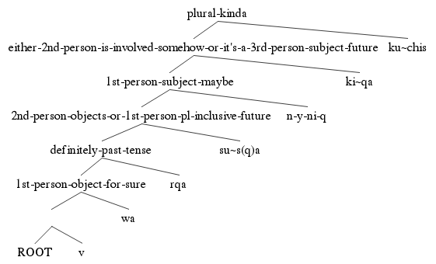
Strengths of Each Model
DM nicely accounts for most of the syncretism
EWP accounts for the fixed order of the morphemes
(I know DM has a way of handling this, but I haven’t been able to work it in yet.)
past present future | 1sg obj | 1pl.excl obj | 1pl.incl obj | 2sg obj | 2pl obj | 3sg obj | 3pl obj
1sg subj |  |  |  | rqayki | rqaykichis | rqani | rqani
 |  |  |  | yki | ykichis | ni | ni
 |  |  |  | s(q)ayki | sqaykiku | saq | saqku
1pl.excl subj |  |  |  | rqaykiku | rqaykiku | rqayku | rqayku
 |  |  |  | ykiku | ykichis | yku | yku
 |  |  |  | s(q)aykiku | sqaykichis | sayku | sayku
1pl.incl subj |  |  |  |  |  | rqanchis | rqanchis
 |  |  |  |  |  | nchis | nchis
 |  |  |  |  |  | sunchis | sunchis
2sg subj | warqanki | warqankichis |  |  |  | rqanki | rqanki
 | wanki | wankiku |  |  |  | nki | nki
 | wanki | wankiku |  |  |  | nki | nki
2pl subj | warqankichis | warqankichis |  |  |  | rqankichis | rqankichis
 | wankichis | wankichis |  |  |  | nkichis | nkichis
 | wankichis | wankichis |  |  |  | nkichis | nkichis
3sg subj | warqa | warqaku | warqanchis | rqasunki | rqasunkichis | rqa | rqa
 | wan | wanku | wanchis | sunki | sunkichis | n | n
 | wanqa | wanqaku | wasunchis | sunki | sunkichis | nqa | nqa
3pl subj | warqaku | warqaku | warqanchis | rqasunki | rqasunkichis | rqaku | rqaku
 | wanku | wanku | wanchis | sunkiku | sunkichis | nku | nku
 | wanqaku | wanqaku | wasunchis | sunkiku | sunkichis | nqaku | nqaku
14
Notes:
Superior is mispelled.
black boxes instead of red

Slide 27
Conclusion
Occum’s razor cuts out DM
EWP can account for the limit of five suffixes on a single verb
EWP captures what regularity that is there
Ordering is not resolved adequately in DM
Bottom line: the EWP model is superior.
15

Slide 28
References
Anderson, Stephen R. 1982. Where’s morphology? Linguistic inquiry 13(4). 571–612.
Anderson, Stephen R. 1992. A-Morphous morphology. (Cambridge Studies in Linguistics 62). Cambridge: Cambridge University Press.
Bateman, Bethany. Personal communication. September 12, 2016.
Collado, Martin Castillo Willkaruna. 2012. Qichwa Yachay Yanapaq Qillqa. Unpublished. Bolivia, ms.
Embick, David. 2015. The Morpheme: A theoretical introduction. (Interface Explorations 31). De Gruyter Mouton.
Glück, Susanne & Roland Pfau. 1999. A Distributed Morphology account of verbal inflection in German Sign Language. Proceedings of ConSOLE, vol. 7, 65–80.
Halle, Morris & Alec Marantz. 1993. Distributed morphology and the pieces of inflection. In K. Hale & S. Keyser (eds.), The View from Building 20: Essays in Linguistics in Honor of Sylvian Bromberger, 111–176. Cambridge: MIT Press.
Harley, Heidi & Rolf Noyer. 1999. Distributed morphology. Glot international 4(4). 3–9.
Howard, Rosaleen. 2014. Kawsay Vida: A Multimedia Quechua Course for Beginners and Beyond. (Recovering Languages and Literacies of the Americas). Austin: University of Texas Press.
Kerke, Simon van de. 1996. Agreement in Quechua: evidence against Distributed Morphology. In Crit Cremers & Marcel den Dikken (eds.), Linguistics in the Netherlands 1996, 121–131. (AVI Publications 13). John Benjamins Publishing Company.
Lakämper, Renate & Dieter Wunderlich. 1998. Person marking in Quechua—A constraint-based minimalist analysis. Lingua 105(3). 113–148.
Langston, Keith. 2016. Stephen Anderson’s “A-Morphous Morphology”/Extended Word-and-Paradigm (EWP) theory. Handout for LING 8120 at the University of Georgia.
Lewis, M. Paul, Gary F. Simons & Charles D. Fennig (eds.). 2016. Ethnologue: Languages of the World. 19th ed. Dallas, Texas: SIL International. Online version: http://www.ethnologue.com (3 May, 2016).
Muysken, Pieter. 1988. Affix order and interpretation: Quechua. Morphology and modularity. 259–279.
Noyer, Rolf. 1997. Features, positions and affixes in autonomous morphological structure. New York: Garland.
Nuckolls, Janis B. 2008. Deictic Selves and Others in Pastaza Quichua Evidential Usage. Anthropological Linguistics 50(1). 67–89.
Pearce, Adrian J. & Paul Heggarty. 2011. “Mining the Data” on the Huancayo-Huancavelica Quechua Frontier. In Paul Heggarty & Adrian J. Pearce (eds.), History and Language in the Andes, 87–109. (Studies of the Americas). Palgrave Macmillan US.
Spencer, Andrew. 1991. Morphological Theory: An Introduction to Word Structure in Generative Grammar. 1st ed. (Blackwell Textbooks in Linguistics). Oxford: Basil Blackwell.
Swanson, Tod. 2011. Napo Runa Shimi: Introduction to the Kichwa Language of the Napo Headwaters. Unpublished. Tena, Ecuador, ms.
Thomas-Flinders, Tracy Georgia. 1981. Inflectional morphology: Introduction to the extended word-and-paradigm theory. UCLA Publications.
Wonderly, William L. 1952. Semantic Components in Kechua Person Morphemes. Language 28(3). 366–376. doi:10.2307/410107.
Yokoyama, Masako. 1951. Outline of Kechua Structure I: Morphology. Language 27(1). 38–67. doi:10.2307/410250.
Zariqueiey, Roberto & Gavina Córdova. 2008. Qayna, Kunan, Paqarin: Una introducción práctica al quechua chanca. San Miguel, Peru: Estudios Generales Letras - Pontificia Universidad Católica del Peru.
16

Slide 29
Special thanks to Keith Langston and Bethany Bateman for
help with theories, data, and feedback.

