Slide 1
How sample size impacts Pillai Scores
(and what sociophoneticians should do about it)
Joseph A. Stanley
Brigham Young University
@joey_stan
Betsy Sneller
Michigan State University
@betsysneller
New Ways of Analyzing Variation 50
San Jose, California
October 14, 2022
See our paper (under review with in JASA) for more details and code.

Slide 2
Pillai scores in Sociolinguistics
A way to quantify overlap in multiple dimensions (e.g., F1, F2, duration) (Hay et al., 2006; Nycz & Hall-Lew 2013)​
Some concern about unequal vowel categories sizes (Johnson 2015; convo on Twitter June 2, 2021)​
Our solution: a big simulation to show exactly what impact sample size has on Pillai scores​
See our paper (under review with in JASA) for more details and code.
Notes:
Vowel mergers are well-studied and play an important part of sociophonetic research. One way to quantify merger is to measure their overlap in the F1-F2 space, which, thanks to Hay et al (2006), is most commonly done with Pillai scores. In this animation you can see how much overlap is required to yield various Pillai scores. 0 suggests complete overlap and 1 suggest complete separation.
However, recently there has been some concern over Pillai scores, such as how to interpret the values and whether the two groups being measured have to have the same number of tokens for the Pillai score to be valid. In this study, we address some of these concerns head-on by running some simulations and seeing how sample size affects Pillai scores.

Slide 3
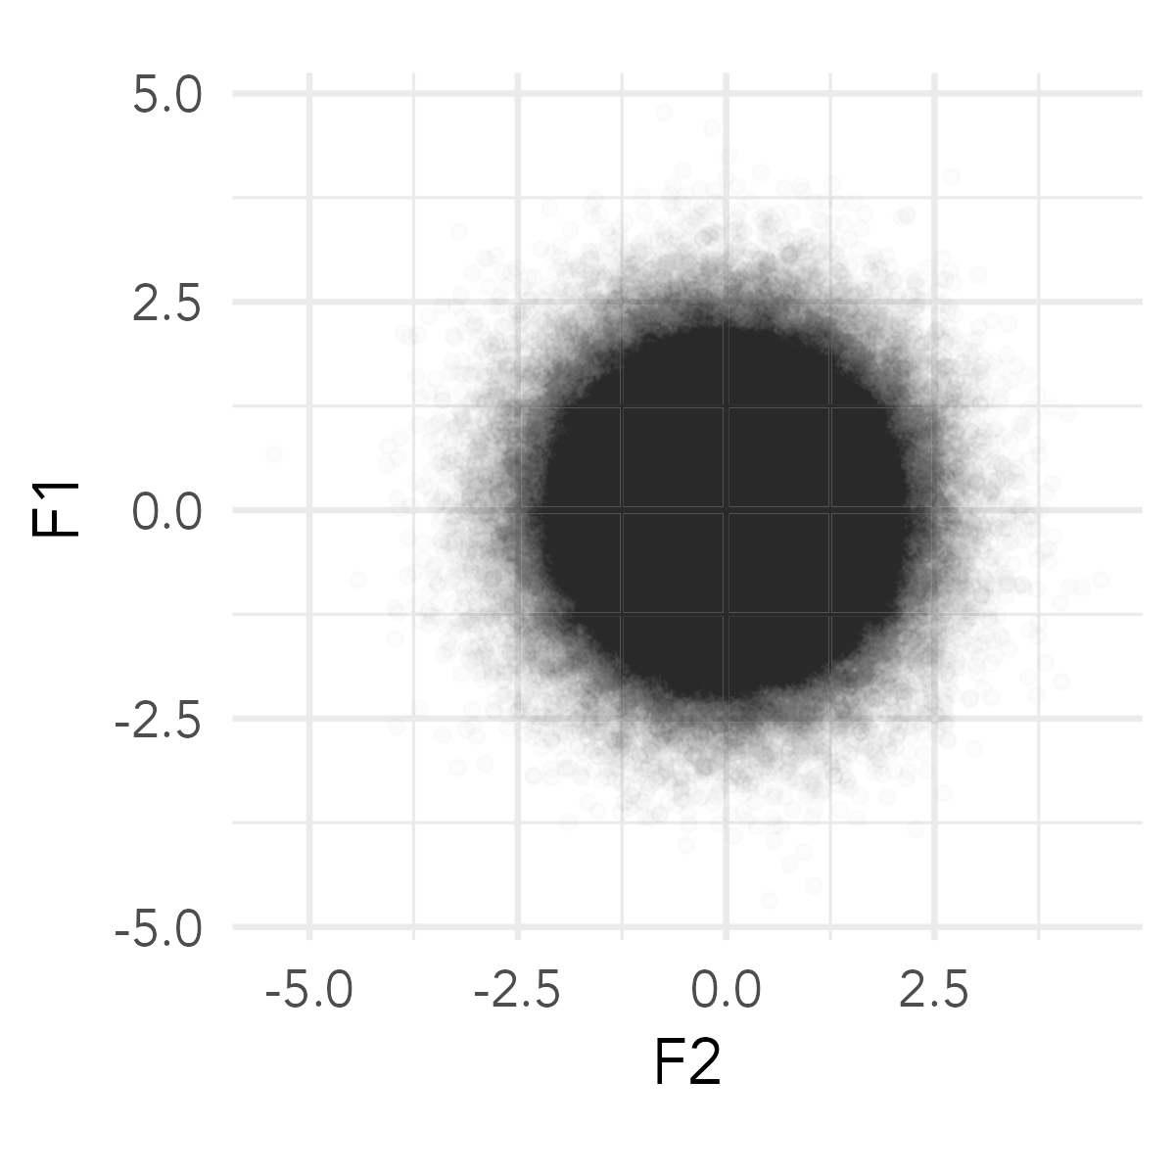
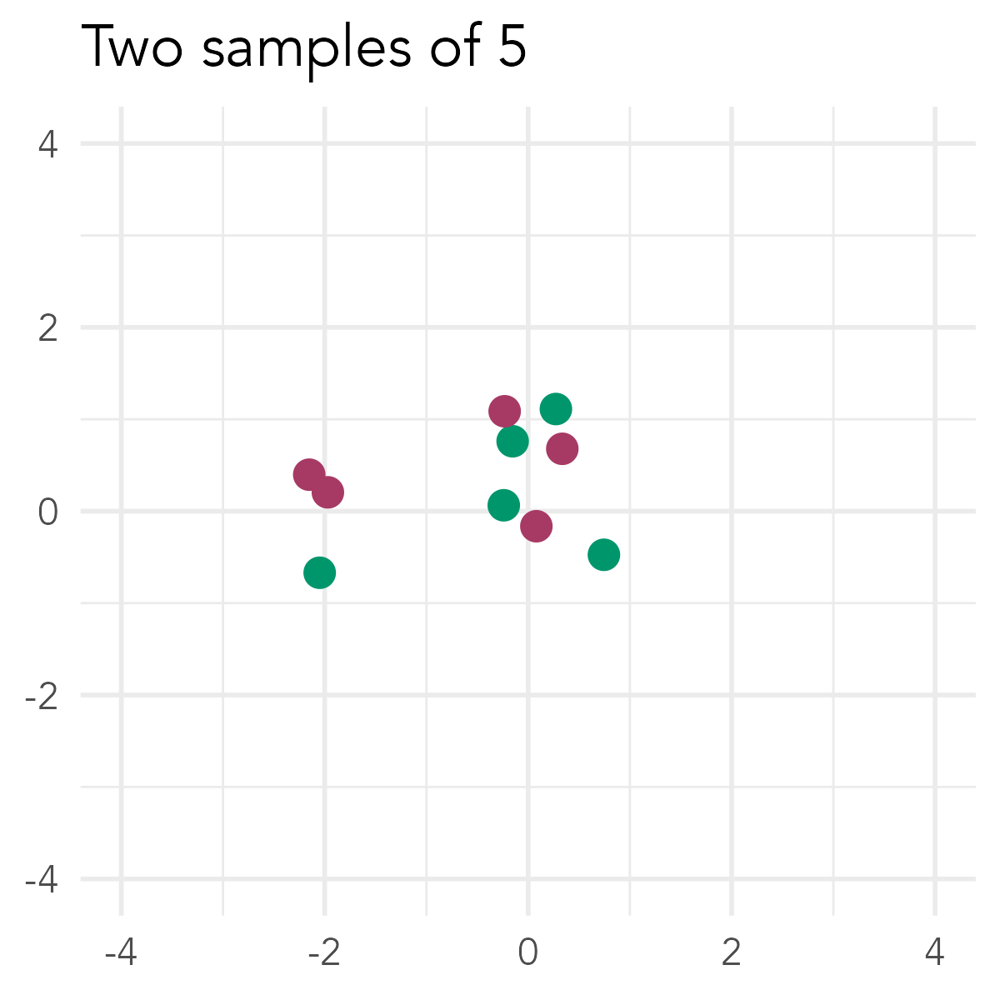
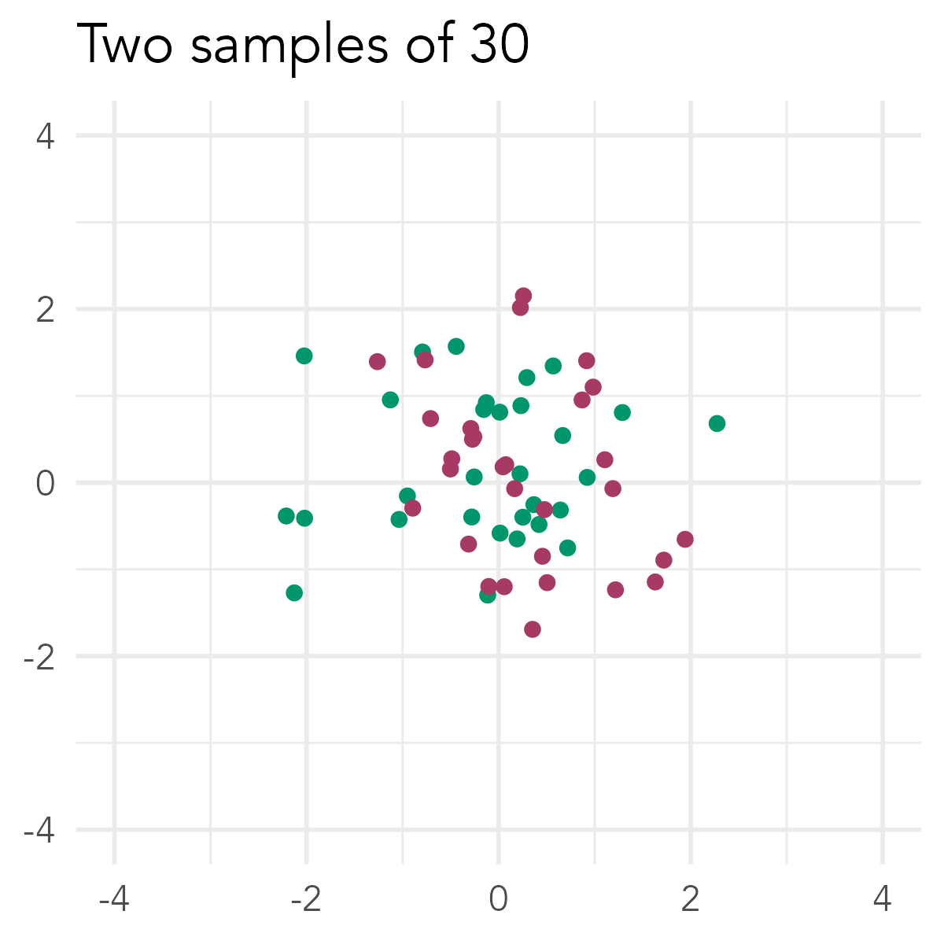
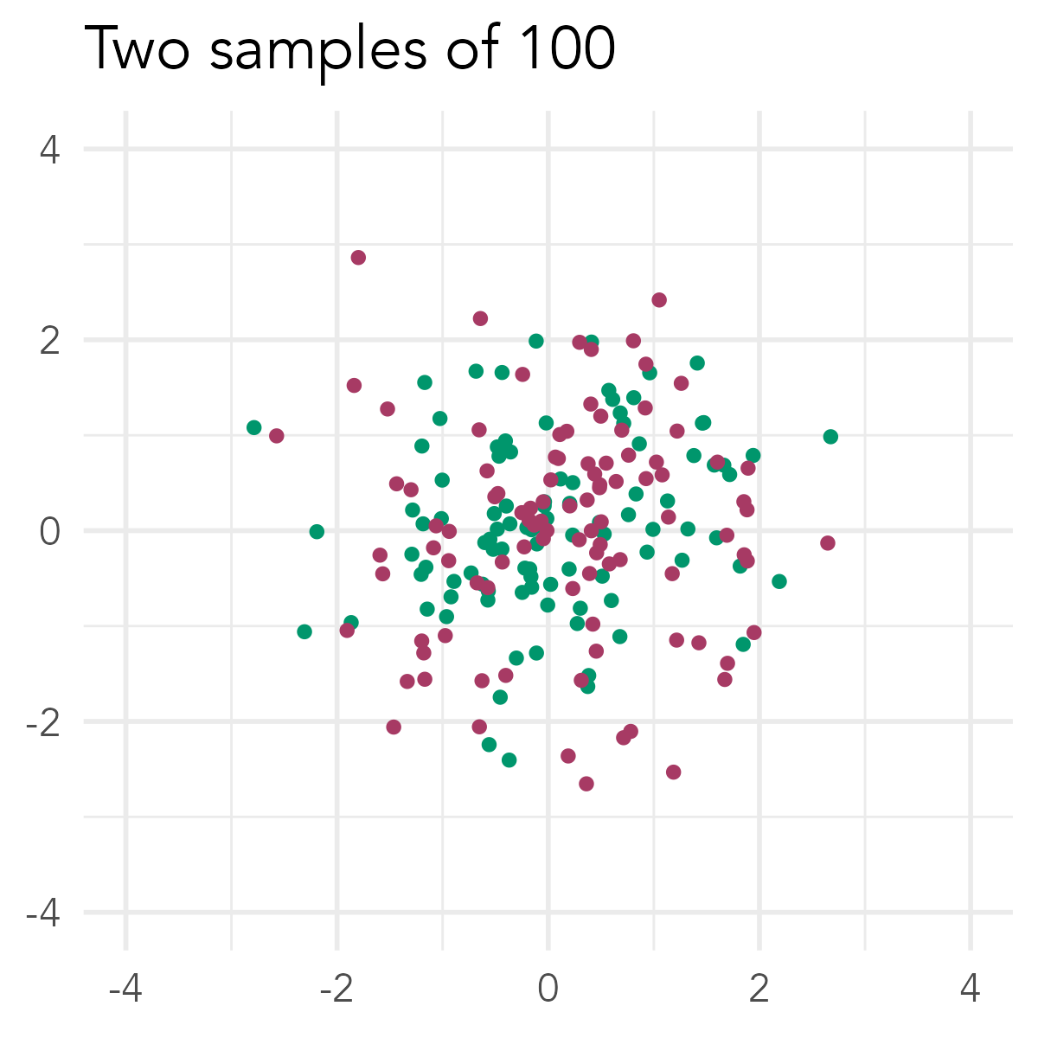
The Simulation
Start with a single bivariate normal distribution ▶︎
Sample two “vowel classes” from this distribution.​ ▼
Ground Truth is they’re merged.
Calculate the Pillai score
Should be close to 0 because they’re merged!
Repeat many, many times
See our paper (under review with in JASA) for more details and code.
Notes:
The simulation was straightforward. [*] We started off with a bivariate normal distribution, visualized here with this black cluster of points. [*] What we then did was draw from that distribution some number of times and call that sample a vowel class. We then drew from the exact same distribution a second time and called that sample a second vowel class. Now, we know that these two simulated vowel distributions are underlyingly merged because we sampled from the distribution twice. [*] So, when we measure the Pillai score of them, it should be pretty low—something close to zero.
[*] We repeated this simulation many, many times for many different sample sizes. We created two distributions of five vowels, two distributions of 6 vowels, all the way up to two distributions of 100 vowels. We did this 1000 times for each sample size. And for each one we measured the Pillai score.

Slide 4
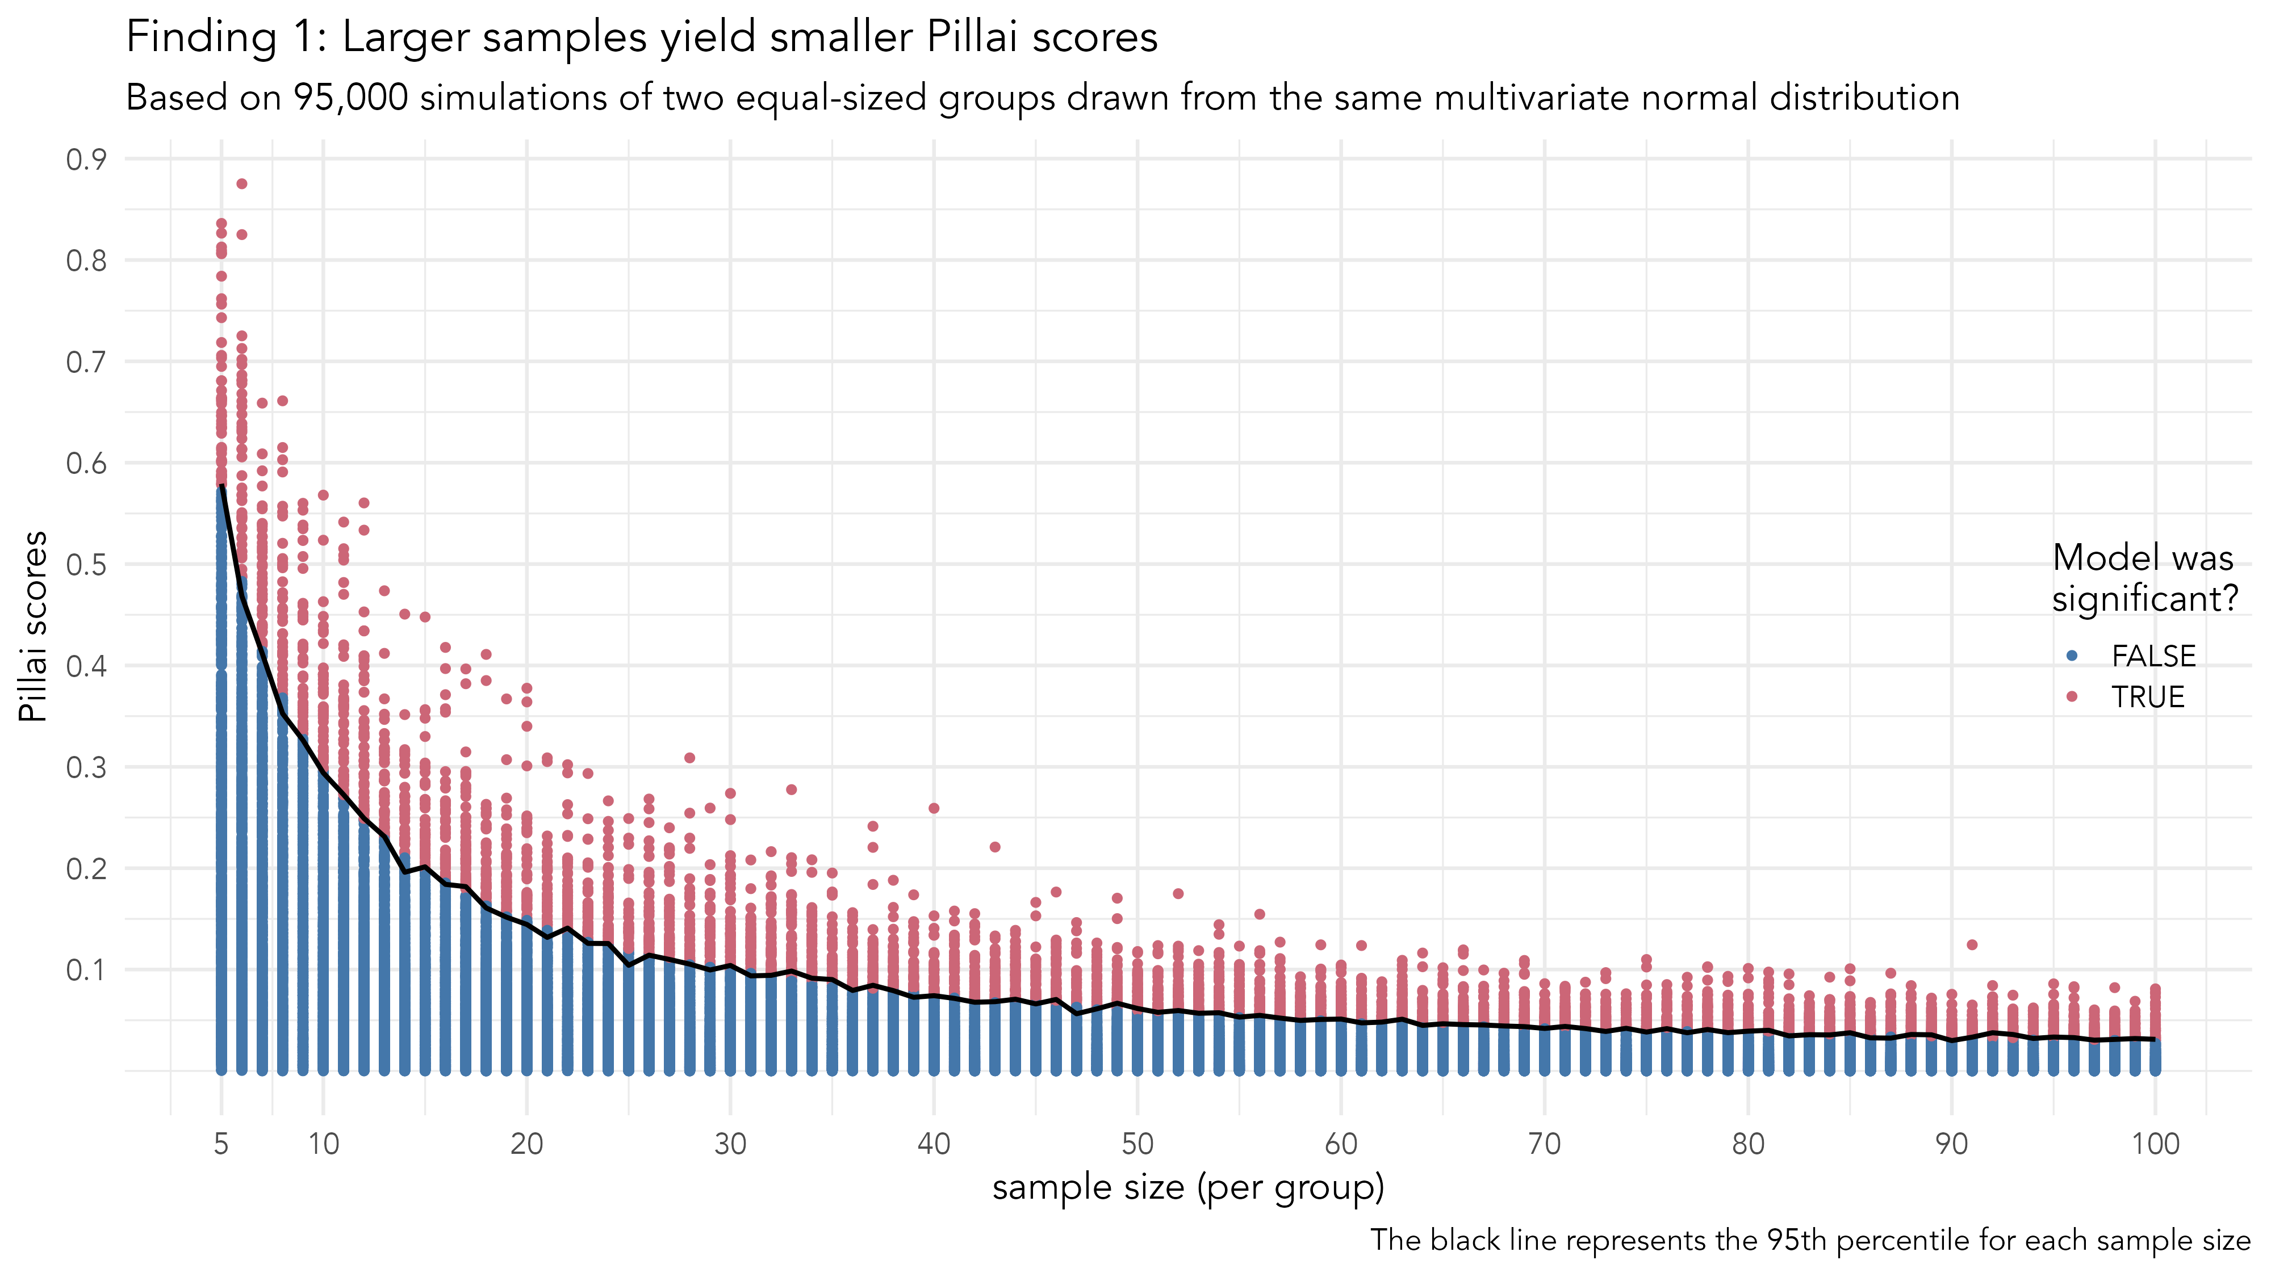
Notes:
The result of this simulation looks like this. Here is a plot of the distribution of all the Pillai scores we got. Blue dots represent simulations where the p-value that accompanied the Pillai score was large, suggesting no significant difference between the vowel classes. Red are ones where the p-value was small, suggesting a statistically significant difference at the p < 0.05 level. The black line follows the 95th percentile for each sample size, which, as expected, divides the significant tests from the nonsignificant tests
What we see is that with small sample sizes, like five or ten vowels in each group, we get pretty large Pillai scores, sometimes closer to 1 than 0, which suggests separation rather than merger. The larger the sample was, the smaller the Pillai scores were.

Slide 5
It takes kind of a lot of data to reliably get small Pillai scores! (i.e. 95% of the time)
Notes:
In fact, it takes about 30 vowels per group to reliably get a small Pillai score. By “reliably” here, I mean that 95% of the time, you can expect a Pillai score smaller than 0.1 for underlyingly merged data. Now, remember that the Ground Truth is that the distributions are underlyingly merged. So, while it’s not a surprise that 5% of the simulations returned false positives, it is surprising to see that underlyingly merged data so often produces large Pillai scores that some people may interpret as indicating separation.

Slide 6
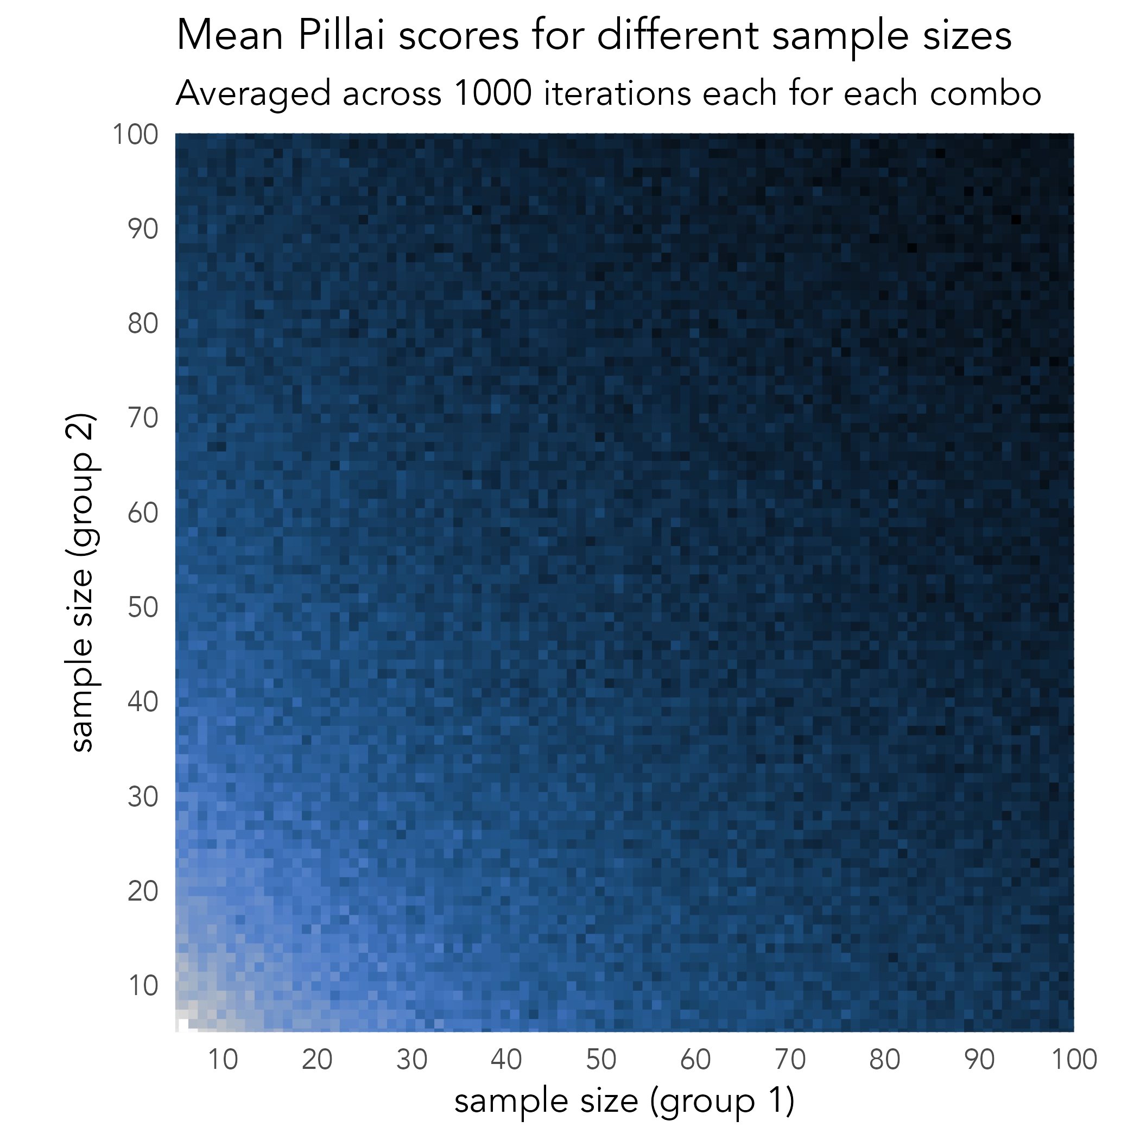
Unequal Groups?
Sample unequally for each group.
Each combo of 5–100 tokens per group, repeat 1000 times.
Surprising results: unequal sample size doesn’t matter! ▶︎
So, what we should consider is total sample size across both vowels​
Good news for us!
See our paper (under review with in JASA) for more details and code.
Notes:
So what about unequal sample sizes? We simulated that too by sampling different-sized groups ranging anywhere from 5 to 100 tokens. [*] This plot shows the results of this experiment, with each cell representing the average Pillai score across 1000 simulations per sample size combination.
[*] Much to our surprise, unequal sample sizes return the same Pillai scores as equal samples, as long as the total token count is the same. [*] The way we see this is by looking at diagonal bands across the plot. The fact that all the cells inside this band are roughly the same color means they yield roughly the same Pillai score. So if you have a sample of around 100 total tokens across both vowels, as represented by this line here, you’re likely to get a Pillai score around 0.02, regardless of whether that’s two equal sized groups or 95 tokens of one group and five of another.
[*] So, what really matters with Pillai scores is the total sample size, not the size of each group. This is good news for all of us because people usually don’t say the same number of LOT and THOUGHT vowels in a given interview. It means we don’t need to worry about having equally sized groups: just collect as much data as you can from either group.

Slide 7
Notes:
So, that’s what we found. Now, with this new knowledge, we need to be cautious about a few things.

Slide 8

Warning 1: Don’t use the same threshold for all speakers
Total sample size | Threshold
10 | 0.5437
15 | 0.3624
20 | 0.2718
25 | 0.2175
30 | 0.1812
40 | 0.1359
50 | 0.1087
60 | 0.0906
70 | 0.0777
80 | 0.0680
90 | 0.0604
100 | 0.0543
200 | 0.0272
500 | 0.0109
The threshold for “I’m sure this is merged” should be based on sample size.​
Great news! We’ve got an equation for you:
threshold = $\frac{2e}{n}$
Or you can just use this table ▶︎
R code: 2*exp(1)/n
total sample size
See our paper (under review with in JASA) for more details and code.
Notes:
First, we now know that it’s nonsensical to use the same threshold for all speakers in your corpus. I feel like I’ve seen studies that consider people merged if their Pillai score is less than 0.1 or something. But sample size matters and you likely have different amounts of data for each person, so a single threshold isn’t going to work.
[*] Fortunately, we’ve come up with a formula for you to use! This formula models the 95th percentile of Pillai scores, given a particular sample size. [*] Essentially, it follows the black line we saw in that red and blue figure earlier. So, if you take this formula, 2e over your sample size, you’ll get a threshold ([*] here's some code you can use to implement this in R). If your data is underlyingly merged, then 95% of the time, you should get a number smaller than that. [*] Or, if math is scary, you can use this table to get an idea of what thresholds are for various sample sizes.
So, don’t use the same threshold for all speakers. Use this formula to get a speaker-specific threshold and compare their Pillai score to that.

Slide 9
Warning 2: Don’t compare to other studies
Only do so unless you know the sample size of the other study.
The solution: report everything to that future people can compare to yours
sample size
details of the MANOVA model
p-value from the MANOVA
Pillai score
Threshold from our formula
“Based on a MANOVA on 179 measurements of F1 and F2, with vowel as the only independent variable, Donna had a Pillai score of 0.0289 (lower than the threshold of 0.0304), with a p-value of 0.0756, so we consider her vowels merged.”
See our paper (under review with in JASA) for more details and code.
Notes:
The second thing to watch out for is that it’s now tricky to compare your Pillai scores to the ones reported in other studies. We’ve looked through lots of studies and very few of them actually report sample sizes. Which means we don’t quite know how to interpret the Pillai scores, because a Pillai score of 0.1 based on a sample of 15 is indicative of a merger, but on a sample of 100 is not.
The solution is that from here on out, we report much more than just Pillai scores. We should be reporting the sample size, the structure of the MANOVA model, the p-value from the MANOVA, the Pillai score, and if you want, the threshold derived from our formula. Here is an example of how we can report Pillai scores.

Slide 10
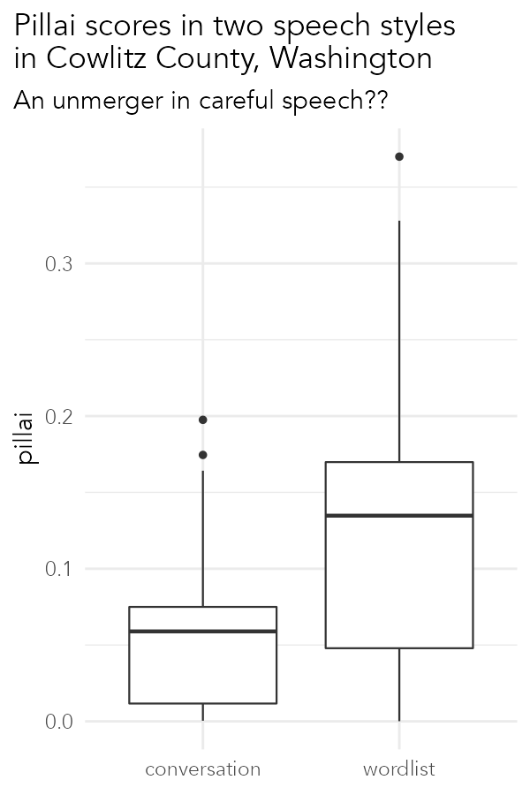
Warning 3: Careful comparing styles
If anything, a merger only in careful speech.
Wordlists often contain less data than conversations.
Likely to have a higher Pillai score
Do we see “unmergers” then?
Or is it just math?
Recommendations
Consider (and report) all stats
Calculate the threshold
Visualize the data
Mean n = 20 tokens
Threshold = 0.272
Mean n = 146 tokens
Threshold = 0.037
See our paper (under review with in JASA) for more details and code.
Notes:
The third thing to watch out for is that we need to be careful when comparing styles from the same speaker. Wordlists typically have less data than an hour of conversation and since we now know that Pillai scores are higher when there’s less data, we’re probably going to see a higher Pillai score in wordlists.
In fact, this is exactly what happened when I was analyzing some of my data, and was the inspiration for starting this study. [*] In this plot, you can see the distribution of 54 speakers’ Pillai scores of the low back vowels used in conversation, which are generally pretty low, and then the distribution of those same speakers’ low back vowels in a wordlist, which are much higher. Is this an unusual case of an unmerger happening in careful speech? Probably not, and here’s why.
On average, the number of low back vowels in the conversation data per speaker was 146 tokens. [*] Based on the formula we presented earlier, we can expect a Pillai score of 0.037 or less if the data were underlyingly merged. So, it looks like most people are actually above that threshold. [*] In the wordlists, there were only 20 tokens, which has a threshold of 0.272, and it turns out most are actually below that threshold. The purpose of today’s talk isn’t to analyze this data [*] but it actually looks like there is more a merger in the wordlist data.

Slide 11
Well, then what do we do?
See our paper (under review with in JASA) for more details and code.
Notes:
So, with this new knowledge and warnings, the question then is what we should do now.

Slide 12
Two basic approaches
Carefully determine a status (“merged” vs “distinct” vs “unclear”?) for each speaker in each style​
Pros: a clear understanding of each speaker’s data
Cons: Discretizing a gradient measure; difficult to analyze change in a speech community over (real and apparent) time
Normalize for sample size by including n in modeling or Monte Carlo simulations
Pros: track change over time in a speech community, as distinct categories may become phonetically closer before a true merger takes place​
Cons: can’t tell whether an individual speaker is phonologically merged​
(The approach you use should depend on which question you’re interested in.)
See our paper (under review with in JASA) for more details and code.
Notes:
We have two recommendations for you.
[*] Our first is that you manually classify each speaker in your corpus as merged, distinct (and maybe also unclear) separately for each style you want to analyze. This involves carefully considering all the output from the MANOVA, as well as the threshold. The benefit of this is that you get a clearer picture of each speaker and their data. The downside is that you’re turning a continuous variable into a discrete one, which may be more difficult to analyze.
[*] Our second recommendation is to normalize for the sample size. You can do this by simply including the sample size as a predictor in models on Pillai scores, but a more sophisticated way that we’ve discovered works well is iteratively downsampling your more talkative speakers’ data to the sample size of your least talkative speaker, and finding the mean Pillai score across many iterations. Due to time constraints, we can’t say more about that right now, but ask us in the Q&A. The benefits of either of these normalization techniques is that it’s easier to see Pillai scores changing over time. The downside is you lose some speaker-level information
Ultimately, choose the one that works best for you, your data, and your research question.

Slide 13
Final Takeaways
Sample size matters! But only total sample size (across both categories)​
Report sample size! And p-values! And everything else!
Use our threshold suggestion if trying to determine “merged” vs “distinct” for an individual speaker ​
Or our normalization suggestion if trying to track a change towards or away from a merger over real/apparent time​
See our paper (under review with in JASA) for more details and code.
Notes:
To conclude, we simply state that sample size matters in Pillai scores. So, report sample sizes, p-values, and everything else to make your results clearer and comparable to other studies. Use our formula to determine a threshold rather than coming up with ad hoc values. Or try one of our normalization techniques if you’re trying to track change over time.
If you have more questions, we have a forthcoming paper in JASA that explains all this in much more depth and we encourage you to take a look at that for more details on methods, results, takeaways, an extended case study, and code for how we did all this stuff.

Slide 14
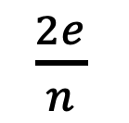
How sample size impacts Pillai Scores
(and what sociophoneticians should do about it)
Total sample size | Threshold
10 | 0.5437
15 | 0.3624
20 | 0.2718
25 | 0.2175
30 | 0.1812
40 | 0.1359
50 | 0.1087
60 | 0.0906
70 | 0.0777
80 | 0.0680
90 | 0.0604
100 | 0.0543
200 | 0.0272
500 | 0.0109
Joseph A. Stanley
Brigham Young University
@joey_stan
Betsy Sneller
Michigan State University
@betsysneller
Threshold formula ▶︎
$\frac{2e}{n}$
Template for reporting Pillai scores ▼
“Based on a MANOVA on 179 measurements of F1 and F2, with vowel as the only independent variable, Donna had a Pillai score of 0.0289 (lower than the threshold of 0.0304), with a p-value of 0.0756, so we consider her vowels merged.”
2*exp(1)/n
R code ▶︎
Thresholds at various sample sizes ▶︎
See our paper (under review with in JASA) for more details and code.

