Slide 1
Introduction to AP CS
[ 1.01 ] [ Today’s Date ] [ Instructor Name ]
Notes:
Things to go over in 1.01:
Why are you taking the class, why AP computer science?
Class expectations, syllabus, and icebreakers.
Setup Eclipse or jGrasp, explain class requirements, notebooks, etc.

Slide 2
Answer the following on paper:
What is your name and grade? What should I call you or what’s your preferred nickname?
Why are you taking this class?
Do you have any previous programming experience?
If so, what computer languages do you know?
What projects have you worked on?

Slide 3
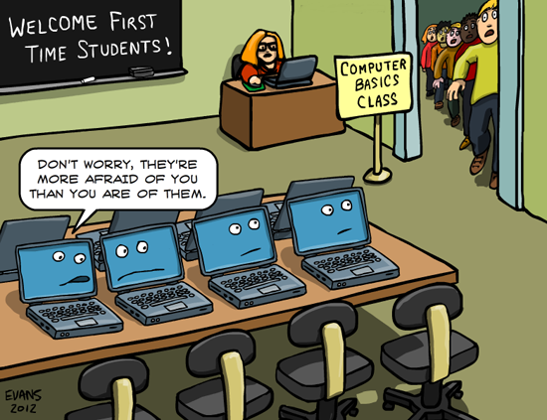
So why computer science?
Is computer science fun?
Are there jobs available?
Does it pay well?

Slide 4

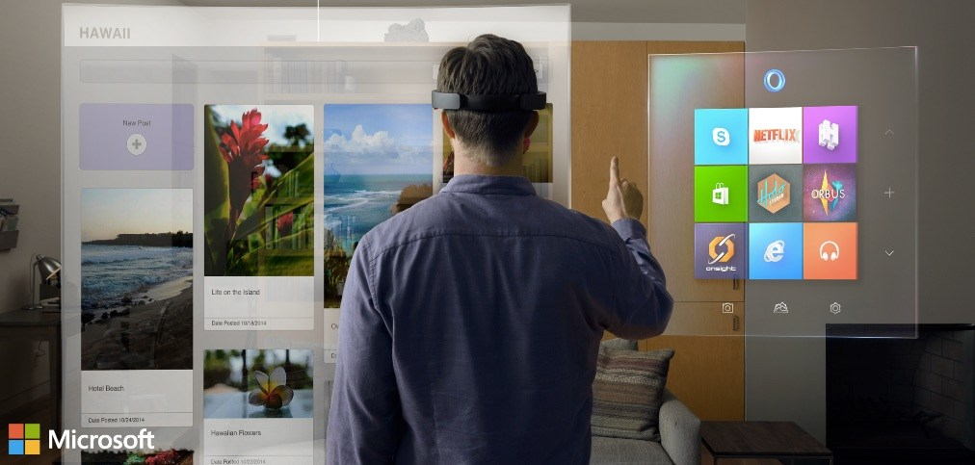
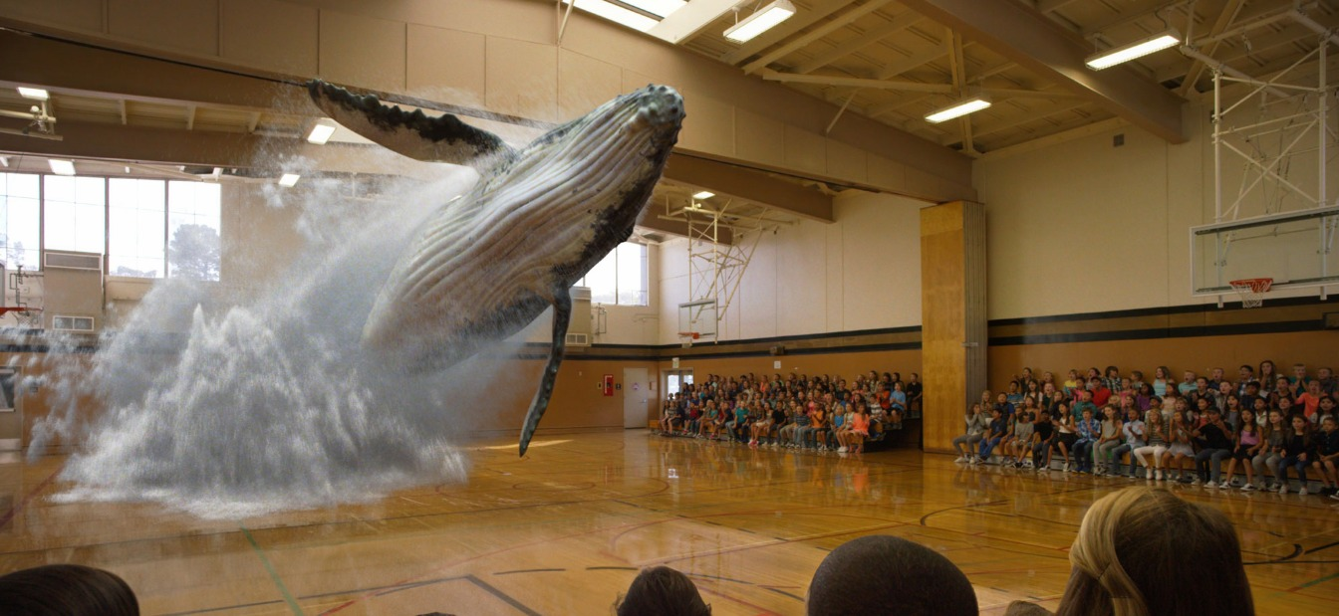
Is computer science fun?
Forbes Top 10 Job Satisfaction list
CS dominates

Slide 5
Are there jobs available?
YES!
2012 Bureau of Labor Statistics Article 2012 – 2022
Computer systems design and related services
3.2% year over year growth.
Ranks 5th overall
2014 Business Insider Article 12 Fast-Growing Jobs in 2014
Role | Rank
Software Developer | 1st
Web Developer | 6th
Database Administrator | 8th

Slide 6
Does it pay well?
Source: Link
Software Developer
Career | Mean Hourly | Mean Annual
Applications | $46.28 | $96.260
Systems | $50.23 | $104.480
National Average? | $22.27 | $46,295

Slide 7
This Class : AP Computer Science A
Equivalent to 1 semester of intro CS in college
You will be prepared for the AP CS A test
You will learn to program in Java using Eclipse
A real taste for software development

Slide 8
Why should you learn computer science?
Part of everything we do!
Enhances problem solving and computational thinking!
Future opportunities in computing are without boundaries

Slide 9
Classroom specific information (edit)
Get set up on eclipse
Explain the file turn in system specific to your class
Explain the plug/un-plug procedures
Instruct students on how take good notes
Notebooks will be graded

Slide 10
School specific information. (edit)
Hand out syllabus (possibly bring it home/get it signed for homework?)
Go over class expectations
What do they need to bring to class for tomorrow?
Icebreakers

Slide 11
Algorithms and Computational Thinking
[ 1.02 ] [ Today’s Date ] [ Instructor Name ]
Notes:
Things to go over in 1.02:
Peanut Butter and Jelly Activity
History
Coding without computers
Debugging
Some vocabulary and algorithms

Slide 12

The earliest computers:
Job description
Mostly women
Similarities
Brain
Information around us
Eyes, ears, nose, mouth, fingers/skin
Behaviors and actions.
Women as computers at the NACA High Speed Flight Station
Courtesy of Wikipedia

Slide 13
Algorithm
Program
“A process or set of rules to be followed in calculations or other problem solving operations”
“A list of instructions to be carried out by a computer”

Slide 14
Activity 1:
Peanut Butter and Jelly Sandwich

Slide 15
Activity 2:
Debugging the Peanut Butter and Jelly Sandwich

Slide 16
Discussion:
How did you debug your algorithm?

Slide 17
Homework
Read chapter 1 section 2 (1.2) for class tomorrow. (p.10-23)
Many of our class examples involve Pokémon; if you don’t know much about the game, we advise that you read up on your Pokéknowledge at http://www.pokemon.com
A lot of our examples also draw from the Pokemon games; if you want to up your knowledge on the game’s mechanics, rules, underlying formulae and characters visit http://bulbapedia.bubagarden.net

Slide 18
Strings and Console Output
[ 1.03 ] [ Today’s Date ] [ Instructor Name ]
Notes:
Things to go over in 1.03:
About JAVA
About Eclipse
First Program
Print vs Println
Escape Sequences
Strings
Little ASCII

Slide 19
Brief History of Java
Originally released in 1995 by Sun Microsystems (now part of Oracle)
Wrote programs for “embedded devices”, specifically TV’s
Turns out, this makes it ideal for writing programs for the internet

Slide 20
Key Characteristics of Java
Write-once, run anywhere
Automatic memory management
Object-oriented

Slide 21
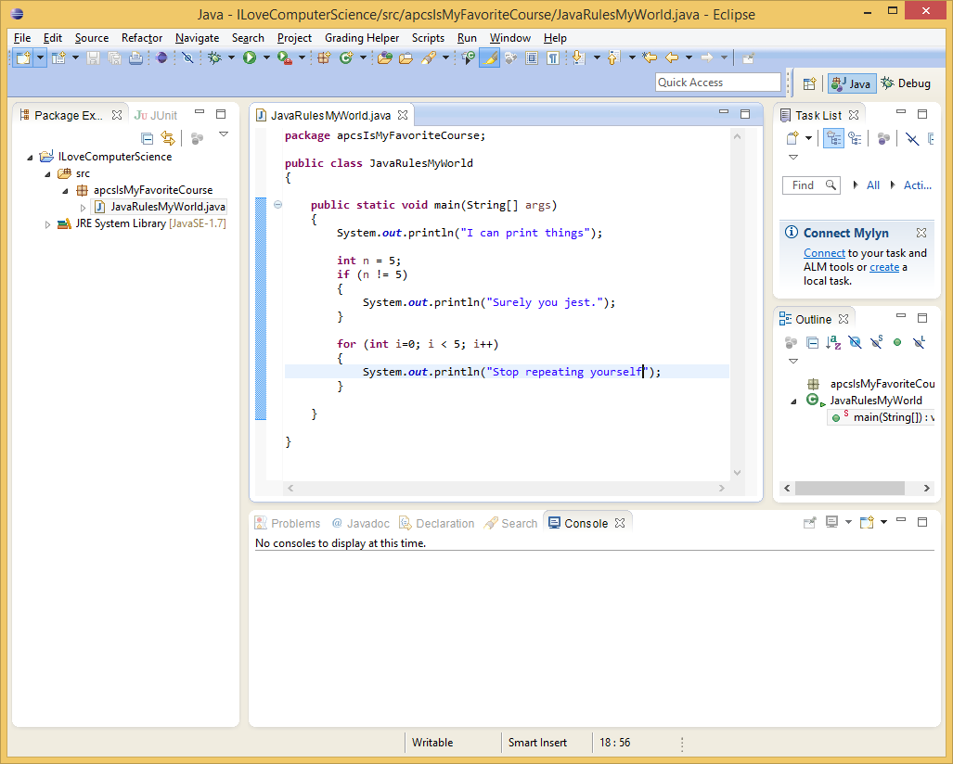
Eclipse:
Code
Window
Package
Explorer
Console
Window

Slide 22
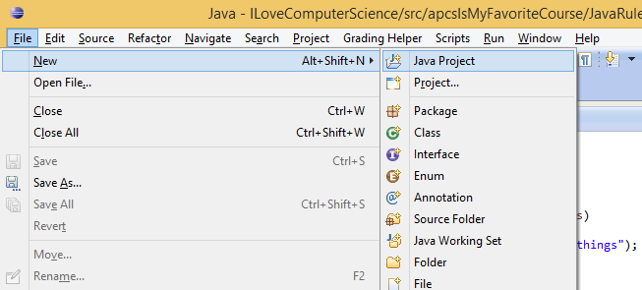
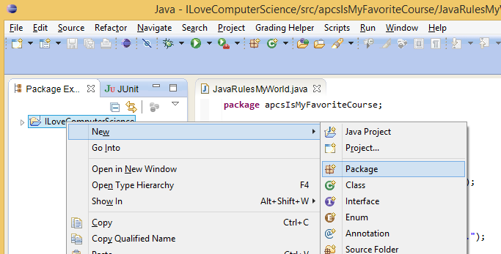
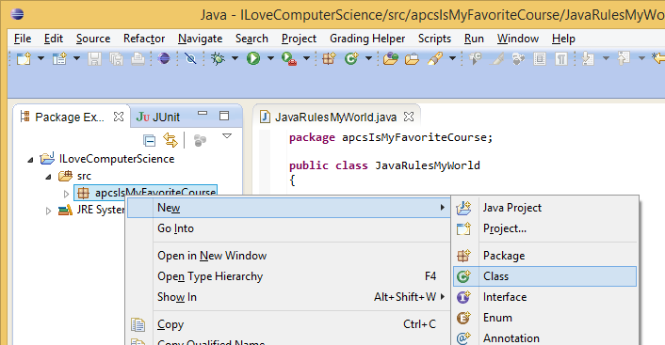
1) File, New, Java Project
(then fill out the dialog, give it a name, etc.)
2) Right-click, New, Package
(right-click on the java project.
then fill out the dialog, give it a name, etc.)
3) Right-click, New, Class
(right-click on the package.
then fill out the dialog, give it a name, etc.)

Slide 23
Your first program!
public static void main(String[] args){
System.out.println(“Hello World!”);
}
Put this inside the class’ curly braces { }
Don’t forget the semicolon ( ; ) after the statement!
Capital and lower case letters matter!
Parentheses, square brackets, and curly braces are different! ( ) { } [ ]

Slide 24
What is a string?
“Hello World”
A sequence of characters is called a string.
Strings in Java are enclosed in double-quotes.
Identify the string in System.out.println(“Hello World”);

Slide 25
println vs print
Replace: System.out.println(“”); with: System.out.print(“”);
What happened?
What do you think is different?

Slide 26
Escape Sequences
Why do you think we need escape sequences (or what are they!)?
\n – new line
\” – quotation mark
\t – tab
\\ – backslash
Why do we need this one?

Slide 27
Challenge: ASCII Pikachu
Write a program that outputs the following:
Pikachu welcomes you to the world of Pokemon!
(\__/)
(o^.^)
z(_(“)(“)

Slide 28
Homework
For homework tonight, read 1.3 in your textbook. (p.24-28)
Also, complete exercises 1 – 5 for chapter 1 (p.54-55)
Remember your syllabus if you haven’t turned it in already

Slide 29
Common Errors and Comments
[ 1.04 ] [ Today’s Date ] [ Instructor Name ]
Notes:
Things to go over in 1.04:
Common Errors (for what we know so far)
Types
Identifiers
Documentation
Style
Comments

Slide 30
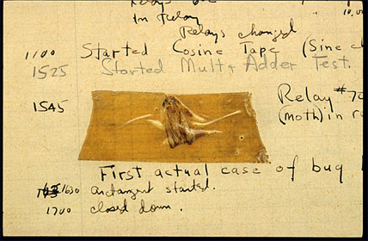
History of Bugs
Origin of (computer) bugs
September 9, 1947
Captain Grace Hopper

Slide 31
Logical Errors (bugs)
Buggy or poorly written programs
Types vary
We’ll see these in our println statement or method call

Slide 32
Syntax Errors
Bad grammar in Java
Syntax errors include misspelled words, forgotten semicolons, and missing words
E.g.:
System.out.pruntln(“”);, system.out.println(“”);,
public static main(String[] args) {

Slide 33
Runtime Errors
So severe that Java stops executing.
These errors occur when a bug causes your computer to be unable to continue executing.

Slide 34
Error-Checking Algorithm
Step 1: Check all code for spelling errors.
Step 2: Check all code for punctuation errors (curly brackets, brackets, parentheses, and semicolons).
Step 3: Check all code for syntax errors.
…
Try made a checklist, decision tree, or mind-map to plan out your error-checking process!

Slide 35
Checking for bugs:
File name matches class name
All code is spelled correctly
All code is capitalized correctly
All statements end in a semicolon
Keywords are included.
Strings are enclosed in “quotation marks”
There are no extra punctuation marks.
All header open-braces are paired with closed-braces

Slide 36
Documentation
Documentation refers to the elements of the code that help a reader understand what’s going on (even as the coder!)
Two types of comments in Java:
Single line comments:
// this is a single-line comment
Multi-line (or C-style) comments:
/* this is a
multi-line comment */
Comments are ignored when your code in compiled

Slide 37
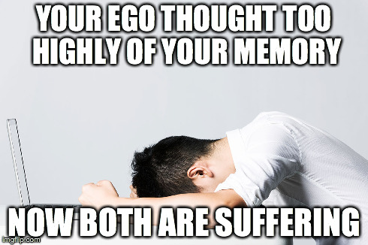
Documentation
Use comments to explain your code
Describe a behavior of your code
Explain anything potentially unclear
Explain why you did something a certain way
Your code should self-document by:
Using readable and descriptive names
Use line breaks to increase legibility
Indenting/aligning things well

Slide 38
Identifiers
The names of classes, methods, variables, etc are identifiers
Descriptive, but not unwieldy
E.g. Bad: x (non-descriptive), myVariableThatIsReallyBig (too long)
Good: count, numTries, xCoordinate

Slide 39
Identifiers
Identifiers are always a single word.
Class names should use uppercase letters at the start of each word:
E.g. ClassName, PrintStream, Car
Variables/methods/etc. should be in camelCase:
E.g. size, numLoops, firstName

Slide 40
Worksheet 1.4

Slide 41
Homework
Read chapter 1 section 4 (1.4) (p. 28-40)
Complete chapter 1 exercises 6 – 9 (p. 55)

Slide 42
Static Methods and Method Calls
[ 1.05 ] [ Today’s Date ] [ Instructor Name ]
Notes:
Things to go over in 1.05:
Method information and breakdown.
How to
Vocabulary
Examples

Slide 43
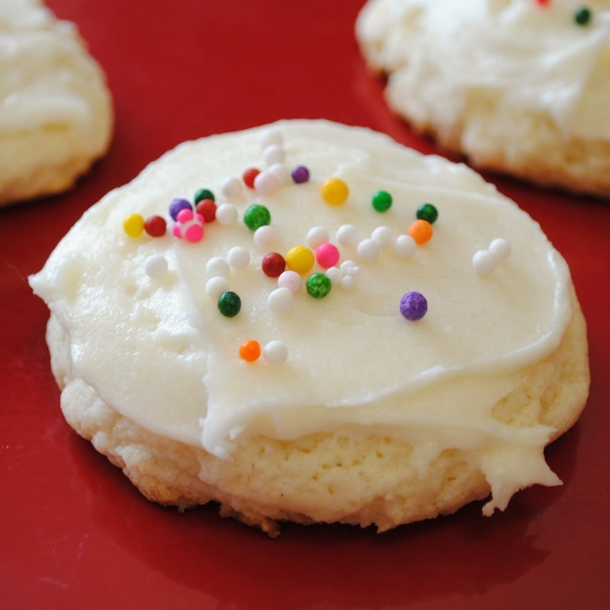
Algorithms
Algorithm: A list of steps for solving a problem.
Example Algorithm: bakeSugarCookies()
Mix the dry ingredients.
Cream the butter and sugar.
Beat in the eggs.
Stir in the dry ingredients.
Set the oven temperature.
Set the timer.
Place the cookies into the oven.
Allow the cookies to bake.
Spread the frosting and sprinkles onto the cookies. , etc.

Slide 44
Problems with Algorithms
Lack of structure: Many tiny steps; tough to remember each step
Redundancy: Consider making a double batch
…
Stir in the dry ingredients
Set the oven temperature
Set the timer
Place the first batch of cookies into the oven
Allow the cookies to bake
Set the oven temperature
Set the timer
Place the second batch of cookies into the oven
Allow the cookies to bake
….

Slide 45
Removing Redundancy
A well-structured algorithm can describe repeated tasks with less redundancy
Make the cookie batter.
Mix in the dry ingredients.
…
Bake the cookies (first batch)
Set the oven temperature.
Set the timer.
…
2a. Bake the cookies (second batch)
Decorate the cookies.
…
By grouping steps and calling the groups, we can eliminate redundancy.

Slide 46
Structure Diagram
Allows you to divide and conquer
Many batches of cookies
Make a batch of cookies
Make the batter
Bake the cookies
Decorate the cookies
System.out.println("Mix the dry ingredients.");
System.out.println("Cream the butter and sugar.");
System.out.println("Beat in the eggs.");
System.out.println("Stir in the dry ingredients.");
…
…

Slide 47
+-------+
| |
| |
+-------+
+-------+
| |
| |
+-------+
+-------+
| |
| |
+-------+
Create a structure diagram for this set of stacked boxes:

Slide 48
Static Methods
Static method: a named group of statements
Procedural decomposition: dividing a problem into methods
Writing a static method is like adding a new command to Java

Slide 49
Using Static Methods
Define / Declare the method
Call (or run) the method
*Insider Tip* The main method always runs first

Slide 50
Defining and Declaring a Method
Giving your method a name so it can be executed:
Syntax: Example:
public static void name(){ public static void makeBatter(){
statement; System.out.println(“Mix the dry ingredients.”);
statement; System.out.println(“Cream the butter/sugar.”);
… System.out.println(“Beat in the eggs.”);
statement; System.out.println(“Stir in dry ingredients.”)
} }

Slide 51
Calling Static Methods
Executes the method’s code
Syntax : <name>() Example: makeBatter()
Output:
Mix the dry ingredients.
Cream the butter/sugar
Beat in the eggs
Stir in dry ingredients
This whole block of code is called every time [ makeBatter()] is called.

Slide 52
// This program displays a delicious recipe for baking cookies.
public static void main(String[] args)
{
// Step 1: Make the cake batter.
System.out.println("Mix the dry ingredients.");
System.out.println("Cream the butter and sugar.");
System.out.println("Beat in the eggs.");
System.out.println("Stir in the dry ingredients.");
// Step 2a: Bake cookies (first batch).
System.out.println("Set the oven temperature.");
System.out.println("Set the timer.");
System.out.println("Place a batch of cookies into the oven.");
System.out.println("Allow the cookies to bake.");
// Step 2b: Bake cookies (second batch).
System.out.println("Set the oven temperature.");
System.out.println("Set the timer.");
System.out.println("Place a batch of cookies into the oven.");
System.out.println("Allow the cookies to bake.");
// Step 3: Decorate the cookies.
System.out.println("Mix ingredients for frosting.");
System.out.println("Spread frosting and sprinkles.");
}

Slide 53
// This program displays a delicious recipe for baking cookies.
public class BakeCookies3
{
public static void main(String[] args)
{
makeBatter();
bake(); // 1st batch
bake(); // 2nd batch
decorate();
}
// Step 1: Make the cake batter.
public static void makeBatter()
{
System.out.println("Mix the dry ingredients.");
System.out.println("Cream the butter and sugar.");
System.out.println("Beat in the eggs.");
System.out.println("Stir in the dry ingredients.");
}
// Step 2: Bake a batch of cookies.
public static void bake()
{
System.out.println("Set the oven temperature.");
System.out.println("Set the timer.");
System.out.println("Place batch into oven.");
System.out.println("Allow the cookies to bake.");
}
// Step 3: Decorate the cookies.
public static void decorate()
{
System.out.println("Mix ingredients for frosting.");
System.out.println("Spread frosting and sprinkles.");
}
}
This affords you a lot
of new capabilities.

Slide 54
Practice Problems
Complete the following practice questions:
Self-Check 1.22: Tricky
Self-Check 1.23: Strange
Self-Check 1.26: Confusing
Self-Check 1.29: LotsOfErrors-errors

Slide 55
Homework
Read chapter 1 section 5 (1.5) (p. 40-46)
Do chapter 1 exercises 11, 12, 14, and 16. (p. 56-58)

Slide 56
Static Methods and Method Calls
[ 1.06 ] [ Today’s Date ] [ Instructor Name ]
Notes:
Things to go over in 1.06:
Method inside method.
Control Flow
Practice It
Can use the optional challenges in the lesson plan; some students may struggle here, make sure that they’re all caught up.

Slide 57
public class MethodsExample
{
public static void main(String[] args)
{
message1();
message2();
System.out.println("Done with main.");
}
public static void message1()
{
System.out.println("This is message1.");
}
public static void message2()
{
System.out.println("This is message2.");
message1();
System.out.println("Done with message2.");
}
}
We can put methods inside methods!
How do you think this program runs?
What is the output of this program?

Slide 58
public class MethodsExample
{
public static void main(String[] args)
{
message1();
message2();
System.out.println("Done with main.");
}
public static void message1()
{
System.out.println("This is message1.");
}
public static void message2()
{
System.out.println("This is message2.");
message1();
System.out.println("Done with message2.");
}
}
Control Flow:
What do you think the output of this program is?
In this case, the program outputs:
This is message1.
This is message2.
This is message1.
Done with message2.
Done with main.

Slide 59
Review Exercises
Write a program that prints your name in the following forms:
FirstName LastName
FirstName MiddleName LastName
LastName, FirstName
LastName, FirstName MiddleName
Rewrite the above program using static void methods

Slide 60
Challenge
*****
*****
* *
*
* *
*****
*****
* *
*
* *
*****
*****
*
*
*
*****
*****
* *
*
* *
There’s a 10 minute time limit.
Write a Java program called StarFigures that generates the following output
You MUST include a structure diagram or your answer will be disqualified
A correct answer will use static methods to show structure and eliminate redundancy in your solution

Slide 61
Practice Problems
If you speed through and finish early, here are some problems for you to try:
Complete Strange 2, Strange 3, Complicated 2 and Complicated 3 Practice
Work on sample test questions with outputs that can be written using method calls. Make sure to include an answer key to your sample!

Slide 62
Homework
No reading tonight!
Complete an outline for chapter 1
Please complete programming project 1.1 and 1.3

Slide 63
Programming Project
[ 1.07 ] [ Today’s Date ] [ Instructor Name ]

Slide 64
Programming Project 2: Similar Letters
Should be able to print similar letters to three people of your choice
Each letter should have one paragraph in common with each other letter
Your main program should only have three method calls
TIPS: Try to isolate repeated tasks into methods. Include comments in with your code so others can easily understand what your code is supposed to do

Slide 65
Programming Project 5: The House that Jack Built
Write a program that produces as output the words of the song,
“The House that Jack Built”
Reference page 60 of your textbook for the full lyrics
Use methods for each verse and repeated text

Slide 66
If you finish early, work on Programming Project 4

Slide 67
Homework
All students must turn in notes for each day of class (including days missed due to absence)
Notes must be fully completed, adding daily summaries if needed
Students may use the book to supplement their notes if needed

Slide 68
Finding and Fixing Errors
[ 1.08 ] [ Today’s Date ] [ Instructor Name ]
Notes:
Things to go over in 1.08:
Touch base on error checking flow/diagram.
Go over common errors.
Go over style guide.

Slide 69
Today’s plan:
Error check and resubmit all chapter 1 assignments
Study for the test by:
Reviewing all of the blue, self-check pages at the end of Chapter 1
Re-reading sections as needed to complete the self-check problems
Submit 5 questions for review in class tomorrow

Slide 70
Homework Regrade/Resubmit
You all have the opportunity to get full credit on your homework grades by correcting them now, in class
Use your error checking algorithm, and if you need help just ask!

Slide 71
Caveat: Style
In order to get your full credit, you’ll need to restyle your code
In programming style is necessary
We’ll touch on a few major style guidelines

Slide 72
Style:
Class Names
MyProgram, CritterMain
Method/Variable Names
greatMethod1(), String firstName, int countOfX
Use header, method, field, and inside-method commenting
Method commenting: //Prints an introduction to programming style
Inside-method commenting: //This variable is used to count your steps
We’ll introduce more commenting and style as we move along!

Slide 73
Style:
Formatting:
Keep your lines under 100 characters of length, preferably 80 characters
Redundancy:
We touched on this previously, but redundant code is bad style
*For advanced coders: Do not use break, break-like, or continue statements in your code! Also no empty return statements!

Slide 74
Style:
UW Commenting Guide:
http://courses.cs.washington.edu/courses/cse142/11au/handouts/comment-guide-eric-arendt.pdf
UW Style Guide:
http://courses.cs.washington.edu/courses/cse143/13sp/handouts/style-guide.pdf

Slide 75
Lab
Error check and resubmit all chapter 1 assignments
Study for the test by:
Reviewing all of the blue, self-check pages at the end of Chapter 1
Re-reading sections as needed to complete the self-check problems
Submit 5 questions for review in class tomorrow

Slide 76
Homework
Begin reviewing chapter one for the Unit Test
Submit any questions you have for review

Slide 77
Review
[ 1.09 ] [ Today’s Date ] [ Instructor Name ]

Slide 78
Review Questions
Use submitted review questions to review for the test
Assemble the questions into categories to go over
Answer individual questions, or make slides for topics you think students need to go over

