Slide 1
Test Review & Reteach
[ 5.00 ] [ Today’s Date ] [ Instructor Name ]

Slide 2
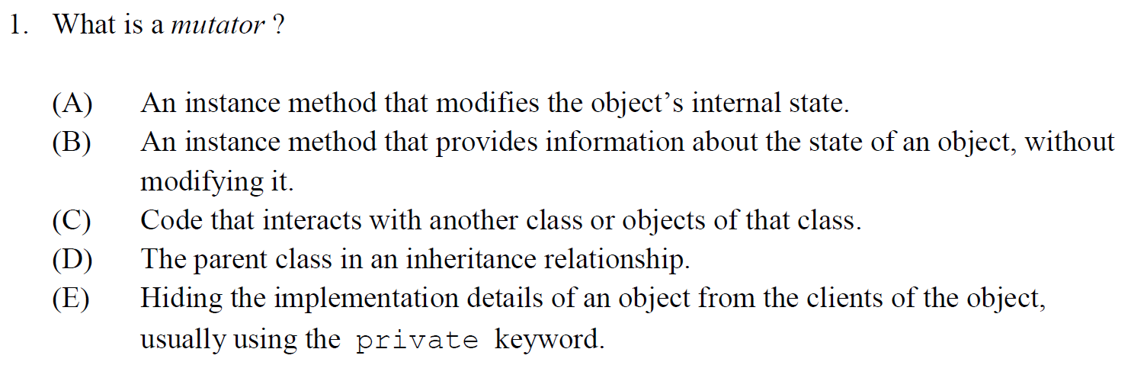

Slide 3
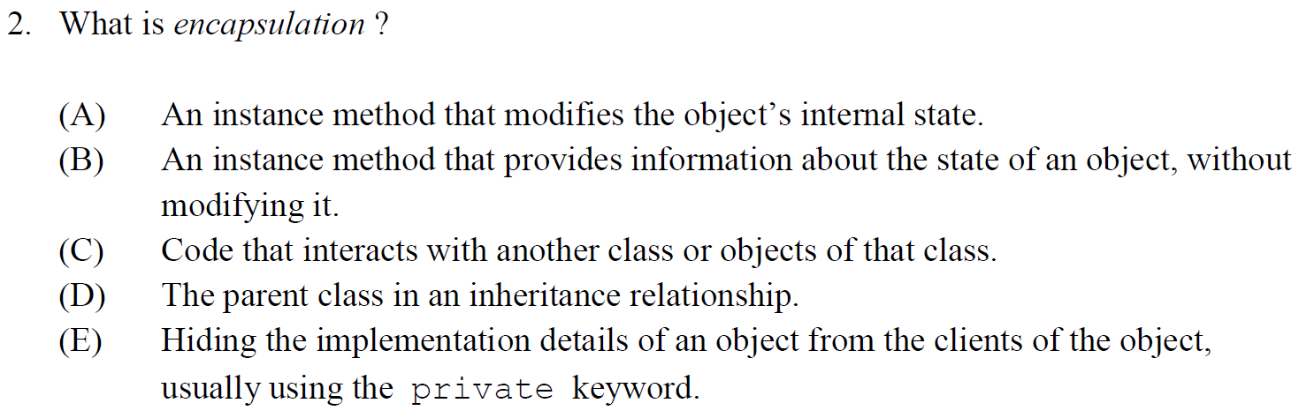

Slide 4
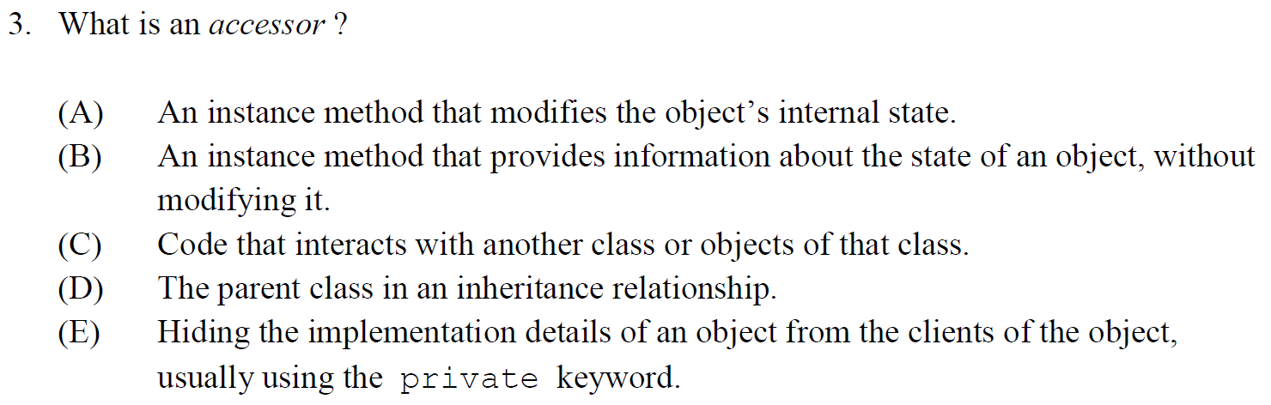

Slide 5
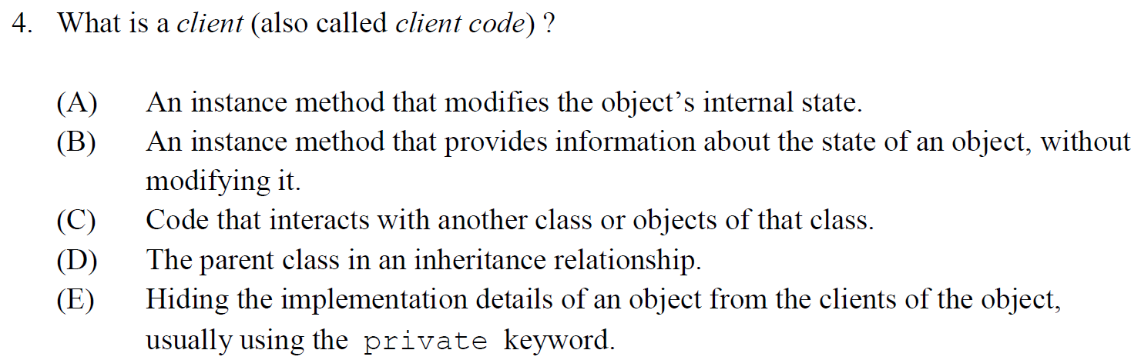

Slide 6
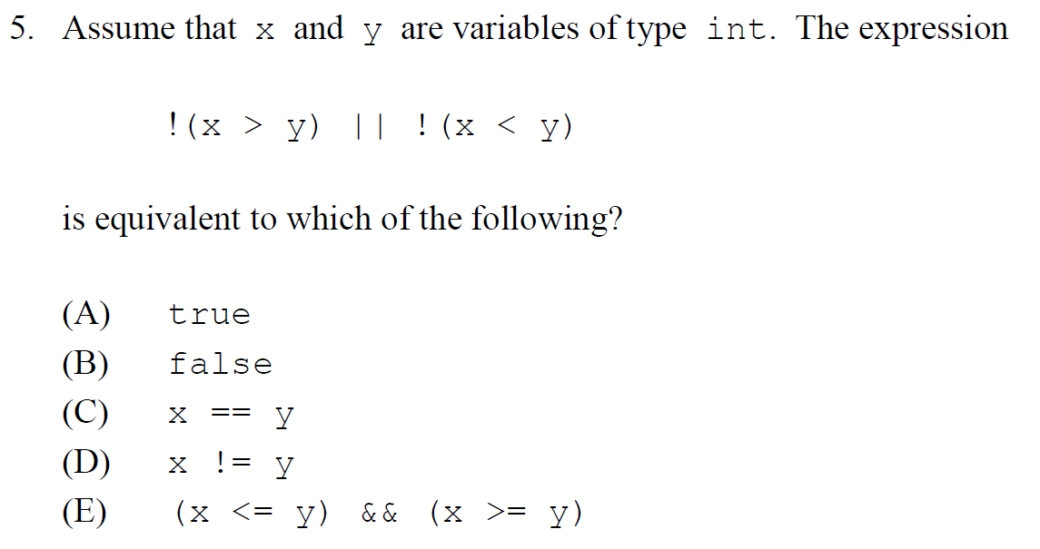

Slide 7
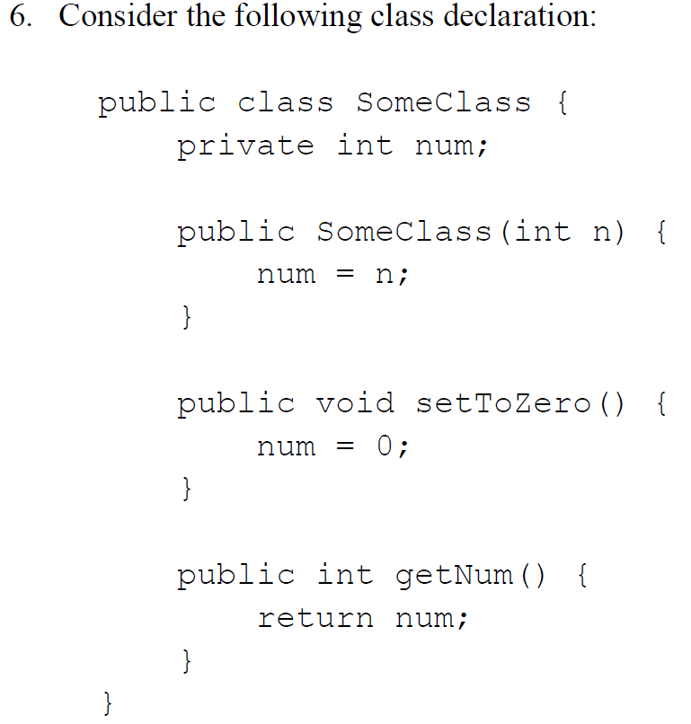
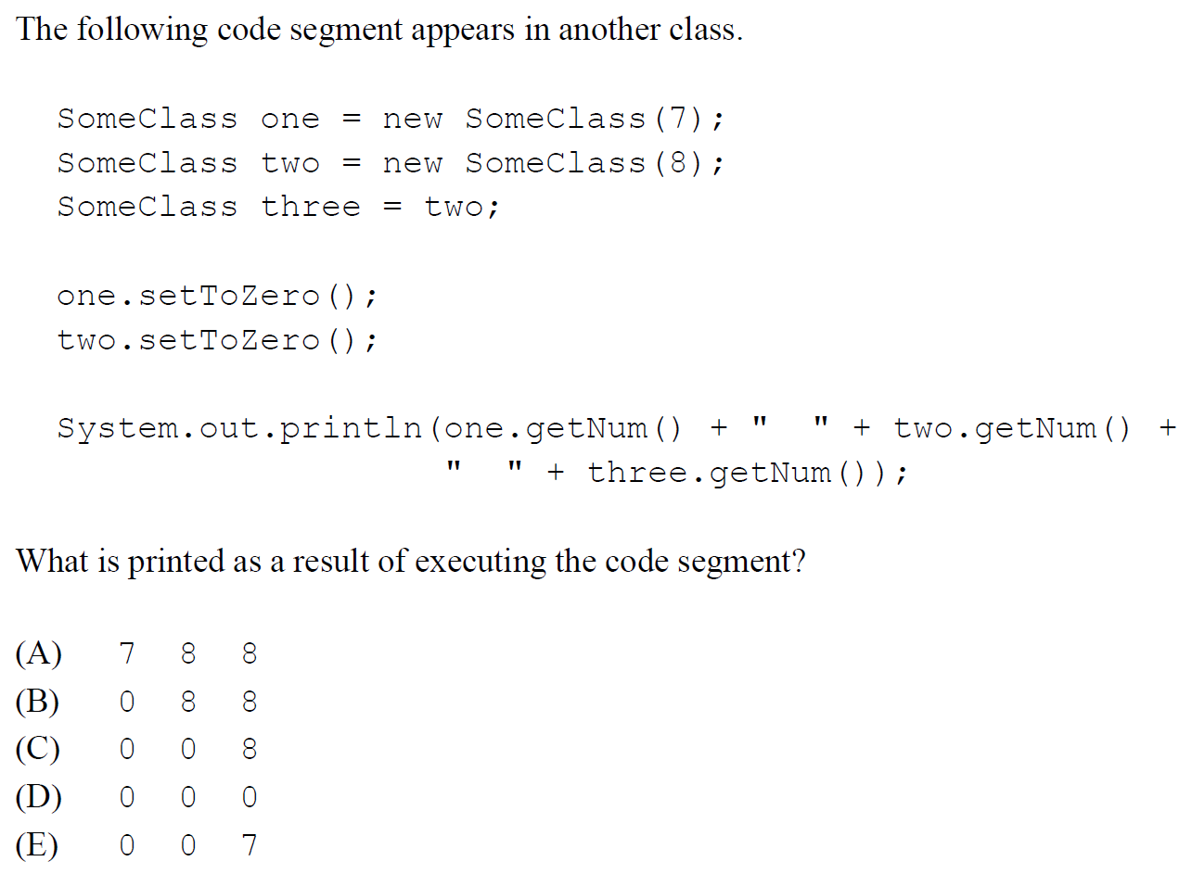

Slide 8
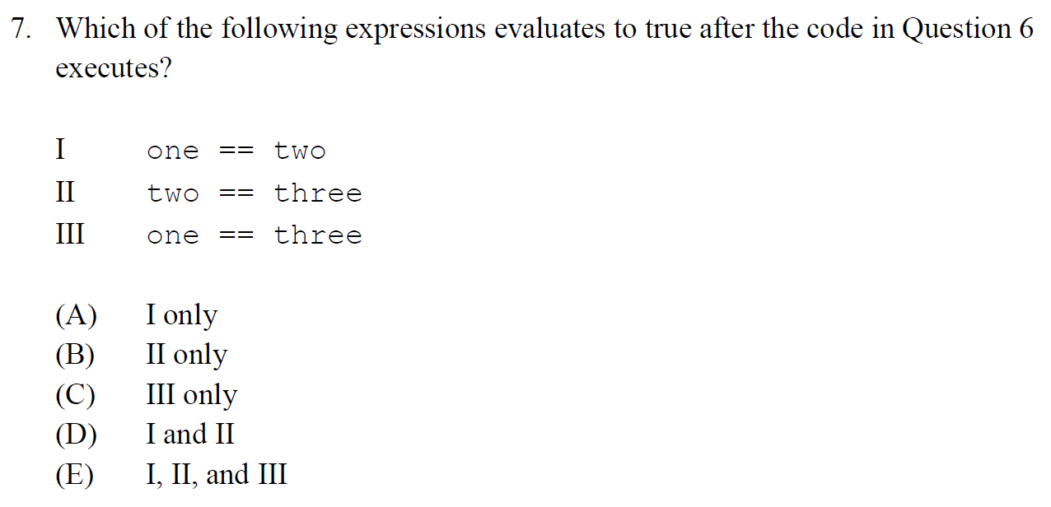

Slide 9
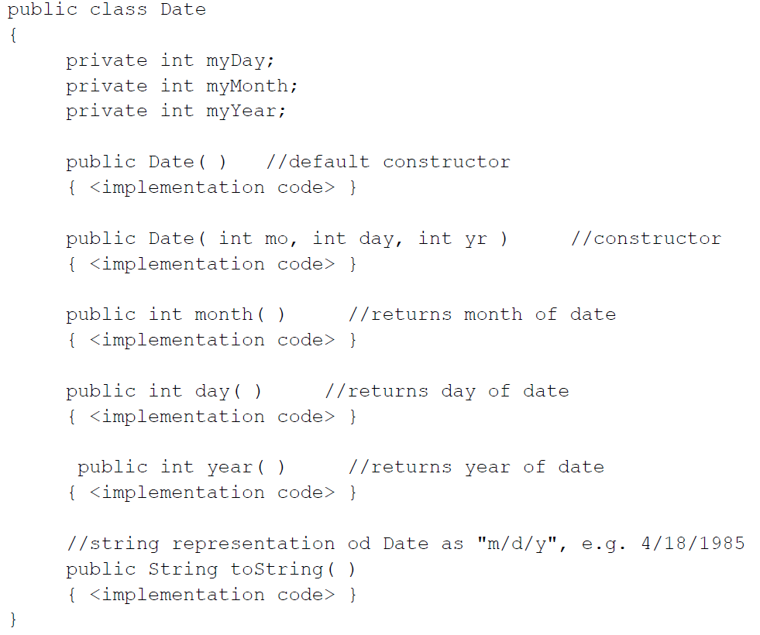
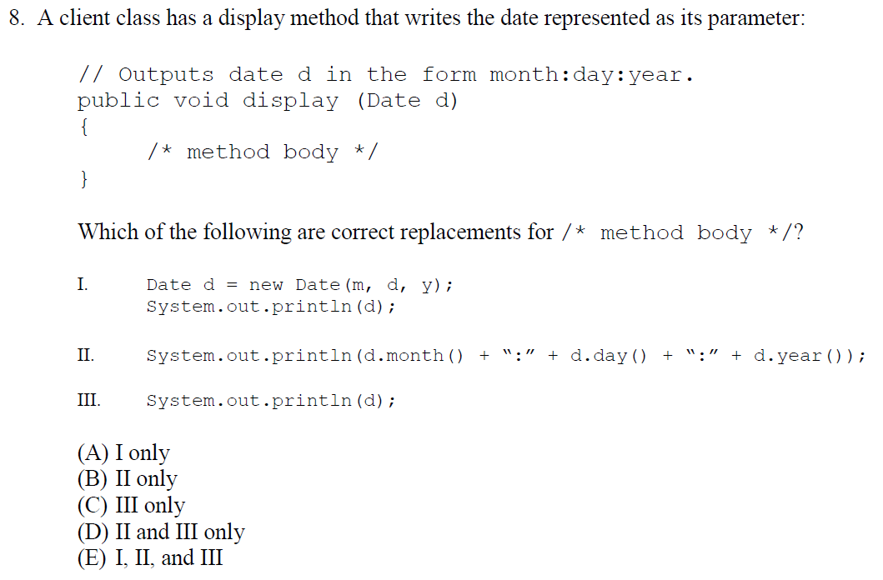

Slide 10
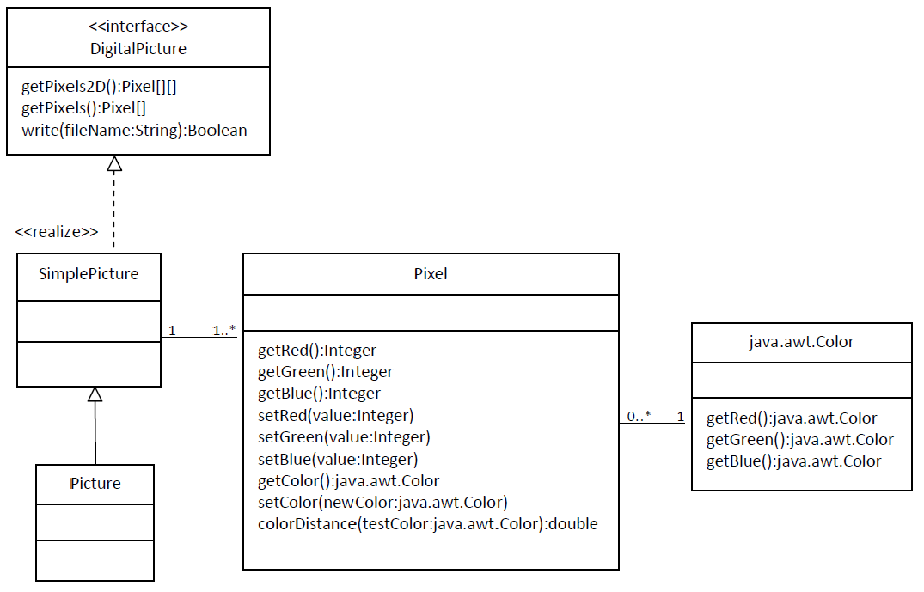
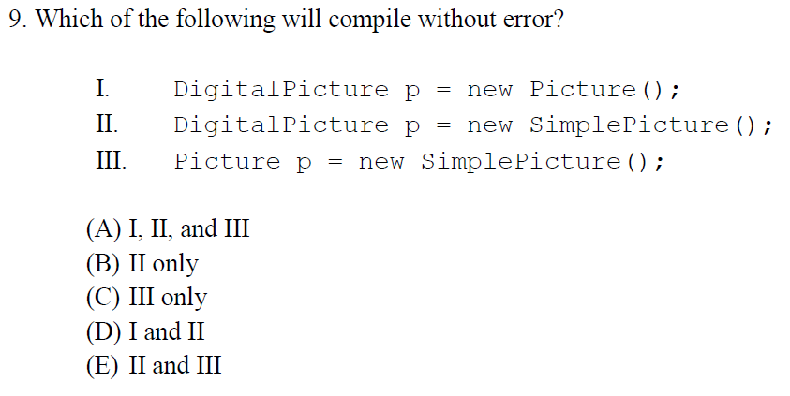

Slide 11
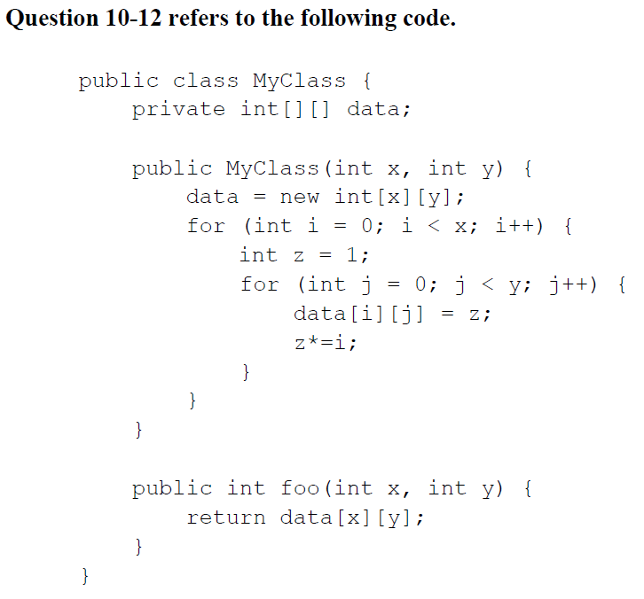
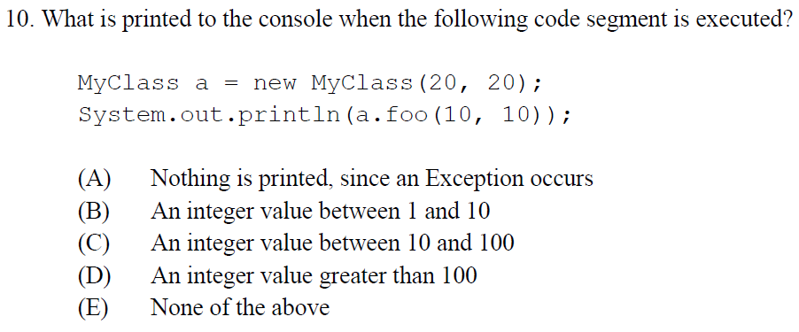

Slide 12
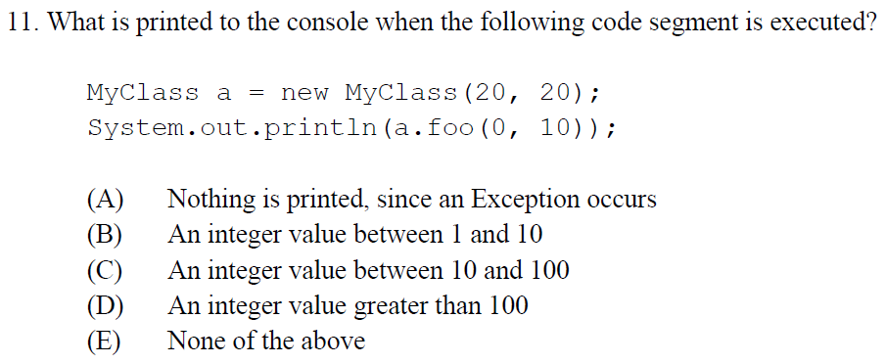

Slide 13
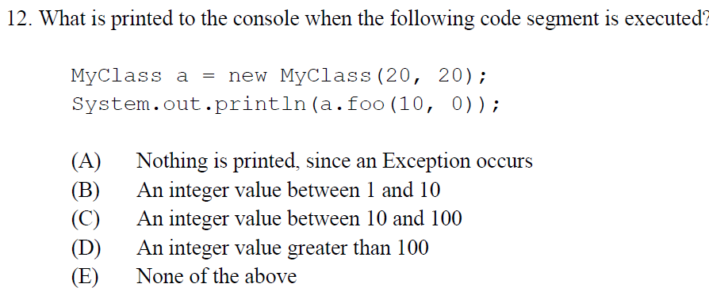

Slide 14
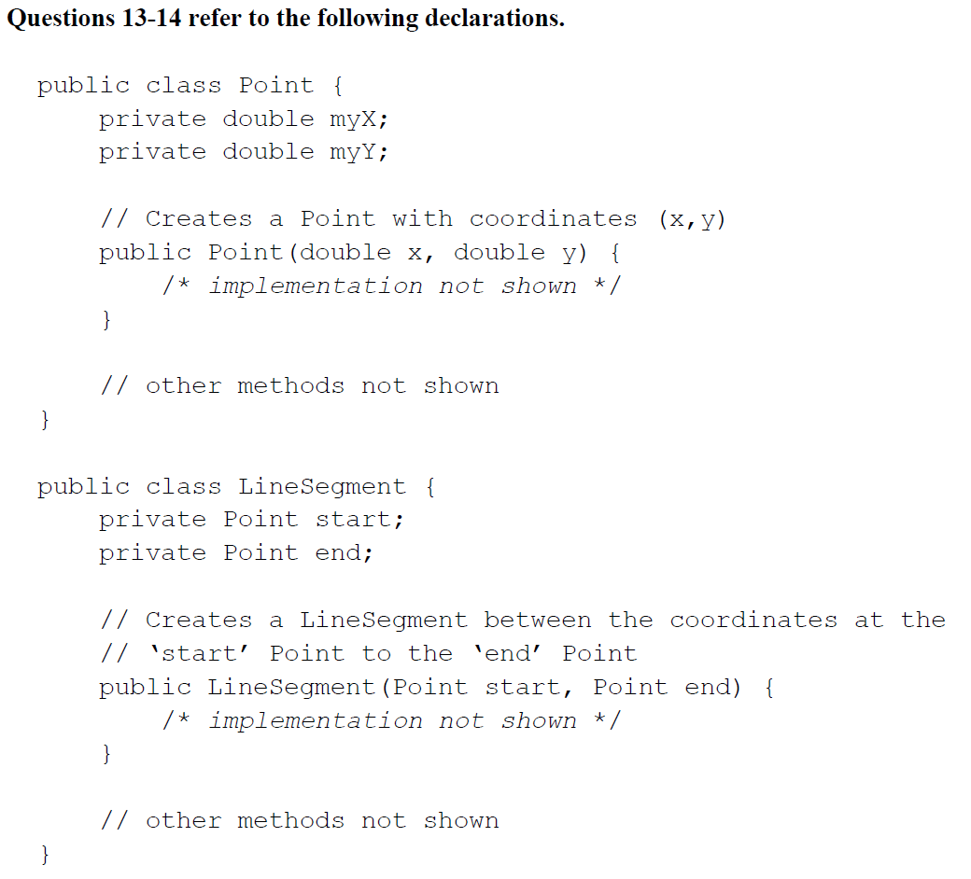
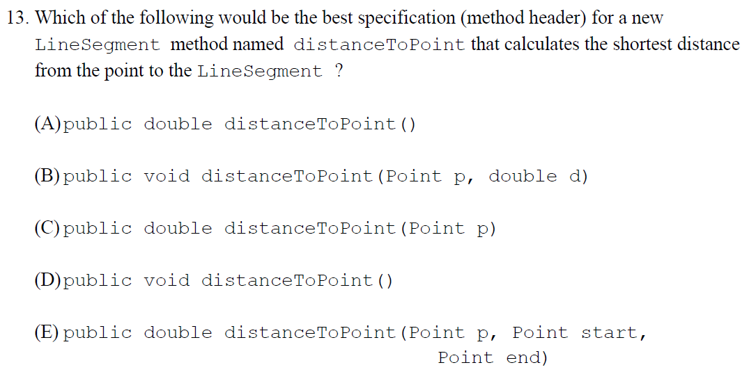

Slide 15
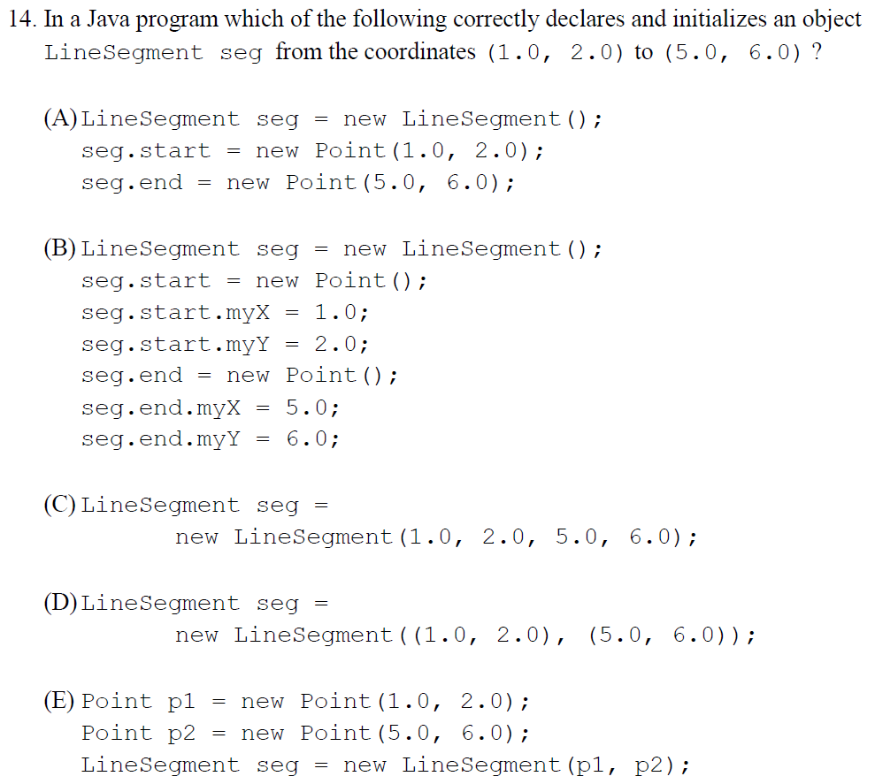

Slide 16
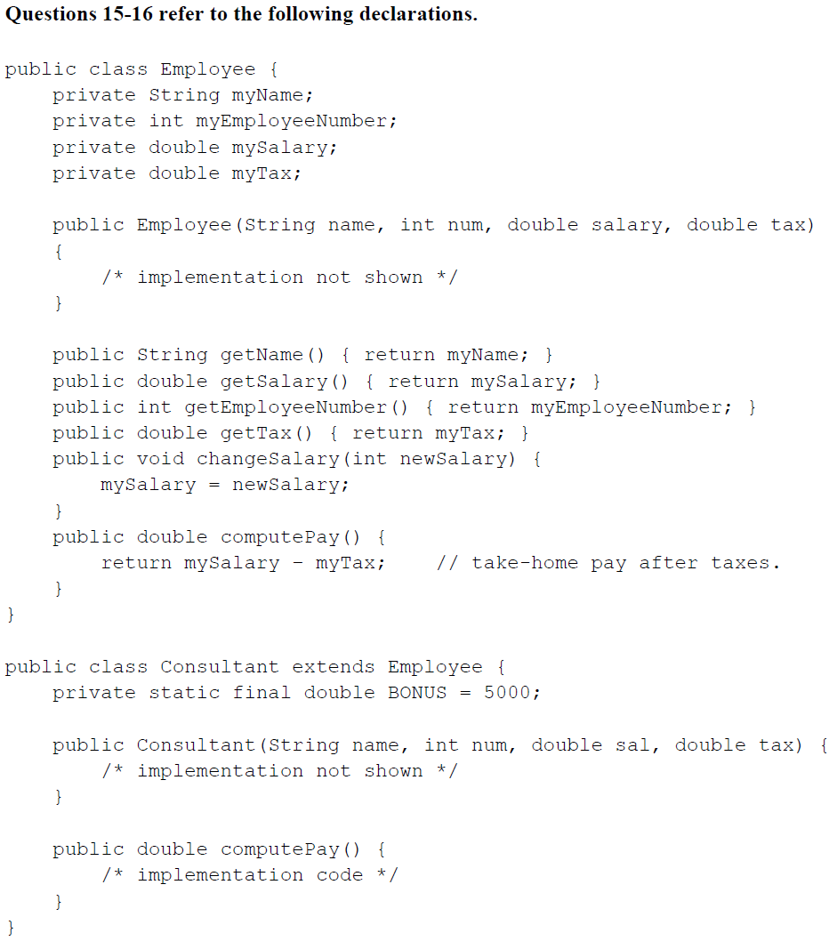
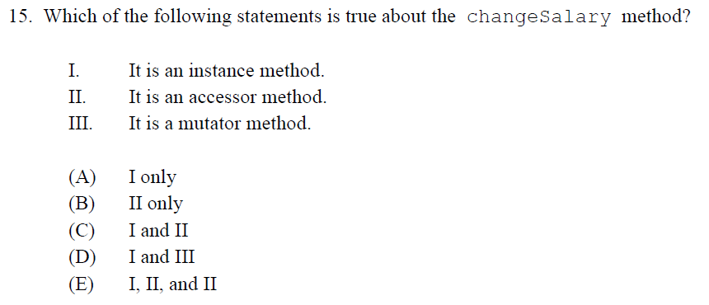

Slide 17
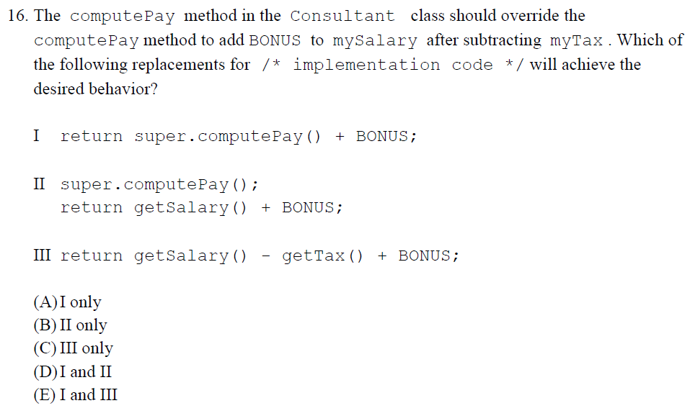

Slide 18
Homework
Read HW 8.1
Correct any incorrect test answers by re-answering on a separate sheet of paper:
To get back credit, you must justify your new answers.
Staple new answer sheet to the old test and return it tomorrow.

Slide 19
Inheritance Basics
[ 6.01 ] [ Today’s Date ] [ Instructor Name ]

Slide 20
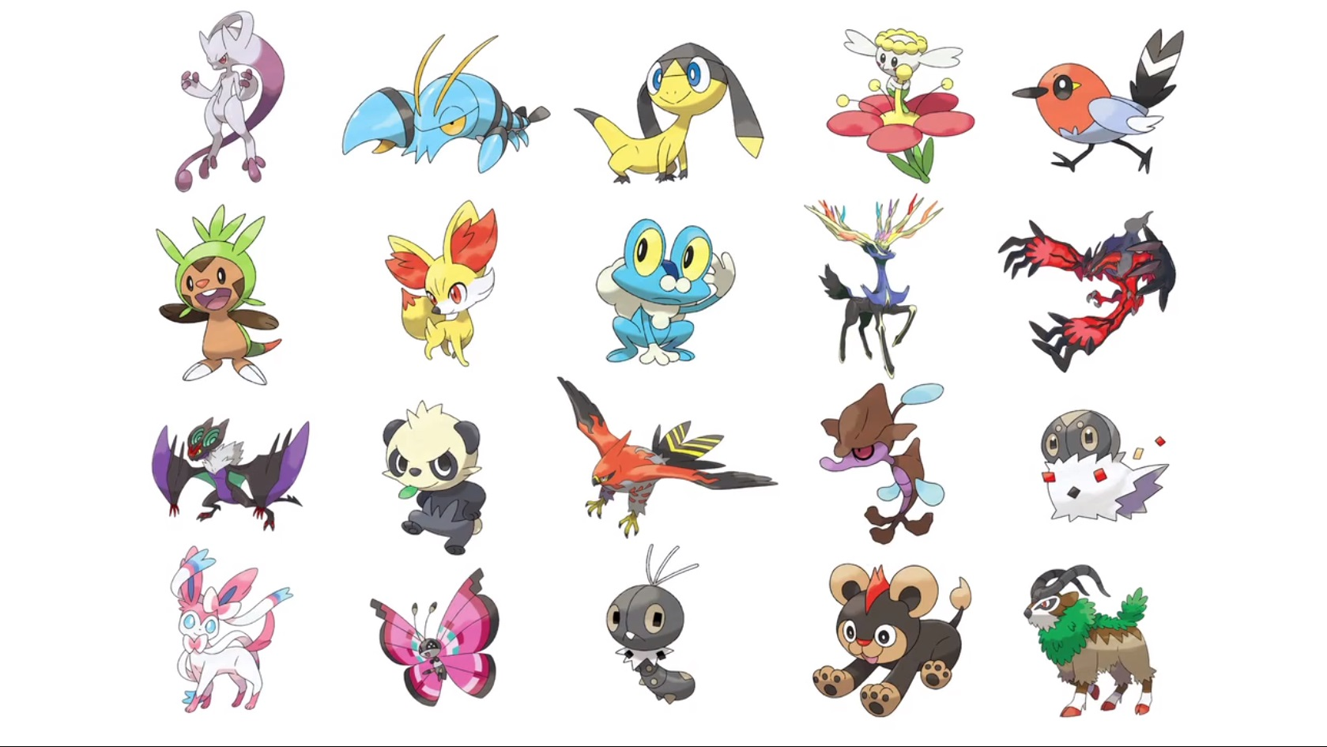

Slide 21
What do all Pokémon have in common?

Slide 22
We need to create a superclass:
Every Pokemon is an instance.
Vocabulary:
Inheritance Hierarchy
Inheritance
Superclass
Subclass, or Child Class

Slide 23
What fields would a specialized subclass have that a superclass wouldn’t?

Slide 24
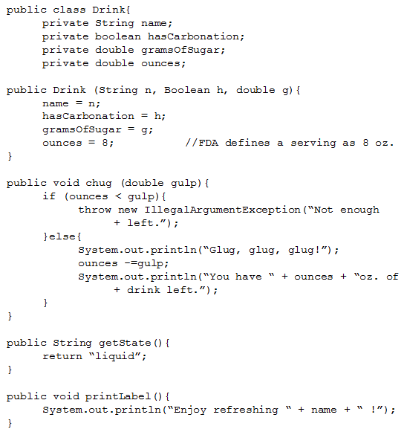


Slide 25
SugarFreeDrink class:
public class SugarFreeDrink extends Drink {
private boolean hasSweetener;
private double caffeineContent;

Slide 26
SugarFreeDrink class:
public SugarFreeDrink(String name, Boolean hasCarbonation, boolean h, double c) {
super(name, hasCarbonation, 0.0); //Superclass’
hasSweetener = h;
caffieneContent = c;
}

Slide 27
SugarFreeDrink methods:
public void printWarningLabel() {
if(hasSweetener) {
System.out.println(“This drink is not safe for
+ Phenylketonurics.”);
} else {
System.out.println(“This drink contains no
+ artificial sweeteners.”);
}
}

Slide 28
Worksheet 6.1: Posters

Slide 29
Quiz 6.1

Slide 30
Homework
Read HW 9.2 up to “DividendStock Behavior”
Collect images that represent instances of the classes created for in-class poster project.

Slide 31
Overriding Methods & Accessing Inherited Code
[ 6.02 ] [ Today’s Date ] [ Instructor Name ]

Slide 32
When might we not want inherited methods?

Slide 33
Problems with inheritance
Subclass FootballPlayer may have a different throwing method than superclass Athlete.
Subclass SoccerPlayer may even ignore the method (design choice, soccer players cannot throw!)

Slide 34
Overriding: chug
// SugarFreeDrink
public void chug(double gulp) {
System.out.println(“Yuck, this tastes terrible!”)
}

Slide 35
Overriding: chug
public void chug(double gulp) {
if (ounces < gulp) {
throw new IllegalArgumentException();
} else {
System.out.println(“Glug, glug, glug!”);
ounces -= gulp;
System.out.println(“You have “ + ounces + “oz.
+ of drink left.”);
}
}

Slide 36
Overriding: chug
//new chug method, SugarFreeDrink
public void chug(double gulp) {
System.out.println(“Yuck, this tasted terrible!”);
super.chug(gulp);
}

Slide 37
How do we access encapsulated information?

Slide 38
get methods:
public double getName() { //written in superclass
return name;
}
public void advertising() {
System.out.println(“Avoid the extra calories by drinking delicious “ + getName() + “every day!!”);
}

Slide 39
Overloading vs Overriding

Slide 40
Worksheet

Slide 41
Homework
Read HW 9.2 up to “The Object Class”

Slide 42
Interacting with the Object Superclass
[ 6.03 ] [ Today’s Date ] [ Instructor Name ]

Slide 43
The Object Superclass
All classes are subclasses of the Object class
The Object class is located in java.lang package
This means all objects inherit some methods:
toString() //only ones on AP
equals()

Slide 44
Who remembers what toString() does?

Slide 45
Why can’t we just use == to test for equality?

Slide 46
The standard == operator:
String z = “z”; a == b
Evaluates to false because a and b
String a = z + z; refer to different strings.
String b = “zz”; c == b
Evaluates to true because c and b
String c = b; refer to the same string.

Slide 47
The String equals methods
a.equals(b)
/* evaluates to true because the content of a and b are the same */
c.equals(b)
/* evaluates to true because c and b refer to the same string */

Slide 48
Overriding the equals method:
public boolean equals(Object o){
Drink other = (Drink) o;
return name.equal(other.name) && ounces == other.ounces;
}
What does this let us compare?
What are some examples of where this can be useful?
Notes:
A good place to touch on boolean zen.

Slide 49
Static vs Dynamic Binding
Static Binding
At compile time, methods in or inherited by the declared type determine the correctness of a non-static method call
Dynamic Binding
At run-time, the method in the actual object type is executed for a non-static method call
Notes:
A good place to touch on boolean zen.

Slide 50
Practice-It
subclassSyntax
inheritanceVariableSyntax
CarTruck
CarTruck2
MonsterTruck

Slide 51
Worksheet

Slide 52
Homework
Read HW 9.3 up to “Interpreting Inheritance Code”

Slide 53
Polymorphism
[ 6.04 ] [ Today’s Date ] [ Instructor Name ]

Slide 54
Review: subclass vs. superclass
subclass “extends” superclass
superclass: More general, less capability
subclass: More specific, more capability
Think of a subclass as being “better” than a superclass.

Slide 55
Variables and Classes
Variable can hold objects of its type or “better” (subclass is “better”!)
Same goes for parameters and fields.
If: public class Lion extends Animal { … }
Then: Animal simba = new Animal();
Or: Animal simba = new Lion();

Slide 56
Variables and Classes
The reverse is NOT true!
If: public class Lion extends Animal { … }
Then: Lion simba = new Lion();
NOT: Lion simba = new Animal(); (Lions > Animals)

Slide 57
Once again:
IF a variable points to an objects…
THEN the object must be of the same type as the variable or “better”
That means that the object can be a subtype of the variable type!

Slide 58
Polymorphism
The ability to use the same code with different types of objects and behave differently with each.
Animal simba = new Lion();
What behaviors does this object have?
Notes:
Polymorphism is a difficult topic to understand, it’s worthwhile to spend extra time here with your students.

Slide 59
Polymorphism
public class Lion extends Animal { … }
Animal simba = new Lion();
System.out.prinln(simba.say());
Output: “Rawr!!”

Slide 60
The Exercise
Given the preceding classes, what would be the output of the following client code?
MusicalInstrument[] insts = {
new MusicalInstrument(), new ElectricKeyboard(),
new Guitar(), new ElectricGuitar() };
for (int i = 0; i < insts.length; i++) {
System.out.println(insts[i]);
insts [i].pickSound();
insts [i].playNote();
System.out.println();
}

Slide 61
Step 1: Class Diagram
Add classes from top (superclass)
to bottom (subclass).
MusicalInstrument
ElectricKeyboard
Guitar
ElectricGuitar

Slide 62
Step 2: Finding output with a table:
Italics inherited but not overridden:
Method | Musical Instrument | Electric Keyboard | Guitar | Electric Guitar
pickSound | Only one sound! | Press sound button | Only one sound! | Hit the fuzz box!
playNote | Playing | Playing | Strumming | Strumming
toString | Musical Instrument | Musical Instrument | Guitar | Guitar

Slide 63
Step 3: Write It Up
MusicalInstrument[] insts = {
new MusicalInstrument(), new ElectricKeyboard(),
new Guitar(), new ElectricGuitar() };
for (int i = 0; i < insts.length; i++) {
System.out.println(insts[i]);
insts [i].pickSound();
insts [i].playNote();
System.out.println();
}

Slide 64

Answer:
MusicalInstrument
Only one sound!
Playing
MusicalInstrument
Press sound button
Playing
Guitar
Only one sound!
Strumming
Guitar
Hit the fuzz box!
Strumming
Notes:
Useing the Step 1 hierarchy graph and the Step 2 Output table:
Walk through each Musical Instrument printed through the loop.
Have students explain how each statement produced the given out in the 3 loop lines:
System.out.println(insts[i]);
insts [i].pickSound();
insts [i].playNote();

Slide 65
Worksheet

Slide 66
Homework
Read HW 9.4 “Is-a Versus Has-a Relationships”
Complete self-check questions #18 – 20

Slide 67
Has-a Relationships
[ 6.05 ] [ Today’s Date ] [ Instructor Name ]

Slide 68
Relationship between a: Animal, Carnivore, Tiger, and Donkey
Animal
Carnivore
Tiger
Donkey
This is an Is-a Relationship

Slide 69
Relationships for: ZooMember ZooFacility
ZooMember
Zookeeper
Trainer
CustomerService
ZooFacility
GiftShop
Bathroom
Cafeteria

Slide 70
So how would we model a zoo? Zoo
Has-a describes the relationship between a class that is client code of another class.
You should use a has-a relationship when you can’t substitute one class for another.
In this case, a Zoo is not an Animal, ZooMember or ZooFacility, rather a Zoo has all of these components.
Zoo
Animal
ZooMember
ZooFacility

Slide 71
Has-a Relationships
How would you design a Zoo?
A Zoo has many parts:
Animals, ZooMember, ZooFacility
You need each of these classes to have an effective Zoo.

Slide 72
Declaring a Has-a Relationship
public class Zoo{
private Animal[] animals;
private ZooMember[] zooMembers;
private ZooFacility[] zooFacilities;
…
}
We create fields that refer to other classes to create a has-a relationship.

Slide 73
Constructors
If no constructor is specified, the compiler will add a no-argument constructor.
A no-argument constructor has no parameters, for example public Zoo().
If a subclass has no call to a superclass constructor using super as the first line in a subclass constructor, then the compiler will automatically add a super() call as the first line in a constructor.
provide no-argument constructors in parent classes
or be sure to use an explicit call to super() as the first line in the constructors of subclasses.
Regardless of whether the superclass constructor is called implicitly or explicitly, the process of calling superclass constructors continues until the Object constructor is called since every class inherits from the Object class.

Slide 74
Worksheet 6.5: Trio

Slide 75
Homework
Read HW 9.5

Slide 76
Interfaces
[ 6.06 ] [ Today’s Date ] [ Instructor Name ]

Slide 77
What are some limitations to inheritance?
Can we inherit code from more than one superclass?
Can we have an is-a relationship or polymorphism without giving the subclass access to our code?

Slide 78
Interfaces
Offer a means to share a common supertype without sharing the code.
An interface consists of a set of method declarations without bodies.
A promise of behavior; methods are declared but not defined.
The method will be defined in the subclass.
An error will be thrown if you don’t define the method.

Slide 79
Interface in practice:
Pork
Bacon
Lard
Salty
Aromatic
Greasy
Edible

Slide 80
Declaring Interfaces
public interface Salty{
double sodiumContent(); ←this is a promise to implement the sodiumContent
} in the class that implements the Salty interface.
public interface Aromatic{
String describeAroma(); ← Notice the lack of “public”! Public is assumed.
}
public interface Greasy{
double amountOfGreaseInMg(); ←point out that interfaces look just like classes
} but without fields or method bodies
public interface Edible{
double calories();
}

Slide 81
Implementing Interfaces
public class Bacon extends Pork implements Salty, Aromatic, Greasy, Edible {
private double amountInKg;
public Bacon(double amount){
amountInKg = amount;
}
public double calories(){
return amountInKg * CALORIES_PER_KG_OF_BACON;
}
}

Slide 82
Class Activity
[Paste example activity or your own from lesson plan to slide]

Slide 83
Homework
Read HW 9.6
Summarize notes in notebook for tomorrow’s notebook check
For extra credit:
Generate your own class hierarchy that demonstrates the same concepts illustrated by the Financial Class Hierarchy outlines in the book. The extra credit project is due [in one week].

Slide 84
Programming Project
[ 6.07 ] [ Today’s Date ] [ Instructor Name ]

Slide 85
[Slides reserved for Programming Project Review]
Edit this slide deck to go over questions that your class has during the programming project days.

Slide 86
Finding and Fixing Errors
[ 6.08 ] [ Today’s Date ] [ Instructor Name ]
Notes:
This unit is mostly done either on practice it or the board. Feel free to edit this slide deck as you see fit!

Slide 87
Today’s plan:
Error check and resubmit all chapter 9 assignments.
Study for the test by:
Reviewing all of the blue, self-check pages at the end of Chapter 9.
Re-reading sections as needed to complete the self-check problems.

Slide 88
Homework Regrade/Resubmit
You all have the opportunity to get full credit on your homework grades by correcting them now, in class.
Use your error checking algorithm, and if you need help just ask!

Slide 89
Homework
Begin reviewing chapter 9 for the Unit 6 Test.

Slide 90
Review
[ 6.09 ] [ Today’s Date ] [ Instructor Name ]

Slide 91
What’s on the test?

Slide 92
Practice Test

Slide 93
Review Topics
Make a list of review topics that you feel you need to go over for the test tomorrow.
For each topic, follow up by reviewing the textbook, self-check problems, and the appropriate Practice-It problems.

Slide 94
Good Luck!

