Slide 1
Test Review & Reteach
[ 4.00 ] [ Today’s Date ] [ Instructor Name ]

Slide 2
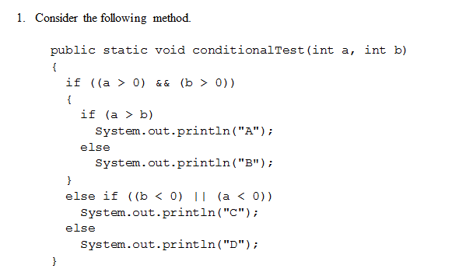
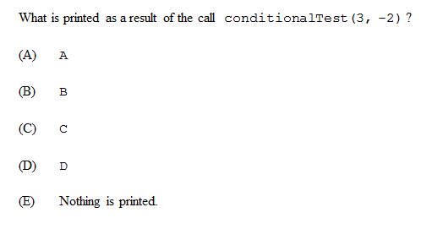

Slide 3
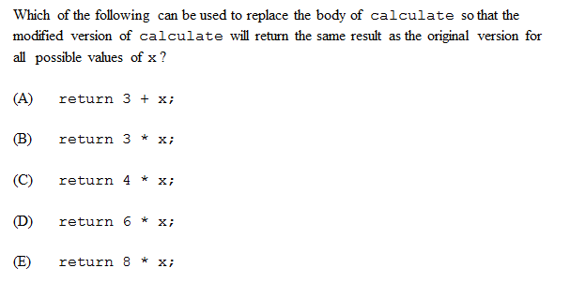
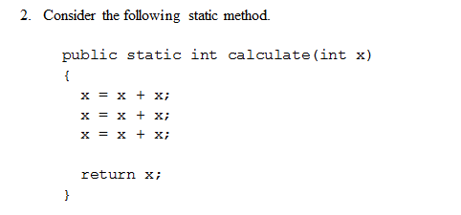

Slide 4
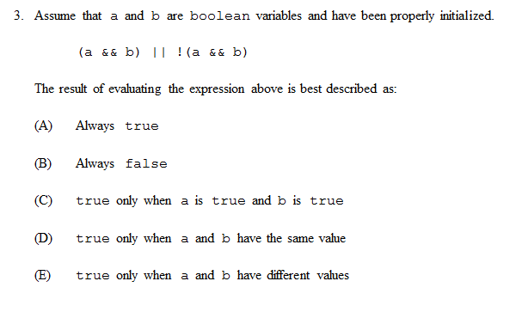

Slide 5
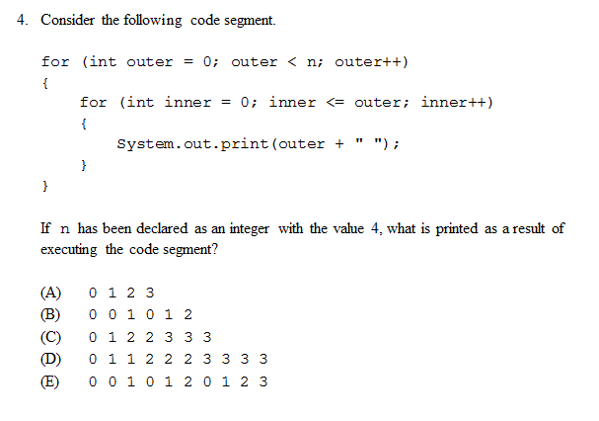

Slide 6
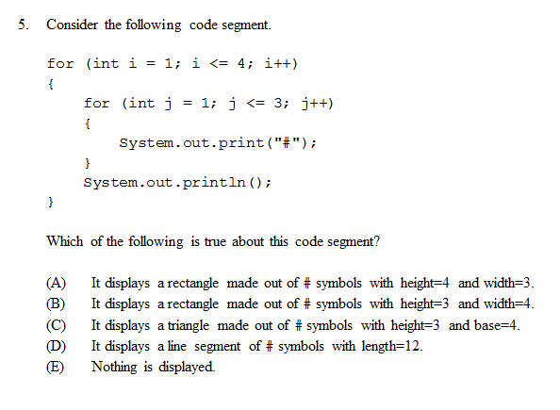

Slide 7
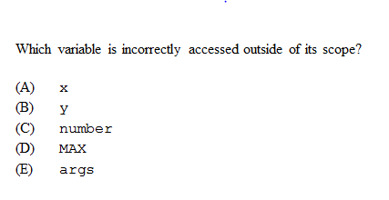
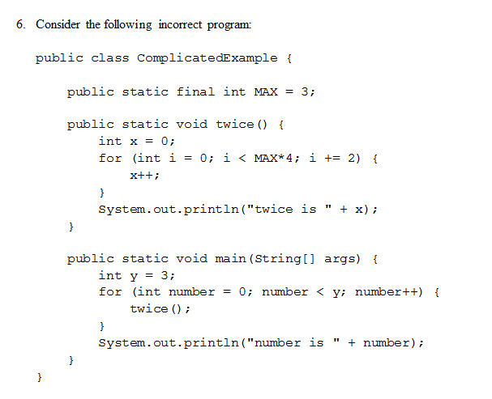

Slide 8
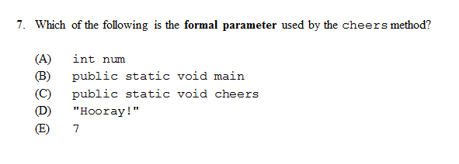
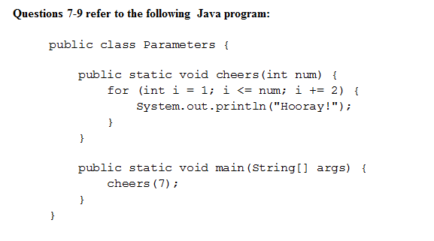
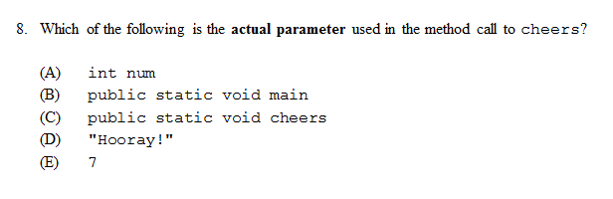
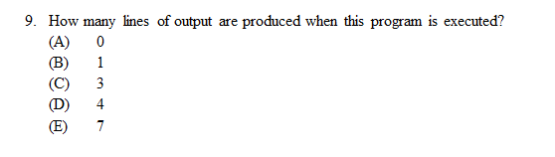

Slide 9
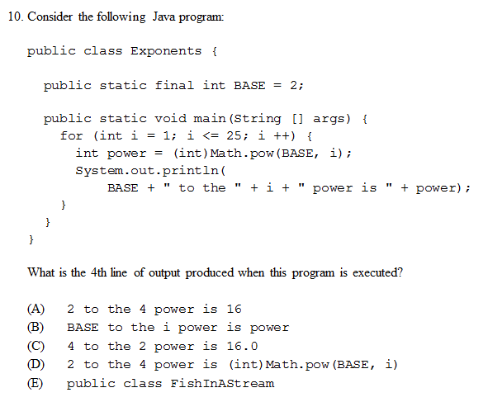

Slide 10
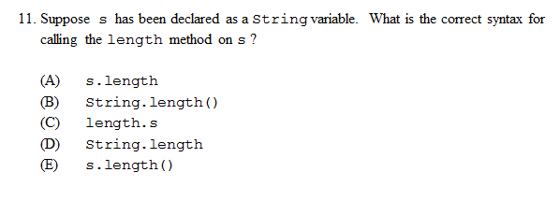

Slide 11
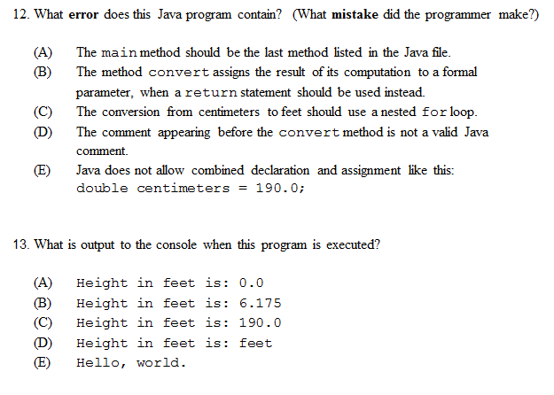
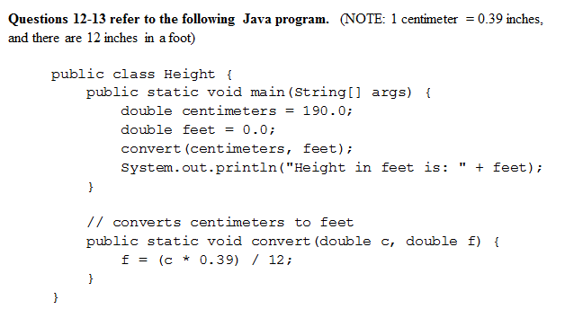

Slide 12
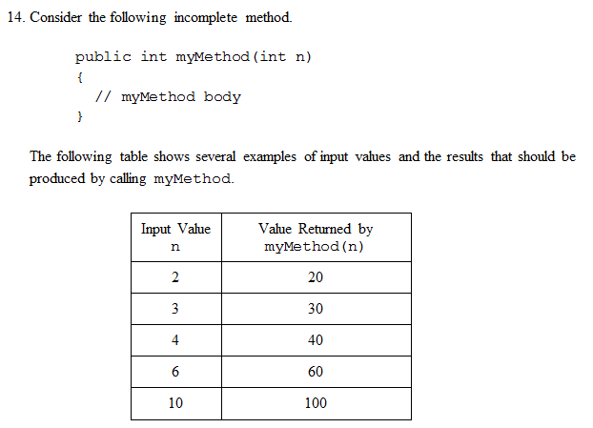
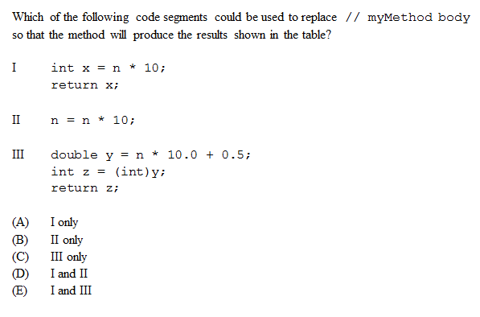

Slide 13
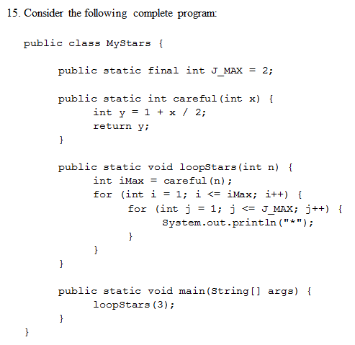
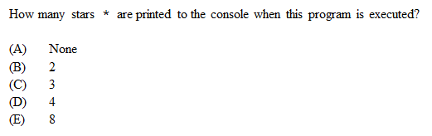

Slide 14
Homework
Read HW 6.1
Correct any incorrect test answers by re-answering on a separate sheet of paper:
To get back credit, you must justify your new answers.
Staple new answer sheet to the old test and return it tomorrow.

Slide 15
Array Basics
[ 4.01 ] [ Today’s Date ] [ Instructor Name ]

Slide 16

How would you write the following program:
How many days’ temperatures? 7
Day 1’s high temp: 45
Day 2’s high temp: 44
Day 3’s high temp: 39
Day 4’s high temp: 48
Day 5’s high temp: 37
Day 6’s high temp: 46
Day 7’s high temp: 53
Average temp = 44.6
4 days were above average.

Slide 17
How would you write the following program:
How many days’ temperatures? 7
Day 1’s high temp: 45
Day 2’s high temp: 44
Day 3’s high temp: 39
Day 4’s high temp: 48
Day 5’s high temp: 37
Day 6’s high temp: 46
Day 7’s high temp: 53
Average temp = 44.6
4 days were above average.

Slide 18
public static void main(String[] args) {
Scanner scanner = new Scanner(System.in);
System.out.println(“How many days?”);
int days = scanner.nextInt();
double sum = 0.0;
for (int day = 0; day < days; day++) {
sum += scanner.nextDouble();
}
System.out.println(“Average: “ + sum/days);
}
How do you calculate the days with temperatures above average?

Slide 19
public static void main(String[] args) {
Scanner scanner = new Scanner(System.in);
System.out.println(“How many days?”);
int days = scanner.nextInt();
double sum = 0.0;
for (int day = 0; day < days; day++) {
sum += scanner.nextDouble();
}
System.out.println(“Average: “ + sum/days);
}
How do you calculate the days with temperatures above average?
You would need to store the temperature for every day.

Slide 20
Arrays:
Array: object that stores many values of the same type.
Element: one value in an array.
Index: a 0-based integer to access an element from an array.
index | 0 | 1 | 2 | 3 | 4 | 5 | 6 | 7 | 8 | 9
value | 12 | 49 | -2 | 26 | 5 | 17 | -6 | 84 | 72 | 3
element 0
element 4
element 9

Slide 21
Array Declaration
type[] name = new type[length];
Example:
int[] numbers = new int[10]
Alternatively: int[] numbers = {0, 0, …, 0}
index | 0 | 1 | 2 | 3 | 4 | 5 | 6 | 7 | 8 | 9
value | 0 | 0 | 0 | 0 | 0 | 0 | 0 | 0 | 0 | 0
Notes:
Ask the class what they notice about the last number and compare it to the length. Should also touch on how length can be any integer expression.

Slide 22
Accessing Elements
numbers[0] = 27;
numbers[3] = -6;
System.out.println(numbers[0]);
if (numbers[3] < 0){
System.out.println("Element 3 is negative.");
}
index | 0 | 1 | 2 | 3 | 4 | 5 | 6 | 7 | 8 | 9
value | 27 | 0 | 0 | -6 | 0 | 0 | 0 | 0 | 0 | 0

Slide 23
Arrays of other types
double[] results = new double [5];
results[2] = 3.4;
results[4] = -0.5;
boolean[] tests = new boolean[6];
tests[3] = true;
index | 0 | 1 | 2 | 3 | 4
value | 0.0 | 0.0 | 3.4 | 0.0 | -0.5
index | 0 | 1 | 2 | 3 | 4 | 5
value | false | false | false | true | false | false

Slide 24
Out-of-bounds
index | 0 | 1 | 2 | 3 | 4 | 5 | 6 | 7 | 8 | 9
value | 0 | 0 | 0 | 0 | 0 | 0 | 0 | 0 | 0 | 0
Okay
Okay
Exception!
Exception!
Legal indexes: between 0 and the array's length - 1.
Example:
int[] data = new int[10];
System.out.println(data[0]);
System.out.println(data[9]);
System.out.println(data[-1]);
System.out.println(data[10]);

Slide 25
Arrays and Scanners
Scanner input = new Scanner(System.in);
int[] numbers = new int[8];
for (int i = 0; i < 8; i++) {
numbers[i] = input.nextInt();
}

Slide 26
Arrays and for loops (Typical pattern)
int[] numbers = new int[8];
for (int i = 0; i < 8; i++) {
numbers[i] = i * 2;
}
For loop starts at 0
Condition is “< array length”

Slide 27
Arrays and for loops
int[] numbers = new int[8];
for (int i = 0; i < 8; i++) {
numbers[i] = i * 2;
}
What does the array look like after this?

Slide 28
Arrays and for loops
index | 0 | 1 | 2 | 3 | 4 | 5 | 6 | 7
value | 0 | 2 | 4 | 6 | 8 | 10 | 12 | 14
int[] numbers = new int[8];
for (int i = 0; i < 8; i++) {
numbers[i] = i * 2;
}

Slide 29
Worksheet

Slide 30
Homework
Read HW 7.1 “For-Each-Loop” and “The Arrays Class”
Chapter 7 self-check questions 1, 7, and 9

Slide 31
For-Each Loop & Arrays Class
[ 4.02 ] [ Today’s Date ] [ Instructor Name ]

Slide 32
Traditional loop:
int [] fallTemperatures = {55, 50, 59, 69, 48, 30, 48};
for(int i = 0; i < fallTemperature.length; i++) {
if(fallTemperatures[i] > 32) {
above++;
}
}

Slide 33
For-each loop
int [] fallTemperatures = {55, 50, 59, 69, 48, 30, 48};
for(int i : fallTemperatures){
if(i > 32){
above++;
}
}

Slide 34
Easy access with a for-each loop:
for (<type> <name> : <array>) {
<statement>;
<statement>;
…
}

Slide 35
Worksheet

Slide 36
Homework
Read HW 7.2 up to “Reversing an Array”
Complete self-check questions #12 – 14

Slide 37
Printing, Searching, and Testing for Equality
[ 4.03 ] [ Today’s Date ] [ Instructor Name ]

Slide 38
Mini Lessons:
Printing an Array
Searching & Replacing
Testing for Equality
Reversing an Array
String Transversal Algorithms

Slide 39
Homework
Day 1: Complete self-check questions #15 – 17 and exercise 3
Day 2: Read HW 7.3 and complete self-check questions #19 – 21

Slide 40
Reference Semantics
[ 4.04 ] [ Today’s Date ] [ Instructor Name ]

Slide 41
Worksheet

Slide 42
Review

Slide 43
Homework
Read HW 7.4 up to “Command-Line Arguments”
Complete chapter 7 exercises #9 and 10

Slide 44
Shifting Values & Arrays of Objects
[ 4.05 ] [ Today’s Date ] [ Instructor Name ]

Slide 45
metroCardRides
int[] metroCardRides = {5, 4, 3, 2, 1};
How would you reorganize this array (within your code) so that the 5 moves from the first element to the last element?
*You cannot reinitialize the array.

Slide 46
Store the first value in the array.
int first = metroCardRides[0];
How do we assign each value in the array to the next value in the array?
Hint: Try using a for loop to cycle through!

Slide 47
Cycle through the array:
for (int j = 0; j < metroCardRides.length – 1; j++){
metroCardRides[j] = metroCardRides[j + 1];
}
What additional code do we need to add to finish our array?
Hint: Our array is currently:
4 | 3 | 2 | 1 | 1

Slide 48
Good job:
public static void firstToLast(int[] metroCardRides) {
int first = metroCardRides[0];
for (int j = 0; j < metroCardRides.length – 1; j++) {
metroCardRides[j] = metroCardRides[j + 1];
}
metroCardRides[metroCardRides.length – 1] = first;
}
How can we do the opposite? Move the last element to the front?

Slide 49
The opposite:
public static void firstToLastRight(int [] metroCardRides){
int last = metroCardRides[metroCardRides.length – 1];
for (int j = metroCardRides.length – 1; j >= 1; j++){
metroCardRides[j] = metroCardRides[j – 1];
}
metroCardRides[0] = last;
}

Slide 50
Practice

Slide 51
Homework
Read HW 7.4 “Nested Arrays” and HW 7.5 “Rectangle Two-Dimensional Arrays
Complete chapter 7 self-check questions #27 – 29 and exercise #4.

Slide 52
Nested Loop Algorithms & Rectangular Arrays
[ 4.06 ] [ Today’s Date ] [ Instructor Name ]

Slide 53
Two-dimensional arrays:
turkey | ham | roast beef | turkey
turkey | ham | roast beef | turkey
ham | turkey | roast beef | chicken
roast beef | roast beef | turkey | roast beef

Slide 54
Write a loop that outputs all inversions:
4 | 3 | 2 | 1
E.g. (4, 3), (4, 2), (4, 1), (3, 2) …

Slide 55
Final code:
for(int i = 0; i < data.length - 1; i++) {
for(int j = i + 1; j < data.length; j++){
if (data [i] > data[j]) {
System.out.println(“(“ + data[i] +”, “ + data[j] + “)”);
}
}
}

Slide 56
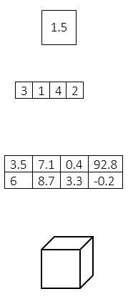
Array data representation:
double
double[]
double[][]
double[][][]

Slide 57
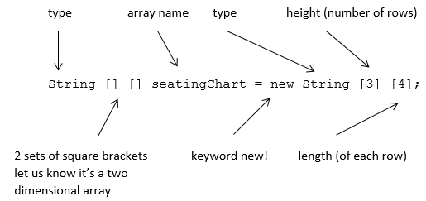
Constructing a double array:

Slide 58
Initializing double arrays:
// Simple 4x4 multiplication table
int[][] multiplicationTable = {
{1,2,3,4},
{2,4,6,8},
{3,6,9,12},
{4,8,12,16}
};

Slide 59
Passing double arrays as parameters:
public static void print(double[][] grid) {
for(int i = 0; i < grid.length; i++) {
for(int j = 0; j < grid[i].length; j++) {
System.out.print(grid[i][j] + “ “);
}
System.out.println();
}
}

Slide 60
Homework
Read HW 10.1 up to “Adding to and Removing from an ArrayList.”
Complete chapter 10 self-check problems #1 – 6.

Slide 61
ArrayList
[ 4.07 ] [ Today’s Date ] [ Instructor Name ]

Slide 62
The ArrayList
ArrayList<String> , ArrayList<Point>
ArrayList<String> spongebob = new ArrayList<String>();
Notes:
The following line of code constructs an empty list:
ArrayList<String> spongebob = new ArrayList<String>();
spongebob.size() returns 0

Slide 63
The ArrayList
spongebob.add(“Patrick Star”);
spongebob.add(“Squidward Tentacles”);
spongebob.add(“Mr. Krabs”);
spongebob.add(“Pikachu”);
spongebob.add(“Sandy Cheeks”);
Predict the output for:
System.out.println(“Some of the character on Spongebob
+ are” + spongebob);

Slide 64
The ArrayList
spongebob.remove(3); //Pikachu is stored at index 3
spongebob.add(3, “Plankton”);

Slide 65
The ArrayList
System.out.println(spongebob.get(3));
System.out.println(spongebob.size());
spongebob.set(3, “Plankton”);
spongebob.clear();

Slide 66
The ArrayList
int sum = 0;
for(int = 0; i < spongebob.size(); i++;) {
String s = spongebob.get(i);
sum += s.length();
}
System.out.println(“Total of lengths = “ + sum);

Slide 67
Grudgeball

Slide 68
Homework
Outline Chapter 7 and HW 10.1 “ArrayList”
Complete self check questions #3 – 6 and exercise 3

Slide 69
Finding and Fixing Errors
[ 4.08 ] [ Today’s Date ] [ Instructor Name ]
Notes:
This unit is mostly done either on practice it or the board. Feel free to edit this slide deck as you see fit!

Slide 70
Today’s plan:
Error check and resubmit all chapter 7 and 10.1 assignments.
Study for the test by:
Reviewing all of the blue, self-check pages at the end of Chapter 7 and 10.1.
Re-reading sections as needed to complete the self-check problems.
Submit 5 questions for review in class tomorrow.

Slide 71
Homework Regrade/Resubmit
You all have the opportunity to get full credit on your homework grades by correcting them now, in class.
Use your error checking algorithm, and if you need help just ask!
Make sure to check for issues with scope!

Slide 72
Homework
Begin reviewing chapters 7 and 10.1 for the Unit Test.
Submit 5 questions you have for review tomorrow.

Slide 73
Magpie Chatbot
[ 4.09 ] [ Today’s Date ] [ Instructor Name ]
Notes:
This unit is mostly done either on practice it or the board. Feel free to edit this slide deck as you see fit!

Slide 74
Empty Powerpoint
If necessary, make your own slides to cover topic students struggle with during the Magpie Chatbot lab.

Slide 75
Review
[ 4.10 ] [ Today’s Date ] [ Instructor Name ]

Slide 76
What’s on the test?

Slide 77
Worksheet

Slide 78
Review Topics
Make a list of review topics that you feel you need to go over for the test tomorrow.
For each topic, follow up by reviewing the textbook, self-check problems, and the appropriate Practice problems.

Slide 79
Good Luck!

