Slide 1
Test Review & Reteach
[ 5.00 ] [ Today’s Date ] [ Instructor Name ]

Slide 2
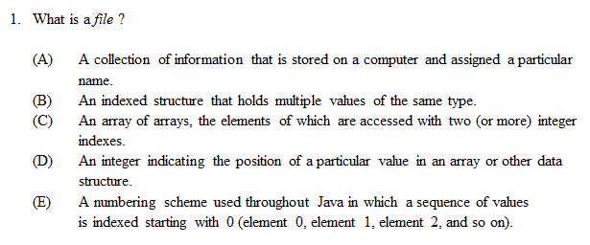

Slide 3
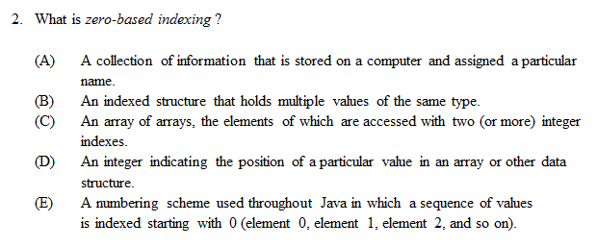

Slide 4
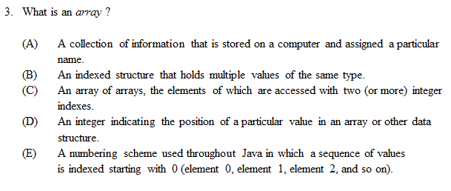

Slide 5
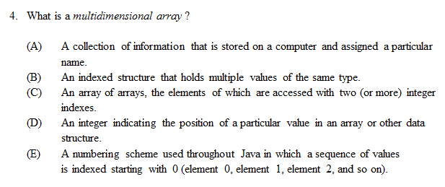

Slide 6
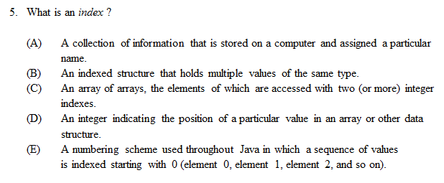

Slide 7
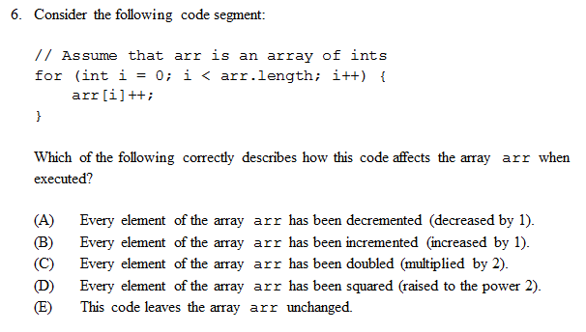

Slide 8
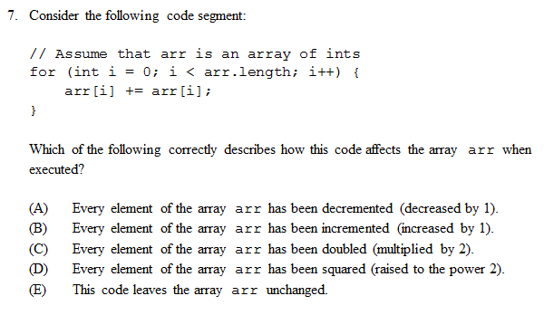

Slide 9
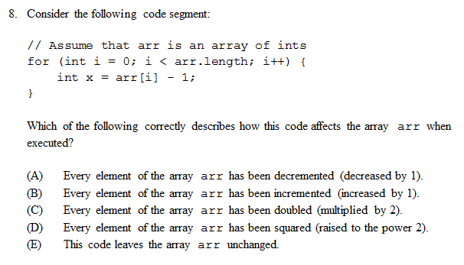

Slide 10
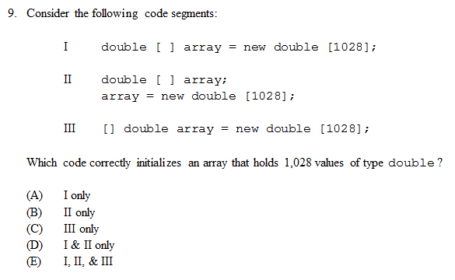

Slide 11
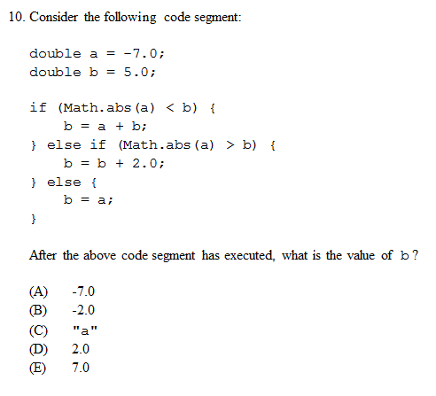

Slide 12
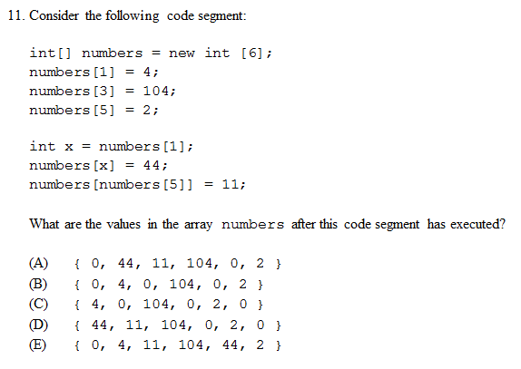

Slide 13
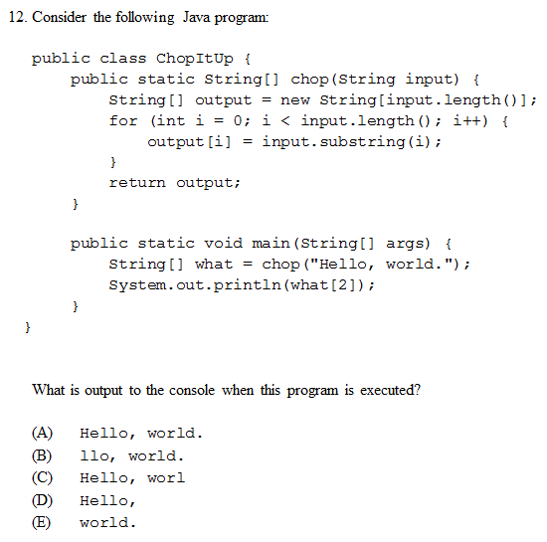

Slide 14
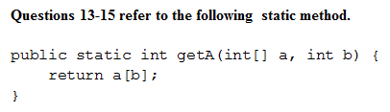
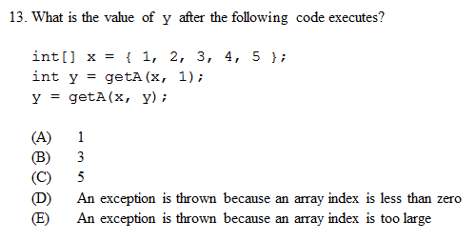

Slide 15
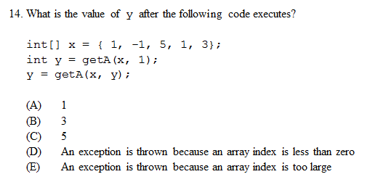

Slide 16
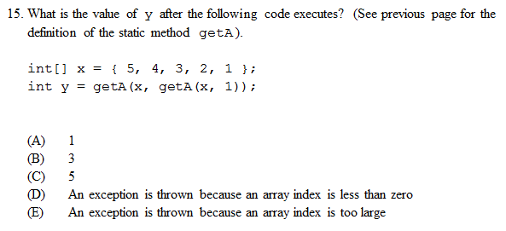

Slide 17
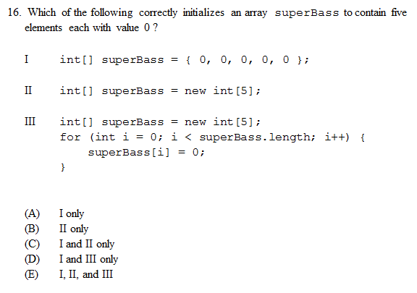

Slide 18
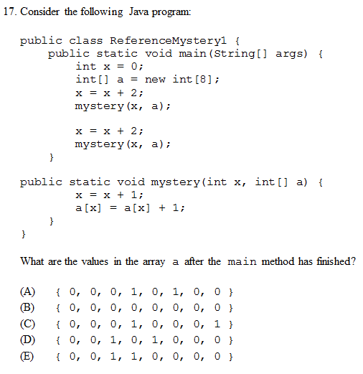

Slide 19
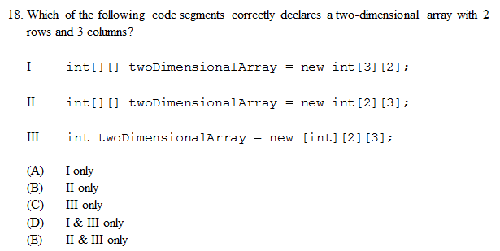

Slide 20
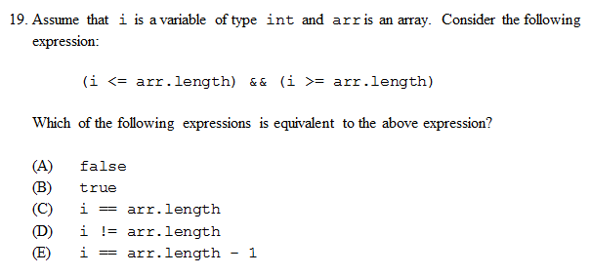

Slide 21
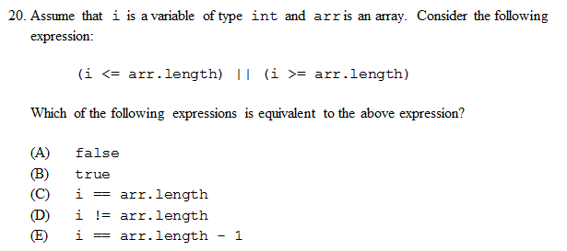

Slide 22
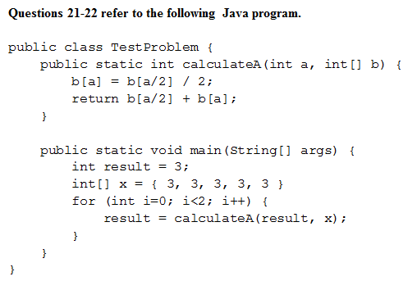
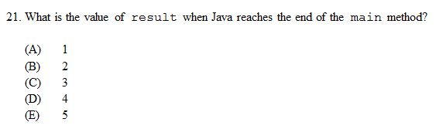

Slide 23
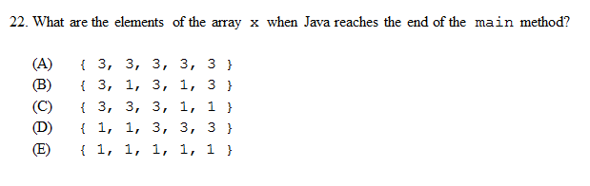

Slide 24
Homework
Read HW 8.1
Correct any incorrect test answers by re-answering on a separate sheet of paper:
To get back credit, you must justify your new answers.
Staple new answer sheet to the old test and return it tomorrow.

Slide 25
Object-Oriented Programming
[ 5.01 ] [ Today’s Date ] [ Instructor Name ]

Slide 26
Modeling and Design

Slide 27
What if you were to write code for these:
myDog, teachersDog, sistersDog
student1, student2, student3
forecastNY, forecastAZ, forecastOK

Slide 28
Dog Object
What behaviors (methods) and data (states) does a common dog have?
Completeness, Robustness, and Simplicity

Slide 29
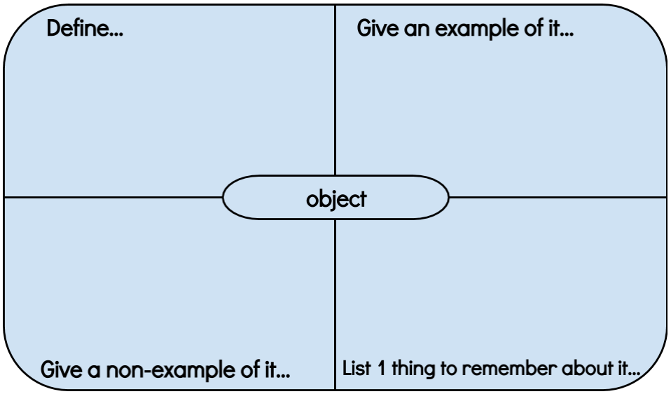
Graphic Organizer

Slide 30
Objects = State (Data) + Behavior (Methods)
// Data is stored in an array.
int[] digits = {1, 2, 3, 4, 5, 6, 7, 8 , 9, 10};
// Method dictates actions.
System.out.println(Arrays.toString(digits));

Slide 31
Why isn’t this an object or model?
while (guess != number) {
System.out.println(“Incorrect.”);
System.out.println(“Your guess? “);
guess = console.nextInt();
numGuesses++;
}

Slide 32


Client Code
Code that uses the object.
What program (client code) might need to access the data and methods stored in:
student1
myDog

Slide 33

Think-Pair-Share
Create these objects:
1. myDog, teachersDog, sistersDog
2. student1, student2, student3
3. forecastNY, forecastAZ, forecastOK

Slide 34
A class
A blueprint or outline for a particular set of objects.
Class: Instances:
Dog myDog, sistersDog, teachersDog, …
What are some other examples?

Slide 35
A class
Fields: outline what data (state) the object will hold.
Methods: outlines the behavior of each object.
Constructor: code that initializes the object being constructed.
______________________________________________________
Encapsulation can protect the data stored in the object.

Slide 36
Read through the Point Class and complete the following Practice problems:
Self-Check 8.1: whatIsOOP
Self-Check 8.2: whatIsAnObject
Self-Check 8.3: StringObject
Self-Check 8.4: ReferenceMystery3
Self-Check 8.5: CalculatorObject

Slide 37
Research a Custom Pokemon Class:
i. http://www.pokemon.com/us/parents-guide/
(Basic overview of the game)
ii. https://youtu.be/DlEbXH8eUTk?t=1m26s
(this is a 30 minute YouTube video of gameplay)
iii. http://www.pokemon.com/us/pokedex/ (types of Pokemon)
iv. http://tinyurl.com/no4mzic (Pokemon with stats)
v. http://en.wikipedia.org/wiki/Gameplay_of_Pokémon
(Wikipedia entry)

Slide 38
Homework
Read HW 8.2 up to “Mutators and Accessors”

Slide 39
Object State & Behavior
[ 5.02 ] [ Today’s Date ] [ Instructor Name ]

Slide 40
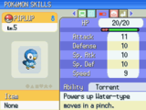
Fields
public class Pokemon {
//What are some examples of fields
//What would fields look like for
\ //a student, dog, or forecast?
}

Slide 41
Methods
What would be a good method to include in all instances of Students?
What would be a good method for all instances of the Dog class?
What method should all forecasts have, no matter what forecast?

Slide 42
Accessor Methods
public class Student {
private String name;
public String getName () { // getter accessor method
return name;
}
public void setName(String newname) { // setter accessor method
name = newname;
}
}

Slide 43
Accessor Example
public class FormGroups {
public static void main (String args[]){
Student groupLeader = new Student();
groupLeader.setName(“Pat”);
System.out.println (“The group leader is “ + groupLeader.getName());
}
}
Note:
The return expression from groupLeader.getName() is a reference to an object.
A copy of that reference is returned, not a copy of the object.

Slide 44
Methods: Pokémon
Pokémon get an effort ribbon if their combined stats exceed a certain value – what’s a good way to get all of a Pokémon's stats?
What would the method sumStats look like?

Slide 45
sumStats:
public int sumStats() {
return(HP + attack + defense + specialAttack + specialDefense + speed);
}

Slide 46
Methods: Pokemon
Pokemon use vitamins to boost their stats. Here are some examples:
Vitamin Function
hpUp + points to HP
protein + points to attack
iron + points to defense
Now write a method, consumeVitamin, that actually changes the state.

Slide 47
consumeVitamin
public void consumeVitamin( int hpUp, int protein …) {
hp += hpUp;
attack += protein;
…
}

Slide 48
Constructors
We need to initialize our values of each instance of the Pokémon class.
This is done in the constructor:
public class Pokemon {
int hp;
int attack;
public Pokemon(int hitpoints, int a) {
hp = hitpoints;
attack = a;
}
}

Slide 49
Constructors
We can then call these constructors to create our instances:
Pokémon pikachu = new Pokémon(70, 120);
We can also call our methods on the object:
pikachu.sumStats(); //returns 190

Slide 50
Worksheet

Slide 51
Homework
Read HW 8.3 up to “The Keyword this”
Complete self-check questions #9 – 11, 13 – 16

Slide 52
Object Initialization: Constructors
[ 5.03 ] [ Today’s Date ] [ Instructor Name ]

Slide 53
Student
public class Student {
public String name;
public int gradeLevel;
public double gpa;
public Student(String n, int gl, double g) {
name = n;
gradelevel = gl;
gpa = g;
}
}

Slide 54
Dog
public class Student {
public String breed;
???; //What else could be made fields?
public Dog(???) { //How do we add these as parameters?
???; //How do we assign values passed through?
}
}

Slide 55
Forecast
public class Forecast {
public boolean tornadoWarning; //Does it make sense to have
???; //a tornado warning? This is
//a design choice!!!
Constructor(???)
}

Slide 56
Exit Ticket:
Write your name and the name of another group’s class.
How would you declare an object according to that group’s constructor?

Slide 57
Homework
Read HW 8.4
Take notes, since you will have to teach a mini-lesson later.

Slide 58
Encapsulation
[ 5.04 ] [ Today’s Date ] [ Instructor Name ]

Slide 59
Mini Lessons on chapter 8 section 4.
Encapsulation and Abstraction
Private Fields
Class Invarients
Changing Internal Implementations
Notes:
Remind your students to also give you quiz questions for the next lesson!

Slide 60
Mini Lesson Guidelines
Each group has 7 minutes to present and 2 minutes for questions.
Each group must submit 3 questions related to your topic for an in class quiz tomorrow.
You have 15 minutes to prepare your presentations and questions.

Slide 61
Homework
Complete chapter 8 self-check questions #17 – 21.

Slide 62
Finding and Fixing Errors
[ 5.05 ] [ Today’s Date ] [ Instructor Name ]
Notes:
This unit is mostly do on the board. Feel free to edit this slide deck as you see fit!

Slide 63
Today’s plan:
Error check and resubmit all chapter 8 assignments.
Study for the test by:
Reviewing all of the blue, self-check pages at the end of Chapter 8.
Re-reading sections as needed to complete the self-check problems.

Slide 64
Homework Regrade/Resubmit
You all have the opportunity to get full credit on your homework grades by correcting them now, in class.
Use your error checking algorithm, and if you need help just ask!

Slide 65
Homework
Begin reviewing chapter 8 for the Unit Test.

Slide 66
Picture Lab
[ 5.06 ] [ Today’s Date ] [ Instructor Name ]
Notes:
This unit is mostly done on the board. Feel free to edit this slide deck as you see fit!

Slide 67
Picture Lab Placeholder
Edit and use this slide deck to go over questions your class has.
Follow the Teacher Guide for the Picture Lab found on sharepoint.
Come prepared with the Student Guide for your students, and make sure that they download the appropriate files.

Slide 68
Review
[ 4.10 ] [ Today’s Date ] [ Instructor Name ]

Slide 69
What’s on the test?

Slide 70
Practice Test

Slide 71
Review Topics
Make a list of review topics that you feel you need to go over for the test tomorrow.
For each topic, follow up by reviewing the textbook, self-check problems, and the appropriate Practice problems.

Slide 72
Good Luck!

